Slide 1
Customer Experience Management System (CEMS)- SP Overview
19 June, 2015

Slide 2
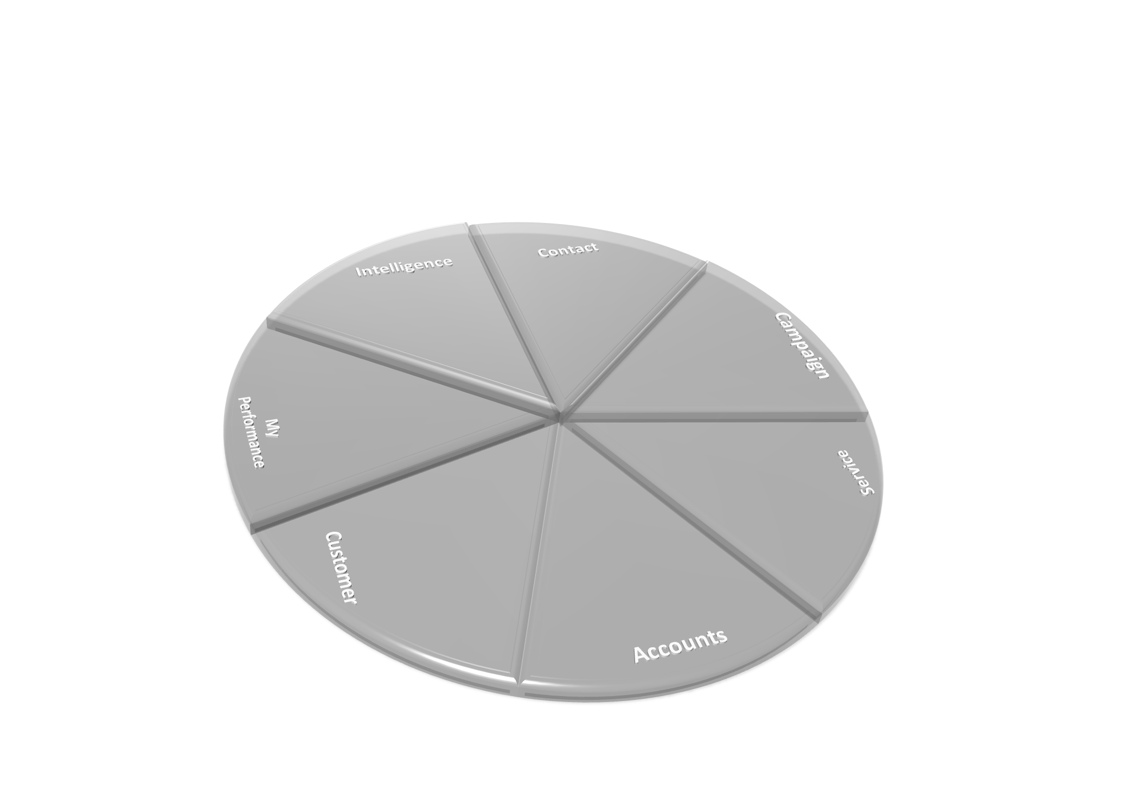
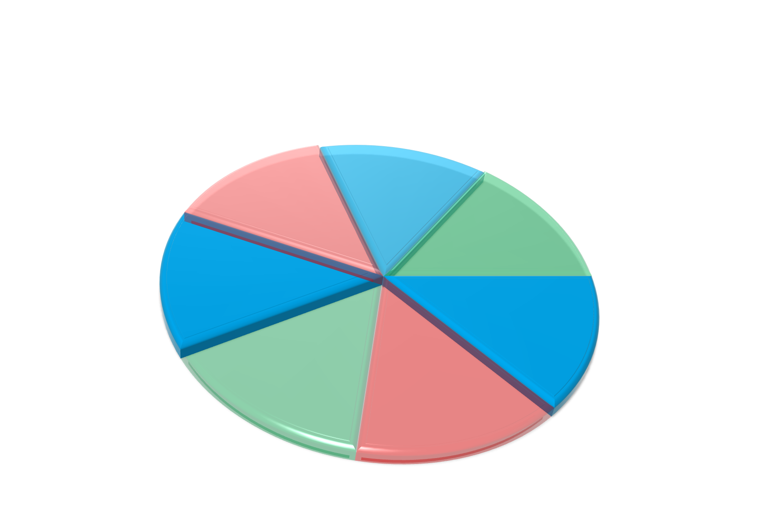





















CEMS : Functional Modules
Analysis
Messaging
Appointment
Reports
Service and TAT
Event
Task
Lead
Opportunity
Frontline Staff Performance
Non-STP
Account Opening
Customer Profile
STP
Banking Services
Account Detail
Complaint
Interaction with Customer
Balances
Account Planning
Transaction History
Risk Detail

Slide 3
CEMS System Architecture & Flow
CEMS Functional Flow
CRM - OD
SAV +
SP+CVD
Online Services
Integration Services(CBIS/ISIS/EDMi)
IR
Customer
&
Account Holding
Data(ODS)
HOST SYSTEMS
OBIEE – Analytics/Reporting
CTI
BL
Online Services
Cust. & linked Accts. Delta
Batch via ISIS
Online Integration
SP - Service Platform BL – Bulk Loading
IR – Intelligent Router SAV – Standard Account View
IVR/CTI – Interactive Voice Response CVD – Customer verification
HOST SYSTEMS

Slide 4
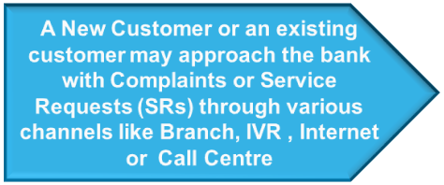





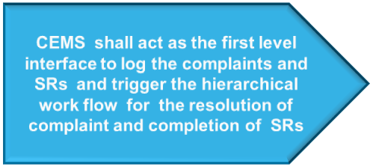

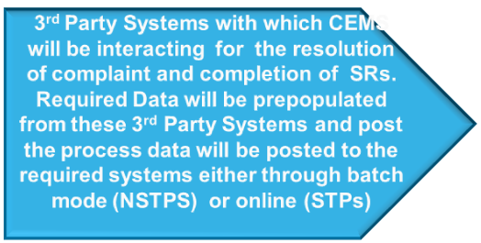





CEMS : High Level Operational Flow
Customer Approaching the Branch
Customer Calling Call Center Executive
Customer Approaching through IVR
CEMS Users
Work Flow based
Customer Experience Management System
Data
Posted to 3rd Party System
Data
Pre-Population
Credit Card Management System (CCMS)
Retail Lending System (RLS)
CRM-OD
Electronic Branch
Banking System (eBBS)

Slide 5
CEMS SP : Service Request Classification
Each service request can be classified based on the fulfillment process as follows:
STP-Straight through request – This request triggers an online request to the respective TP system for the fulfillment of the opted service.
-pre population – either online or ODS and online posting to TP system
NSTP-Non Straight through request – This request triggers a manual workflow for the fulfillment. The Non-straight through service request enables the user to capture the service and route it to pre-defined user groups for fulfillment.
There are two categories of NSTP
NSTP - Customized
- pre population – either online or ODS and no posting
NSTP – Standard
- pre population – only from ODS and no posting
CEMS acts as a hub and interacts with various third party systems within the bank to retrieve data and post the data to the third party system after required business validations are met, thus enabling the users to efficiently handle the service requests which otherwise would have spread across multiple third party systems;
Provides an efficient workflow with maker-checker options , ensuring efficient and accurate service to the customers;
Tracks the TAT for each of the Service and Complaint, and raises escalation if the TAT is not met, thus ensuring timely service to the customers;

Slide 6
Service Request Classification(Contd.1)
Service Requests – Features Comparison
The features of the different Service Request are given in the following table:
No. | Features | STP | NSTPC (Customized) | NSTPS (Standard)
1 | Defining no. of input fields with specific field attributes | Unlimited (Subject to Technical feasibility) | Unlimited (Subject to Technical feasibility) | Limited to 95 *
2 | Pre-population of data from ODS for common section except Service Detail section | ✓ | ✓ | ✓
3 | Pre-population of data from TP Systems or ODS into the input fields. | ✓ | ✓ | X
4 | Posting to TP systems | ✓ | X | X
5 | Business Rules Validations | ✓ | ✓ | X
6 | Field level Complex Validation: Based on Specific logic Comparing interdependent fields Number Range Date Range | ✓ | ✓ | X
7 | Specific logic handling – like computation | ✓ | ✓ | X
8 | Field Level Simple Validation: Data Type Mandatory or Optional Field Length | ✓ | ✓ | ✓

Slide 7
Service Request Classification(Contd.2)
Service Requests – Features Comparison
The features of the different Service Request are given in the following table:
* - The following table contains the break-up of 95 field attributes allowed per ‘NSTP Standard’ Request.
No. | Features | STP | NSTPC (Customized) | NSTPS (Standard)
9 | Supports default value for ‘Pick List’, ‘Check Box’ and ‘Radio Button’ | ✓ | ✓ | X
10 | Decision based workflow Based on DOA Based on User Group Input Based on Field Input | ✓ | ✓ | X
11 | Sequential Workflow routing based on pre-defined process steps. | ✓ | ✓ | ✓
Field Type | Max Field Count | Max Chars Allowed
Short Text | 20 Fields | 75 Characters
Long Text / Text Area | 15 Fields | 1000 Characters
Picklist | 15 Fields | 110 Characters
Date | 15 Fields | 25 Characters
Checkbox | 20 Fields | 50 Characters
Radio Button | 10 Fields | 50 Characters

Slide 8






CEMS Service Request Usage Flow (Contd.)
Scenario 1 (NSTP): An existing CASA customer approaches the branch requesting a change in the mobile number provided as part of the account opening
An existing CASA customer approaches the branch frontline staff with the request to change the mobile number
If the Branch Manager rejects the change in mobile number , the SR is returned to the Branch frontline staff to view in CEMS for consideration
Branch line staff approves and raises a SR for mobile number change in CEMS for the Branch manager’s approval
Customer
The branch frontline staff logs into CEMS and views the single customer view screen for the customer
If the Branch Frontline rejects the change in mobile number , the process stops here.
Branch Manager
CEMS
Branch Frontline
If the Ops – SDU Maker rejects the SR, the SR is returned to Branch Manager to view in CEMS
Branch Manager approves the change. The SR is forwarded to the Ops – SDU Maker for approval and change in eBBS
Once the ops-SDU maker approves the SR and modifies the mobile number in CEMS, the SR has to be approved by Ops-SDU Checker through CEMS
Ops – SDU Checker
If the Ops-SDU Checker rejects the SR, the SR is returned to Ops-SDU maker to view in CEMS and check the mobile number change in eBBS
Ops – SDU Maker
eBBS
Once the Ops-SDU Checker approves the SR, the mobile number change in eBBS is updated in Batch mode and the SR is closed successfully

Slide 9






CEMS Usage Flow
Scenario 2 (NSTP) : A new customer approaches the call center official (CSO) requesting for a Term Deposit (TD)
A new customer calls the Call Center Official(CSO) to open a Term Deposit (TD)
CSO logs into Lead Management System (CRM-OD) and captures the lead’s personal details
Customer
CRM-OD
TPIN verification
CSO logs the call and verifies & confirms the lead is not an existing customer
Approved in print shop
By Passes the TPIN verification to talk to the CSO
Account Details printed
and dispatched to customer and SR is closed successfully
If the CSO rejects the TD issue, the process stops here.
CSO
Print shop
CSO creates a Service Request (SR) in CEMS for Term Deposit for the GSSC FINOPS maker to review.
GSSC FINOPS Checker approves the TD creation in eBBS
Rejected from print shop for GSSC FINOPS Checker to view in CEMS
Once TD is created in eBBS, GSSFINOPS Checker’s approval is required
CEMS
GSSC FINOPS Checker
If the GSS FINOPS maker rejects the SR, is returned to CSO to view in the CEMS.
GSSC FINOPS Checker rejects the TD creation in eBBS and the SR is returned to GSSC FINOPS maker to view in CEMS and TD is not created in eBBS
If the GSS FINOPS maker approves the SR, a new TD is created in eBBS (Batch Mode)
eBBS
GSSC FINOPS maker

Slide 10

CEMS Usage Flow (Contd.)
Scenario 3 (STP): An existing CASA customer approaches the Call Center Executive (CSO) requesting the transfer of fund from CASA account to Credit Card
An existing CASA customer approaches the CSO to transfer fund from the CASA account to Credit Card
The CSO logs into CEMS and views the single customer view screen for the customer
On successful verification the Customer can talk to CSO
CSO approves and raises an SR in the CEMS for the fund transfer from CASA account to Credit Card .
TPIN verification
If the CSO rejects the Fund transfer , the process stops here.
CSO
Required data for the SR will be pre-populated from eBBS and CCMS
if TPIN verification fails, manual verification will be done
System validates the Business Rules defined like: Debit Amount requested by customer should not exceed balance in the debit account
Once the Business Rules are validated successfully, the funds will be debited from the CASA account and credited to CCMS .The new values will be posted online to eBBS and CCMS and SR will be closed successfully
eBBS
CCMS

Slide 11
CEMS: Service Request Flow
1. Service Request Creation
Customer talks to the frontline staff of the bank depending on the channel
CEMS User A creates the Service Request in CEMS based on the customers request
Post the Business Rule validations the Service Request is created
TPIN verification
CEMS User A
CEMS
Customer calls the call center for service request
TPIN verification is done for the existing customers of the bank approaching through call center /IVR
CEMS User A is the owner of the Service Request(SR) created;
CEMS User B assigns the Service to Self or to any other CEMS user under him/her;
Once assigned the SR follows the defined workflow for the respective SR.

Slide 12
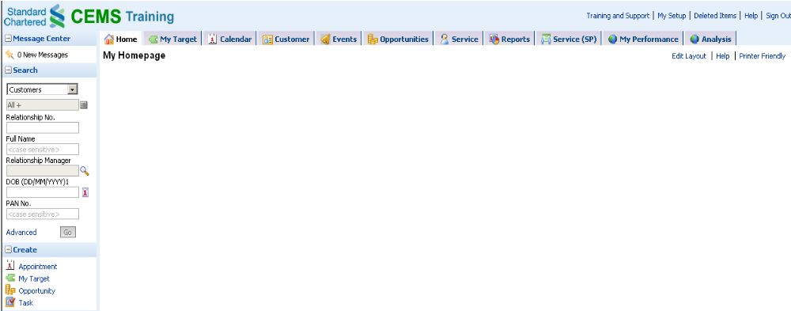
CEMS: Service Request Flow (Contd.)
Searching for a customer in the CEMS
CEMS User A logs into the CEMS and searches for the Customer entering the required search parameters
If the customer is a new customer, the CEMS user will not get any results for the search. In such a case the CEMS user logs into the Lead Management System (CEM-OD) and log the lead’s details

Slide 13
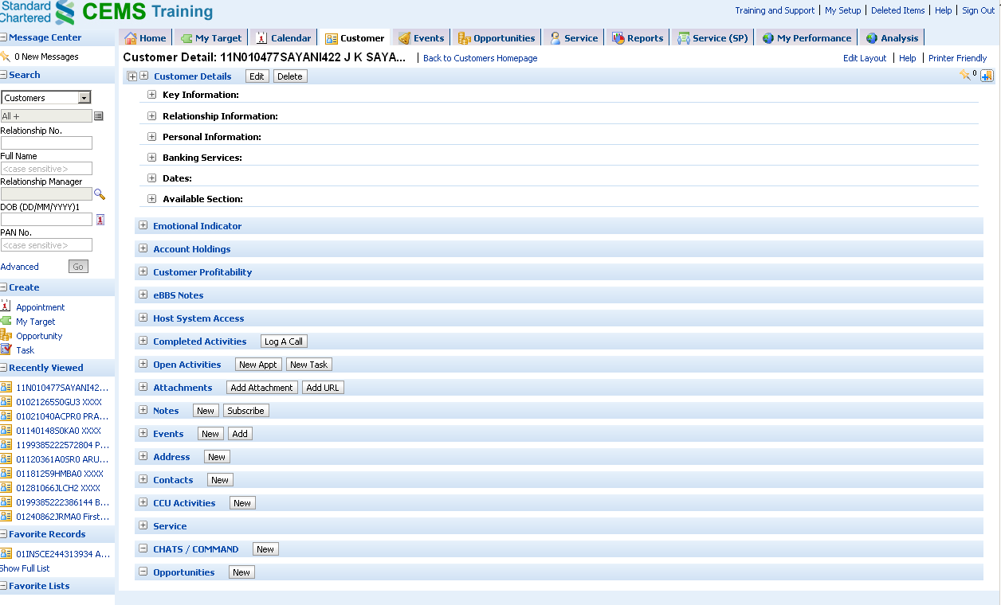
CEMS: Service Request Flow (Contd.)
Single Customer View Screen provides all the details for the existing customer in the single screen
These are the information available as part of the single Customer view screen.
Expanding the header “Service” shall display the services requested by the customer till now and their status

Slide 14
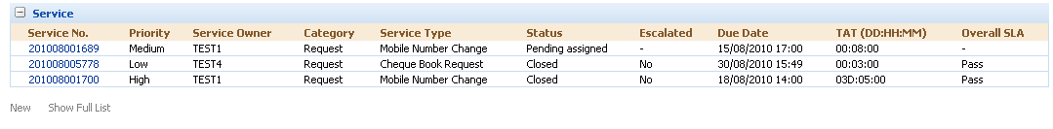
CEMS: Service Request Flow (Contd.)
Service Request Details for the Customer
The section provides the Service Request details for the Customer, along with their status as well as the adherence to SLA
Clicking on the link “New” shall enable the CEMS User A to create a new service request for the Customer

Slide 15
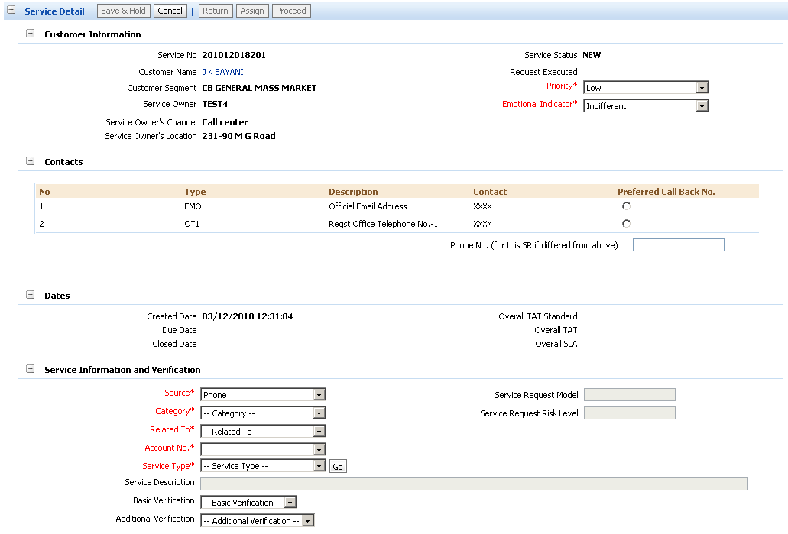
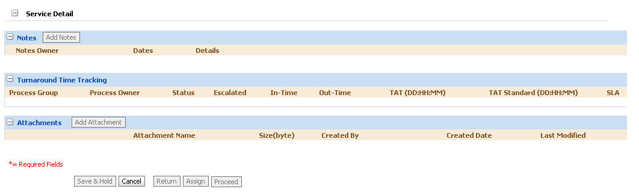
CEMS: Service Request Flow (Contd.)
Service Request Creation
The section shall display the creation date of the SR, Due date of the SR based on the over all TAT and Over all SLA configured for the SR
The section enables the CEMS user A to log the details related to SR. The Pre-Populated values will be retrieved from ODS and local database.
On clicking Go the “Go level” validations will be done . On successful validation, the system will proceed further
CEMS user A
can cancel the SR creation
CEMS user A can proceed with the creation of SR. Validations at the proceed level have to be successfully completed to proceed further. SR will be created.

Slide 16
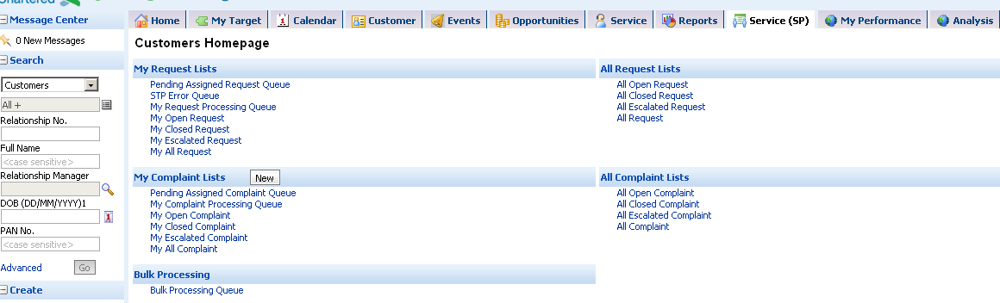
CEMS: Service Request Flow (Contd.)
To view the Service Requests created in the CEMS
The links starting with “ALL” provides the details of all the SRs created in the CEMS by all users
The links starting with “MY” shall provide details of the Service Requests (SRs) for which the CEMS user A is the owner i.e. created by the CEMS User A.
“My Open Request” –lists the SRs created by CEMS User A and are still open;
“My Closed Request”- lists the SRs created by the CEMS user A and have been closed;
“My Escalated Request”-lists the SRs for the TAT and the SLA defined has been breached at one or more of the workflow stages/users;
“My all Request” lists all the requests created by the CEMS user A;
“My Request Processing Queue” shall display the stage of the workflow at which the Service Request created by the CEMS User A is lying at. Also this will display requests created by self to be processed by self.

Slide 17
CEMS: Service Request Flow (Contd.)
Viewing the SRs from pending assigned Queue and assigned to the User
This link shall list down the SRs assigned to the particular group

Slide 18
CEMS: Service Request Flow (Contd.)
Assigning a new SR
Clicking on the “Assign” button the Service Request owner can assign the SR to a particular role

Slide 19
CEMS: Service Request Flow (Contd.)
2 . Assigning a Service Request to another Role
CEMS
SR
CEMS User A
CEMS User B
CEMS User A assigns the created SR to the CEMS User B based on the type of the Service Request
CEMS User A assigns the Service to Self or to any other CEMS user under his/her group.
Once assigned the SR follows the defined workflow for the respective SR, as it is approved or returned at each of the stage

Slide 20
CEMS: Service Request Flow (Contd.)
Action on the assigned SR by the user
User can return the SR to the previous stage (user can enter the notes and do attachment)
User can approve and proceed to the next stage of the workflow ( user can enter the notes and do attachment)

Slide 21
CEMS: Service Request Flow (Contd.)
3 . Closing a Service Request
In case the connectivity with the 3rd Party system is not available , the SR lies in the CEMS under the link “STP Error Queue”
CEMS
TP System
SR
Once the SR is closed by the CEMS User B successfully, the changed data is posted to the respective TP system either through Batch Mode (NSTPS) or Online(STPS)
CEMS User B
CEMS User A
CEMS User B can either close the SR or can return the SR to the CEMS user A;
In case the connectivity with the 3rd Party system is not available , the SR lies in the CEMS under the link “STP Error Queue”. This will be applicable only for the STPs

Slide 22
Test environment details
https://soddev.intranet.standardchartered.com/OnDemand/logon.jsp
User ID : TD_CB_IN\TESTIN01
Password :

Slide 23
Go Level Validation
Before Display the “Service Details” Section
Mandatory validation
Business rule validation based on SR type (applicable for NSTP-C and STP)
Multiple BR validation can be done.

Slide 24
Proceed Level Validation
After Display the “Service Details” Section
Business rule validation based on SR type (applicable for NSTP-C and STP)
Multiple BR validation can be done.

Slide 25
Thank You

