Slide 1

Business Data Management Capstone Project
TITLE: Streamlining Customer Orders and Payments in Iron Trading
Abhishek Jha
23f3004013
IIT Madras
01

Slide 2
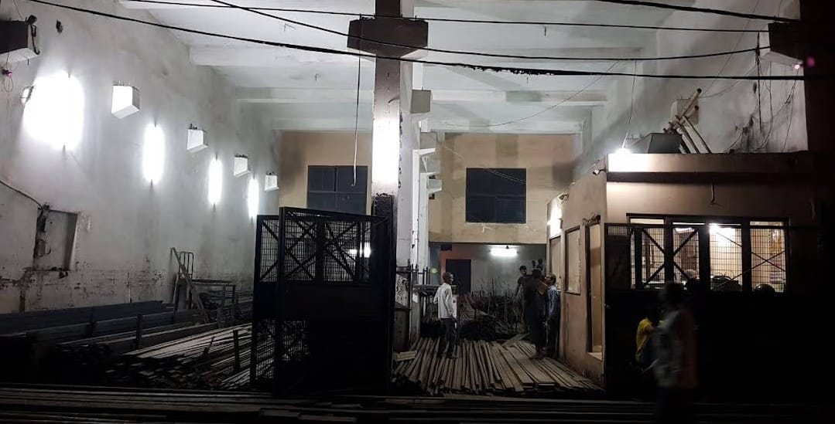
Project Overview:
Organization: Aditya Iron Traders, MSME based in Naraina Loha Mandi, New Delhi.
Industry: Iron and iron products trading (primarily B2B, some B2C).
1. Business Context:
Founded in April 2022, leveraging decades of family expertise in iron trading.
Operates 10:00 AM–7:00 PM with a lean core team and additional labor hired as required.
Serves over 130 businesses, with a strong presence in Delhi-NCR’s construction and manufacturing sectors.
02

Slide 3
2. Data & Methodology
Data Source: For this project, all analyses and insights are based on original, primary data provided directly by Aditya Iron Traders. The data covers the period from April 2024 to August 2024 and was officially transferred by the business owner.
Types of Data Collected
Transactional Sales Data:
Contains detailed records of every order placed by 136 different business customers over five months.
Key fields: Date, Customer Name, Order Amount, Voucher Number.
Pending Payments Data:
Tracks the number of days each payment remained outstanding after goods delivery.
Includes customer name and calculated payment delay in days.
Operational Expenses Data:
Includes monthly labor charges, fixed salaries, and other indirect expenses.
Used to analyze the impact of order frequency on operational costs.
Geographical Data:
Pin codes of customer locations, allowing for analysis of sales concentration by region (zone-wise aggregation).
Profit & Loss Data:
Monthly summaries of gross profit, net profit, and the breakdown of direct and indirect expenses.
03

Slide 4
Data Preparation:
Data cleaned for duplicates, invalid/canceled entries, and standardized for analysis.
Payment durations binned into intervals (0–90, 91–180, 181–270, 271–360 days).
PIN codes grouped for regional analysis.
Tools Used:
Microsoft Excel for data cleaning, aggregation, and visualization.
Pivot tables, conditional formatting, and basic statistical analysis.
3. Problem Statements
Operational Cost Inefficiency: Frequent small-value orders increase labor and transportation costs, reducing overall profitability.
Delayed Customer Payments: Extended payment cycles block working capital, causing cash flow strain.
Logistics Bottlenecks: Shipment delays and regional order concentration impact customer satisfaction and delivery efficiency.
04

Slide 5
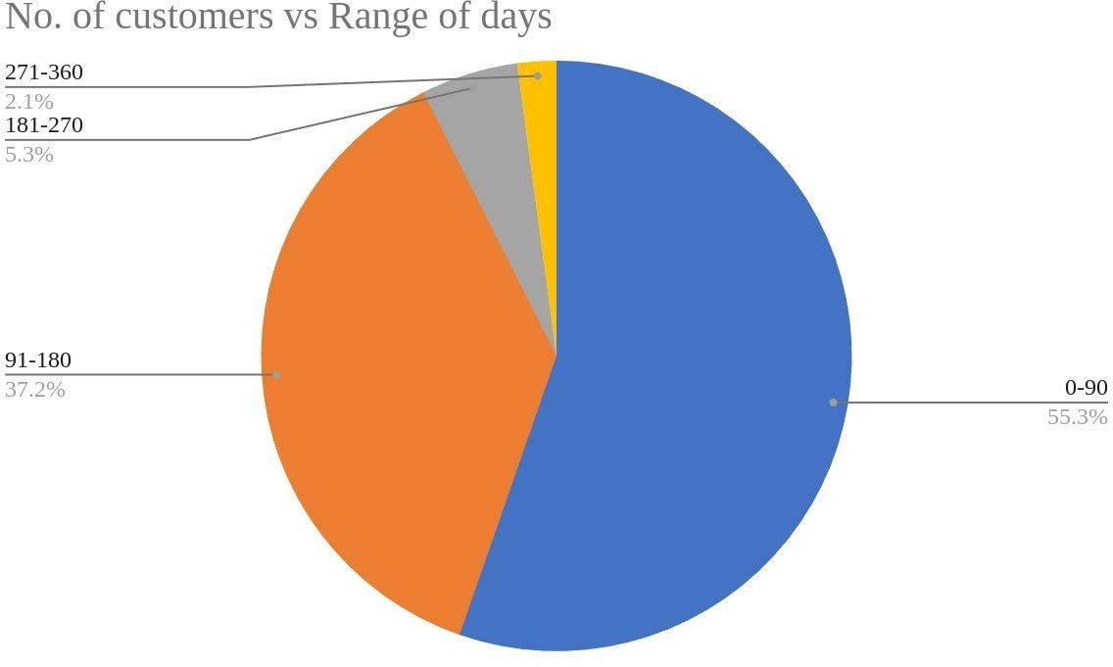
4. Key Analyses & Findings
A. Operational Cost Analysis
Labor charges are a major cost driver, accounting for 30–43% of revenue in peak months.
Months with more consolidated (larger, less frequent) orders saw a notable drop in labor costs and a rise in net profit margin.
High order frequency (multiple small orders) leads to a 29% increase in operational overheads, with no proportional revenue gain.
B. Payment Cycle Analysis
55% of customers pay within 90 days, but over 40% delay payments up to or beyond 180 days.
Average payment delay is 95 days; extreme cases exceed 300 days.
Delayed payments block up to 14% of working capital, directly impacting liquidity and reinvestment capacity.
05

Slide 6
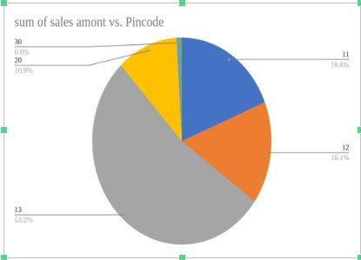
C. Logistics & Regional Sales Analysis
Over 53% of revenue comes from a single PIN code (Zone 13), with another 35% from two adjacent zones.
High concentration leads to delivery delays and resource strain in core regions, while other zones remain under-served.
5. Recommendations
A. Order Consolidation & Cost Optimization
Introduce order consolidation incentives:
Volume-based discounts or free delivery for larger orders.
Scheduled ordering windows for high-frequency clients.
Implement minimum order thresholds:
Encourage fewer, larger transactions to reduce per-order labor and
transport costs.
Adopt digital order management:
Automate intake, monitor patterns, and forecast demand for
efficient resource allocation.
06

Slide 7
B. Payment Policy Reform
Structured payment terms:
Early payment discounts (e.g., 2% off for payment within 10 days).
Tiered incentives for faster settlements.
Credit profiling:
Segment customers by payment behavior, set dynamic credit limits, and automate reminders.
Loyalty rewards:
Offer future benefits for timely payments to shift customer habits.
C. Logistics Enhancement
Zone-based delivery scheduling:
Fixed delivery windows for high-demand zones to optimize routes and reduce delays.
Resource allocation:
Cross-train staff and deploy extra resources during peak periods.
Micro-warehousing:
Pilot small storage hubs in high-density regions for faster fulfillment.
07

Slide 8
6. Strategic Impact & Implementation Roadmap
Short-term (0–3 months):
Launch order consolidation and payment incentive pilots; initiate zone-based delivery schedules.
Medium-term (3–6 months):
Deploy digital order/payment management tools; develop customer risk profiles; test micro-warehousing.
Long-term (6–12 months):
Expand logistics optimization, predictive analytics for inventory, and build strategic partnerships in growth zones.
7. Expected Outcomes
Operational cost reduction by up to 25% through order consolidation and logistics optimization.
Improved cash flow by unlocking 14% of blocked capital via faster payment cycles.
Enhanced delivery efficiency and customer satisfaction, supporting sustainable market expansion.
8. Conclusion
By leveraging data-driven insights, Aditya Iron Traders can streamline operations, strengthen financial health, and improve customer experience—positioning itself for robust growth in Delhi-NCR’s iron trading sector.
08

