Slide 1

Retail Sales Data Analysis
A Full-Stack Web Application with Real-Time Analytics
Presented by: Barsha Priyadarshini Parida
Roll No: 24MC034
Department: MCA
Internal Faculty Name
Prof. Prangya Paramita Mohapatra
Assistant Professor(MCA)
DEPARTMENT OF MCA
GITA AUOTONOMOUS COLEGE,BHUBANESWAR
1/15

Slide 2
Content Page
Table of Contents
1.
Introduction
3
2.
Objective of Work
4
3.
Technologies Used (Frontend & Backend)
5
4.
Specification Requirement
6
5.
Project Flow Diagram — ER Diagram
7
6.
Project Flow Diagram — DFD
8
7.
Page Layout (Screenshots — Part 1)
9
8.
Page Layout (Screenshots — Part 2)
10
9.
Security Applied
11
10.
Result Analysis
12
11.
Conclusion
13
12.
Future Enhancement
14
13.
Bibliography / Reference
15
2/15

Slide 3
Introduction
About SalesDB
SalesDB is a full-stack web application designed for managing sales operations, customer relationships, product inventory, and invoice generation.
Built using Python Flask as backend, PostgreSQL as database, and a modern HTML/CSS/JavaScript frontend with Chart.js for interactive analytics.
The system provides a real-time dashboard with KPI cards, revenue charts, and customer segmentation analysis.
It includes 7 modules: Dashboard, Sales, Customers, Products, Invoices, Stocks, and Reports.
Admin authentication with session-based login ensures data security while keeping the dashboard publicly accessible.
3/15

Slide 4
Objective of Work
Goals of the Project
01.
Design and develop a full-stack web application for sales data management.
02.
Implement CRUD operations for Customers, Products, and Sales records.
03.
Create an interactive dashboard with KPIs and Chart.js visualizations.
04.
Design a star-schema database with 5 tables (3 dimension + 2 fact).
05.
Develop 20+ RESTful API endpoints using Python Flask.
06.
Implement session-based admin authentication with @login_required decorator.
07.
Build a professional invoice generator with PDF export (ReportLab).
08.
Create real-time stock tracking with low-stock alerts and history logging.
09.
Develop advanced sales reports with date, category, and region filters.
10.
Build a responsive, modern dark-themed UI with glassmorphism effects.
4/15

Slide 5
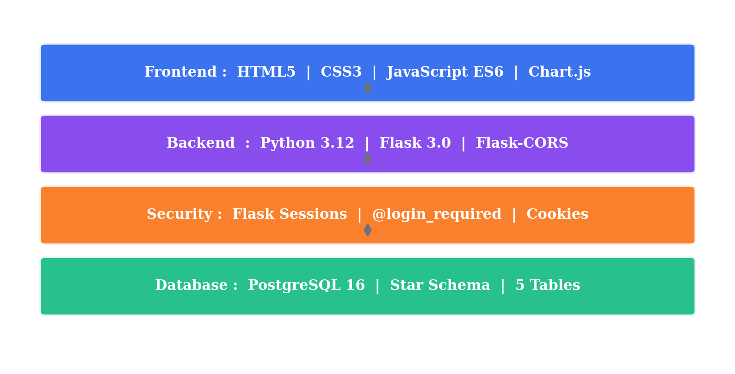
Technologies Used
Frontend & Backend Stack
FRONTEND
BACKEND
• HTML5 — Structure & Semantics
• Python 3.12 — Core Language
• CSS3 — Dark Theme + Glassmorphism
• Flask 3.0 — Web Framework + API
• JavaScript ES6 — DOM + Fetch API
• PostgreSQL 16 — Star Schema DB
• Chart.js 4.x — Interactive Charts
• ReportLab — PDF Invoice Generation
5/15

Slide 6
Specification Requirement
Hardware & Software
⚙️ HARDWARE REQUIREMENTS
💻 SOFTWARE REQUIREMENTS
Processor
OS
Intel Core i3 or above
Windows 10/11, Ubuntu 20+, macOS
RAM
Python
4 GB minimum (8 GB recommended)
Version 3.8 or above
Storage
PostgreSQL
500 MB free disk space
Version 14 or above
Display
Browser
1366 × 768 or higher resolution
Chrome, Firefox, Edge (latest)
Network
pip Packages
Internet connection for fonts/CDN
flask, psycopg2, reportlab, flask-cors
Architecture
IDE
64-bit operating system
VS Code, PyCharm (optional)
6/15

Slide 7
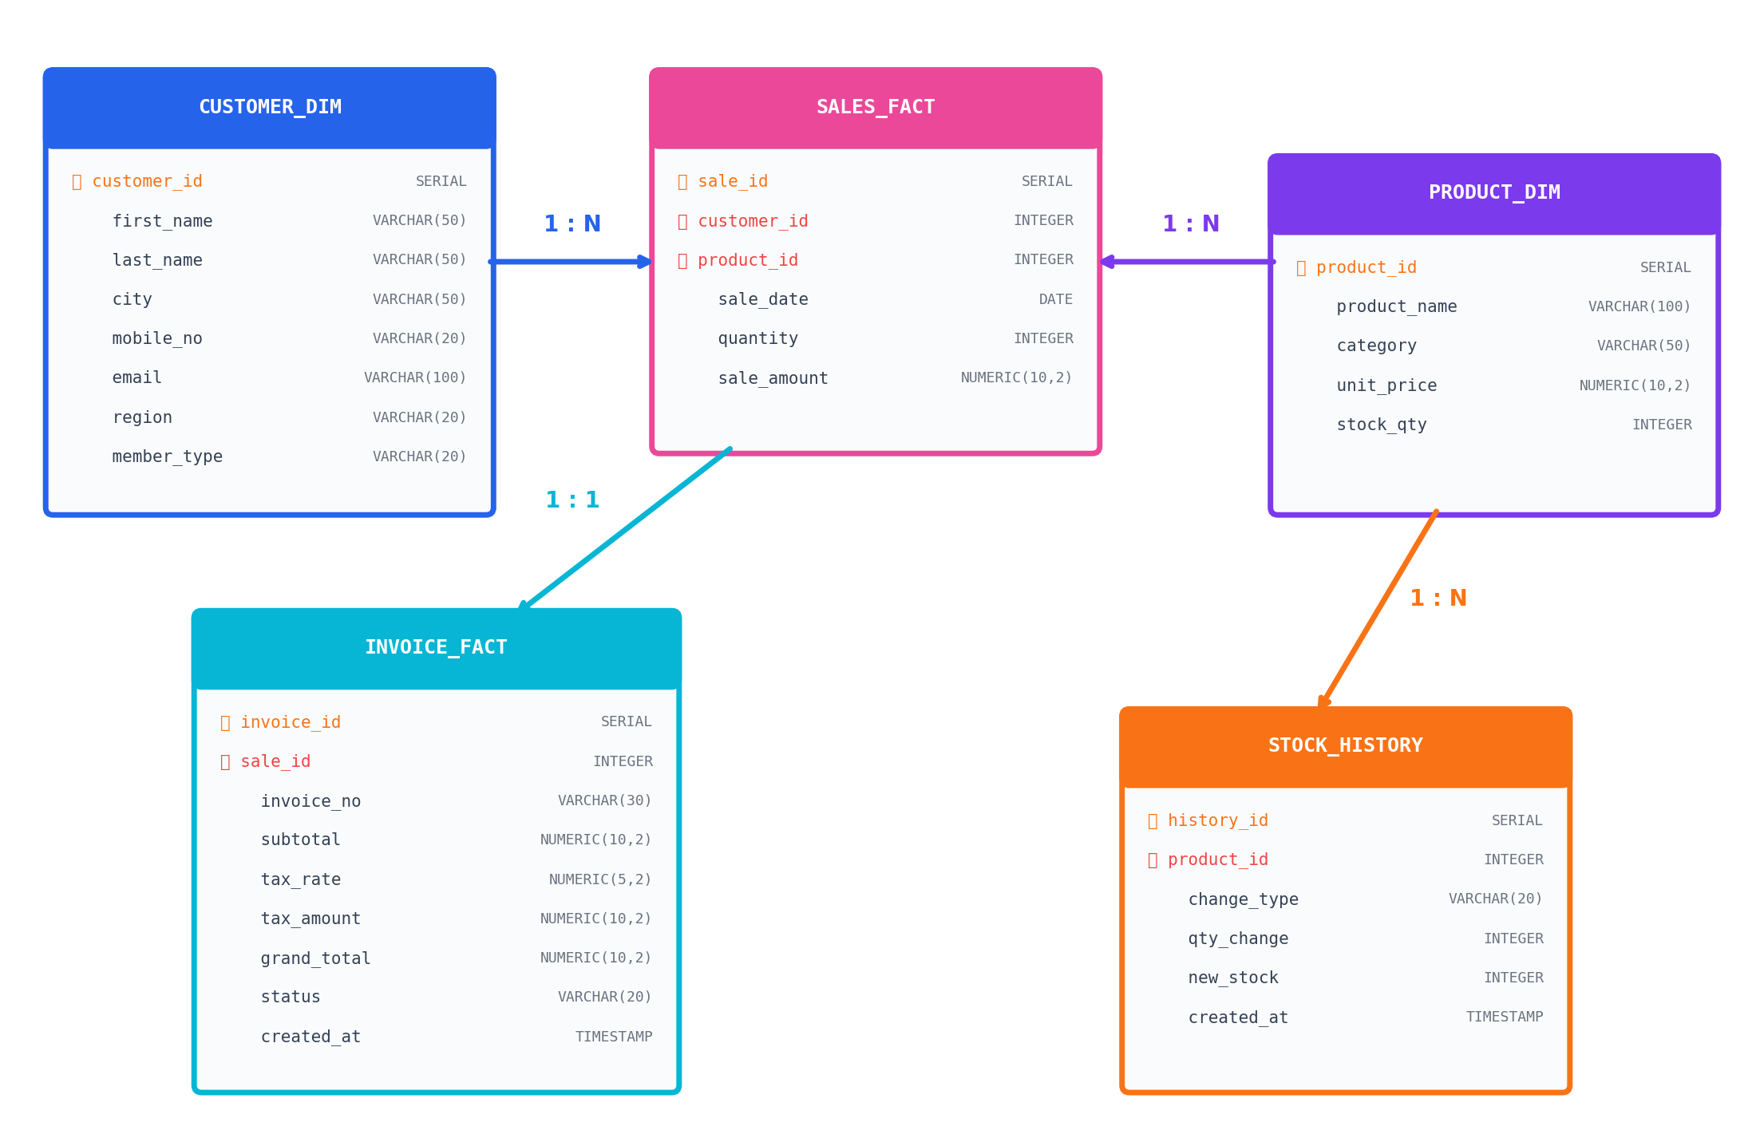
Project Flow — ER Diagram
5-Table Star Schema Design
7/15

Slide 8
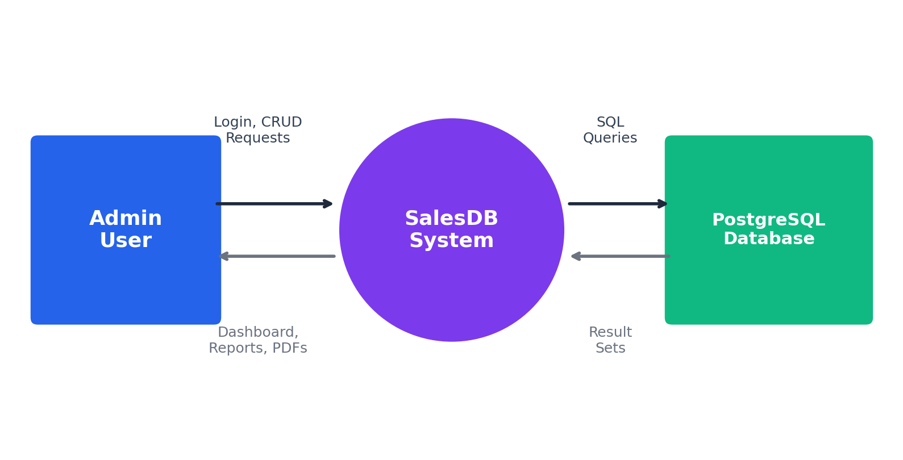
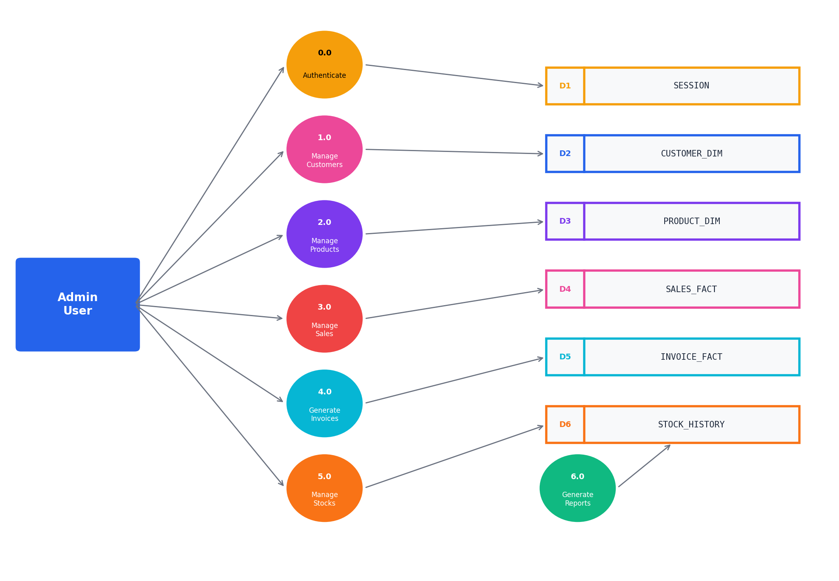
Project Flow — DFD
Data Flow Diagrams (Level 0 & Level 1)
DFD Level 0 (Context Diagram)
DFD Level 1 (Detailed Processes)
8/15

Slide 9
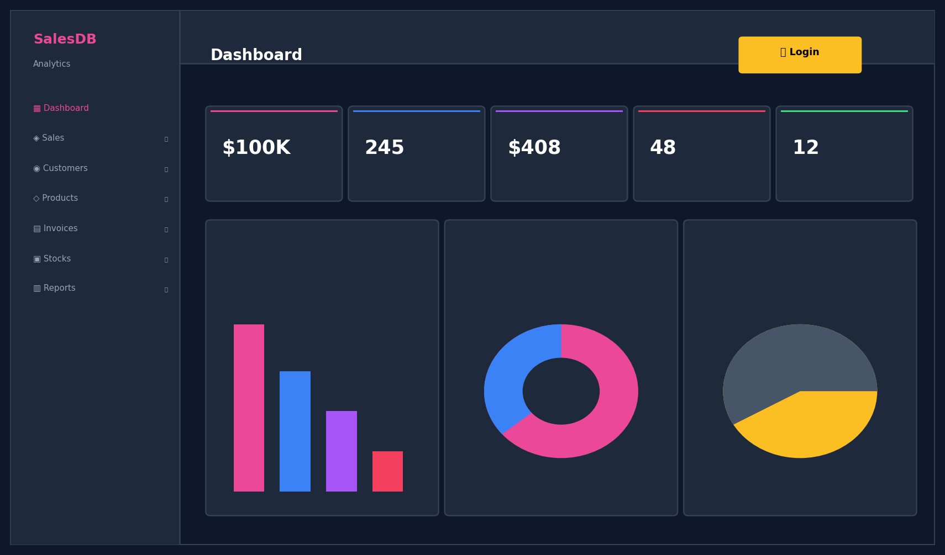
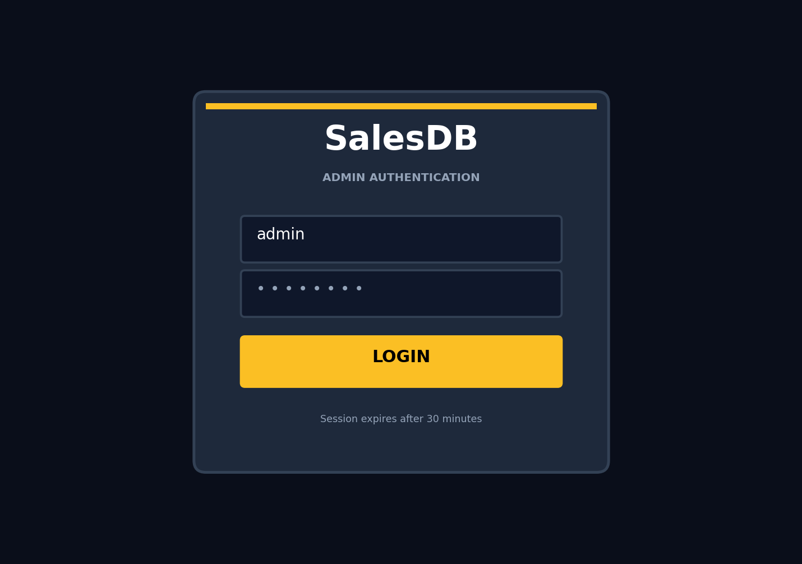
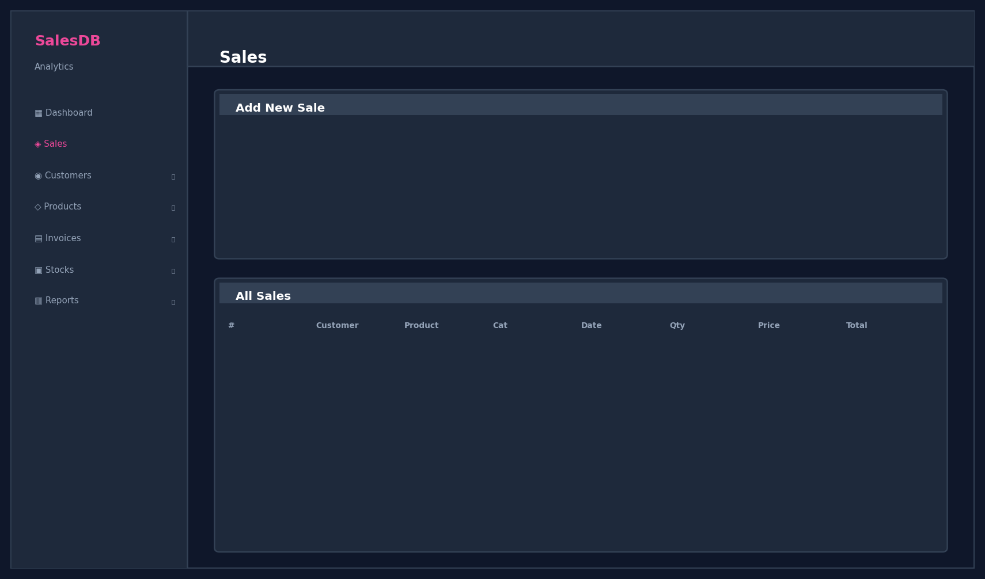
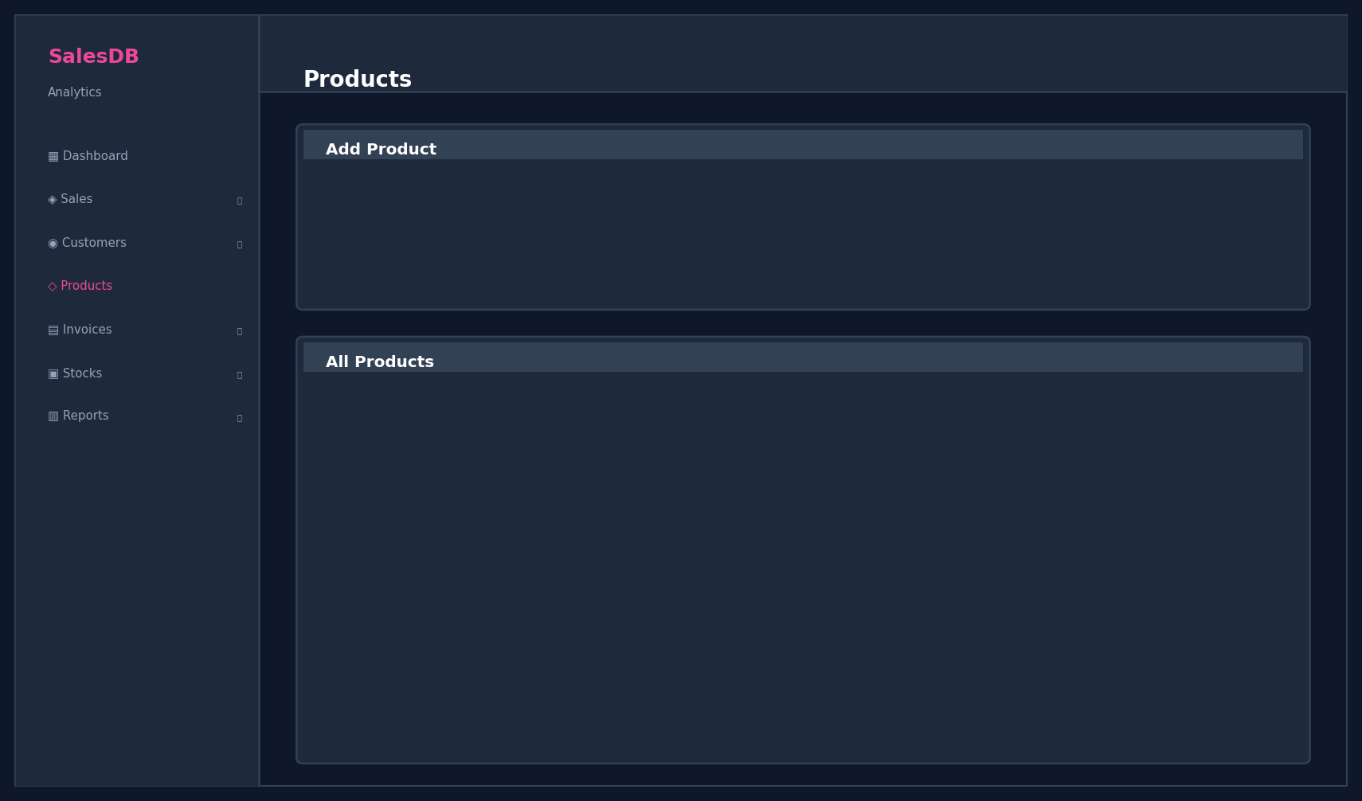
Page Layout — Screenshots
Dashboard, Login & Sales Pages
Dashboard (Public)
Admin Login
Sales Management
Products
9/15

Slide 10
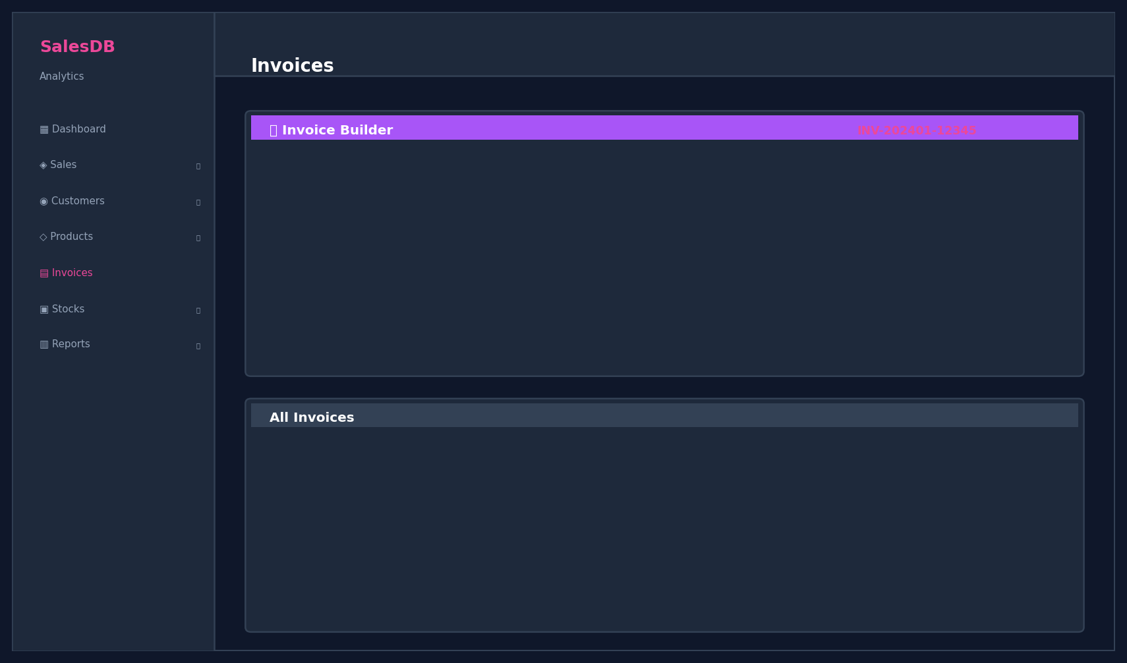
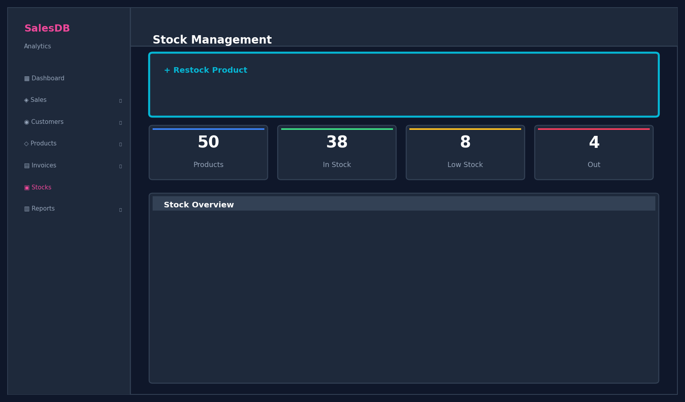
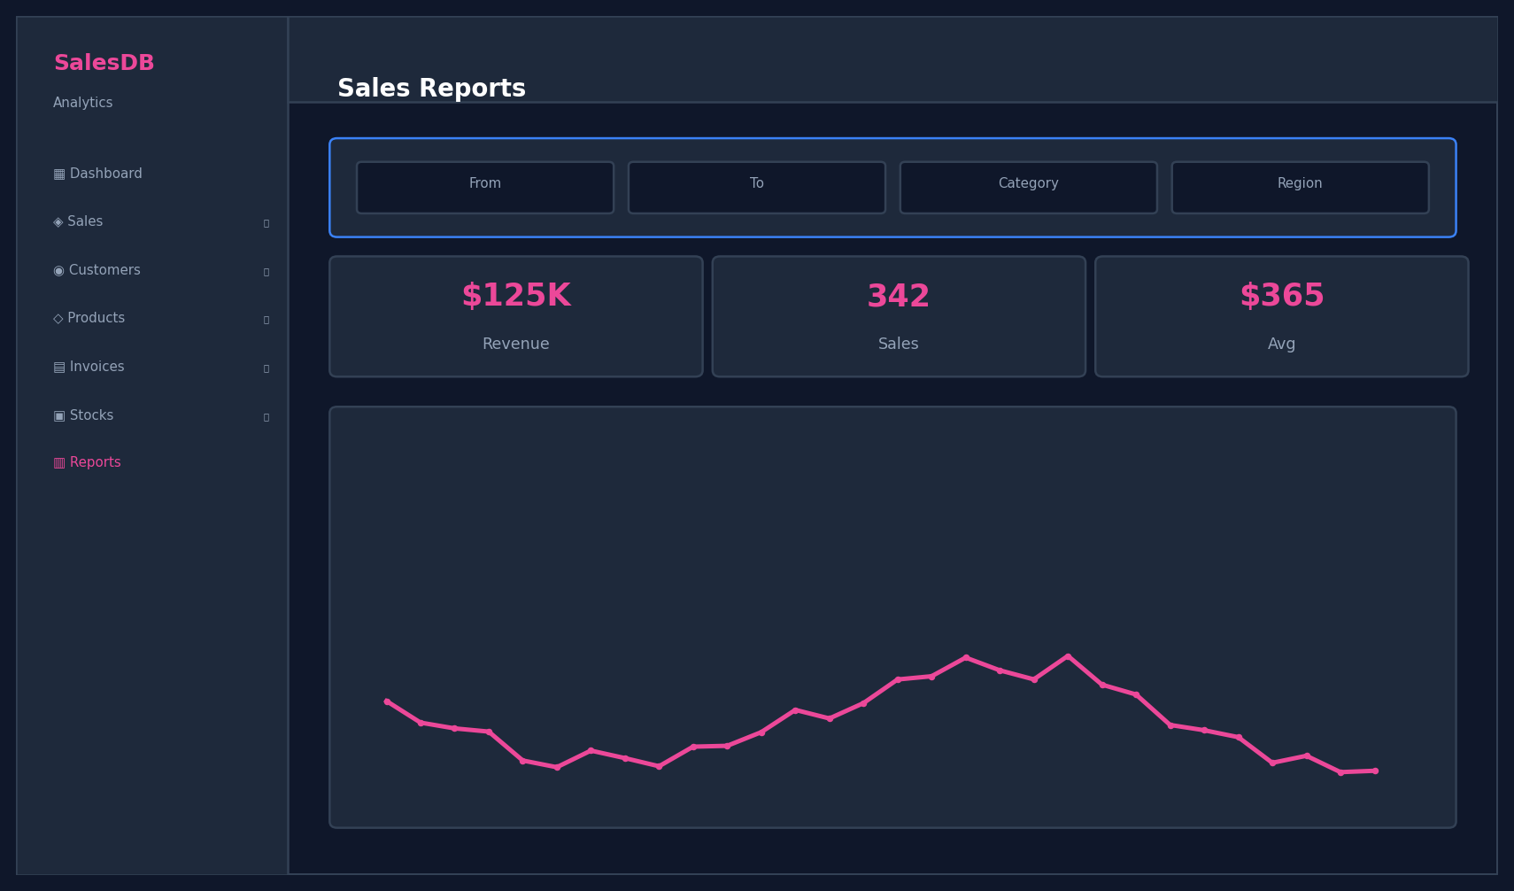
Page Layout — Screenshots
Invoices, Stocks & Reports
Invoice Builder
Stock Management
Reports & Analytics
10/15

Slide 11
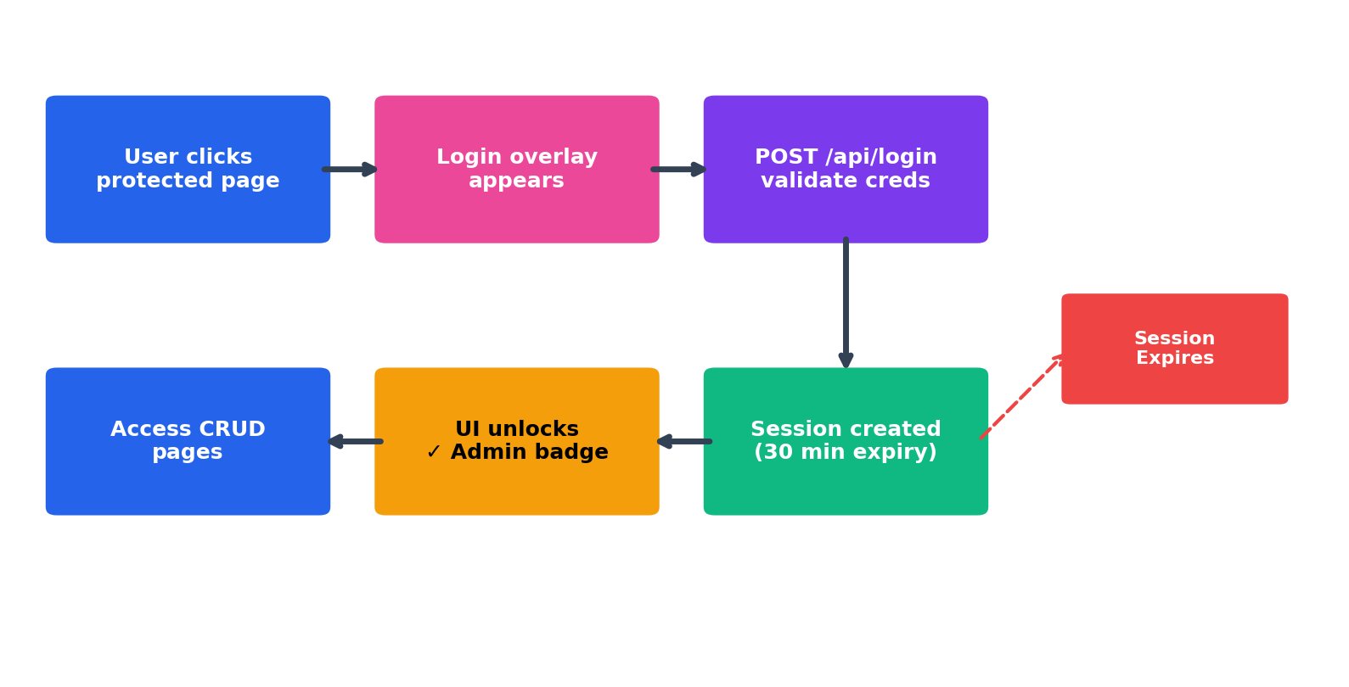
Security Applied
Authentication & Access Control
🔐 SECURITY FEATURES
▸ Session-Based Auth
Flask sessions with secure cookies
▸ 30-Min Expiry
Auto-logout after inactivity
▸ @login_required
Python decorator protects routes
▸ Public Dashboard
GET endpoints remain accessible
▸ Protected CRUD
POST/PUT/DELETE require login
▸ 401 Auto-Redirect
Expired session → login overlay
▸ CORS Protection
flask-cors for cross-origin security
▸ Password Validation
Server-side credential checking
11/15

Slide 12
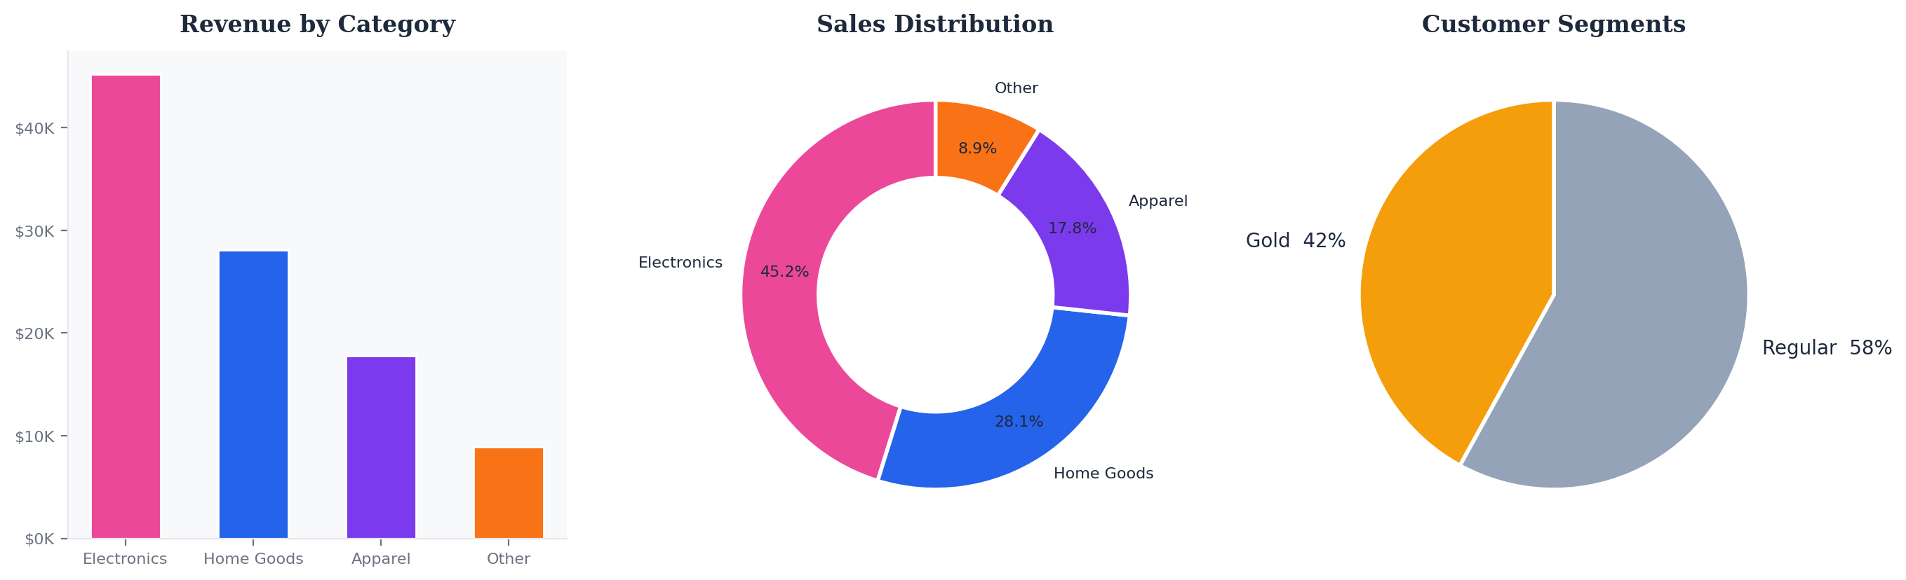
Result Analysis
Dashboard Analytics & KPIs
$100,000
245
$408.16
48
12
Total Revenue
Total Sales
Avg Order Value
Total Customers
Total Products
12/15

Slide 13
Conclusion
Project Summary
✅ ALL PROJECT OBJECTIVES SUCCESSFULLY ACHIEVED
SalesDB delivers a complete, functional sales management system with modern UI.
Developed a full-stack web application using Flask, PostgreSQL, and modern JavaScript.
Implemented comprehensive CRUD operations across 7 application modules.
Created 5 relational database tables following star schema design.
Built 20+ RESTful API endpoints with session-based authentication.
Delivered professional PDF invoice generation using ReportLab.
Integrated real-time stock tracking with automated alerts.
Provided advanced reporting with multi-filter support and CSV export.
7
Modules
20+
API Endpoints
5
DB Tables
15+
Features
13/15

Slide 14
Future Enhancement
Planned Improvements
💳 Payment Gateway Integration
📧 Email Invoice Delivery
Stripe/Razorpay for online payments
Auto-send PDF invoices via SendGrid/SMTP
👥 Multi-User Role System
📱 Mobile Application
Admin, Manager, Employee with different permissions
React Native / Flutter companion app
🔍 Barcode / QR Scanner
☁️ Cloud Deployment
Quick product lookup and inventory scanning
Deploy on AWS / Heroku / Railway with CI/CD
📊 Advanced Analytics
🔔 Real-time Notifications
Predictive sales forecasting with ML models
WebSocket-based live updates for stock alerts
14/15

Slide 15
Bibliography / Reference
Resources & Documentation
[1]
Flask Documentation
https://flask.palletsprojects.com/
[2]
PostgreSQL Documentation
https://www.postgresql.org/docs/
[3]
Chart.js Documentation
https://www.chartjs.org/docs/
[4]
ReportLab User Guide
https://www.reportlab.com/docs/
[5]
MDN Web Docs (HTML/CSS/JS)
https://developer.mozilla.org/
[6]
psycopg2 Documentation
https://www.psycopg.org/docs/
[7]
python-pptx Documentation
https://python-pptx.readthedocs.io/
[8]
GitHub — Version Control
https://github.com/
[8]
Stack Overflow Community
https://stackoverflow.com/
15/15

Slide 16
THANK YOU
Any Question ?

