Slide 1
SALESDB
Sales Analytics Dashboard
Full-Stack Web App with Admin Authentication & Real-time Analytics
Presented by: [Your Name]
Roll No: [Your Roll Number]
Department: [Your Department]
Guide: Prof. [Guide Name]
Institution: [Your Institution]
1/18

Slide 2
SalesDB
Agenda
18-Slide Presentation Outline
01
Project Overview
02
Problem Statement
03
Objectives
04
Technology Stack
05
System Architecture
06
Database & ER Diagram
07
Data Flow Diagrams
08
Dashboard Features
09
CRUD Operations
10
Authentication & Security
11
Auto-Calculation & Sequence
12
Program Execution Flow
13-16
Screenshots (Dashboard, Login, Sales, etc.)
17
Advantages
18
Conclusion & Thank You
2/18

Slide 3
SalesDB
Project Overview
What is SalesDB?
SalesDB is a full-stack web app for managing sales, customers & products with real-time analytics, admin authentication, and auto-calculation features.
📊 Real-time Dashboard
🔐 Admin Authentication
👥 Customer Management
KPI cards + 3 interactive charts
Session-based login with 30min expiry
7 fields with Gold/Regular membership
📦 Product Catalog
💰 Auto-Calculation
🔗 REST API
Name, category & unit price tracking
Amount = Unit Price × Quantity
17 endpoints — Flask + PostgreSQL
3/18

Slide 4
SalesDB
Problem Statement
Why SalesDB is needed
📋 Scattered Data
📉 No Analytics
Sales spread across spreadsheets & notebooks
Cannot quickly assess revenue or KPIs
🧮 Manual Errors
📊 Poor Visualization
Computing totals is tedious and error-prone
Raw numbers lack intuitive insights
🔓 No Access Control
🔍 No Audit Trail
Anyone can modify or delete critical data
Can't track who changed what and when
4/18

Slide 5
SalesDB
Project Objectives
9 Goals Achieved
01
Design & develop a full-stack web app for sales data management
02
Implement CRUD operations for Customers, Products & Sales
03
Create interactive dashboard with KPIs & Chart.js visualizations
04
Design star schema database with dimension & fact tables
05
Develop RESTful API using Python Flask as middleware
06
Implement admin authentication with session-based login
07
Auto-calculate sale amount (Unit Price × Quantity)
08
Build responsive dark-themed UI with modern patterns
09
Ensure data integrity via foreign keys & login protection
5/18

Slide 6
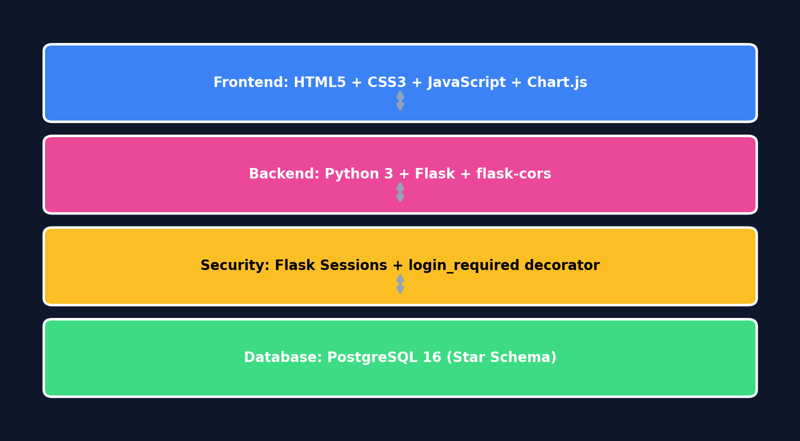
SalesDB
Technology Stack
Tools & Technologies (including Auth)
6/18

Slide 7
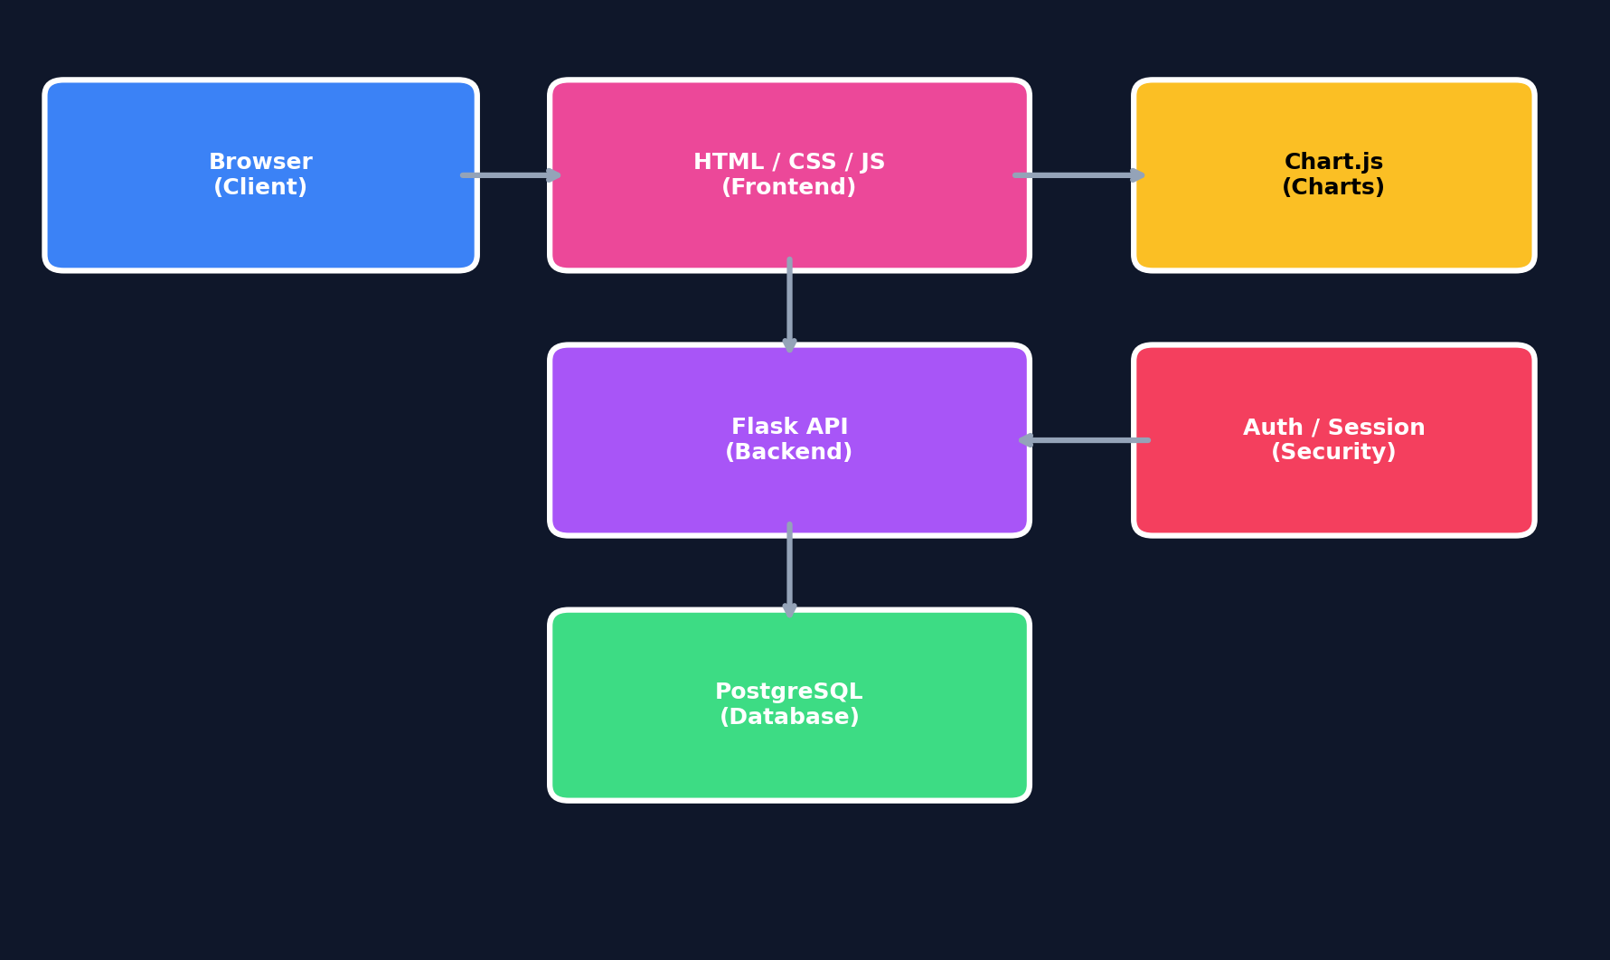
SalesDB
System Architecture
Three-Tier + Authentication Layer
7/18

Slide 8
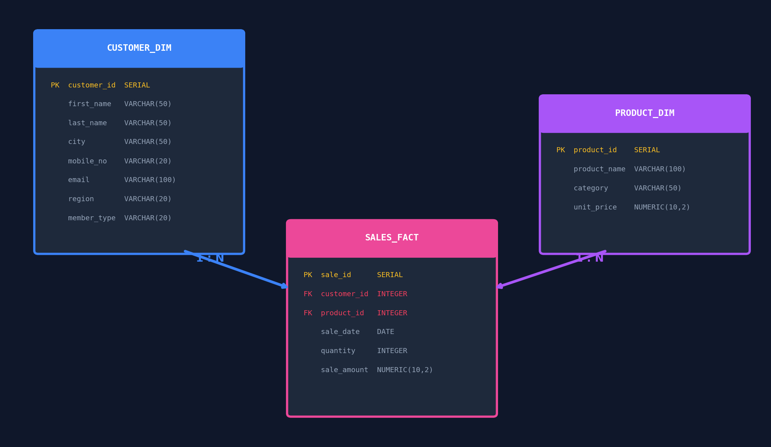
SalesDB
Database Design
Star Schema — Entity Relationship Diagram
8/18

Slide 9
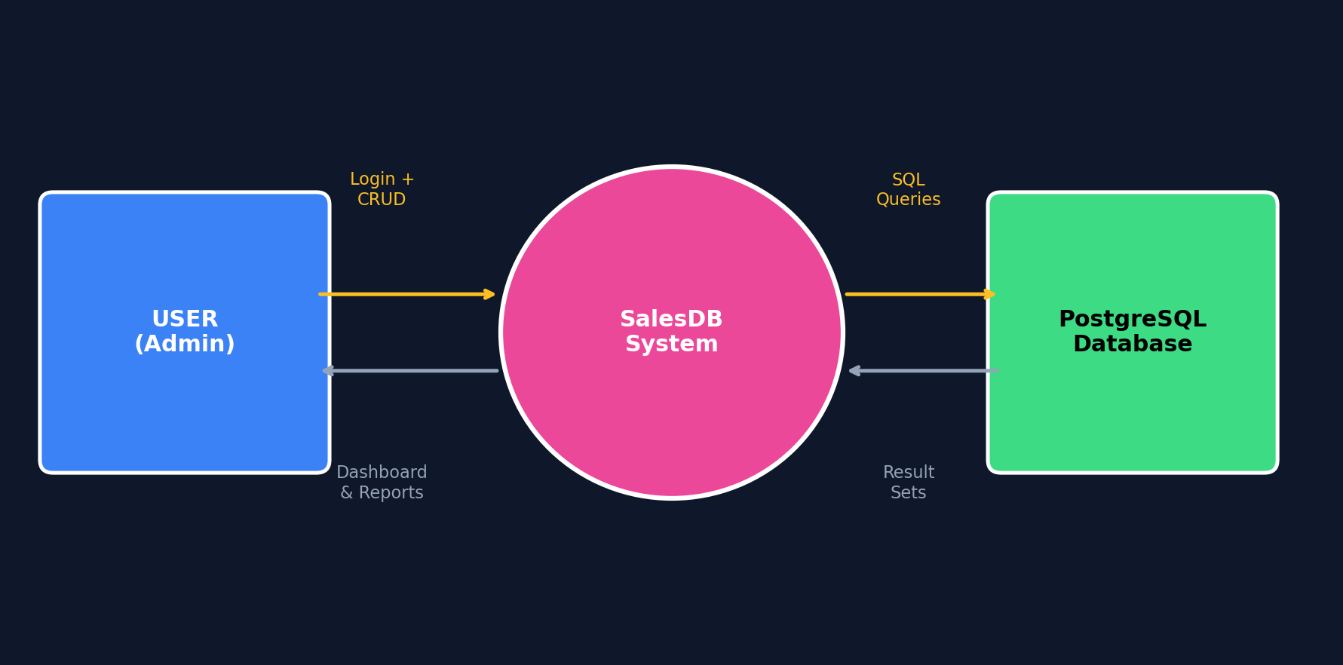
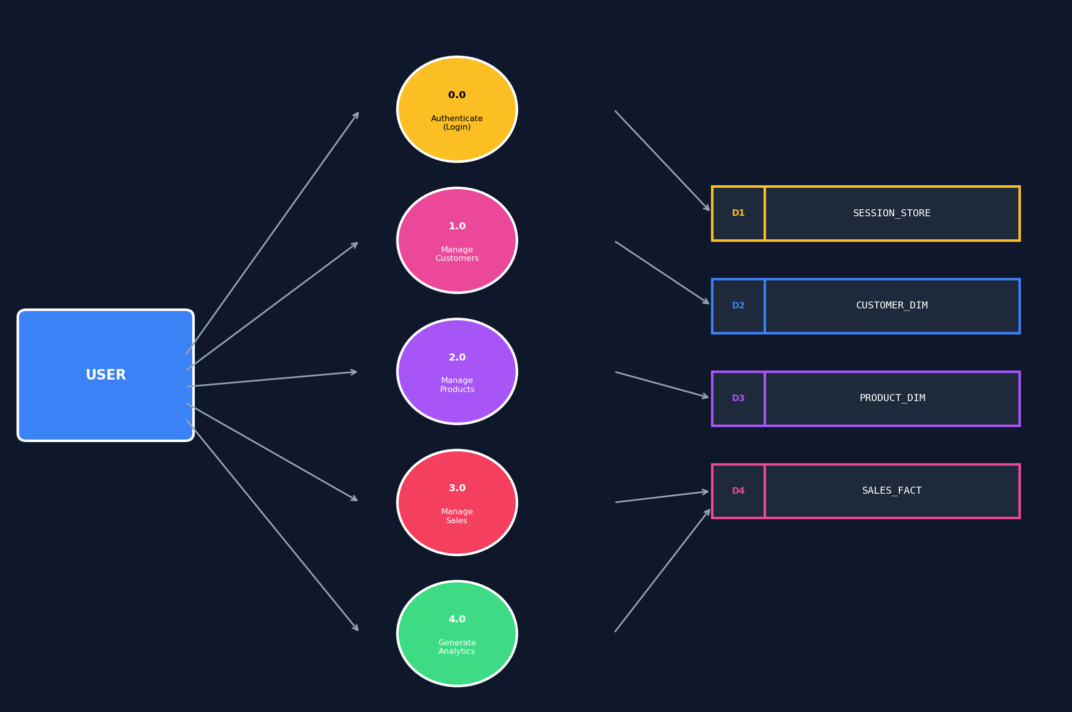
SalesDB
Data Flow Diagrams
Level 0 (Context) & Level 1 (with Auth)
DFD Level 0
DFD Level 1 (with Auth process)
9/18

Slide 10
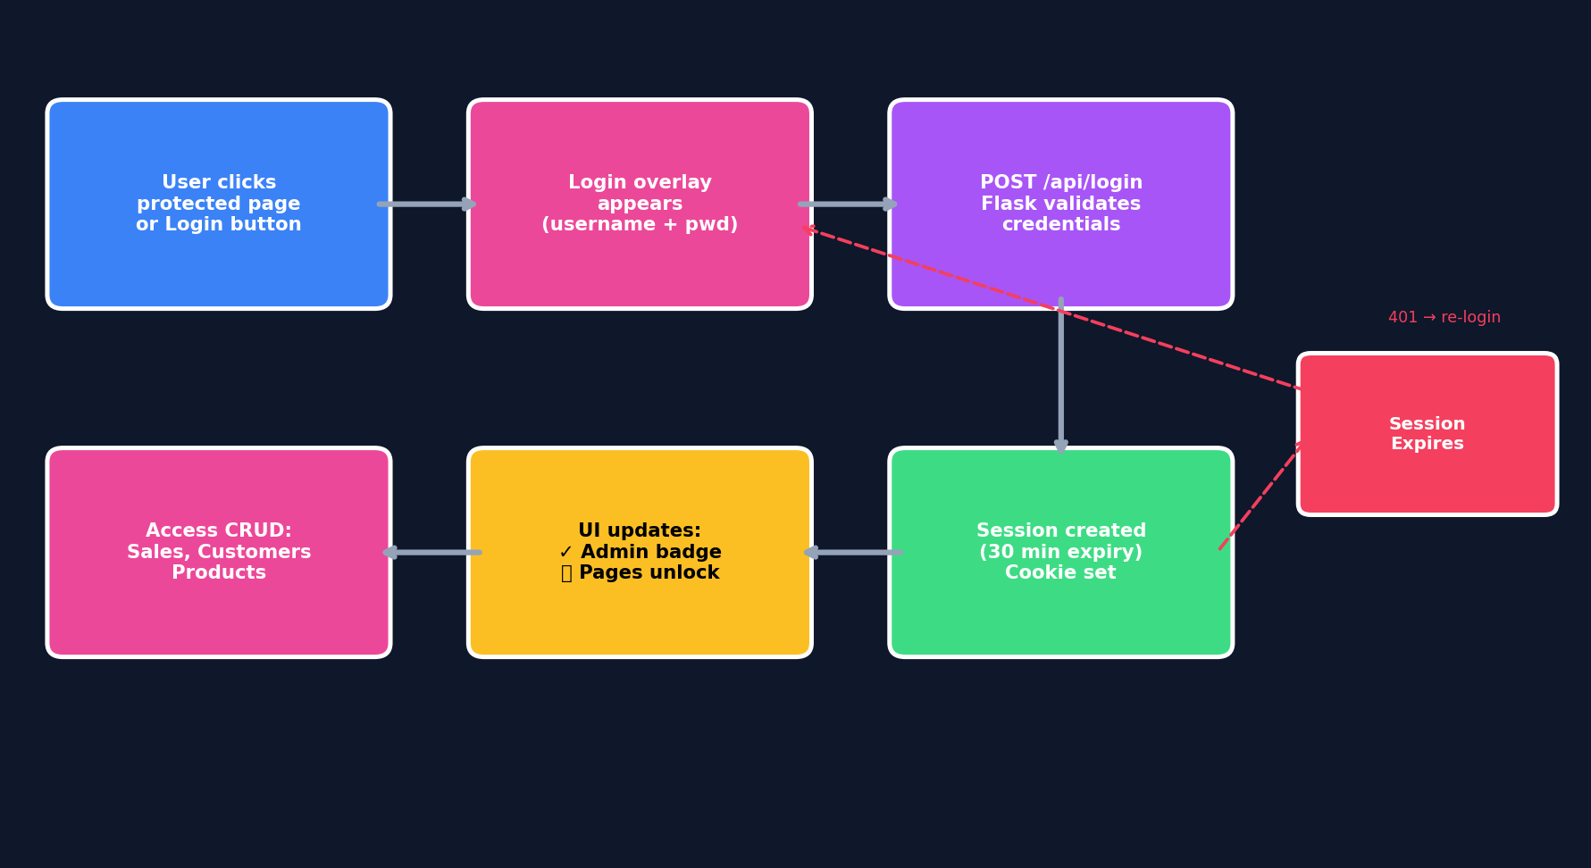
SalesDB
Authentication & Security
Session-Based Admin Login System
HOW IT WORKS
Authentication Flow
🔒
Dashboard = PUBLIC
Anyone can view KPIs & charts
🔐
CRUD = PROTECTED
Sales, Customers, Products need login
👤
Session Login
Username + password → Flask session
⏱️
30-min Expiry
Auto-logout after inactivity
🛡️
@login_required
Python decorator protects POST/PUT/DELETE
401
Auto-redirect
Expired session → login overlay shown
🟢
Admin Badge
Green ✓ Admin badge when logged in
🟡
Login Button
Yellow button in topbar → opens overlay
10/18

Slide 11
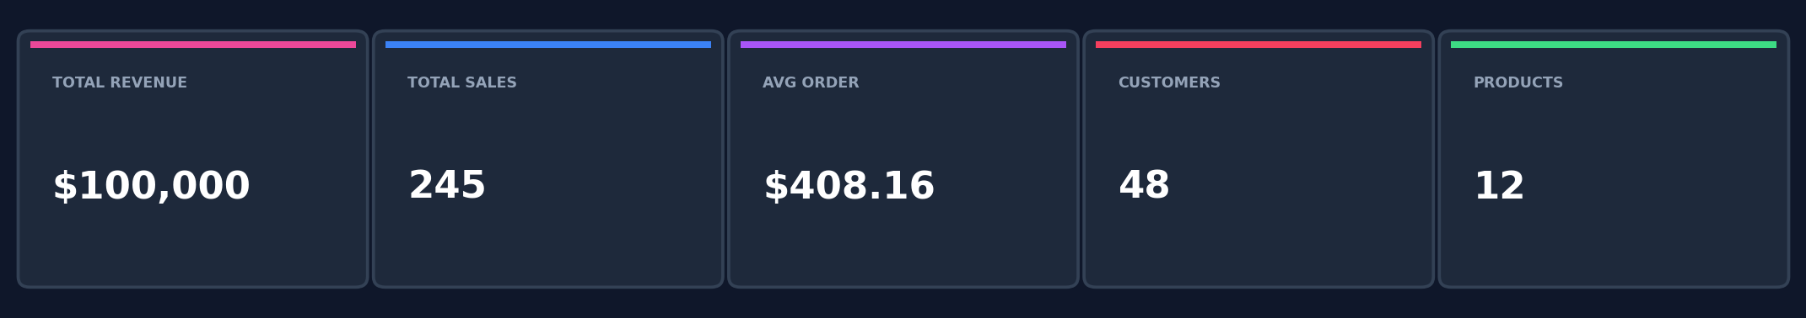
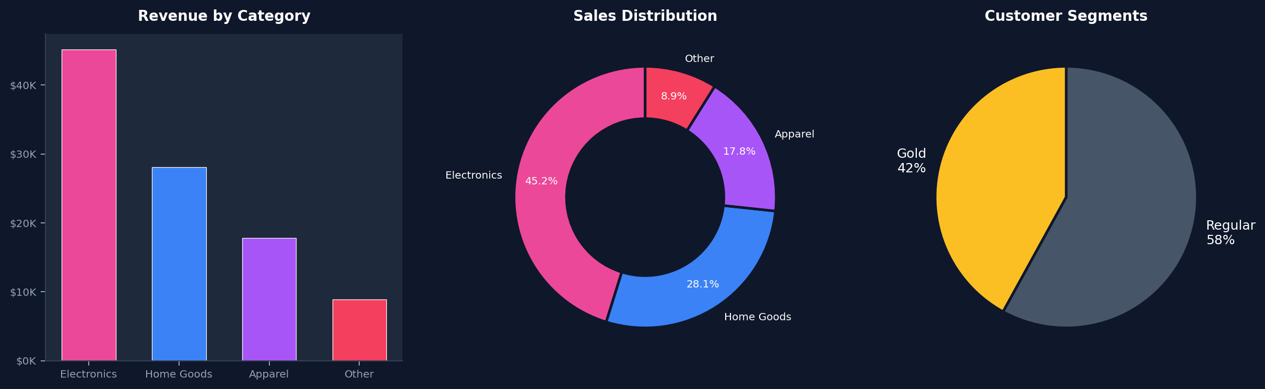
SalesDB
Dashboard Features
KPI Cards & Interactive Charts (Public)
11/18

Slide 12
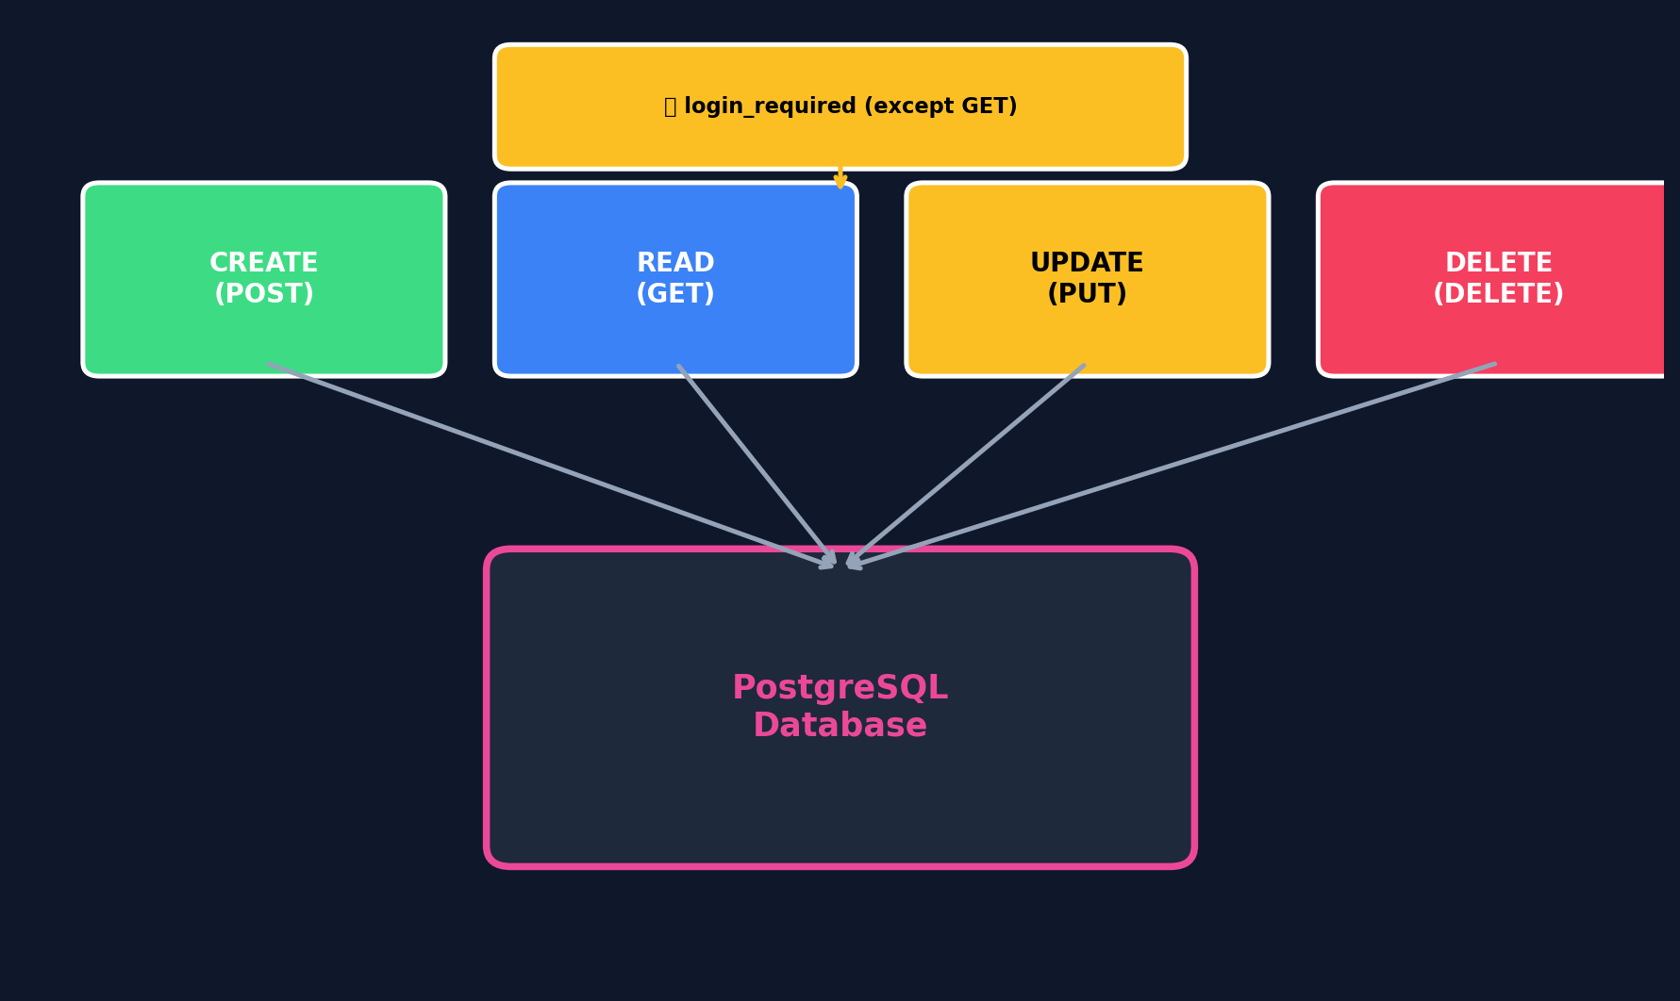
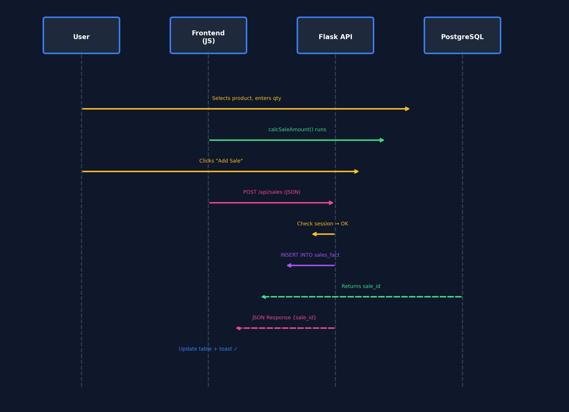
SalesDB
CRUD & Auto-Calculation
Protected Operations + Smart Pricing
AUTO-CALCULATION
Amount = Price × Qty
12/18

Slide 13
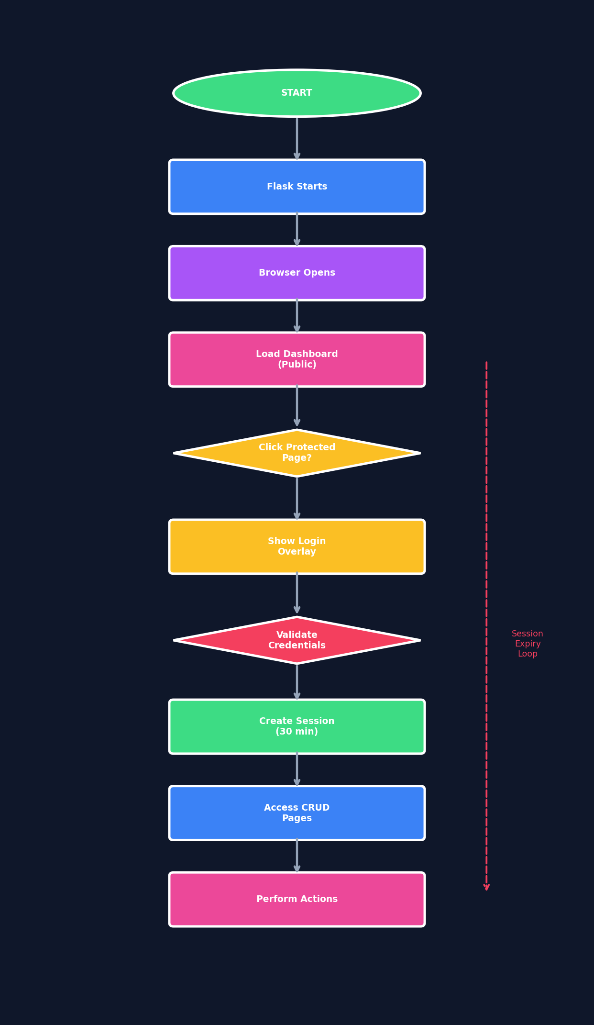
SalesDB
Program Execution Flow
Full Lifecycle with Auth Gates
EXECUTION STEPS
1.
Flask starts on port 5000
2.
Browser loads dashboard (public)
3.
KPIs & charts render
4.
User clicks protected page
5.
Login overlay appears
6.
Credentials validated
7.
Session created (30 min)
8.
CRUD pages unlocked
9.
API calls include session cookie
10.
Session expiry → re-login
13/18

Slide 14
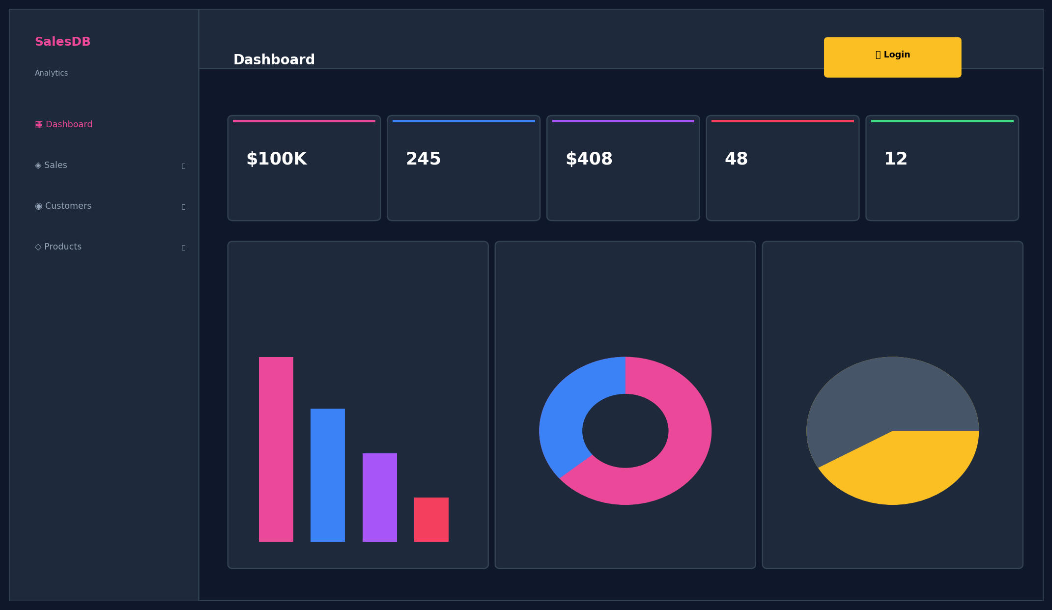
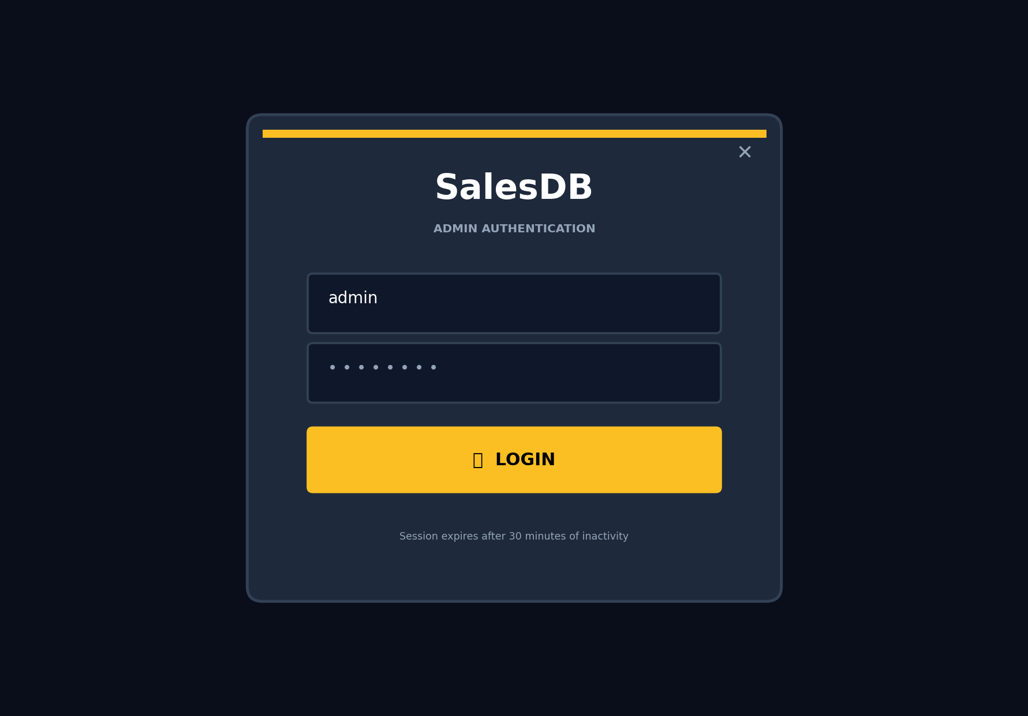
SalesDB
Screenshots — Dashboard & Login
Public Dashboard + Admin Login Overlay
Dashboard (Public — no login needed)
Login Overlay (for admin access)
14/18

Slide 15
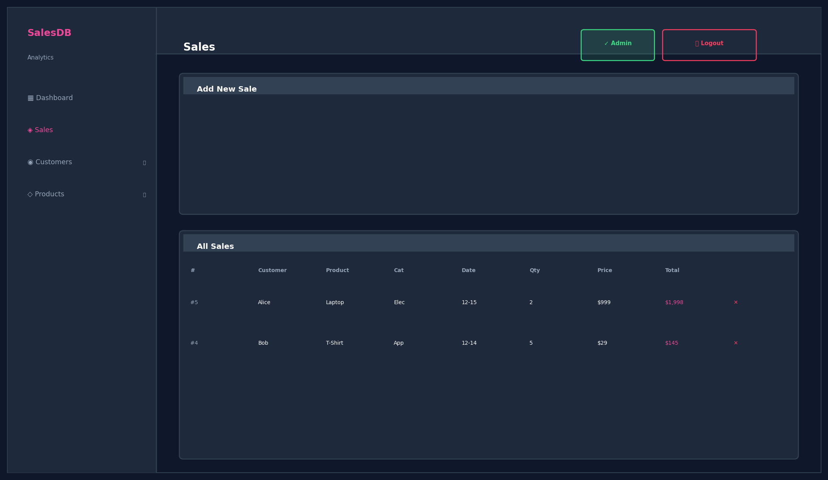
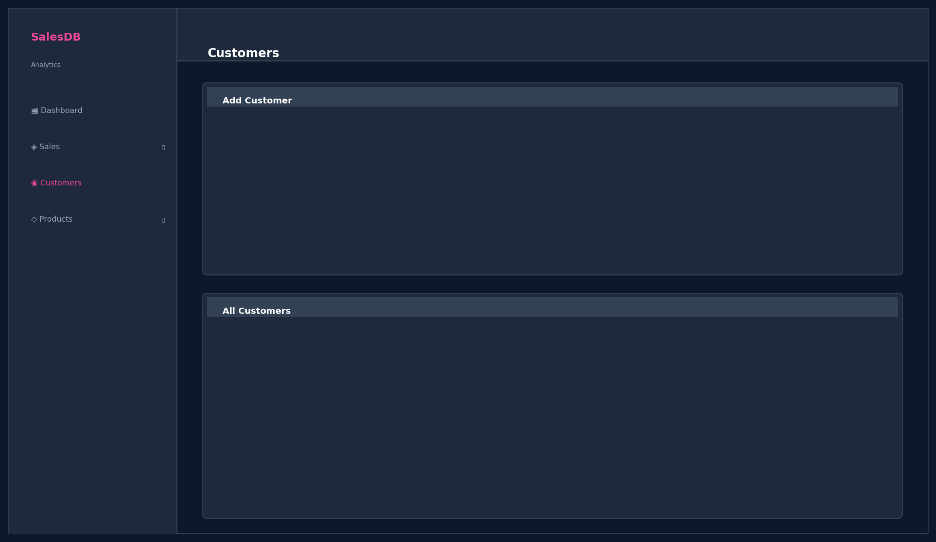
SalesDB
Screenshots — Sales & Customers
Admin-Only Pages (after login)
Sales Management (Protected)
Customer Management (Protected)
15/18

Slide 16
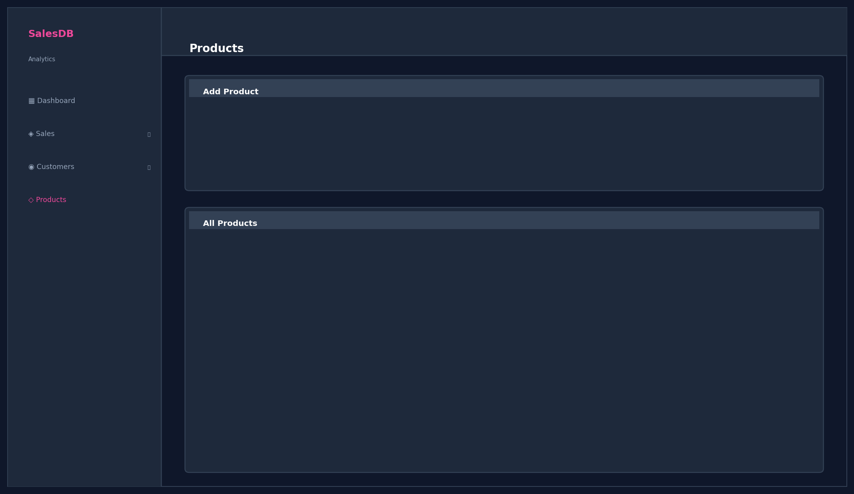
SalesDB
Screenshots — Products
Admin-Only Product Management
Product Management (Protected — requires admin login)
16/18

Slide 17
SalesDB
Advantages
Why SalesDB Stands Out
⚡ Real-time Analytics
🔐 Admin Authentication
Dashboard updates instantly — no refresh needed
Session-based login protects all data mutations
🔒 Data Integrity
💰 Auto-Calculation
Foreign keys + CASCADE + login = secure & clean data
Eliminates manual errors in sale amounts
🎨 Modern UI/UX
🔌 RESTful API
Dark-blue theme with login overlay & toast alerts
17 endpoints with @login_required decorator
🆓 100% Open Source
📱 Responsive Design
All technologies are free — zero licensing costs
Works on desktop, tablet & mobile screens
17/18

Slide 18
SalesDB
Conclusion & Thank You
✅ ALL 9 OBJECTIVES ACHIEVED — 100% TEST PASS RATE
Full-stack app with CRUD, dashboard, admin login, auto-calculation, and responsive UI.
4
17
3
21
100%
Modules
API Endpoints
DB Tables
Test Cases
Pass Rate
18/19

Slide 19
SalesDB
Thank You!
Any Questions ?
🌐 Demo: http://localhost:5000
🔐 Login: admin / admin123
💻 Stack: Flask + PostgreSQL + Chart.js
19/19

