Slide 1
SALESDB
Sales Analytics Dashboard
Full-Stack Web App with Admin Authentication & Real-time Analytics
Presented by: [Your Name]
Roll No: [Your Roll Number]
Department: [Your Department]
Guide: Prof. [Guide Name]
Institution: [Your Institution]
1/21

Slide 2
SalesDB
Agenda
21-Slide Comprehensive Presentation
01
Project Overview
02
Problem Statement
03
Objectives
04
Technology Stack
05
System Architecture
06
Database Design
07
Data Flow Diagrams
08
Dashboard Features
09
CRUD Operations
10
Authentication
11
Auto-Calculation
12
Invoice Management ★
13
Stock Management ★
14
Reports & Analytics ★
15
Program Flow
16-19
Screenshots
20
Advantages
21
Conclusion
2/21

Slide 3
SalesDB
Project Overview
What is SalesDB?
SalesDB is a full-stack web app for managing sales, customers & products with real-time analytics, admin authentication, invoicing, and stock management.
📊 Real-time Dashboard
🔐 Admin Authentication
📄 Invoice Builder
KPI cards + 3 interactive charts
Session-based login with 30min expiry
Professional PDF invoices with GST
📦 Stock Management
📈 Advanced Reports
💰 Auto-Calculation
Auto-tracking with low stock alerts
Filterable reports with CSV export
Amount = Unit Price × Quantity
3/21

Slide 4
SalesDB
Problem Statement
Why SalesDB is needed
📋 Scattered Data
📉 No Analytics
Sales spread across spreadsheets
Cannot quickly assess KPIs
🧮 Manual Errors
📊 Poor Visualization
Computing totals is error-prone
Raw numbers lack insights
🔓 No Access Control
📦 No Stock Tracking
Anyone can modify data
Inventory not monitored
4/21

Slide 5
SalesDB
Project Objectives
10 Goals Achieved
01
Design & develop a full-stack web app for sales data management
02
Implement CRUD operations for Customers, Products & Sales
03
Create interactive dashboard with KPIs & Chart.js visualizations
04
Design star schema database with dimension & fact tables
05
Develop RESTful API using Python Flask as middleware
06
Implement admin authentication with session-based login
07
Build professional invoice generation with PDF export
08
Create real-time stock tracking with low stock alerts
09
Develop advanced reports with date/category/region filters
10
Build responsive dark-themed UI with modern UX patterns
5/21

Slide 6
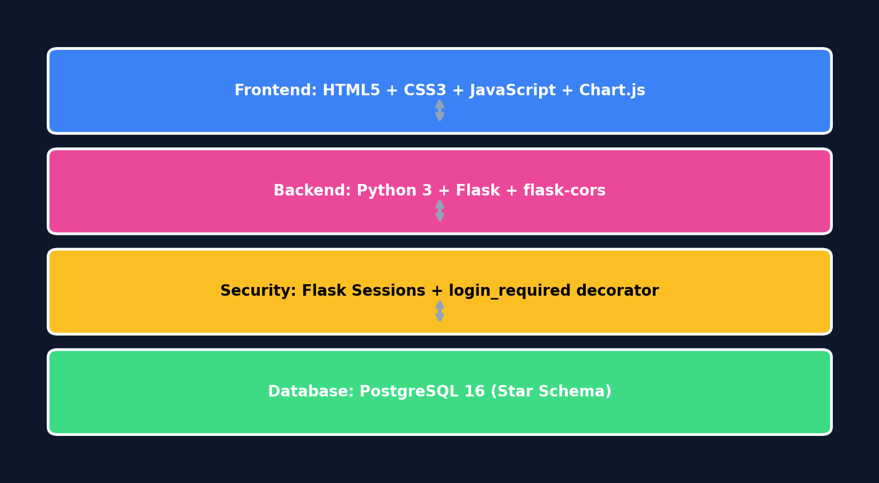
SalesDB
Technology Stack
Tools & Technologies
6/21

Slide 7
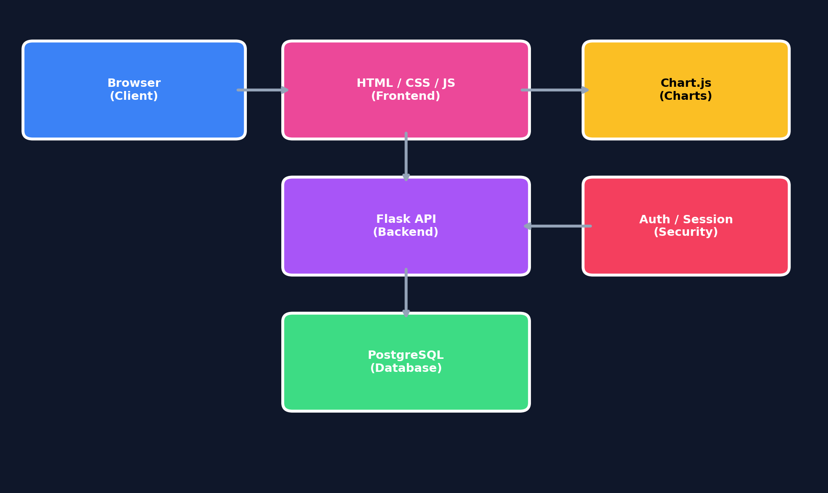
SalesDB
System Architecture
Three-Tier + Authentication Layer
7/21

Slide 8
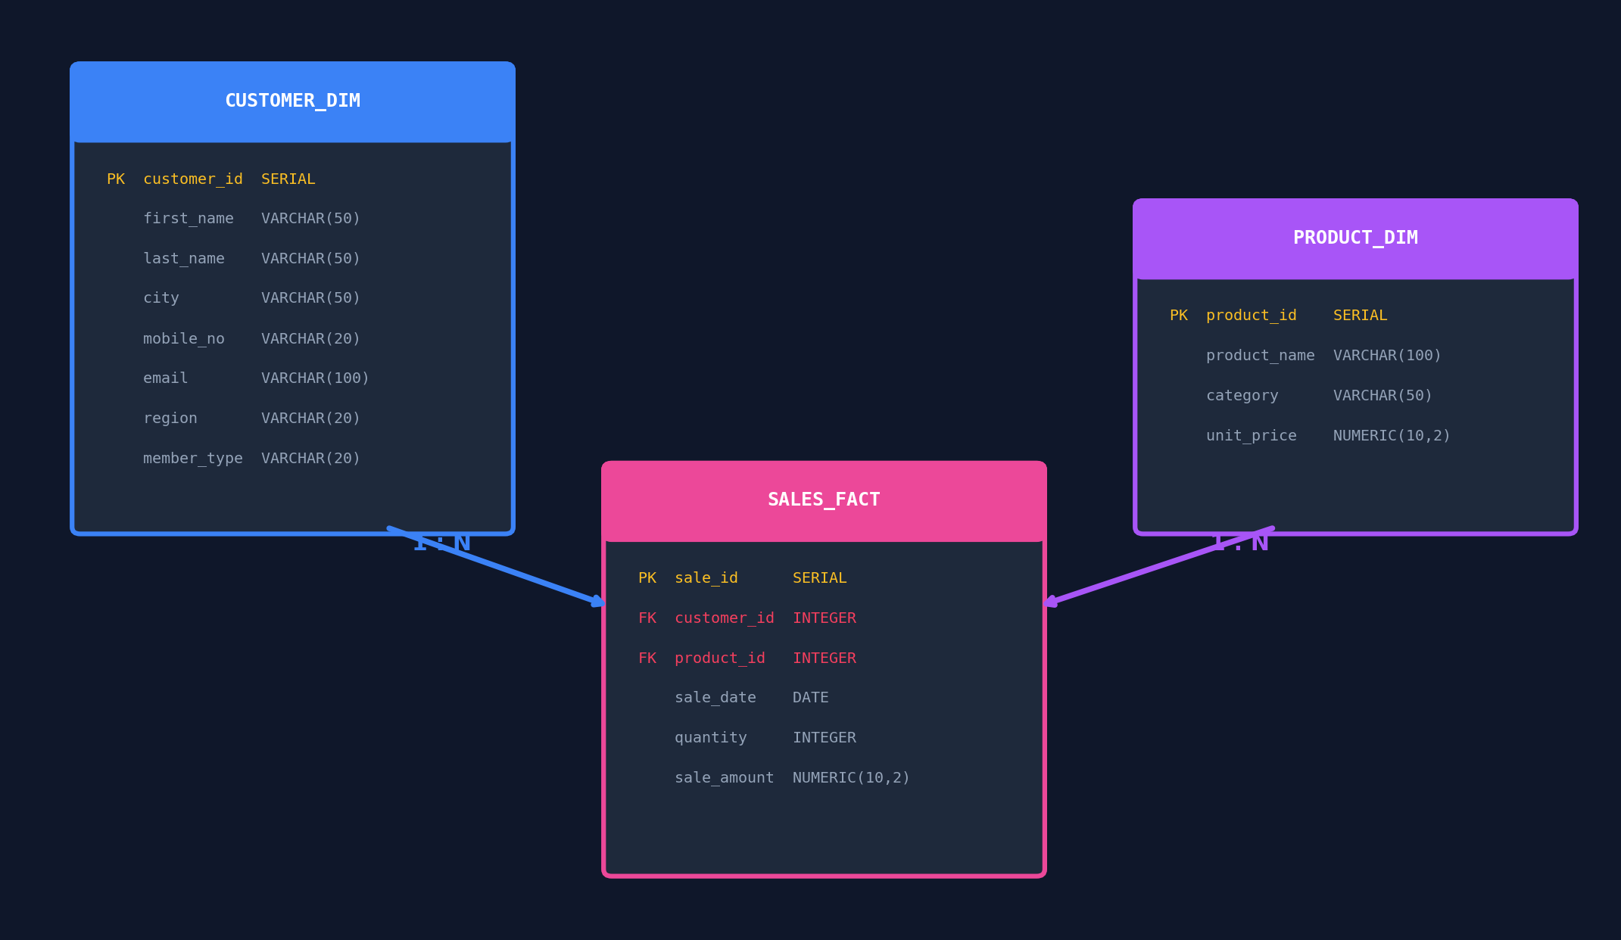
SalesDB
Database Design
Star Schema — ER Diagram
8/21

Slide 9
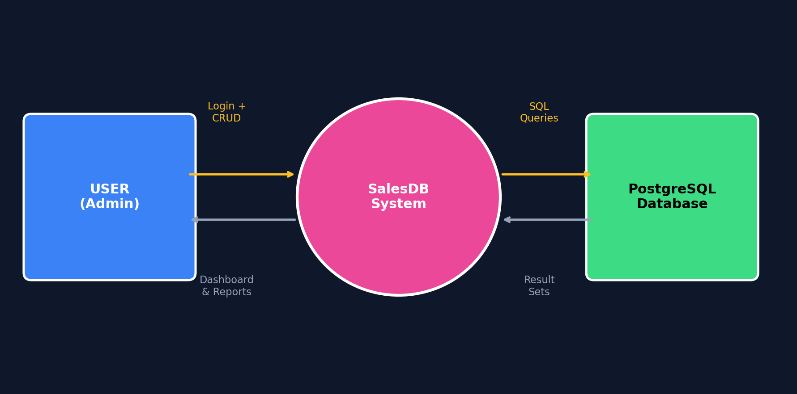
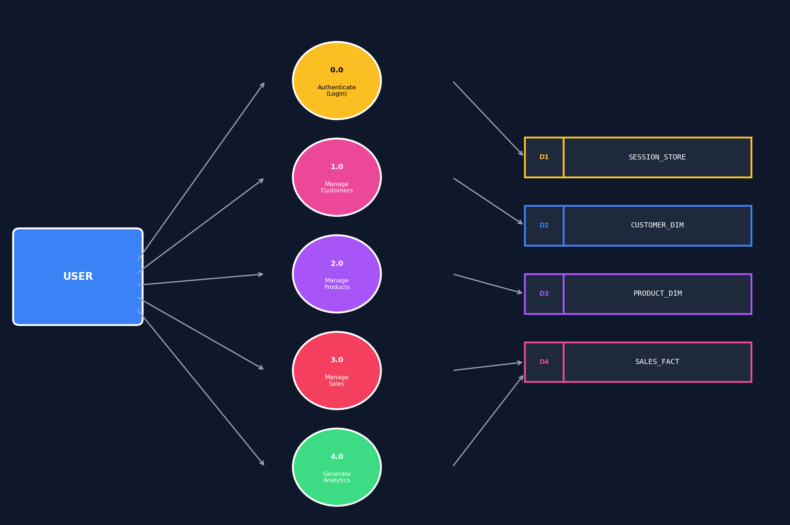
SalesDB
Data Flow Diagrams
Level 0 & Level 1
DFD Level 0
DFD Level 1
9/21

Slide 10
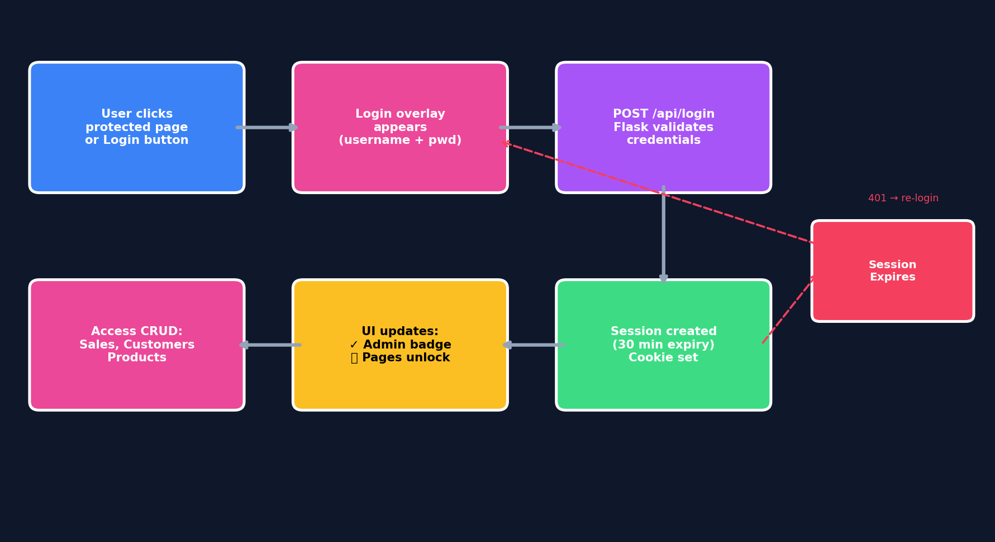
SalesDB
Authentication & Security
HOW IT WORKS
Session-Based Admin Login
🔒
Dashboard = PUBLIC
🔐
CRUD = PROTECTED
👤
Session Login
⏱️
30-min Expiry
🛡️
@login_required
401
Auto-redirect
🟢
Admin Badge
🟡
Login Button
10/21

Slide 11
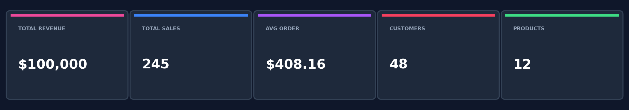
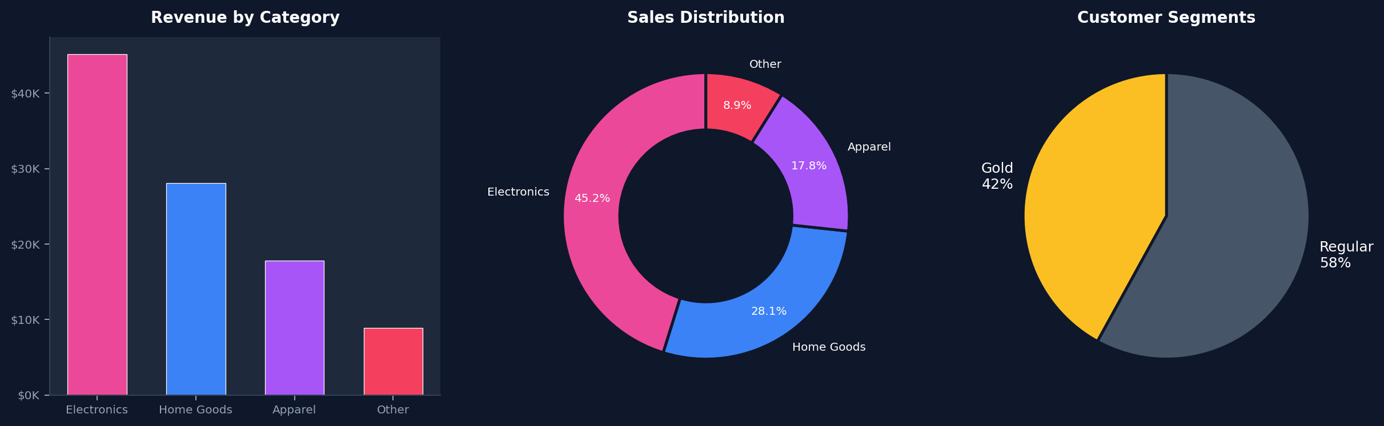
SalesDB
Dashboard Features
KPI Cards & Charts
11/21

Slide 12
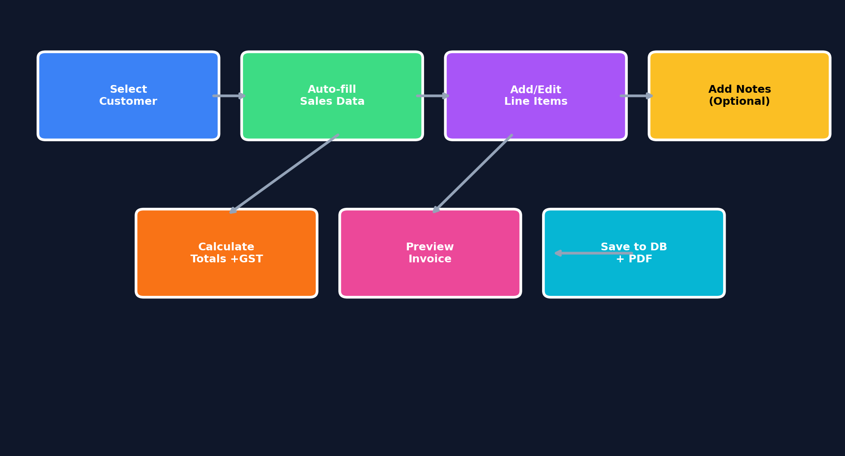
SalesDB
Invoice Management
Professional Invoice Builder & PDF
INVOICE FEATURES
📝
Custom Line Items
🤖
Auto-fill Sales
💰
Auto GST 18%
👁
Live Preview
💾
Save to Database
📄
PDF Download
📊
Status Tracking
🔢
Auto Invoice #
12/21

Slide 13
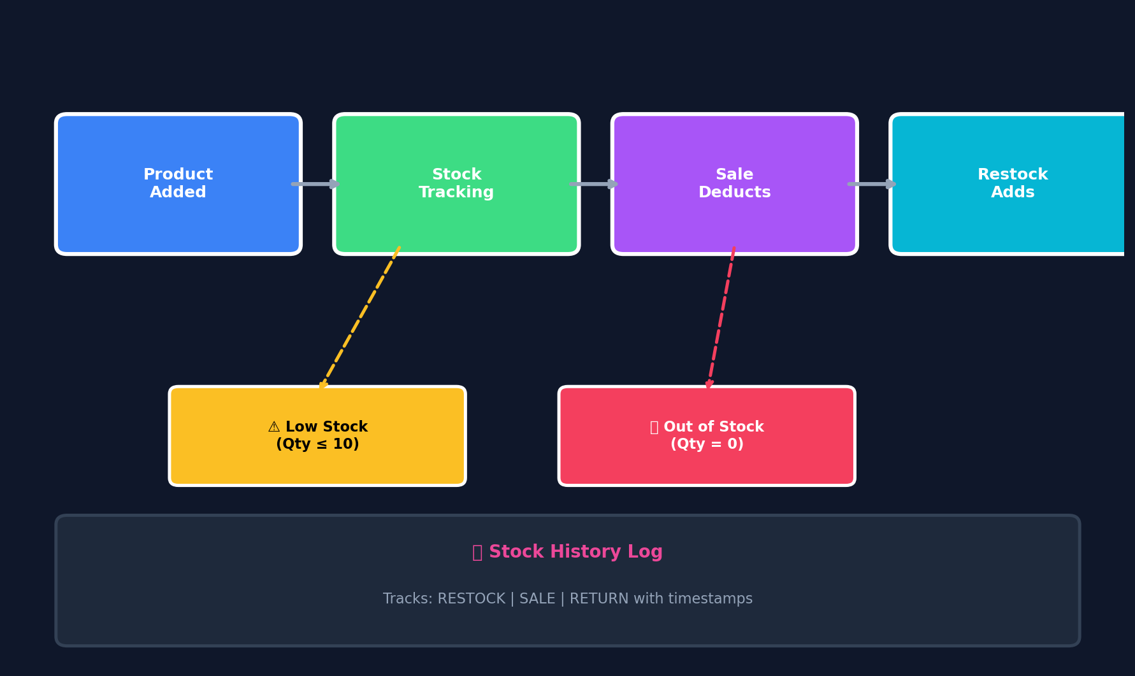
SalesDB
Stock Management
Real-time Inventory Tracking
📦 Auto-Deduct on Sale
➕ Restock Functionality
⚠️ Low Stock Alerts
❌ Out of Stock Badge
📊 Stock History Log
📈 Stock Charts
13/21

Slide 14
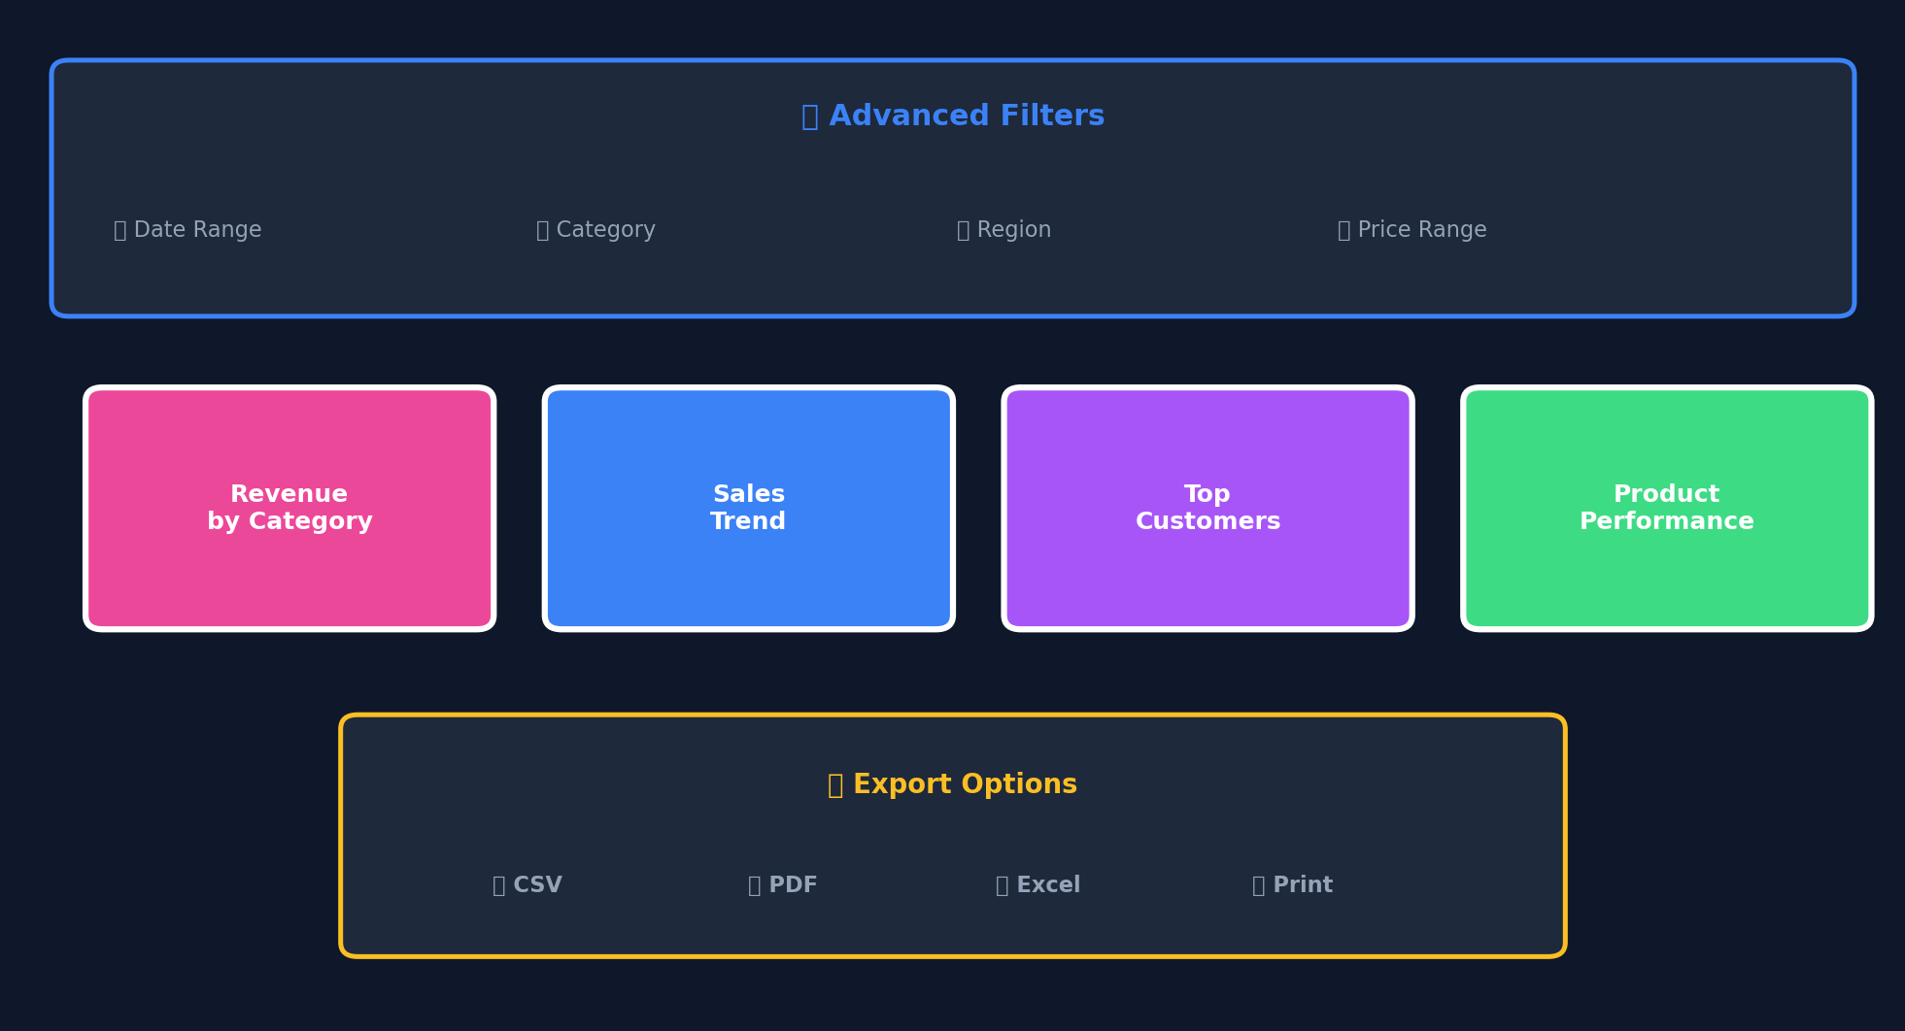
SalesDB
Reports & Analytics
Advanced Filtering & Export
14/21

Slide 15
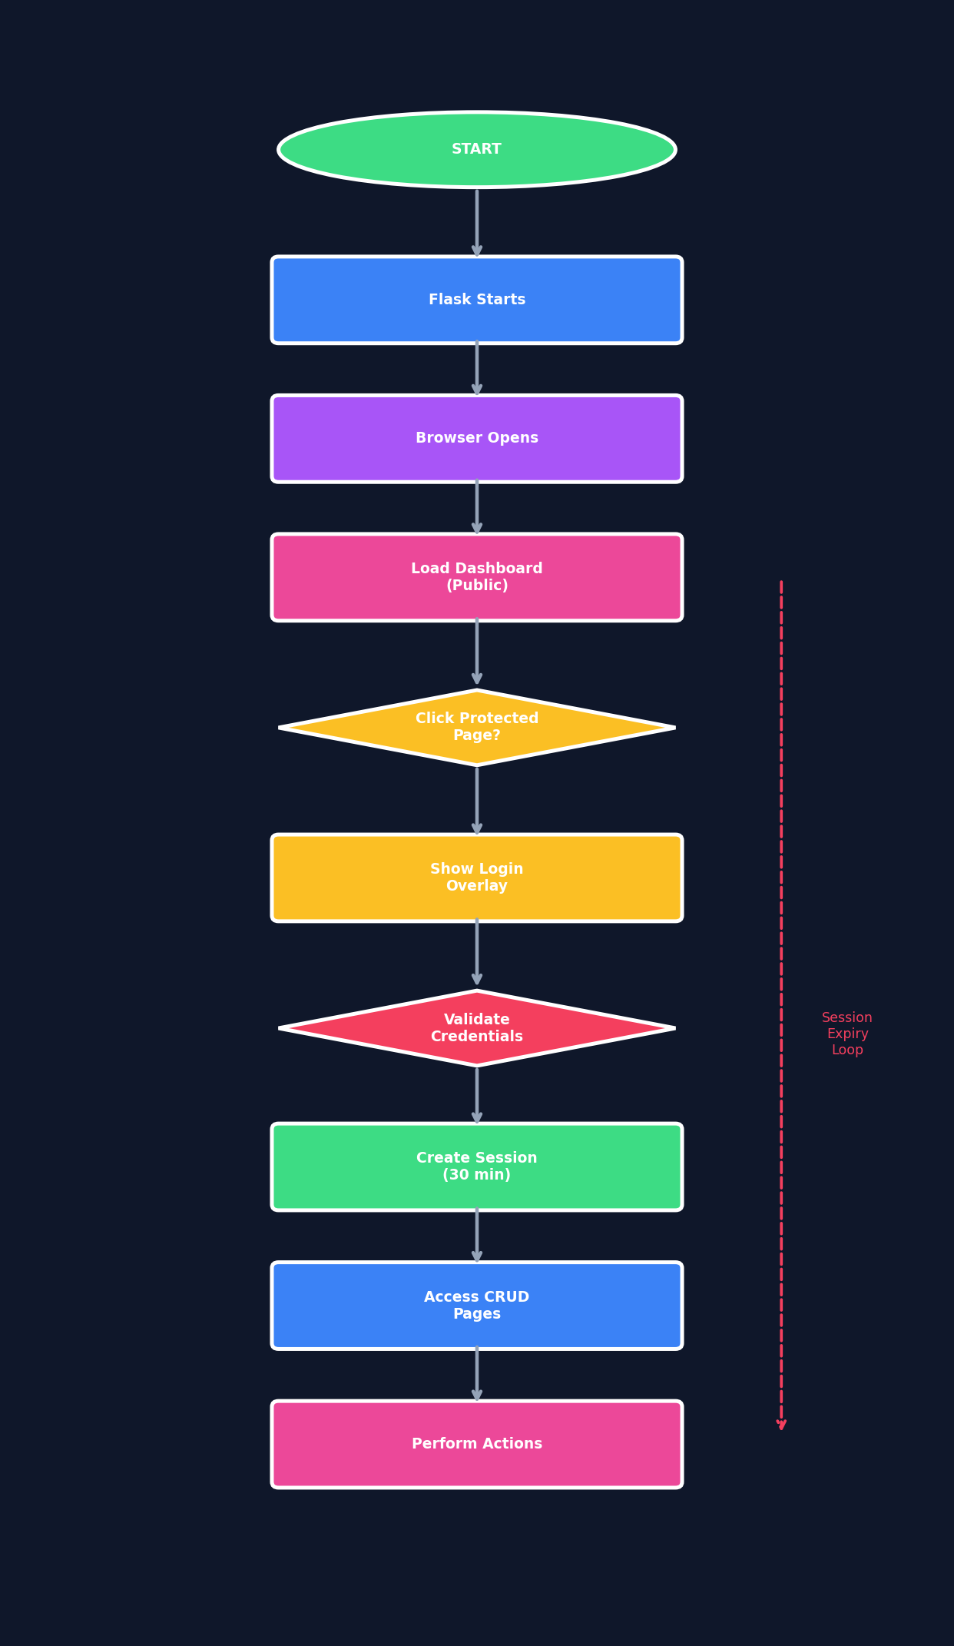
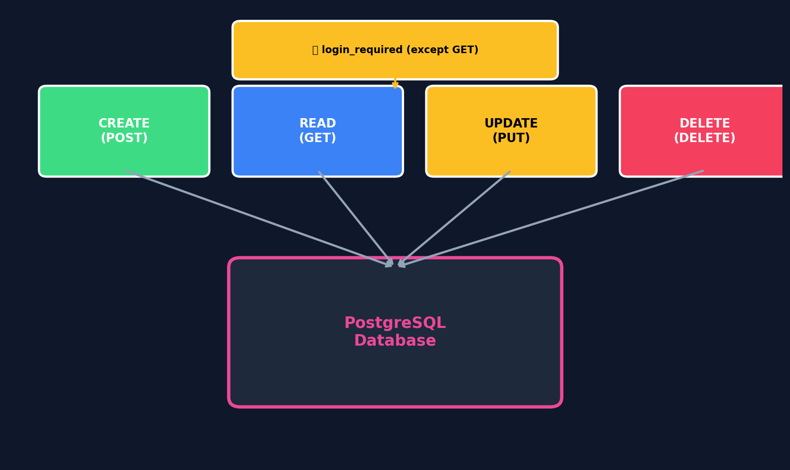
SalesDB
CRUD & Program Flow
Operations + Lifecycle
15/21

Slide 16
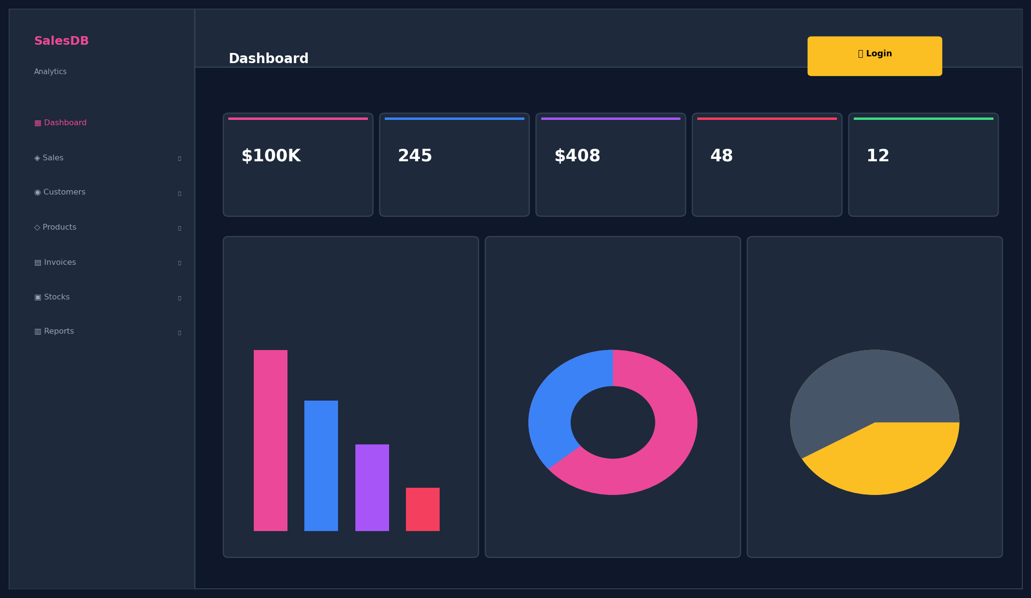
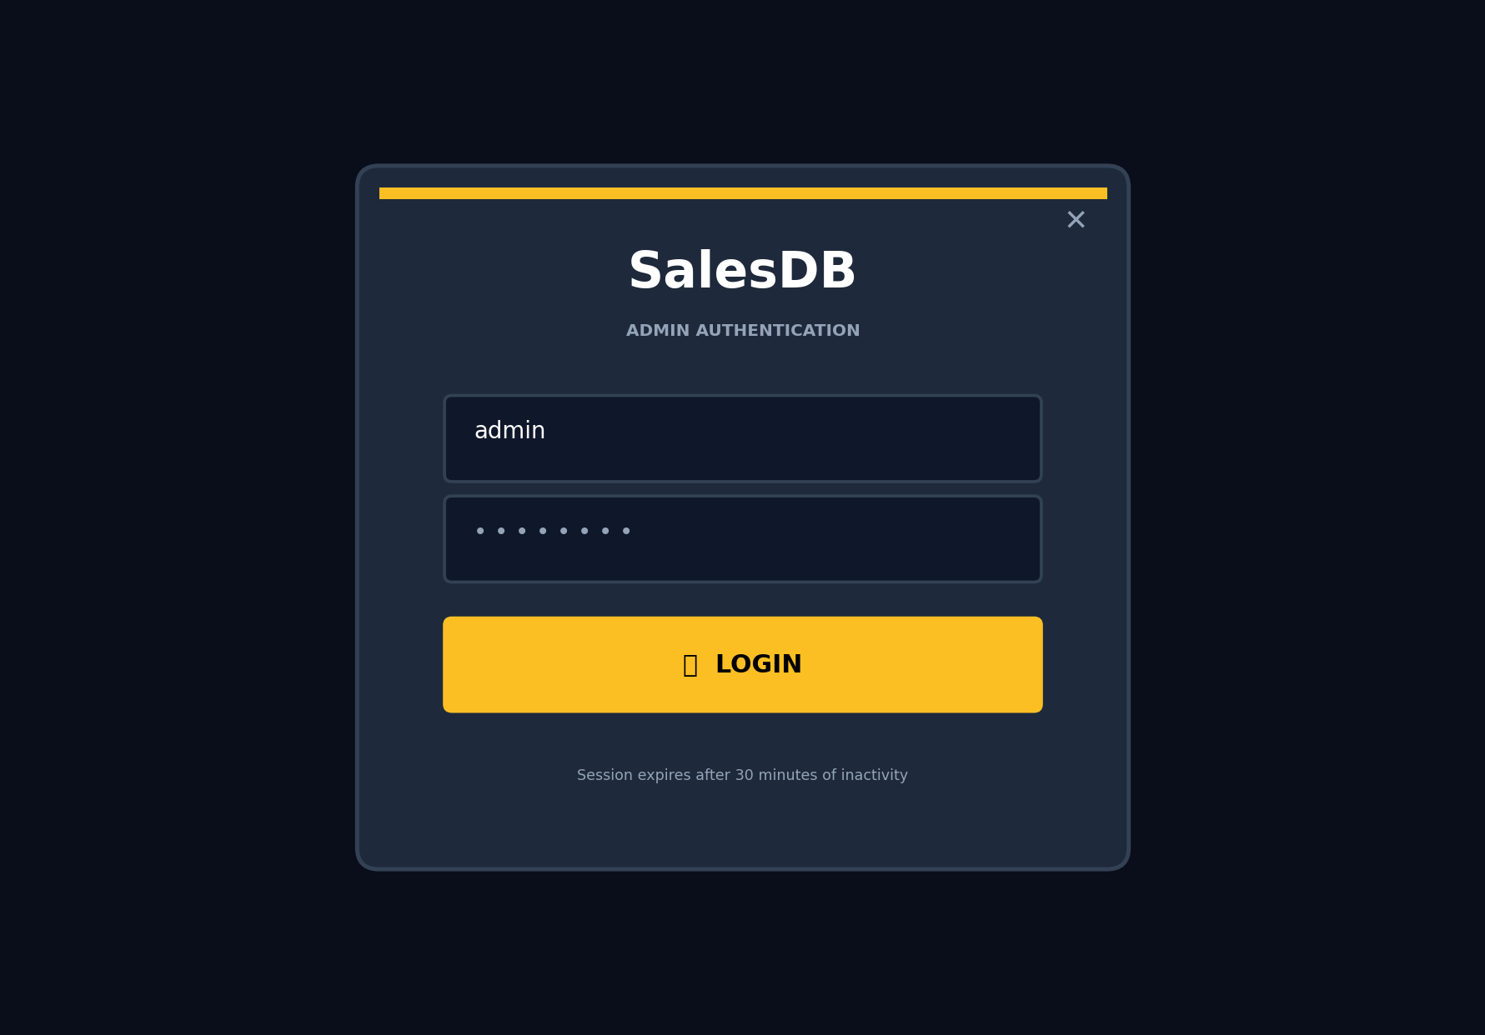
SalesDB
Screenshots — Dashboard & Login
Public + Admin Access
Dashboard (Public)
Login Overlay
16/21

Slide 17
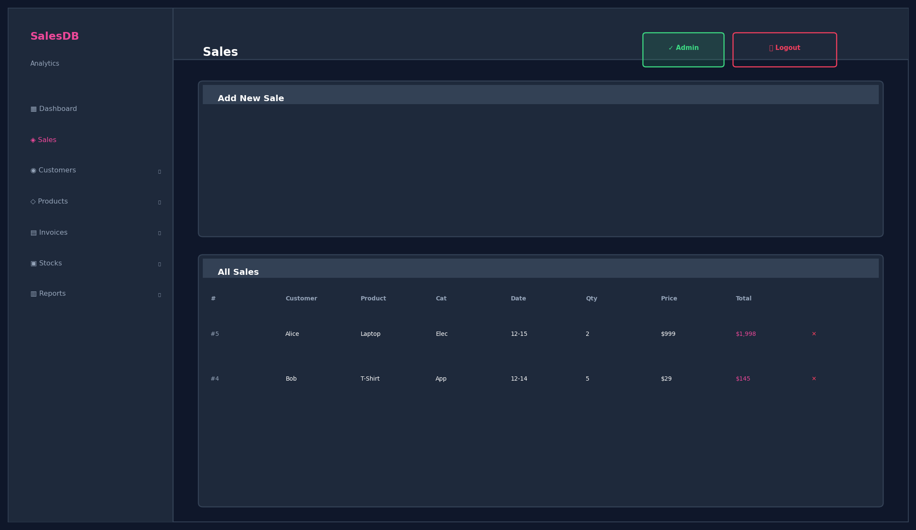
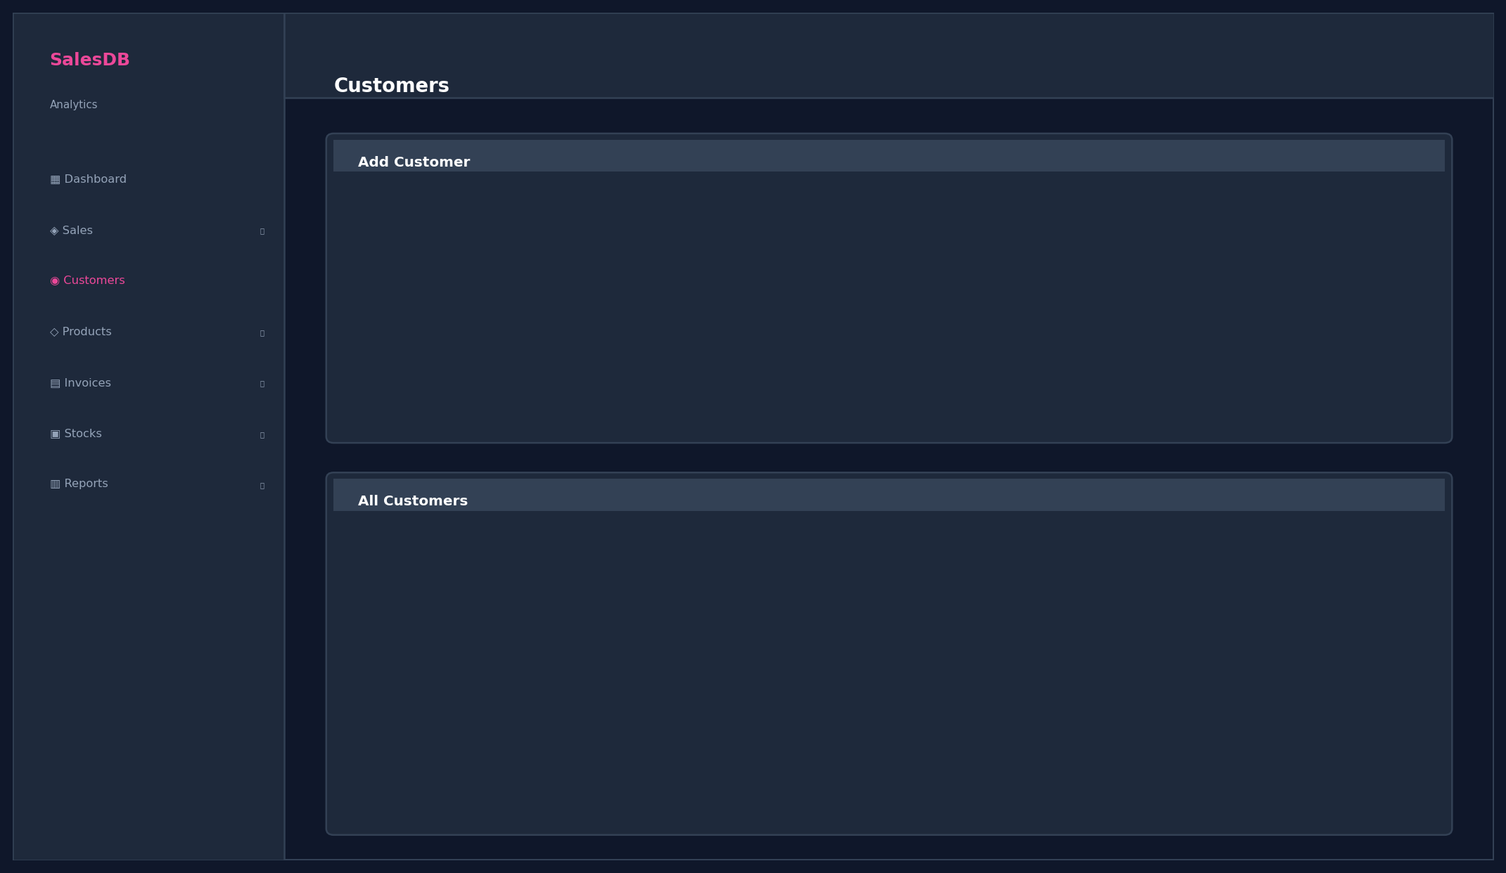
SalesDB
Screenshots — Sales & Customers
Admin Pages
Sales Management
Customer Management
17/21

Slide 18
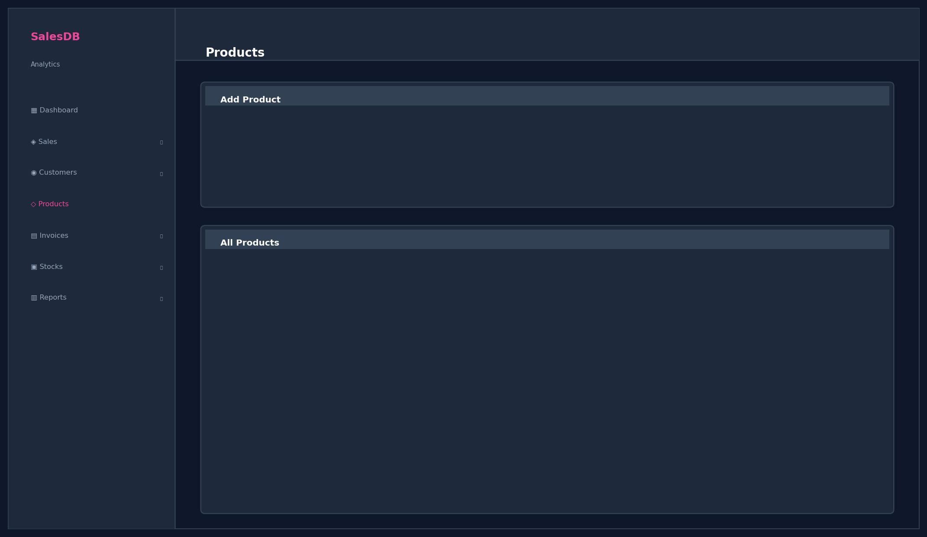
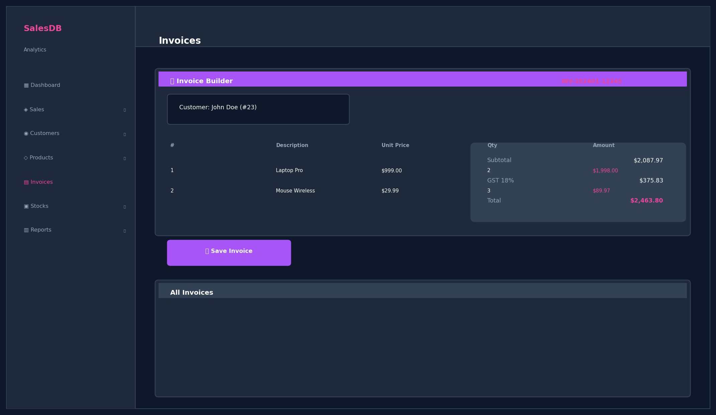
SalesDB
Screenshots — Products & Invoices
Inventory & Billing
Product Management
Invoice Builder ★NEW
18/21

Slide 19
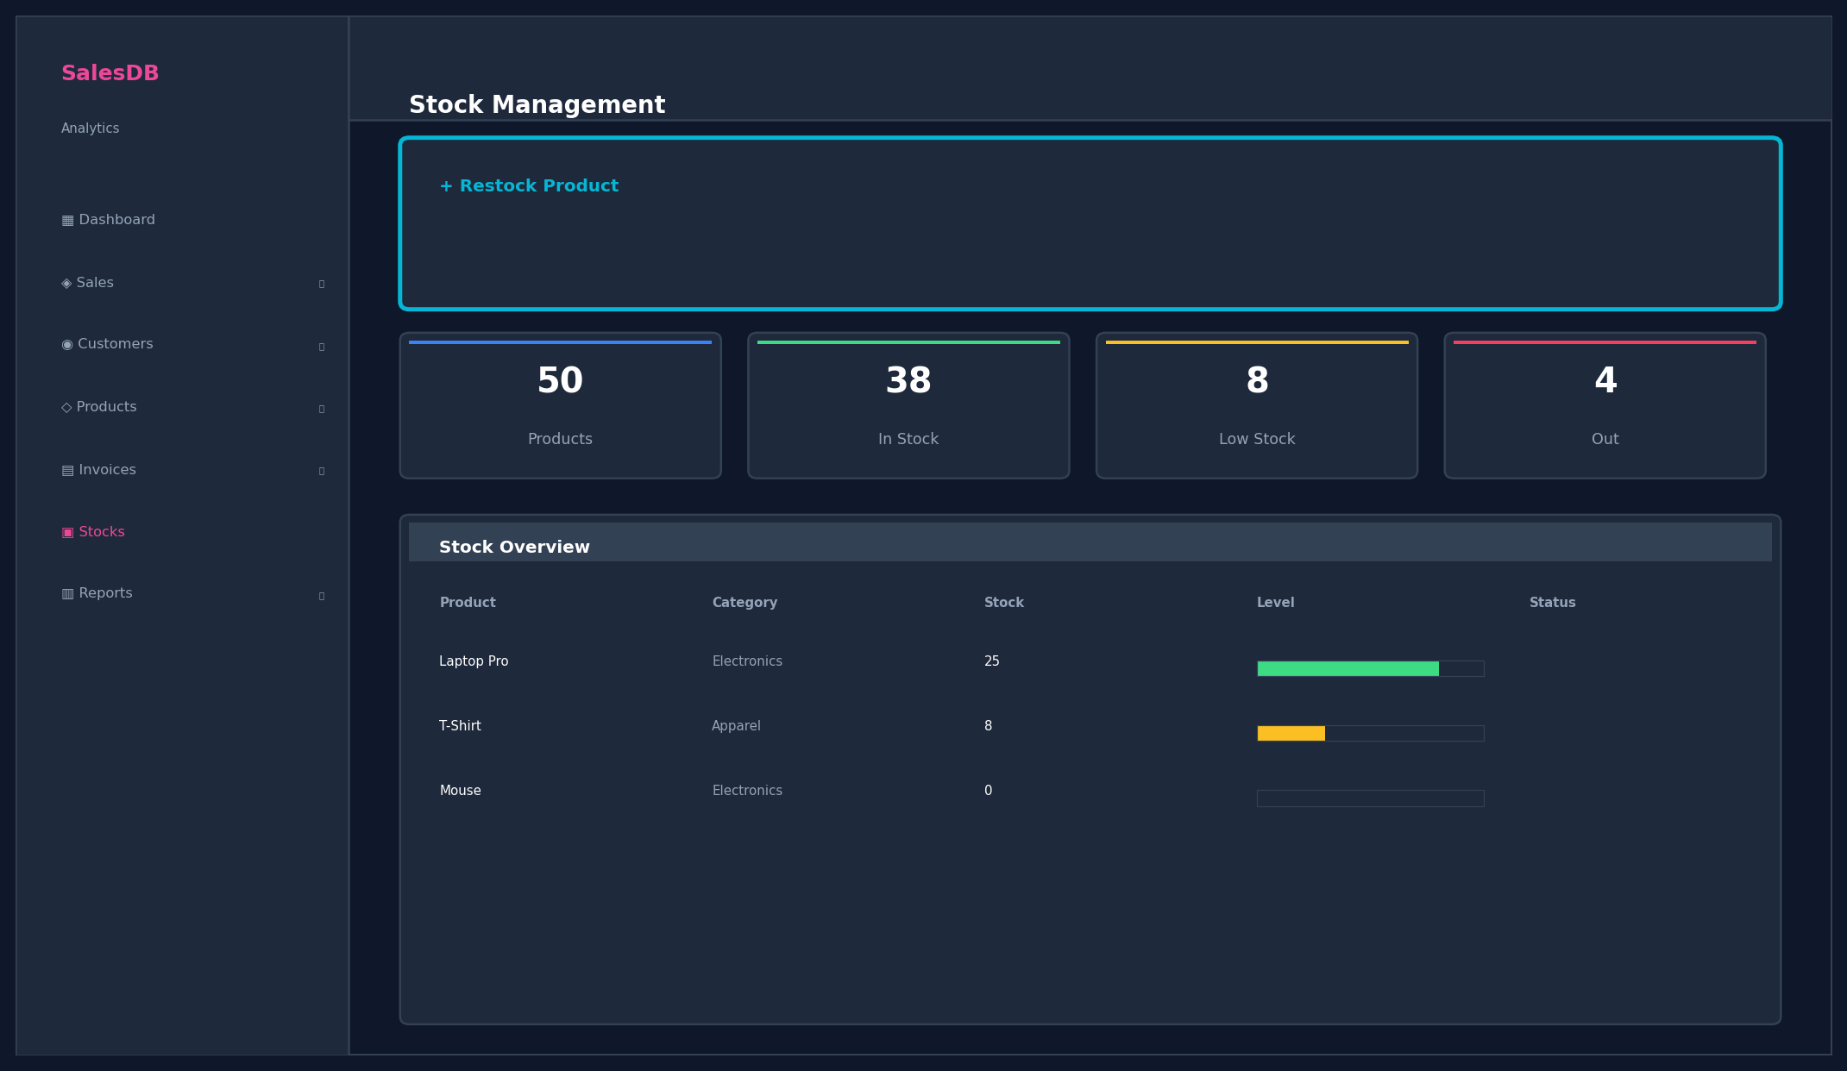
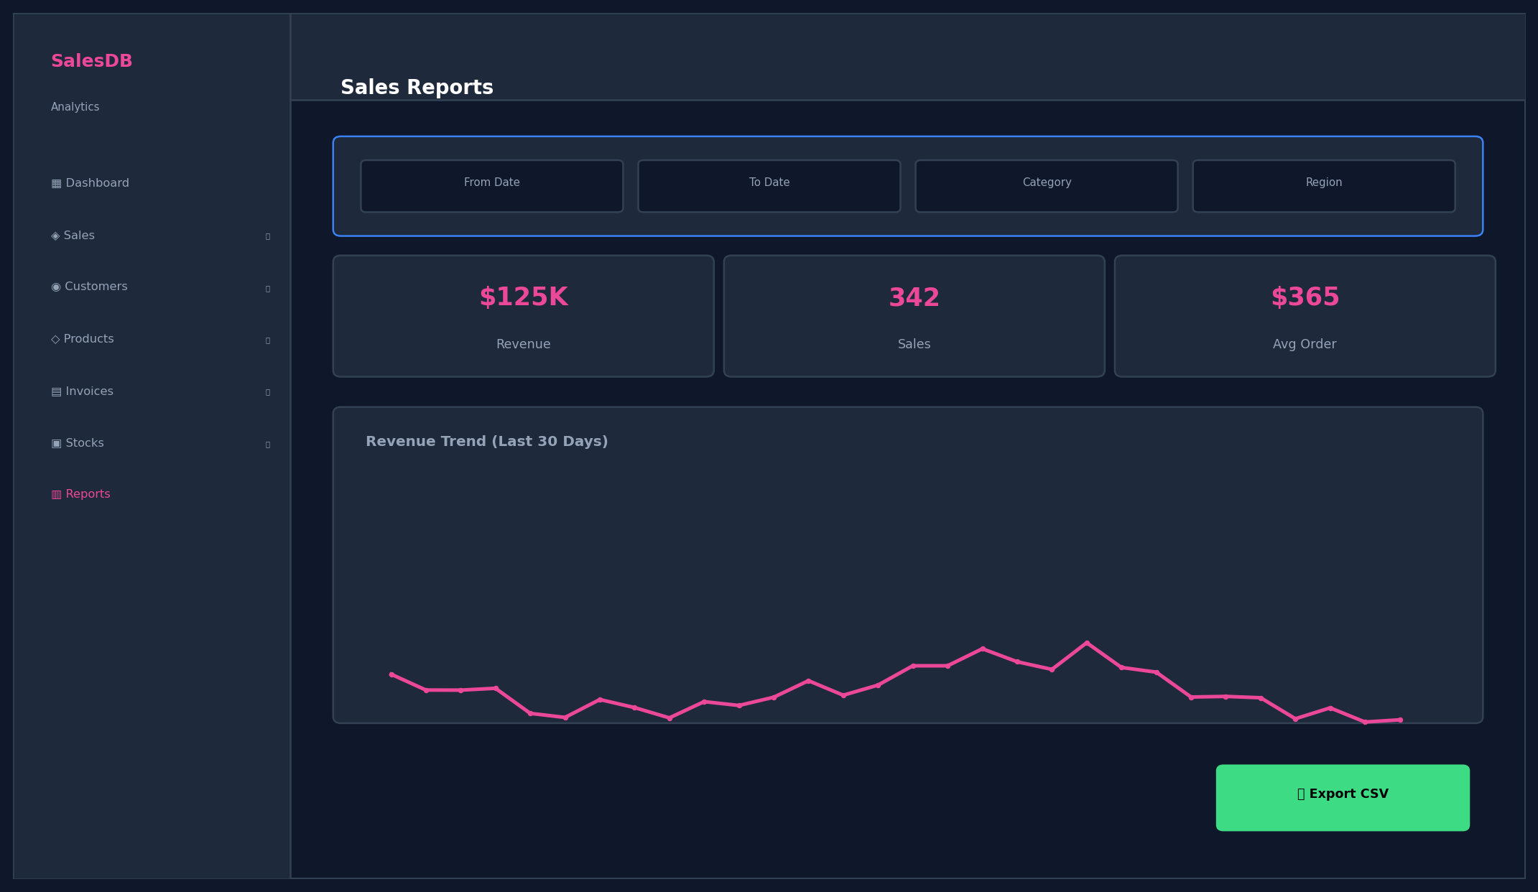
SalesDB
Screenshots — Stocks & Reports
Inventory & Analytics
Stock Management ★NEW
Reports & Analytics ★NEW
19/21

Slide 20
SalesDB
Advantages
Why SalesDB Stands Out
⚡ Real-time Analytics
🔐 Admin Authentication
💰 Auto-Calculation
📄 Invoice Generation
📦 Stock Tracking
📊 Advanced Reports
🎨 Modern UI/UX
🆓 100% Open Source
🔗 RESTful API (20+)
📱 Mobile Responsive
20/21

Slide 21
SalesDB
Conclusion & Thank You
✅ COMPLETE SALES MANAGEMENT SYSTEM — 100% FUNCTIONAL
Full-stack with CRUD, invoicing, stock tracking, analytics, and admin security.
7
20+
5
30+
100%
Modules
API Endpoints
DB Tables
Features
Complete
Thank You!
Any Questions ?
🌐 Demo: http://localhost:5000
🔐 Login: admin / admin123
💻 Tech: Flask + PostgreSQL + Chart.js + ReportLab
21/21

