Slide 1





Regional Heating Networks: An Overview
This presentation will provide an overview of regional heating networks.
We will cover the basic concept, connections, data representation, and code implementation.
by Aditya Mukherjee

Slide 2

Core Concept: Subregional Networks
Network Segmentation
Closed Circuit System
Intermediate Junctions
The region is divided into several subregions.
Heated water flows in a closed circuit.
The system incorporates intermediate junctions.
Each subregion acts as an independent heating network.
This circuit runs throughout the entire network.
These junctions are critical for managing heat distribution.

Slide 3


Network Connections and Dynamics
1
Temperature Gradients
2
Pressure Management
Junctions supply water at temperature (Ts).
Each junction has supply (Ps) and return pressure (Pr).
Water returns at return temperature (Tr).
3
Closed Circuit Operation
4
Temperature Drop
Network is a closed circuit.
50K drop across each user node.
Special boilers may remove water.
Mass flow rate adjusts energy needs.

Slide 4
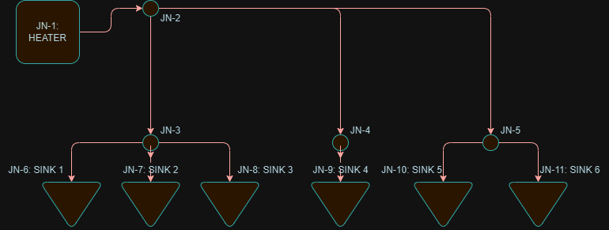

Data Representation in Excel
Data Organization
Junction Properties
Excel is used to store network parameters and connectivities.
Includes supply/return temperatures.

Slide 5
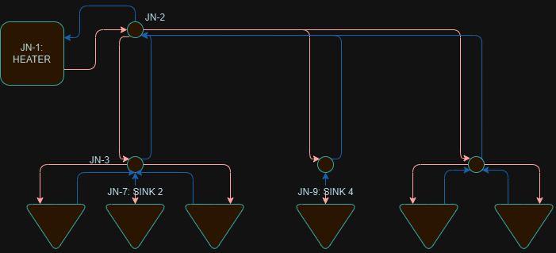

Code Implementation Overview
1
Data Input
Reads network data.
This loads from Excel.
2
Calculation
Executes calculations.
Determines flow parameters.
3
Visualization
Presents network performance.
Displays key metrics.

