Slide 1
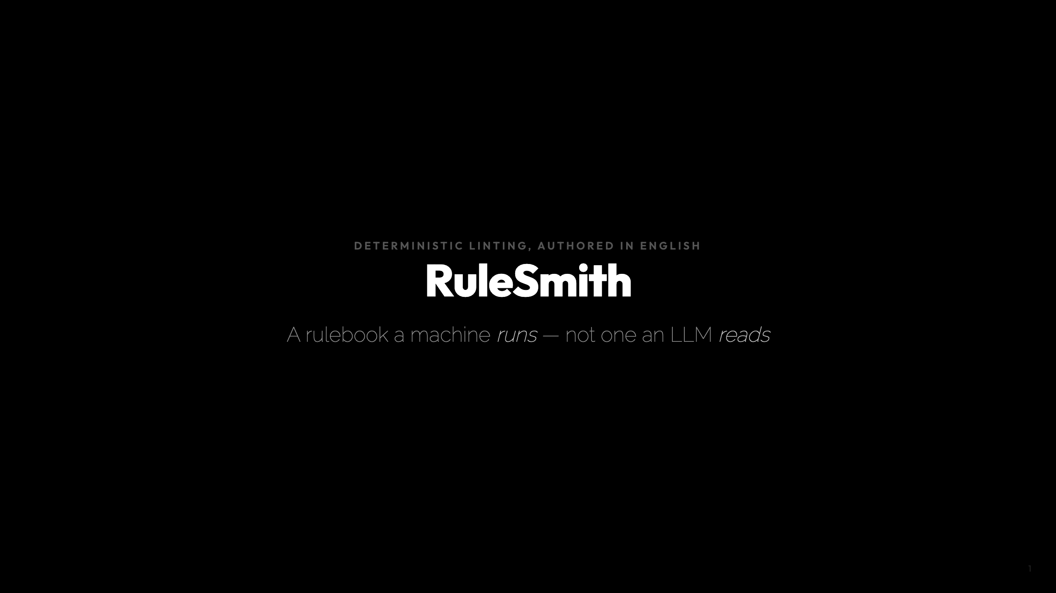
Notes:
~7 min. Setup off-screen: cd ~/workspace/experiments/rule-smith && source .venv/bin/activate BC=~/Desktop/clones/backend-connectors FIVE=builder-terminal-before-setters,pure-method-no-side-effects,guarded-by-lock-held,blocking-call-while-holding-lock,lambda-captures-mutable-state Record a fallback video of the `add` beat (calls claude -p).

Slide 2
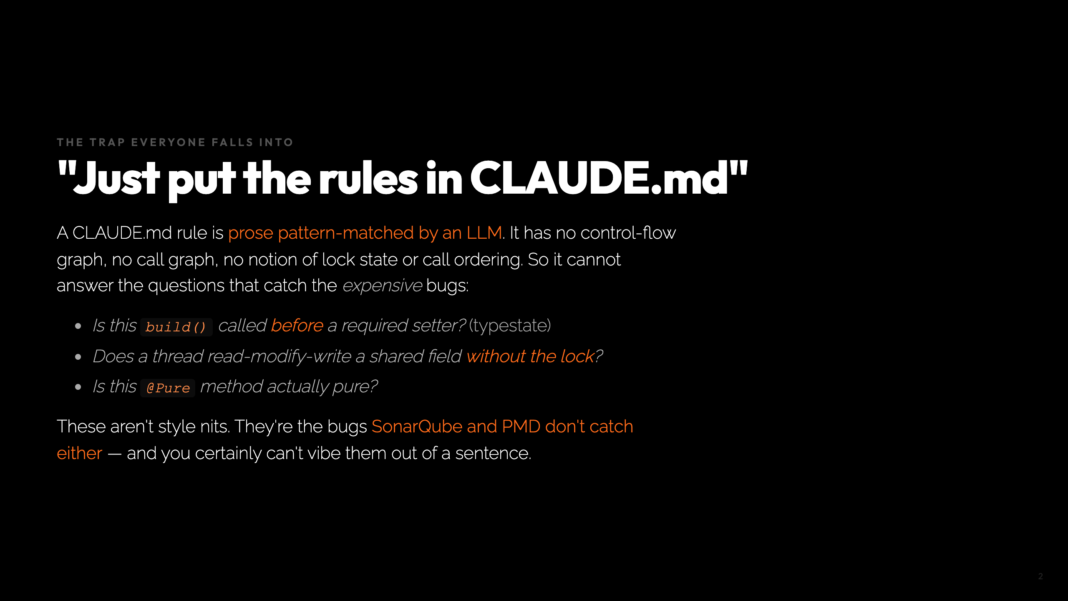
Notes:
Beat 0, 45s. Set up that the interesting rules are the ones standard tools miss.

Slide 3
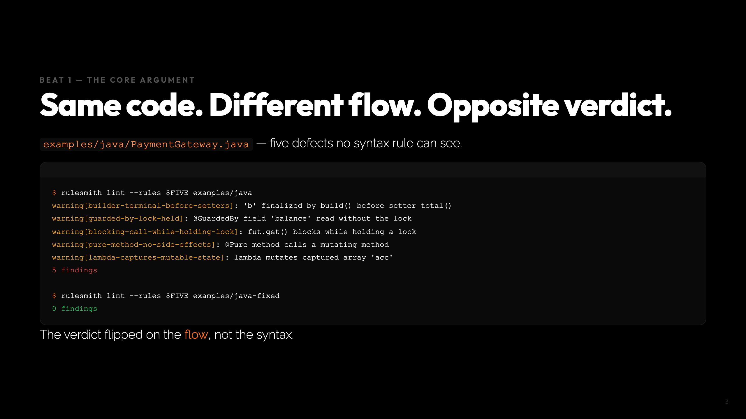
Notes:
Beat 1, 110s. The money slide. Typestate, lock-dominance, deadlock, purity, closure capture -- all in one screen.

Slide 4
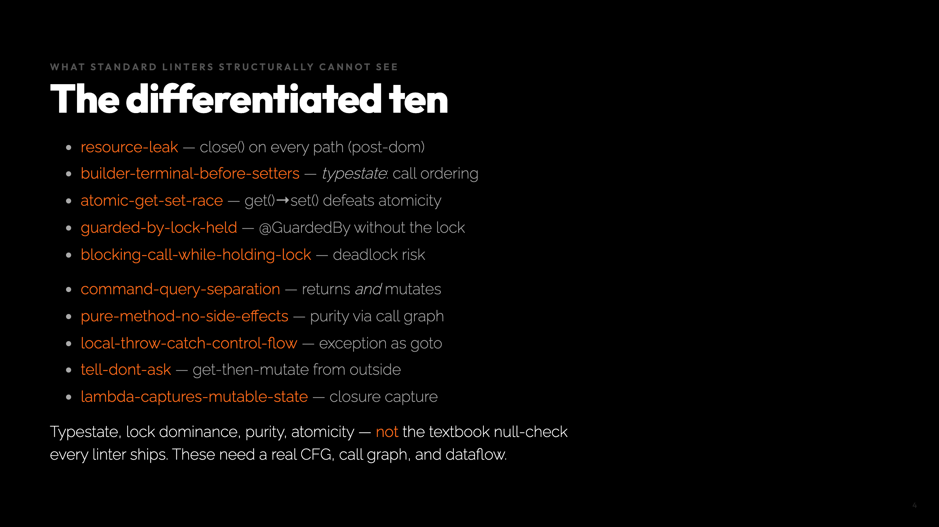
Notes:
Beat 1 continued. This is the slide that answers "isn't this just SonarQube?". No -- these are the ones it misses.

Slide 5
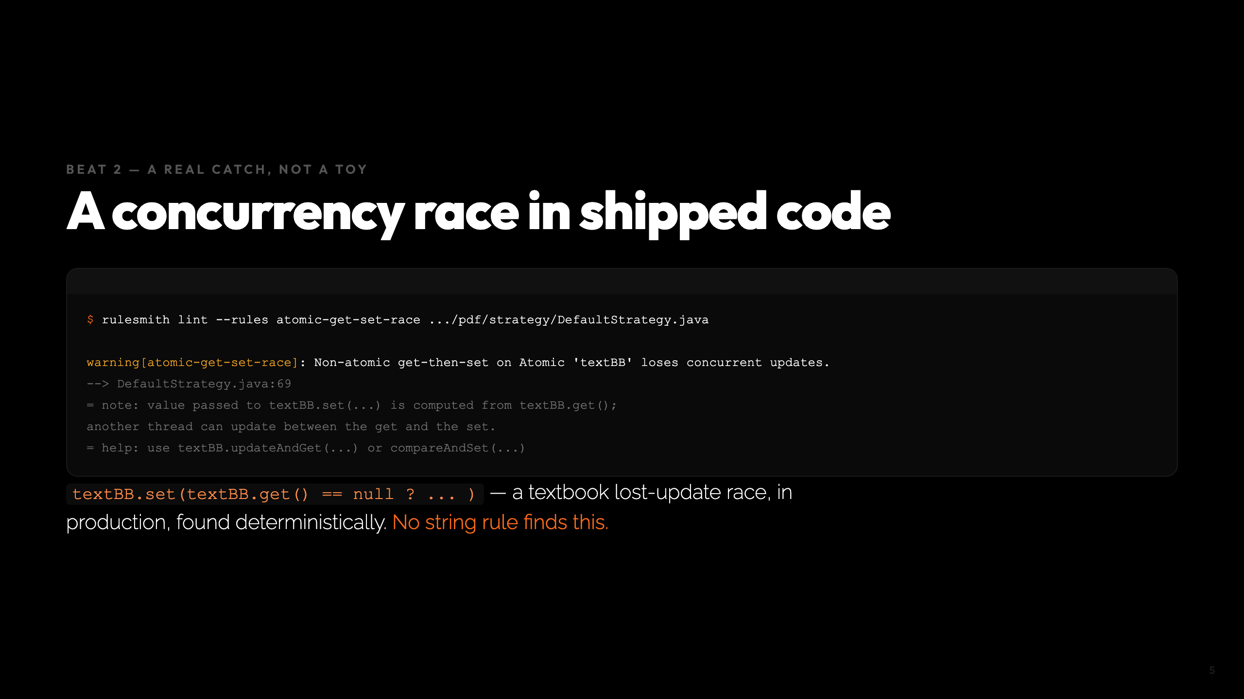
Notes:
Beat 2, 75s. The star finding. Real backend-connectors code. Read the textBB line aloud.

Slide 6
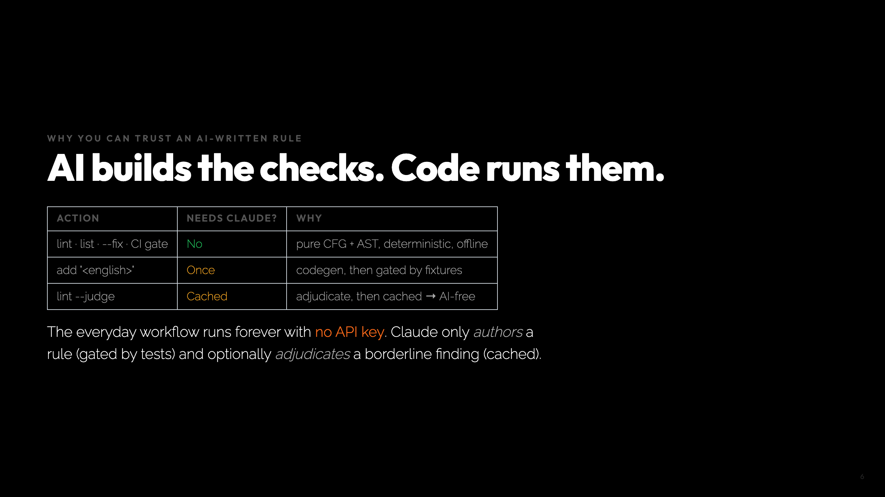
Notes:
Preempts "isn't this just AI linting?". The runtime is deterministic code.

Slide 7
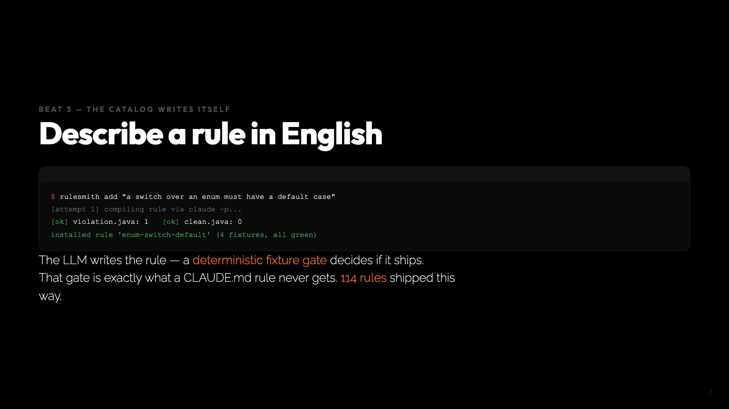
Notes:
Beat 3, 90s. Trust = the fixture gate. Fallback: play recording.

Slide 8
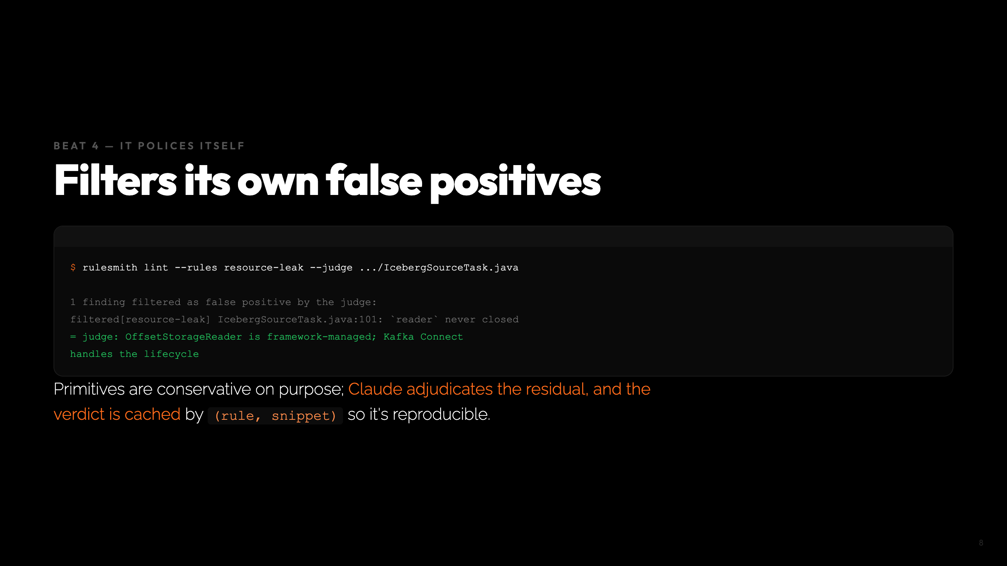
Notes:
Beat 4, 75s. AI-in-the-loop without losing reproducibility.

Slide 9
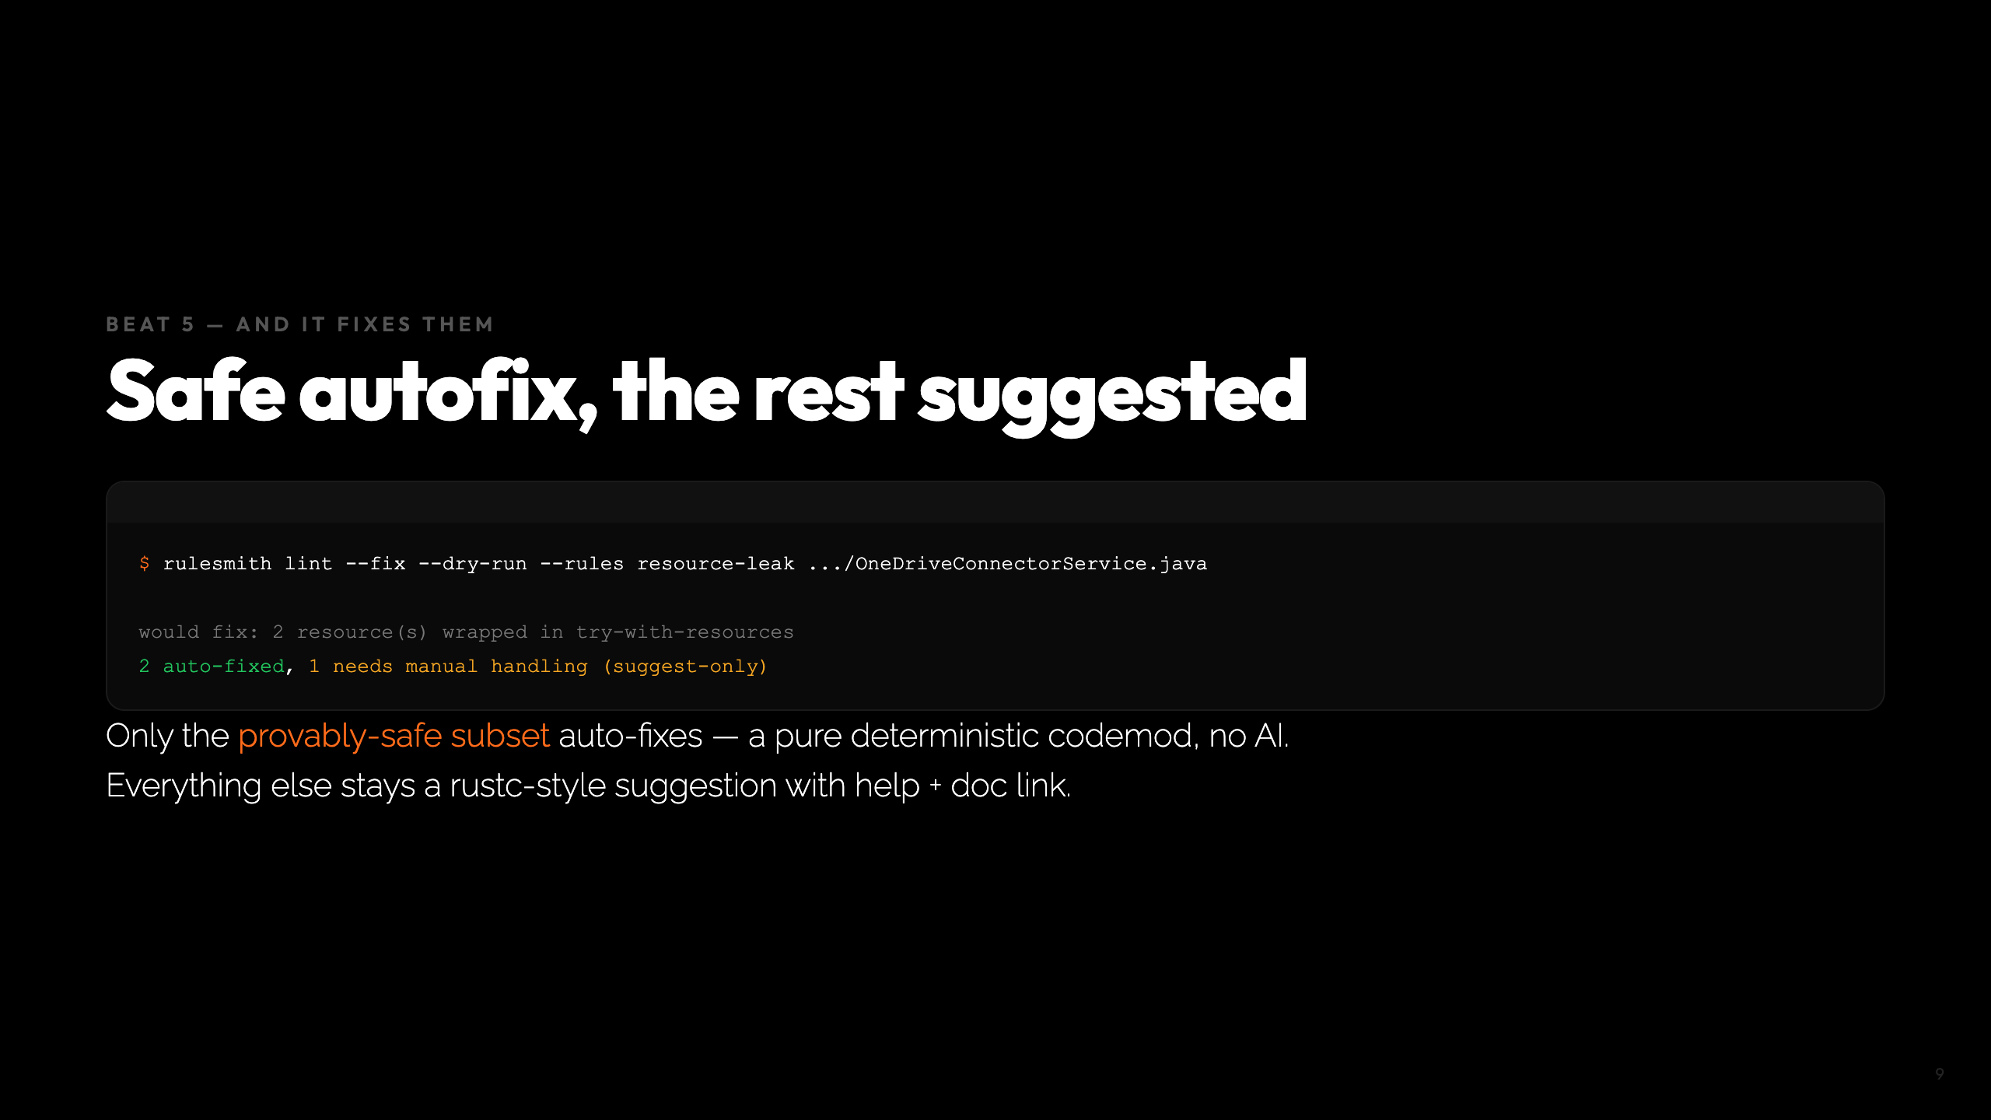
Notes:
Beat 5, 45s. The tool never AI-rewrites code; it won't touch what it can't prove safe.

Slide 10
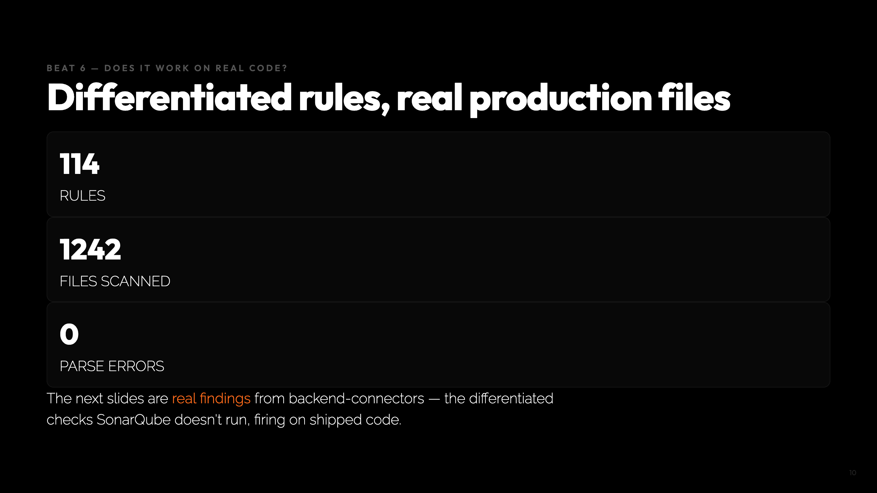
Notes:
Beat 6, 90s. Five real findings, one per slide. The atomic race already shown is the headliner.

Slide 11
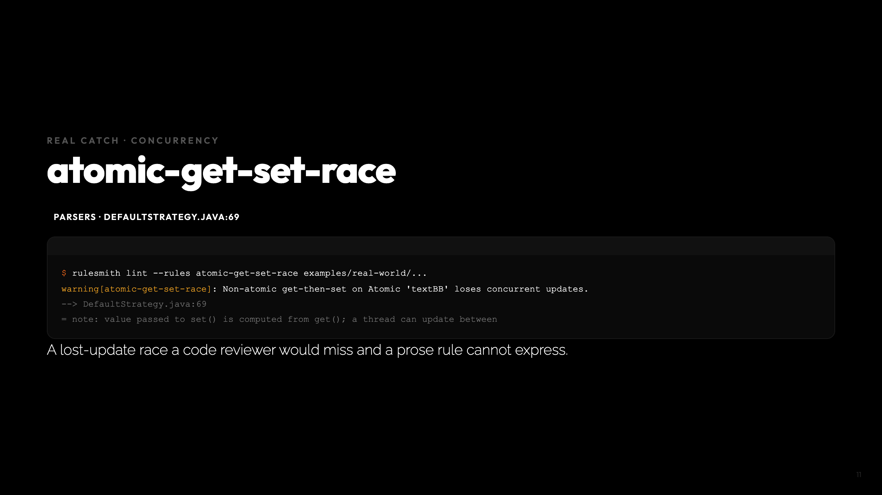
Notes:
Real file 1/5. The headliner.

Slide 12
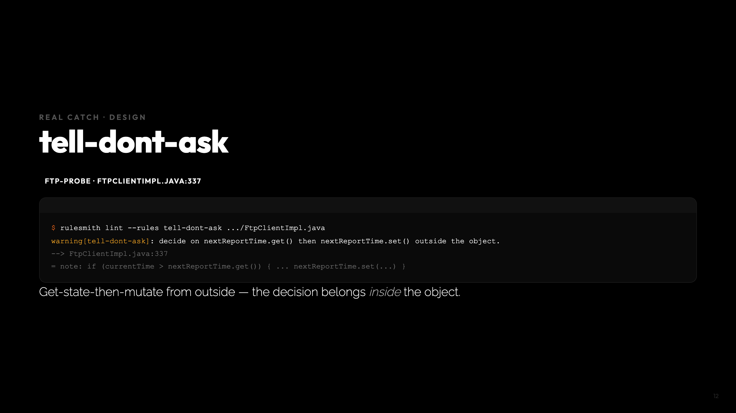
Notes:
Real file 2/5. Design smell, real code.

Slide 13
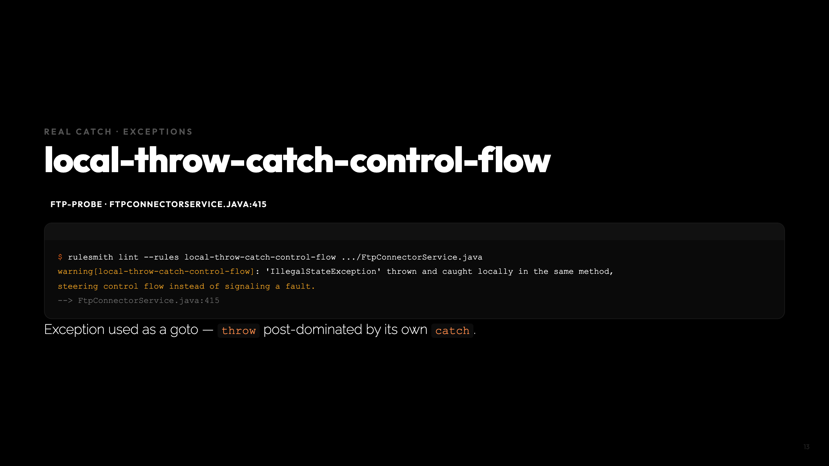
Notes:
Real file 3/5. CFG post-dominance over exception edges.

Slide 14
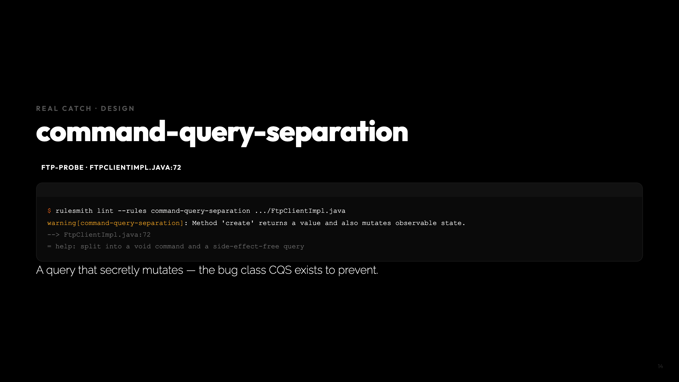
Notes:
Real file 4/5.

Slide 15
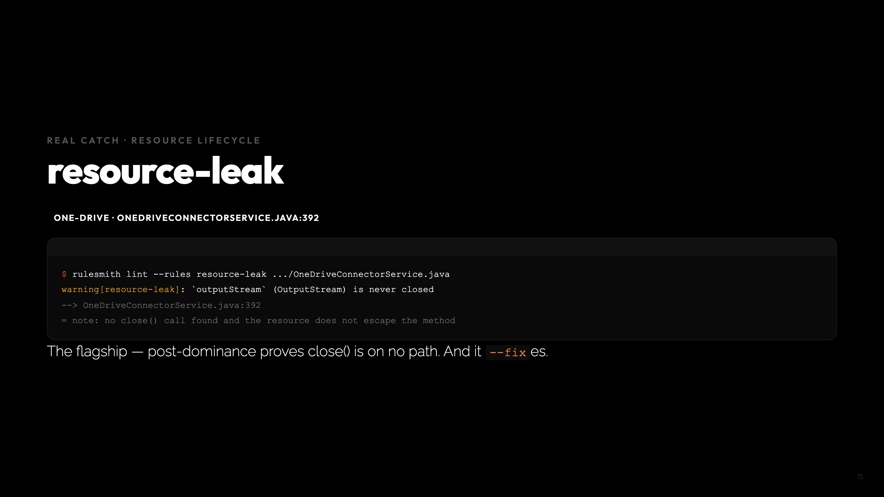
Notes:
Real file 5/5. Ties back to Beat 5 autofix.

Slide 16
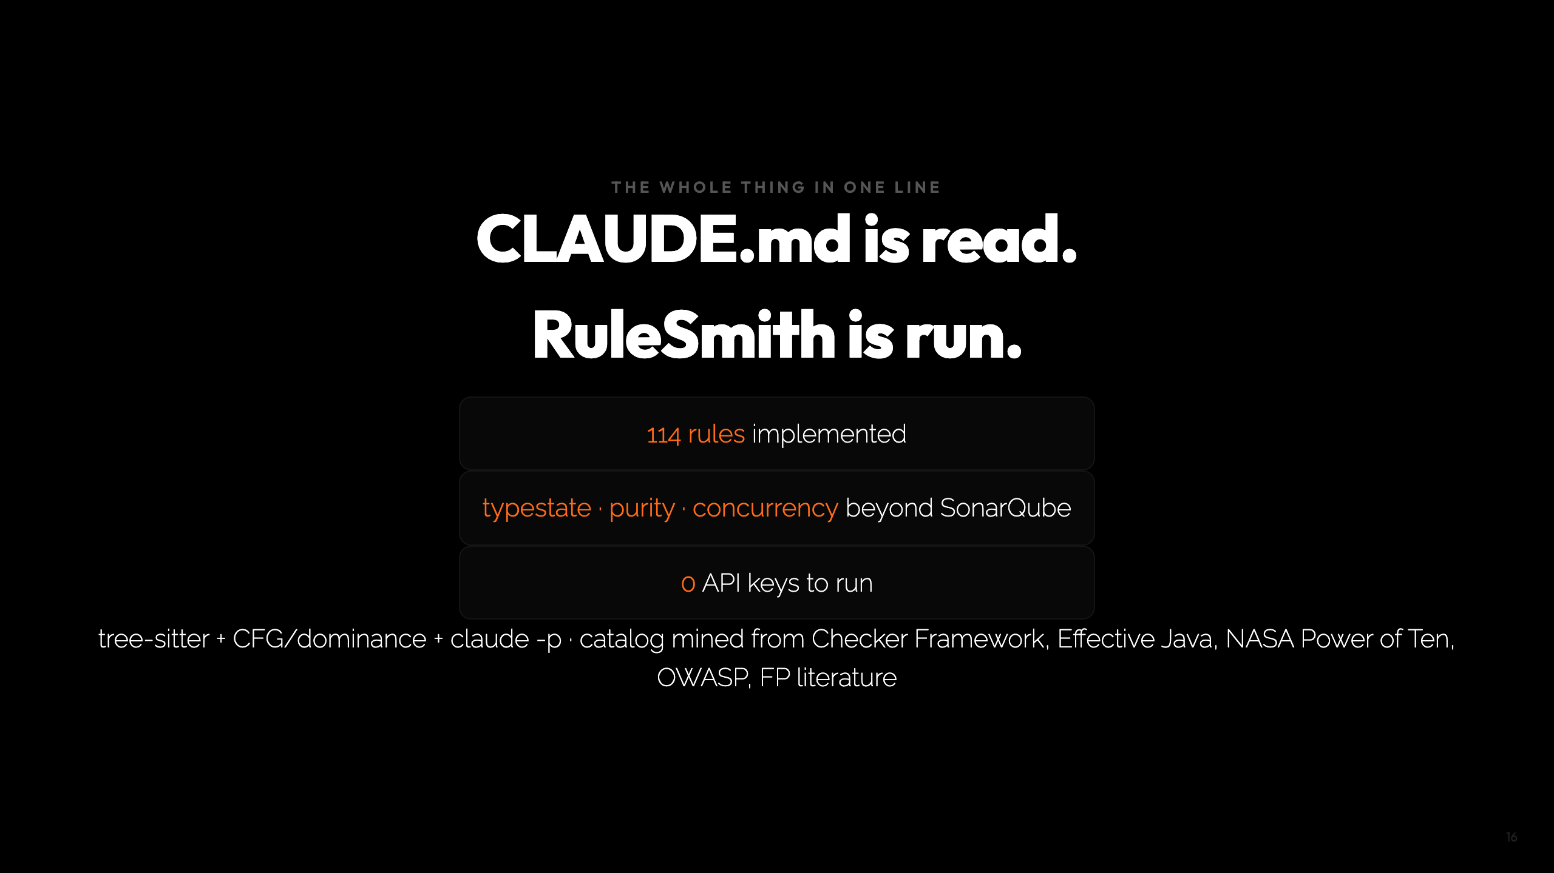
Notes:
Close, 30s. The differentiator: the rules that matter are the ones standard tools miss, and an English description compiles to one. Cheat sheet: - Beat 1: examples/java/PaymentGateway.java (5) vs java-fixed (0) - Star real catch: DefaultStrategy.java:69 atomic-get-set-race - Others: FtpClientImpl tell-dont-ask/cqs, FtpConnectorService throw-catch, OneDrive leak

