Slide 1
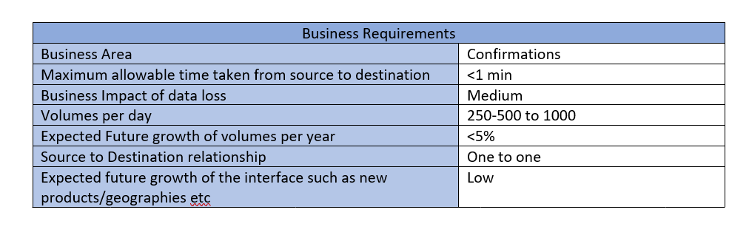
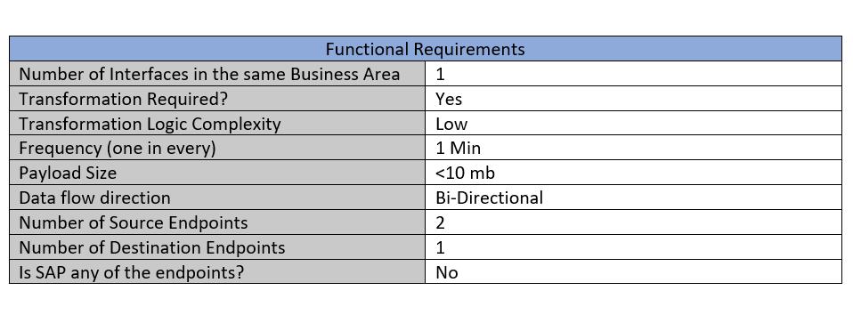
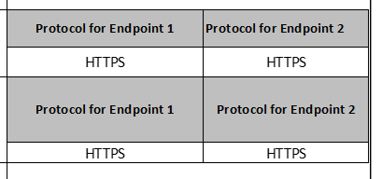
Ponton- Requirement (Framework Input Requirement )

Slide 2
Ponton- Requirement Description
Requirement | Description
Resiliency | All components of To – Be Interface should be resilient enough If target system is not available – 1. Send notification to the support team 2. Auto recovery of the connection b/w interface & target system
Reprocessing | Auto reprocessing of configurable number of times to be enabled
Exception Handling | For any exception (Known/Unknown) notification needs to be triggered to support team (configurable) using Reusable Common Email Service
Performance | Autoscaling of PODS Usage of Streaming Messaging Broker (Kafka)
Security | SSL Certification TLS 1.2 Config Maps Secrets & Azure Key Vault for credential management
Monitoring | Entire trade journey is captured in Centralized Monitoring Dashboard
Operational | Request – Response should be stored inside Azure File Storage to help support team to debug any issue. Reusable Custom Logging Implementation integrated with Log Analytics. Archiving of logs inside File storage to prevent loss of logs. Usage of Serverless components as per feasibility. Reusability of components as per possibility.

Slide 3
Ponton- Pain Points Description
Pain Points
Middleware support team highlighted “frequent bundle stuck issue for one of the ETRM route which is going unnoticed” .Manual checks must be performed to address this.(New solution will add more resilience to this System).
CMS is missing
Everything runs in a single Fuse container and microservice architecture is missing.

