Slide 1
STUDENT FEEDBACK SYSTEM
Name: Abhijit Das
Roll Number: 18771021027

Slide 2
INTRODUCTION
Online Student feedback system is which is helpful for college to do educational improvements . This project collects feedback from student. Student Feedback System for college students have been developed which aims to rate and analyse the college faculty’s performance. This type of Student Feedback system reduces the strenuous work of physically examining the feedback pages of each and every student. The system also reduces the burden of efforts and burden of keeping and maintaining the records on a manual base, it requires a lot of space and safety to keep up such records. Now a day’s college ask feedback for student about faculties how they are handle the class and some social oriented things. This Student Feedback System for college students.

Slide 3
SYSTEM REQUIREMENTS
Software Requirements:
Front end: bootstrap, HTML, CSS
Backend: PHP, MYSQL
Hardware Requirements:
Processor: Pentium dual core 2.00GHZ
Hard disk: 20GB
Ram: 4GB(minimum)

Slide 4
MODULES
Admin Module:
Admin can add/delete department, subject and faculty.
Admin can calculate the values in the calculation by department wise.
View and download the overall final feedback report.
Admin can change own password after login.
Student Module:
Student can login with the valid username and roll number.
Give feedback to their respective department staff members.
Can give comments to the respective staff members.

Slide 5
IMPORTANCE'S OF FEEDBACK SYSTEM
Helps to achieve goal of the communication.
Helps in problem solving and decision making.
To exchange idea and opinion.
Effective co-ordination.
Effective communication.

Slide 6
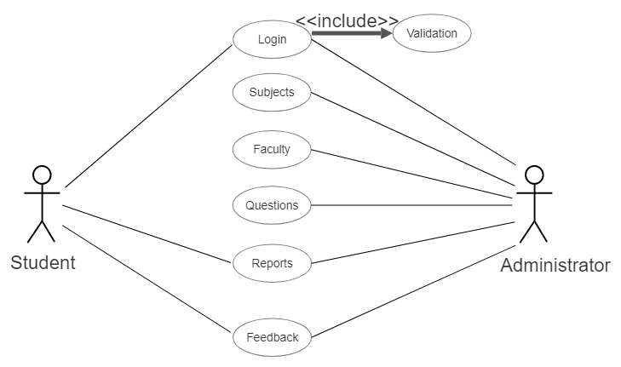
UML DIAGRAM (Unified Modeling Language)
USE CASE DIAGRAM:
A use case diagram is a diagram that shows a set of use cases and actors and relationships.
OVERALL USE CASE:

Slide 7
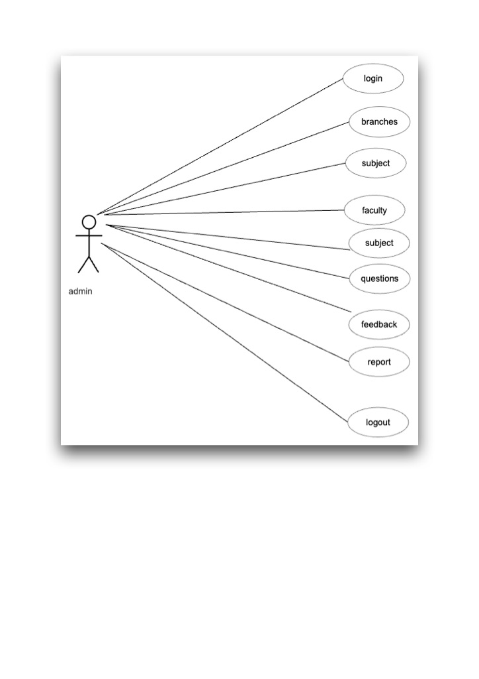
ADMINISTRATOR USE CASE:

Slide 8
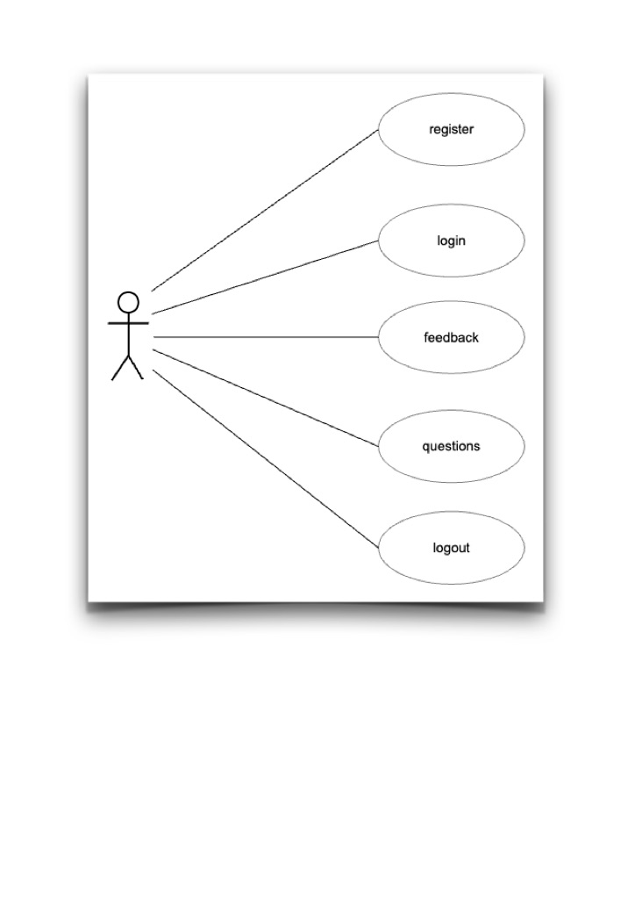
STUDENT USE CASE:
Student

Slide 9
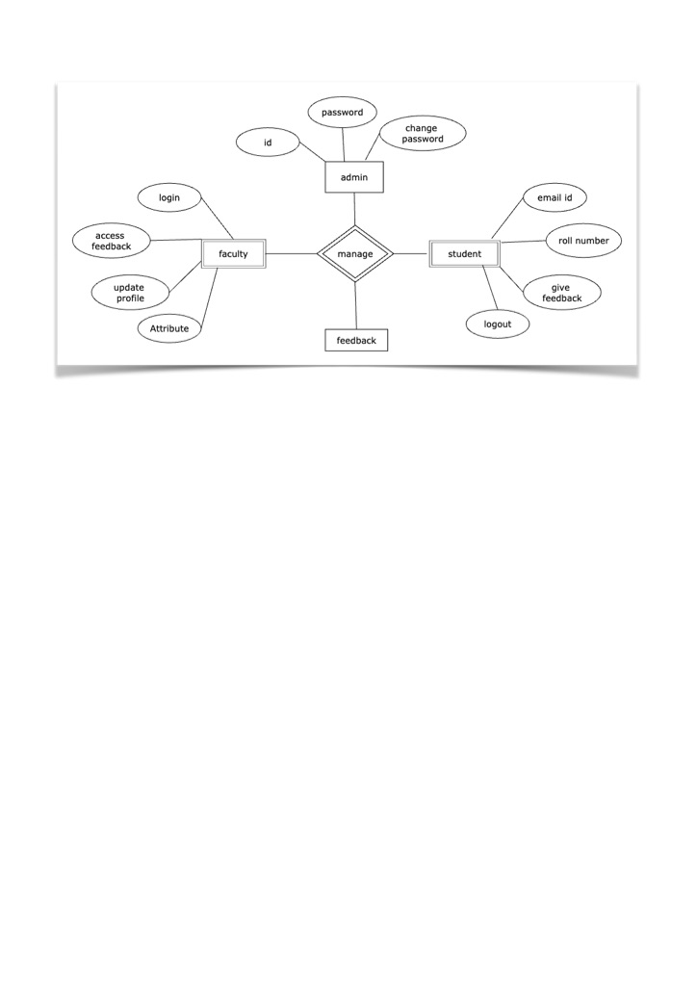
ER-DIAGRAM:

Slide 10
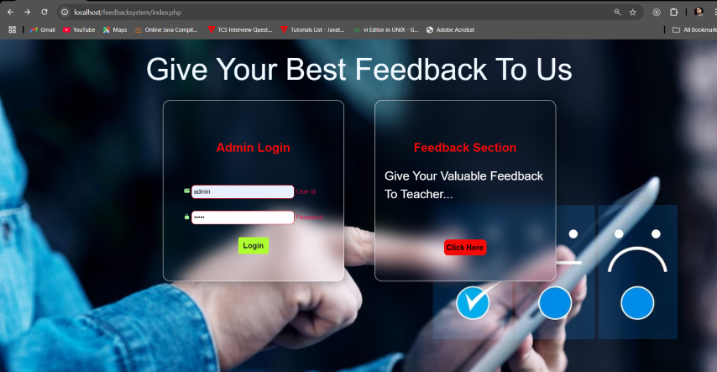
HOME PAGE

Slide 11
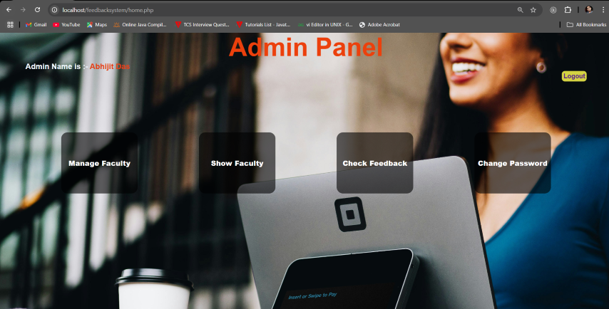
WELCOME ADMIN PAGE

Slide 12
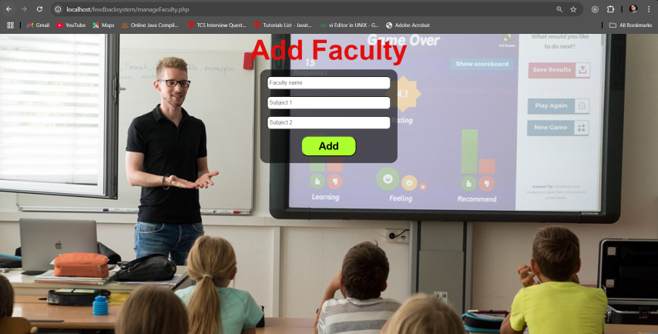
ADD FACULTY SECTION

Slide 13
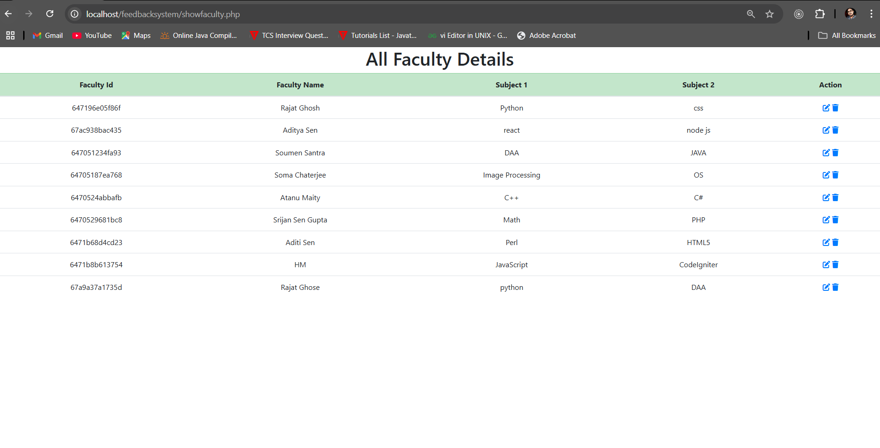
FACULTY DETAILS

Slide 14
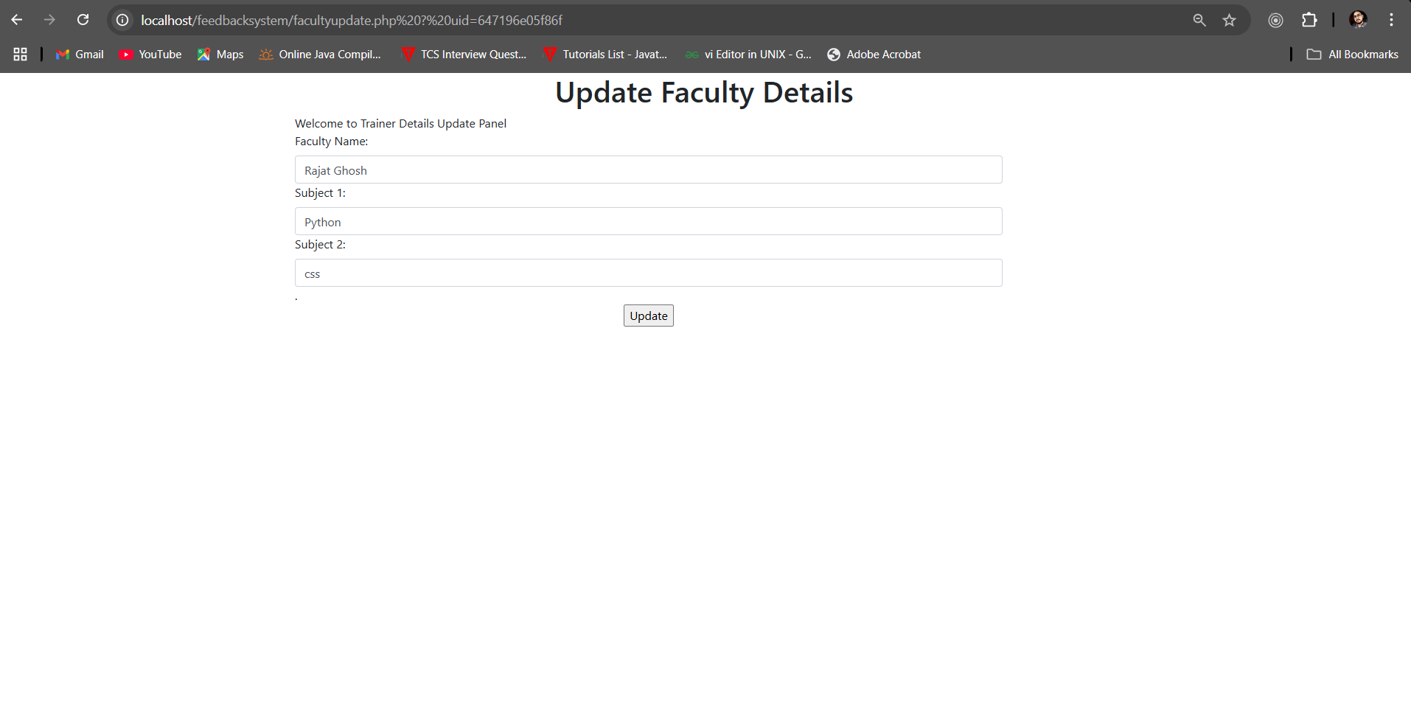
UPDATE FACULTY DETAILS

Slide 15
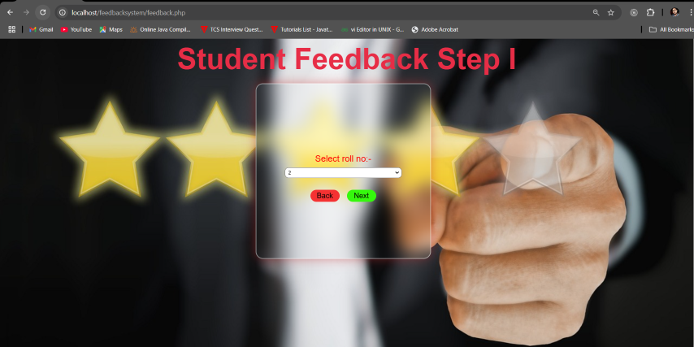
STUDENT FEEDBACK SECTION 1

Slide 16
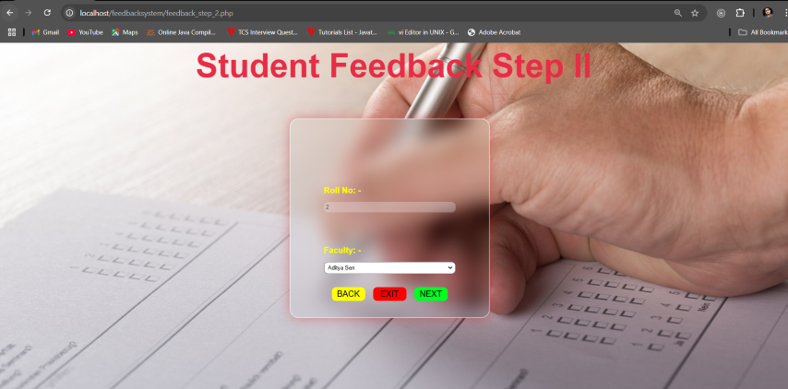
STUDENT FEEDBACK SECTION 2

Slide 17
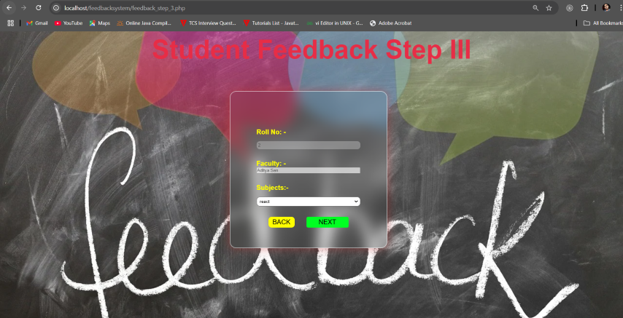
STUDENT FEEDBACK SECTION 3

Slide 18
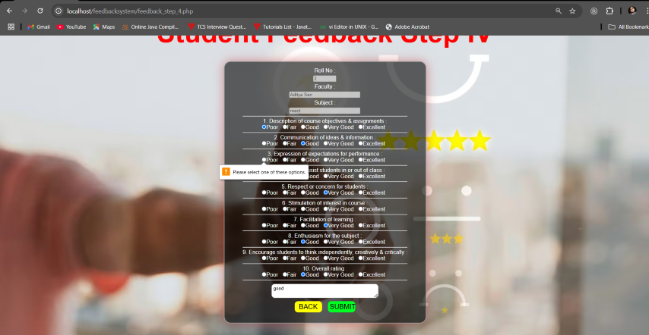
STUDENT FEEDBACK SECTION 4

Slide 19
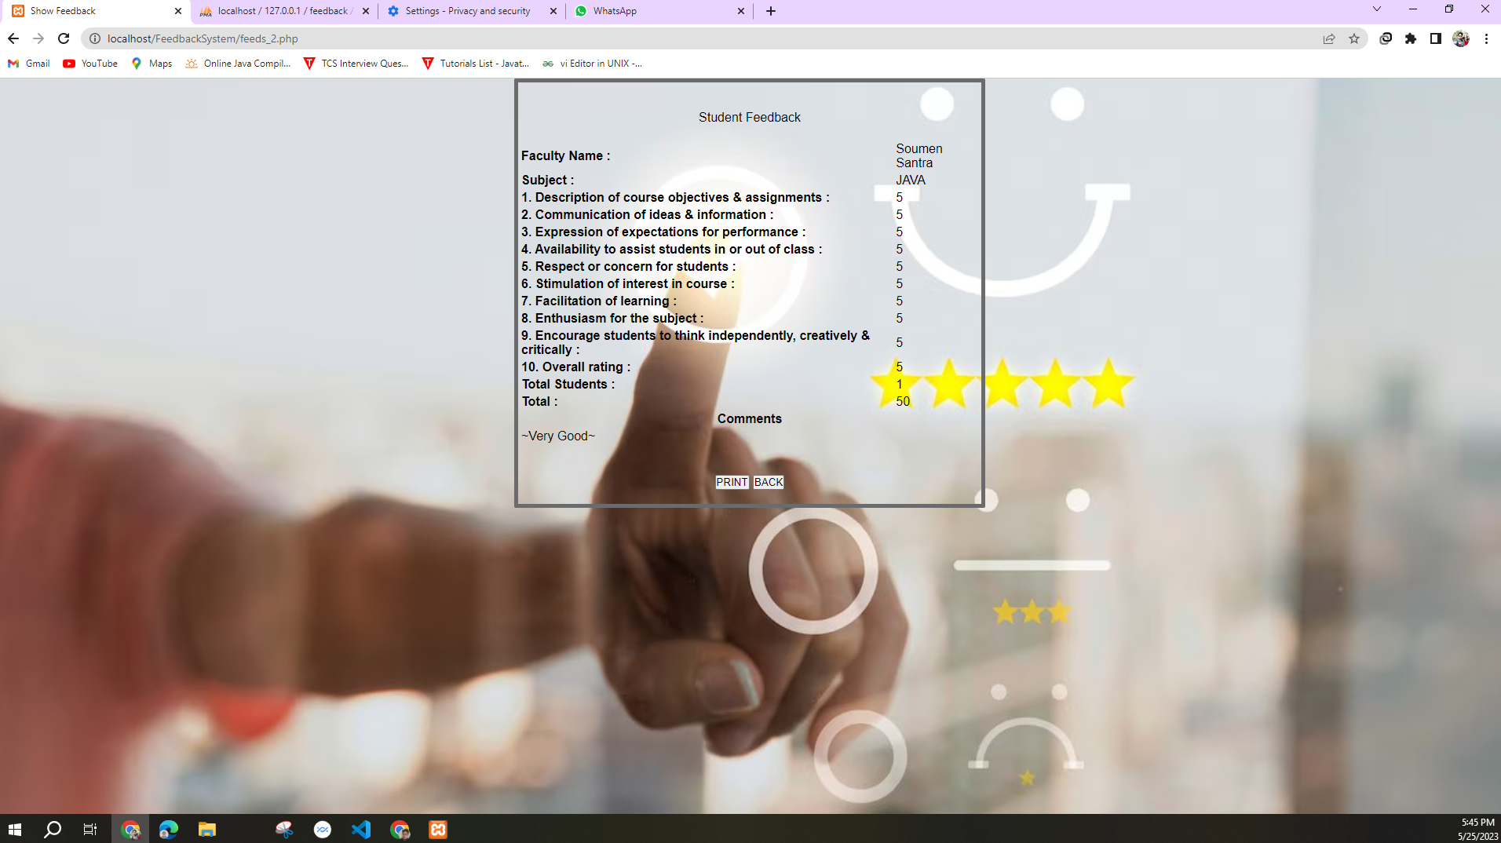
SHOW STUDENT’S FEEDBACK

Slide 20
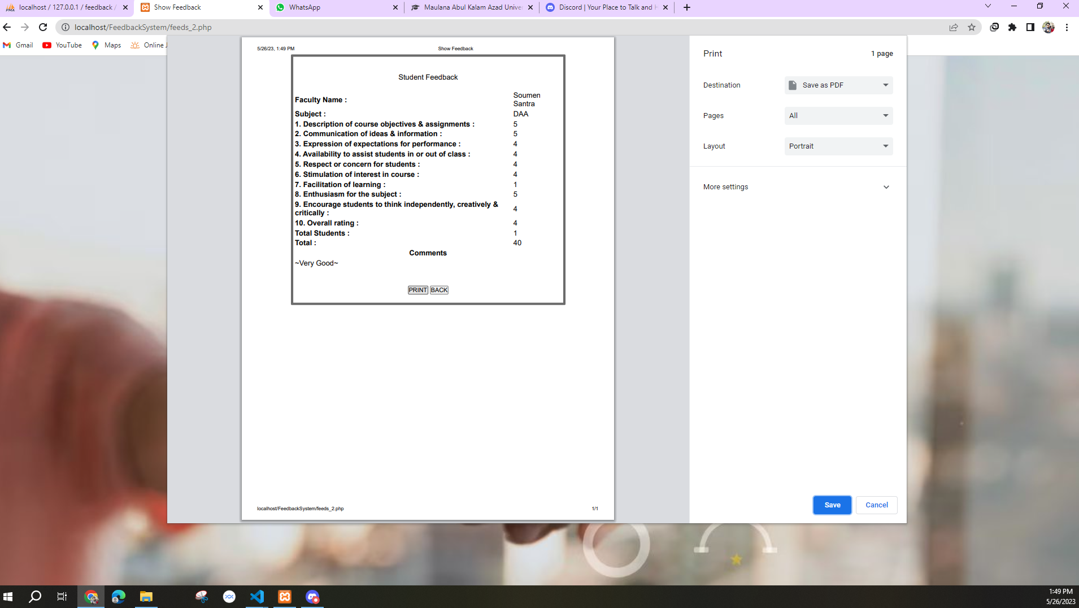
PRINT FEEDBACK PAGE

Slide 21
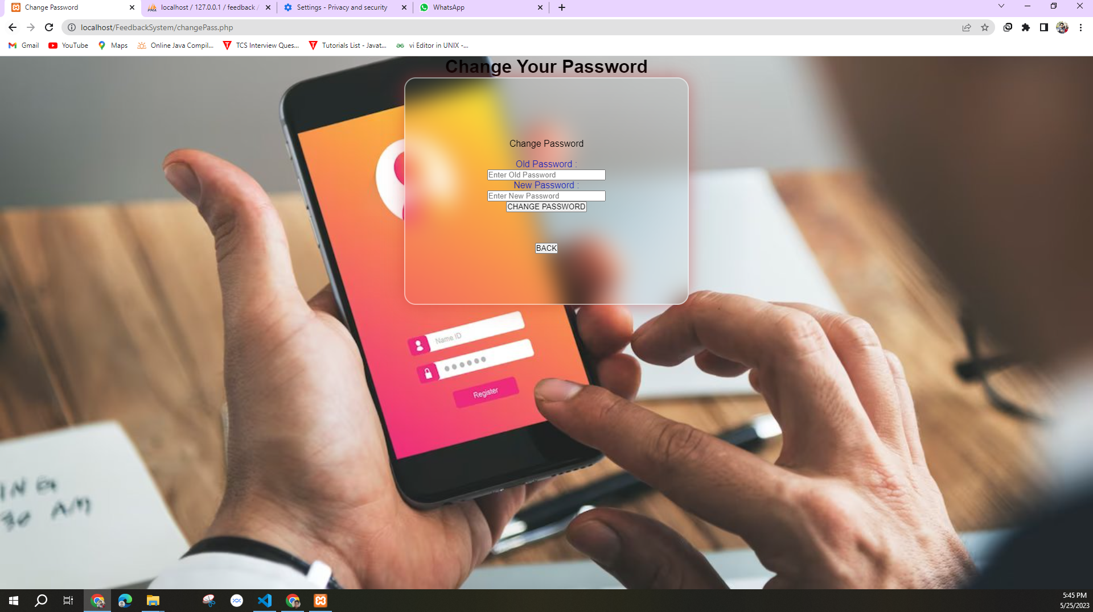
CHANGE PASSWORD SECTION

Slide 22
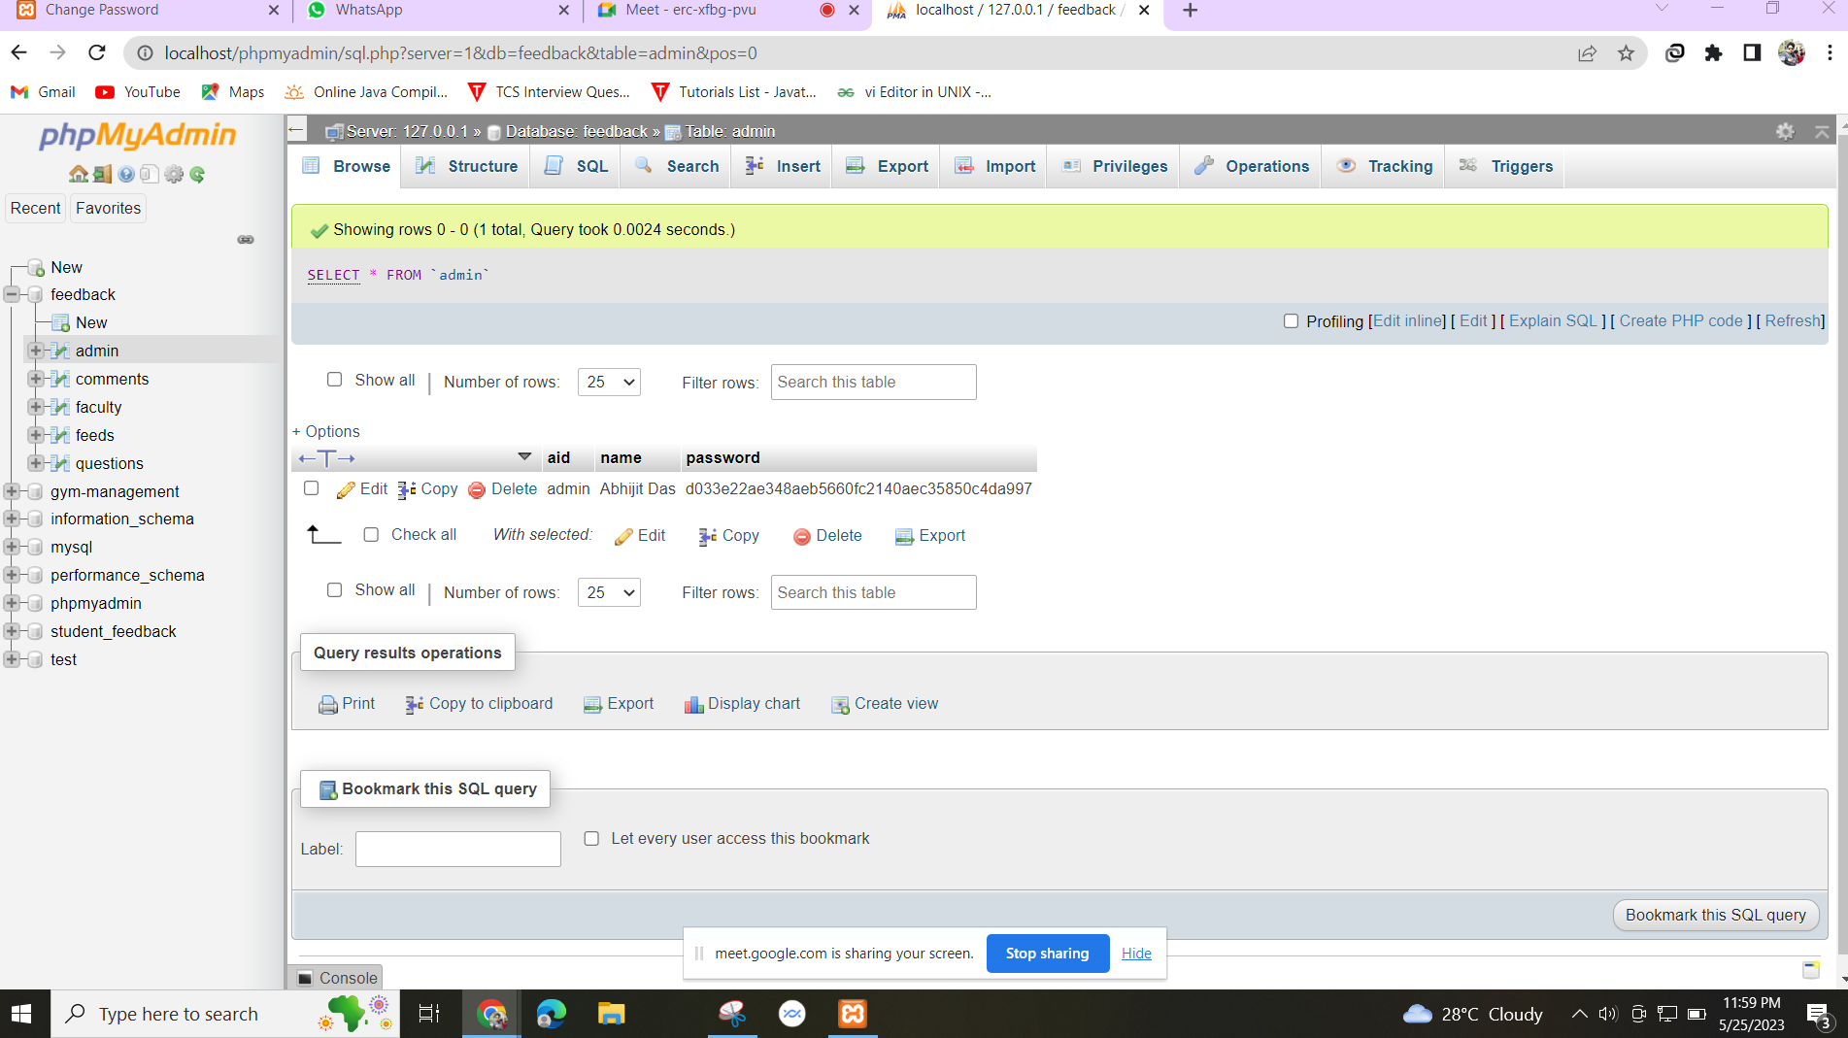
ADMIN DATABASE

Slide 23
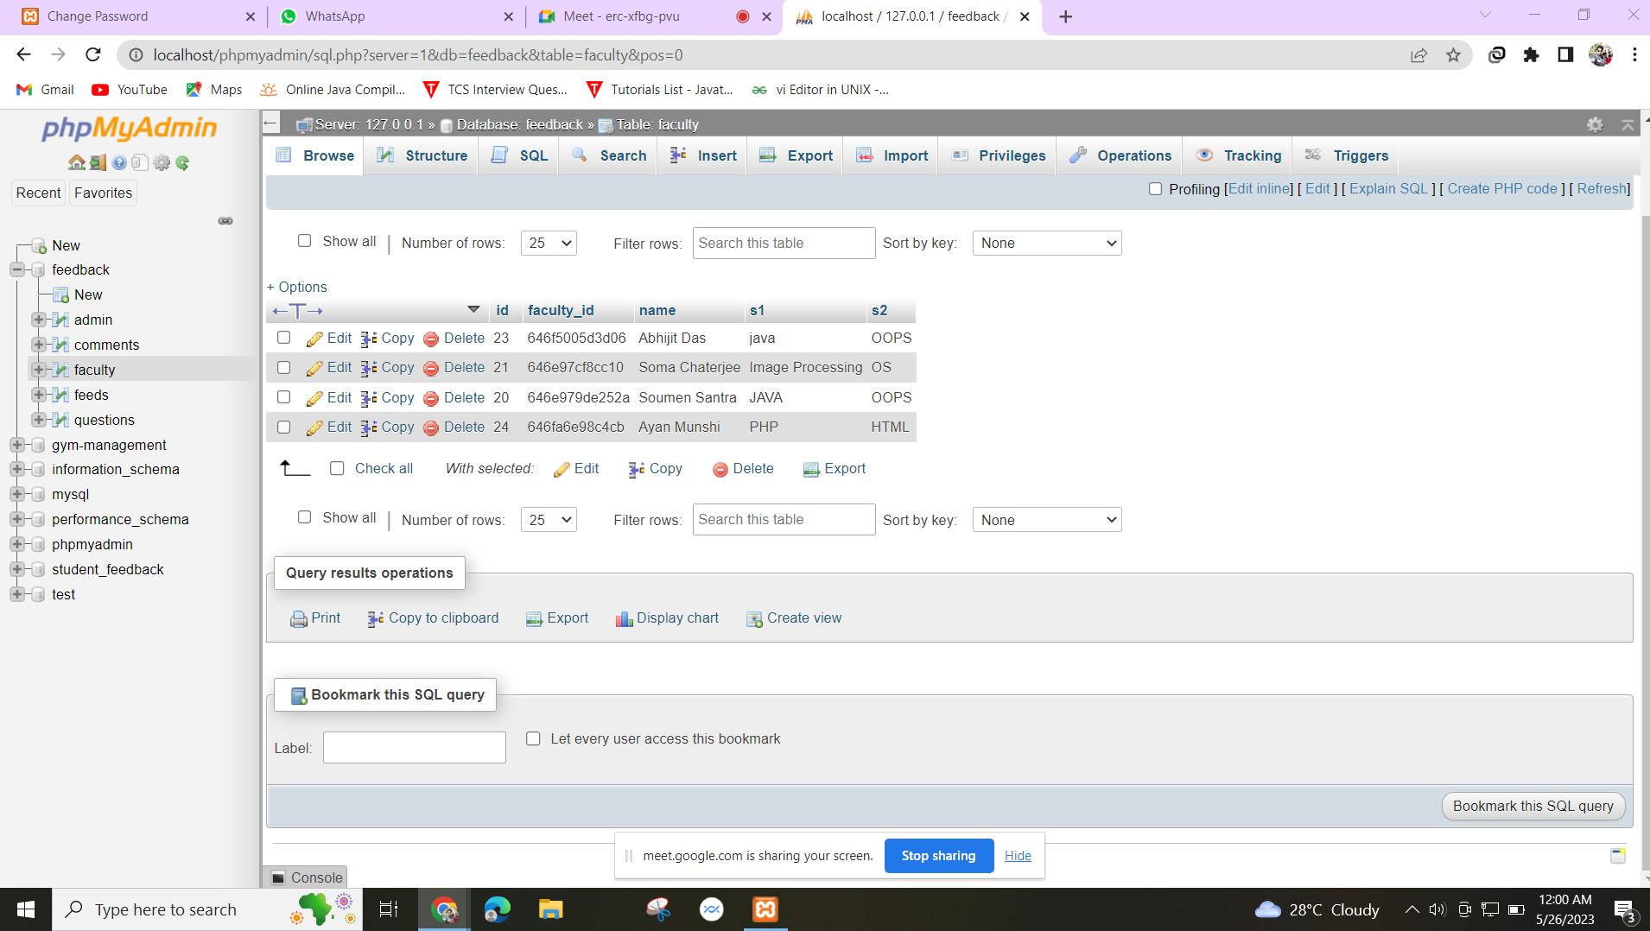
FACULTY DETAILS DATABASE

Slide 24
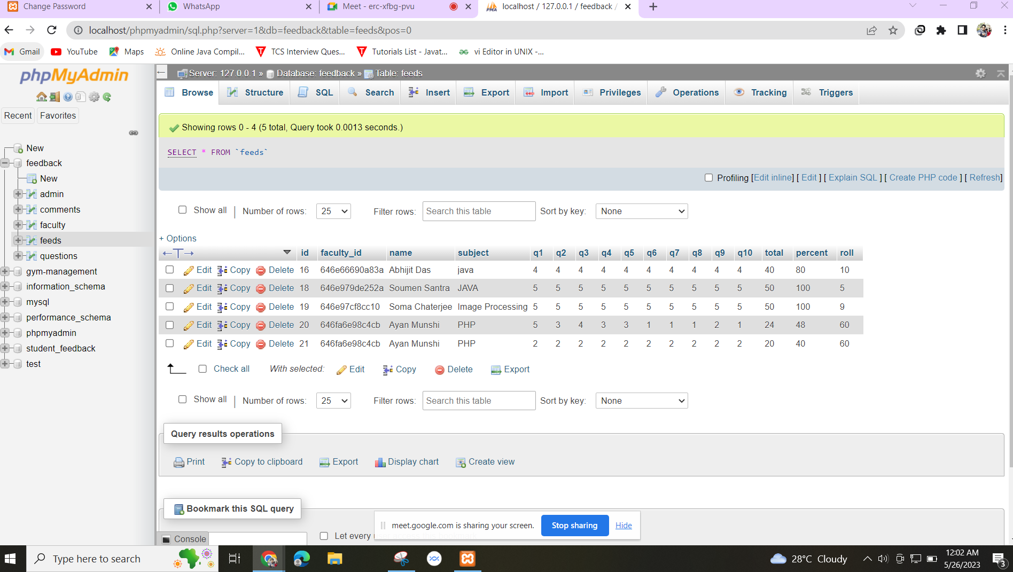
FEEDBACK DATABASE

Slide 25
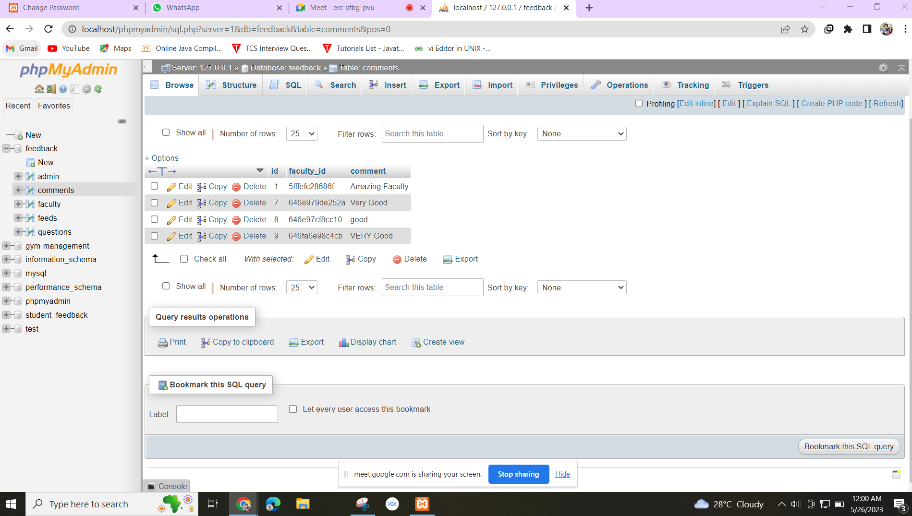
FEEDBACK COMMENTS DATABASE

Slide 26
CONCLUSION
The project feedback management system is designed in order to reduce the burden of maintaining the bulk of records of records of all the students feedback details.
Inserting, retrieving and updating the feedback details of a student are easy when it is compared to the manual feedback.
In collage student feedback system it is very easy process to save each and every record of individual student by the use of database.

Slide 27


