Slide 1
Development
Runtime
Clojure
Bytecode
Machine Code
Groovy
…
Java
Programming Language Source Files
Machine independent Bytecode
Machine dependent executable code
Interpreted by the JIT (Just in Time Compiler)
Compiled into Bytecode

Slide 2
Stack
Free memory available
Memory available to a process
Heap
Data
Text

Slide 3
main()
The first method invoked
The current stack
printf()
The last method invoked and currently active method

Slide 4
main()
The first method invoked
a()
b()
The current stack
c()
The last method invoked and currently active method

Slide 5
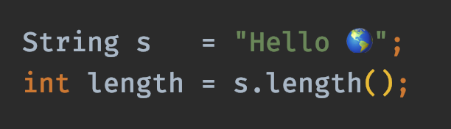
reference type
primitive type
variables
values

Slide 6
stack
heap
mno
Point[x=1,y=2]
pqr
Point[x=3,y=4]
stu
Point[x=5,y=6]

Slide 7
stack
heap
a
7

Slide 8
stack
heap
a
3

Slide 9
stack
heap
a
7
s
xyx
xyz
"my object type"

Slide 10
stack
heap
a
7
s
xyx
xyz
"my object type"
s1
xyx
s2
xyx
s3
xyx

Slide 11
stack
heap
a
xyz
b
xyx
xyz
Point[x=7,y=3]
c
xyx

Slide 12
stack
heap
s
null

Slide 13
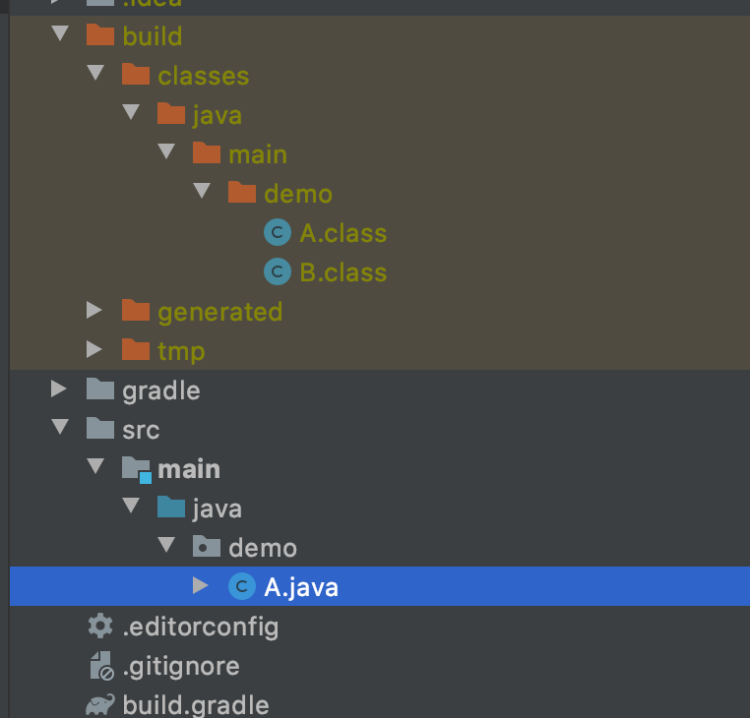
One Java source file produces two class files

Slide 14
new
empty & closed
full & closed
open()
close()
close()
open()
empty & open
full & open
putItem()

Slide 15

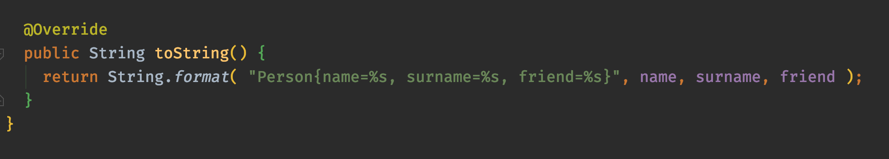
albert
john

Slide 16
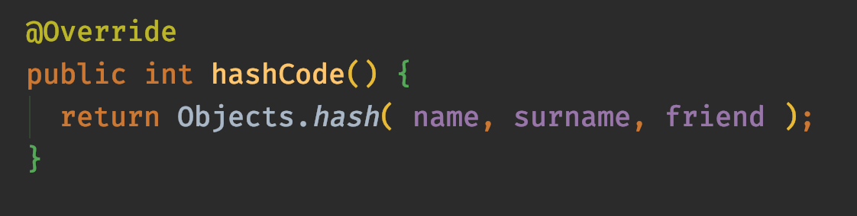
albert
john

Slide 17
Object
Person
(extends Object)
Upcasting
Downcasting
Very Important Person
(extends Person)

Slide 18
Object
is a
is a
Person
(extends Object)
Box
(extends Object)
has
is a
String
int
LightBox
(extends Box)

Slide 19
Stack Data Structure

Slide 21
Test Double
Dummy
Stub
Spy
Mock
Fake

