Slide 1
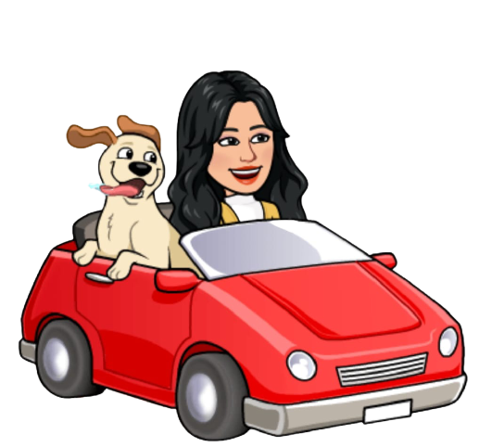
Akatsuki
Let's travel the world !

Slide 2

Hi!
My name is Samantha

Slide 3
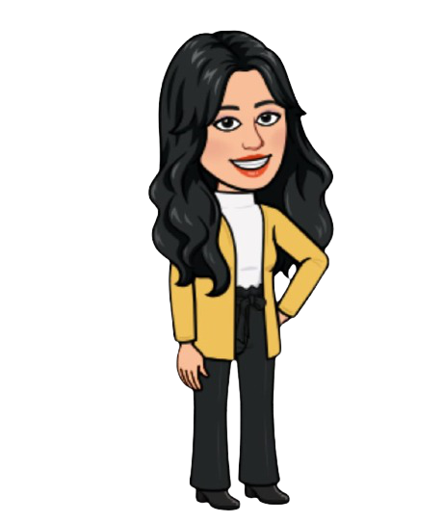
Now that many people are getting vaccinated in India

Slide 4
The government is bringing down some restrictions on travelling

Slide 5
People are very happy with this decision

Slide 6

and so are my friends

Slide 7
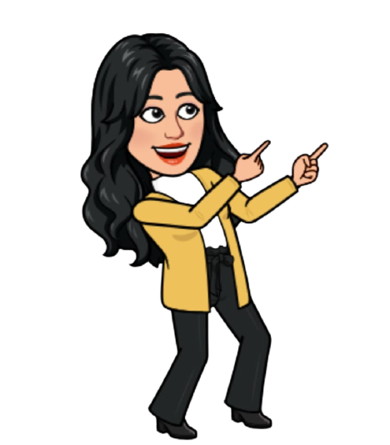
They want to go on their much awaited trips with me

Slide 8
To visit popular cities in India

Slide 9
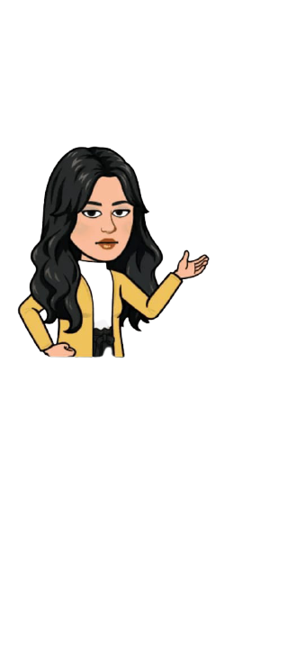
But there are still some rules

Slide 10
Set by the government that we need to follow

Slide 11
in order to travel during these times

Slide 12
Help me and my friends

Slide 13
To visit as many destinations as you can

Slide 14


