Slide 1



Supervised Contrastive Learning Approach for Contextual Ranking
Abhijit Anand, Jurek Leonhardt, Koustav Rudra, Avishek Anand

Slide 2
01
Introduction

Slide 3
Motivation
Contextual Models have impressive performance vs classical models.
But have following drawbacks:
Training data requirement is large
Fine-tuning with small amount of data does not generalise
How to use contextual model in low data regime?
Notes:
Contextual models have impressive performance compared to classical models. But they have also the following drawbacks:
These contextual models are over-parameterized data hungry models requiring large amount of training data.
Fine-tuning these models generally do not generalise well.
So the question is how to use contextual model for a low data regime setup.
We want to answer this question and do that end we define our problem statement.

Slide 4
Problem Statement
To come up with an effective method to improve document ranking performance on smaller datasets

Slide 5
Approach
To improve document ranking performance for smaller dataset we use data augmentation(to increase dataset size) coupled with supervised contrastive learning
Notes:
We use Data augmentation along with Supervised contrastive learning. To verify our method works we want to answer 3 research questions.

Slide 6
Research Questions
RQ1: Does Data Augmentation or Supervised Contrastive Learning help to improve document re-ranking performance for smaller datasets?
RQ2: Does the augmentation style impact the ranking performance?
RQ3: How does training data size impact ranking performance?
Questions

Slide 7
02
Methodology

Slide 8
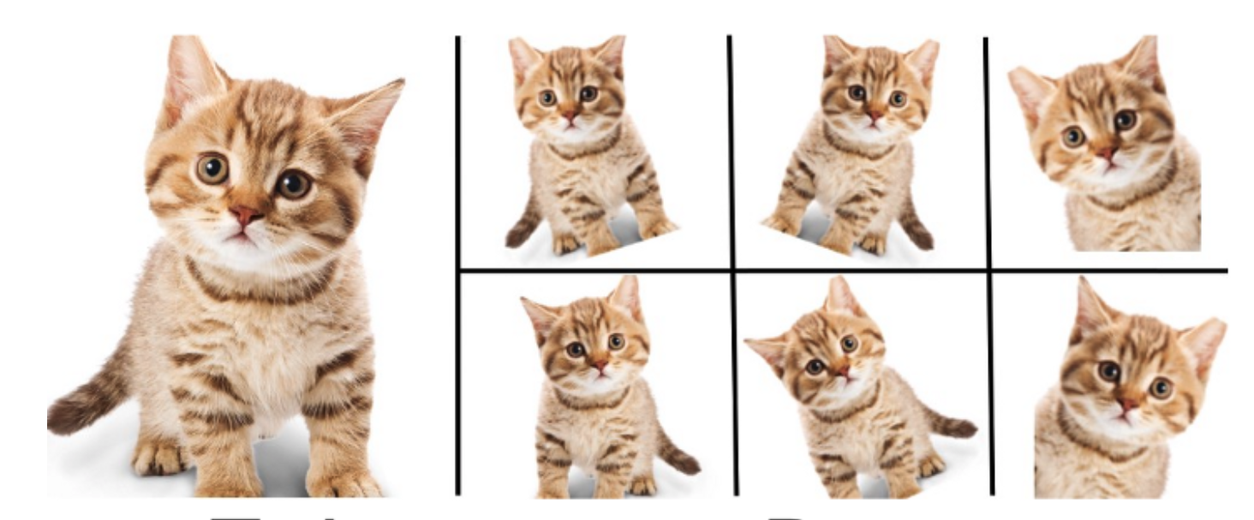
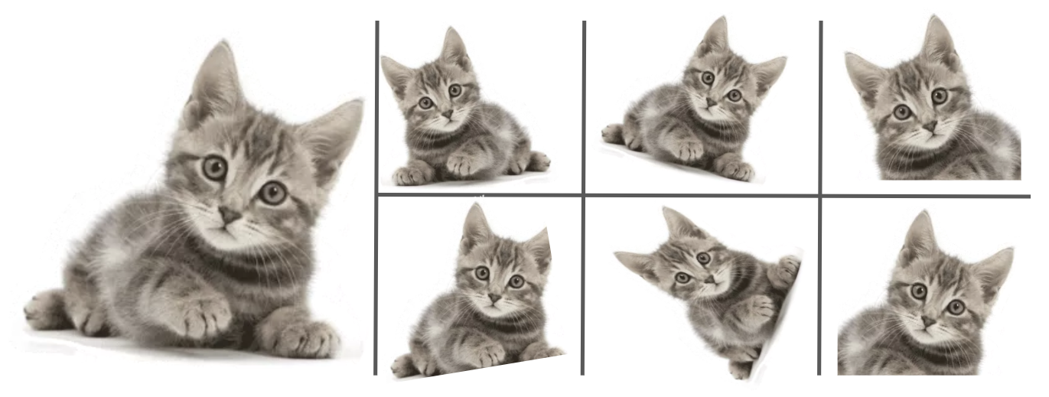
Data Augmentation
Why do data augmentation?
To increase the training data without collecting more data
How to do data augmentation?
Create modified copies of existing data or create synthetic data
Notes:
That makes sense…for example in images you want to respect physics
In case of an image classification task

Slide 9
Data Augmentation
Why do data augmentation?
To increase the training data without collecting more data
How to do data augmentation?
Create modified copies of existing data or create synthetic data
Challenges in data augmentation for ranking?
Relevance of a document is query specific
Positive labels are sparse in most ranking datasets

Slide 10
Data Augmentation
Query
Query
Is september a good time to go to aruba?
What is a parenthesis phrase?
Positive Document
Positive Document
The Best Time to Travel to Aruba "Catch sunsets from a private beach palapa year-round in Aruba. In Aruba one can almost always count on sunny skies and calm seas. The best time to visit the island depends on the type of vacation. If looking for the cheapest hotel rooms and best travel deals, go when the trade winds stop blowing.
Algebraic expressions Mathematical phrases Mathematical phrases can be written as verbal sentences You should be able to:- translate verbal sentences into algebraic expressions, - translate algebraic expressions into phrases. Example: The product of two and three. Word „ product ” indicates, that there should be multiplication of these numbers (“product” is a result of multiplication).

Slide 11
Simple Data Augmentation Strategies
Query
The Best Time to Travel to Aruba "Catch sunsets from a private beach palapa year-round in Aruba.
P1
Is september a good time to go to aruba?
In Aruba one can almost always count on sunny skies and calm seas.
P2
Positive Document(D⁺)
The best time to visit the island depends on the type of vacation.
P3
The Best Time to Travel to Aruba "Catch sunsets from a private beach palapa year-round in Aruba. In Aruba one can almost always count on sunny skies and calm seas. The best time to visit the island depends on the type of vacation. If looking for the cheapest hotel rooms and best travel deals, go when the trade winds stop blowing.
If looking for the cheapest hotel rooms and best travel deals, go when the trade winds stop blowing.
P4

Slide 12
Simple Data Augmentation Strategies
Scoring
The Best Time to Travel to Aruba "Catch sunsets from a private beach palapa year-round in Aruba.
P1
S1=S(q,P1)
Query(q)
In Aruba one can almost always count on sunny skies and calm seas.
P2
S2=S(q,P2)
Score: S(q,P_{i})
Is september a good time to go to aruba?
The best time to visit the island depends on the type of vacation.
P3
S3=S(q,P3)
If looking for the cheapest hotel rooms and best travel deals, go when the trade winds stop blowing.
P4
S4=S(q,P4)

Slide 13
Simple Data Augmentation Strategies
Scoring
The Best Time to Travel to Aruba "Catch sunsets from a private beach palapa year-round in Aruba.
P1
S1=S(q,P1)
Query(q)
In Aruba one can almost always count on sunny skies and calm seas.
P2
S2=S(q,P2)
Score: S(q,P_{i})
Is september a good time to go to aruba?
The best time to visit the island depends on the type of vacation.
P3
S3=S(q,P3)
Matching: BM25,
Semantic: Glove,
Random sampling
If looking for the cheapest hotel rooms and best travel deals, go when the trade winds stop blowing.
P4
S4=S(q,P4)
Notes:
Lexical matching, semantic similarity

Slide 14
Simple Data Augmentation Strategies
Scoring
The Best Time to Travel to Aruba "Catch sunsets from a private beach palapa year-round in Aruba.
P1
S1=S(q,P1)
Query(q)
In Aruba one can almost always count on sunny skies and calm seas.
P2
S2=S(q,P2)
Score: S(q,P_{i})
Is september a good time to go to aruba?
The best time to visit the island depends on the type of vacation.
P3
S3=S(q,P3)
If looking for the cheapest hotel rooms and best travel deals, go when the trade winds stop blowing.
P4
S4=S(q,P4)
S1>S3>S2>S4
Top 2 Passage for Augmentation

Slide 15
Simple Data Augmentation Strategies
The Best Time to Travel to Aruba "Catch sunsets from a private beach palapa year-round in Aruba. The best time to visit the island depends on the type of vacation
combined
The Best Time to Travel to Aruba "Catch sunsets from a private beach palapa year-round in Aruba.
P1
The best time to visit the island depends on the type of vacation.
P3

Slide 16
Simple Data Augmentation Strategies
Query(q)
Augmented Positive Document(D_{A}⁺)
The Best Time to Travel to Aruba "Catch sunsets from a private beach palapa year-round in Aruba. The best time to visit the island depends on the type of vacation
Is september a good time to go to aruba?
combined
Positive Document(D⁺)
The Best Time to Travel to Aruba "Catch sunsets from a private beach palapa year-round in Aruba. In Aruba one can almost always count on sunny skies and calm seas. The best time to visit the island depends on the type of vacation. If looking for the cheapest hotel rooms and best travel deals, go when the trade winds stop blowing.
The Best Time to Travel to Aruba "Catch sunsets from a private beach palapa year-round in Aruba.
P1
The best time to visit the island depends on the type of vacation.
P3

Slide 17
Supervised Contrastive Learning
Bitcoin can be sent from user to user on the peer-to-peer bitcoin network. Bitcoin miners join large mining pools to minimize the variance of their income.
Query
What is Bitcoin?
positive
Dangerous is the eighth studio album by American singer Michael jackson. It was released by Epic records on November 26, 1991.
Bitcoin is a decentralized digital currency. Bitcoin is acc. To some is a store of value just like gold.
positive
negative
negative
negative

Slide 18
Supervised Contrastive Learning
Ranking Supervised Contrastive loss
Query
Bitcoin can be sent from user to user on the peer-to-peer bitcoin network. Bitcoin miners join large mining pools to minimize the variance of their income.
Bitcoin miners join large mining pools to minimize the variance of their income.
What is Bitcoin?
augmented positive
positive
Dangerous is the eighth studio album by American singer Michael jackson. It was released by Epic records on November 26, 1991.
Bitcoin is a decentralized digital currency. Bitcoin is acc. To some is a store of value just like gold.
positive
negative
augmented positive
negative
Bitcoin is acc. To some is a store of value just like gold.
negative

Slide 19
Supervised Contrastive Learning
Ranking Supervised Contrastive loss
Query
Bitcoin can be sent from user to user on the peer-to-peer bitcoin network. Bitcoin miners join large mining pools to minimize the variance of their income.
Bitcoin miners join large mining pools to minimize the variance of their income.
What is Bitcoin?
augmented positive
positive
Dangerous is the eighth studio album by American singer Michael jackson. It was released by Epic records on November 26, 1991.
Bitcoin is a decentralized digital currency. Bitcoin is acc. To some is a store of value just like gold.
positive
SCL loss
negative
augmented positive
negative
Bitcoin is acc. To some is a store of value just like gold.
negative

Slide 20
Ranking Supervised Contrastive Loss
Ranking Supervised Contrastive loss
Query
Bitcoin can be sent from user to user on the peer-to-peer bitcoin network. Bitcoin miners join large mining pools to minimize the variance of their income.
Bitcoin miners join large mining pools to minimize the variance of their income.
What is Bitcoin?
augmented positive
positive
Dangerous is the eighth studio album by American singer Michael jackson. It was released by Epic records on November 26, 1991.
Bitcoin is a decentralized digital currency. Bitcoin is acc. To some is a store of value just like gold.
positive
Pairwise loss
SCL loss
negative
augmented positive
negative
Bitcoin is acc. To some is a store of value just like gold.
negative

Slide 21
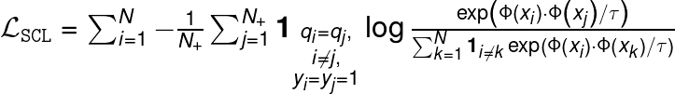
Supervised Contrastive Loss
Positives
Temperature
Notes:
Where Ranking SCL is either pointwise or pairwise loss
Add labels(TODO)
Just add text box

Slide 22
Ranking Supervised Contrastive Loss
Notes:
Where Ranking SCL is either pointwise or pairwise loss
Interpolation of pairwise/pointwise with SCL
We have now seen How do do data augmentation and supervised contrastive learning work? We have also seen our implementation of SCL loss function. Now lets see how we create smaller augmented datasets from large datasets.

Slide 23
Augmented Datasets and Models
N (q,D+) training data
(q,D+) training data
Select negatives
Data Augmentation
2n (q,D) with negatives
(q,D_{A}+) training data
Positive pairs(2n)
Notes:
So we create not 1 but 4 datasets of varying sizes in our experiments. 1k, 2k ,10k, 100k. 1k contains 1000 original(q,D) positive pairs before data augmentation.
After augmentation and negative selection the dataset has 4k instances.

Slide 24
03
Experimental Setup

Slide 25
Large Experimental Space
3 Models X 3 Augmentation X 3 Loss functions X 4 datasets
BERT
RoBERTa
DistillBERT
BM25
GloVe
Random
Pointwise Loss
Pairwise Loss
SCL Ranking Loss
MsMarco Doc
ROBUST
FiQA
SciFact
Notes:
Dataset , Relevant Doc/Query ratio
MsMarco 1.1
ROBUST 5
FiQA 2.6
SciFact 1.1

Slide 26
04
Results
Notes:
As mentioned before we want to answer 3 research questions through our experiments.

Slide 27
RQ I. Does data augmentation or Supervised Contrastive Learning help to improve document re-ranking performance for smaller datasets?
Notes:
We experiment with all 3 augmentation strategy, 3 losses (Pointwise, pairwise and SCL ranking) with 3 models (BERT,ROBERTA and distill bert) in all our experiments. We only show results only for a few of these combinations.
To answer this we experiment on augmented datasets of different sizes(1k,2k,10k,100k) with 3 loss objectives(pointwise, pairwise and SCL ) different models(BERT, Roberta, DistillBERT)

Slide 28
Augmented Datasets and Models
Large Training Data
1000(1K), 2000(2K), 10K, 100K datasets
2n (q,D) with negatives
Random n positives pairs
(q,D+) training data
(q,D+) training data
Select negatives
Data Augmentation
(q,D_{A}+) training data
Positive pairs(2n)
Notes:
So we create not 1 but 4 datasets of varying sizes in our experiments. 1k, 2k ,10k, 100k. 1k contains 1000 original(q,D) positive pairs before data augmentation.
After augmentation and negative selection the dataset has 4k instances.

Slide 29
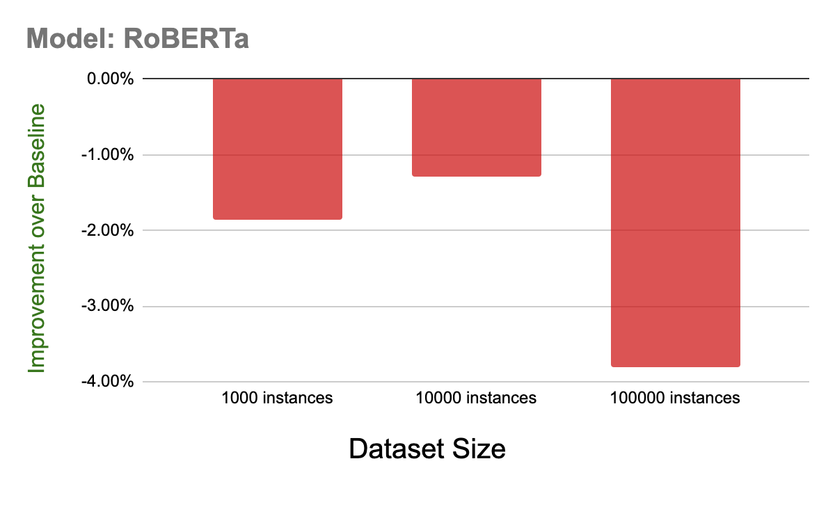
RQ I. Does data augmentation or Supervised Contrastive Learning help to improve document re-ranking performance for smaller datasets?
Notes:
Here we experiment on Roberta with Pointwise(Cross entropy) loss objective on datasets of different sizes with data augmentation and we can clearly see that performance using pointwise loss is worse that the baseline(which is pointwise loss without data augmentation).

Slide 30
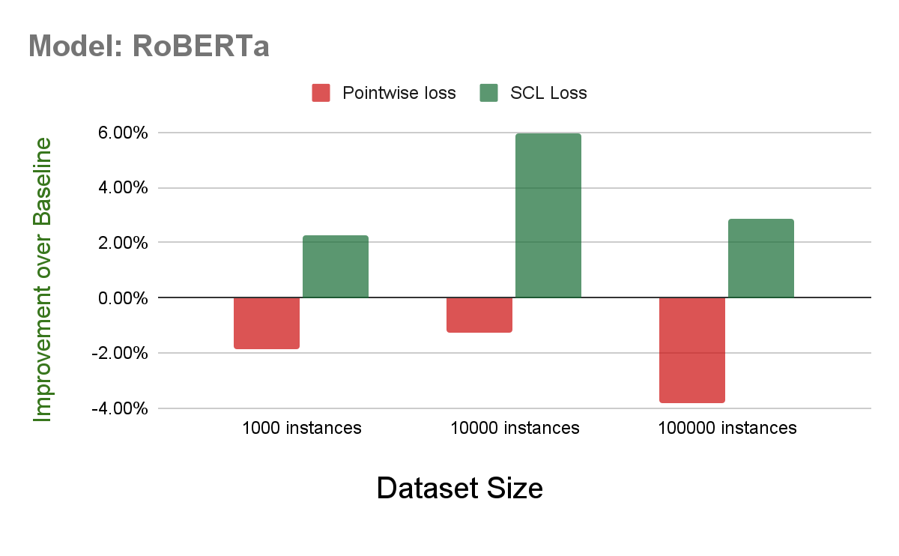
RQ I. Does data augmentation or Supervised Contrastive Learning help to improve document re-ranking performance for smaller datasets?
Notes:
With SCL ranking loss we clearly see a performance improvement.

Slide 31
RQ I. Does data augmentation or Supervised Contrastive Learning help to improve document re-ranking performance for smaller datasets?
Data augmentation is useful only when a proper loss function is used in conjugation, i.e.Pointwise RankingSCL or Pairwise RankingSCL loss

Slide 32
RQ II. Does the augmentation style impact the ranking performance?
Notes:
To answer this we experiment on 3 augmentation strategy.

Slide 33
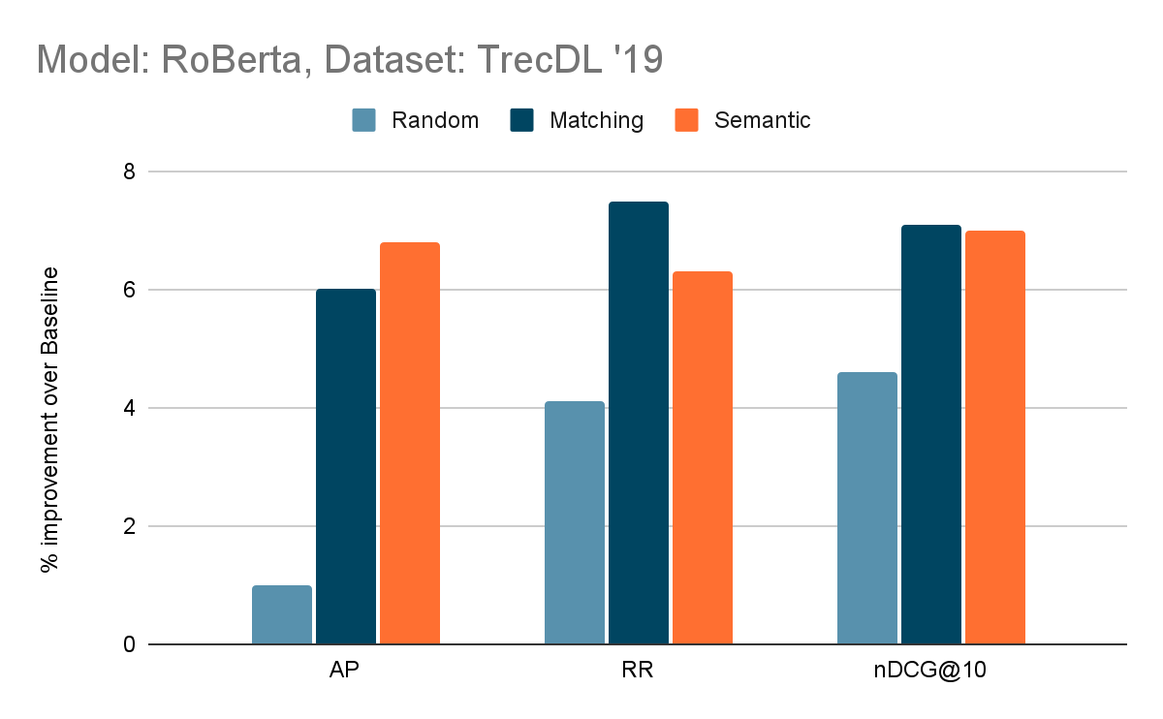
RQ II. Does the augmentation style impact the ranking performance?
Notes:
Here we see random aug does worse but its difficult to say who is a clear winner among matching and semantic augmentation technique.

Slide 34
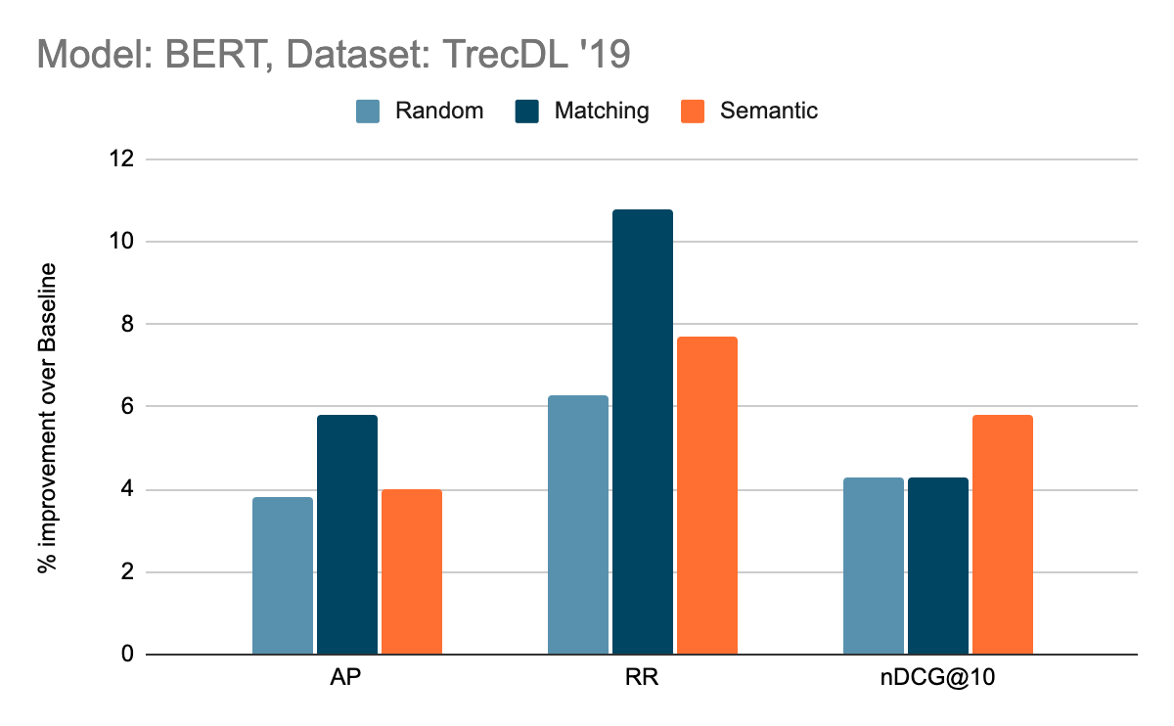
RQ II. Does the augmentation style impact the ranking performance?
Notes:
Her for BERT we see that random performs better than previous but similar to semantic. And choosing a clear winner here is difficult too.

Slide 35
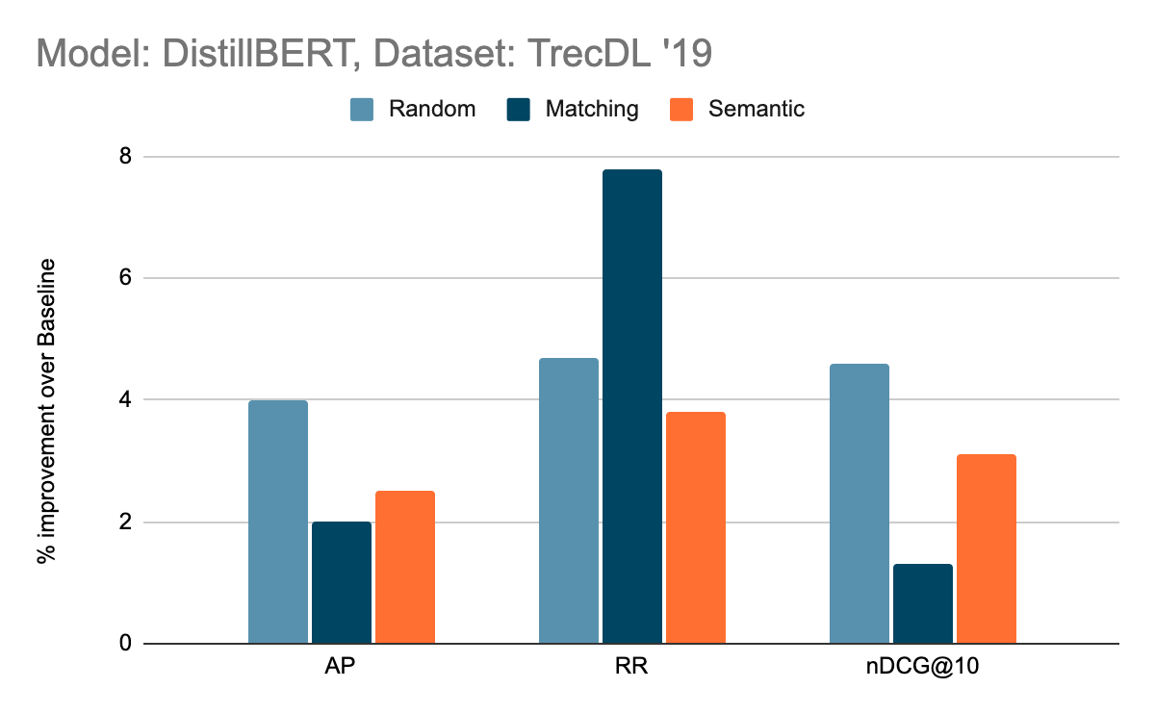
RQ II. Does the augmentation style impact the ranking performance?
Notes:
Here random does better for average precision, matching in reciprocal ranking and difference between random and semantic in nDcG is not that much.

Slide 36
RQ II. Does the augmentation style impact the ranking performance?
Simple data augmentation strategies do not have a big impact on the ranking performance
Notes:
So to sum up. Simple data augmentation technique do not have a big impact on ranking performance. For future studies we can look at other data augmentation technique which might work.

Slide 37
RQ III. How does training data size impact ranking performance?

Slide 38
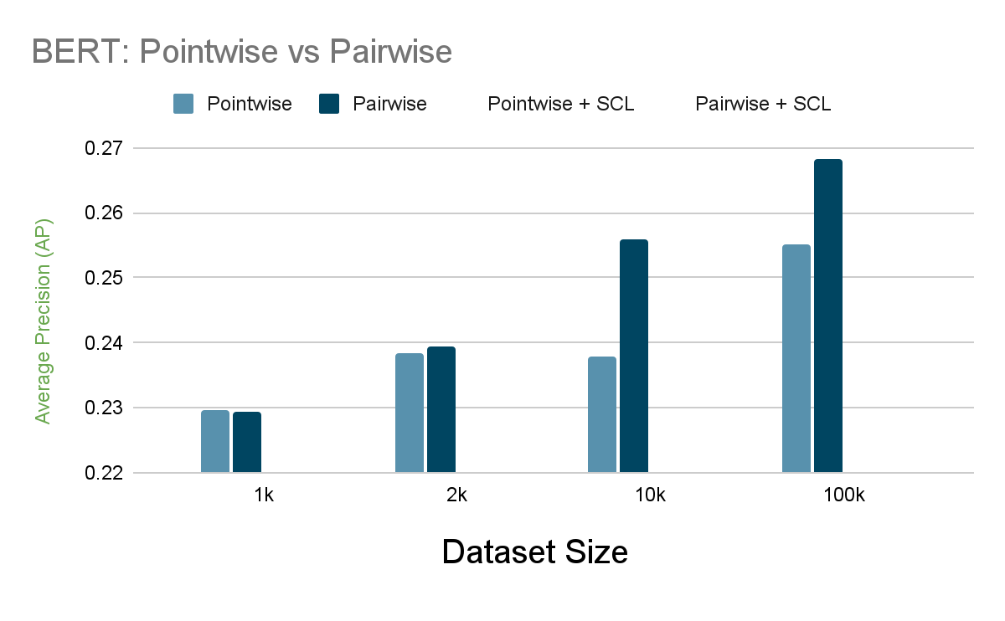
RQ III. How does training data size impact ranking performance?
Notes:
Check if marginal utility argument is true for this example.

Slide 39
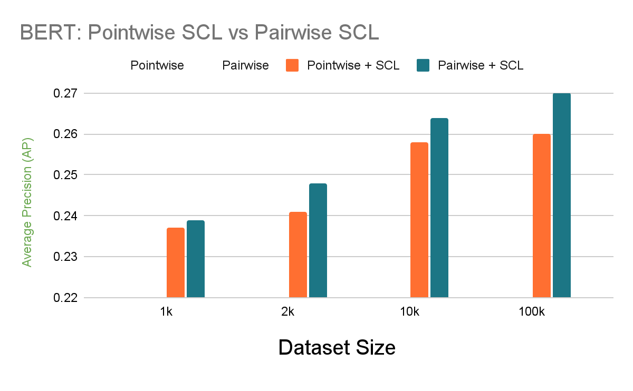
RQ III. How does training data size impact ranking performance?

Slide 40
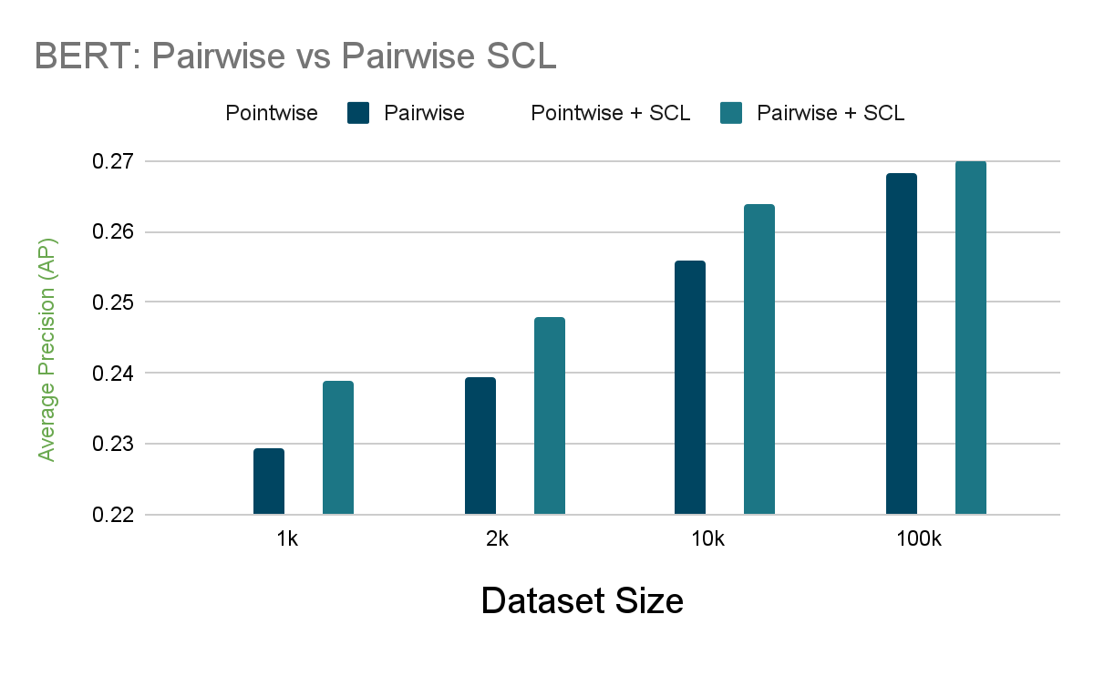
RQ III. How does training data size impact ranking performance?
RankingSCL has the highest marginal utility when the dataset sizes are small
The utility diminishes with increasing dataset size
Notes:
Check if marginal utility argument is true for this example.

Slide 41
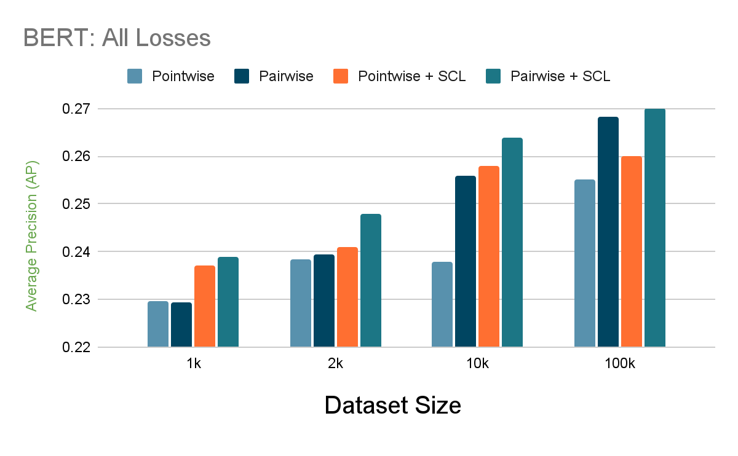
RQ III. How does training data size impact ranking performance?
RankingSCL has the highest marginal utility when the dataset sizes are small
The utility diminishes with increasing dataset size
Notes:
Check if marginal utility argument is true for this example.

Slide 42
Can we replicate the performance on small datasets?

Slide 43
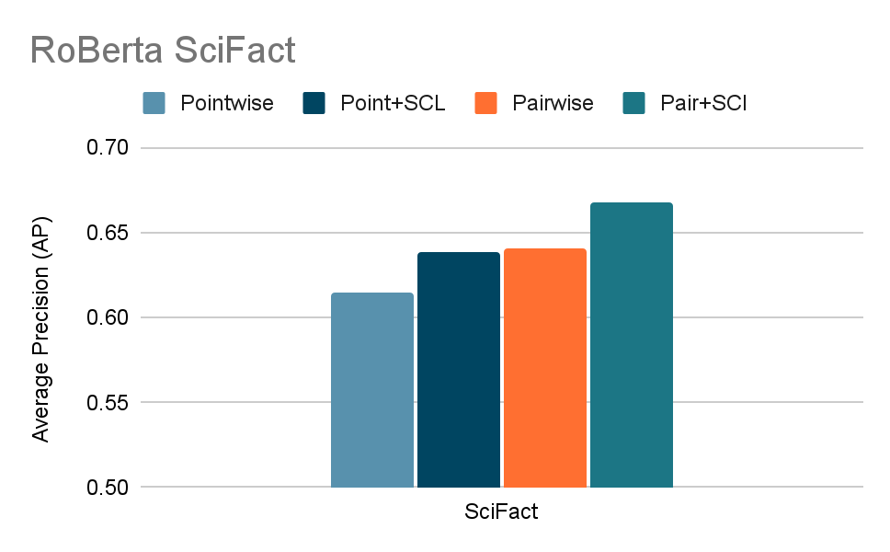
Can we replicate the performance on small datasets

Slide 44
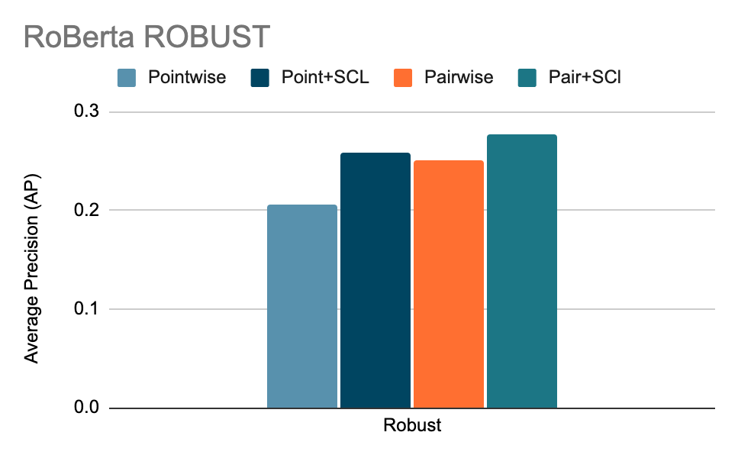
Can we replicate the performance on small datasets

Slide 45
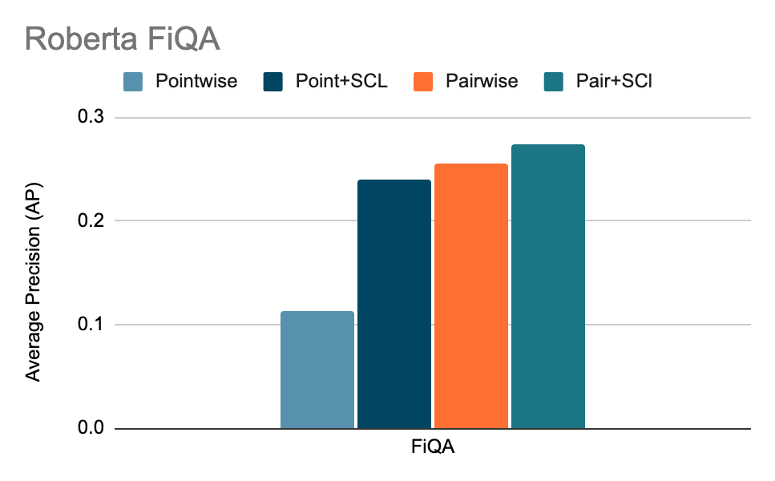
Can we replicate the performance on small datasets
RankingSCL results in large performance gains on a variety of small ranking datasets
Notes:
it turns out that there is a large variance in the ranking metrics for the RankingSCL model when trained in the pointwise regime, i.e., MAP value of 0.24°+-0.11.

Slide 46
05
Conclusion

Slide 47
Conclusion
Data augmentation is useful only when a proper loss function is used in conjugation, i.e.Pointwise RankingSCL or Pairwise RankingSCL loss
Choice of simple data augmentation strategies do not have a big impact on the ranking performance when using RankingSCL (Pointwise or Pairwise).
RankingSCL has the highest marginal utility when the dataset sizes are small. The utility diminishes with increasing dataset size.
RankingSCL results in large performance gains on a variety of small ranking datasets.

Slide 48
Thank You SIGIR for the Student Travel Grant

Slide 49
Additional Slides

Slide 50
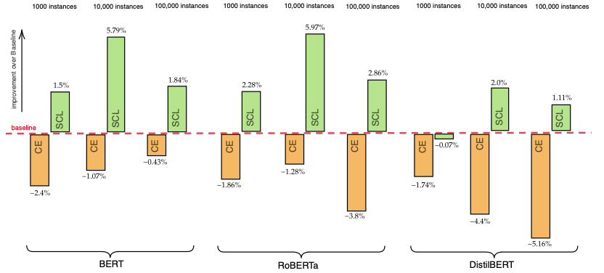
SCL Loss
Baseline
Pointwise Loss
Notes:
Explain slide, re do. slide

Slide 51
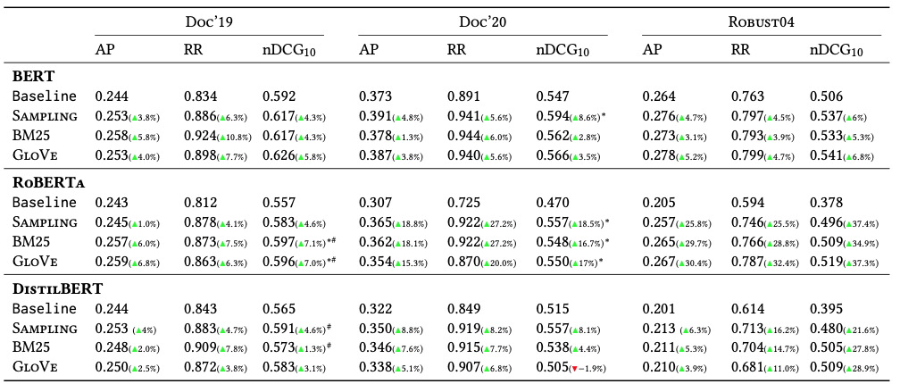
Notes:
Highlight the improvment part roberta. Show impressive gains. Spefic areaas to look at.
IN your opinion why does not simple augmentation technique work? Is it cos of the augmentation style? The data used?
What do you do with documents with small number of passages?
How did you divide documents into passages?
How many passages in average do trecdl have? distribution?

Slide 52
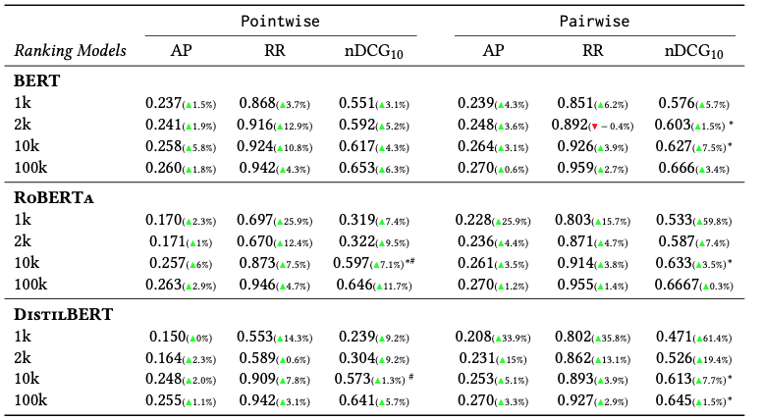
Notes:
Document re-ranking results on the \trecdldf{} datasets for \ce{} and \pairwise{} with \scl{} with data augmentation using BM25 selection strategy. We show the relative improvement of the augmentation approaches against a baseline without augmentation in parentheses. Statistically significant improvements at a level of $95\%$ and $90\%$ are indicated by $*$ and $\#$ respectively~\cite{paired_significance_test}.
Animate figure

Slide 53
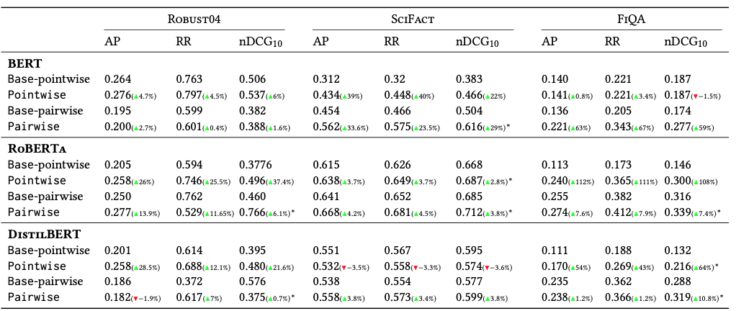
Can we replicate the performance on small datasets
Notes:
Add threat to Validity here.
Document re-ranking results on the \robust{}{}, \scifact{} and \fiqa{} datasets. We train each ranker using \random{} data augmentation techniques on different datasets. The models are trained using a linear interpolation of \ce{} (\ce{} and \scl{}) and \pairwise{} (\pairwise{} and \scl{}) loss functions. Values in brackets are percentage improvement from baseline. Statistically significant improvements at a level of $95\%$ and $90\%$ are indicated by $*$ and $\#$ respectively~\cite{paired_significance_test}.

