Slide 1
DC-OPS
On-Device Data Center Operations Assistant
Qualcomm x Meta ExecuTorch Hackathon — June 2026
Real-time AI-powered server rack inspection
Running entirely on Samsung Galaxy S25 Ultra — Snapdragon 8 Elite NPU

Slide 2
THE PROBLEM
🔒
Air-Gapped Environments
Data centers prohibit cloud connectivity in server rooms — no API calls possible
🕐
Slow Manual Inspection
Technicians walk aisles checking thousands of LEDs, ports, and cables by eye
🔐
Sensitive Infrastructure Data
Serial numbers, rack topology, and server status are classified information
📶
No Connectivity
Even connected DCs have dead zones between rack rows — WiFi is unreliable

Slide 3
THE SOLUTION
Point your phone at any server rack.
AI identifies every component in real-time.
All processing happens on-device — zero cloud.
16 Component Classes
RAG Knowledge Overlay
CPU vs NPU Toggle
Compute trays, ports, LEDs, cables, fans, drives, PSUs, DPUs, and more
Tap any detection → specs, troubleshooting, LED meanings, maintenance steps
Live comparison: XNNPACK (CPU) ↔ QNN HTP (Snapdragon NPU) with FPS/latency

Slide 4
WHY ON-DEVICE?
0ms
100%
0 bytes
4-5x
Cloud Latency
Offline
Data Leaked
Power Efficient
No round-trip — inference directly on Hexagon NPU
Works in air-gapped rooms with zero connectivity
Serial numbers and infra data never leave the device
NPU vs CPU — longer battery life for extended inspections

Slide 5
ARCHITECTURE
Camera
(CameraX 30fps)
RetinaNet
(INT8 Quantized)
QNN HTP
(Snapdragon NPU)
16 DC Classes
(Polygon Overlay)
→
→
→
3D NVL72 Rack
(Three.js Interactive)
RAG Knowledge Overlay: CLIP ViT-B-32 → FAISS (160KB) → Specs, Troubleshooting, LED Meanings
Android App → ExecuTorch Runtime → QAIRT SDK → Snapdragon NPU

Slide 6
TECH STACK
Detection (NPU)
RetinaNet-ResNet50-FPN
QNN HTP, INT8, 36MB
Detection (CPU)
YOLOv8n-seg v3
XNNPACK, FP32, 13MB
RAG Retrieval
CLIP ViT-B-32 + FAISS
160KB index, on-device
Runtime
ExecuTorch 1.4
QNN backend for SM8750
App
Kotlin + CameraX
ExecuTorch AAR (3.4MB)
Device
Galaxy S25 Ultra
Snapdragon 8 Elite, Hexagon v79
3D Visualization
Three.js NVL72 Model
Interactive rack explorer

Slide 7
TRAINING PIPELINE
PHASE 1 — Bootstrap
BrightData Web Unlocker scraped 300+ data-center images → auto-labeled with Grounding DINO + SAM (3,045 polygons)
PHASE 2 — 2,036 human-labeled images from 4 Roboflow datasets (CC BY 4.0) · used for final models
Server Vision
1,293 imgs
30 classes (CPU, DIMM, fans, PSUs, drives)
PC Ports
327 imgs
4 classes (HDMI, RJ45, USB-A, USB-C)
Ports (ym)
138 imgs
7 classes (DP, ethernet, power, USB)
Server Detection
54 imgs
9 classes (SFP, XFP, patch panels)
50+ source classes → mapped to 16 DC-Ops classes · Augmentations: Moiré, screen glare, brightness, color tint, scanlines
⚡ Powered by BrightData — web data infrastructure for the bootstrap dataset

Slide 8
MODEL PERFORMANCE
0.749
0.85
6.4ms
mAP50 (box)
Final Loss
Inference
YOLOv8n-seg v3
RetinaNet (moiré aug)
Per frame on T4 GPU
compute tray
0.924
server rack
0.683
network port
0.912
drive bay
0.912
power shelf
0.832
DPU
0.808
LED indicator
0.808
cooling manifold
0.833

Slide 9
LIVE DEMO
0:00
Point phone at server rack / mini PC
Real-time colored polygon overlays appear
1:00
Tap detected component
RAG info panel: specs, troubleshooting, LED meanings
2:00
Toggle CPU ↔ NPU
Live FPS/latency comparison on screen
3:00
Enable airplane mode
Everything still works — fully offline
4:00
3D rack explorer
Interactive NVL72 model with component details

Slide 10
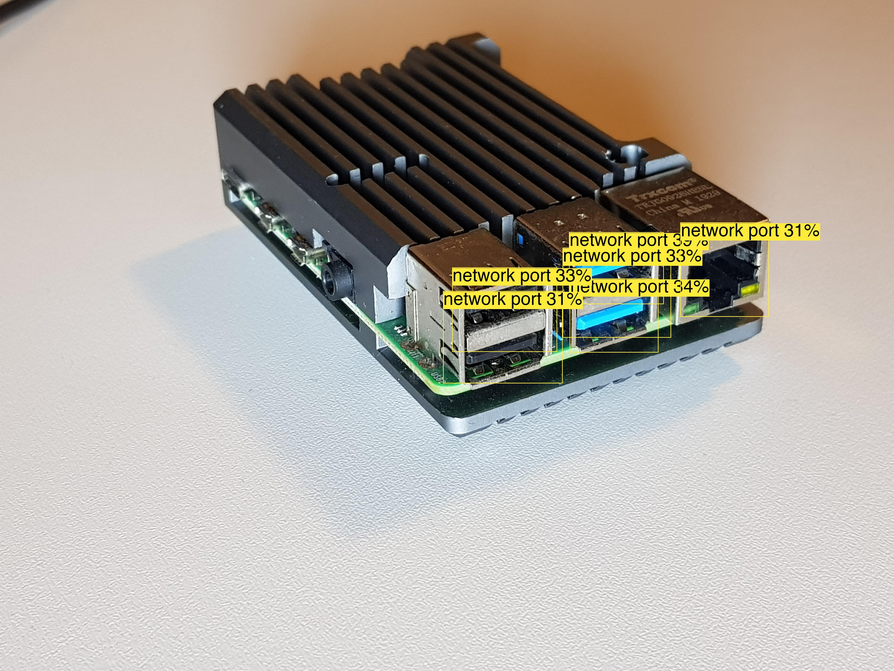
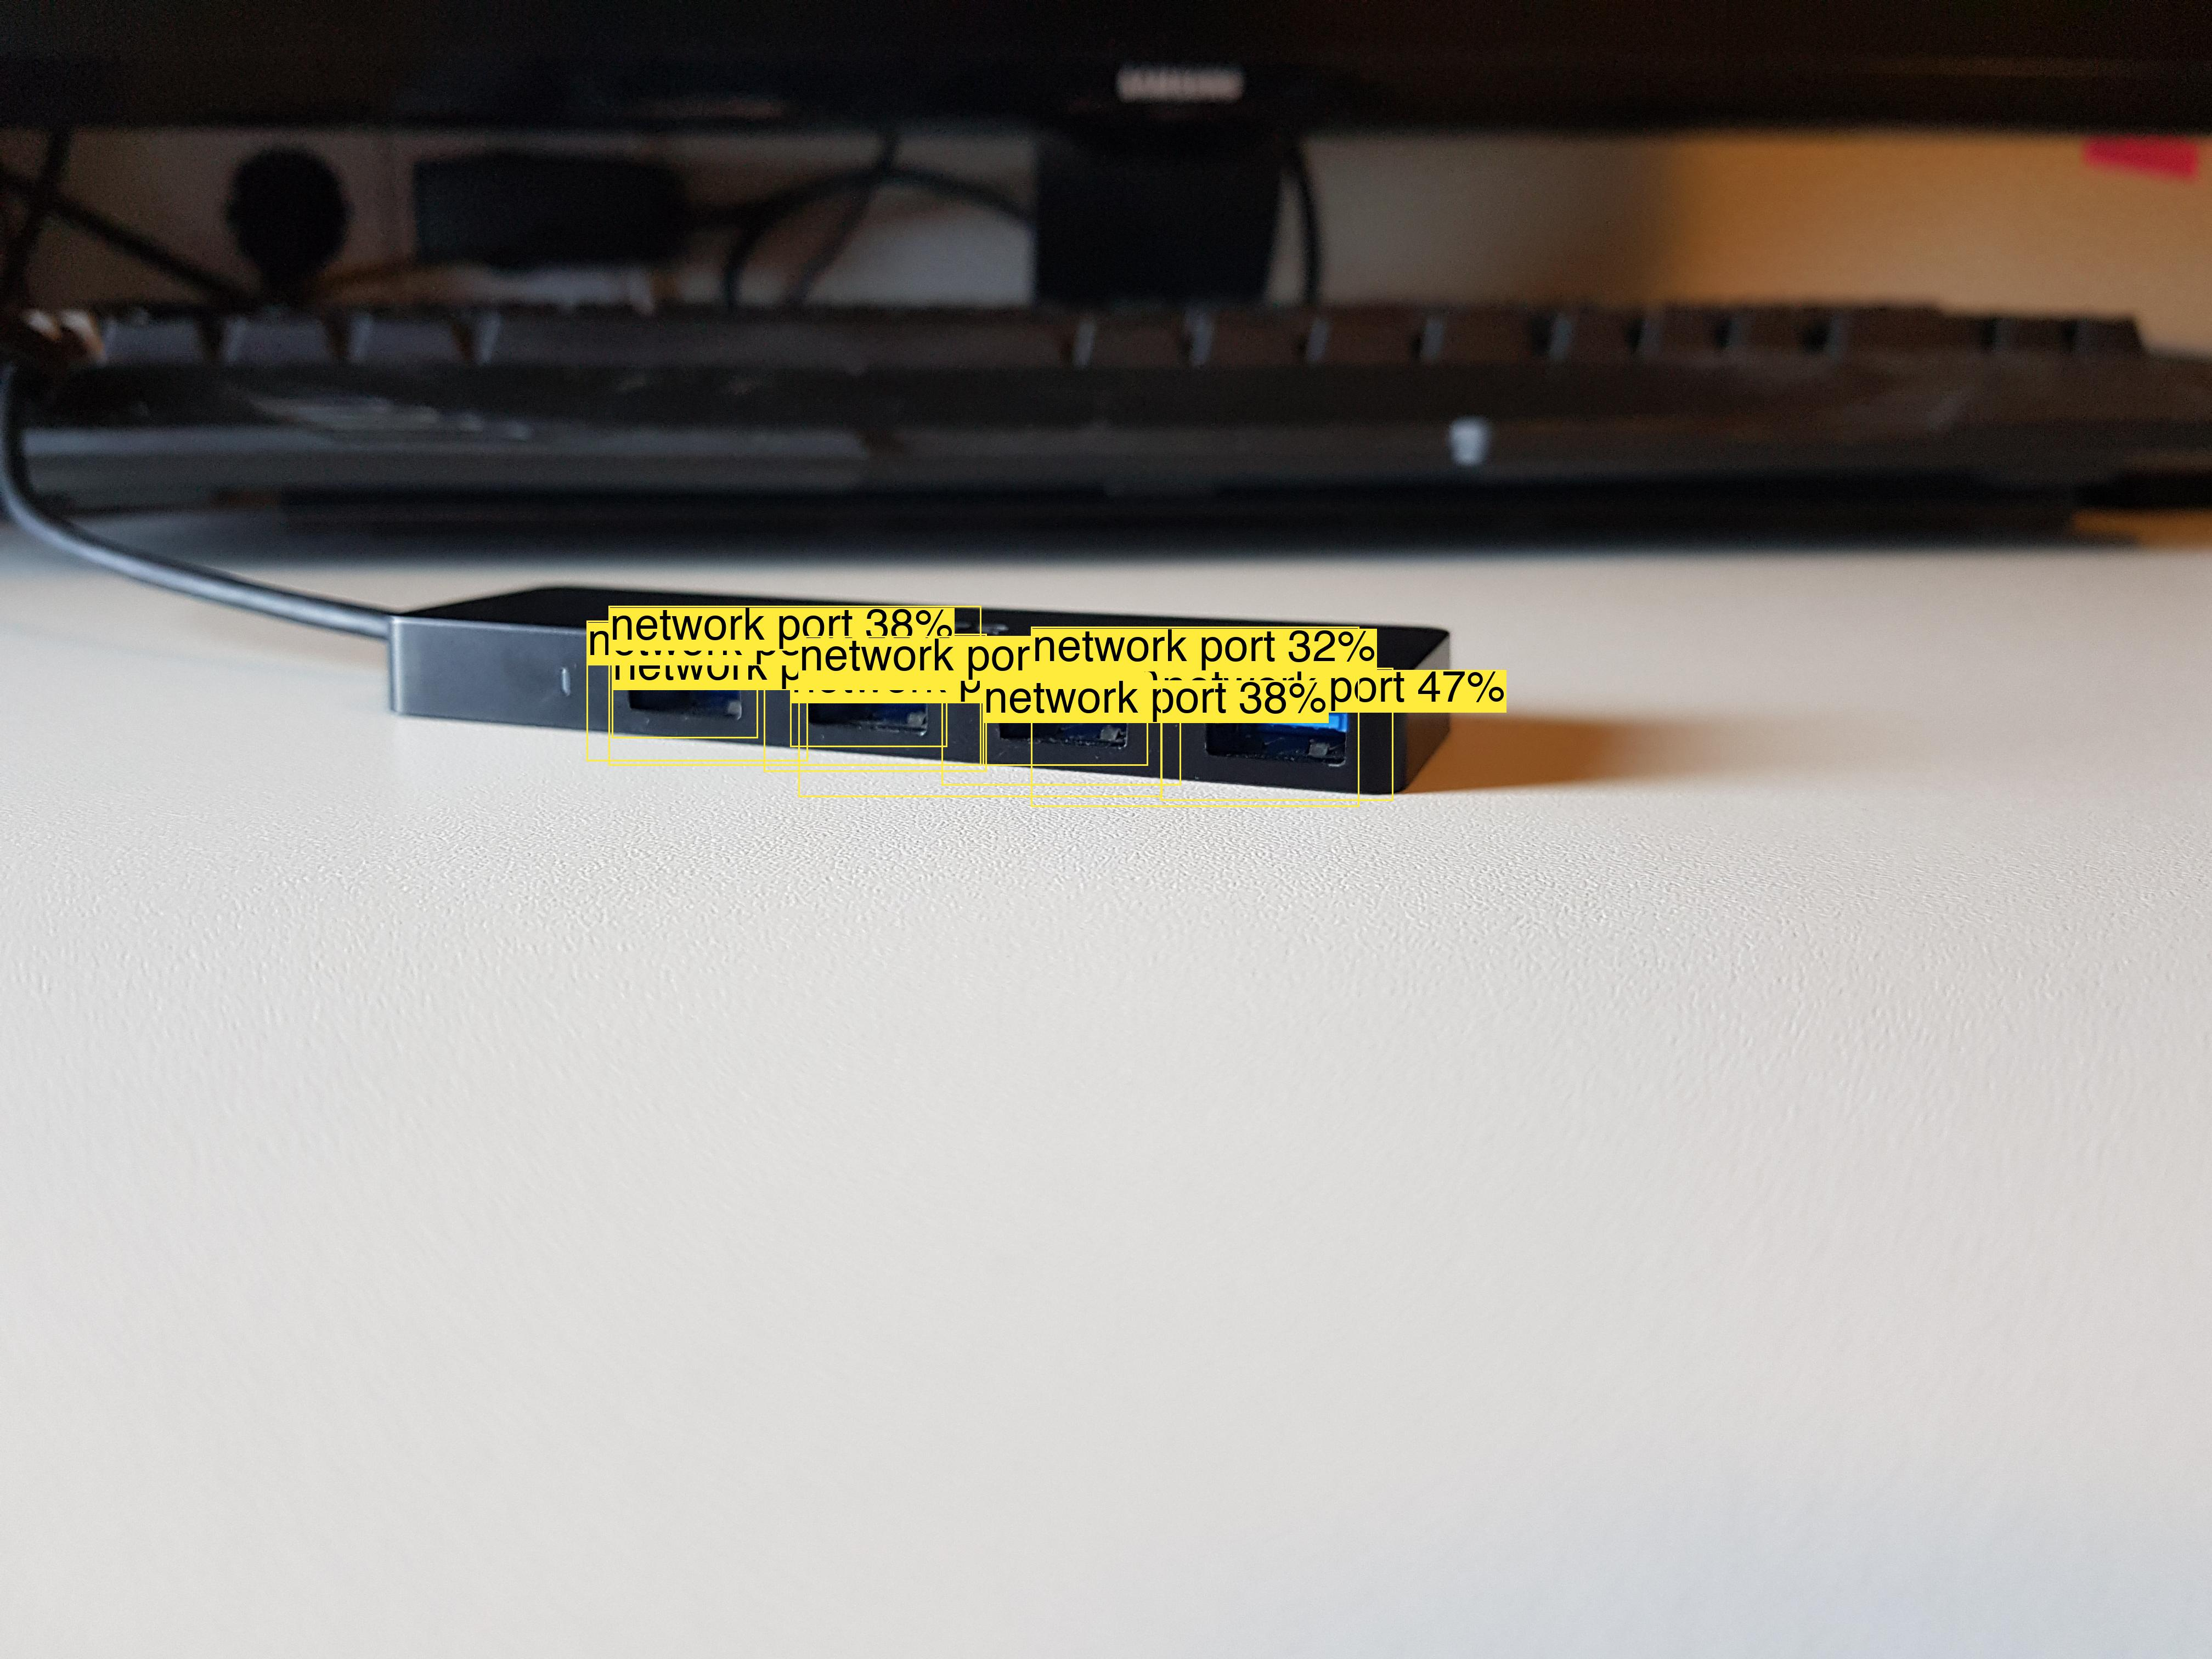
RETINANET IN ACTION
Real detections on a Raspberry Pi & USB hub — mirrors our physical demo prop
All USB + RJ45 ports detected as 'network port' — fully on-device

Slide 11
RAG KNOWLEDGE OVERLAY
Detect → Embed → Retrieve → Display
COMPUTE TRAY 92%
▸ 80 knowledge chunks
⚙️ 2x Grace CPU, 4x B200 GPU, 192GB HBM3e
🟢 Green LED = healthy and operational
🟡 Amber LED = check BMC log, verify coolant
🔴 Red LED = critical hardware failure
🔧 Maintenance: check cold plate contact,
verify NVLink connector seating
▸ CLIP ViT-B-32 embeddings
▸ FAISS vector index (160KB)
▸ NVL72-specific documentation
▸ All on-device, zero cloud

Slide 12
CPU vs NPU COMPARISON
Backend
XNNPACK (CPU)
QNN HTP (NPU)
Model
YOLOv8n-seg
RetinaNet
Size
13 MB
36 MB
Quantization
FP32
INT8
Hardware
ARM Kryo cores
Hexagon HTP v79
Latency †
~15-30 ms
~3-5 ms
Throughput †
~30-60 FPS
~100+ FPS
Power †
Baseline
4-5x efficient
† Estimated from Qualcomm QNN HTP benchmarks — not yet measured on our specific model. Measured FPS shown live in-app.

Slide 13
WHAT'S NEXT
Fine-grained Port Classification
Split 'network port' into HDMI, USB-A, USB-C, RJ45, SFP individually
LED State Detection
Classify LED colors (green/amber/red) and blink patterns for health scoring
On-Device LLM Integration
LLaMA 3.2 1B via ExecuTorch for natural language troubleshooting Q&A
Audit Log + Reporting
SQLite database of all inspections, exportable via secure channel
Multi-Rack Mapping
Combine depth estimation + detection for spatial rack layout understanding

Slide 14
DC-OPS
On-Device Data Center Operations Assistant
GitHub
github.com/abhijitbetigeri/DC-Ops
HuggingFace
huggingface.co/datasets/abhijitbetigeri/dc-ops-dataset
Models
RetinaNet QNN HTP (.pte) + YOLOv8n-seg (.pte) + RAG index
Built with ExecuTorch + Qualcomm QNN HTP + Snapdragon 8 Elite
Thank you!

