Slide 1
DC-Ops
On-Device Data Center Operations Assistant
Qualcomm x Meta ExecuTorch Hackathon — June 2026
Real-time AI-powered server rack inspection
Running entirely on Samsung Galaxy S25 Ultra — Snapdragon 8 Elite NPU

Slide 2
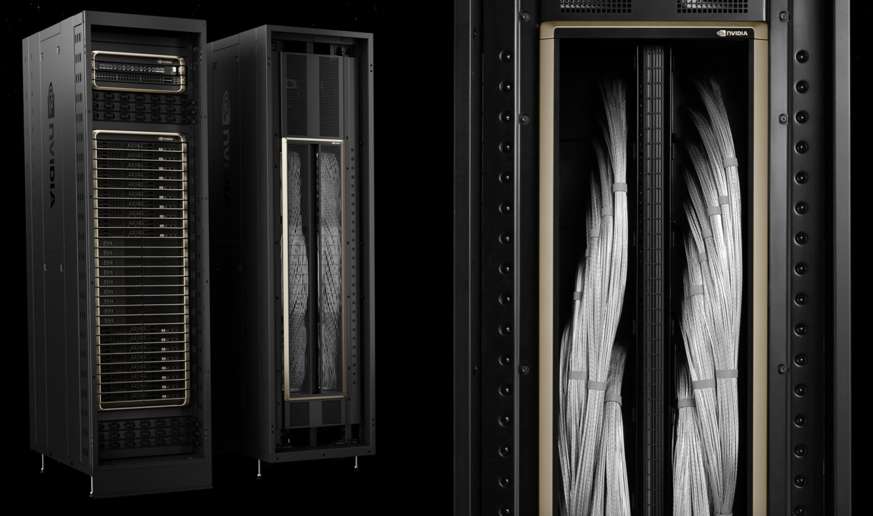
THE PROBLEM
1000+
~4000+
80%
Server racks built every week
Total weekly volume over the next few years
Of racks are installed incorrectly the first time they are built
Cables in the wrong place
A rack is a dense mesh of cables linking trays, assembled at volume by labor crews constantly cross-referencing a paper assembly guide — slow and error-prone.

Slide 3
THE SOLUTION
Point your phone at any server rack.
AI identifies every component in real-time.
All processing happens on-device — zero cloud.
16 Component Classes
RAG Knowledge Overlay
CPU vs NPU Toggle
Compute trays, ports, LEDs, cables, fans, drives, PSUs, DPUs, and more
Tap any detection → specs, troubleshooting, LED meanings, maintenance steps
Live comparison: XNNPACK (CPU) ↔ QNN HTP (Snapdragon NPU) with FPS/latency

Slide 4
WHY ON-DEVICE?
0ms
100%
0 bytes
4-5x
Cloud Latency
Offline
Data Leaked
Power Efficient
No round-trip — inference directly on Hexagon NPU
Works in air-gapped rooms with zero connectivity
Serial numbers and infra data never leave the device
NPU vs CPU — longer battery life for extended inspections

Slide 5
ARCHITECTURE
Camera
(CameraX 30fps)
RetinaNet
(INT8 Quantized)
QNN HTP
(Snapdragon NPU)
16 DC Classes
(Polygon Overlay)
→
→
→
3D NVL72 Rack
(Three.js Interactive)
RAG Knowledge Overlay: CLIP ViT-B-32 → FAISS (160KB) → Specs, Troubleshooting, LED Meanings
Android App → ExecuTorch Runtime → QAIRT SDK → Snapdragon NPU

Slide 6
TECH STACK
Detection (NPU)
RetinaNet-ResNet50-FPN
QNN HTP, INT8, 36MB
Detection (CPU)
YOLOv8n-seg v3
XNNPACK, FP32, 13MB
RAG Retrieval
CLIP ViT-B-32 + FAISS
160KB index, on-device
Runtime
ExecuTorch 1.4
QNN backend for SM8750
App
Kotlin + CameraX
ExecuTorch AAR (3.4MB)
Device
Galaxy S25 Ultra
Snapdragon 8 Elite, Hexagon v79
3D Visualization
Three.js NVL72 Model
Interactive rack explorer

Slide 7
TRAINING PIPELINE
2,036 human-labeled images from 4 Roboflow datasets (CC BY 4.0)
Server Vision
1,293 imgs
30 classes (CPU, DIMM, fans, PSUs, drives)
PC Ports
327 imgs
4 classes (HDMI, RJ45, USB-A, USB-C)
Ports (ym)
138 imgs
7 classes (DP, ethernet, power, USB)
Server Detection
54 imgs
9 classes (SFP, XFP, patch panels)
50+ source classes → mapped to 16 DC-Ops classes
Augmentations: Moiré patterns, screen glare, brightness variation, color tint, scanlines

Slide 8
MODEL PERFORMANCE
0.749
0.85
6.4ms
mAP50 (box)
Final Loss
Inference
YOLOv8n-seg v3
RetinaNet (moiré aug)
Per frame on T4 GPU
compute tray
0.924
server rack
0.683
network port
0.912
drive bay
0.912
power shelf
0.832
DPU
0.808
LED indicator
0.808
cooling manifold
0.833

Slide 9
LIVE DEMO

Slide 10
RAG KNOWLEDGE OVERLAY
Detect → Embed → Retrieve → Display
COMPUTE TRAY 92%
▸ 80 knowledge chunks
⚙️ 2x Grace CPU, 4x B200 GPU, 192GB HBM3e
🟢 Green LED = healthy and operational
🟡 Amber LED = check BMC log, verify coolant
🔴 Red LED = critical hardware failure
🔧 Maintenance: check cold plate contact,
verify NVLink connector seating
▸ CLIP ViT-B-32 embeddings
▸ FAISS vector index (160KB)
▸ NVL72-specific documentation
▸ All on-device, zero cloud

Slide 11
CPU vs NPU COMPARISON
Backend
XNNPACK (CPU)
QNN HTP (NPU)
Model
YOLOv8n-seg
RetinaNet
Size
13 MB
36 MB
Quantization
FP32
INT8
Est. Latency
~15-30ms
~3-5ms
Est. FPS
~30-60
~100+
Power
Higher drain
4-5x efficient
Hardware
ARM Kryo cores
Hexagon HTP v79

Slide 12
WHAT'S NEXT
Fine-grained Port Classification
Split 'network port' into HDMI, USB-A, USB-C, RJ45, SFP individually
LED State Detection
Classify LED colors (green/amber/red) and blink patterns for health scoring
On-Device LLM Integration
LLaMA 3.2 1B via ExecuTorch for natural language troubleshooting Q&A
Audit Log + Reporting
SQLite database of all inspections, exportable via secure channel
Multi-Rack Mapping
Combine depth estimation + detection for spatial rack layout understanding

Slide 13
DC-OPS
On-Device Data Center Operations Assistant
GitHub
github.com/abhijitbetigeri/DC-Ops
HuggingFace
huggingface.co/datasets/abhijitbetigeri/dc-ops-dataset
Models
RetinaNet QNN HTP (.pte) + YOLOv8n-seg (.pte) + RAG index
Built with ExecuTorch + Qualcomm QNN HTP + Snapdragon 8 Elite
Thank you!

