Slide 1
Presentation on Descriptive Statistical Analysis for Spring Houses Data Set

Slide 2
Introduction
Understanding the distribution and characteristics of a dataset is a critical step in drawing meaningful insights and making informed decisions.
Descriptive statistics techniques can help us to gain a deeper understanding of the distribution, central tendency, variability, and relationship between these attributes.
We will apply various descriptive statistics techniques to analyse the Spring Houses dataset and draw insights into the factors that influence house prices.

Slide 3
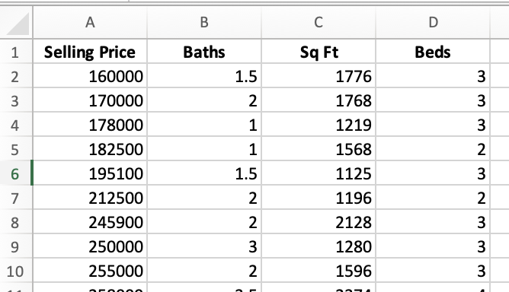
Housing Data Description
Name | Variable | Data type | Variable type
Selling Price | In pounds | Ratio | Target Variable
Baths |  | Ratio | Predictor Variable
Sq ft |  | Ratio | Predictor Variable
Beds |  | Ratio | Predictor Variable

Slide 4
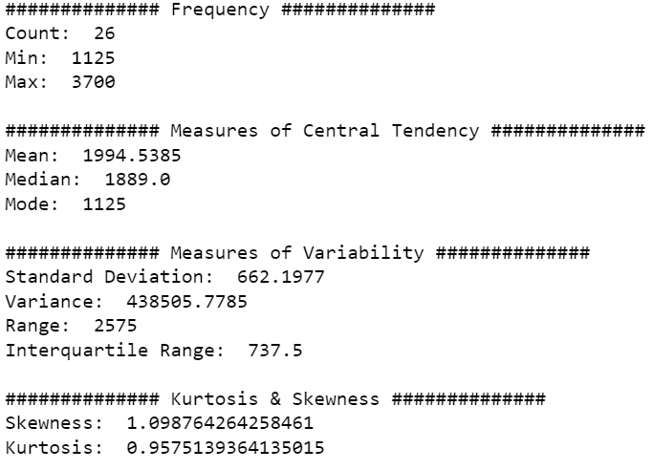
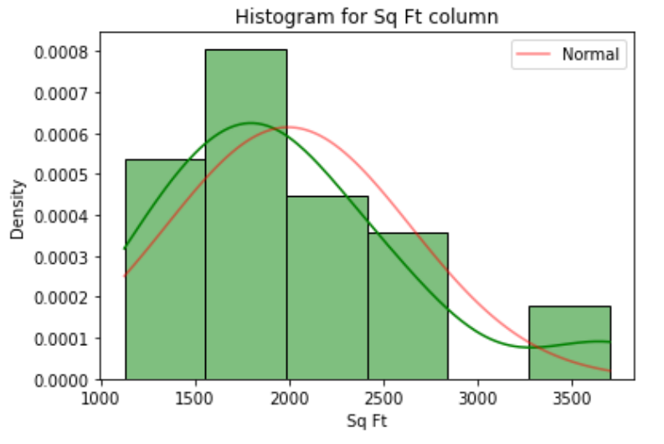
Central Tendency, Variability and Histogram Distribution of Sq Ft Column

Slide 5
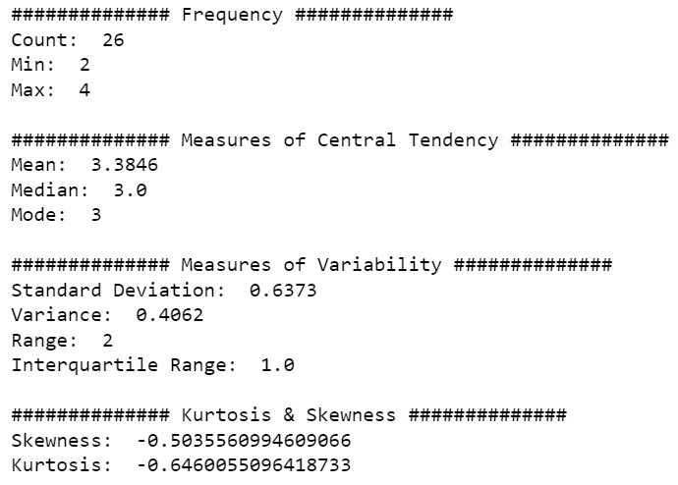
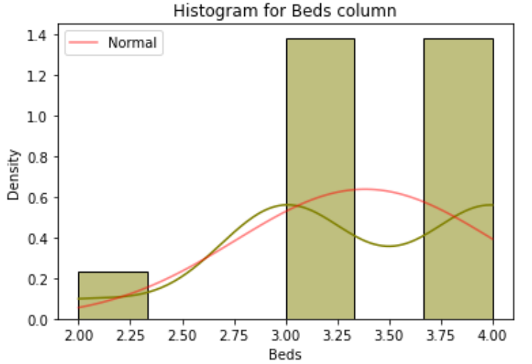
Central Tendency, Variability and Histogram Distribution of Beds Column

Slide 6
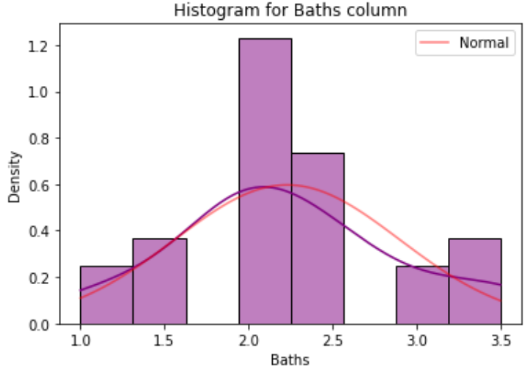
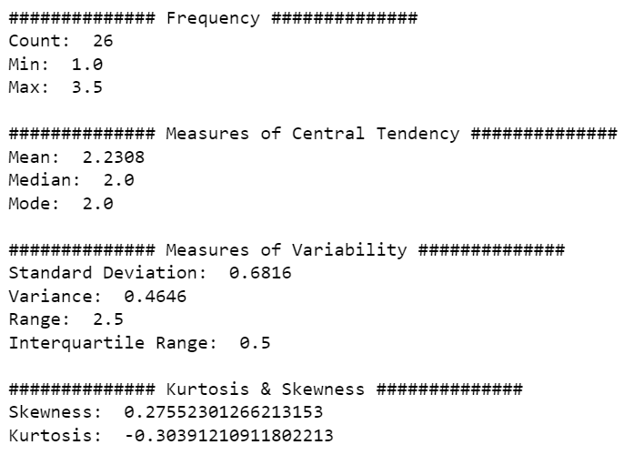
Central Tendency, Variability and Histogram Distribution of Baths Column

Slide 7
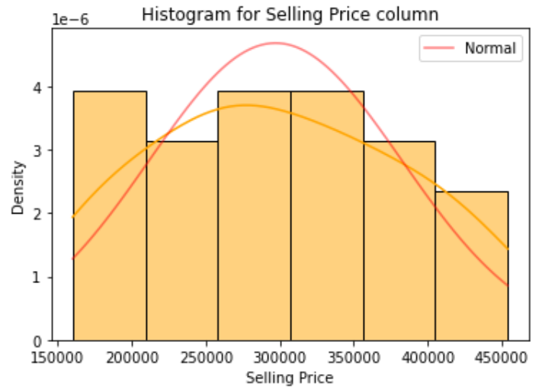
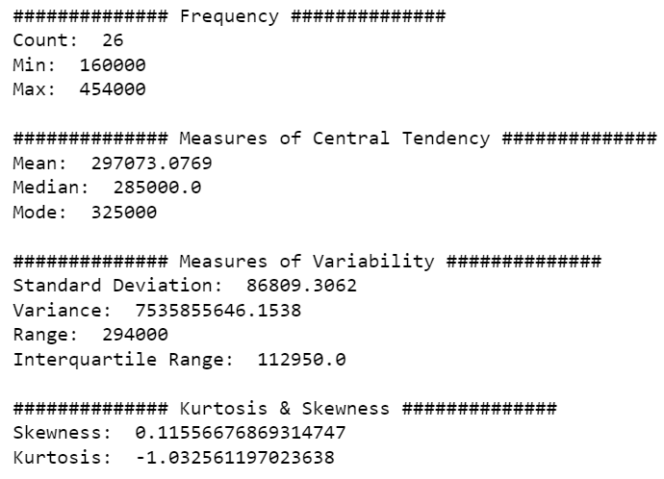
Central Tendency, Variability and Histogram Distribution of Selling Price Column

Slide 8
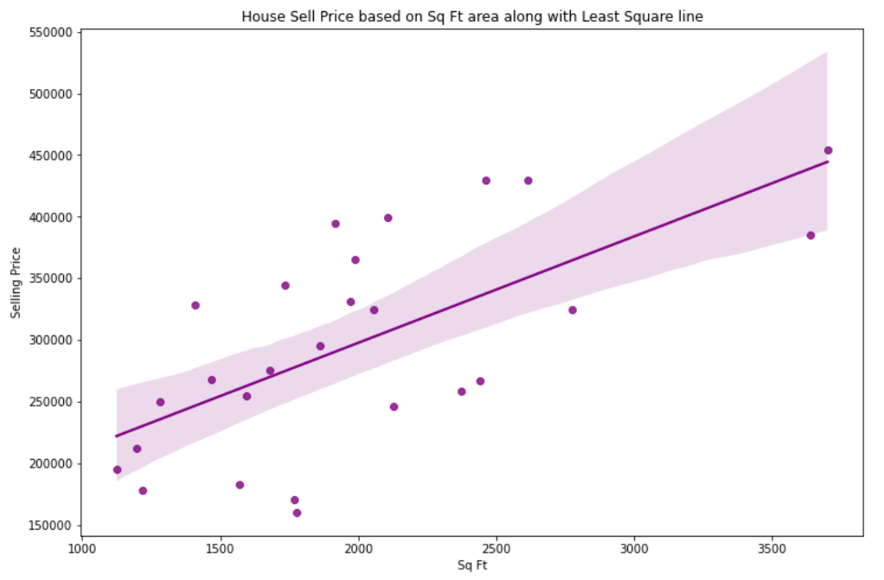
Sq Ft vs Selling Price Scatterplot
Sq Ft area and Selling Price have a strong linear relationship which is visible from this scatterplot
Which indicate as the Sq Ft area increase the Selling Price for a hose is also increases.

Slide 9
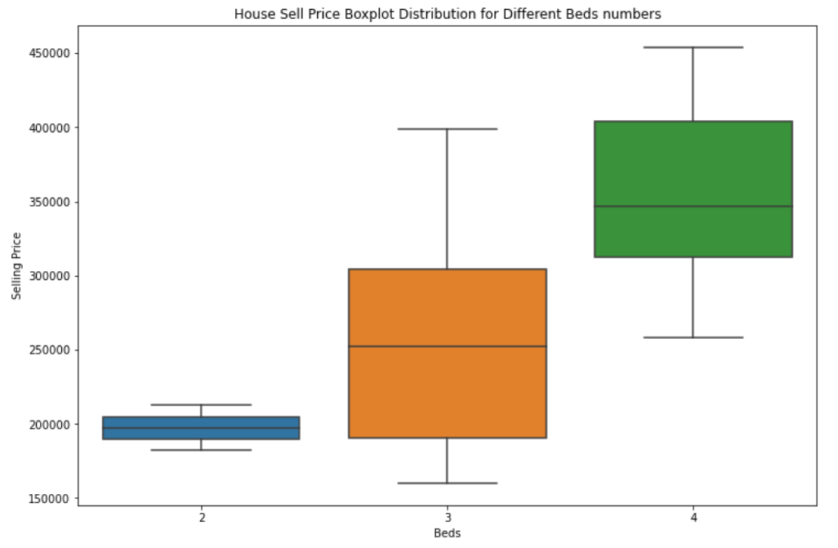
Boxplot distribution of Beds column against Selling Price
This boxplot distribution suggests that if any house has more number of Bedrooms then the price range for that house will be in higher side.
This shows positive linear relationship between Bedrooms and Selling Price of a house

Slide 10
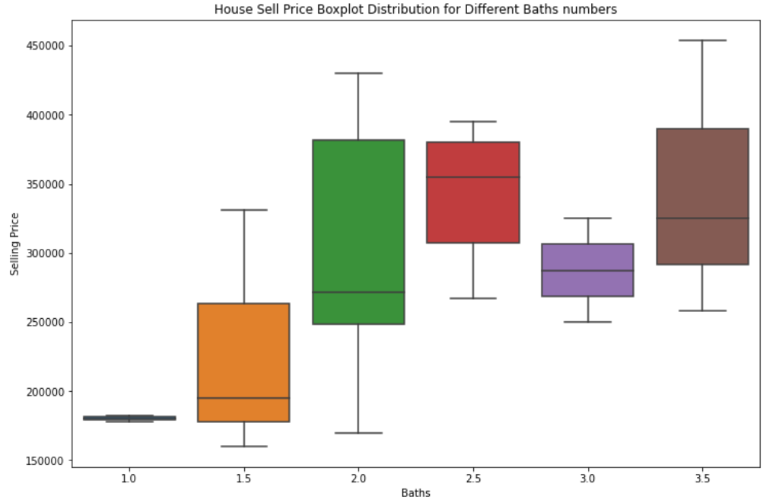
Boxplot distribution of Baths column against Selling Price
This boxplot distribution also implies that if any house has more number of Bathrooms then the price range for that house will be in higher side though it is not always valid.
This shows weak linear relationship between Bathrooms and Selling Price of a house

Slide 11
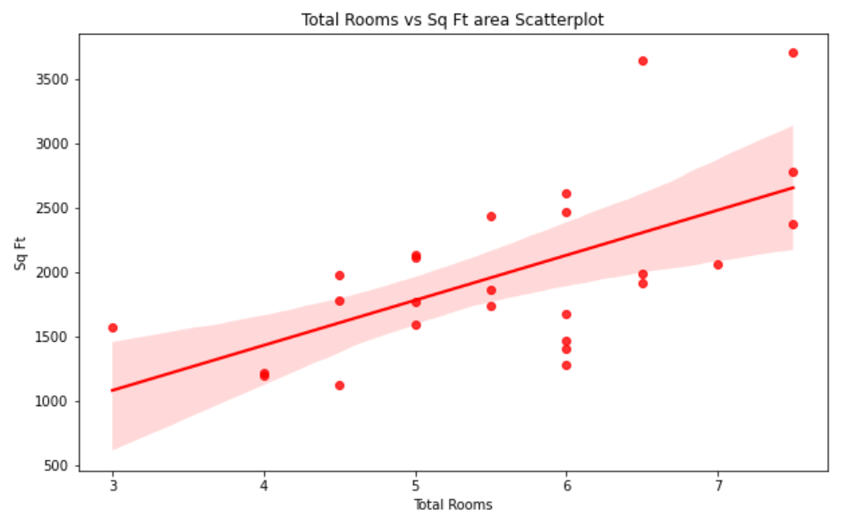
Total Rooms vs Sq Ft area Scatterplot
Total Rooms = Number of Bedrooms + Number of Bathrooms
Graph indicates higher number of Total Rooms in a house will have
more Sq. Ft area.

Slide 12
Conclusion
We found that square footage and number of bedrooms have a strong influence on selling price, while number of bathrooms has a weaker but still significant influence.
Despite the valuable insights gained from our descriptive statistical analysis, there are limitations like other important factors that influence house prices that are not captured in the dataset, such as location, condition, and age of the property.

