Slide 1
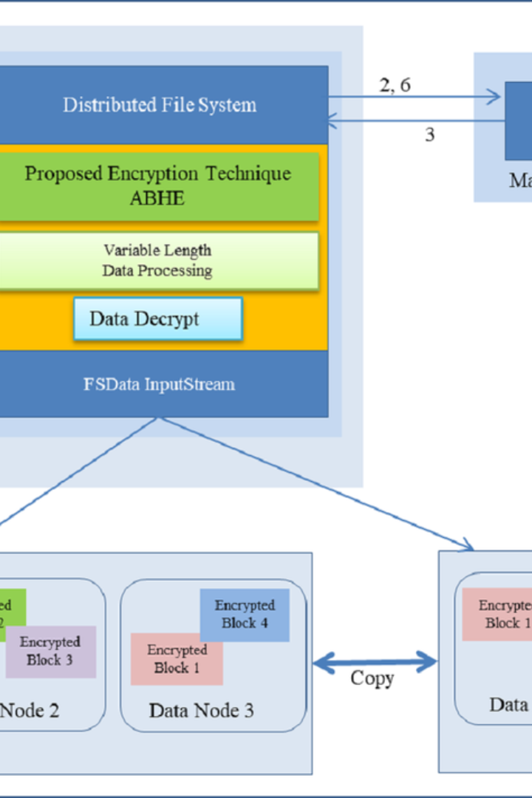


Introduction to Hadoop Storage File system
Hadoop Distributed File System (HDFS) is a distributed file system designed to run on commodity hardware. It provides high-throughput access to application data and is suitable for applications that have large data sets.
by Abhijith

Slide 2
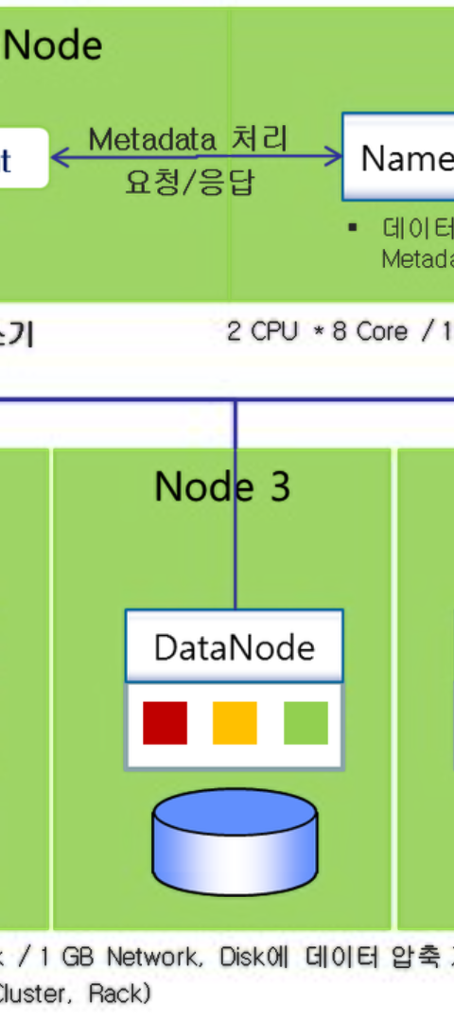
What is HDFS?
1
Distributed File System
2
Fault Tolerance
HDFS is designed to store and manage large volumes of data across multiple machines.
It provides fault tolerance and high availability of data by replicating it across different nodes.
3
Scalability
HDFS is highly scalable and allows seamless addition of more nodes to the cluster.

Slide 3
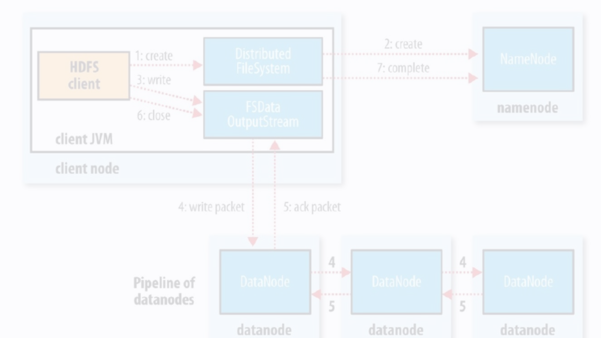
Benefits of using HDFS
1
Data Reliability
Replication of data ensures reliability and fault tolerance, reducing the risk of data loss.
2
Scalability
HDFS scales horizontally, allowing easy expansion as data grows, maintaining performance.
3
Cost-Effective
It provides a cost-effective solution for storing and managing large-scale data.

Slide 4


Creating a Directory Structure in HDFS
Create Root Directory
Create Nested Directories
The first step is to create the root directory in HDFS using the command mkdir.
Nested directories are created using the mkdir command with the -p option to create parent directories if they do not exist.

Slide 5
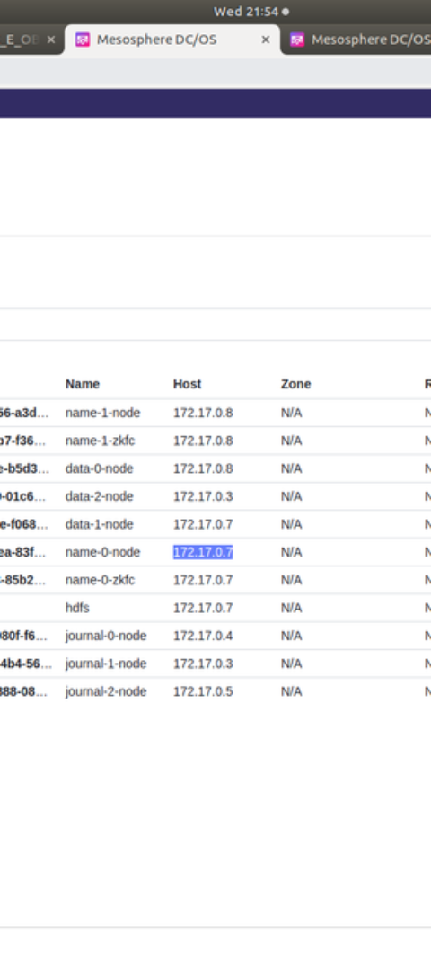
Command for creating a directory in HDFS
Command Syntax
Example
The command syntax for creating a directory in HDFS is: hdfs dfs -mkdir /user/newdir
To create a directory named "data" under the user directory, the command will be: hdfs dfs -mkdir /user/data

Slide 6
Creating nested directories in HDFS
1
2
Create Parent Directory
Create Nested Directory
Use the command mkdir to create the parent directory.
Add the -p option with mkdir to create nested directories.

Slide 7
Best practices for organizing directory structure in HDFS
Use Hierarchical Structure
Set Proper Permissions
Implement Retention Policies
Ensure proper permissions are set for directories to restrict unauthorized access.
Organize directories in a hierarchical structure to mimic the application's data access pattern.
Define retention policies to manage data lifecycle and prevent unnecessary data accumulation.

Slide 8
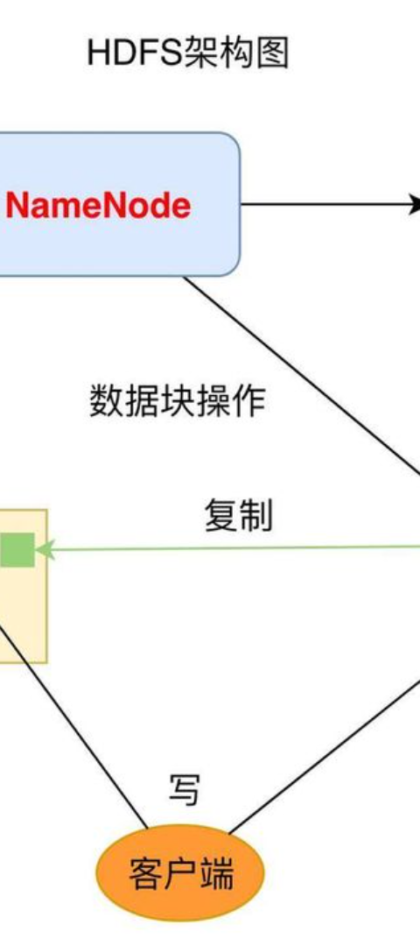



Conclusion
Efficient Storage
HDFS provides an efficient and reliable storage solution for big data applications.
Scalable Architecture
The scalable architecture of HDFS ensures seamless scalability as data grows.
Best Practices
Adhering to best practices ensures optimal performance and data management within HDFS.

