Slide 1
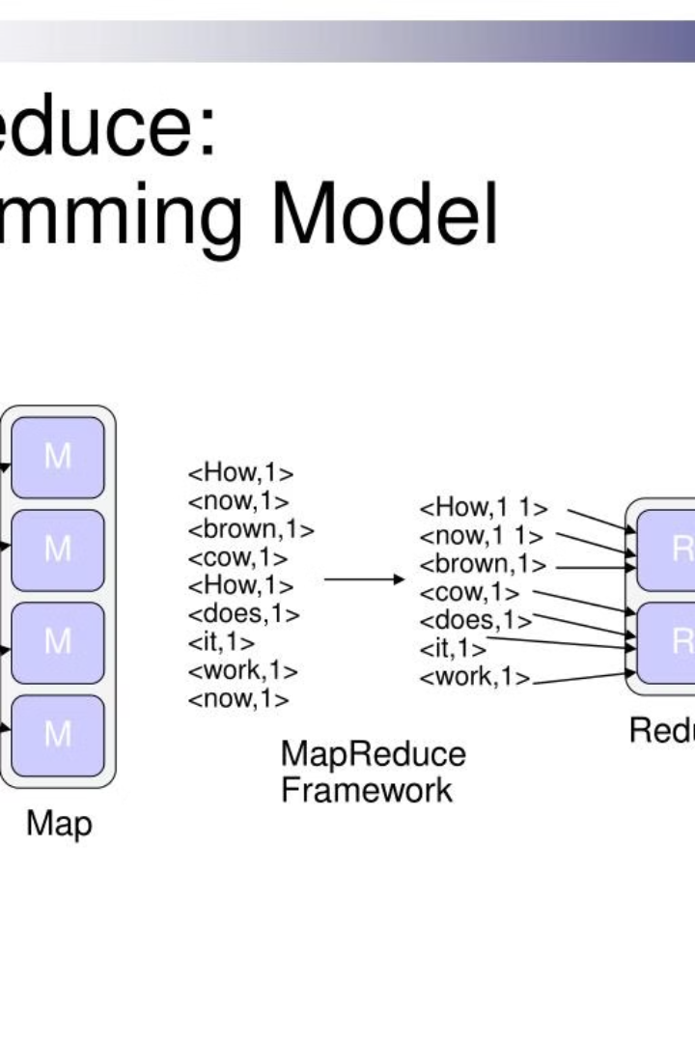


MapReduce Overview
MapReduce is a programming model and data processing technique designed for processing and generating large-scale datasets. It provides a simple and efficient way to process vast amounts of data in parallel across large clusters of commodity hardware.
by Abhijith

Slide 2
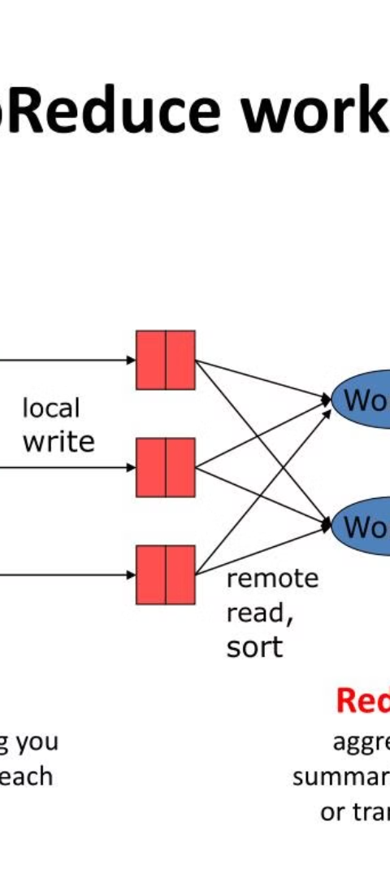
What is MapReduce?
1
Definition
MapReduce is a computational paradigm that enables distributed processing of large datasets across clusters of computers.
2
Process
It involves 2 steps: Map, where data is divided into key-value pairs, and Reduce, which processes and summarizes the data.
3
Scalability
MapReduce allows for seamless scalability, making it ideal for handling big data processing.

Slide 3
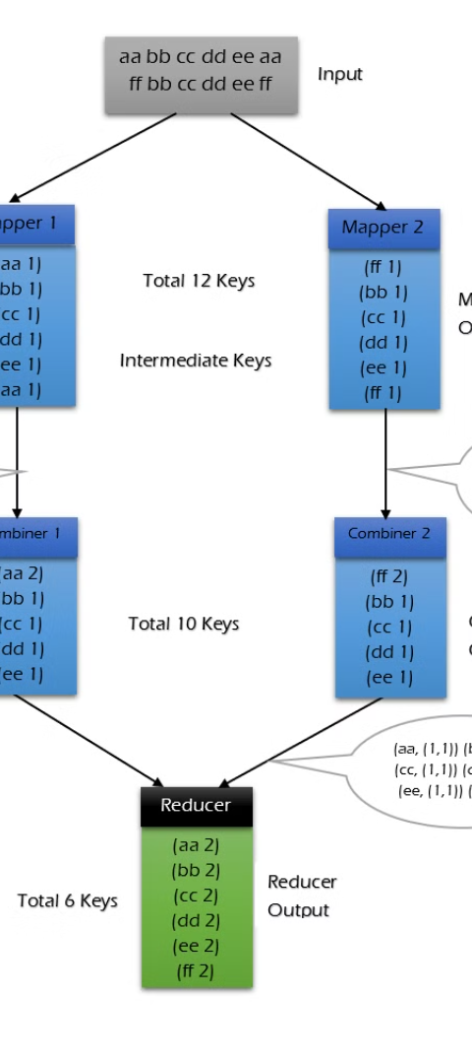
How does MapReduce work?
1
Mapping
2
Shuffling
Data is processed and converted into intermediate key-value pairs.
Intermediate data is sorted and transferred across different nodes.
3
Reducing
Data is aggregated, summarized, and the final output is produced.

Slide 4
Key Components of MapReduce
Mapper
Reducer
Job Tracker
Responsible for data mapping and converting it into key-value pairs.
Handles the sorting, shuffling, and summarization of intermediate data.
Manages and monitors all MapReduce jobs in the cluster.

Slide 5
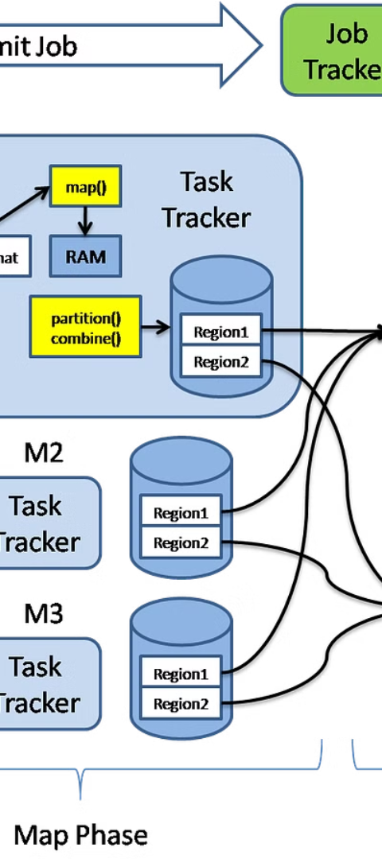
Advantages of Using MapReduce
1
Scalability
2
Reliability
Effortlessly handles immense volumes of data due to its distributed computing nature.
Automatically handles failures, making it a reliable framework for data processing.
3
Parallel Processing
Enables concurrent and efficient processing of data across multiple nodes.

Slide 6



MapReduce in Practice: Real-World Examples
Retail
Healthcare
Finance
Using sales data for inventory management and customer behavior analysis.
Analyzing patient records and medical imaging for improved diagnostics.
Processing financial transactions and fraud detection in banking systems.

Slide 7
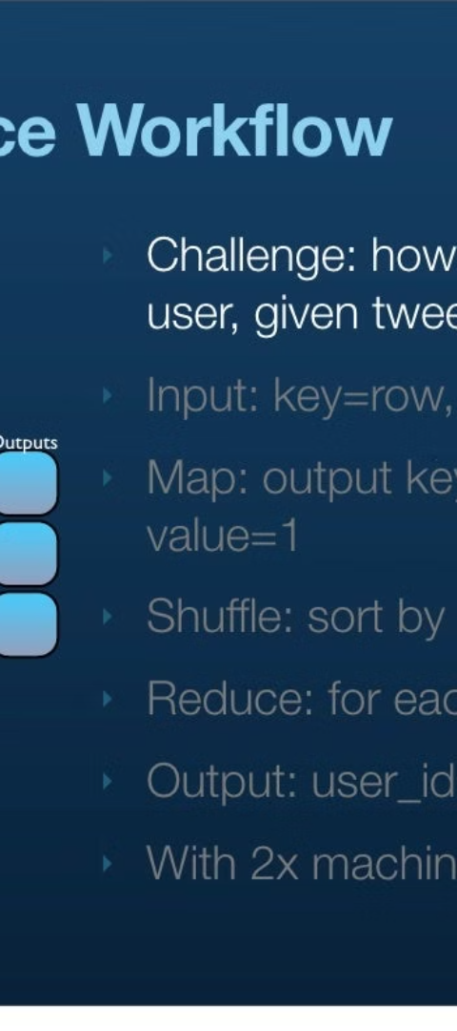
Limitations and Challenges of MapReduce
Data Transfer
Complexity
High volume of intermediate data transfer can lead to network congestion.
Developing MapReduce algorithms requires a deep understanding of distributed computing.
Real-Time Processing
MapReduce may not be suitable for real-time data processing tasks.

Slide 8
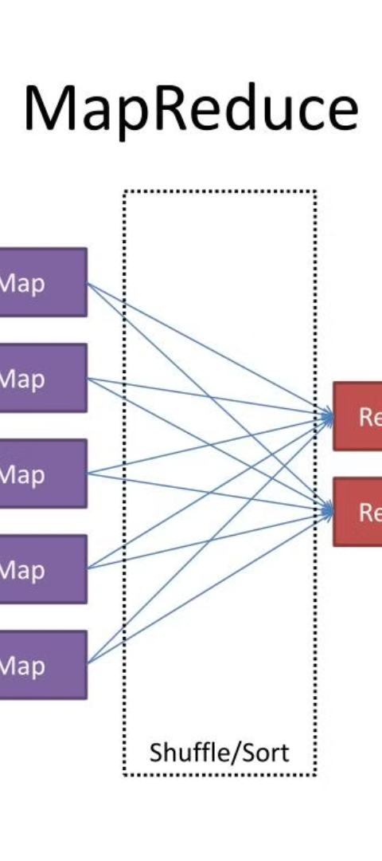



Alternatives to MapReduce
Apache Spark
A fast and general-purpose cluster computing system for big data processing.
Apache Flink
An open-source stream processing framework with fault-tolerance and high throughput.
Amazon EMR
Managed big data platform providing various alternatives for distributed processing.

