Slide 2
Wine is an alcoholic beverage made from grapes which is fermented without the addition of sugars, acids, enzymes, water, or other nutrients
Red wine is made from dark red and black grapes. The color usually ranges from various shades of red, brown and violet.
This is produced with whole grapes including the skin which adds to the color and flavor of red wines, giving it a rich flavor.
White wine is made from white grapes with no skins or seeds. The color is usually straw-yellow, yellow-green, or yellow-gold. Most white wines have a light and fruity flavor as compared to richer red wines

Slide 3
Data Cleaning
Data Analysis
Data Exploration
Conclusion
Data Modelling
Data Understanding

Slide 4
Domain Knowledge
Fixed acidity – Taste of wine
Volatile acidity – Undesirable taste of wine
Citric acid – Freshness of wine
Residual Sugar - Natural Sugar from grapes

Slide 5
Chlorides – Saltiness in wine
Free Sulfur Dioxide – When in excess, gives pungent odour
Total Sulfur Dioxide – Kill harmful bacteria. Total of Free Sulfur Dioxide
Density - weight of a specific volume of wine to an volume of water

Slide 6
pH – Power of Hydrogen. Ranges from 0 to 14
Sulphates – For aroma and flavor
Alcohol – Major component for taste
Quality – Ranges from 3 to 8

Slide 7
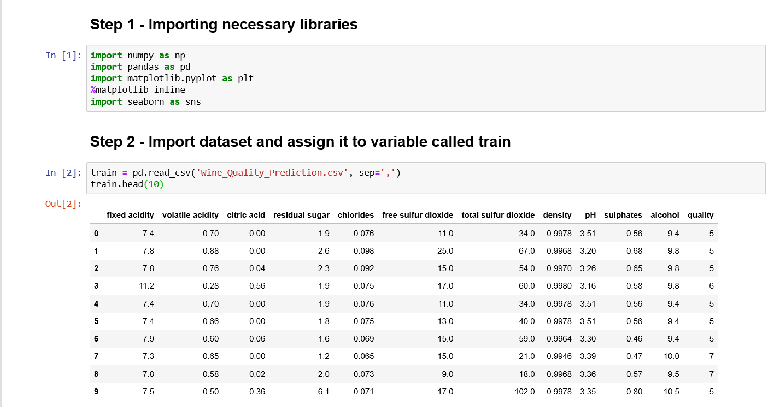
Importing Data
Importing necessary libraries such as pandas, numpy , matplotlib, seaborn
Import dataset Wine Quality Prediction

Slide 8
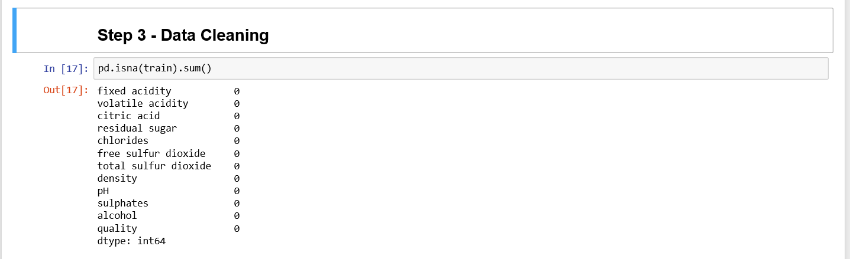
Data Cleaning
Data cleaning is the effort to improve the overall quality of data by removing or correcting inaccurate, incomplete, or irrelevant data from a data system.
There are no null or irrelevant values in dataset.

Slide 9
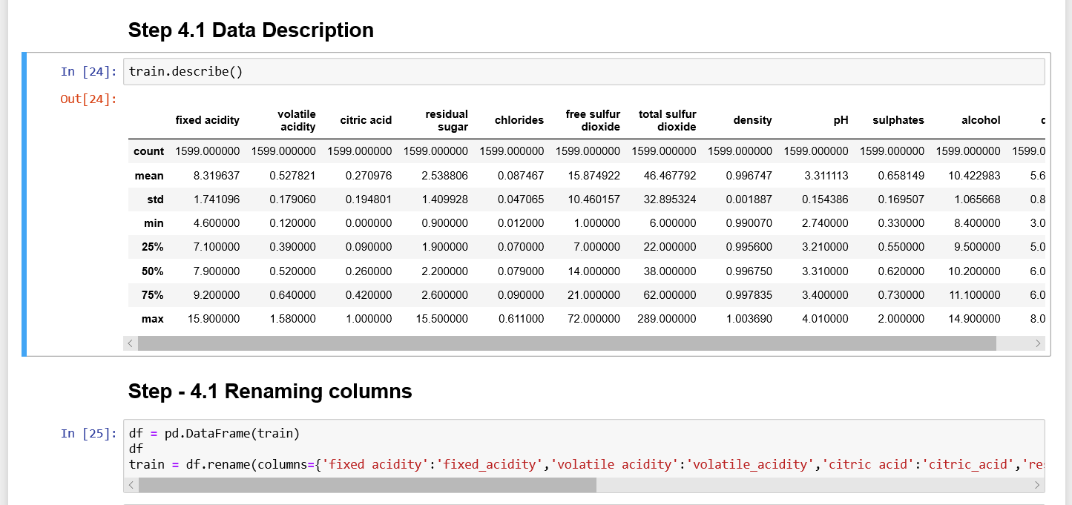
Data Description

