Slide 1
Modern Health Care: Innovations and Challenges
Generated by Gemini AI

Slide 2
The Evolution of Health Care
- Definition: A shift from reactive treatment to proactive, predictive, and personalized care.
- Key Pillars: Technology, Patient-Centricity, Data-Driven Decisions, and Accessibility.
- Core Transition: Moving from a 'one-size-fits-all' model to tailored health solutions for individuals.
- From Illness to Wellness: Emphasis on prevention and overall well-being, not just curing diseases.

Slide 3
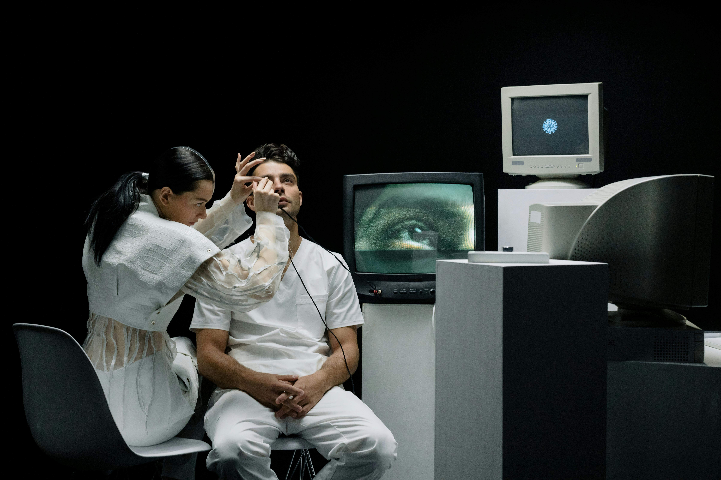
The Digital Revolution in Medicine
- Telehealth & Remote Monitoring: Virtual consultations and wearable devices providing real-time data.
- Artificial Intelligence (AI): Powering faster, more accurate diagnostics and predicting disease outbreaks.
- Personalized Medicine: Using genomics to tailor treatments and drugs to an individual's genetic profile.
- Electronic Health Records (EHRs): Centralizing patient data for seamless, coordinated care.

Slide 4

The Empowered Patient: You Are at the Center
- Patient-Centric Care: Treatment plans are co-created, respecting patient values and preferences.
- Shared Decision-Making: A collaborative approach where clinicians and patients make choices together.
- Unprecedented Access to Information: Patients use apps, patient portals, and online resources to manage their health.
- Focus on the Whole Person: Integrating mental and physical health for comprehensive well-being.

Slide 5
Hurdles and Ethical Considerations
- Data Privacy & Security: Safeguarding sensitive health information in a connected world is paramount.
- The Digital Divide: How do we ensure equitable access to new technologies for all socioeconomic groups?
- Cost & Affordability: The high price of innovation can create barriers to access.
- Algorithmic Bias: Ensuring AI tools are fair and do not perpetuate existing health disparities.

Slide 6
The Future: A Connected and Collaborative Horizon
- Summary of Key Trends: Technology, patient empowerment, and preventative care are reshaping our world.
- Future Vision: Health care will become more predictive, personalized, participatory, and preventative (4 P's).
- Final Thought: Our goal is to leverage innovation to build a more equitable, effective, and humane health care system for everyone.
- Thank You & Q&A

