Slide 1
5G NR PDCP
Integrity Testing

Slide 2
Contents
Introduction to PDCP in 5G NR
PDCP Integrity Protection
3GPP Specification References
Integrity Protection Workflow
Test Setup and Prerequisites
PDCP Integrity Testing Scenarios
Test Procedure

Slide 3
Introduction to PDCP in 5G NR

Slide 4
Introduction to PDCP in 5G NR
PDCP Overview (Packet Data Convergence Protocol) Positioned in the NR stack between RLC and SDAP/Application layer
Primary PDCP responsibilities:
ROHC-based header compression
Data encryption
Data integrity verification
Detecting and discarding duplicates
Delivering packets in order

Slide 5
Overview of PDCP (Packet Data Convergence Protocol)
The Packet Data Convergence Protocol (PDCP) is a layer within the 5G/NR radio protocol stack. It manages both control and user plane data for different Radio Bearers (RBs), such as DRBs (Data Radio Bearers), SRBs (Signaling Radio Bearers), and MRBs (MBS Radio Bearers).
Key Traits & Placement:
PDCP runs above the RLC layer (used over Uu and PC5 interfaces) and may also sit above SRAP or N3C for certain multi-path cases.
It supports upper layers like RRC and SDAP.
Typically, one PDCP entity is linked to one radio bearer.

Slide 6
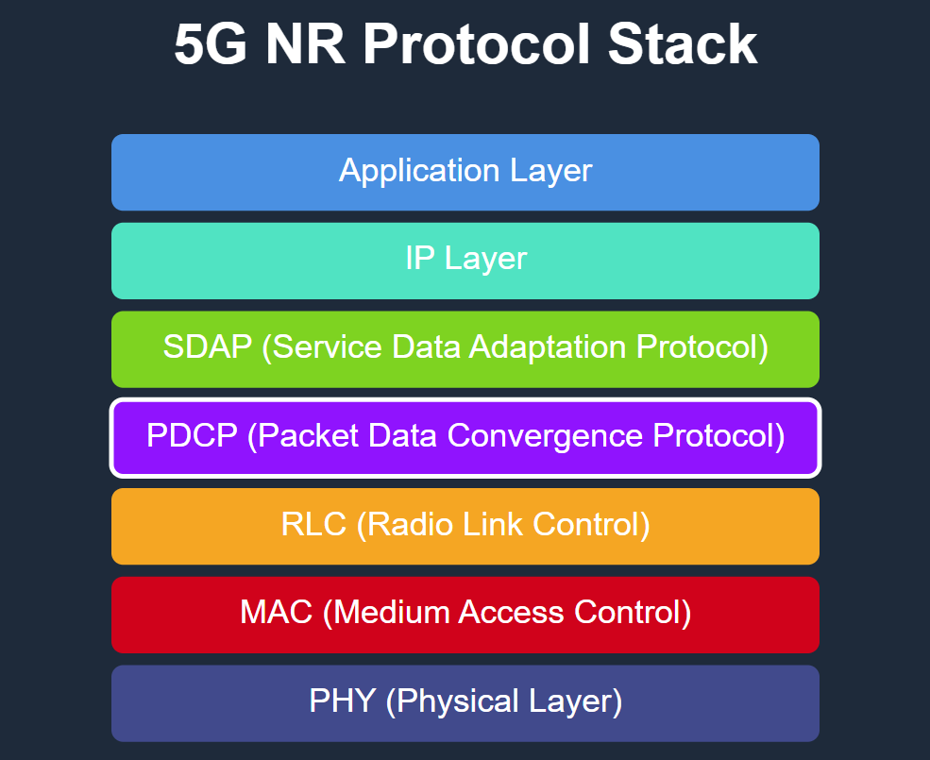
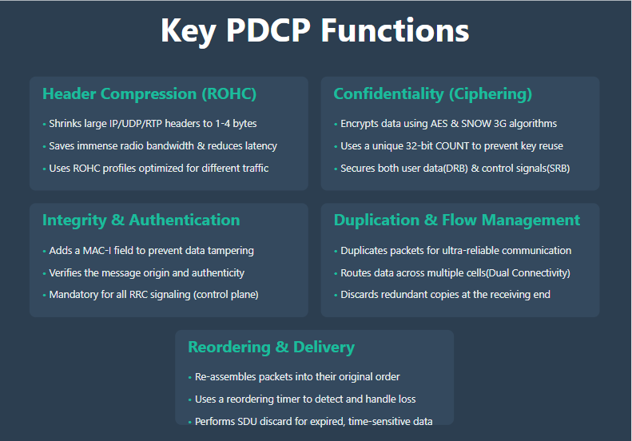
PDCP in 5G NR - Protocol Stack Overview

Slide 7
PDCP Integrity Protection

Slide 8
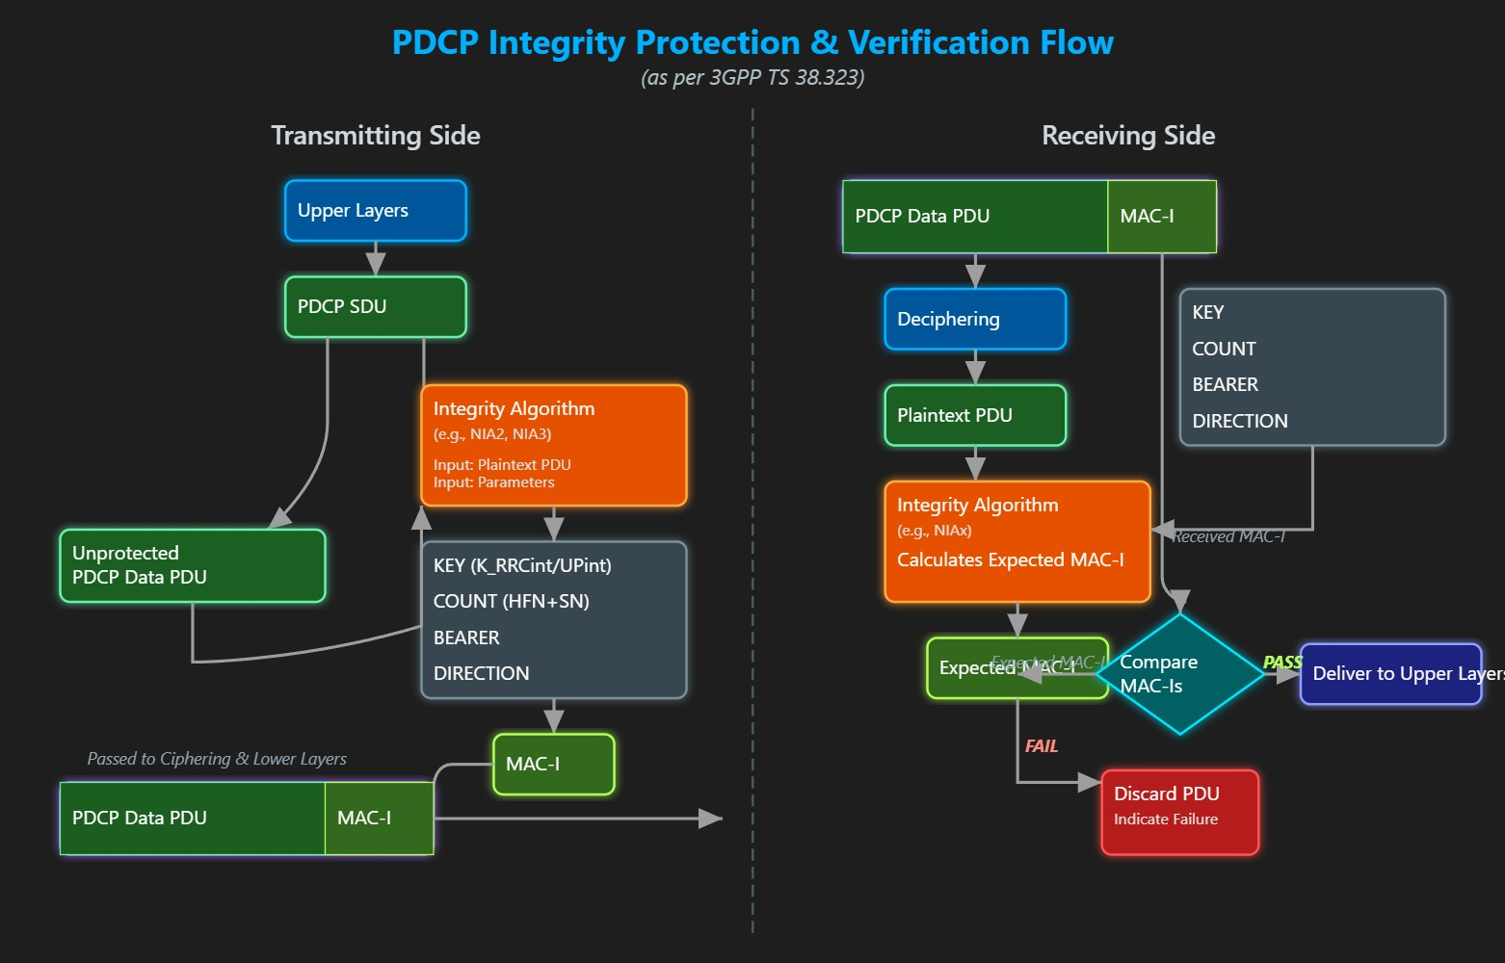
PDCP Integrity Protection

Slide 9
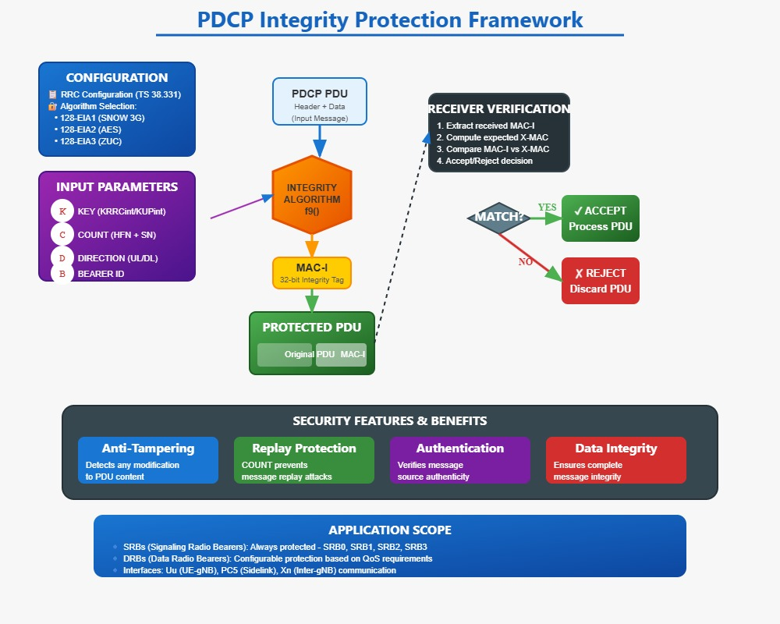
PDCP Integrity Protection

Slide 10
3GPP Specification References

Slide 11
3GPP Specification References
Key 3GPP Specifications Related to PDCP:
TS 38.323 – Defines the protocol specification for the PDCP layer in 5G NR.
TS 33.501 – Describes the overall 5G security architecture and associated procedures, including PDCP security aspects.
TS 38.331 – Details the Radio Resource Control (RRC) protocol, including integrity protection mechanisms involving PDCP.
TS 38.413 – Specifies the NGAP protocol, covering signaling security across the NG interface (NG-C).
TS 38.321 – Provides details about the RLC layer, which interacts directly with PDCP and is essential for PDCP testing and integration.

Slide 12
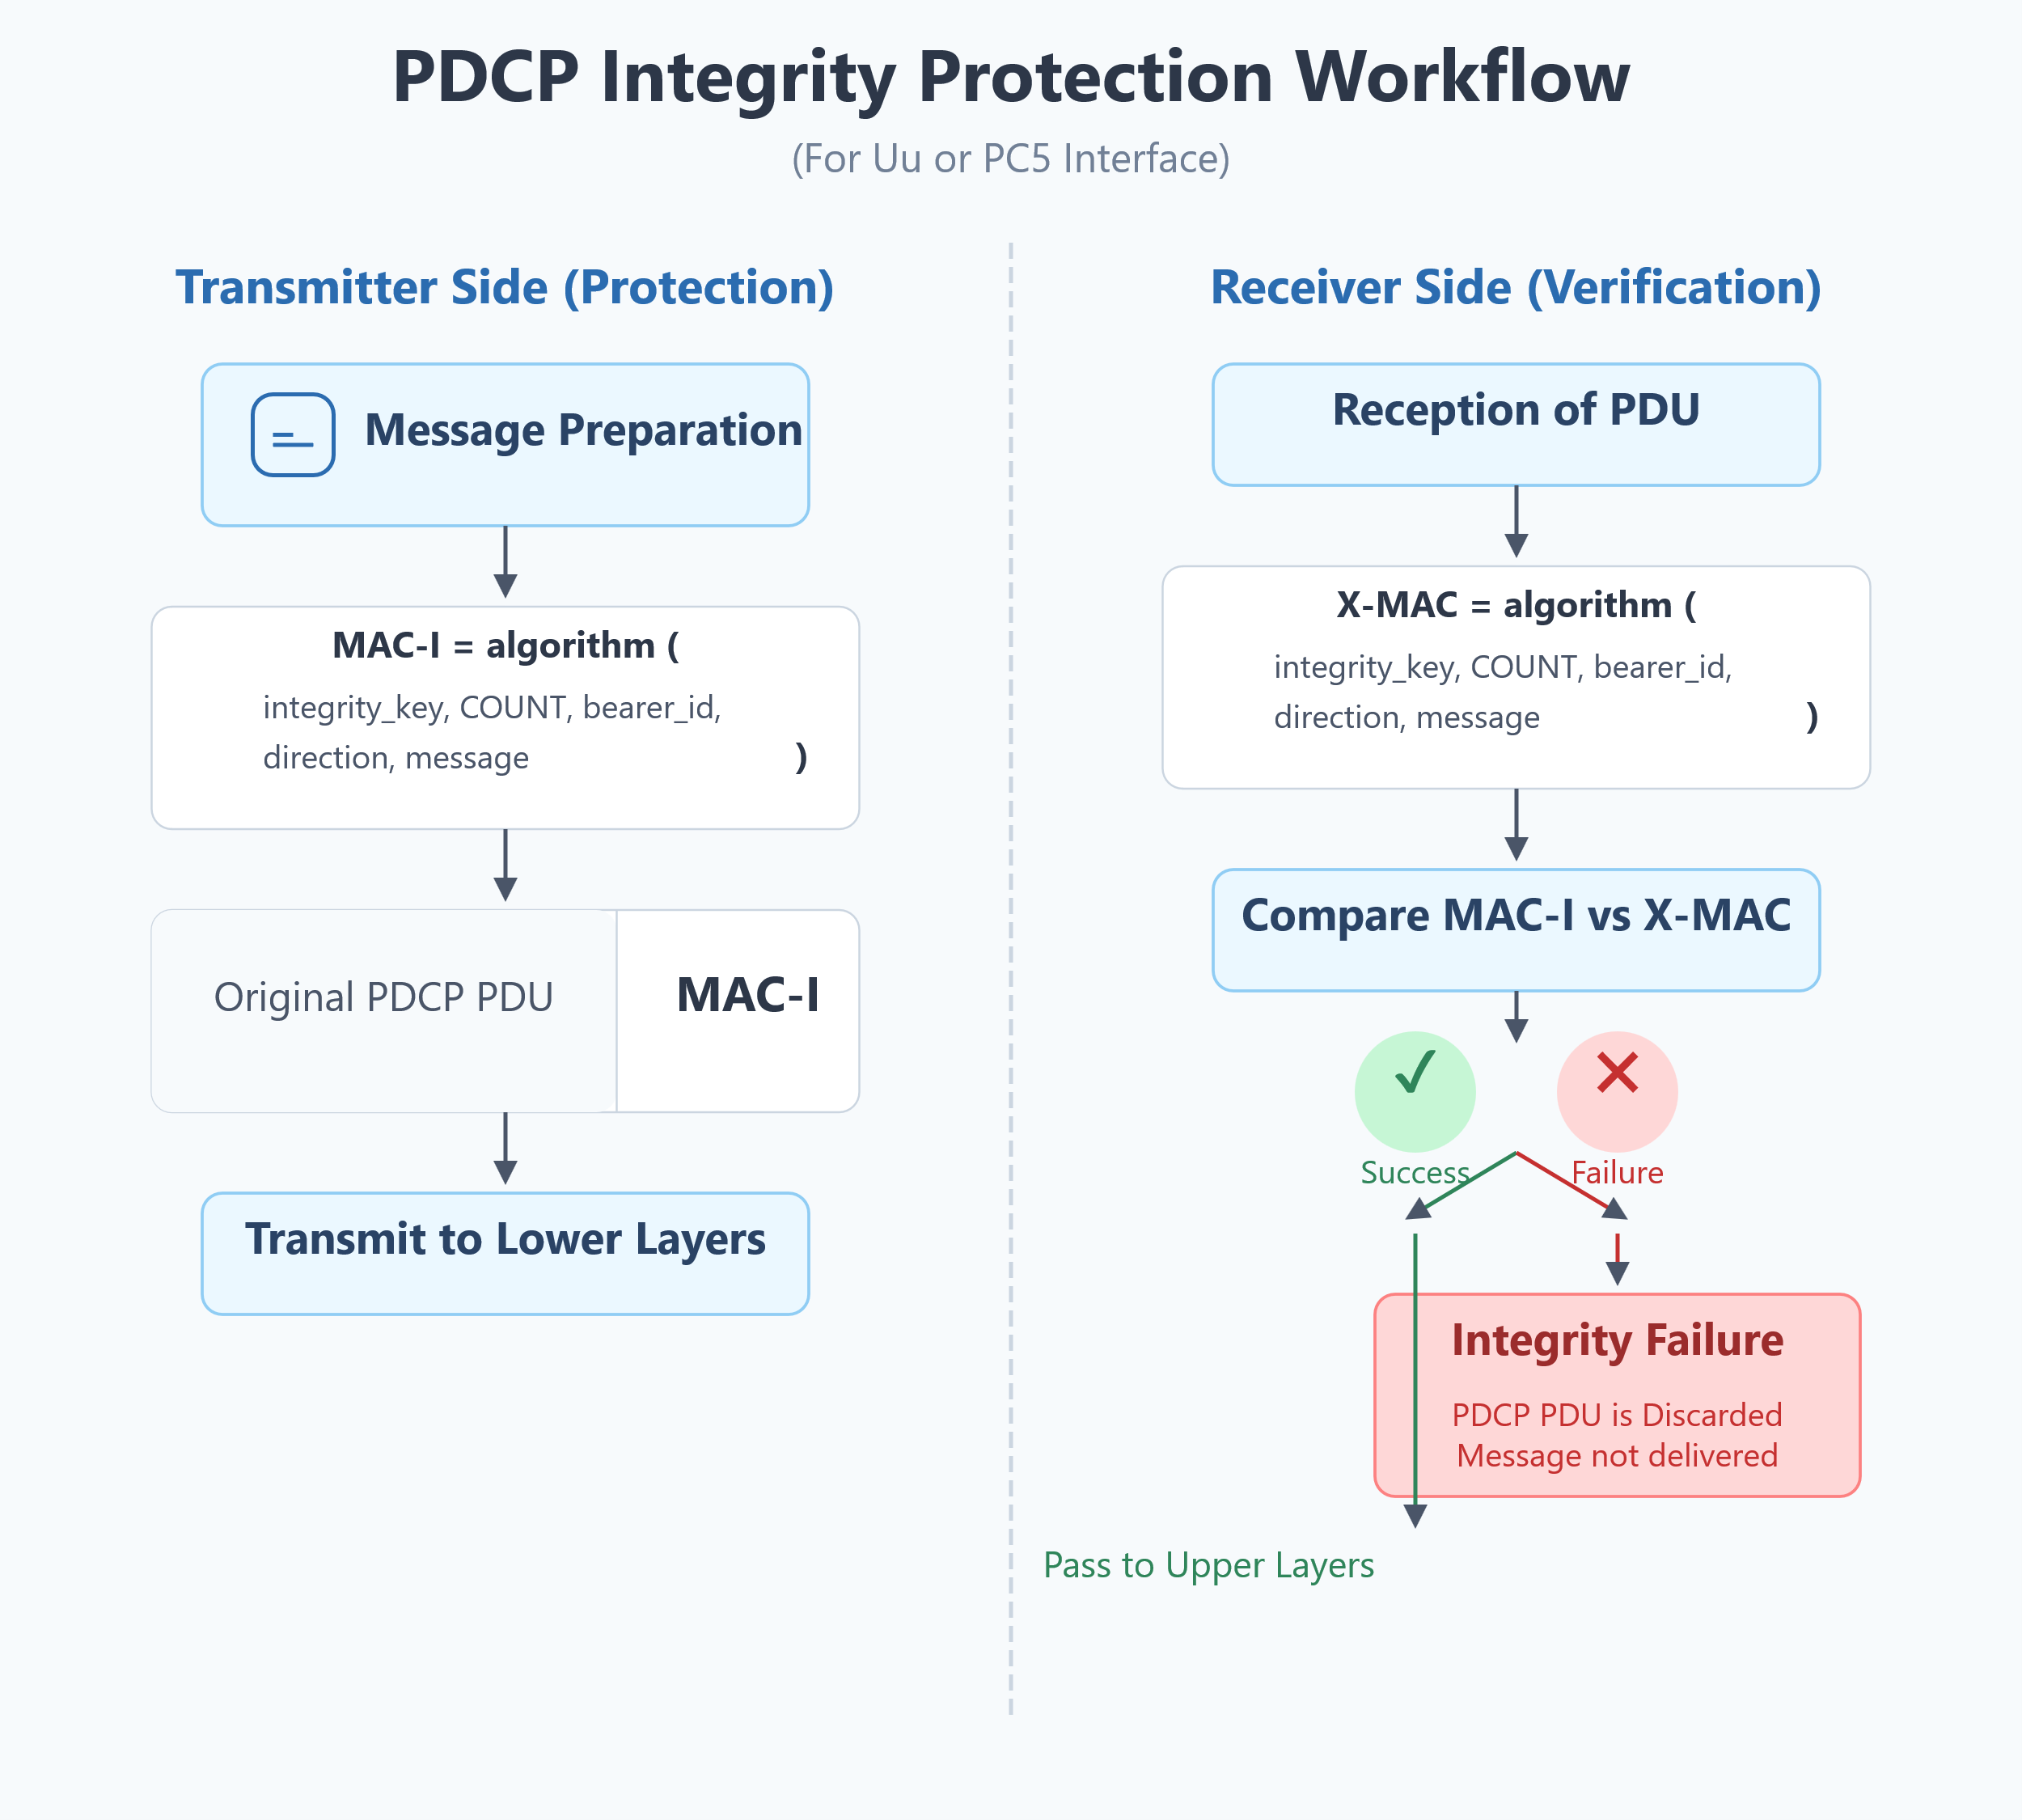
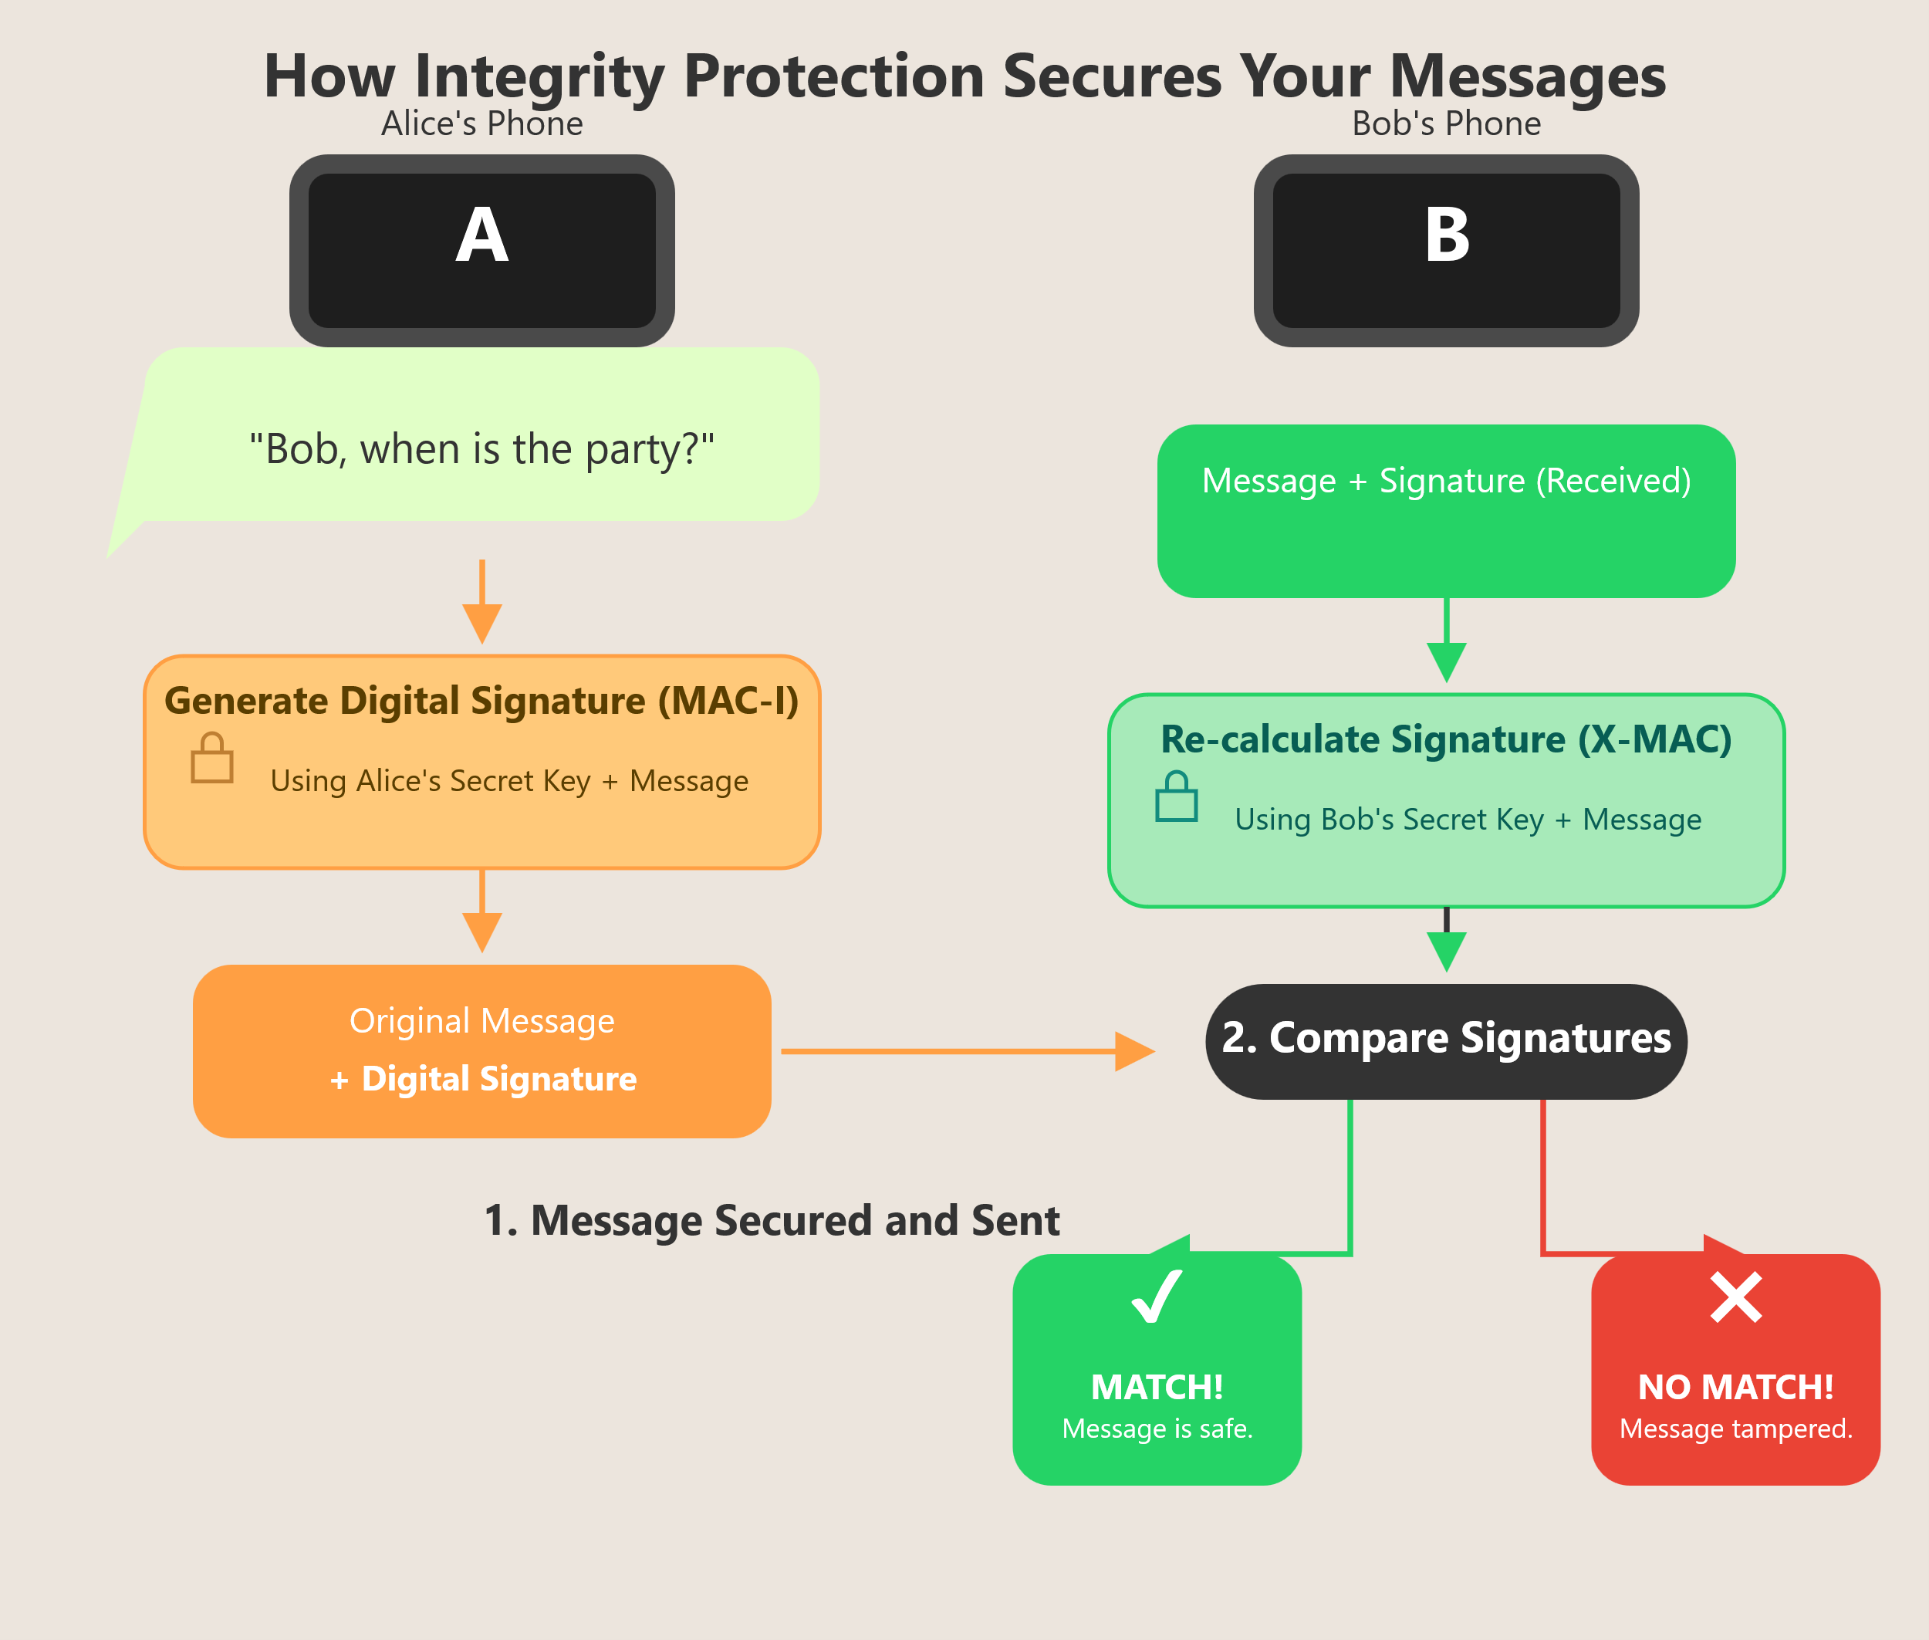
PDCP Integrity Protection

Slide 13
Test Setup and Prerequisites
PDCP Integrity Protection
Test Setup: A complete environment including UE, gNodeB, and Core Network. This can be emulated using commercial tools (e.g., Keysight, Anritsu) or open-source platforms (e.g., Open5GS with UERANSIM).
Required Tools: Includes both software and hardware components for validation.
Wireshark with NR Protocol Support: Used for analysing PDCP integrity-protected messages with proper NR dissector support.

Slide 14
Test Setup and Prerequisites
Test Suites and Simulators: Employ TTCN-3 based scripts or compliance test platforms like GCF/PTCRB suites.
Key Tracing: Key derivation function (KDF) and integrity keys are essential for analyzing message protection and replay prevention.

Slide 15
PDCP Integrity Testing Scenarios

Slide 16
Test Setup Prerequisite
Test Environment & Setup:
Use a 5G/NR testbed or simulator (e.g., Ns3.42, Open5GS + UERANSIM)
Components: UE, gNodeB, Core (can be physical or simulated)
Security Configuration:
Configure integrity protection (algorithms, keys, COUNT, SN lengths)
Typically done via RRC signaling on both UE and gNB sides
Traffic Generation:
Generate specific traffic types:
RRC messages (on SRBs)
User plane data (on DRBs)

Slide 17
Test Setup Prerequisite
Logging & Monitoring Tools:
Capture and analyze:
PDCP PDUs (headers, data, MAC-I)
RRC signaling logs
PDCP internal state variables (e.g., TX_NEXT, RX_NEXT, RX_DELIV, RX_REORD)
Integrity failure indications from PDCP to upper layers

Slide 18
Test Scenario
Test Case 1: Valid MAC-I verification (expected pass)
Test Case 2: Tampered MAC-I field (expected fail)
Test Case 3: Replay of PDCP PDU (duplicate detection)
Test Case 4: Boundary tests with COUNT values
Test Case 5: Control plane message integrity under poor SINR
Test Case 6: End-to-end secure RRC Connection Setup flow

Slide 19
Test scenario and Procedures
Test Case 1: Valid MAC-I verification (expected pass)
Objective: To verify that the UE correctly calculates and validates a legitimate MAC-I for an integrity-protected PDCP PDU.
Procedure:
gNB Action: The gNB simulator constructs a valid RRC message (e.g., an RRCReconfiguration message).
The simulator's PDCP layer calculates the correct MAC-I for this message using the shared integrity key (K_RRCint), the current COUNT value, the bearer ID (SRB1), and the direction (downlink).
The gNB simulator transmits the PDCP Data PDU (containing the RRC message and the valid MAC-I) to the UE.

Slide 20
Test scenario and Procedures
UE Action (DUT): The UE receives the PDU. Its PDCP layer separates the message from the MAC-I.
The UE's PDCP layer independently calculates the X-MAC using its own key and state variables.
Verification:
Pass Condition: The UE's calculated X-MAC must perfectly match the received MAC-I. The RRC message is successfully processed, and the UE sends an appropriate response (e.g., RRCReconfigurationComplete).
Logs to Check: The protocol analyzer should show the downlink RRC message and the subsequent successful uplink response. No integrity failure indications should be logged by the UE.

Slide 21
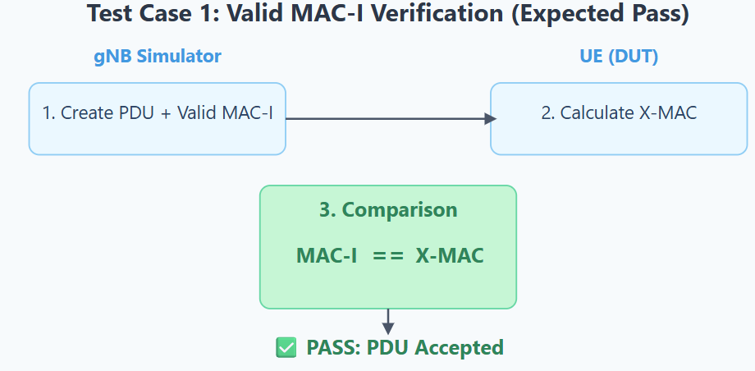
TEST CASE 1:

Slide 22
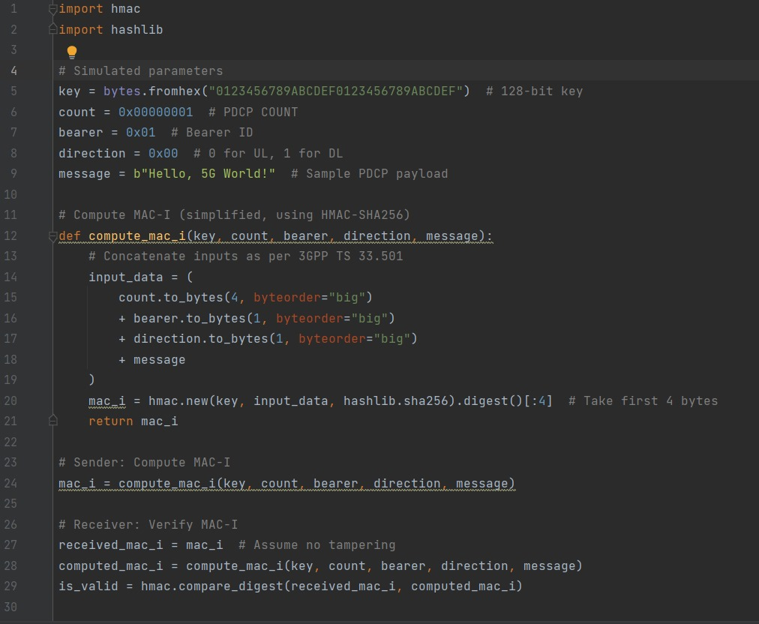
TEST CASE 1: CODE

Slide 23
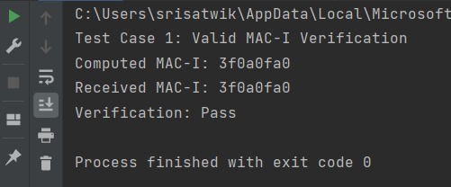
TEST CASE 1: OUTPUT

Slide 24
Test Scenarios and Procedures
Test Case 2: Tampered MAC-I field (expected fail)
Objective: To verify that the UE detects a manipulated MAC-I and discards the PDU as per the specification.
Procedure:
gNB Action: Follow steps 1 & 2 from Test Case 1 to generate a valid RRC message and its correct MAC-I.
Manipulation: Before transmission, the gNB simulator intentionally corrupts the MAC-I field (e.g., flips one or more bits).

Slide 25
Test Scenarios and Procedures
The gNB simulator transmits the PDCP PDU with the tampered MAC-I to the UE.
UE Action (DUT): The UE receives the PDU and calculates its own X-MAC.
Verification:
Pass Condition: The UE's calculated X-MAC will not match the tampered MAC-I. The UE's PDCP layer must discard the entire PDU. The RRC message should be ignored. The UE must not act on the contents of the message or send a response related to it.
Logs to Check: The UE's internal logs should explicitly show an "Integrity Verification Failure" for that PDCP PDU. The protocol analyzer will show the downlink message, but there will be no corresponding uplink response from the UE.

Slide 26
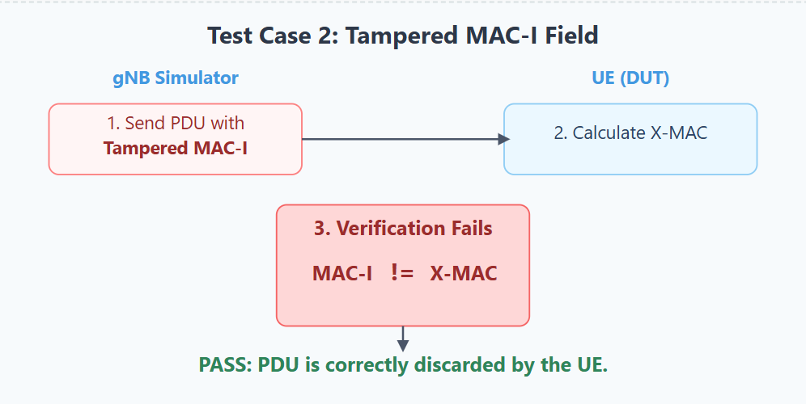
TEST CASE 2:

Slide 27
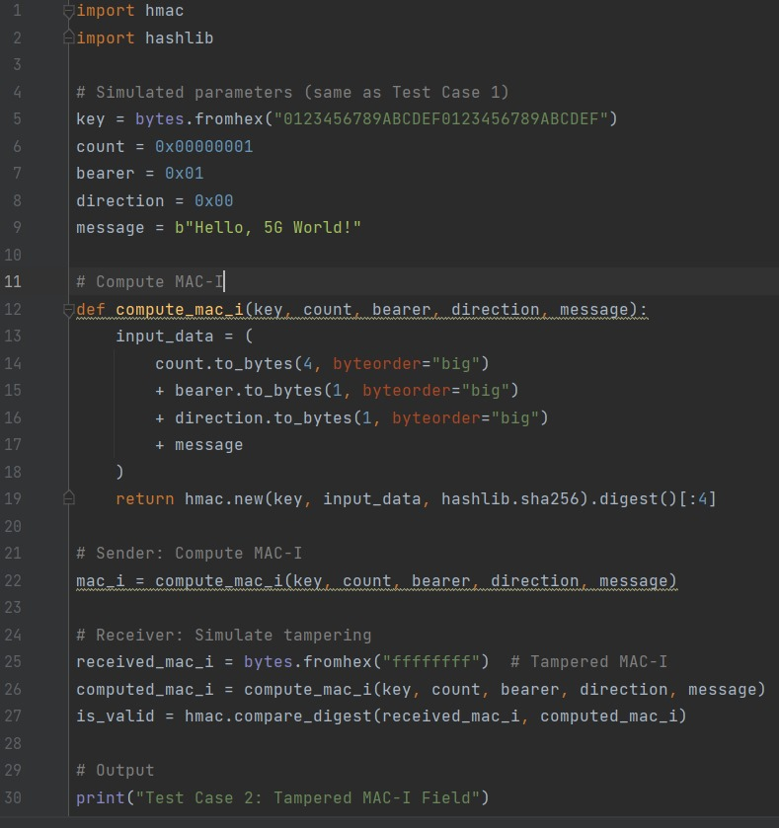
TEST CASE 2: CODE

Slide 28
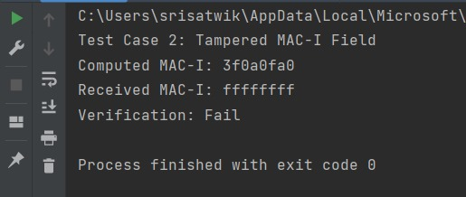
TEST CASE 2: OUTPUT

Slide 29
Test Scenarios and Procedures
Test Case 3: Replay of PDCP PDU (duplicate detection)
Objective: To ensure the UE's PDCP layer, using the COUNT state, detects and discards a replayed PDU to prevent replay attacks.
Procedure:
gNB Action: Transmit a valid, integrity-protected PDCP PDU with COUNT = N.
UE Action: The UE receives and successfully verifies the PDU. Its RX_DELIV window advances past N.

Slide 30
Test Scenarios and Procedures
gNB Replay Action: The gNB simulator immediately re-transmits the exact same PDCP PDU (with COUNT = N).
Verification:
Pass Condition: The UE's PDCP layer receives the second PDU with COUNT = N. It recognizes that this COUNT value is within its reception window but has already been successfully processed. The PDU must be detected as a duplicate and discarded silently.
Logs to Check: The protocol analyzer will show two identical downlink PDUs. The UE logs should show the first PDU being processed and the second being discarded as a duplicate. There should only be one response to the first PDU.

Slide 31
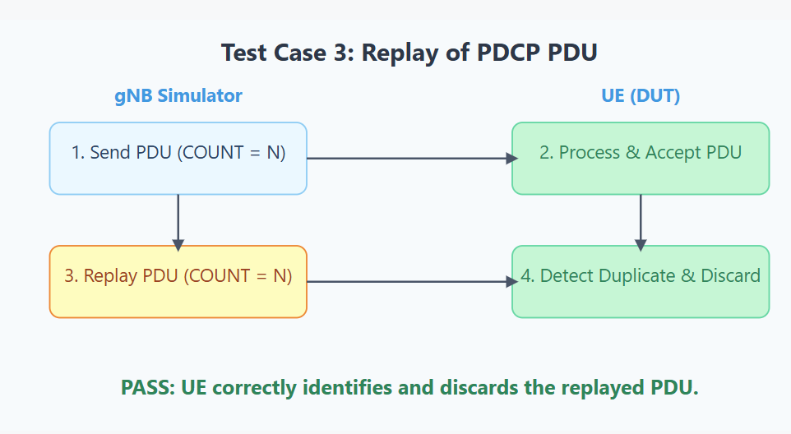
TEST CASE 3:

Slide 32
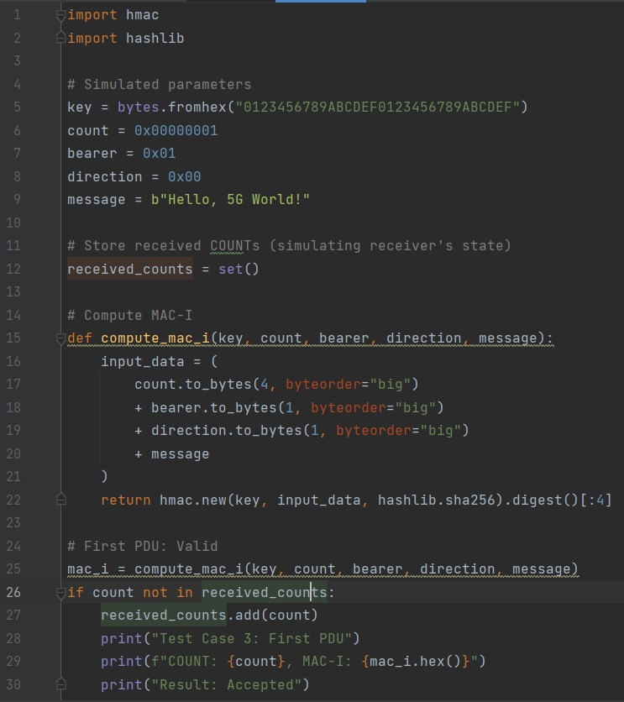
TEST CASE 3: CODE

Slide 33
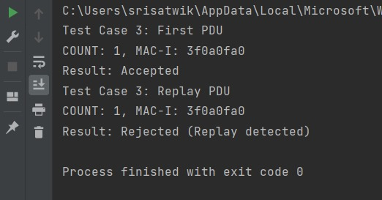
TEST CASE 3: OUTPUT

Slide 34
Test Scenarios and Procedures
Test Case 4: Boundary tests with COUNT values
Objective: To test the robustness of the COUNT handling at the wrap-around boundary of the PDCP Sequence Number (SN).
Procedure:
Setup: Force the UE and gNB PDCP entities to a state where the COUNT is very close to an SN wrap-around point (e.g., for a 12-bit SN, set the SN to 4094).
gNB Action: Transmit a series of valid PDUs with COUNT values that cross the boundary (e.g., SNs: 4094, 4095, 0, 1). The HFN (Hyper Frame Number) part of the COUNT must increment correctly when the SN wraps from 4095 to 0.

Slide 35
Test Scenarios and Procedures
The UE's PDCP layer must calculate the X-MAC for each PDU using the correctly derived COUNT value (including the new HFN).
Verification:
Pass Condition: The UE must successfully verify the integrity of all PDUs, including those immediately after the SN wrap-around. This confirms the HFN calculation is correct.
Logs to Check: The protocol traces should show successful verification and processing of all messages across the SN boundary.

Slide 36
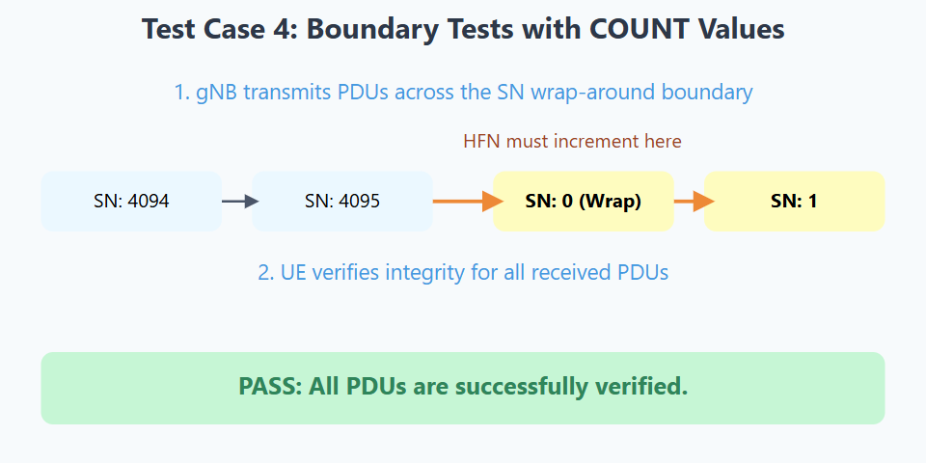
TEST CASE 4:

Slide 37
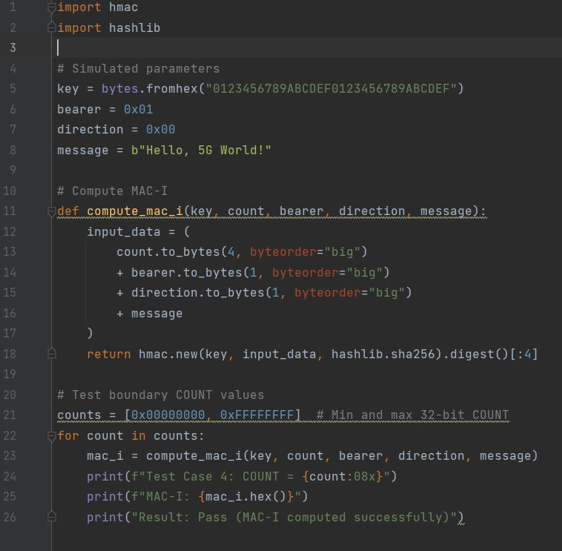
TEST CASE 4: CODE

Slide 38
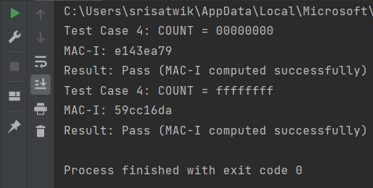
TEST CASE 4: OUTPUT

Slide 39
Test Scenarios and Procedures
Test Case 5: Control plane message integrity under poor SINR
Objective: To verify that integrity protection is robust even when the physical layer is stressed and bit errors are likely.
Procedure:
gNB Action: Use the network simulator to degrade the radio link quality, setting a low SINR (Signal-to-Interference-plus-Noise Ratio) for the downlink channel.
Transmit a valid, integrity-protected PDCP PDU. Due to poor SINR, it's possible the PDU arrives at the UE with bit errors.

Slide 40
Test Scenarios and Procedures
Verification:
Pass Condition (Case A - PDU Corrupted): If any bit in the message or MAC-I is flipped due to radio errors, the integrity check must fail. The UE must discard the PDU. This demonstrates that random corruption is correctly caught.
Pass Condition (Case B - PDU Not Corrupted): If the PDU is successfully received without bit errors (thanks to FEC/HARQ), the integrity check must pass.
Logs to Check: Run the test multiple times. Expect to see a mix of successful verifications and integrity failures due to the noisy channel. This validates that the mechanism is sensitive to any form of corruption.

Slide 41
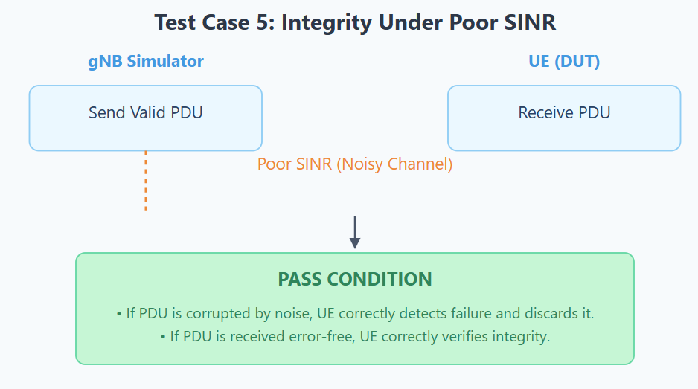
TEST CASE 5:

Slide 42
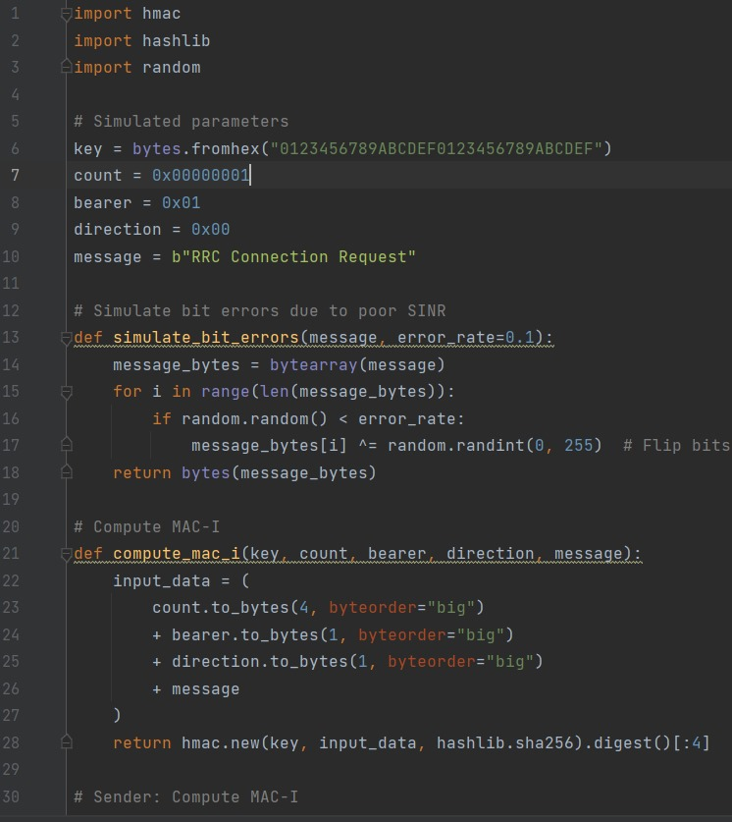
TEST CASE 5: CODE

Slide 43
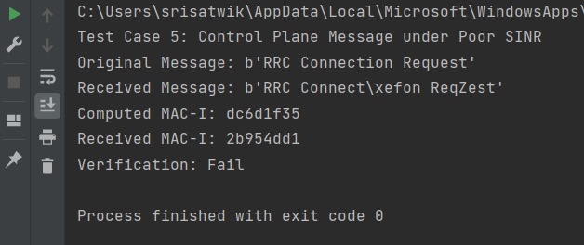
TEST CASE 5: OUTPUT

Slide 44
Test Scenarios and Procedures
Test Case 6: End-to-end secure RRC Connection Setup flow
Objective: To validate the full, dynamic security activation flow, where keys are derived and integrity protection is enabled as part of the initial connection.
Procedure:
Setup: Start with the UE in RRC_IDLE state (not connected).
UE Action: Trigger the UE to initiate an RRC connection (e.g., by turning on data). The UE sends an RRCSetupRequest.
gNB Action: The gNB responds with RRCSetup. This message is not integrity protected yet.
The UE and gNB derive security keys based on their pre-configured root keys.

Slide 45
Test Scenarios and Procedures
UE Action: The UE sends an RRCSetupComplete message. This message is the first uplink message to be integrity protected using the newly derived keys.
gNB Action: The gNB receives this message and must verify its integrity. If successful, it sends a SecurityModeCommand message, which is now also integrity protected.
UE Action: The UE verifies the SecurityModeCommand and responds with SecurityModeComplete.
Verification:
✅ Pass Condition: The entire message exchange must complete successfully. The gNB must successfully verify the RRCSetupComplete, and the UE must successfully verify the SecurityModeCommand.
Logs to Check: The protocol analyzer must show the complete RRC connection and security mode activation sequence without any failures. This confirms that dynamic key derivation and the initial application of integrity protection work correctly end-to-end.

Slide 46
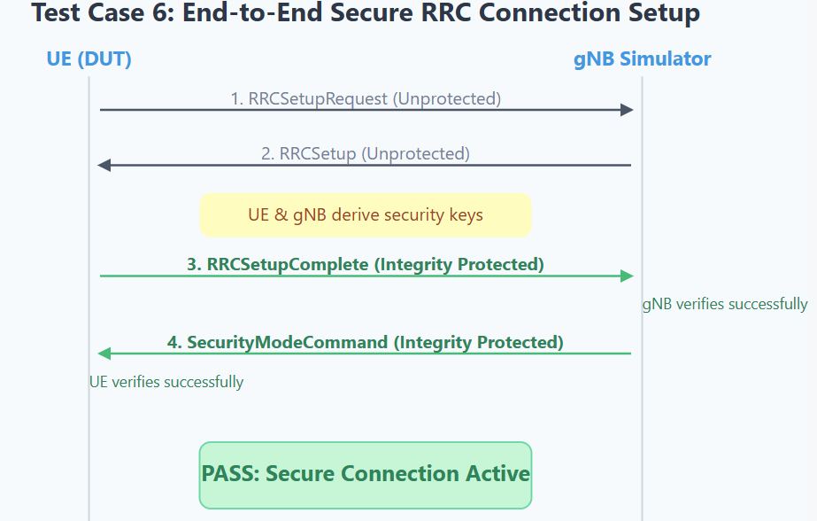
TEST CAST 6:

Slide 47
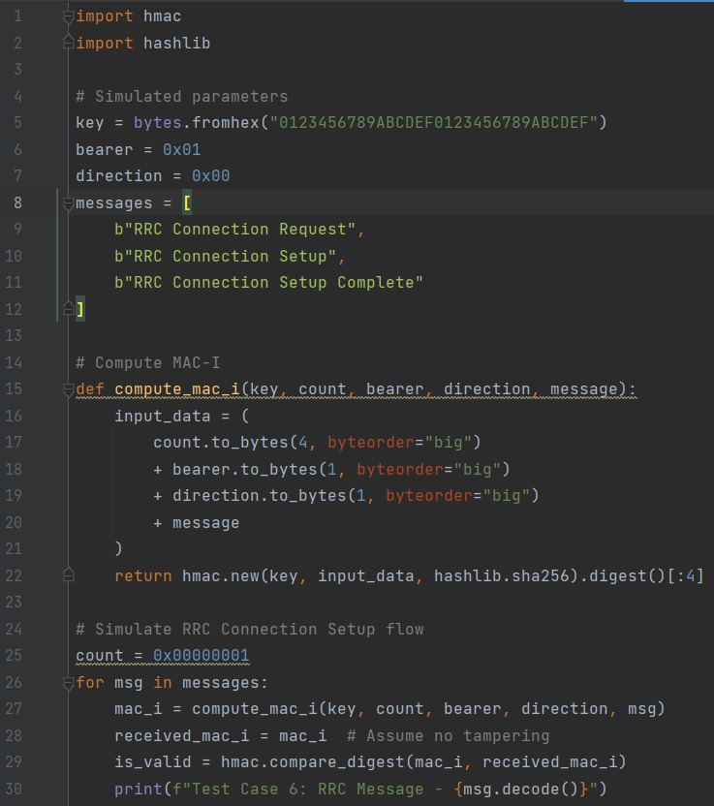
TEST CASE 6: CODE

Slide 48
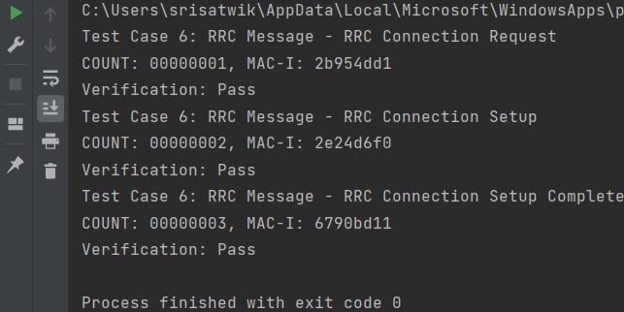
TEST CASE 6: OUTPUT

