Slide 1
POWER BI PROJECT
Global Tech
Layoff Analysis
An interactive dashboard exploring layoff trends, company impact, industries, geography and company stage.
2,673 recorded events
752K employees affected
Data coverage: 11 Mar 2020 – 2 Jul 2025
Presented by
Abhijith S
Dashboard built in Microsoft Power BI
01

Slide 2
AT A GLANCE
Executive snapshot
The dashboard turns reported layoff events into a consolidated view of scale, timing and concentration.
EMPLOYEES AFFECTED
RECORDED EVENTS
COUNTRIES
INDUSTRY CATEGORIES
LARGEST SINGLE EVENT
752K
2,673
54
31
22K
752,040 across all records
Individual layoff announcements
Geographies represented
Including one unclassified category
Intel · April 2025
What stands out
The story in one line
• 2023 was the highest full year, with 264,220 reported layoffs.
Layoffs are concentrated in a small number of very large events, led by mature public companies and a strong US footprint.
• The United States accounts for about 69% of recorded layoffs.
• Only 142 events in the 1,000+ range account for 54.6% of all layoffs.
Source: Global Tech Layoffs Analysis dataset; event-level records through 2 Jul 2025
02

Slide 3
PROJECT OVERVIEW
Project objective & analytical approach
Build an interactive view that helps a business audience understand where layoffs are concentrated and how the pattern changes over time.
01
02
03
04
05
TIME
COMPANIES
INDUSTRIES
GEOGRAPHY
COMPANY STAGE
When did layoffs rise or fall?
Which employers reported the largest totals?
Which sectors account for the most impacted employees?
Which countries carry the greatest share?
How do totals differ by company lifecycle?
Analysis flow
Event-level data
Explore patterns
Aggregate KPIs
Interactive views
Business insights
Power BI features used: KPI cards, time trends, bar charts, classification breakdown, map, detail table and slicers.
Source: Global Tech Layoffs Analysis dataset; event-level records through 2 Jul 2025
03

Slide 4
DATA FOUNDATION
Dataset & scope
The presentation summarizes the event-level export used in the dashboard, rather than population-wide employment estimates.
RECORDS
TOTAL LAID OFF
COMPANY NAMES
COUNTRIES
COVERAGE
2,673
752,040
~1.9K
54
2020–25
One reported layoff event per row
Summed event-level counts
Dashboard rounds to 2K
Country / HQ label
Through 2 July 2025
Fields used in the analysis
Data source
• Layoff date, year, quarter and month
Global Tech Layoffs Analysis dataset (Kaggle)
• Company, headquarters country and industry
Records in this export run from 11 March 2020 to 2 July 2025. Totals are reported layoff counts, and the dashboard uses rounded KPI display values.
• Funding stage and layoff-size band
• Employees laid off and event classification flags
Kaggle: blixture/global-tech-layoffs-analysis-dataset
Source: Global Tech Layoffs Analysis dataset; event-level records through 2 Jul 2025
04

Slide 5
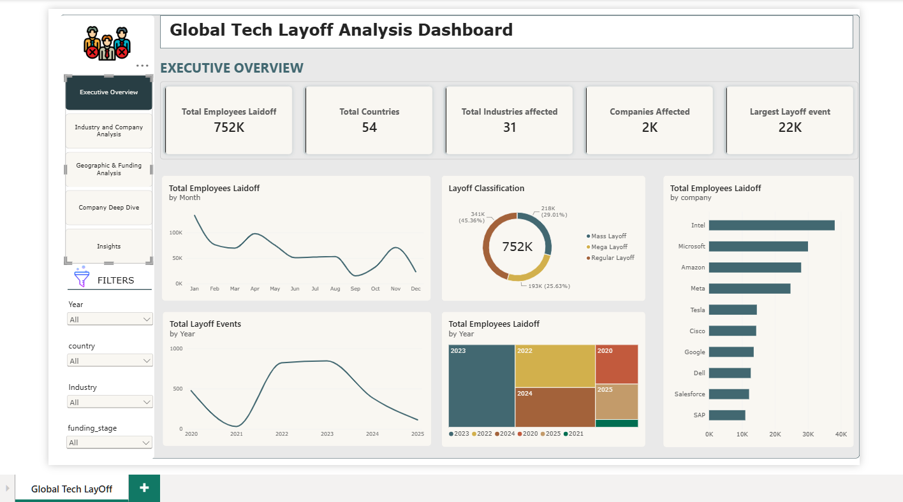
POWER BI DASHBOARD
The dashboard at a glance
Executive Overview brings the headline metrics and main trends together in a single view.
Slicers: Year · Country · Industry · Funding stage
Source: Global Tech Layoffs Analysis dataset; event-level records through 2 Jul 2025
05

Slide 6
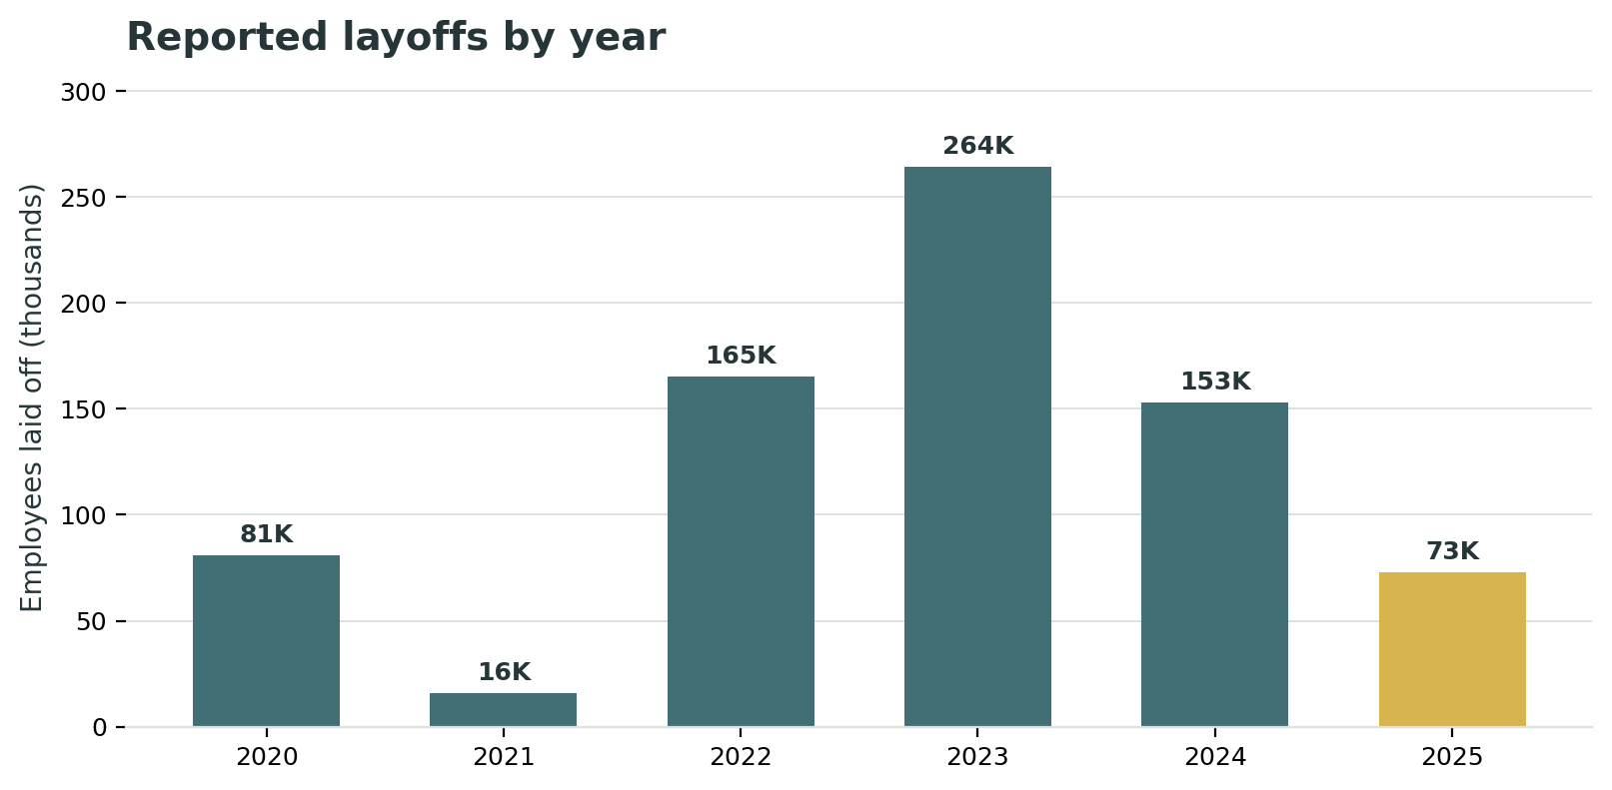
TIME TRENDS
Layoffs accelerated through 2023
2023 recorded the highest full-year total in the data; the 2025 figure is partial through 2 July.
2023 PEAK
264,220
employees laid off
YEAR-OVER-YEAR
+60% in 2023
vs. 165,269 in 2022
2024 RESET
−42%
to 152,922 reported layoffs
2025 includes 72,808 layoffs by 2 July; it should not be compared with full years as a completed annual total.
Source: Global Tech Layoffs Analysis dataset; event-level records through 2 Jul 2025
06

Slide 7
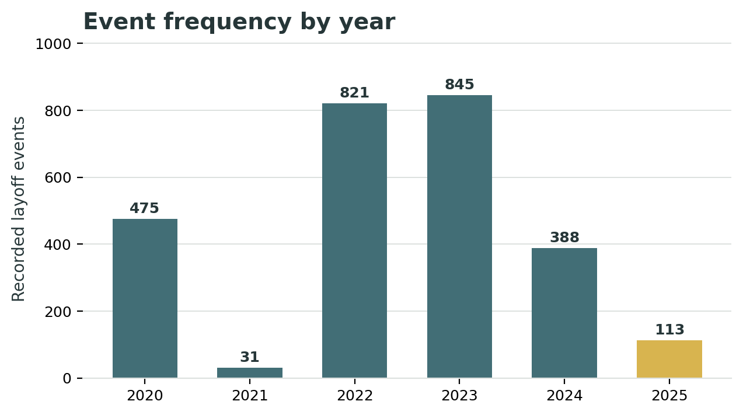
TIME TRENDS
Event volume and event size tell different stories
The number of announcements and the size of the typical event provide complementary views of layoff activity.
MOST EVENTS
845 in 2023
compared with 821 in 2022
MEDIAN EVENT SIZE
125 employees
for 2025-to-date records
WHY IT MATTERS
A year can have fewer announcements yet still show substantial employee impact when large events make up a bigger share.
Event counts and median sizes are from the event-level export; 2025 covers only the period through 2 July.
Source: Global Tech Layoffs Analysis dataset; event-level records through 2 Jul 2025
07

Slide 8
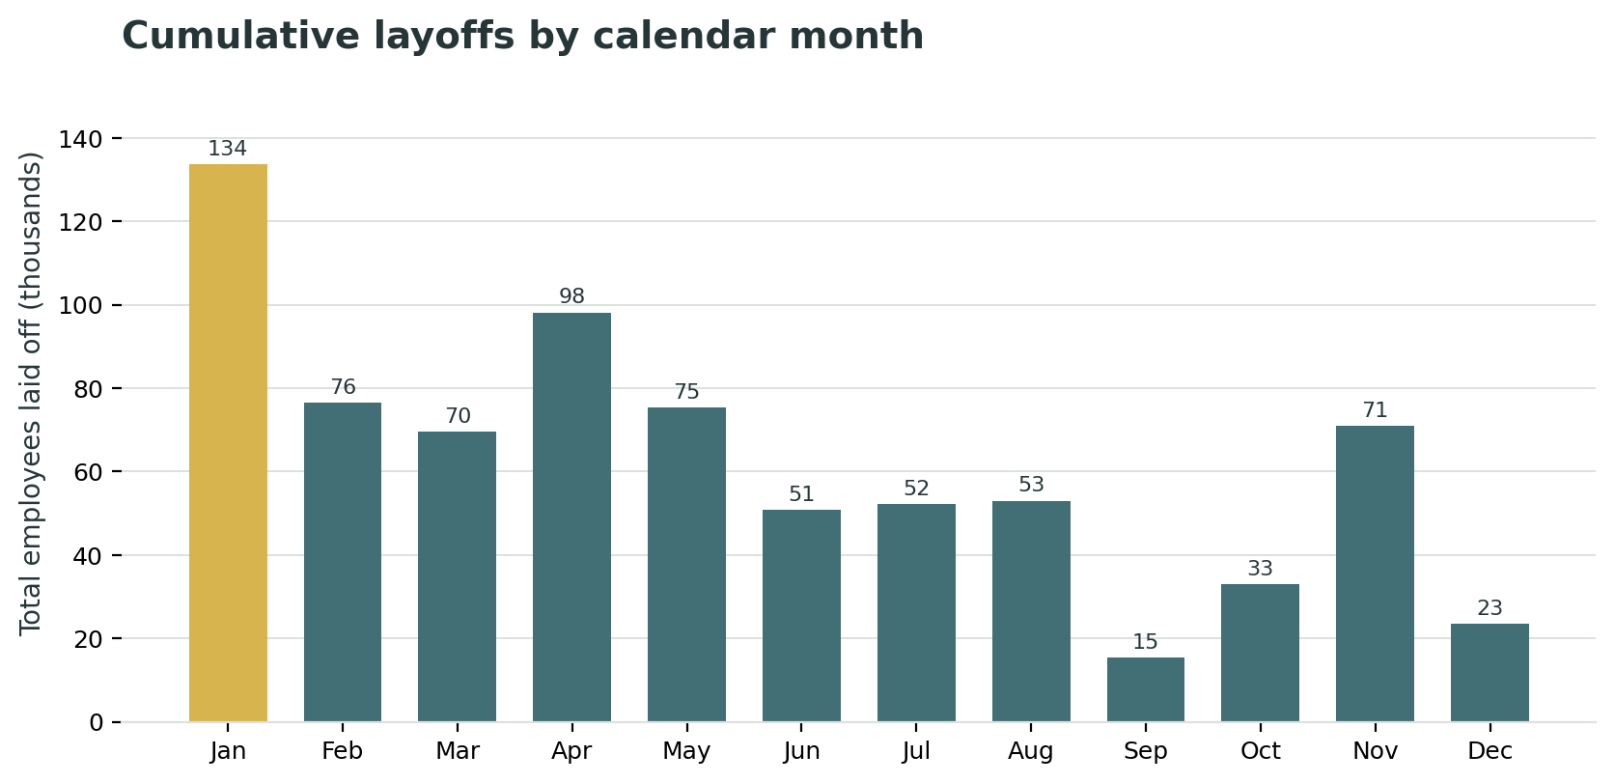
TIME TRENDS
Monthly totals show pronounced peaks
Aggregating all available records by calendar month highlights when the dataset contains the largest cumulative totals.
HIGHEST CUMULATIVE MONTH
January
133,661 layoffs
SECOND-LARGEST
April
98,167 layoffs
These are cumulative totals across all available years, not average monthly values. The observation window starts in March 2020 and ends in July 2025.
Source: Global Tech Layoffs Analysis dataset; event-level records through 2 Jul 2025
08

Slide 9
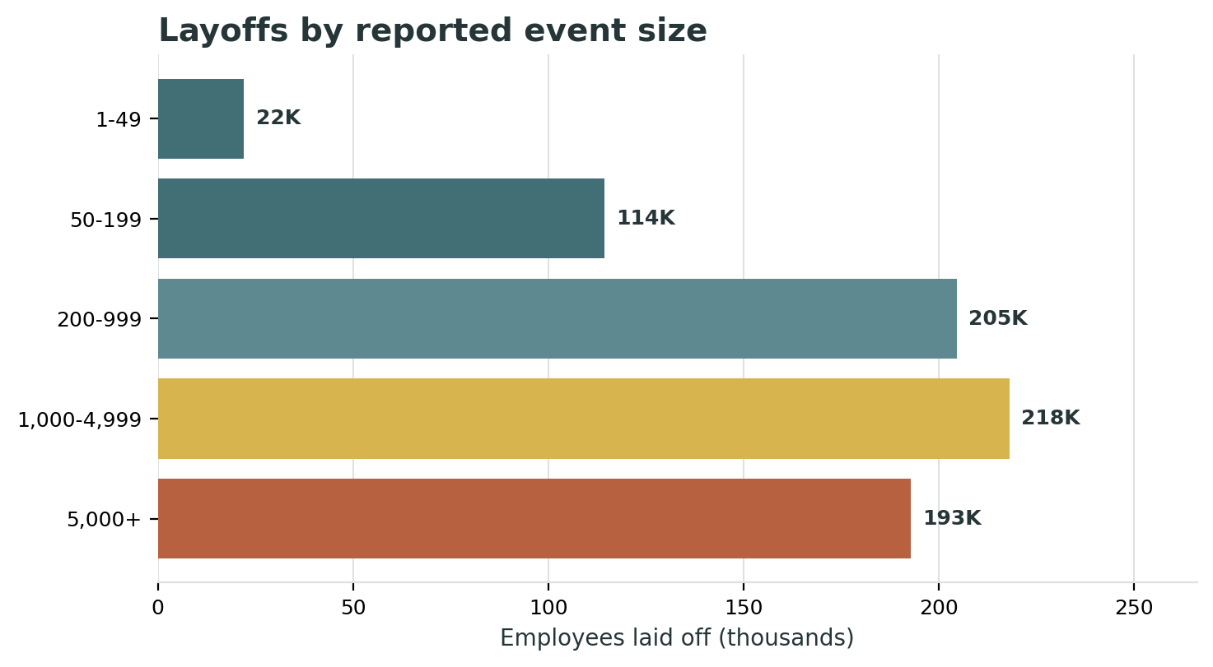
EVENT COMPOSITION
A small share of events accounts for over half of layoffs
High-impact events dominate the employee total even though they represent a small share of all announcements.
MASS EVENTS · 1,000–4,999
122 events · 218,193 layoffs
MEGA EVENTS · 5,000+
20 events · 192,750 layoffs
TOGETHER
5.3% of events
54.6% of employees laid off
Source: Global Tech Layoffs Analysis dataset; event-level records through 2 Jul 2025
09

Slide 10
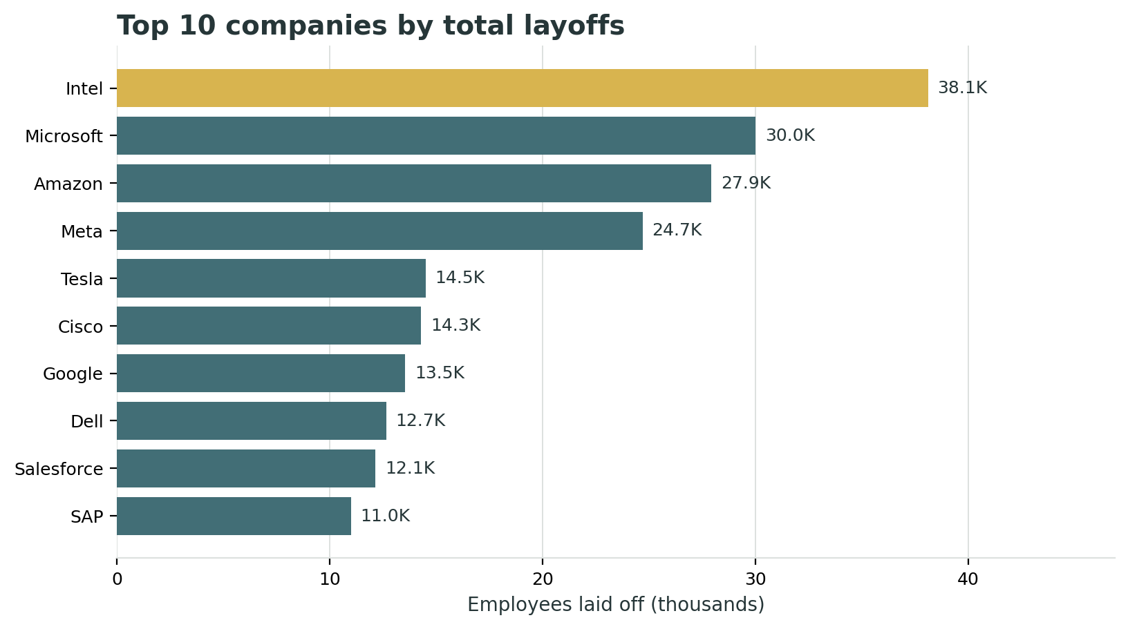
COMPANY IMPACT
Large technology employers lead the company totals
The leaderboard combines repeat announcements with very large single events.
TOP COMPANY
Intel
38,115 total layoffs
LARGEST SINGLE EVENT
22,000
Intel · 23 Apr 2025
CONCENTRATION
Top 10 = 26.4%
of all recorded layoffs
Source: Global Tech Layoffs Analysis dataset; event-level records through 2 Jul 2025
10

Slide 11
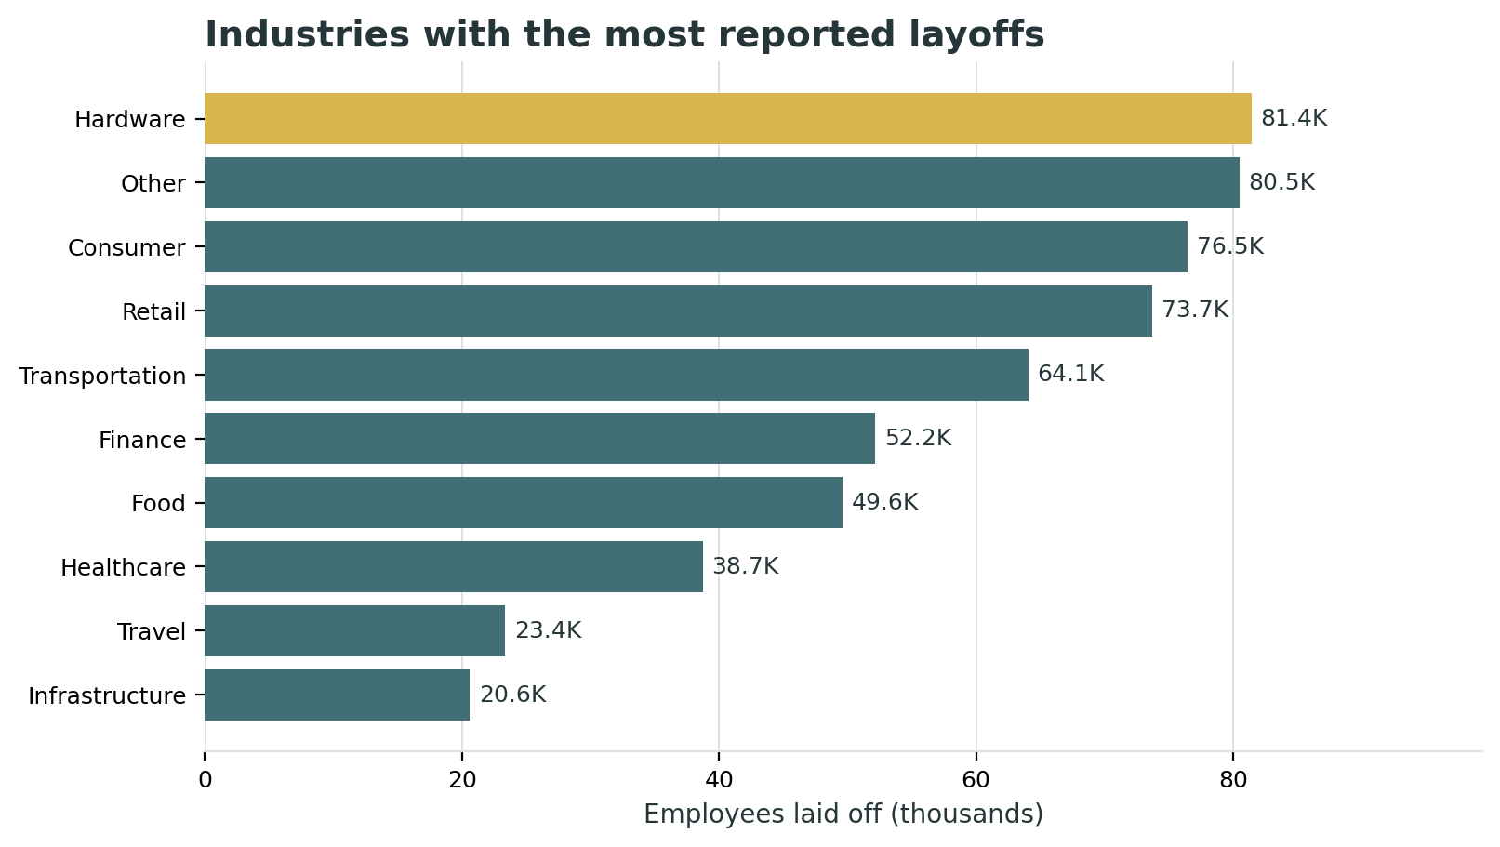
INDUSTRY IMPACT
Hardware leads industry totals; Finance leads event volume
Employee totals and event counts answer different questions about sector impact.
HIGHEST EMPLOYEE TOTAL
Hardware
81,428 layoffs · 44 events
MOST RECORDED EVENTS
Finance
326 events · 52,173 layoffs
Other and Consumer are also near the top of the employee totals, showing that layoffs span several types of technology-related businesses.
Source: Global Tech Layoffs Analysis dataset; event-level records through 2 Jul 2025
11

Slide 12
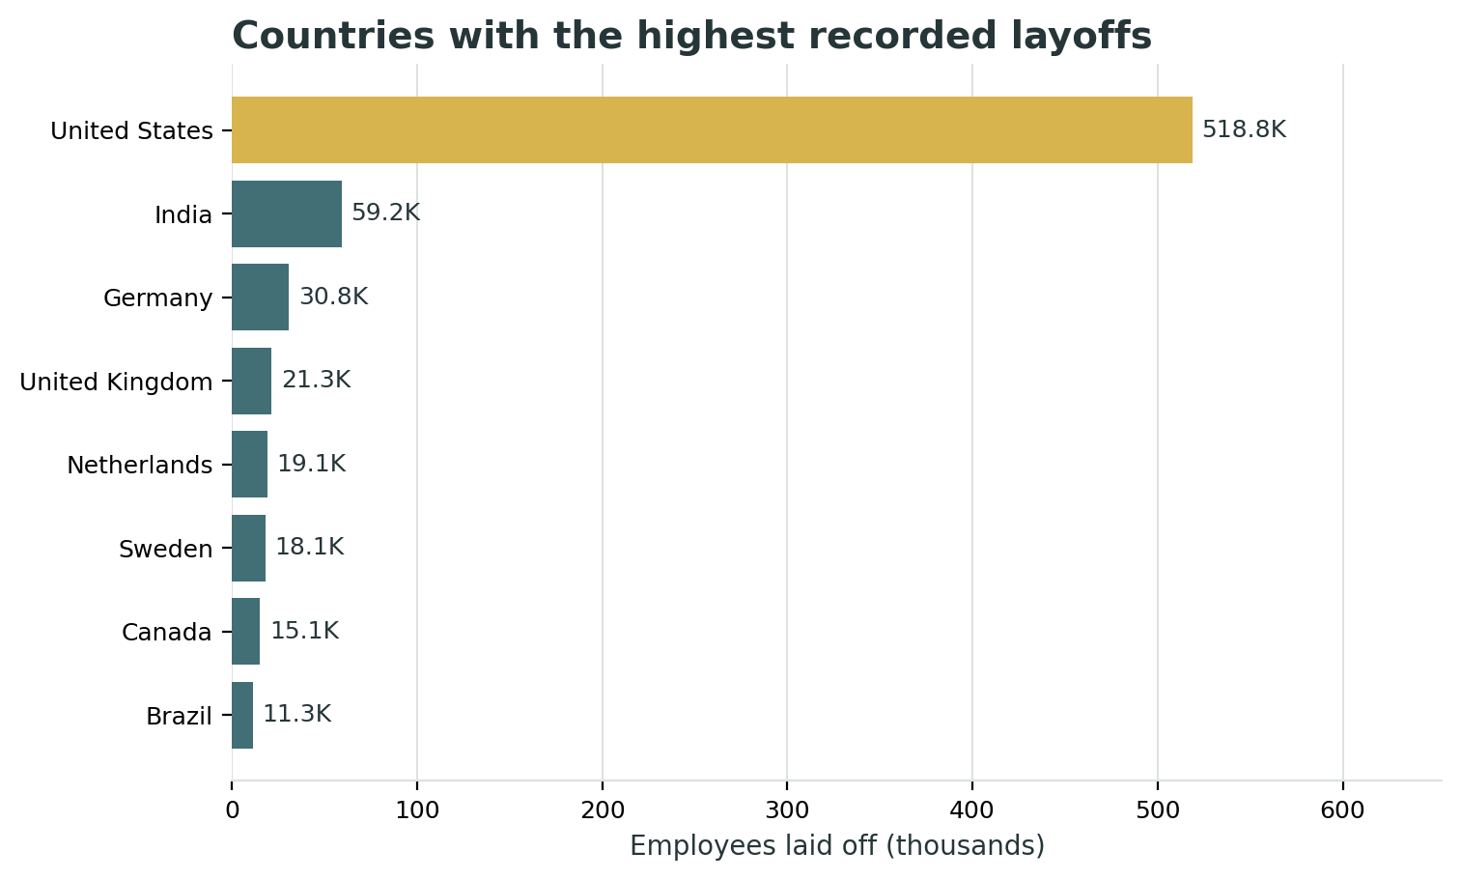
GEOGRAPHIC ANALYSIS
Layoffs are geographically concentrated
The United States represents the largest share of records, with India a clear second.
UNITED STATES
518,812
69.0% of global total
INDIA
59,216
7.9% of global total
TOP 5 COUNTRIES
86.3%
of all recorded layoffs
Source: Global Tech Layoffs Analysis dataset; event-level records through 2 Jul 2025
12

Slide 13
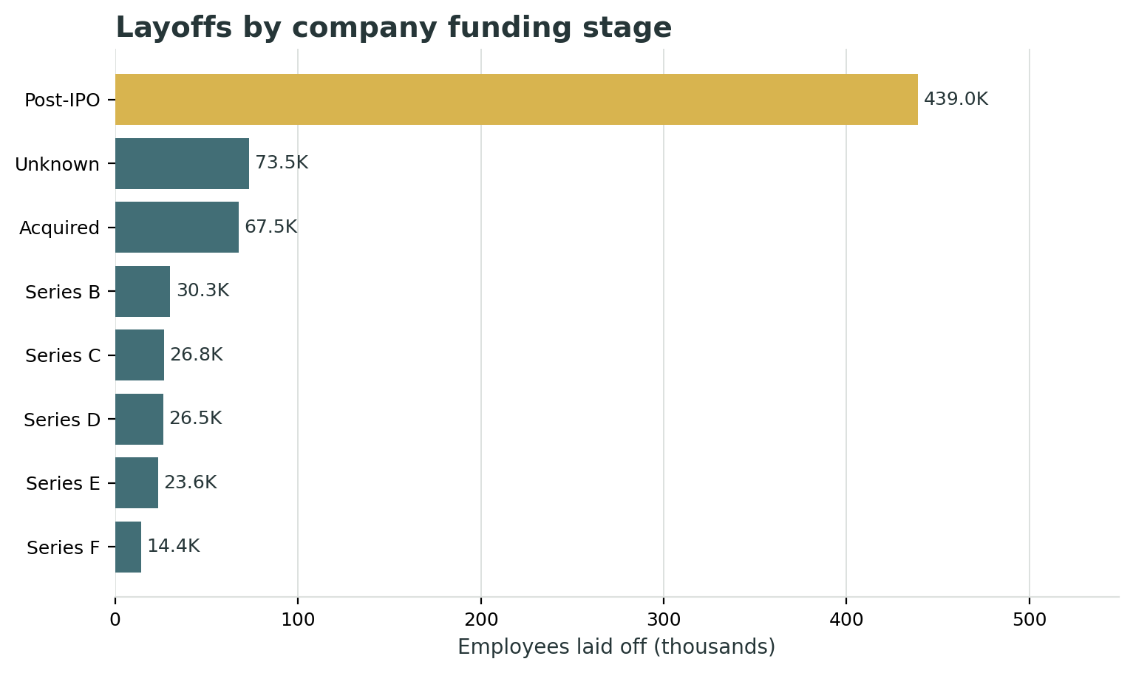
COMPANY-STAGE ANALYSIS
Post-IPO companies account for the largest stage total
The dashboard compares reported layoffs by funding stage / company lifecycle category.
POST-IPO
439,048
58.4% of all recorded layoffs
NEXT LARGEST STAGES
Unknown · 73.5K
Acquired · 67.5K
This view compares stage labels and layoff totals; it does not quantify funding raised in dollars.
Source: Global Tech Layoffs Analysis dataset; event-level records through 2 Jul 2025
13

Slide 14
COMPANY DRILL-DOWN
Company deep dives reveal repeat layoff activity
Filtering to an individual company helps distinguish a single large event from a pattern of repeated announcements.
Most repeated company records
What the drill-down supports
Company
Events
Total layoffs
• Intel leads in cumulative layoffs and includes the largest single recorded event.
Microsoft
9
30,013
Amazon
9
27,940
• Microsoft and Amazon have 9 recorded events each in the export.
Intel
8
38,115
Google
8
13,547
• Google, Salesforce and Intel each have 8 recorded events.
Salesforce
8
12,140
Redfin
7
2,347
Use company, industry and year filters to inspect each company’s timing and event size.
AppLovin
7
790
Source: Global Tech Layoffs Analysis dataset; event-level records through 2 Jul 2025
14

Slide 15
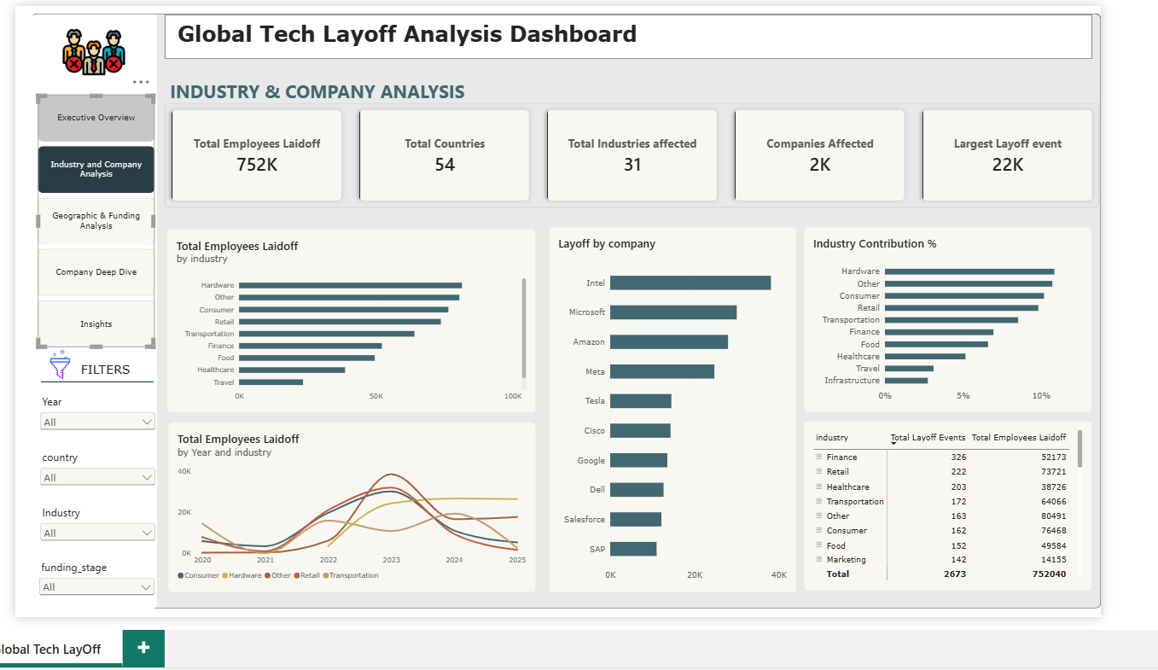
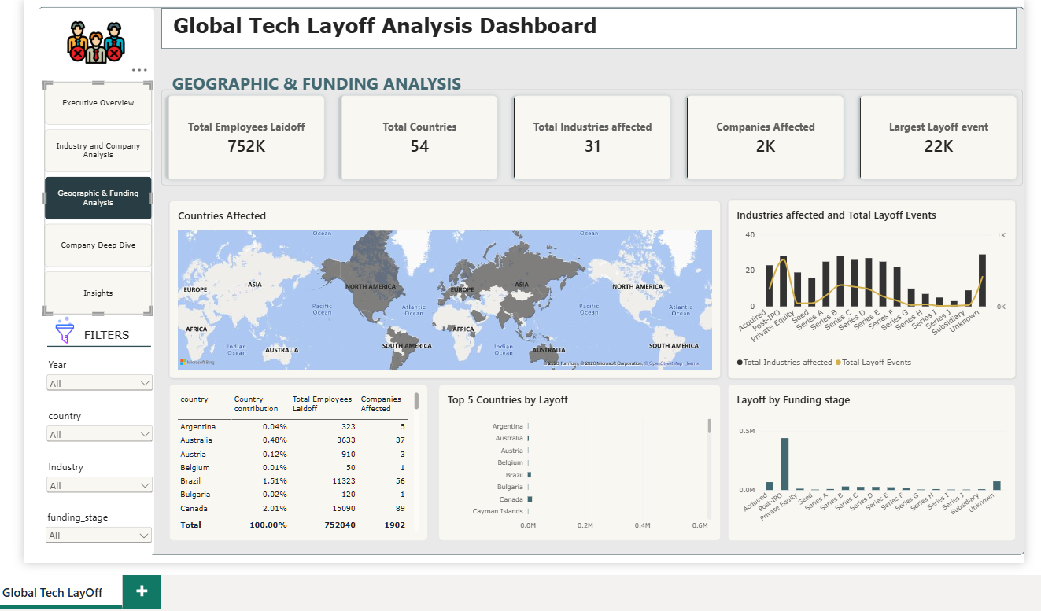
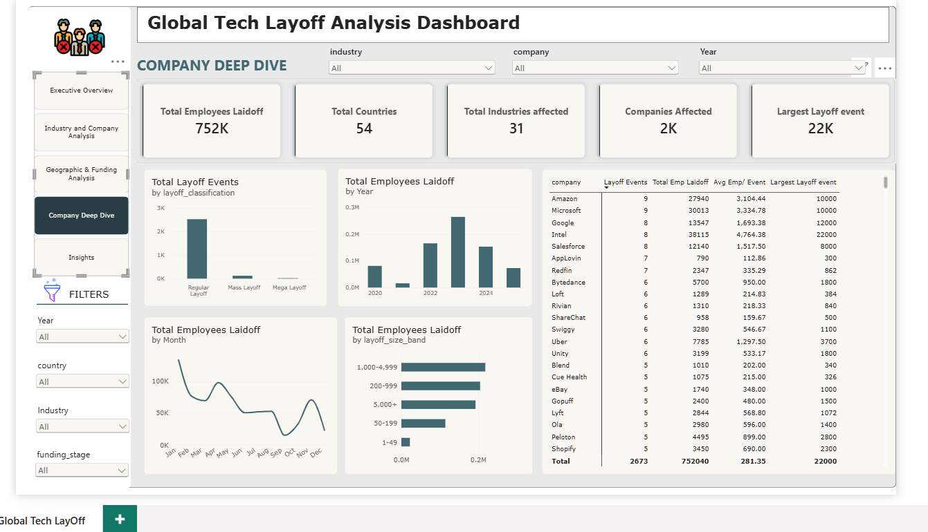
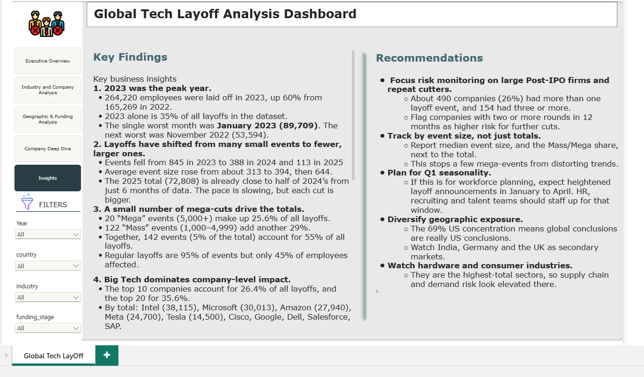
POWER BI BUILD
Interactive dashboard views
The report combines an executive summary with views for industry, geography, company detail and business insights.
Industry & Company Analysis
Geographic & Funding Analysis
Company Deep Dive
Insights & Recommendations
Source: Global Tech Layoffs Analysis dataset; event-level records through 2 Jul 2025
15

Slide 16
INSIGHTS
Key findings from the analysis
The dashboard highlights the most important patterns across time, company, sector, geography and event size.
01
Timing
2023 is the peak full year at 264,220 layoffs; 2024 fell to 152,922.
02
Concentration
The top 10 companies represent 26.4% of all recorded layoffs; the top 20 represent 35.6%.
03
Event size
Just 142 mass/mega events account for 54.6% of employees laid off.
04
Geography
The United States accounts for 69.0%; the top five countries account for 86.3%.
05
Industry & stage
Hardware leads industry totals; Post-IPO is the largest company-stage group by layoff count.
Source: Global Tech Layoffs Analysis dataset; event-level records through 2 Jul 2025
16

Slide 17
RECOMMENDATIONS
Business implications & recommended actions
Use the dashboard to focus attention on repeat activity, large events and where exposure is concentrated.
Monitor large events
Track recurring cuts
Build an alert view for announcements above 1,000 employees, since mass and mega events account for over half of the reported total.
Prioritize company-level monitoring where multiple layoff announcements appear across the period.
Segment by geography
Compare sectors with two measures
Create country-specific briefings, especially for the US and India, while preserving visibility into smaller markets.
Review both total employees affected and number of events; Hardware leads totals while Finance leads event count.
Keep the data current
Refresh the dataset regularly and treat the 2025 value as year-to-date, not a completed annual figure.
Decision principle: use layoff totals to understand scale, event counts to understand frequency, and stage/geography/industry filters to understand context.
Source: Global Tech Layoffs Analysis dataset; event-level records through 2 Jul 2025
17

Slide 18
CONCLUSION
A clear view of the
scale and concentration
of tech layoffs
PROJECT OUTCOME
• A consolidated executive overview
• Company, industry and geography drill-downs
The Power BI dashboard brings together 2,673 events and 752,040 reported layoffs to show when cuts peaked, where they were concentrated, and which companies and industries contributed most.
• Interactive filters for focused analysis
• Evidence-based findings and recommendations
Global Tech Layoff Analysis · Microsoft Power BI
18

