Slide 1
Nepal Flood & Weather: Next-Day River Discharge Prediction

Slide 2
Dataset at a glance
Coverage
Stations
Daily records, 1 Jan 2023 to 31 Aug 2026. 13,390 rows x 19 columns.
10 gauges, incl. Kusum, Belsot, Chameliya/Nayalbadi, Devghat, Khokana.
Variables
Quality
10 weather fields, 8 date/station fields, 1 target: river_discharge_m3s.
0 missing values, 0 duplicate rows, 0 duplicate date-station pairs.

Slide 3
Station discharge varies 180x
Mean discharge in m³/s
Kusum averages 125.8, Bhada Bridge 0.7
One scale for all stations hides small rivers
Motivates station one-hot encoding and station-specific flood thresholds

Slide 4
A heavily skewed target
1.88
20.37
median m³/s
mean m³/s
84.33
3,176
std deviation
max m³/s
Extremes were kept: they are the flood signal. Log transform used for the histogram.

Slide 5
The monsoon dominates the year
Peak: August, 72.46 m³/s
Surge begins in June (6.3), jumps in July (53.7)
Dry months sit near 3-4 m³/s
Month is a strong predictor

Slide 6
When do unusually high flows occur?
666 station-days exceed their own 95th percentile
Aug alone holds 346; none in Jan-May or Dec
All 10 largest discharges belong to Kusum
Record: 3,175.87 m³/s on 28 Sep 2024 with only 8.4 mm rain: flood driven by upstream and antecedent water

Slide 7
Weather vs discharge: weak links
Pooled |r| never exceeds 0.23
Dew point leads; same-day rain only 0.10
Why: stations differ 100x in scale, and rain reaches the gauge with a delay
Fix: lag and rolling rainfall, per-station view

Slide 8
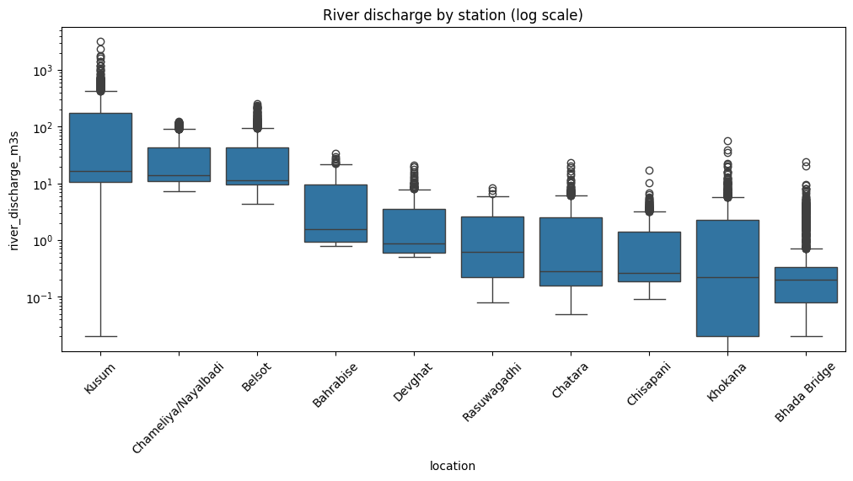
Stations compared on a log scale
Kusum, Chameliya and Belsot have the highest medians
Spreads span 3+ orders of magnitude
Long upper whiskers = flood spikes
Station identity is essential model information

Slide 9
Feature engineering pipeline
Rain lags
Rolling rain
Discharge history
Calendar + station
Previous 1, 2 and 3 day rainfall
3-day and 7-day sums, 7-day mean (shifted 1 day)
Lag 1, lag 2, 7-day mean
Year, month, 10 one-hot stations
All lags computed per station after sorting by date, so no cross-station leakage
35 features = 14 raw + 11 engineered + 10 station dummies
70 warm-up rows dropped (13,390 to 13,320); 10 more lost to the next-day target (13,310)

Slide 10
Time-based train/test split
TRAIN 10,630 rows
TEST 2,680
9 Jan 2023
7 Dec 2025 (cutoff)
31 Aug 2026
Cutoff at the 80th percentile of dates; split on target_date, with assertions confirming no overlap
Thresholds and scaler fitted on training data only
Test window covers the full 2026 monsoon, a stringent out-of-time check
Caveat: test contains one monsoon season

Slide 11
Regression model comparison
Model | MAE | RMSE | R²
Linear Reg. | 6.06 | 15.04 | 0.934
Random Forest | 2.42 | 16.66 | 0.920
Grad. Boosting | 2.84 | 19.34 | 0.892
Decision Tree | 3.11 | 23.08 | 0.846
Metrics in m³/s. RF wins MAE; Linear Regression wins RMSE and R².

Slide 12
Linear vs Random Forest
Linear Regression
Random Forest (preferred)
Best RMSE (15.04) and R² (0.934), driven by large peaks.
But MAE is 6.06, and it predicts negative discharge on low flows (-1.16 vs actual 1.64), which is physically impossible.
Lowest MAE (2.42): accurate on the many low-flow days (1.78 vs 1.77 actual).
Larger misses at peak surges raise RMSE to 16.66.
No negative outputs; captures non-linear behaviour.

Slide 13
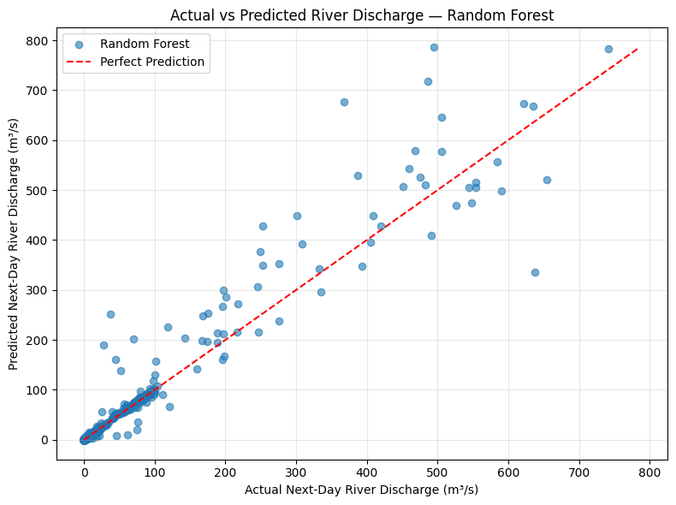
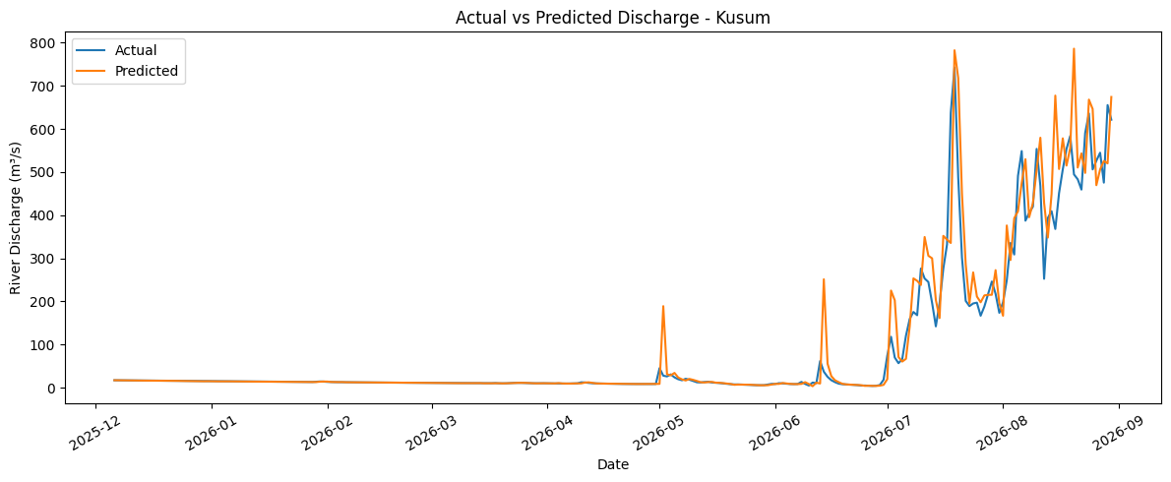
Random Forest: actual vs predicted
Points hug the diagonal, with scatter at high flows. Kusum time series (right) follows the 2026 monsoon surge closely.

Slide 14
Error analysis: largest flows
Date | Actual | Predicted | Error
19 Jul 2026 | 742.0 | 782.2 | -40.2
29 Aug 2026 | 655.2 | 520.0 | +135.1
18 Jul 2026 | 637.3 | 335.6 | +301.7
24 Aug 2026 | 635.8 | 667.9 | -32.1
30 Aug 2026 | 621.3 | 674.0 | -52.7
All top-10 flows are Kusum
Biggest miss: 18 Jul, a surge onset under-predicted by 302 m³/s
Hardest station: Kusum
Easiest: low-flow gauges (Bhada Bridge, Chisapani); per-station error not in notebook
Values in m³/s; error = actual - predicted.

Slide 15
What drives next-day discharge
Current discharge alone = 81.4%
River flow is highly persistent
Weather and rainfall refine, not drive, the forecast
Persistence baseline needed to prove added skill

Slide 16
Did feature engineering help?
-2.19%
-6.54%
MAE
RMSE
R² rose from 0.908 to 0.920
Gain is modest because raw discharge already carries most of the signal
Biggest benefit: fewer large errors (RMSE)

Slide 17
High-flow classification setup
Station | p90 m³/s | Station | p90 m³/s
Kusum | 427.75 | Chatara | 4.57
Belsot | 94.68 | Rasuwagadhi | 3.59
Chameliya | 92.29 | Chisapani | 2.63
Bahrabise | 13.68 | Bhada Bridge | 2.66
Devghat | 6.29 | Khokana | 5.00
Label 1 if next-day flow exceeds the station's train-set 90th percentile
Class share: 10% train vs 6.4% test
Imbalance handled with class_weight="balanced"

Slide 18
Classifier performance
Random Forest: best F1 (0.762)
Logistic: perfect recall but 28.7% precision
Tree: middling on both

Slide 19
Random Forest confusion matrix
Precision 76.9%, recall 75.6%
Logistic Regression catches all 172 floods but raises roughly 430 false alarms (derived from its precision)
Flood warning favours recall; trust needs precision: tune the threshold
2,469
39
True normal
False alarm
42
130
Missed flood
Caught flood
Predicted: normal | high

Slide 20
What signals a high-flow day?
Importance is spread out, unlike regression
Accumulated 7-day rainfall and humidity matter for flood onset
Month encodes monsoon timing

Slide 21
Conclusion
Next-day river-discharge prediction using weather, river history, seasonality and station information
72.46 m³/s
15.04 m³/s
2.42 m³/s
0.762
AUGUST MEAN DISCHARGE
BEST RMSE · LINEAR REGRESSION
LOWEST MAE · RANDOM FOREST
BEST CLASSIFIER F1 · RF
REGRESSION FINDINGS
HIGH-FLOW CLASSIFICATION
Discharge showed strong seasonality, peaking in August at 72.46 m³/s on average.
Linear Regression led on RMSE (15.0433) and R² (0.9344); Random Forest led on MAE (2.4167 m³/s).
Feature engineering reduced Random Forest MAE by 2.19% and RMSE by 6.54%.
High flow was defined as next-day discharge above each station’s training-set 90th percentile; positives were 10% of train and 6.4% of test.
Random Forest achieved 97.0% accuracy, 76.9% precision, 75.6% recall and the best F1 (0.762).
Logistic Regression reached 100% recall but only 28.7% precision, producing many false alarms.
NEXT STEP Tune the decision threshold to balance missed high-flow events against false alarms; validate with a persistence baseline and station-level metrics before operational use.
The 90th-percentile labels are statistical thresholds, not official warning levels. Results reflect one chronological test period.

