Slide 1

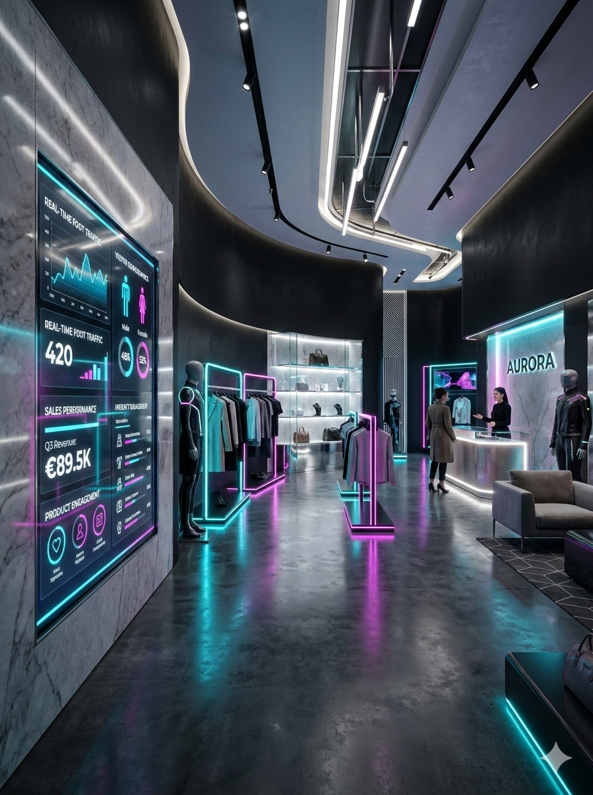

EXECUTIVE ANALYTICS
Retail Sales Performance
& Customer Behaviour
Comprehensive 2020–2026 performance evaluation, revenue trends, margin structure, regional dynamics, and strategic growth recommendations.
date_range
TIMEFRAME & DATA
Jan 2020 – Nov 2026
83 months analyzed
payments
TOTAL NET SALES
$76.9M
250,000 orders placed
trending_up
PROFIT & MARGIN
$46.9M | 61%
Consistent profit margin
track_changes
TARGET ACHIEVEMENT
89.4%
0 of 83 months on target
EXECUTIVE SUMMARY
High-performing, stable, and profitable global retail operations spanning 17 key markets.
Executive Presentation • Source: Power BI Retail Model (Jan 2020 – Nov 2026)

Slide 2

Retail Sales Performance & Customer Behaviour
Executive summary: stable, profitable, flat and never on target
$76.9M
$46.9M
61.0%
89.4%
Total sales
Total profit
Profit margin
Target achievement
shopping_bag
Order Volume & Unit Sales
250,000 orders, 469,896 units, average order value $307.73.
trending_flat
Annual Sales Trend
Annual sales flat at $11.5M to $11.7M since 2020; Jan to Oct 2026 is 1.2% below 2025.
track_changes
Target Gap Consistency
All 83 months missed target, in a narrow 87% to 93% band.
calendar_month
Seasonal Fluctuations
November and December run at about 2.2x an average month; January drops about 78%.
Source: Power BI retail model, 1 Jan 2020 to 6 Nov 2026

Slide 3
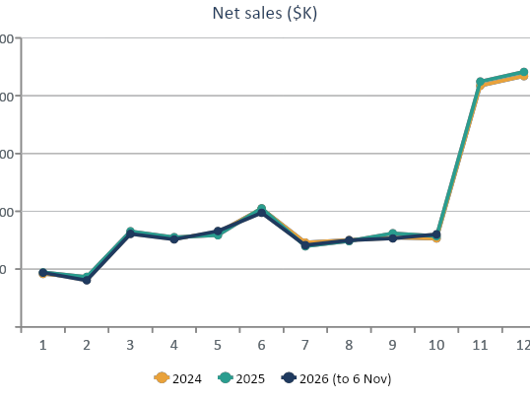
Monthly Sales Trend and Seasonality
Same shape every year: Jan/Feb trough, June bump, Nov/Dec peak
calendar_month
Q4 Peak & Seasonality
Q4 delivers about 43% to 44% of annual sales.
January falls 77%–79% post-December; July falls ~30% post-June.
trending_up
FY2026 Forecast & Trend
Forecast: FY2026 about $11.55M (-1.2% vs 2025).
Last two years: +0.8% vs prior two.
info
Data Note (Nov 2026)
Nov 2026 is only 6 days old, so its -50% reading is an artefact.
Source: Power BI retail model, 1 Jan 2020 to 6 Nov 2026

Slide 4
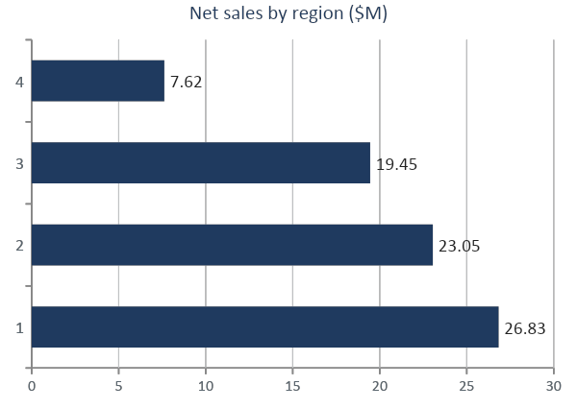
Region-wise performance
North America leads with 34.9% of sales; margins are identical
Region | Margin | Target | 2025 YoY
N. America | 61.0% | 89.7% | +1.7%
Europe | 60.9% | 89.1% | -0.1%
APAC | 61.1% | 89.3% | -0.5%
LATAM | 60.9% | 89.8% | +5.9%
trending_up
Fastest Regional Growth
LATAM is the fastest-growing region from the smallest base (+5.9% YoY).
track_changes
Uniform Target Gaps
Target gaps are consistent across all regions (~89% achievement).
Source: Power BI retail model, 1 Jan 2020 to 6 Nov 2026

Slide 5
Products and categories
Accessories earn the best margin; Footwear is the weak spot
Top 5 products by sales
Product | Sales | Margin
Outerwear 178 | $938K | 68.9%
Sandal 986 | $868K | 57.5%
Activewear 377 | $810K | 68.4%
Watches 890 | $806K | 77.1%
Jacket 925 | $800K | 66.7%
insights
Product Concentration & Pricing Dynamics
• Top 5 products: 5.5% of total sales, showing minimal dependency.
• Price-driven: Rankings reflect price; unit volumes are near-equal.
• Discount impact: Discounts above 30% cut profit margin sharply to 41%.
Source: Power BI retail model, 1 Jan 2020 to 6 Nov 2026

Slide 6
Customers and segments
VIP is the most valuable per customer; Wholesale lags on margin
Segment | Customers | Sales | Margin | Profit / cust.
Returning | 1,970 | $30.9M | 61.7% | $9,673
New | 1,771 | $27.0M | 60.7% | $9,255
VIP | 783 | $12.8M | 63.1% | $10,299
Wholesale | 476 | $6.3M | 54.8% | $7,208
loyalty
Segment Profitability
• Returning: Leads in total profit ($19.06M).
• VIP Segment: Dominates margin (63.1%) and profit/cust ($10,299).
• Wholesale: Lags at 54.8% margin and $7,208/customer.
group
Customer Concentration
• Broad Base: Exceptionally low revenue concentration across base.
• Top 10% Share: Generates only 13.6% of overall sales volume.
• Active Buyers: ~80% of customers purchased in the last 90 days.
fingerprint
ID vs Name Data Quality
• Top Accounts: Luis Lynch, Barbara Clark, Daniel Whitaker ($25K–$27K).
• Grouping Risk: 'James Smith' combines 5 distinct IDs ($80.6K).
• Action Needed: Entity resolution needed for accurate account tracking.

Slide 7
Targets, correlation and dashboard checks
Where the numbers need care
89.4%
All-Time Target Achievement
Q4: 88.8% | Q3 2026: 90.1%
0 of 83
Months On Target
Every month missed target
~12%
Systematic Target Gap
Narrow 87%–93% band
track_changes
Target Setting & Model Calibration
• 83-Month Target Miss: Target achievement sits consistently between 87% and 93% with zero variance.
• Structural Inflation: Targets appear to be set ~12% above a flat historical baseline rather than reflecting actual demand.
• Recent Trajectory: Q3 2026 achieved 90.1%; Q4 to date stands at 88.8%, tracking the historical baseline closely.
analytics
Correlation: Quantity vs Profit
• Monthly Aggregate (r = 0.998): Strong correlation between total monthly unit volume and monthly gross profit.
• Customer & Order Level (r = 0.78 / 0.61): Moderate-to-strong linkage between volume and profit at the buyer level.
• Category Disconnect (r ~ 0.1): Negligible correlation across categories; profit is governed by margin and discount discipline.
Source: Power BI retail model, 1 Jan 2020 to 6 Nov 2026

Slide 8
Sales channels and fulfillment dynamics
Digital platforms and shipping tiers deliver identical 61.0% margins: mix variables, not margin levers
Sales by Acquisition Channel
Fulfillment & Shipping Speed
Channel | Sales | Share | Margin
Web | $34.42M | 44.7% | 61.0%
Mobile App | $30.89M | 40.2% | 61.0%
Social Media | $11.63M | 15.1% | 61.0%
Shipping Method | Orders (Est.) | Share | Margin
Standard | 150,000 | 60.0% | 61.0%
Express | 75,000 | 30.0% | 61.0%
Next Day | 25,000 | 10.0% | 61.0%
Channel Invariance
Margin: Identical 61.0% across all channels.
Web: Leads with $34.42M (44.7% of sales).
App & Social: App $30.89M (40.2%); Social $11.63M.
Shipping Distribution
Standard: Delivers 60% of volume (150K orders).
Express: Represents 30% (75K orders) with no bleed.
Next Day: Accounts for 10% (25K orders) at 61% margin.
Strategic Takeaways
Neutral Levers: Platforms and delivery do not sway margin.
Channel Shifts: Web vs App mix will not bridge target miss.
Focus Areas: Drive Accessories and curb shoe discounts.
Source: Power BI retail model, 1 Jan 2020 to 6 Nov 2026

Slide 9
Recommendations
Close the target gap by fixing margin, mix and the model itself
1
Reset targets
Rebase on run-rate and seasonality, or fund a real growth plan.
2
Fix footwear discounting
Cap deep discounts; 5 margin points is about $1.0M profit.
3
Shift mix to Accessories
72.8% margin vs 49.8% for Footwear.
4
Smooth the Jan/Feb trough
Campaigns and loyalty offers; plan stock for Nov/Dec.
5
Protect VIP, fix Wholesale
VIP fell 4.1% in 2025; Wholesale pricing and cost-to-serve review.
6
Grow LATAM and New customers
+5.9% and +5.4% in 2025; watch discount depth.
Source: Power BI retail model, 1 Jan 2020 to 6 Nov 2026

