Slide 1
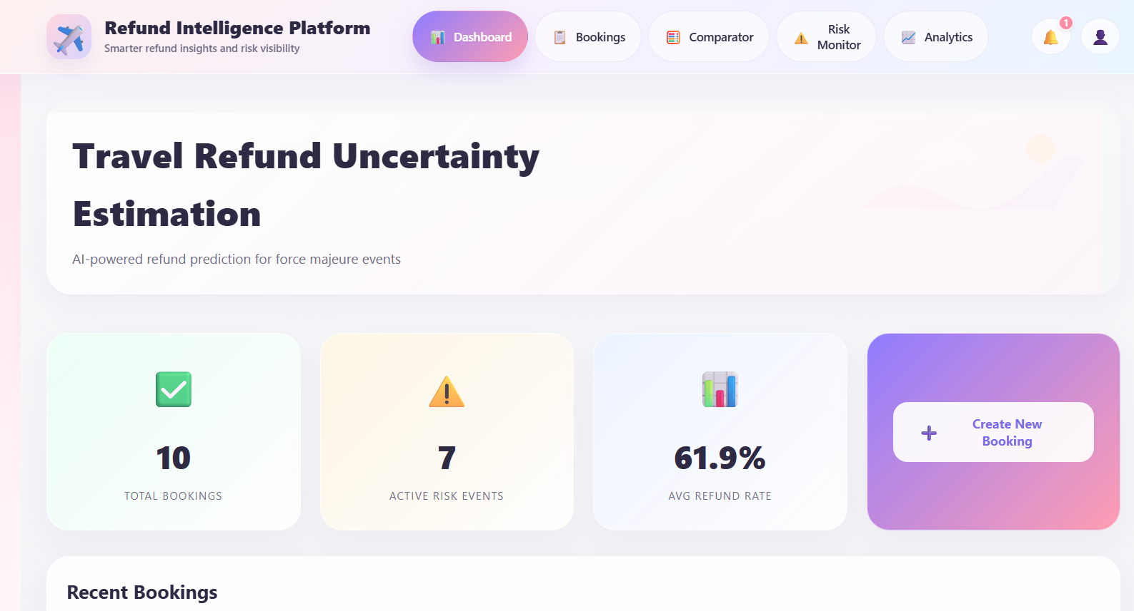
Refund Intelligence Platform
AI-assisted refund estimation, risk monitoring platform
Presented by: Abhijit Joshi
A platform as a decision-support solution for refund estimation under uncertainty. Iintegrated with booking workflows, risk events, historical analytics, and model comparison.

Slide 2
The Problem We Are Solving
Travel refund decisions become uncertain during force majeure situations
Customers and operators need visibility into possible refund outcomes
Manual estimation is slow, inconsistent, and difficult to explain
Different calamity types influence refund likelihood differently
Historical outcomes are hard to compare without a unified platform
Speaker cue: Position the project as a decision intelligence platform, not just a booking app. Explain that the goal is to improve confidence and speed in refund-related decisions.

Slide 3
Solution Overview
Centralized booking management
Risk event monitoring dashboard
Refund estimation engine
Historical refund analytics
Model comparison workflow
Bell notifications for new bookings and risk events
Screenshot Placeholder
Optional collage of app screens
Speaker cue: Summarize the end-to-end workflow supported by the platform. Explain that users can create data, analyze scenarios, and compare outcomes in one interface.

Slide 4
System Architecture
Frontend: React + Vite + SCSS
Backend: FastAPI
Database: SQLite (backend/refund_estimation.db)
ML / Estimation: Random Forest, Gradient Boosting, Rule-based logic
Data inputs: bookings, provider policies, historical refunds, risk events
Screenshot Placeholder
Add architecture diagram here
Speaker cue: Briefly explain the relationship between frontend, API layer, database, and estimation logic. Mention that synthetic data is used to bootstrap historical analysis and model behavior.

Slide 5
Dashboard Overview
Displays summary metrics for bookings, refund trends, and active risks
Provides quick-access navigation to major workflows
Acts as the operational snapshot screen for the platform
Screenshot Placeholder
Insert Dashboard screenshot here
Speaker cue: Describe the dashboard as the starting point for users and stakeholders. Highlight the high-level visibility it gives before drilling into detailed screens.

Slide 6
Bookings List
Shows all customer bookings in a structured list
Supports review of routes, dates, customer details, and total cost
Provides access to booking details and refund estimation workflows
Screenshot Placeholder
Insert Booking List screenshot here
Speaker cue: Explain that bookings are the primary records used for refund analysis. Mention that this screen organizes customer travel information for operations teams.

Slide 7
Create New Booking
Captures customer details and travel information
Stores booking component costs such as flight and hotel values
Feeds later refund estimation and comparison workflows
Triggers a bell notification when a new booking is created
Screenshot Placeholder
Insert Create Booking screenshot here
Speaker cue: Explain that the booking creation form is the main data entry point. Mention the notification feature for immediate operational visibility.

Slide 8
Booking Details and Refund Estimate
Displays complete booking information and cost breakdown
Generates refund estimate for the selected booking
Shows refund amount, refund percentage, confidence range, and risk score
Presents best-case, likely, and worst-case views
Screenshot Placeholder
Insert Booking Details screenshot here
Speaker cue: Use this slide to explain how a single booking can be evaluated in detail. Emphasize scenario visibility and explainability of the result.

Slide 9
Refund Model Comparator
Select an existing booking
Choose estimation model: Auto, Random Forest, Gradient Boosting, or Rule-based
Choose calamity type and severity
Compare refund outcomes for the selected scenario
Screenshot Placeholder
Insert Refund Comparator screenshot here
Speaker cue: Highlight this as a key differentiator of the project. Explain how comparator support allows scenario testing and model selection flexibility.

Slide 10
Risk Monitor and Event Entry
Tracks disruptions such as war, natural disaster, pandemic, or strikes
Displays severity, region, date range, and status of risk events
Allows users to add new risk events through a form
New risk event creation triggers a bell notification
Screenshot Placeholder
Insert Risk Monitor screenshot here
Speaker cue: Explain how real-world disruptions are modeled as risk events in the platform. Mention that these events directly support risk-aware refund reasoning.

Slide 11
Bell Notifications
Notification badge appears on the header bell icon
Triggered when a new booking is created
Triggered when a new risk event is created
Dropdown shows recent notifications with clear action
Screenshot Placeholder
Insert Notification dropdown screenshot here
Speaker cue: Describe notifications as a lightweight operational awareness feature. Mention that current notifications are session-based and can be extended later.

Slide 12
Historical Refund Analytics
Visualizes historical refund patterns and averages
Supports filtering by component or event type
Helps interpret model behavior using historical trends
Strengthens explainability beyond a single prediction
Screenshot Placeholder
Insert Analytics screenshot here
Speaker cue: Present analytics as the explanatory layer of the platform. Explain that it helps users understand past outcomes, not just current estimates.

Slide 13
How Refund Estimation Works
Booking components are evaluated individually
Risk score is derived from active events or selected calamity and severity
The engine supports Auto Ensemble, Random Forest, Gradient Boosting, and Rule-based fallback
Final refund result aggregates component-level reasoning into one estimate
Screenshot Placeholder
Optional flow diagram here
Speaker cue: Summarize the backend decision process in simple language. Note that rule-based logic provides resilience when ML comparison is not preferred.

Slide 14
Suggested 3-5 Minute Demo Flow
Start with Dashboard
Open Bookings List
Create a new booking and show notification
Open Booking Details and generate estimate
Open Comparator and compare models
Add a new event in Risk Monitor and show notification
End with Analytics for historical interpretation
Screenshot Placeholder
Optional end-to-end workflow image
Speaker cue: This slide can guide your live or recorded narration. Keep the flow concise and focused on user value and system capabilities.

Slide 15
Business Value
Faster refund decision support
Better visibility into uncertainty and disruptions
Model-based comparison for scenario analysis
Centralized platform for bookings, events, and analytics
Improved communication for customers and operators
Screenshot Placeholder
Optional impact graphic here
Speaker cue: Explain why the platform matters from an operational and analytical perspective. Position the project as both practical and extensible.

Slide 16
Future Enhancements
Persistent notifications
External live risk feeds
Provider-specific refund policy intelligence
Model evaluation metrics and benchmarking
Authentication and role-based access
Exportable reports and comparison snapshots
Screenshot Placeholder
Optional roadmap visual here
Speaker cue: Show that the platform can evolve into a production-grade decision-support system. Mention the most realistic next steps for future scope.

Slide 17
Thank You
Questions? Demo complete.
Refund Intelligence Platform
AI-assisted refund estimation under uncertainty
Screenshot Placeholder
Optional closing visual
Speaker cue: Close the presentation confidently and invite questions.

