Slide 1
Travel Cost Refund Intelligence Platform
AI-assisted travel cost refund estimation & risk monitoring
Uncertainty Modeling
Force Majeure
Decision Support

Slide 2
The Problem
⚡ Uncertain Travel Cost Refund Outcomes
🐢 Manual & Slow Estimation
Force majeure events make refund decisions unpredictable — no consistent framework exists.
Operations teams rely on ad-hoc judgment, creating inconsistent and hard-to-explain decisions.
📊 No Unified Historical View
🔍 No Risk Visibility
Past refund outcomes are scattered — impossible to compare across calamity types or booking components.
Active disruptions (war, pandemic, disaster) are not linked to refund reasoning in real-time.

Slide 3
Our Solution
🧠 Refund Estimation Engine
🔄 Model Comparator
Random Forest, Gradient Boosting & Rule-based models with confidence ranges & risk scores
Compare Auto / Random Forest / Gradient Boosting / Rule-based side by side
📋 Booking Management
End-to-end booking lifecycle with component-level cost tracking and refund workflows
📈 Historical Analytics
Visualize past refund patterns to explain and validate current estimates
⚠️ Risk Event Monitor
Log disruptions (war, disaster, pandemic) — directly feeds refund reasoning engine
🔔 Real-time bell notifications for new bookings & risk events

Slide 4
Bob-a-thon Journey: 8 steps to success
1. Project Ideation with Bob AI Assistant
2. Building Complete Full-Stack Application
3. Creating Context Graph with Detailed Schema (812 lines)
4. Implementing MCP Server with JSON-RPC 2.0
5. Creating Basic Agent in ICA
6. Building Agent Orchestration with LangGraph
7. Linking Agent to MCP Server
8. Demo Preparation and Testing
Project Ideation with Bob
Problem Statement
Travel companies struggle with refund estimation during force majeure
Manual process is inconsistent and time-consuming
Customers need transparent, data-driven estimates
Solution: AI-Powered System
ML predictions with 95% confidence intervals
Real-time risk assessment
Multi-component booking support
IBM ICA integration for enterprise deployment

Slide 5
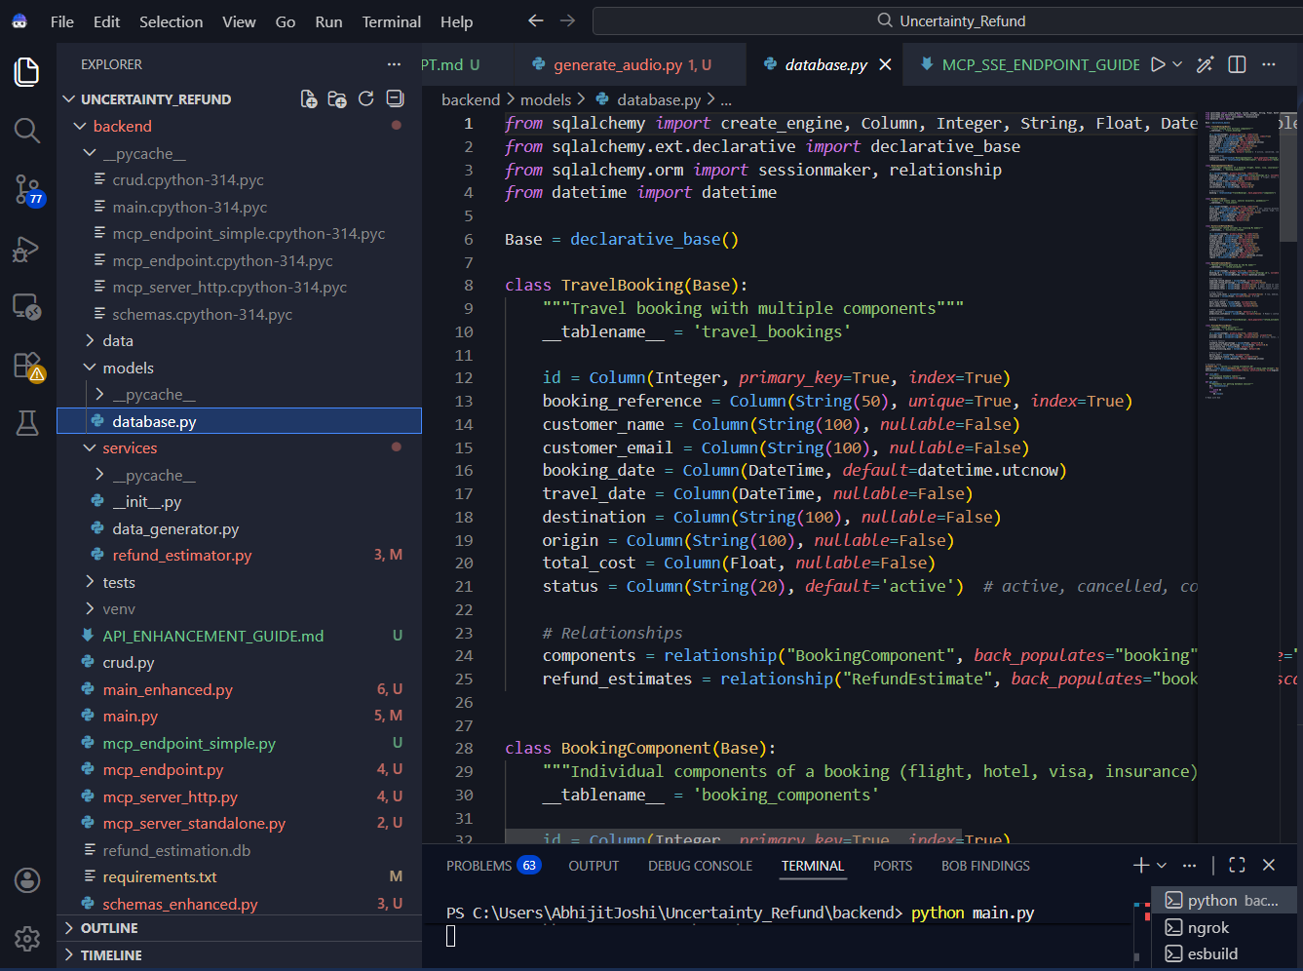
Technology Stack
Frontend: React 18 + Vite
7 pages: Dashboard, Bookings, Analytics, Risk Monitor
Interactive charts with Recharts
Responsive design with SCSS
Backend: FastAPI + Python
11 REST API endpoints
SQLite database with SQLAlchemy ORM
500+ synthetic records for testing
ML Models: scikit-learn
Random Forest + Gradient Boosting ensemble
95% confidence interval calculation
Uncertainty quantification

Slide 6
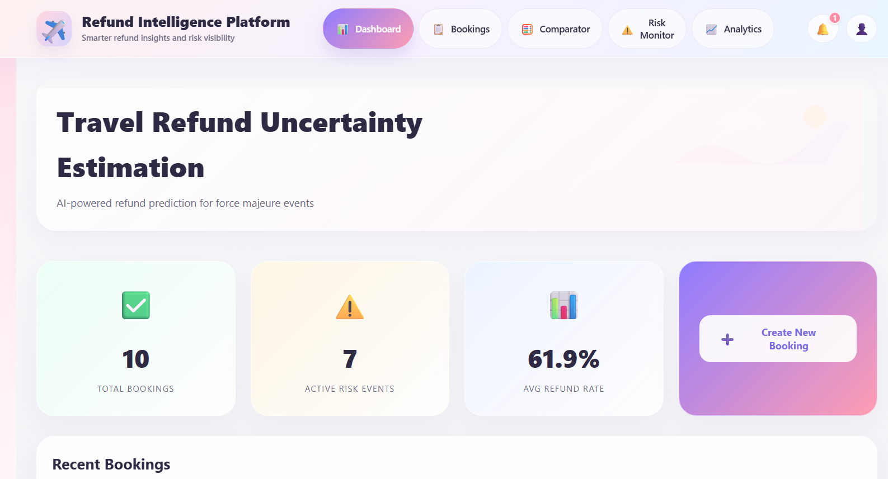
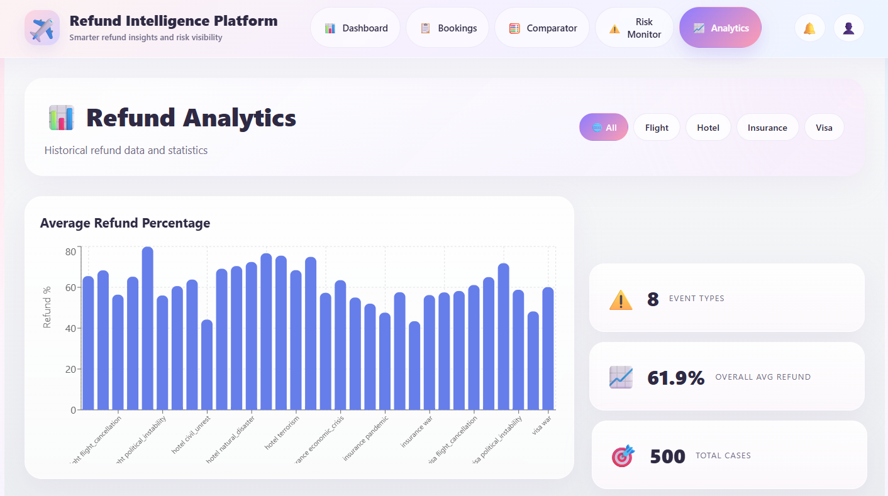
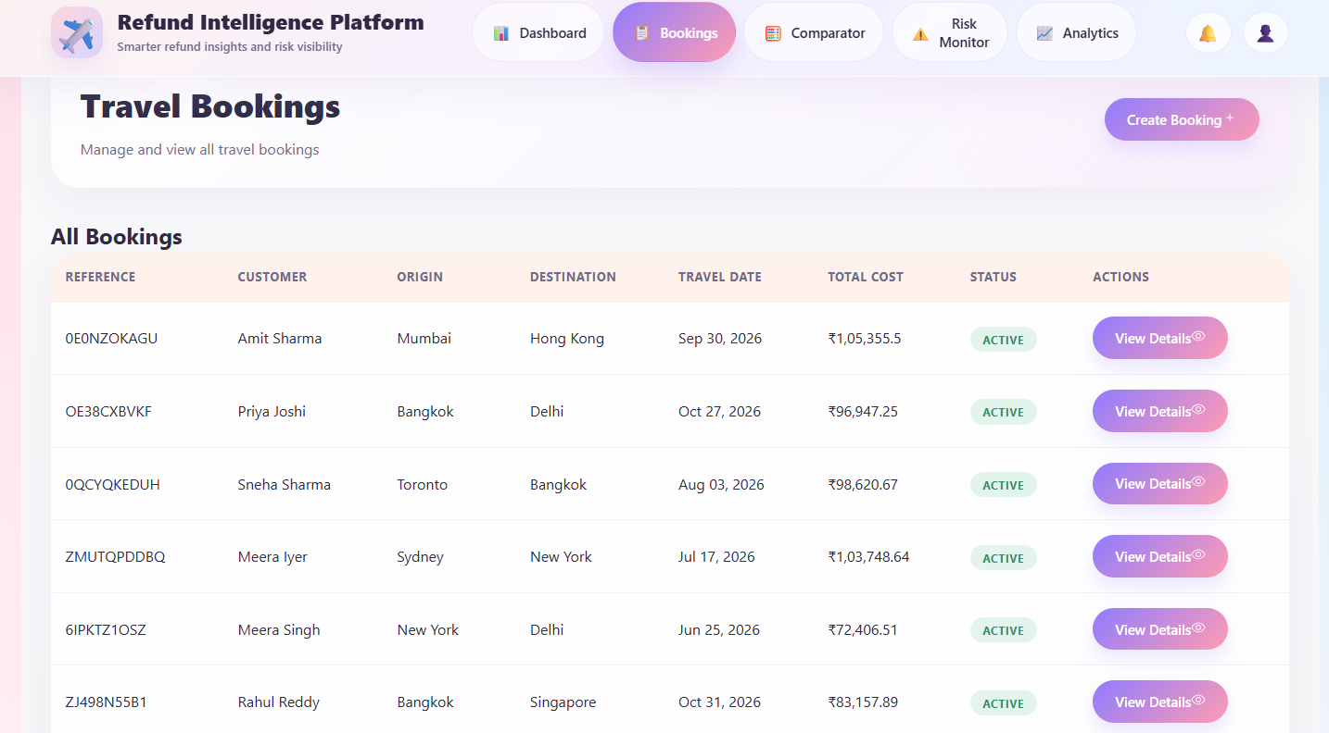
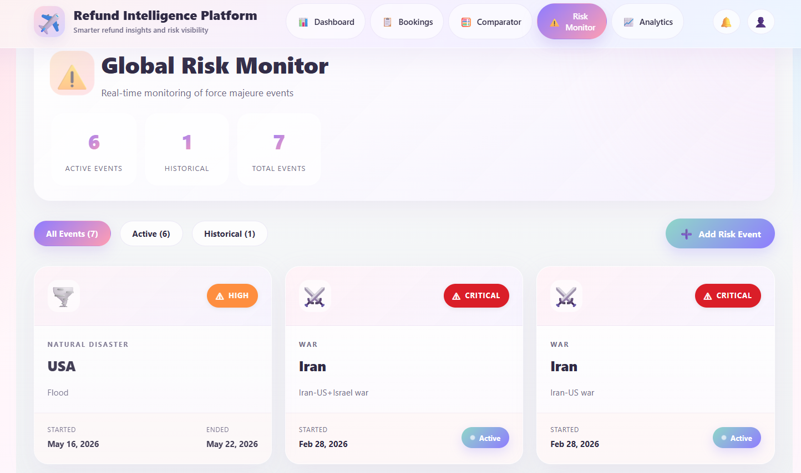
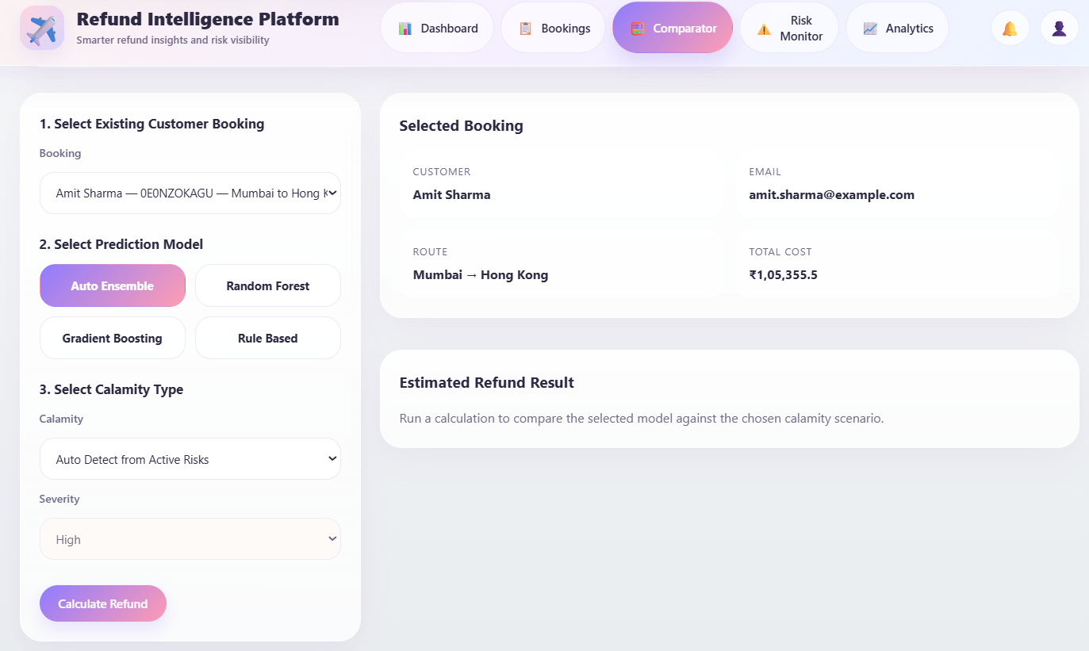
Platform Screens
Dashboard
Refund Analytics
Booking Details
Risk Monitor
Model Comparator

Slide 7
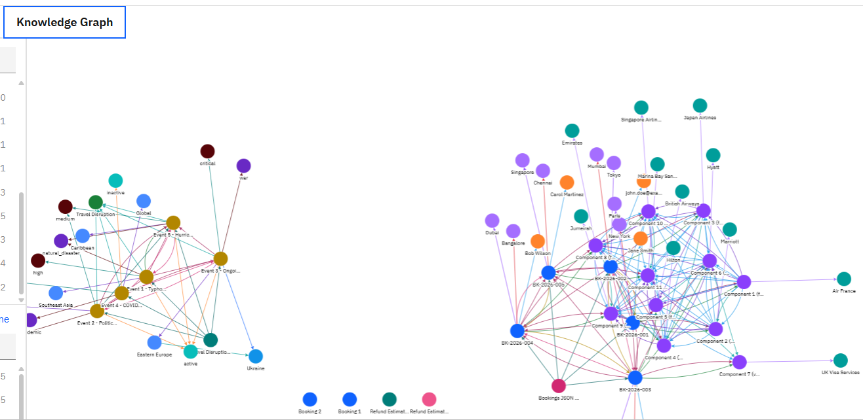
Context Studio
context_schema.yaml (812 lines)
System Architecture: Full-stack components definition
Backend API: 11 endpoints with complete specifications
Database Schema: 6 tables with relationships
Data Models: Request/response schemas with validation
ML Models: Random Forest + Gradient Boosting specs
Business Rules: Refund calculation logic
refund-api-bulk-import-v2.json (465 lines)
11 REST API tool definitions for Context Forge
Complete JSON Schema validation for each tool
Ready for IBM ICA Agent Orchestration
Knowledge Graph: 80+ nodes, 179+ relationships
Entities: Bookings, Components, Events, Providers, Policies
Context Studio- Knowledge Graph

Slide 8
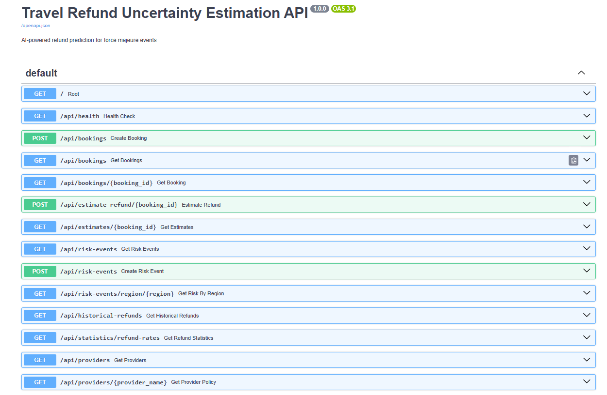
APIs

Slide 9
Key Features
IBM ICA Platform
Agent Orchestration (LangGraph + ReAct)
MCP Server (External) - Tool discovery & calling
Local Development Environment
FastAPI Backend - 11 REST endpoints, MCP endpoint
ML Models - Random Forest + Gradient Boosting
SQLite Database - 6 tables with relationships
React Frontend - 7 pages, interactive charts
Integration Layer
JSON-RPC 2.0 protocol
ngrok tunnel for public access
HTTPS communication
Model Context Protocol (MCP)
JSON-RPC 2.0 protocol for AI agent communication
7 tools exposed to IBM ICA agents
Custom implementation in backend/mcp_endpoint_simple.py
Public Access:
ngrok tunnel: https://famished-vertebrae-basil.ngrok-free.dev/mcp
refund-api-bulk-import-v2.json (465 lines)
v2-create-booking: POST /api/bookings
v2-get-bookings: GET /api/bookings (with pagination)
v2-get-booking-details: GET /api/bookings/{id}
v2-estimate-refund: POST /api/estimate-refund/{id} (ML-powered)
v2-get-refund-estimates: GET /api/estimates/{id}
v2-get-risk-events: GET /api/risk-events (global monitoring)
v2-get-regional-risk: GET /api/risk-events/region/{region}
v2-get-historical-refunds: GET /api/historical-refunds
v2-get-refund-statistics: GET /api/statistics/refund-rates
v2-get-provider-policies: GET /api/providers
v2-get-provider-policy: GET /api/providers/{name}
Each tool: Complete JSON Schema, headers, authentication, descriptions
Basic Agent Creation
Created TravelRefundAdvisor in Agent Studio
Conversational interface configured
Agent Orchestration
LangGraph + ReAct pattern
gpt-5.2 model
All 7 MCP tools integrated
Linking to MCP Server
Registered External MCP Server in ICA Tools
Tool discovery successful (7 tools)
End-to-end integration working
Agent successfully calling tools and retrieving data

Slide 10
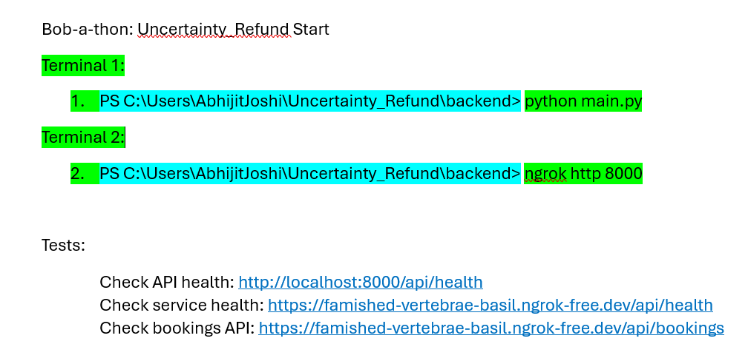
Project Start

Slide 11
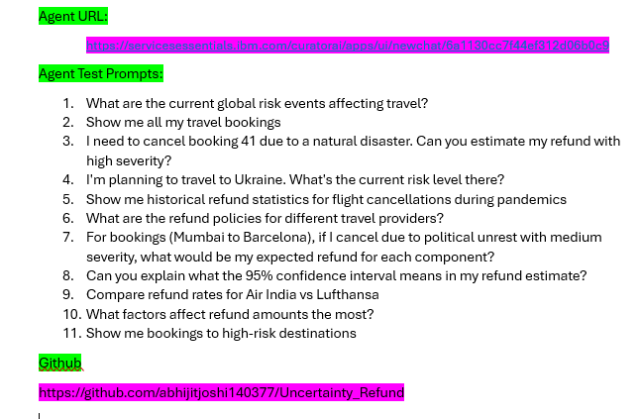
Agent Test

Slide 12
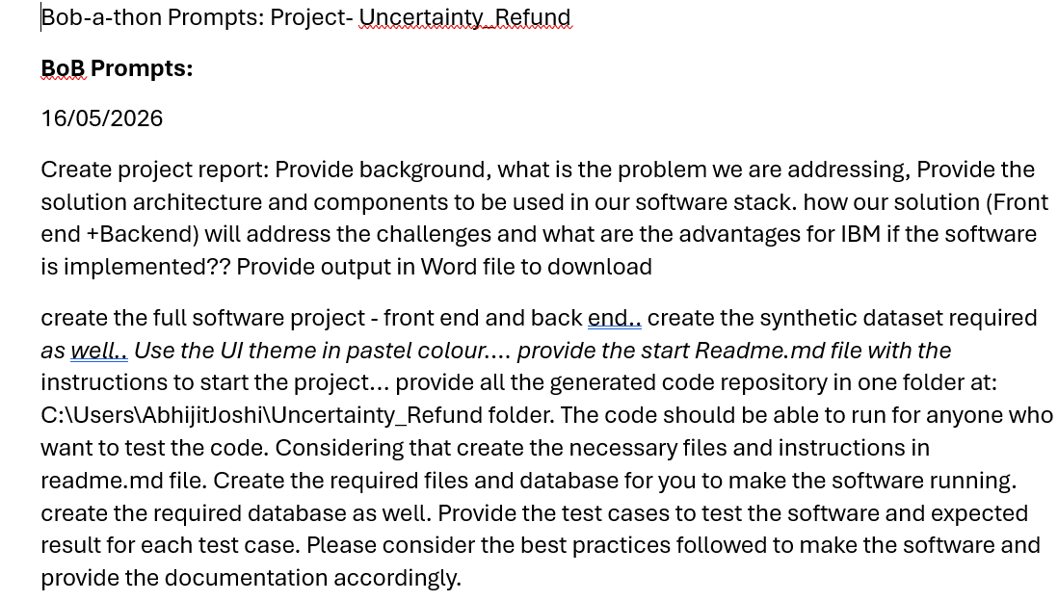
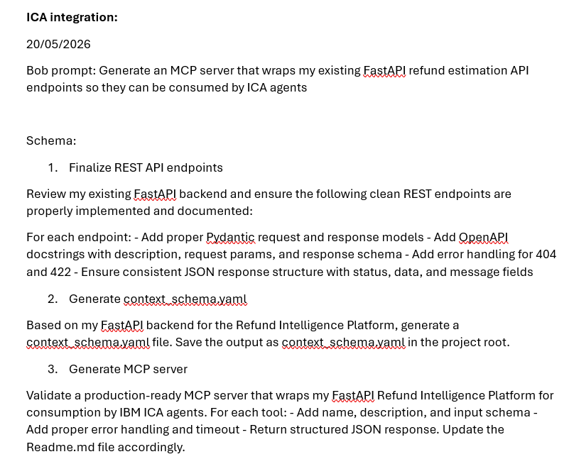
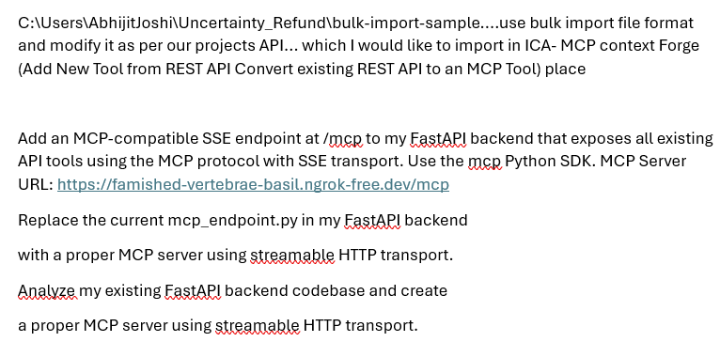
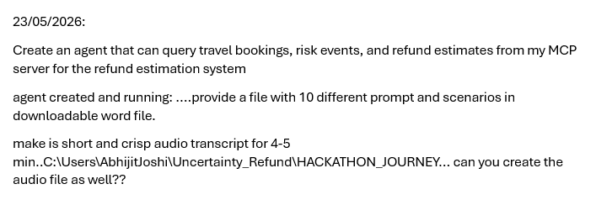
Sample Prompts
1
2
3
4

Slide 13
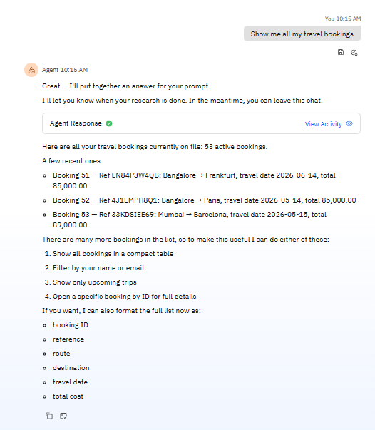
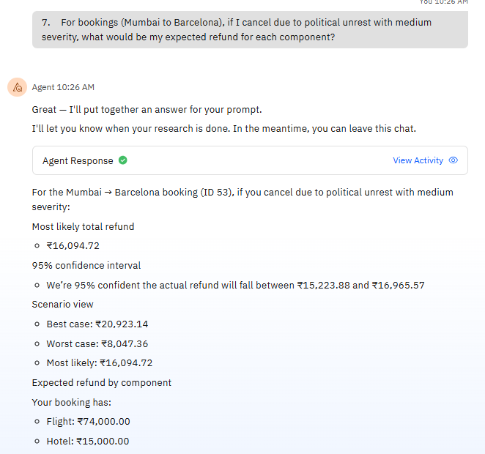
Final Agent Test

Slide 14
Results & Impact
Quantitative Results
11 API endpoints - All functional
7 MCP tools - Successfully integrated
95% confidence intervals - Uncertainty quantification
53 sample bookings - Realistic synthetic test data
500+ historical records - ML training data
100% success rate - All demo prompts working
Qualitative Impact
Customer Experience: Instant, transparent estimates
Business Efficiency: Automated vs manual process
Risk Management: Real-time global monitoring
AI Transparency: Explainable predictions
Enterprise Ready: IBM ICA integration

Slide 15
Business Value & Next Steps
Value Delivered
Roadmap
⚡ Faster refund decisions — model-backed, not manual
→ Persistent notifications & role-based access
🎯 Scenario analysis across 4 estimation models
→ Live external risk feed integration
📊 Historical analytics for explainability & audit
→ Provider-specific refund policy intelligence
🔔 Real-time operational awareness via notifications
→ Model benchmarking & exportable reports
Refund Intelligence Platform · AI-assisted decision support under uncertainty

Slide 16
Conclusion
Complete System Built in 48 Hours
Technical Excellence: Full-stack with ML and enterprise integration
Innovation: Uncertainty quantification and AI transparency
Business Value: Solves real travel industry problem
Production Quality: Professional code, docs, testing
Integration with IBM ICA through MCP protocol showcases how modern AI agents can connect to specialized business applications, creating powerful, transparent, user-friendly solutions.
This project represents the future of AI-powered business applications that are intelligent, explainable, and seamlessly integrated.

