Slide 1
Scalable R, Spark, and H20
Introduction to Spark
R and Spark
R and h2o

Slide 2
Introduction to Spark
➔ Introduction to Spark
Section 2
Section 3

Slide 3
Spark Illustrated
Schema / SQL
Real Time
Machine Learning
Graph Processing
Spark
SQL
Spark
Streaming
ML lib
Graph
Spark Core
Cluster
managers
Standalone
YARN
MESOS
Data Storage
S3
HDFS
Cassandra
???
3
Notes:
See the next slide for a brief explanation of each component.

Slide 4
Spark Structure
Data Storage: Pluggable data storage systems
Integrates with HDFS, S3, Cassandra DB, and more
Cluster Manager: Manages distributed node clusters
Provides the distributed execution environment
Works with Mesos, Yarn, and its own standalone manager
Spark Core: Distributed computing engine
Spark Components: Modules layered on top of core
Specialized functionality, e.g., Spark SQL for SQL-based querying
4
Notes:
We will get into more detail on how each of these components works and how they integrate together.
Standalone manager is called Scheduler.
Along with SQL, it also supports HQL–Hive Query Language.

Slide 5
Spark Core
Basic building blocks for distributed computing engine
Task schedulers and memory management
Fault recovery (recovers missing pieces on node failure)
Storage system interfaces
Defines Spark API and data model
Data Model: RDD/Dataframe/Dataset
Distributed collection of items
Can be worked on in parallel
Easily created from many data sources (Any HDFS input source)
Spark API: Scala, Python, and Java
Compact API for working with RDD and interacting with Spark
Much easier to use than MapReduce API
5
Notes:
We will get into more detail on how each of these components works and how they integrate together.
RDD–is akin to a table in a database. It can hold any type of data.
RDD helps in computation and optimization of data processing.
RDD is also fault tolerance–it can recreate itself.

Slide 6
Spark Components
Spark SQL: Structured data
Supports SQL and HQL (Hive Query Language)
Data sources include Hive tables, JSON, CSV, Parquet
Spark Streaming: Live streams of data in real-time
Low latency, high throughput (1000s events per second)
Log files, stock ticks, sensor data, IOT (Internet of Things)
ML Lib: Machine Learning at scale
Classification/regression, collaborative filtering…
Model evaluation and data import
GraphX: Graph manipulation, graph-parallel computation
Social network friendships, link data
Graph manipulation, operations, and common algorithms
6
Notes:
Parquet is an on disk, columnar format that is heavily compressed.
Spark Streaming–user activity, user updates, etc.

Slide 7
Spark: 'Unified' Stack
Spark components support multiple programming models
MapReduce style batch processing
Streaming/real-time processing
Querying via SQL
Machine learning
Graph Processing
All modules are tightly integrated
Facilitates rich applications
Spark can be the only stack you need!
No need to run multiple clusters (Hadoop cluster, Storm cluster, etc.)
7

Slide 8
R and Spark
Introduction to Spark
➔ R and Spark
R and h2o

Slide 9
R and Big Data
R has traditionally had weak support for large data
typically all data must be loaded into memory.
Weak support for "swapping" to disk or database.
R could be used with Hadoop
Hadoop Streaming API
A bit kludgy and very difficult to use a lot of R's power.
Revolution R Analytics (now Microsoft)
Developed a "Big Data" R (not free)
Developed an open-source RHadoop to use R with Hadoop.

Slide 10
R and Spark
R was the 4th language supported by Spark
after Scala, Java, Python.
Includes special runtime shell sparkR.
But R not really integrated
sparkR a separate binary
Not integrated with Rstudio.
sparkR basically translates the scala/Java objects to R

Slide 11
Configuring SparkR (old way)
install.packages("SparkR")
(but this may not work), so
Install directly from Git
if (!require('devtools')) install.packages('devtools') devtools::install_github('apache/spark@v1.4.0', subdir='R/pkg')
Set up Spark environment variables
See http://stackoverflow.com/questions/31184918/installing-of-sparkr
sc <- sparkR.init()
Use sc as you would in other Spark shells (next slide)

Slide 12
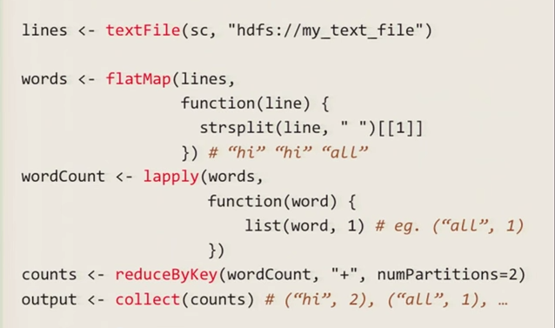
Using R with SparkR
Some R code:

Slide 13
Sparklyr Package: Real Spark/R Integration
The new sparklyr package gives us much better integration.
Provides an easy way to install spark locally for development
Great for Windows Users!
Easy one-liner
install.packages(“sparklyr”)
library(“sparklyr”)
spark_install(“2.1.0”)

Slide 14
Connecting to a production spark cluster
We can connect to a production spark cluster
This enables us to run our R code on big Data
We just need a parallelized operation to run it on
Unfortunately, we can’t run just ANY R code on it.
library(“sparklyr”)
sc <- spark_connect(“master = “spark://masterIPADDRESS:7077”)

Slide 15
dplyr and Spark
dplyr is the standard data exploration library in R
Written by Hadley Wickham
Extremely powerful and fast (written in optimized C++)
dplyr integrates with DBI to perform transparent database queries.
dplyr can also integrate with Spark objects
We can do push processing to spark that would normally done in memory on dplyr
We can use ggplot2 on dplyr objects created with spark.

Slide 16
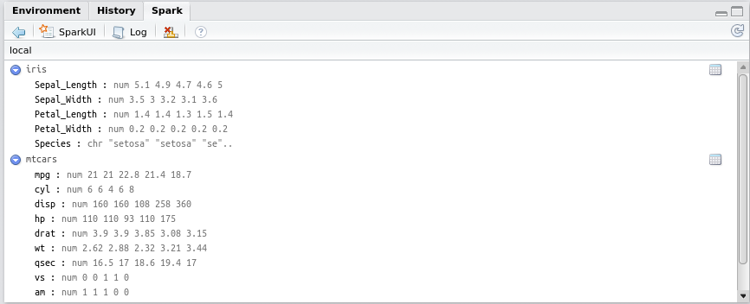
Rstudio Integration

Slide 17
R and Spark Mllib
Mllib is a Spark library of parallelized machine learning operations. Examples:
Kmeans
Random Forests
GBMs
PCA
Etc
We can call these from R on our data to run at scale on the cluster.

Slide 18
R and h2o
Introduction to Spark
R and Spark
➔ R and h20

Slide 19
What is h2o?
A open-source, machine learning library
written in Java
Hooks into Python, R, and other languages
Integrates with Hadoop for distributed processing
Runs on top of distributed HDFS data
h20's distributed processing engine.
Provides a broad range of distributed machine learning.

Slide 20
Using h2o with R
We don’t need Spark to use h2o with R.
h2o has very good R integration.
Aims to solve some of the scalability issues with R data.

Slide 21
Sparkling Water (h2o + Spark)
Putting h2o together with Spark, we get:
Sparkling Water
Allows us to process h2o and Spark together.
What Spark Brings to the table:
Better data management/SQL of hadoop data
Better scalability to Big Data sets
Ability to use mllib routines as well.
What h2o brings to the table:
Richer ML library than mllib alone
Ability to easily export models to self-contained Java objects.

Slide 22
Example: R + h2o + Spark
Let’s look at an example of R + h2o + Spark

