Slide 1
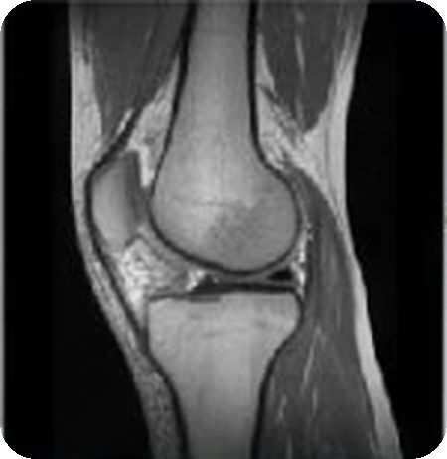
Auditable Multi-Model Ensemble for Knee MRI Abnormality Detection
MAJOR PROJECT · MID-SEMESTER EVALUATION
RSNA 2026 Knee Abnormality Detection AI Challenge
October 2026
DINOv3
RadImageNet
CoAtNet
Notes:
Introduce the project: we work on the RSNA 2026 Knee Abnormality Detection challenge on Kaggle. Our work is an auditable multi-model ensemble inference pipeline built from public pretrained components, plus our own experiment layer (ABG) and verification harness.

Slide 2
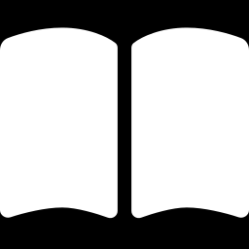
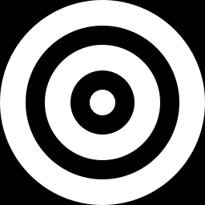
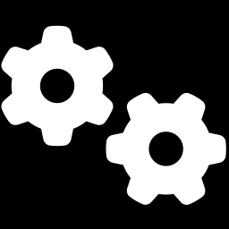
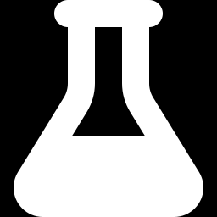
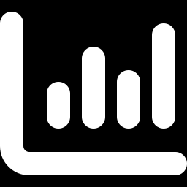
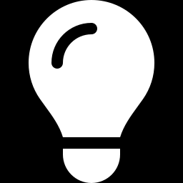
Outline
OVERVIEW
01 Introduction
02 Problem & data
03 Method
Why knee MRI and why this challenge
12 findings, macro-AUC, Kaggle constraints
Pipeline, encoders, rank fusion
04 Experiments
05 Results
06 Conclusion
ABG layer, simulation study, ablation batch, retired ideas
Verification, leaderboard, discussion
Limits, takeaways, next steps
Notes:
Standard structure: introduction, problem and data, method, experiments and ablations, results and discussion, conclusion.

Slide 3
Abstract
INTRODUCTION
Knee MRI is the gold standard for diagnosing internal derangement of the knee, yet interpretation varies between readers. The RSNA 2026 challenge asks for models that score 12 abnormalities per exam, ranked by mean AUC. We assembled a five-stage ensemble inference pipeline from pretrained DINOv3 transformers, a RadImageNet ResNet-50 and CoAtNet hybrids, fused by percentile-rank blending under Kaggle's offline, two-T4, eight-hour limits. On top we designed ABG, a pre-specified experiment layer with three post-calibration additions, and a verification harness that binds every submission to a hashed receipt. Our two graded submissions, the parent recipe and ABG, scored 0.940 and 0.922 on the public leaderboard. A synthetic simulation of the fusion mechanics suggests such additions should move the score by thousandths, so the observed 0.018 gap needs investigating; three retired ideas show gates set in advance at work.
12
findings scored per study
0.940 · 0.922
public score: parent · ABG
3
encoder families in a 5-stage pipeline
Notes:
Read the abstract in one breath. Emphasise: ensemble of pretrained components, our ABG experiment layer, verification, the two graded submissions (parent 0.940, ABG 0.922), the synthetic mechanism study, and honest reporting of what failed.

Slide 4
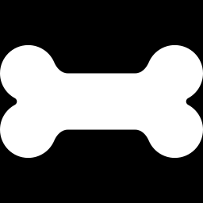
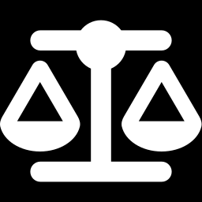
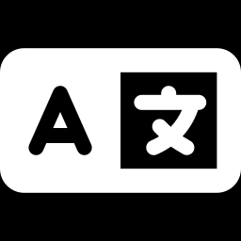
Why knee MRI, and why this challenge
INTRODUCTION
Whole-joint view
MRI shows ligaments, menisci, cartilage loss, effusion, synovitis, Baker cysts and bone-marrow lesions.
5,000+
12
training knee MRI exams
report languages
Reader variability
Interpretation differs across readers and sites, and specialist musculoskeletal radiologists are scarce.
16
12
A first for RSNA
First musculoskeletal challenge and the first to pair images with multilingual radiology reports.
training sites worldwide
findings to score
Source: RSNA news release, 5 Aug 2026 (training set: more than 5,000 exams from 16 sites).
Notes:
Context from the RSNA announcement. Note the figure of 16 sites is the training set as stated in the RSNA release.

Slide 5
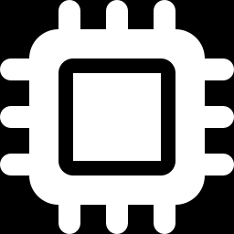
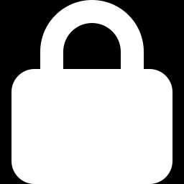
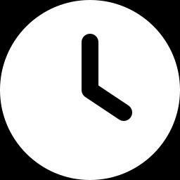
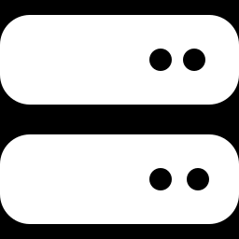
Task: 12 findings, one macro AUC
PROBLEM & DATA
LIGAMENTS
ACL
MCL
LEADERBOARD METRIC
MENISCI
Medial
Lateral
Score = 1/12 · Σ AUC_{k}
CARTILAGE / OA
Medial OA
Lateral OA
Patellofemoral OA
Unweighted mean of the 12 per-finding AUCs. Only the ordering of scores matters, so outputs are ranking scores, not calibrated probabilities.
JOINT & SOFT TISSUE
Effusion
Synovitis
Baker's cyst
BONE
Contusion
Fracture
KAGGLE CODE-COMPETITION CONSTRAINTS
2 × Tesla T4
Internet off
8 h hard cap
Hidden test set
the only accelerators
all weights attached offline
an over-budget run fails
notebook is re-run by Kaggle
Notes:
The twelve targets and the metric. A 0.001 rise in the macro score needs about 0.012 total AUC gain across targets, which is why small single-target improvements barely move the leaderboard. Code competition: the notebook is re-run offline by Kaggle on a hidden test set.

Slide 6
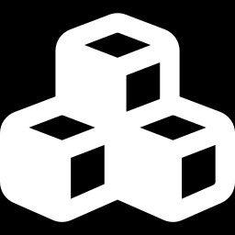
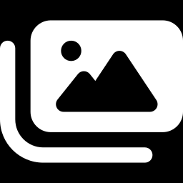
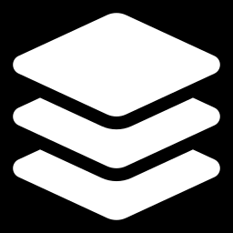
Three pretrained model families
METHOD
DINOv3 ViT-S/16
RadImageNet ResNet-50
CoAtNet hybrid
Self-supervised vision transformer (Meta). Splits slices into 16×16 patches and applies multi-head self-attention.
Convolutional network pretrained on radiology images rather than natural images.
Convolution blocks (MBConv) combined with transformer self-attention, run over several MRI views.
ROLE HERE
ROLE HERE
ROLE HERE
20 ensemble members + 5 A5 folds with slot-attention pooling.
Frozen feature extractor feeding Rad heads and a frozen calibrator.
Raptor 4-arm model plus a residual CoAtNet (epochs 4, 6, 8).
Weights: pilkwang; M. Angeli (A5 folds)
Heads: Antoine, S. Anjenje; encoder mirror: Marwan
Weights: J. Wagner (DreadDevelopment); M. Angeli
All weights are public releases, credited on the References slide.
Notes:
The three families and what each contributes. These are public pretrained releases; we credit the authors of each. Different architectures make different errors, which is the reason to ensemble them.

Slide 7
What we built on, and what we added
METHOD
BUILT ON (public releases)
ADDED IN THIS PROJECT
Pretrained weights and inference code for the DINO members, A5 folds, Rad heads, Raptor CoAtNet and residual CoAtNet
M. Angeli's V27 prediction graph, which our parent submission (V17, public 0.940) reproduces
Meta's DINOv3 and RadImageNet backbones
15 public Kaggle inputs, each pinned by version and attached offline
Apache 2.0 notebook code; CC0 weight datasets; RadImageNet heads CC-BY-NC-SA 4.0
A
Native E11 head residual
new post-calibration signal
B
Alternate Rad family residual
activates diagnostic predictions
G
Raptor gain marginalisation
extra intensity views
✓
Experiment protocol and receipt
pre-specified batch; hashed audit trail
Notes:
Be explicit about the split. The pretrained components and the parent recipe are public work by others. Our contributions are the ABG layer (A, B and G), the pre-specified experiment protocol, and the per-target diagnostics and receipt that bind each submission to its exact configuration. Our retired-idea evaluations are on the experiments section.

Slide 8
Pipeline architecture
METHOD
INPUT
PREPROCESS
DINOv3 ViT-S/16 · 20 members + 5 A5 folds
RANK FUSION
12 SCORES
DICOM geometry gives plane and laterality
Series text gives fat-sat or structural
6 slots; missing slots masked
≈130 mm crop, resize, slice window
Right knees flipped
Slices × 6 slots
ViT + slot attention
Rank mean, A5 at 0.45
T′ = rank(T + R_{A} + R_{B})
H = 0.6·Raptor + 0.4·ResCoAt
final = rank((1−w)·T′ + w·H)
w = 0.60; lateral meniscus 1.00
ACL
MCL
Med. meniscus
Lat. meniscus
Med. OA
Lat. OA
PF OA
Effusion
Synovitis
Baker's cyst
Contusion
Fracture
RadImageNet ResNet-50 · frozen features
A
B
Knee MRI study
ResNet-50 features
Heads: ref · E13 · E11 · E10
Frozen calibrator
Several series: sagittal, coronal, axial; fat-sat and structural
CoAtNet · Raptor 4 arms + residual CoAt
G
Raptor ×4 arms
Gain views 0.9 · 1.0 · 1.1
+ residual CoAt (60/40)
submission.csv + hashed receipt
DINOv3
RadImageNet
CoAtNet
A
B
G
ABG experiment additions
T = DINO/A5 + calibrated Rad branch
Notes:
Walk left to right. Input study, preprocessing into six slots, three encoder families, rank fusion, twelve scores plus a hashed receipt. Purple badges mark where the ABG additions attach: A and B on the Rad branch after the frozen calibrator, G on the Raptor CoAtNet branch. The original schematic figure in our report shows trainable MLP heads; in the implementation the final combination is rank blending and no new network is trained.

Slide 9
From DICOM series to a six-slot input
METHOD
1
Study
2
Read headers
3
Fill slots
4
Normalise
Several DICOM series per exam: sagittal, coronal and axial, fluid-sensitive (fat-sat) and structural.
Plane from image orientation; fat-sat from series text and sequence tags; laterality from tag or geometry; slices ordered by position.
Sag
Cor
Ax
Right knees flipped to a common side, ≈130 mm crop around the knee, resize, slice window.
fat-sat
struct.
6 slots; a missing slot is masked, never invented
INPUT GEOMETRY BY MODEL FAMILY
Family | Resolution | Slices | Notes
DINOv3 members (20) | 336 px | 12 per slot | ≈130 mm crop; 10 overlapping windows vote
A5 folds (5) | 336 px | 16, band 12–88 % | per-slice intensity scaling
RadImageNet heads | 224 px | per slot-series | E10 layout: 8 slot-series; E11 layout: 7
Raptor max-span arm | 336 px (res 384) | 64, span 2–98 % | 62 windows per study
Notes:
Preprocessing is DICOM-header driven. Series are classified into a fixed six-slot layout (three planes by fat-suppressed or structural). Right knees are flipped so all knees look the same way. Each model family consumes its own resolution and slice count, listed in the table from the notebook configuration and logs.

Slide 10
DINOv3 ensemble with slot attention
METHOD
Slice stack
Patch embedding
ViT-S/16 backbone
Pool per slot
Slot head
12–16 slices per slot, 336 × 336
16 × 16 patches become tokens plus CLS
12 blocks; last 6 trainable (≈10.7 M params)
CLS + mean-pooled feature, dim 768
12 finding queries attend over 6 slots; missing slots masked
20-member ensemble
A5 attention-pooling folds
45%
Released DINO MRI weights, each with its own saved preprocessing
Combined by rank mean across members
Every weight fingerprint verified: 20 of 20 matched, largest difference 0.0000046
5 further DINOv3 folds with token cross-attention pooling
Blended at a fixed weight, not tuned
A5 weight in the DINO / A5 blend
Notes:
Each slot is encoded by a DINOv3 ViT-S/16. A slot head lets each of the twelve findings attend over the six slots, so for example meniscus findings can lean on sagittal views. The 20 released members are rank-averaged; five A5 folds are added at a fixed 45 percent weight. All 20 weight fingerprints matched in the run log (largest difference 4.6e-6).

Slide 11
RadImageNet heads and CoAtNet arms
METHOD
RadImageNet ResNet-50 → Rad heads
CoAtNet → Raptor + residual CoAt
Frozen ResNet-50 (RadImageNet) features, 224 px
RAPTOR ARM MIXTURE (4 VIEWS)
60
10
10
20
HEAD FAMILIES
G
Gain marginalisation G: each arm averaged over gains 0.9 · 1.0 · 1.1 with weights 1/6 · 4/6 · 1/6
Reference (v15)
E13, two-pass (α 0.15)
A
B
E11 native
E10 alternate
Residual CoAtNet, epochs 4 · 6 · 8
Original frozen calibrator → T branch
H = 0.60 · Raptor + 0.40 · ResCoAt
A and B are added after the calibrator; its inputs and coefficients stay untouched.
For the lateral meniscus the final score is H alone.
Notes:
Left: RadImageNet ResNet-50 features feed several head families; the original calibrator is frozen and A and B are added after it. Right: the Raptor CoAtNet has four arms mixed 60/10/10/20; G averages each arm over three intensity gains; a residual CoAtNet (epochs 4, 6, 8) is blended 40 percent to form H.

Slide 12
Percentile-rank fusion
METHOD
FUSION RULE
T′ = rank( T + R_{A} + R_{B} )
H = 0.60 · rank(Raptor_{G}) + 0.40 · rank(CoAt_{res})
ŷ_{k} = rank( (1 − w_{k})·T′ + w_{k}·H )
w_{k} = 0.60; lateral meniscus: w = 1.00
Why rank space?
Each model emits scores on its own scale. AUC depends only on ordering, so we blend percentile ranks and re-rank, which keeps one model's scale from dominating.
Notes:
The blend is done on percentile ranks. For eleven targets the transformer and Rad branch carries 40 percent, and the Raptor and residual CoAtNet hybrid 60 percent, split 36 and 24. For the lateral meniscus the hybrid alone is used. These are nominal rank-space weights, taken directly from the final composition code.

Slide 13
ABG: three post-calibration additions
EXPERIMENTS
A
Native E11 head residual
B
Alternate Rad family residual
G
Raptor gain marginalisation
R_{A} = 0.15 · (rank(E11 native) − rank(E13 on E11 pixels))
R_{B} = 0.85 · 0.500001 · (rank(alt E10) − rank(ref E10))
p̄ = ⅙·p(0.9) + ⅔·p(1.0) + ⅙·p(1.1)
Five existing E11 heads on features already computed
No extra encoder pass
Uses predictions the parent already computes as diagnostics
Exactly zero for Baker's cyst and fracture
Each Raptor arm averaged over intensity gains
Two extra forward passes per study and arm
Shared rules: calibrator inputs and coefficients untouched · residual scales inherited, not newly fitted · no new training · hard 8-hour limit
Notes:
The three additions. A and B are rank residuals added after the frozen calibrator; A uses five native E11 heads on features that are already computed, B activates predictions that the parent computed only as diagnostics. G averages each Raptor arm over intensity gains inside the range the model saw in training. None of them trains anything new, and their scales are inherited, not fitted to the leaderboard.

Slide 14
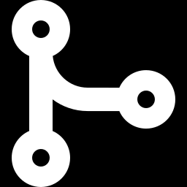
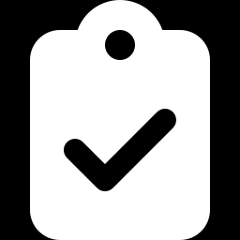
Gain marginalisation (G)
EXPERIMENTS
Supported variation
Training used intensity-gain augmentation, so 0.9 and 1.1 stay inside the range the model has seen.
Less scanner sensitivity
Averaging softens dependence on scanner brightness; the arm mixture 60/10/10/20 is kept.
Exactness check
With gains fixed to 1.0 the parent Raptor output is reconstructed exactly.
Weights 1 : 4 : 1 act like a quadrature over the gain range, so the unmodified view still dominates.
Largest raw difference between gain views: 0.048 (3-study check)
Notes:
G changes only the test-time input intensity, using the three gains 0.9, 1.0 and 1.1 with weights one sixth, four sixths and one sixth. The notebook verifies that with the gain fixed at 1.0 the parent prediction is reproduced exactly, and records the largest raw difference between gain views, 0.048.

Slide 15
Mechanism study: why ensembling helps
EXPERIMENTS
Going from 10 to 20 members adds only +0.0020. Blending three families gains +0.0284 at ρ = 0.2 but −0.0033 at ρ = 0.8.
SYNTHETIC SIMULATION, NOT RSNA DATA · 1,500 studies × 12 targets, prevalence 25%, 40 repetitions; score = signal + correlated Gaussian noise; parameters assumed. 95% intervals ≤ ±0.003.
Notes:
This is a controlled simulation, not a result on the competition data. Each model score is a signal plus Gaussian noise, with a chosen correlation between models. It shows the mechanism behind our design: ensemble gains saturate quickly, and blending different families only pays off when their errors are not strongly correlated. All parameters are assumed; the script is in the project repository under simulation/.

Slide 16
Mechanism study: residuals and gain views
EXPERIMENTS
At the inherited scale 0.15 a worse head costs −0.0056; 1:4:1 gain weights keep +0.0018 when off-centre views are weaker, equal thirds do not.
SYNTHETIC SIMULATION, NOT RSNA DATA · same setup as the previous slide; heads a and b share most of their noise (ρ = 0.92), gain views share noise with ρ = 0.9; parameters assumed. Paired 95% intervals ≤ ±0.0003.
Notes:
Same synthetic setup. Left: a post-calibration residual, as in A and B, changes the macro AUC by a few thousandths at the inherited scale, helpful if the added head is better, harmful if it is worse. Right: gain averaging with weights 1 to 4 to 1 keeps a small gain even when the off-centre views are slightly weaker, whereas equal weights lose it. This motivates the 1:4:1 choice. These are simulated mechanisms, not measured effects of A, B or G on the competition data.

Slide 17
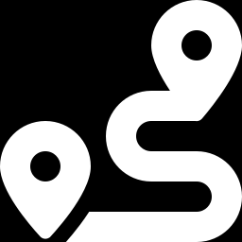
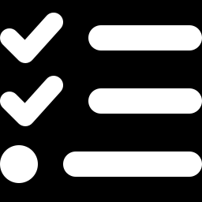
Submissions and ablation batch
EXPERIMENTS
Run | A | B | G | Status
Parent recipe (V17) |  |  |  | Graded: 0.940 (submission 1)
A | ● |  |  | Planned
B |  | ● |  | Planned
G |  |  | ● | Planned
AB | ● | ● |  | Planned
ABG | ● | ● | ● | Graded: 0.922 (submission 2)
PROTOCOL
Fixed in advance
The whole batch was defined before any leaderboard result.
No chasing the score
Later entries are not tuned to earlier results.
Gates stay failed
Acceptance criteria are set up front; a later score never overrules a failed gate.
Two submissions are graded so far. A, B, G and AB are the next runs, and the only way to attribute the change to one addition.
Notes:
The batch A, B, G, AB, ABG was fixed before looking at any leaderboard result so later entries cannot be tuned to earlier scores. Our two graded submissions are the parent recipe at 0.940 and ABG at 0.922. The single-addition runs are planned next and are the way to attribute any gain or loss to one addition.

Slide 18
Ideas tested and retired
EXPERIMENTS
Idea | Recorded evidence | Decision
OrthoDiffusion ACL overlay | Positive gains, but bootstrap confidence 0.677 vs 0.80 required | Retired
OrthoDiffusion on MCL and menisci | Negative on all three pre-set targets | Retired
Anchor-bilinear residual | ACL +0.00095 ≈ +0.00008 macro; below frozen floors | Retired
LCSE anatomical residual | ACL −0.00109; 2 of 4 folds positive; all six gates failed | No submission
A failed gate is never overruled by a later public score. These are historical results from frozen evaluation packages, not fresh runs of this notebook.
A +0.001 change in one target moves the 12-target macro score by only ≈0.0001.
Notes:
Three ideas we evaluated and retired because they failed gates that were set in advance. OrthoDiffusion gave positive point gains for ACL but its confidence fell short of the required 0.80 and it was negative for MCL and menisci. Anchor-bilinear gave a gain worth about 0.00008 on the macro score. The LCSE residual was negative and failed all six gates. These are historical results from frozen evaluation packages.

Slide 19
Verification of the final pipeline run
RESULTS
Check | Outcome | Result
GPU preflight | 2 × Tesla T4 detected; CUDA probes passed on both | PASS
DINO stage | 20 / 20 weight fingerprints matched (≤ 4.6e-6); output (3, 13) | PASS
A5 and Rad stages | Row count, UID order, finite values and 0–1 range checked | PASS
Raptor stage | 4 arms completed in ≈93 s for the 3 visible studies | PASS
Gain check (G) | Parent output reconstructed exactly; max gain-view difference 0.048 | PASS
Final candidate | Reproduction and candidate check; CSV hash f0ceb6ae…fa48d729 | PASS
20 / 20
DINO members matched
≈100 s
3-study run, end to end
PASS
final candidate check
These checks show that the pipeline runs correctly and writes a valid file. They do not measure AUC.
Notes:
These are the checks recorded in the notebook run on the three visible test studies. They validate execution, schema and identity of the output file. They are not accuracy measurements.

Slide 20
Leaderboard results
RESULTS
OUR TWO GRADED SUBMISSIONS
0.940
submission 1: parent recipe (V17)
0.922
submission 2: ABG
Public leaderboard, mean AUC over 12 findings; Kaggle re-runs the full notebook on the hidden test set.
Sources: our graded submissions; mid-Aug 2026 values from the Kaggle discussion forum (≈0.92 and ≈0.951), now out of date.
Notes:
Our parent submission (the V17 recipe) scored 0.940 and our ABG submission scored 0.922 on the public leaderboard. For context, a Kaggle forum thread from mid-August quoted about 0.92 for shared public notebooks and about 0.951 for the top public score. Those two mid-August figures are old and the leaderboard has moved since.

Slide 21
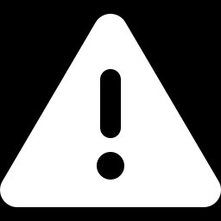
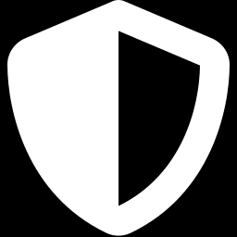
Reading the two scores honestly
RESULTS
Below the parent
ABG scored 0.922, 0.018 under our parent submission at 0.940, so the three additions did not help on the public leaderboard.
Cause not isolated
A, B and G were graded only together. In simulation a clearly worse residual costs ≈0.006 at the inherited scale, so a 0.018 gap needs the single-addition runs to explain.
No tuning to the result
Residual scales are inherited, not fitted, and the batch was fixed in advance, so we report the outcome as it came.
Macro AUC is a mean of 12, so each target counts 1/12: +0.001 overall needs +0.012 summed over targets.
Notes:
Be direct about the result. ABG scored lower than our parent submission, so as a whole it did not improve it. We cannot say which of A, B or G is responsible because they were graded together; the simulation suggests the design alone should cost far less than 0.018, and the planned single-addition runs answer it. The chart is simple arithmetic: a single-target gain is divided by 12 in the macro score.

Slide 22
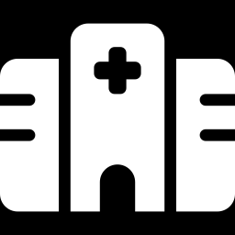
Limitations and responsible use
CONCLUSION
No new training or validation
Not clinical evidence
Base models are public releases and no held-out validation was run. The mechanism study uses synthetic data with assumed parameters.
A leaderboard score does not establish performance on other scanners, sites or patients.
Licences differ per component
A ranking score, not a probability
RadImageNet-based heads are CC-BY-NC-SA 4.0, DINOv3 has its own licence, and several datasets are CC0.
Outputs are percentile ranks for AUC, not calibrated probabilities for clinical decisions.
Notes:
Limitations: nothing new was trained, there is no new held-out validation, the leaderboard is not clinical evidence, some components carry non-commercial share-alike licences, and the outputs are ranking scores.

Slide 23
Conclusion and next steps
CONCLUSION
WHAT WE SHOWED
NEXT STEPS
A five-stage, three-family ensemble runs reproducibly inside Kaggle's offline two-T4 budget and writes a receipt-bound submission.
Our parent submission scored 0.940 and ABG 0.922; ABG did not beat its parent, a clear negative result we can now investigate.
A synthetic study suggests such additions move the score by thousandths, so the 0.018 gap needs a closer look.
A pre-specified protocol and hard gates kept three weak ideas out of the submission.
1
Run A, B, G and AB separately on the real test set to attribute the gap to the parent
2
Record each graded score against earlier submissions
3
Evaluate prospectively: patient-level splits, acceptance criteria set before opening held-out results
4
Finalise report and presentation before the competition closes on 22 Oct
Notes:
Close with three takeaways and the next steps. The competition closes on 22 October 2026 according to RSNA; winners are announced in November.

Slide 24
References and acknowledgements
CONCLUSION
Challenge and data
RSNA Knee Abnormality Detection AI Challenge (2026). rsna.org/artificial-intelligence/ai-image-challenge/knee-mri-ai-challenge
Kaggle competition: kaggle.com/competitions/rsna-knee-abnormality-detection
RSNA News, “RSNA Launches Knee Abnormality Detection AI Challenge”, 5 Aug 2026
Models and methods
Siméoni et al., DINOv3, Meta AI, 2025 (arXiv:2508.10104)
Oquab et al., DINOv2, 2023 (arXiv:2304.07193)
Dosovitskiy et al., An Image is Worth 16×16 Words (ViT), ICLR 2021
Dai et al., CoAtNet, NeurIPS 2021
Mei et al., RadImageNet, Radiology: Artificial Intelligence, 2022
He et al., Deep Residual Learning for Image Recognition, CVPR 2016
Released components used (Kaggle)
Mattia Angeli: V27 notebook, A5 fold weights, residual CoAtNet
pilkwang: DINO MRI ensemble weights
Johnathan Wagner / DreadDevelopment: Raptor CoAtNet
Antoine (antoinegg1): reference Rad heads, E11 v20 heads
Sofia Anjenje: E11 / E13 implementations
Marwan: RadImageNet ResNet-50 mirror
Bee V17 notebook lineage: parent submission, public score 0.940
Mechanism study: simulation/fusion_simulation.py in the project repository
Licences
Apache 2.0 notebook code; CC0 datasets; RadImageNet-based heads CC-BY-NC-SA 4.0; DINOv3 License (Meta)
Notes:
Credit every component. Our contribution is the ABG layer, the protocol and the receipt; the pretrained components and parent recipe come from the authors listed here.

Slide 25
Thank you
QUESTIONS
Auditable multi-model ensemble for knee MRI abnormality detection

