Slide 1

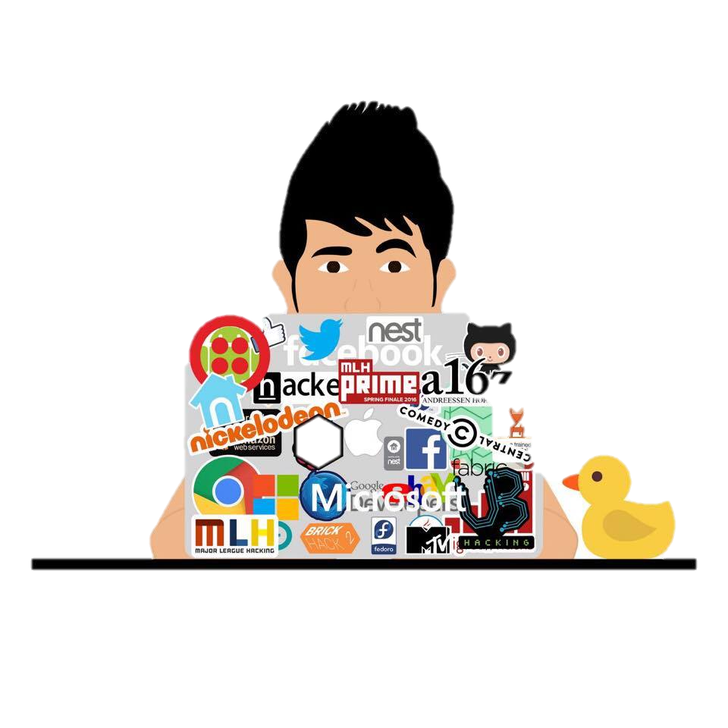





Brijesh Rakholia
rakholiabrijesh@gmail
brijeshrakholia.me
brijeshrakholia
brijeshrakholia
Work Experience
+1 (716)-939-7102
.
.
Stark & Wayne, LLC Cloud Engineering Intern Buffalo, NY
June 2017 – Present
Currently working with cloud native technologies such as Cloud Foundry, Bosh, and Concourse. More details about the project will be updated at http://brijeshrakholia.me soon.
.
.
Tutr Co-founder, Backend Engineer Buffalo, NY
Aug 2016 – Dec 2016
Tutr is a web application that provides on-demand tutoring service for college students, just like Uber.
Built the Tutr backend infrastructure using nodejs, socket.io, mongodb, and auth0.
Developed a continuous integration deployment bot for the website build cycle using Slack API.
.
.
Viacom Software Engineering Intern New York, NY
May 2016 – Aug 2016
Worked closely with the Video Player Team to develop live-streaming support for MTV Apple TV app using tvOS and TVML. Launched the feature of the Video Music Awards 2016.
Developed an internal tool using d3.js to visualize Git repositories in order to analyze software development practices.
.
.
blue Systems Research Group Systems Researcher Buffalo, NY
Feb 2015 – May 2017
Worked towards quantifying and prioritizing smartphone Quality of Experience (QoE).
Developed an offline-processing pipeline to analyze on-screen user interactions and events such as touch events, progress bars, screen freezing, etc.
It combines low-level Android Logging (android platform instrumentation) and analysis to measure the length of time user waits for apps to complete certain actions.
University at Buffalo
.
.
Aug 2016 – May 2017
Computer Science TA Buffalo, NY
CSE421/521 : Operating Systems (OS/161 by Harvard)
CSE199 : How the Internet Works
Held office hours (8 – 10 hrs/week), organized and hosted multiple 24 hour hacknights to help students debug their virtual memory implementation.
Developed tools & infrastructure needed for the course. Interacted with students one-on-one during the class.
CSE250 : Data Structures in C++
CSE115 : Intro to Computer Science
Held office hours (5 – 10 hrs/week), and helped students with programming assignments.
Held office hours (3 hrs/week), helped students with programming assignments, and taught recitations.
Software Projects (more at github.com/brijeshrakholia)
BridgeOS - An Instructional Operating System | C
Implemented synchronization primitives such as mutex locks, conditional variables, and reader/writer locks.
Designed and implemented the entire file system syscall interface (read, write, close, lseek, dup2, chdir) , and process support (exec, fork, waitpid) so that user-programs can be executed by launching a simple shell.
Carefully designed and successfully implemented virtual memory, including address translation, TLB management, page replacement, and swapping – without any memory leaks.
SpinBot (UBHacking Finalist) | Arduino, Python
Muvis (muvis.herokuapp.com) | JavaScript
Built a persistence of vision display for Slack from recycled 5.25” optical drives, LEDs, and Arduinos; capable of running in live `message ticker` via a custom Slack integration using Slack API.
Muvis is a music visualizer usign d3.js and paper.js developed at Spotify Music Hackathon
3D Hologram Generator | Unity
Silver | JavaScript, Python
Built a Hologram Generator using a screen and acrylic sheet. Wrote a music visualizer using unity to project that visualization over the hologram generator.
Wrote a slack bot and a web crawler to book private rooms every midnight at University at Buffalo Libraries.
Robotic Arm (tiny.cc/roboticarm) | JavaScript
Network.js | JavaScript
Built a robotic arm to follow the movements of my hands in 3D space using leap motion and Arduino.
Developed a visualization using js canvas portraying a network. It is basically a simpler version of particle.js.
Education
University at Buffalo
B.S Computer Science, Expected December 2017
Relevant Courses
OS, Networking, Distributed Systems, Database Concepts, Robotic Algorithms, Software Engineering.

