Slide 1
Neurohack
NightHawks:
Akash Kirodiwal
Abhijit Pal
Ajith H
Nikhil Doye
Sandra Mary Jacob

Slide 2
Table of Contents
Problem Statement
Technology Stack
Approach towards ticket categorization
Approach towards anomaly detection
Major Challenges
Future Scope
Demo

Slide 3
Problem Statement
Categorization of the Application support ticket data based on description/summary
Analyze the ticket trends through patterns and detect the anomalies & refresh the data to present a revised view

Slide 4
Technology Stack
Python
Django Web Framework
MySQL
ML libraries

Slide 5
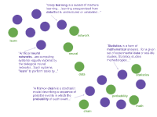
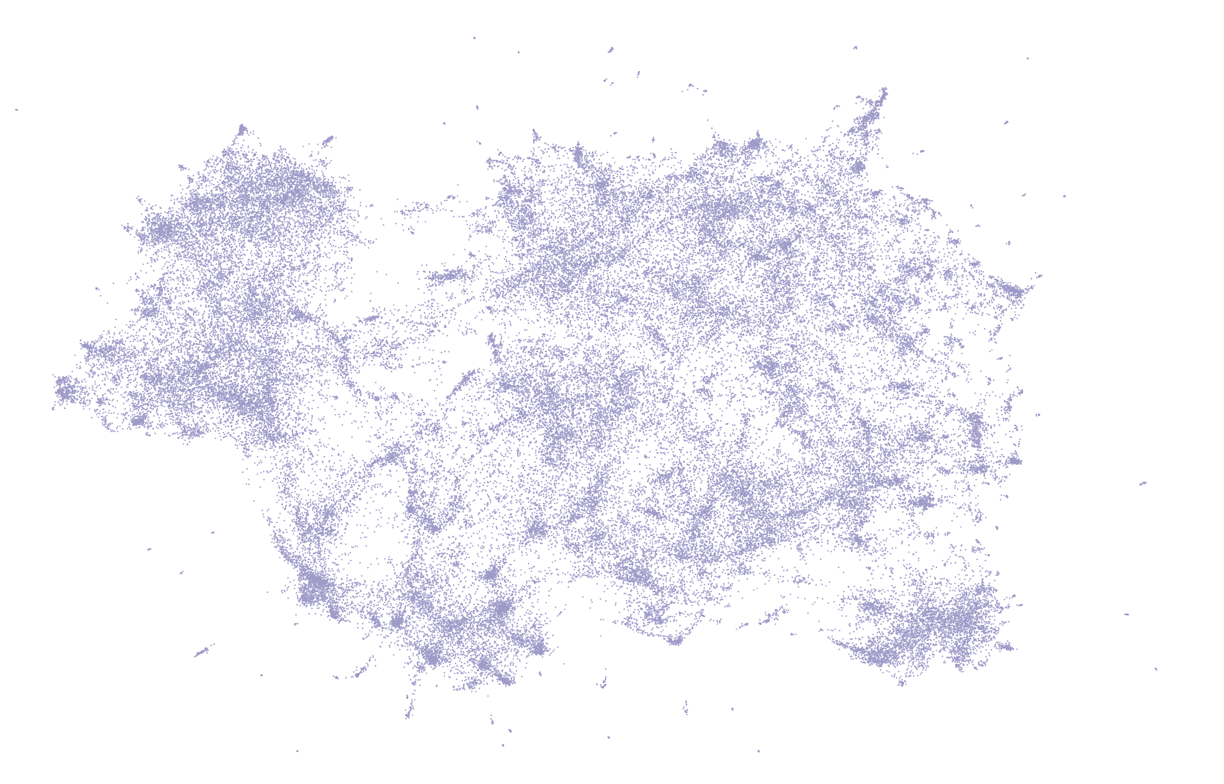
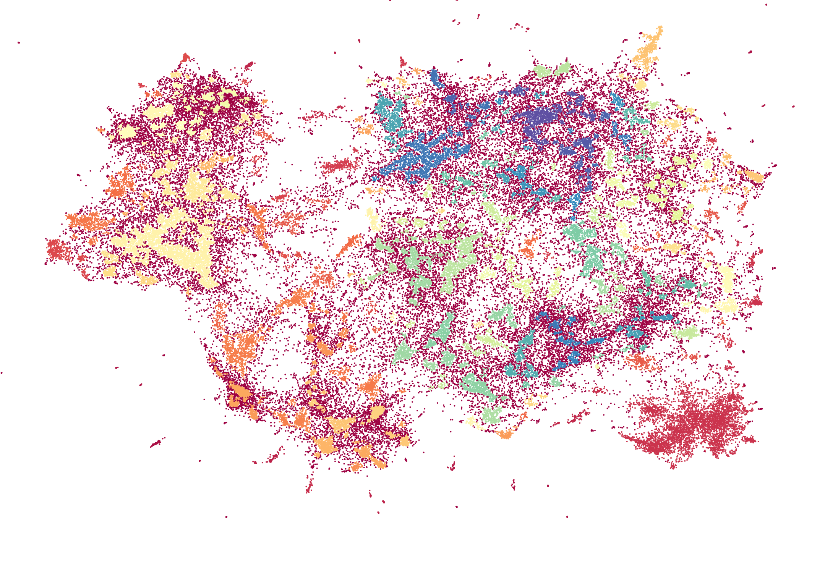
Ticket Categorization
Raw Ticket Description
Top2Vec
L1
Noise entity removal
Text Normalization
Pre-Processed Data
Word Standardization
L1
Doc2Vec
UMAP
Dimensional
Reduction
HDBSCAN
L1
L1
L1
L2
Topics
L1
L1
L1
Topics

Slide 6
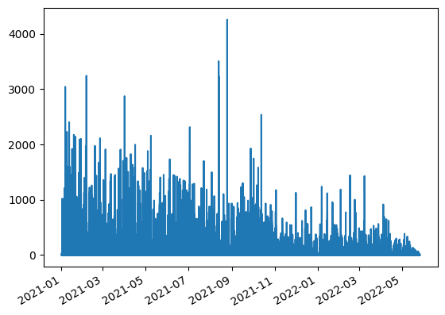
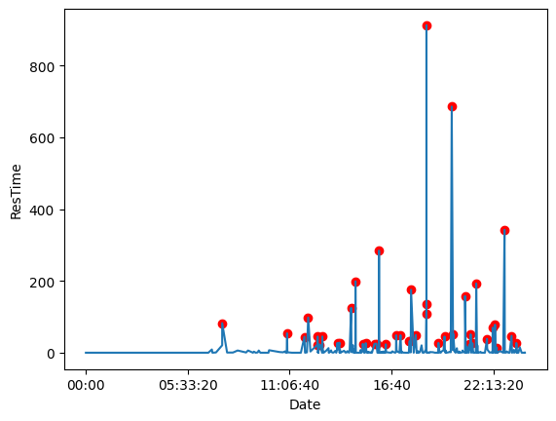
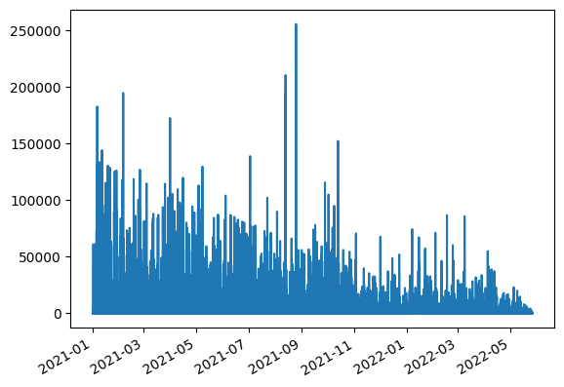
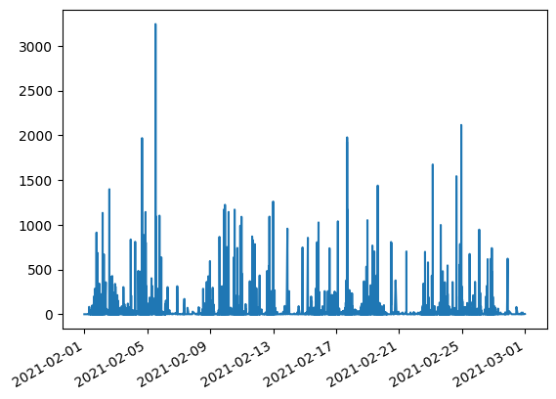
Anomaly Detection
Isolation Forest
Time series data
(Created Time vs Resolution time in hours)
Data Preparation
Anomaly Detection

Slide 7
Major Challenges
Ticket Data was huge for it to be trained in CPU.
Pre-processing of the data took a lot of time.
Time Constraint.
Validation of model performance was difficult due to lack of ground truth.
Lot of Permutations and Combinations to assess the model.

Slide 8
Future Scope
Manual Retagging of Clusters.
Pipeline to upload data and process the ticket dump.
Interactive Visualization Dashboards.
Comparison of the anomaly detected on different parameters.
Trial and Error to find best embedding technique for the ticket dump.

Slide 9
Demo

