Slide 1
Credit Card Fault Detection

Slide 2
Introduction
Overview of the Dataset
This dataset encapsulates vital information on credit card clients in Taiwan from April 2005 to September 2005.
Comprising 25 variables, it includes demographic factors, credit data, repayment history, and bill statements.
Importance of Predicting Default Payments
Predicting default payments is crucial for financial institutions to mitigate risks and make informed decisions.
Identifying clients likely to default allows for proactive measures, reducing financial losses and maintaining a healthy credit portfolio.
Goal: Building a Model for Credit Card Fault Detection
Our primary objective is to develop a robust model for credit card fault detection.
Through advanced machine learning techniques, we aim to predict default payments, providing a valuable tool for risk assessment and financial planning.

Slide 3
Dataset Overview
Number of Rows: 30,000
Number of columns: 25
Key features:
ID
LIMIT_BAL
SEX, EDUCATION, MARRIAGE, AGE
PAY_0 to PAY_6 (Repayment status)
BILL_AMT1 to BILL_AMT6 (Bill statements)
PAY_AMT1 to PAY_AMT6 (Previous payments)
Default payment (target variable)

Slide 4
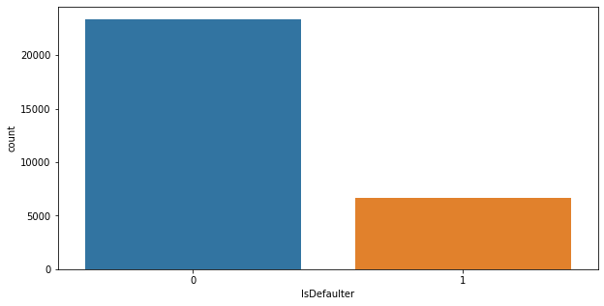
Data Exploration
Dataset Overview:
Exploring the dataset's basic characteristics, including the number of rows, columns, and data types.
Data Quality Check:
Conducting a preliminary check for missing values, duplicates, and outliers to ensure data integrity and reliability.
Distribution of default and non-default cases:
Imbalanced Dataset:
Acknowledging an imbalance between default and non-default cases, which may impact model performance.

Slide 5
Data Preprocessing
Handling Missing Values
No Missing Values Detected:
Fortunately, our dataset is pristine with no missing values, ensuring the integrity of our analysis.
Addressing Imbalance Dataset
Utilizing the Synthetic Minority Over-sampling Technique (SMOTE) to balance the dataset.
Encoding Categorical Variables
Categorical Variables: SEX, EDUCATION, MARRIAGE
Already Encoded:
These variables are already provided in encoded format, eliminating the need for additional encoding steps.
Feature Scaling for Numerical Variables
Standard Scaling:
Utilizing Standard Scalar to normalize numerical variables (e.g., LIMIT_BAL, AGE, PAY_AMT1 to PAY_AMT6).
Ensures all features contribute equally to the model and enhances its performance.

Slide 6
Model Selection
Brief Overview of Machine Learning Models
Supervised Learning Models:
SVM (Support Vector Machine)
KNN (K-Nearest Neighbors)
Decision Tree
Gradient Boosting
Logistic Regression
Ada Boosting
Naive Bayes
Classification Problem:
The given dataset is a classification problem, aiming to predict default payments using supervised machine learning models.

Slide 7
Model Training
Splitting the Dataset into Training and Testing Sets
Train-Test Split:
Utilizing a 67-33 split (train data, test data) to ensure model evaluation on an independent dataset.
Training the Selected Models
Supervised Learning Approach:
Employing a supervised machine learning approach to train the models on labeled data.
Utilizing the training set to enable the models to learn patterns and relationships.
Evaluating Model Performance Using Metrics
Metrics Used:
Employing standard evaluation metrics such as accuracy, precision, recall, etc.
Finalized Model: Gradient Boosting
Chosen due to comparable performance on both training and testing sets.

Slide 8
Results
Best Model Found:
Gradient Boosting
Model Performance:
Accuracy:
Train Accuracy: Achieved a training accuracy of 79.02%, indicating the model's proficiency in learning from the training dataset.
Test Accuracy: Demonstrated a testing accuracy of 79.08%, reflecting the model's ability to generalize well to new, unseen data.
Gradient Boosting demonstrated strong predictive performance on both training and testing sets.
Precision and Recall:
Demonstrated strong precision and recall values, indicating effective identification of default cases.

Slide 9
Q&A
About the Data
Q: Can you elaborate on any specific challenges or anomalies found in the dataset during the exploration?
A: During data exploration, we didn't encounter any missing values or duplicates. However, the dataset exhibited an imbalance between default and non-default cases, prompting the use of SMOTE for balancing.
Model Selection
Q: What considerations led to the selection of the Gradient Boosting model as the final choice?
A: Gradient Boosting demonstrated robust performance with high accuracy on both training and testing sets. Its ability to handle complex relationships and provide reliable predictions influenced its selection.

Slide 10
Feature Importance
Q: How did you determine the importance of features in the Gradient Boosting model?
A: We utilized the built-in feature importance attribute of the Gradient Boosting model. This analysis revealed that repayment status, credit-related features, and demographic variables played significant roles in predicting defaults.
Model Evaluation
Q: What specific metrics were used to evaluate the model's performance, and why?
A: We used accuracy, precision, and recall as key metrics. Accuracy gauges overall correctness, while precision and recall focus on the model's ability to correctly identify default cases.
Handling Imbalanced Data
Q: Can you explain the rationale behind using SMOTE to address the imbalance in the dataset?
A: SMOTE (Synthetic Minority Over-sampling Technique) was employed to balance the dataset and improve the model's performance on the minority class, i.e., default cases. It generates synthetic samples to address the imbalance.

Slide 11
Feature Scaling
Q: Did you perform feature scaling on the numerical variables, and what method did you use?
A: Yes, we applied feature scaling to ensure numerical variables were on a similar scale. We used Standard Scaling (Z-score normalization) to transform the features, making them more comparable and preventing certain variables from dominating the model training process.
Future Work
Q: What are the potential avenues for further improvement in the model or the analysis?
A: Future work could involve exploring additional features, fine-tuning hyperparameters, and incorporating more advanced techniques for handling imbalanced data, potentially leading to further improvements in predictive accuracy.
Practical Implementation
Q: How would the insights from this analysis be practically applied by credit card companies?
A: Credit card companies can leverage the model to identify clients at risk of default, allowing for proactive risk management. The insights gained can inform credit decisions and portfolio management.

Slide 12
Thank You

