Slide 1





ESG Framework - Ripplr

Slide 2
Agenda
What is ESG?
Why ESG?
ESG Fators
SWOT Analysis

Slide 3
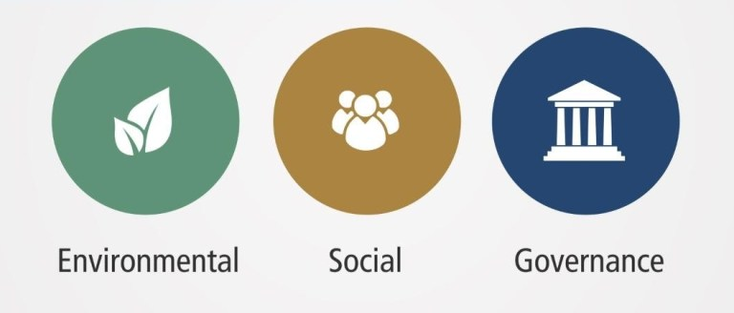
What is ESG?

Slide 4

What is ESG?
Environmental criteria addresses a company’s operations environmental impact, and environmental stewardship
Governance criteria refers to a company’s leadership & management philosophy, practices, policies, internal controls, and shareholder rights.
ENVIRONMENT
ESG
GOVERNANCE
SOCIAL
Social criteria refers to how a company manages relationships with and creates value for stakeholders

Slide 5
Why ESG?
1. Corporate Reputation
2. Risk Reduction
3. Opportunity Management
4. Culture and Intrinsic Values

Slide 6
1. Corporate Reputation : Enhanced customer & investor acquisition
2. Risk Reduction: Reduced disruptions & losses
3. Opportunity Management : Greater workforce productivity & org. resilience
4. Culture and Intrinsic Values: Identification of new markets/customers, products/services, revenue streams

Slide 7
ESG Factors?
ENVIRONMENT
SOCIAL
GOVERNANCE
Climate Change
Natural Resource Scarcity
Pollution & Waste
Community Engagement
Responsible Sourcing
Environmental
Social

Slide 8
Environment

Slide 9
Social – Community eNGAGEMENT
At Ripplr, our people are integral to our success. Our human capital strategy is focused on attracting, developing and retaining the high performing diverse work force.
Ripplr has various initiatives, programs designed to create diversity, equity and inclusion.

Slide 10
Social – Community eNGAGEMENT
Talent Community (Biased free, women empowerment, EEO)
Access Ability (From NGO'S)
NextGen (Campus Hire)
Talent Development
Skill Based Hiring
Upskilling & Reskilling
Talent Retention
Min wages & benefits
Safe & Non hazourdious work environment
VETS (military, veterans & their families)
Local Community (Unskilled/ women empowerment/ local resource)

Slide 11
Governance

Slide 12





THANK YOU
Let's Begin
080-41255511
Intelligent Retail Pvt Ltd Bengaluru, Karnataka 560102
Contactus@ripplr.in

Slide 13
Social
Human Capital : At Ripplr, our people are integral to our success, our human capital strategy is focused on attracting, develoing and retaining the high performing diverse work force.
Work force composition. (Current men to women ratio) target to 2022
We have a variety of longstanding initiatives, forums and programs designed to advance diversity and inclusion within our firm, while creating a sense of community and allyship for diverse employee populations.

Slide 14
ESG is used as a framework to assess how a company manages risks and opportunities that shifting market & non-market conditions create.
Holistic concept related to competitive advantage and risk & reward management.
ESG is about the ability to create & sustain long-term value in a rapidly changing world, and managing the risks & opportunities associated with these changes
Environmental, social, and governance (ESG) criteria are a set of standards for a company’s operations that socially conscious investors use to screen potential investments.
There is no universal categorization for ESG issues, and some can be defined in different ways depending on the industry, company characteristics, and the business model.

Slide 15
What is ESG?
Three key factors in ESG’s growth
Materiality-ESG’s influence on investor risk and returns
Transparency- Greater transparency on how client money is invested
Regulation - Address both national & international threats (i.e. climate change)

Slide 16
Why ESG important?
ESG has a significant positive impact on fundamental business issues relevant to the long-term success of any company across industries:
1. Corporate Reputation : ESG can enhance a company’s license to operate making it easier to accomplish business objectives and respond to crisis scenarios with key stakeholder groups.
2. Risk Reduction: ESG helps identify immediate & long-term risks (e.g. material and labor availability, evolving regulations) depending on the industry and business model.
3. Opportunity Management : Shifting market & non-market conditions can expose unmet needs for new products/services, unserved or underserved customer bases, and strategic relationships for addressing ESG issues.
4. Culture and Intrinsic Values: ESG maturity is an indicator of a company’s commitment to building a high performing, purpose-driven workforce and inclusive culture. Integrating ESG factors into valuation allows for greater insight into intangible factors: culture, talent recruitment & retention, operational excellence and risk, that can improve investment outcomes.

Slide 17
ESG Factors
All have a material impact on a wide spectrum of industries
1. Environmental Issue
Climate Change: Natural disaster due to rising temp present significant risk. Risk assessments should account for impact on the asset, as well as the insurance & maintenance costs.
Natural Resource Scarcity: Changing environmental conditions have increased the depletion of natural resources, which have become more important to stakeholders
Pollution & Waste: Can cause reputational risks, which influences product R&D, retail expectations and consumer requirements. Pollution can also cause health concerns that influence license to operate, which can have legal & regulatory ramifications.
Environmental factors may not impact the company/portfolio directly, but it will have a material impact on key stakeholders (customers, consumers, or suppliers)

Slide 18
Water utilization was from recycling source
Invested in our communities
Corporate Human Rights benchmark Assessment
Local employees are hired (Providing employment opp)
Women employment (Increase year on year)
Pollution contribution if any
Power utilization and environmental incidents

Slide 19
Water utilization was from recycling source
Invested in our communities
Corporate Human Rights benchmark Assessment
Local employees are hired (Providing employment opp)
Women employment (Increase year on year)
Pollution contribution if any
Power utilization and environmental incidents

Slide 20
People
Protecting our workforce
- standards of health and hygeine
Committed to manintain health benefit policy
Dedicated to highest level of ethical and legal conduct in all business activities • Zero tolerance for corruption & bribery and expect the same from our employees and contractors • Continuously striving to embrace evolving stakeholder expectations and implement best practices
IT infrastructure and information security management systems are reviewed by internal audit firm (Deloitte) annually

