Slide 1
CSE3004 – Design and Analysis of Algorithms
– Notion of an Algorithm
– Fundamentals of Algorithmic Problem Solving
– Important Problem Types
– Fundamentals of the Analysis of Algorithm Efficiency
– Analysis Framework
– Asymptotic Notations and its properties
– Mathematical analysis for Recursive and Non-recursive algorithms.

Slide 2
Algorithm
An Algorithm is a set of instructions to be followed to solve a problem
There can be more than one solution (more than one algorithm) to solve a given problem
An algorithm can be implemented using different programming languages on different platforms

Slide 3
Characteristics of an Algorithm
Clear and Unambiguous: The algorithm should be clear and unambiguous. Each of its steps should be clear in all aspects and must lead to only one meaning.
Well-Defined Inputs: If an algorithm says to take inputs, it should be well-defined inputs.
Well-Defined Outputs: The algorithm must clearly define what output will be yielded and it should be well-defined as well.
Finite-ness: The algorithm must be finite, i.e. it should terminate after a finite time.
Feasible: The algorithm must be simple, generic, and practical, such that it can be executed with the available resources. It must not contain some future technology or anything.
Language Independent: The Algorithm designed must be language-independent, i.e. it must be just plain instructions that can be implemented in any language, and yet the output will be the same, as expected.

Slide 4
Advantages of Algorithms
It is easy to understand.
It’s a step-wise representation of a solution to a given problem.
In Algorithm the problem is broken down into smaller pieces or steps hence, it is easier for the programmer to convert it into an actual program.

Slide 5
Disadvantages of Algorithms
Writing an algorithm takes a long time so it is time-consuming.
Understanding complex logic through algorithms can be very difficult.
Branching and Looping statements are difficult to show in Algorithms(imp).

Slide 6
Fundamentals of Algorithmic Problem Solving
A Sequence of steps involved in designing and analyzing an algorithm
Understanding the problem
Decision Making (Choose suitable algorithm design technique)
Design an algorithm
Analyse the algorithm
Code the algorithm

Slide 7
Types of Algorithms
There are many types of algorithms but the most important and the fundamental
algorithms that you must know
Brute Force Algorithm
Recursive Algorithm
Divide and Conquer Algorithm
Dynamic Programming Algorithm
Greedy Algorithm
Backtracking Algorithm

Slide 8
Methods of Specifying an Algorithm
There are three ways to specify an algorithm. They are:
a. Natural language
b. Pseudo code
c. Flowchart

Slide 9
Important Problem Types
The most important problem types are
Sorting.
Searching
String processing
Graph problems
Combinatorial problems
Geometric problems
Numerical problems.

Slide 10
Analysis of Algorithms
Algorithm analysis is an important part of computational complexity theory, which provides theoretical estimation for the required resources of an algorithm to solve a specific computational problem.
Analysis of algorithms is the determination of the amount of time and space resources required to execute it.
Memory: how much space is needed?
Time: how fast the algorithm runs?
FACT: running time grows with the size of the input
Input size (number of elements in the input)
Size of an array, polynomial degree, # of elements in a matrix, vertices and edges in a graph
Def: Running time = the number of primitive operations (steps) executed in terms of input size before termination

Slide 11
Why Analysis of Algorithms is important?
To predict the behavior of an algorithm without implementing it on a specific computer.
It is much more convenient to have simple measures for the efficiency of an algorithm than to implement the algorithm and test the efficiency every time a certain parameter in the underlying computer system changes.
It is impossible to predict the exact behavior of an algorithm. There are too many influencing factors.
The analysis is thus only an approximation; it is not perfect.
More importantly, by analyzing different algorithms, we can compare them to determine the best one for our purpose.

Slide 12
Time & Space Complexity
The Efficiency of an Algorithm can be measured by the following metrics.
Time Complexity
Space Complexity
Time Complexity
The amount of time required for an algorithm to complete its execution is
its time complexity. An algorithm is said to be efficient if it takes the
minimum (reasonable) amount of time to complete its execution.
Space Complexity
The amount of space occupied by an algorithm is known as Space
Complexity. An algorithm is said to be efficient if it occupies less space and
required the minimum amount of time to complete its execution

Slide 13
Asymptotic Notations
Asymptotic notations are used to indicate the running time of an algorithm
It’s a shorthand way to represent the time complexity
O (Big – Oh)
f(n)=O(g(n)), Big-Oh of g of n, the Upper Bound;
W (Big – Omega)
f(n)=W(g(n)), Omega of g of n, the Lower Bound.
Q (Big – Theta)
f(n)=Q(g(n)), Theta of g of n, the Average Bound;

Slide 14

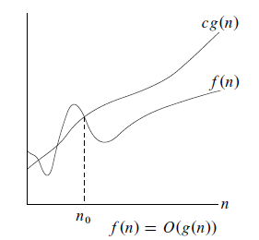
O (Big – Oh)
Using Big “oh” notation we can denote longest amount of time taken by the algorithm to complete

Slide 15
Example
Let f(n) = 3n + 2 , g(n) = n
We can say f(n) = O (g(n))
If f(n) <= C. g(n)
where C>0 and n>n0
3n+2 <= 4n
where C=4 and n>=2
Let f(n) = 2n+2 and g(n) =n²
We can say f(n) = O (g(n))
If f(n) <= C. g(n)
where C>0 and n>n0
2n + 2 <= n²
where n>=2 and C=2

Slide 16

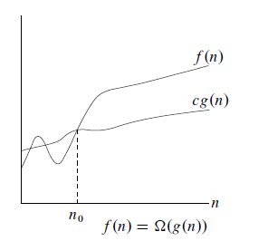
Ω (Big – Omega)
Using Big “Omega” notation we can denote smalest amount of time taken by the algorithm to complete

Slide 17
Example
Let f(n) = 3n + 2 , g(n) = n
We can say f(n) = Ω (g(n))
If f(n) >= C. g(n) where C>0 and n>n0
3n+2 >= n where C= 1 and n0>=1

Slide 18
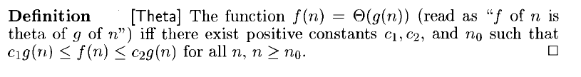
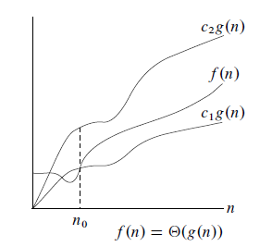
Θ (Big – Theta)
Using Big “Theta” notation we can represent running time between upper bound and lower bound

Slide 19
Example
Let f(n) = 2n+8 g(n) = n
if 2n+8 >= 5n where C1= 5 and n>=2
2n+8 <=7n where C2= 7 and n>=2
Hence, C1 =5, C2= 7 and n>=2
The Theta notation is more precise than both big oh and omega notation

Slide 20
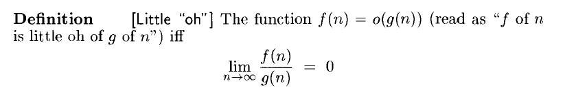
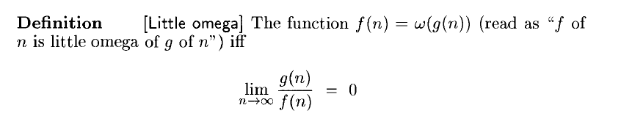
Little “Oh” and Little “Omega”

Slide 21
Examples
3n+2=O(n) /* 3n+2≤4n for n≥2 */
3n+3=O(n) /* 3n+3≤4n for n≥3 */
10n²+4n+2=O(n²) /* 10n²+4n+2≤11n² for n≥5 */
3n+2=Omega(n) /* 3n+2>=3n for n≥1 */
10n²+4n+2=Omega(n²) /* 10n²+4n+2>=n² for n≥1

Slide 22
Typical Running Time Functions
We will use some important functions in the analysis of algorithm
Constant function - If input size grows then we get larger running time
Ex: Scanning Array Elements
Logarithmic function – If the algorithm does not consider all its input rather the problem is divided into smaller parts on each iteration
Ex: Binary Search
Linear – The running time of algorithm depends on the input size n
Ex: Sequential Search
nlogn – some instance of input is considered for the list of size n
Ex: Sorting the elements using merge or quick sort

Slide 23
5. Quadratic - when the algorithm has two nested loops
Ex: Scanning matrix elements
Cubic – when the algorithm has three nested loops
Ex: Matrix multiplication
7. Exponential – when the algorithm has very faster rate of growith
Ex: Generating all subsets of elements

Slide 24
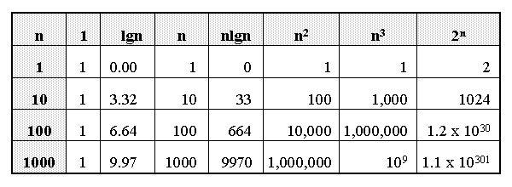
Growth of Functions

Slide 25
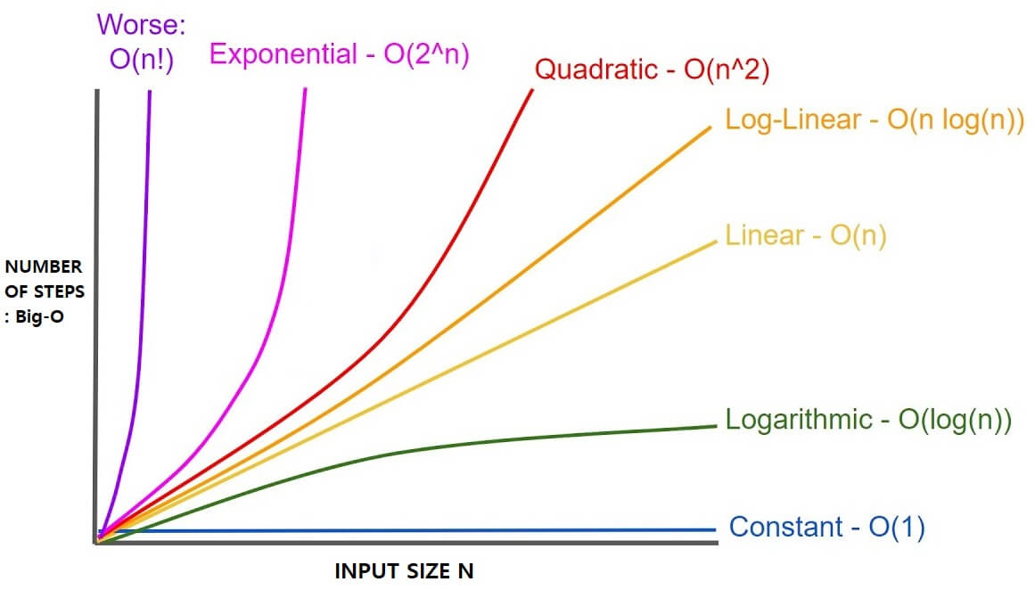
Graphical Representation of different functions

Slide 26
Algorithm Analysis : Example
Algorithm Swap ( a, b)
{
temp←a; 1 unit of time
a← b; 1 unit of time
b ← temp: 1 unit of time
}
---------
3 Units of Time
Time Complexity f(n) = 3 (Constant)
Space Complexity s(n) = 3 (Constant)

Slide 27
Algorithm Analysis : Example
Algorithm Sum ( A, n)
{
s=0;
for (i=1; i<=n; i++)
{
s = s+A[i];
}
return s;
}
Time Complexity f(n) = 2n + 3 i.e. O(n)
Space Complexity s(n) = n+3 i.e. O(n)

Slide 28
Calculating complexity of a simple loop
Time complexity of a loop can be determined by running time of statements ins
int m=0; // executed in constant time -----1unit
// executed n times
for (int i = 0; i < n; i++) ----------- (n+1) units
{
m=m+1; // executed in constant time – n units
}
f(n)=1+(n+1)+n => 2n+2; So O(n)=n

Slide 29
Complexity will be :n+n*n —>O(n^2)
int m=0;
// Executed n times
for (int i = 0; i < n; i++) {
m=m+1;
}
// outer loop executed n times
for (int i = 0; i < n; i++) {
// inner loop executed n times
for(int j = 0; j < n; j++)
m=m+1;
}

Slide 30
i =1; s =1;
While (s <=n)
{
i++;
s = s+i;
printf (“VIT-AP”);
}
Time Complexity is O(√n)

Slide 31
for (i =1; i < n; i = i * 2)
{
printf(“VIT-AP”)
}
Time Complexity is O(logn)

Slide 32
i =1;
for (i =1; i² <=n; i++)
{
printf(“VIT-AP”);
}
Time Complexity is O(√n)

Slide 33
for (i =1; i <=n; i++)
{
for (j =1; j <=i; j++)
{
for (k =1; k<=100; k++)
{
pf (VIT-AP);
}
}
}
Time Complexity is O(n²)

Slide 34
Iterative function to sum a list of numbers
Tabular Method
steps/execution

Slide 35
Recursive Function to sum of a list of numbers

Slide 36
Time Complexity for Recursive Algorithms using Recursive Tree
A (n) ------ T(n) Recursive Tree/Tracing Tree
{
if ( n > 0) --C/1
{
print(n); ----1
A(n-1); --- T(n-1)
}
}
T(n) = 1+T(n-1)
Suppose n = 3
A (3)
3 A(2)
2 A1)
1 A(0)
It prints 3 times and in 3+1 calls
f(n) = O(n+1) = O (n)

Slide 37
Time Complexity for Recursive Algorithms using Substitution Method
Recurrence Relation
T (n) ={ 1 n=0
T(n-1) +1 n>0
We can solve the relation with back substitution method
T (n) = T (n-1) + 1 if T (n) = T (n-1) + 1 then T(n-1) = T(n-2)+1
Substitute T(n-1) in above equation
T(n) = [T(n-2)+1]+1 = [T(n-2)+2]
T(n) = [T(n-3)+1]+2 = [T(n-3)+3]
:
T(n) = [T(n-k)+k]
Assume n-k =0 => n = k
T(n) = 1 + n => O (n)

Slide 38
Time Complexity for Recursive Algorithms using Master’s Theorem
Master’s theorem is one of the many methods that are applied to calculate time complexities of algorithms.
Master’s theorem can only be applied on decreasing and dividing recurring functions. If the relation is not decreasing or dividing, master’s theorem must not be applied.

Slide 39
Master’s Theorem for Dividing Functions
Consider the recurrence relation
T(n) = aT(n/b) + f(n)
where, a >= 1 and b > 1,
n − size of the problem
a − number of sub-problems in the recursion
n/b − size of the sub problems based on the assumption that all sub-problems are of the same size.
f(n) − represents the cost of work done outside the recursion ->
Θ(n^{k} logn^{p}) ,where k >= 0 and p is a real number;

Slide 40
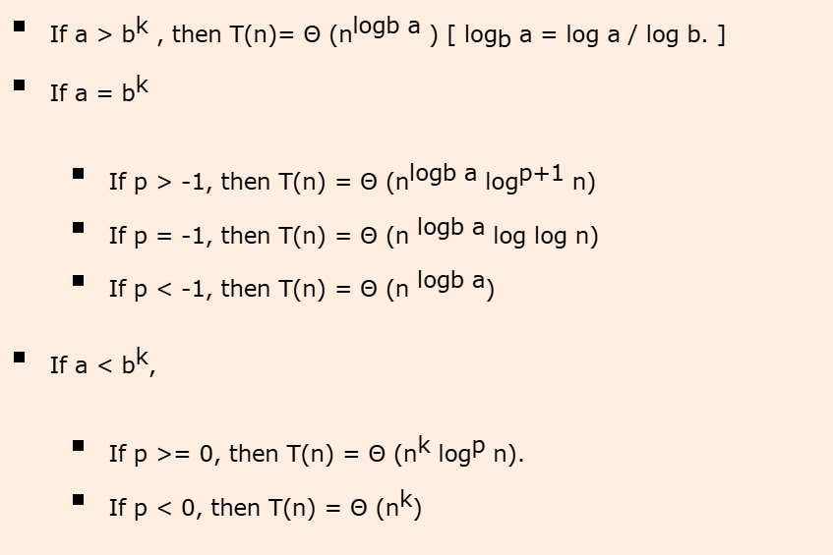
If the recurrence relation is in the above given form, then there are three cases in the master theorem to determine the asymptotic notations

Slide 41
Master’s Theorem for Decreasing Functions
Consider the relation
T(n) = aT(n-b) + f(n)
where, a >= 1 and b > 1, f(n) is asymptotically positive
Here,
n − size of the problem
a − number of sub-problems in the recursion
n-b − size of the sub problems based on the assumption that all sub-problems are of the same size.
f(n) − represents the cost of work done outside the recursion -> Θ(n^{k}), where k >= 0.

Slide 42
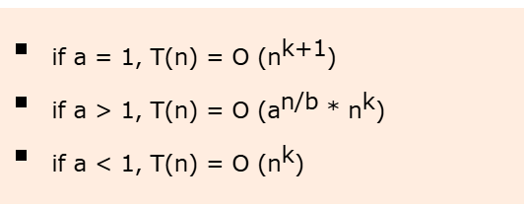
If the recurrence relation is in the above given form, then there are three cases in the master theorem to determine the asymptotic notations

