Slide 1



PROBLEM STATEMENT 1
Redesigning ABTalks
Reimagining the 60-Day Public Building Challenge Platform for modern developers.
Live Demo: ctrl-alt-next-abtalks.vercel.app

Slide 2

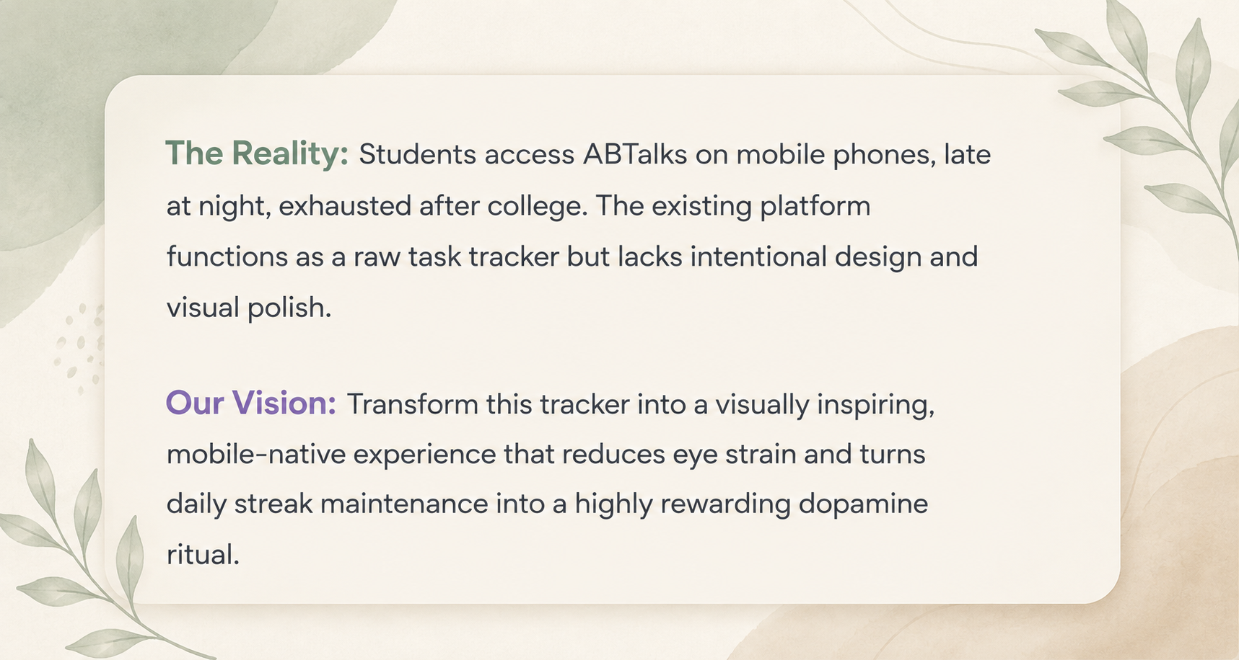
The Situation & Our Vision

Slide 3






Design Philosophy & Visual Language
Mobile-First
Fluid Motion
Clear Hierarchy
Designed for one-handed smartphone navigation with thumb-friendly touch targets. A high-contrast dark aesthetic strictly optimized for low-light, late-night screen time.
Incorporated subtle hover effects, smooth spring transitions, and animated glowing accents. Micro-animations upon completing tasks trigger dopamine and boost retention.
Clean, highly readable typography crafted for rapid scanning. Complex daily instructions are broken down visually so exhausted students know exactly what to do.

Slide 4

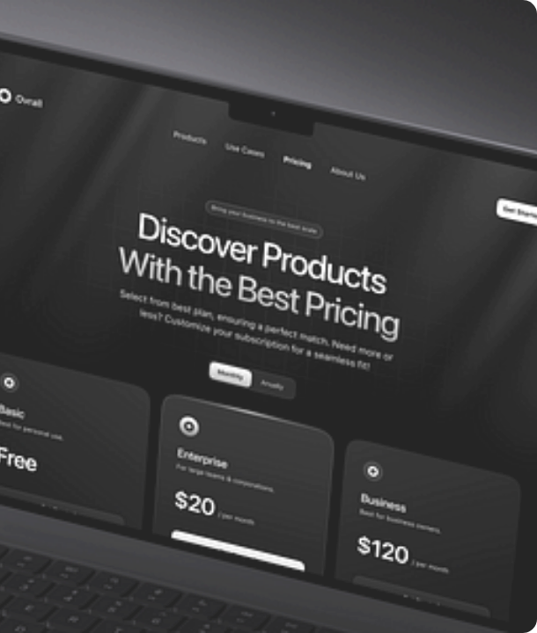

Screen 1: Landing Page (/)
TRUST IN 5 SECONDS
The first experience for a student who has never heard of ABTalks must exude trust, clarity, and motivation immediately.
High-Impact Hero
"Build your portfolio, one day at a time" — commanding value proposition.
3-Step Flow
Clean visual breakdown: Start Day 1 → Build & Share → Grow Portfolio.
Proof Over Streaks
Focus shifted from empty streaks to generating 60 recruiter-ready artifacts.

Slide 5

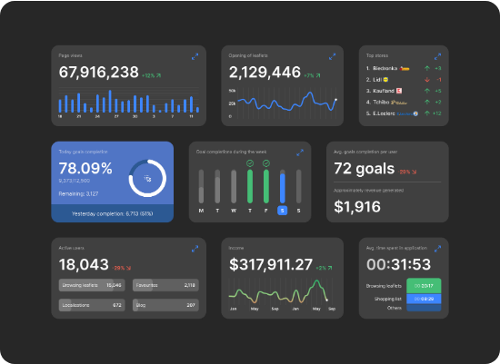
Screen 2: Student Dashboard (/dashboard)
A frictionless home screen for logged-in students to track momentum and upcoming milestones at a single glance.
Current Streak & Standings: Dynamic progress indicators showcasing daily commitment.
Today's Task Card: Centralized highlight directing students instantly to their active challenge.
Challenge Roadmap: Visual timeline mapping completed days and locking future milestones.
Gamified Achievements: Visual rewards for maintaining consistency across weeks.

Slide 6
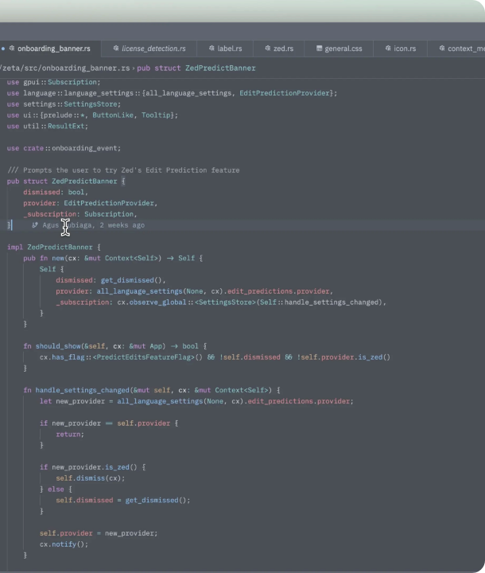

Screen 3: Challenge Day (/day/12)
THE BUILDER'S FOCUS
A distraction-free, hyper-focused space dedicated solely to reading, building, and submitting daily proof-of-work.
Structured Task Breakdown
Clear problem statement, expected output, and necessary technical resources.
Dual Proof-of-Work
Seamless input cards tailored specifically for GitHub Repository URLs and LinkedIn Post URLs.
Interactive Feedback
Animated success state validating the submission and instantly locking in the daily streak.

Slide 7
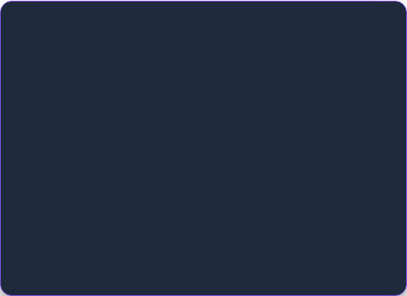
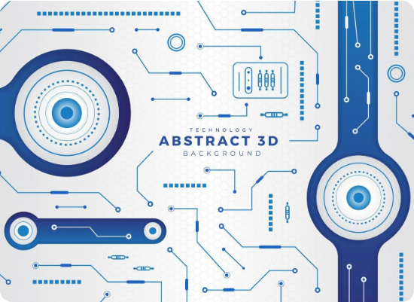
Engineering & Workflow
Modern Web Stack
Next.js (App Router): Chosen for ultra-fast page transitions and edge rendering capabilities.
Tailwind CSS: Highly polished custom styling combined with CSS keyframe animations.
Vercel: Edge network deployment for lightning-fast mobile load times.
Powered by Claude Code
Rapid Prototyping: Leveraged Claude Code CLI to iterate swiftly on complex, responsive UI layouts.
Design System Integrity: Ensured uniform spacing tokens and accessible color contrast across all screens.

Slide 8

60 days. 60 artifacts.
One life-changing public portfolio.
Our redesign transforms a raw habit tracker into a proud visual portfolio, reducing onboarding friction and vastly increasing daily completion rates for students.

