Slide 1
“Covid19 Data Analysis & Prediction”

Slide 2
ABSTRACT
COVID-19 outbreak was first reported in Wuhan, China and has spread to more than 50 countries.
WHO declared COVID-19 as a Public Health Emergency of International Concern (PHEIC) on 30
January 2020. Naturally, a rising infectious disease involves fast spreading, endangering the health
of large numbers of people, and thus requires immediate actions to prevent the disease at the
community level. Therefore, “Covid19 Data Analysis & Prediction” was born as the application that provides latest and reliable news development, as well as statistics and analysis on COVID-19. This paper is done by the research team in the “Covid19 Data Analysis & Prediction” aims to predict and forecast COVID-
19 cases, deaths, and recoveries & Vaccination through predictive modelling.
Methods:
Real-time data query is done and visualized in our Application, then the queried data is used for
Susceptible-Exposed-Infectious-Recovered (SEIR) predictive modelling. We utilize SEIR
modelling to forecast COVID-19 outbreak within India based on daily observations.

Slide 3
INTRODUCTION
On 31 December 2019, the first reported case in the COVID-19 outbreak was reported in Wuhan, China. The first case outside of China was reported in Thailand on 13 January 2020 [1]. Since then, this ongoing outbreak has now spread to more than 50 other countries [2]. WHO declares COVID-19 outbreak as a Public Health Emergency of International Concern (PHEIC) by WHO on 30 January 2020 [3]. There are over 76,000 cases of confirmed COVID-19 worldwide as of 20 February [2]. An infectious disease outbreak is the occurrence of a disease that is not usually expected in a particular community, geographical region, or time period [4]. Typically, a rising infectious disease involves fast spreading, endangering the health of large numbers of people, and thus requires immediate action to prevent the disease at the community level [5]. COVID-19 is caused
by a new type of corona virus which was previously named 2019-nCoV by the World Health Organization (WHO). It is the seventh member of the corona virus family, together with MERS- nCoV and SARS-nCoV, that can spread to humans [1]. The symptoms of the infection include fever, cough, shortness of breath, and diarrheal. In more severe cases, COVID-19 can cause pneumonia and even death [6]. The incubation period of COVID-19 can last for 2 weeks or longer [7]. During the period of latent infection, the disease may still be infectious. The virus can spread from person to person through respiratory droplets and close contact [8].
Social media now serves as a major, immediate information source but while the focus of latest information has been on the role of social media during infectious disease outbreaks, the question that should be brought to light is still, how the use of social media may trigger the public’s emotional or
noncognitive response, affect perception of risk, and preventive behaviors [10]. Therefore, “Covid19 Data Analysis & Prediction” was born as the application that provides the latest and verified news development, statistics and analysis on COVID-19. This platform is a community-based project initiated on 25th February out of concerns on the outbreak that halted Mainland Chinese of Lunar New Year’s celebration. The “Covid19 Data Analysis & Prediction” Application was launched on 1/11/2021, after two days working relentlessly, and has gathered more than 1300 volunteers across the globe. This paper is a part of a work by the research team of “Covid19 Data Analysis & Prediction”. The main objective of this paper is to predict and forecast COVID-19 cases, deaths, and recoveries through predictive modelling, and to decipher patterns on public sentiment related to health information dissemination. At the same time, assess the political and economic impact of the virus spread.

Slide 4
Review Study
We propose a comprehensive framework to manage health information data as a tool for public health practitioners in managing epidemics and crafting public health response and policy. This study focuses on the role of audiences in the process of disseminating health risk information and examines behaviors that contribute to information amplification upon hearing the news.
The structure of this paper is as follows: introduces COVID-19 as well as explains the significance of this research. describes
on related works in predictive modelling of the paper and news-based sentiment analysis for this research on psychological, politics and economics aspects. explains our study design and methodologies. presents our findings in current trends, predictive modelling and sentiment analysis of the outbreak. Our findings are discussed.

Slide 5
Project Plan
The Project "Covid19 Data Analysis" is an application to Analysis the process of raising Confirmed ,Death , Recovered cases in India & how much Vaccinated. This application also administrates its populations and Vaccine.
->This project will serve the following objectives
1.How Corona Virus is Rising(Read Any CSV file that related to
Covid19(column=[Date,State,Region,Populations,Confirmed,Deaths,Recovered,Vaccined])
2. Take Necessary Action (Particular State Wise)
3.Populations & Vaccinated( State Wise)
4.Show the Number of confirmed, Deaths and Recovered cases in each State
5.State Wise confirmed, Deaths and Recovered cases & Vaccine
6.Show all the records where Confirmed case > (Your choice)
7.In which State ,Minimum/Maximum number of Confirmed','Deaths','Recovered','Vaccined' cases
8.Show All Data( State(Your Choice) and Date(Your choice) Wise)
9.Visualising the spread Geographically (#How many Sate Effect)
10. Confirmed Vs Recovered/Deaths
11.Populations Wise Confirmed / Recovered / Deaths / Vaccine
12.Date Wise Compare (Populations,Confirmed,Recovered,Deaths,Vaccined)
13.State Wise Vaccine Due
14.Date wise Total 'Confirmed', 'Recovered', 'Deaths', 'Vaccined'
15.Prediction 'Confirmed','Recovered', 'Deaths', 'Vaccined' Date wise

Slide 6
Project Category
Basic Python(External Library) & some CSV files
The project is based on the concepts of
1.Python Basic
i) Data Type & Variable
ii) Control Statement
iii) Iterative Control
iv) Function/Argument Function
v) Array
2.External Library (Python)
Numpy , Pandas , ipywidgets,seaborn,matplotlib,plotly.graph_objects,
sklearn,datetime)
3.CSV File
i) covidv_data.CSV
ii) covid19_data.CSV
iii) latlong.CSV
iv) vaccine_due.CSV
......................................................................................................................................................................................................
-> Technology & Tools
Software Use:-
1.Language Use->Python
2.Jupyter Notebook
Operating System :
->Windows(10)

Slide 7
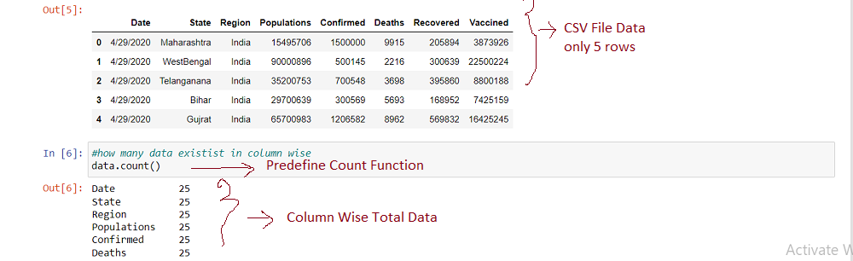
Methodology with Design,Figures
->Data Source
Data is extracted from verified sources such as John Hopkins University [21], WHO a website authorized by the Chinese government. The sites reported confirmed COVID-19 cases, as well as recovered and deaths for affected countries and regions.
Install & Load External Library for Read CSV File and Data Counts
Using pandas Library for load CSV File and use predefine counts function for how much data exits in our CSV file on column basis.

Slide 8
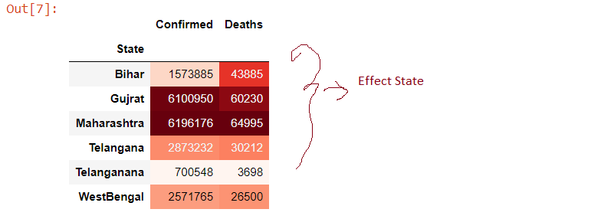
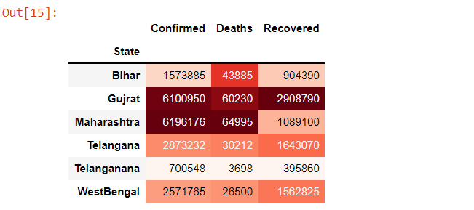
2. Take Necessary Action (Particular State)
Use Predefine Drop Function for temporary delete some columns & Show Data on State Wise Confirmed & Death Case use predefine groupby & Sum Function.
3. Show the Number of confirmed, Deaths and Recovered cases in each State

Slide 9
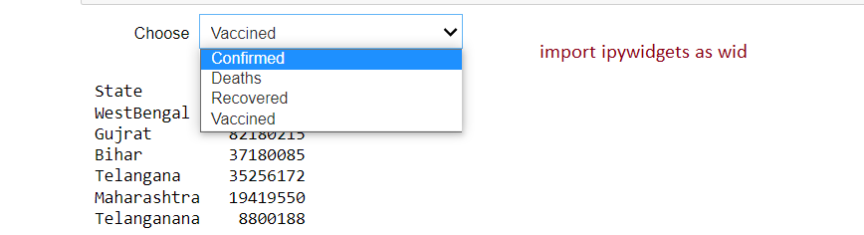
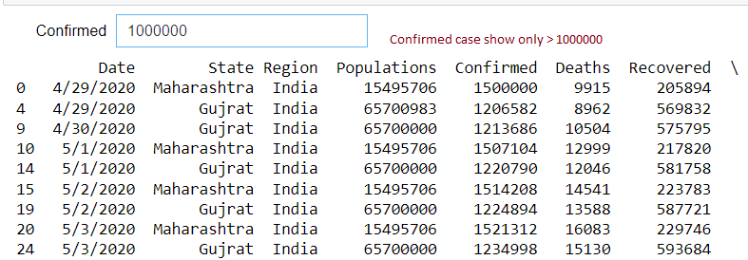
4. State Wise confirmed, Deaths and Recovered cases & Vaccined
Use ipywidgets Library(Interact Function) for Create Drop Down Box & Dynamatically Select your Text (Show Output)
5. Show all the records where Confirmed case > (Your choice)
Use ipywidgets Library(Interact Function) for Create Text Box & Dynamatically Select your Text (Show Output)

Slide 10
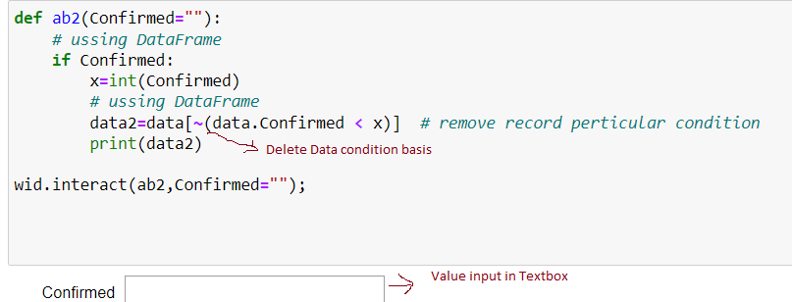
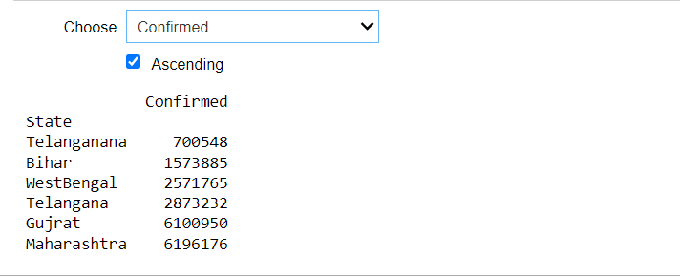
6. If You Want to Remove Data Confirmed case ( value Wise)
Remove Data on Particular Condition Basis
7. In which State ,Minimum/Maximum number of Confirmed','Deaths','Recovered','Vaccined' cases ASC/DESC Order
Use ipywidgets Library(Interact Function) for Create Drop Down Box & Checkbox for Dynamatically Select your Text (Show Output)

Slide 11
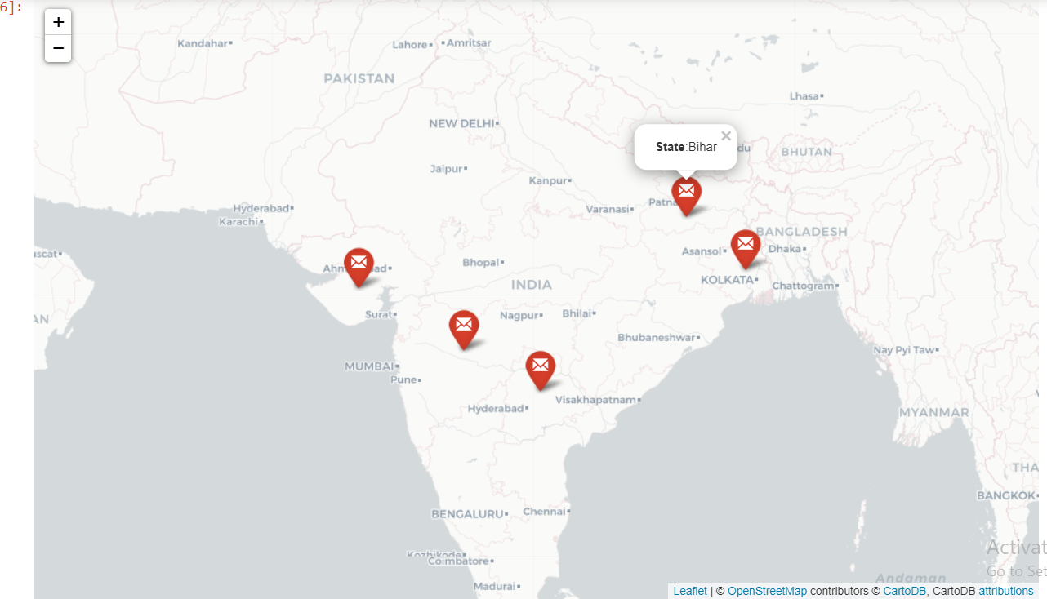
8. Visualising the spread Geographically (#How many Sate Effect)
Show State (Effective) Position in our Map on Lat Long Basis use folium & Figure Library

Slide 12
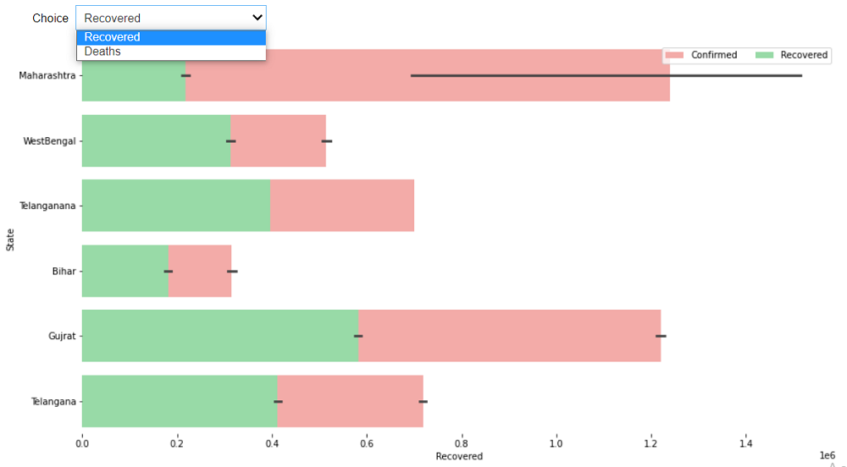
9. Confirmed Vs Recovered/Deaths
Represent our Data on Graphically(x & y basis) use Matplotlib,Seaborn , matplotlib.pyplot

Slide 13
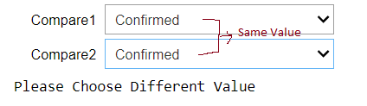
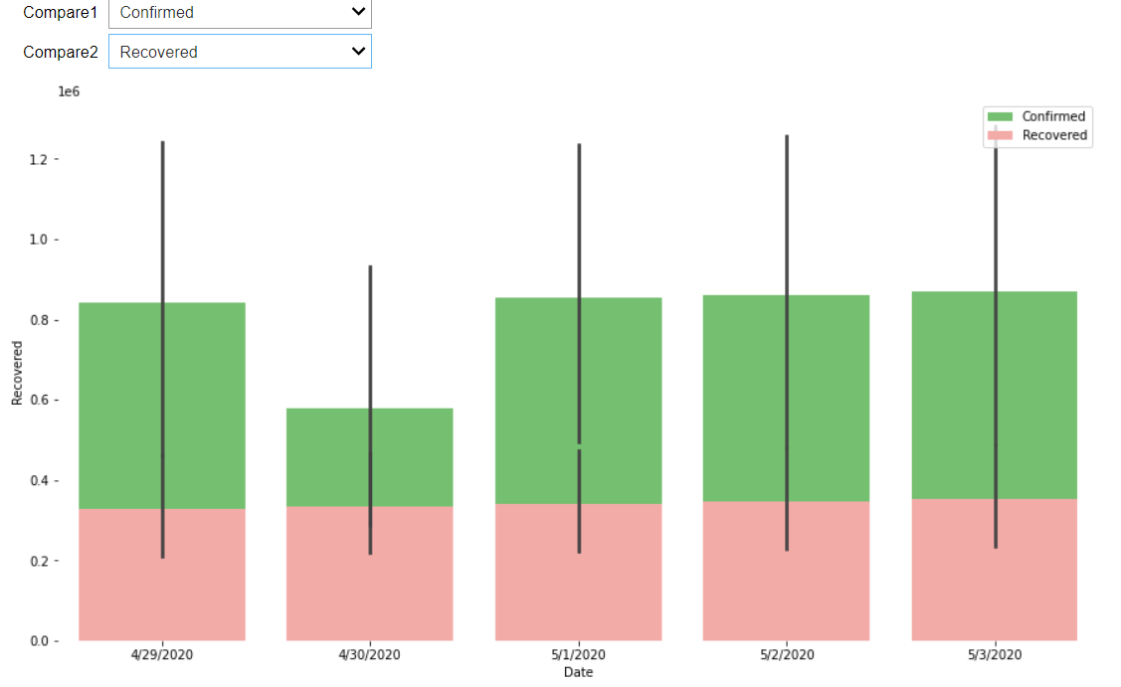
10. Date Wise Compare (Populations,Confirmed,Recovered,Deaths,Vaccined)
Create BarPlot (Matlotlib Library) & compare All things
If both Drop Down Box value Same return Please choose
Different value.

Slide 14
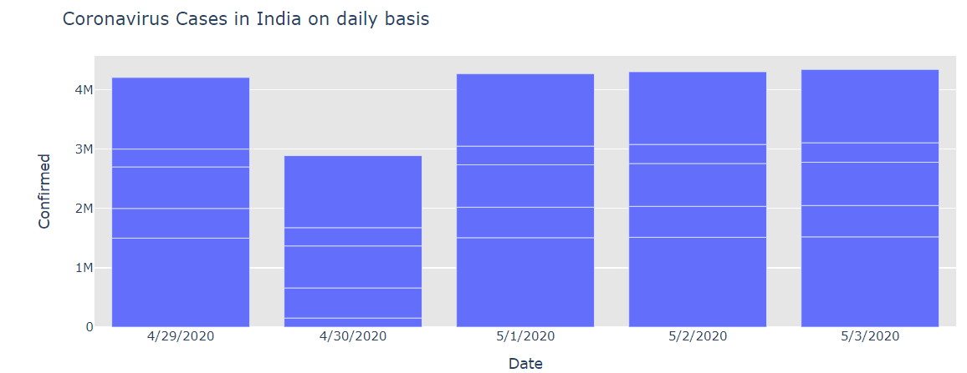
11. How Corona Virus is Rising
Show data graphically Date Wise Confirmed cases are increases (Use plotly.graph_objects Library create bar graph & represent our Data )

Slide 15
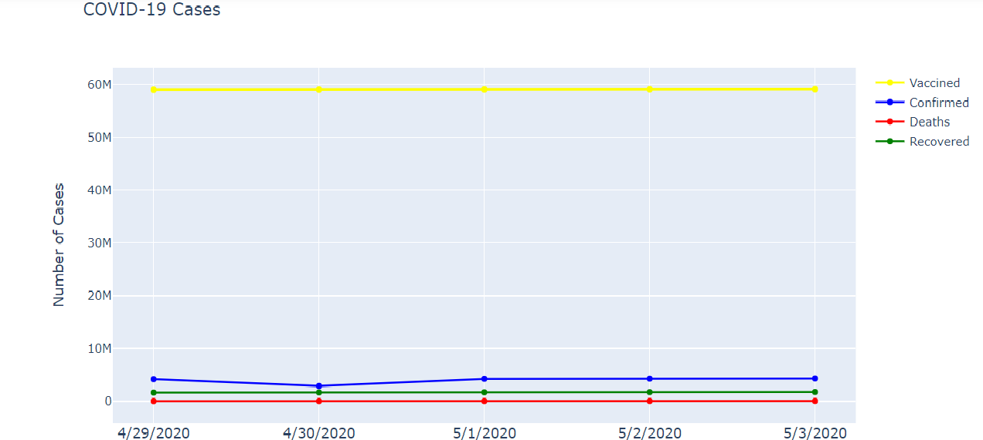
12. Date Wise Vaccined ,Confirmed,Deaths & Recovered
Scatter Plot Show (use plotly.graph_objects Library)

Slide 16
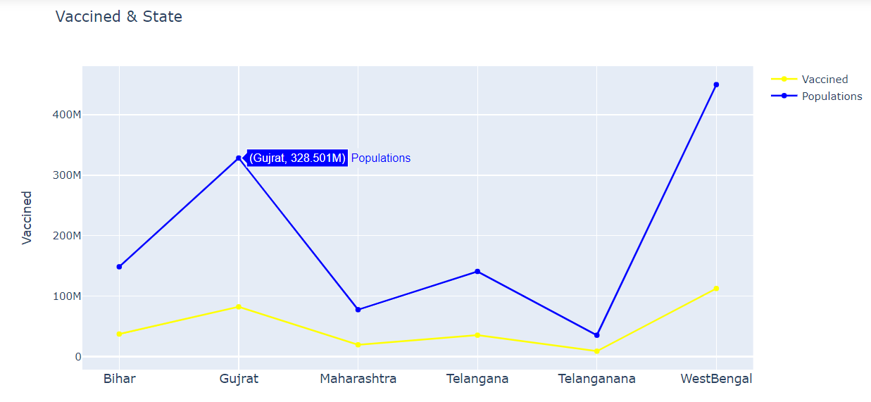
13. Vaccine & Populations(State Wise )
Graphically Represent State wise Populations & Vaccine

Slide 17
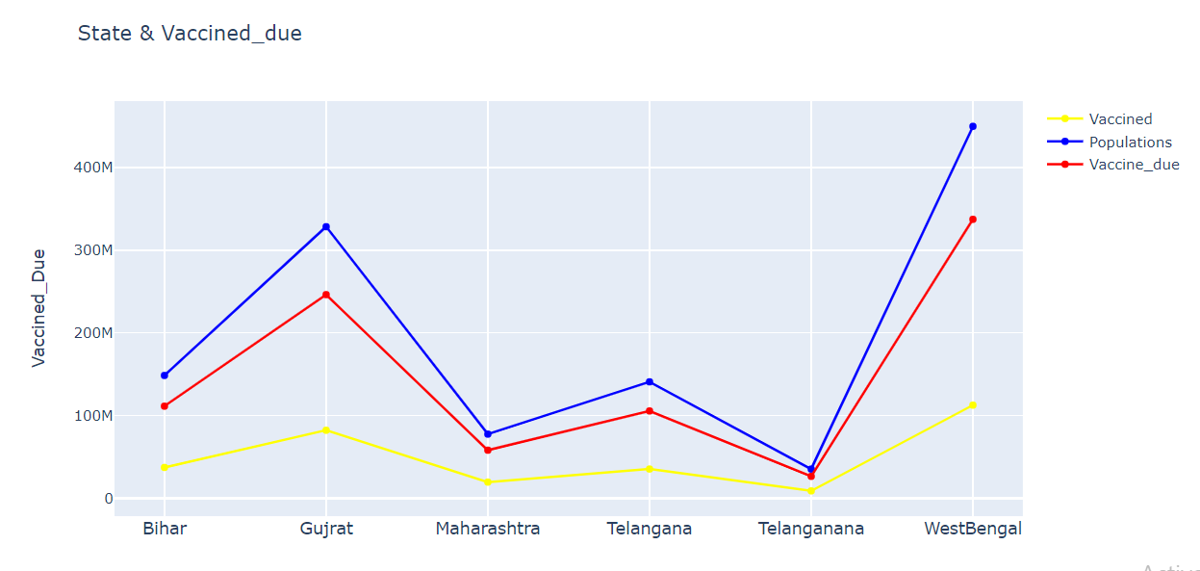
14.State Wise Vaccine Due

Slide 18
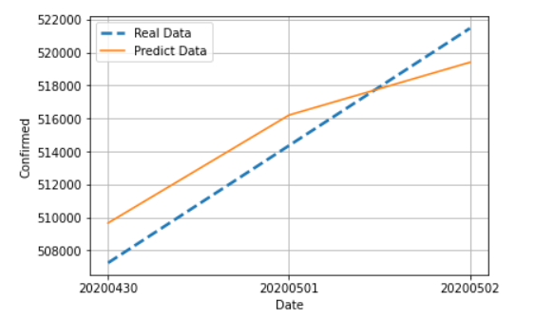
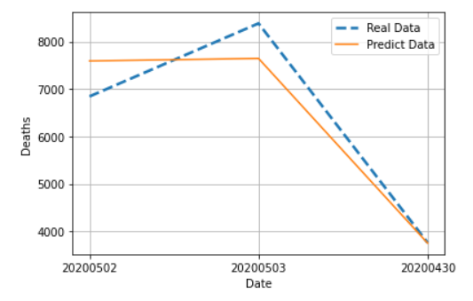
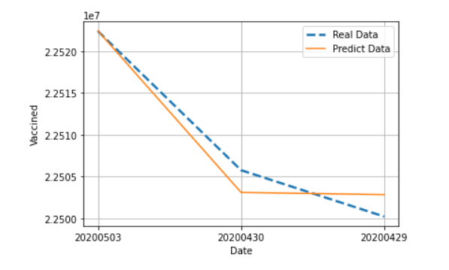
15. Regression Apply (ML Algorithm) for Predict Confirmed Cases /Deaths/Vaccined

Slide 19
Conclusion
This research presented current trends of COVID-19 outbreak from 29nd Apr 2020 to 5thAug 2020 as visualized in Covid19 Data Analysis & prediction Application. The trajectory of the outbreak is also
forecasted by using SEIR model. We also analyzed the Vaccinations
from news extracted by Covid19 Data Analysis & prediction to further understand people’s reaction towards this outbreak. COVID-19 is still an infectious disease with some unclear or unknown properties, which
means accurate SEIR prediction can only be obtained once the outbreak has been successfully
contained. The outbreak spreads are largely influenced by each country’s policy and social
Responsibility. In a pandemic like this, providing timely information to the public is paramount. A
platform like Covid19 Data Analysis & prediction will assist the government and authorities to disseminate verified articles, provide updates to the situation, and advocate good personal hygiene to the people.
Covid19 Data Analysis & prediction is built out of social responsibility to spread awareness to the common people by providing scientific-based data analysis, prediction and verified news.
This paper is still an ongoing research as many more investigations regarding this disease can be carried out. Yet, it serves as the starting phase to research more in depth on questions that
revolve around this global pandemic.

