Slide 1

B.Tech Project - Semester 7
Recommendation Systems-Neural Unified Review Recommendation
under the guidance of
(Prof. Sudeshna Sarkar)
Submitted By:
Abhik Naskar
17CS30001
Department of Computer Science and Engineering
Indian Institute of Technology, Kharagpur
November, 2020

Slide 2
Introduction
_________________________________
Motivation
Perform sentiment analysis on user reviews to predict the nature of reviews(positive or negative) with certain accuracy and thereby eventually predict the rating of an unobserved item by user.
Work Done:
Worked on various model using deep learning methodologies and text preprocessing techniques to analyse the reviews like :
Neural Network with Fully connected hidden layers
LSTM with dropout
Deep CNN model
Plan of Work:
To improve the quality of recommendation and to perform better sentiment analysis on user reviews I had referred the research paper to implement better text preprocessing and deep neural network models as discussed later.

Slide 3
SENTIMENT ANALYSIS - AMAZON FINE FOOD REVIEWS
Steps for Sentiment Analysis
Text Preprocessing
1. Replace regex with ' ' apart from english alphabet
2. Convert all the words to lowercase alphabets
3. Perform stemming on the words to retain the original words
Word Embeddings
1. Simple hashing of words to represent them in numerical format
2. Tf-Idf vectoriser for word embeddings
3. Padded the word sequences of sentences to match the length of each input

Slide 4
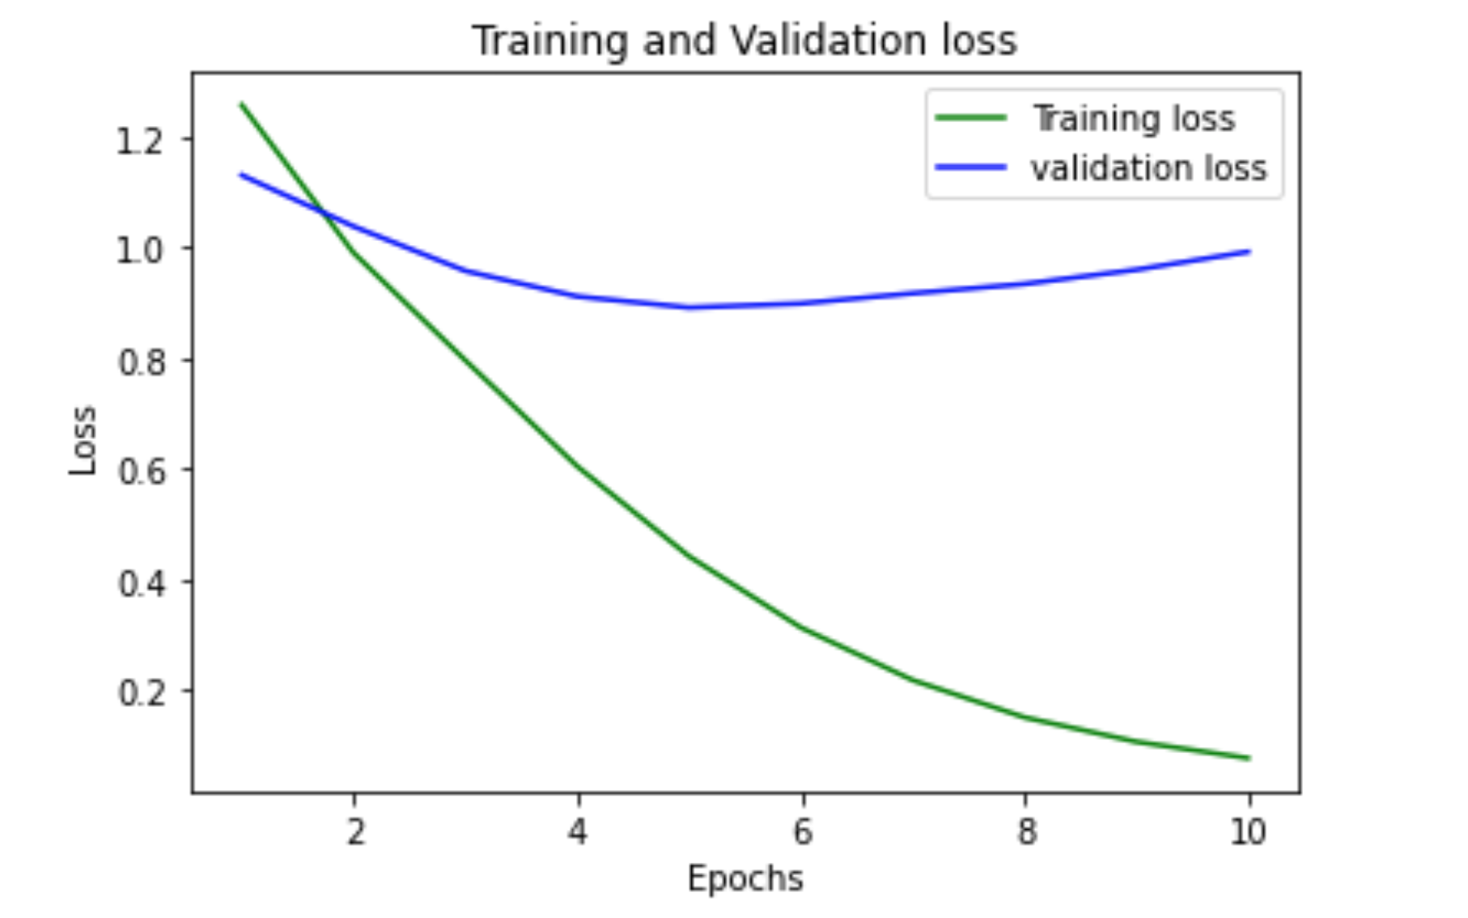
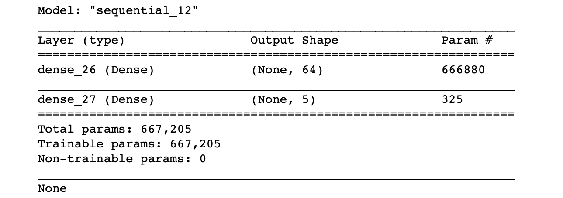
SENTIMENT ANALYSIS - AMAZON FINE FOOD REVIEWS
____________________________________________________________________________________________________________________
Model 1 : Neural Network Model using single hidden layers followed by an output layer
1. The output layer is a dense layer with 5 output units(representing 5 scores for reviews).
2. Performance Accuracy : 67.5%.
3. The model is seem to overfit upon training over epochs.
4. In the further models we annotate the ratings>3 with ‘Positive’ and ratings<=3 with ‘Negative’ .

Slide 5
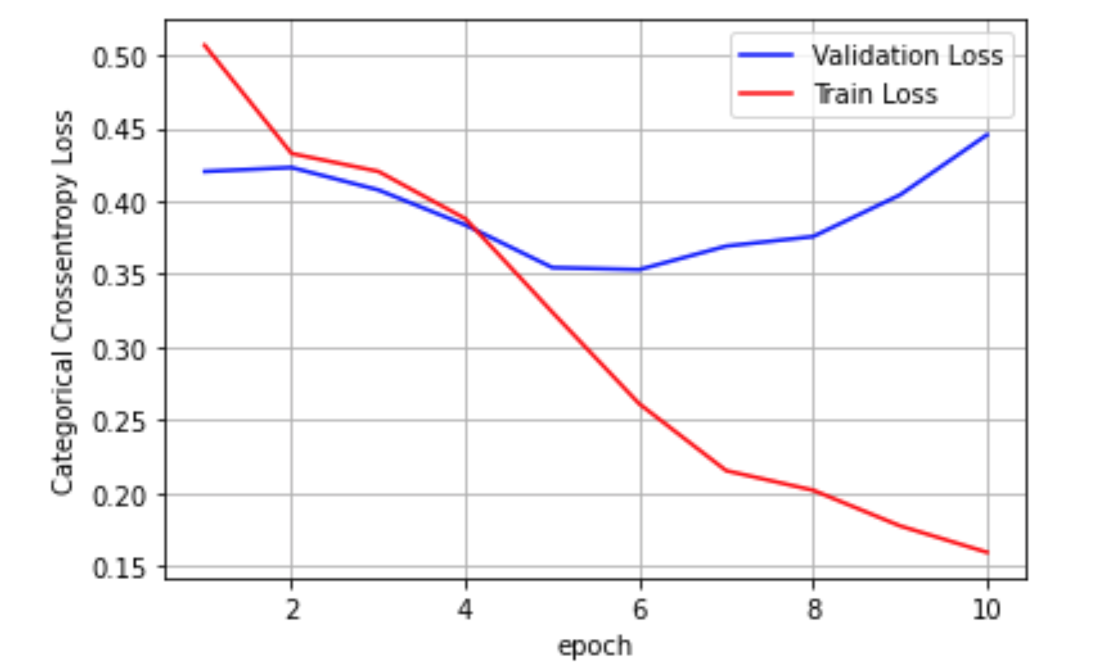
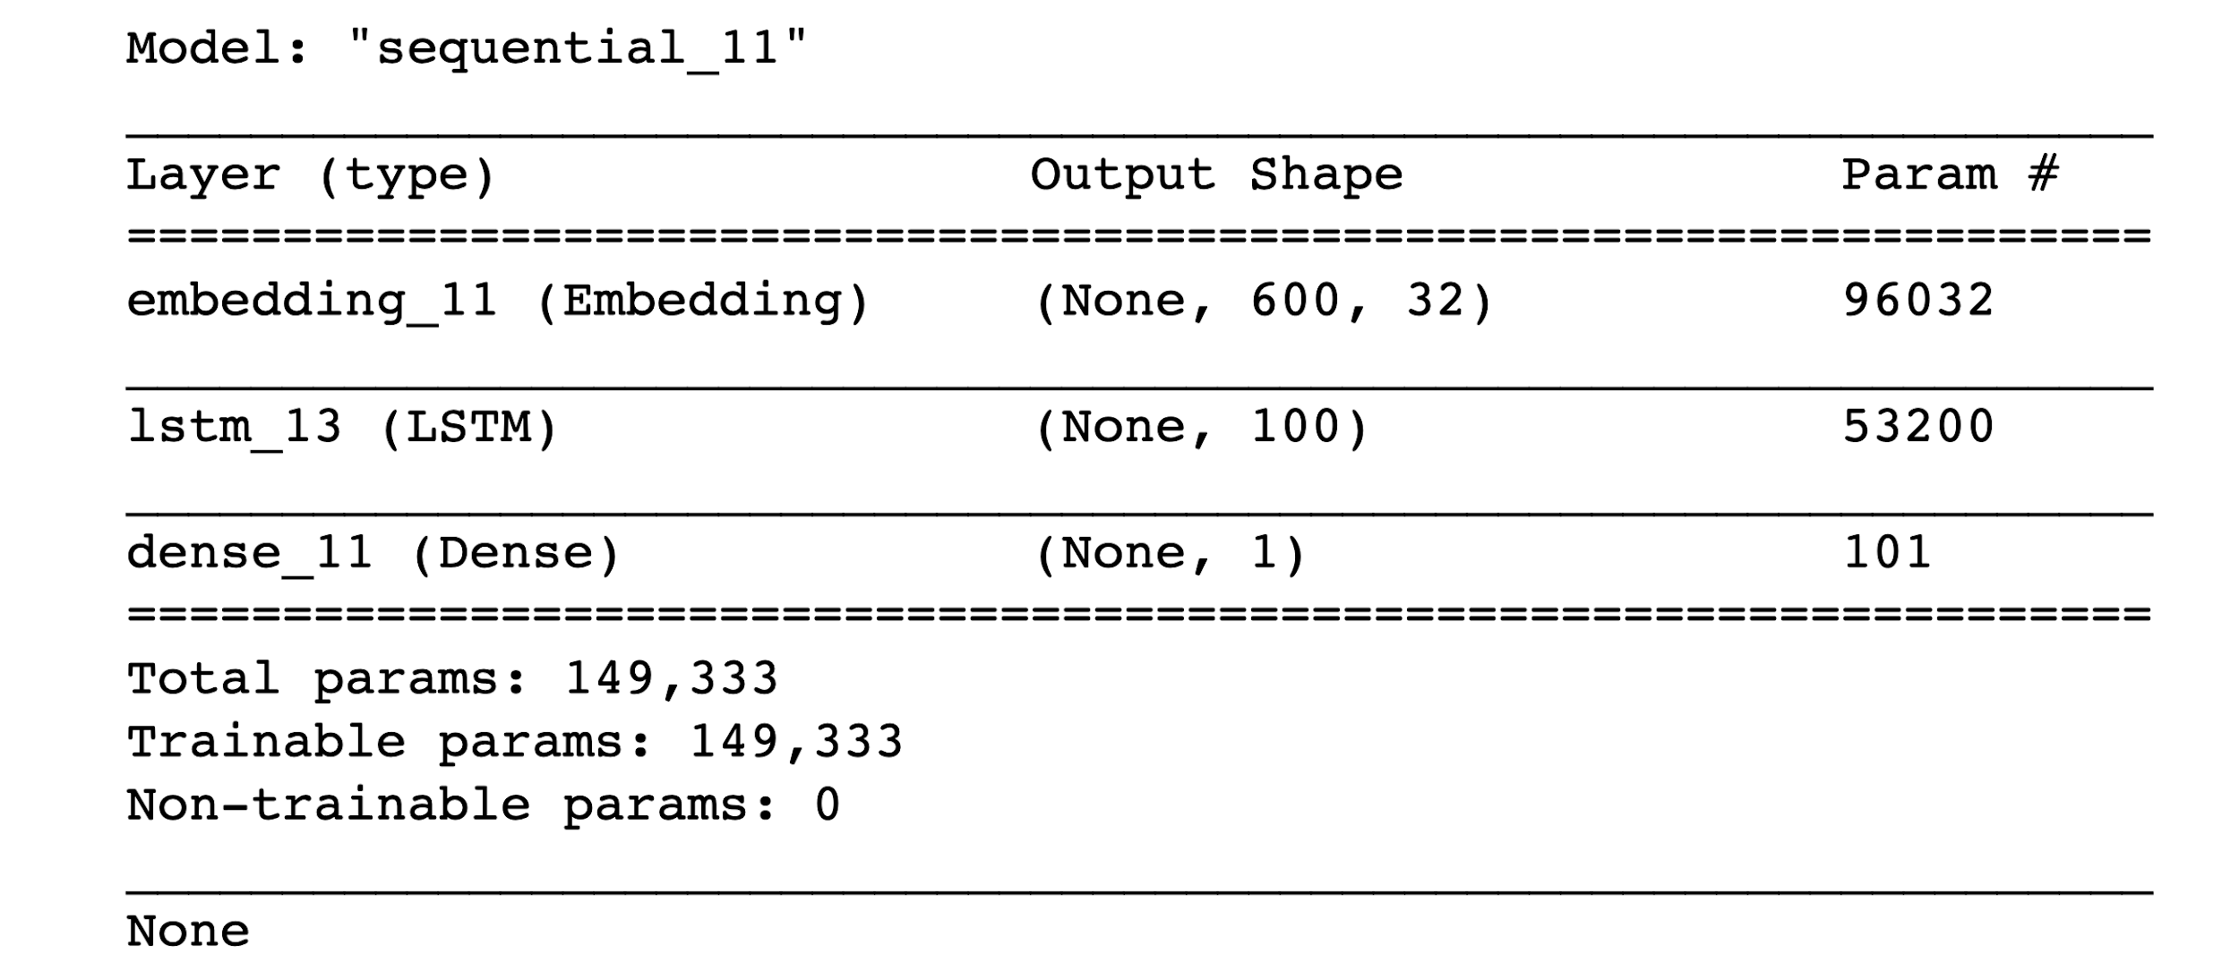
SENTIMENT ANALYSIS - AMAZON FINE FOOD REVIEWS
____________________________________________________________________________________________________________________
Model 2 : LSTM with single output Dense Layer
1. The model clearly overfits as evident from the plots.
2. The model has an accuracy of 81.58% .
3. Example : Sentence :"Not as Advertised”
Output : "Negative review with 52 % Accuracy"

Slide 6
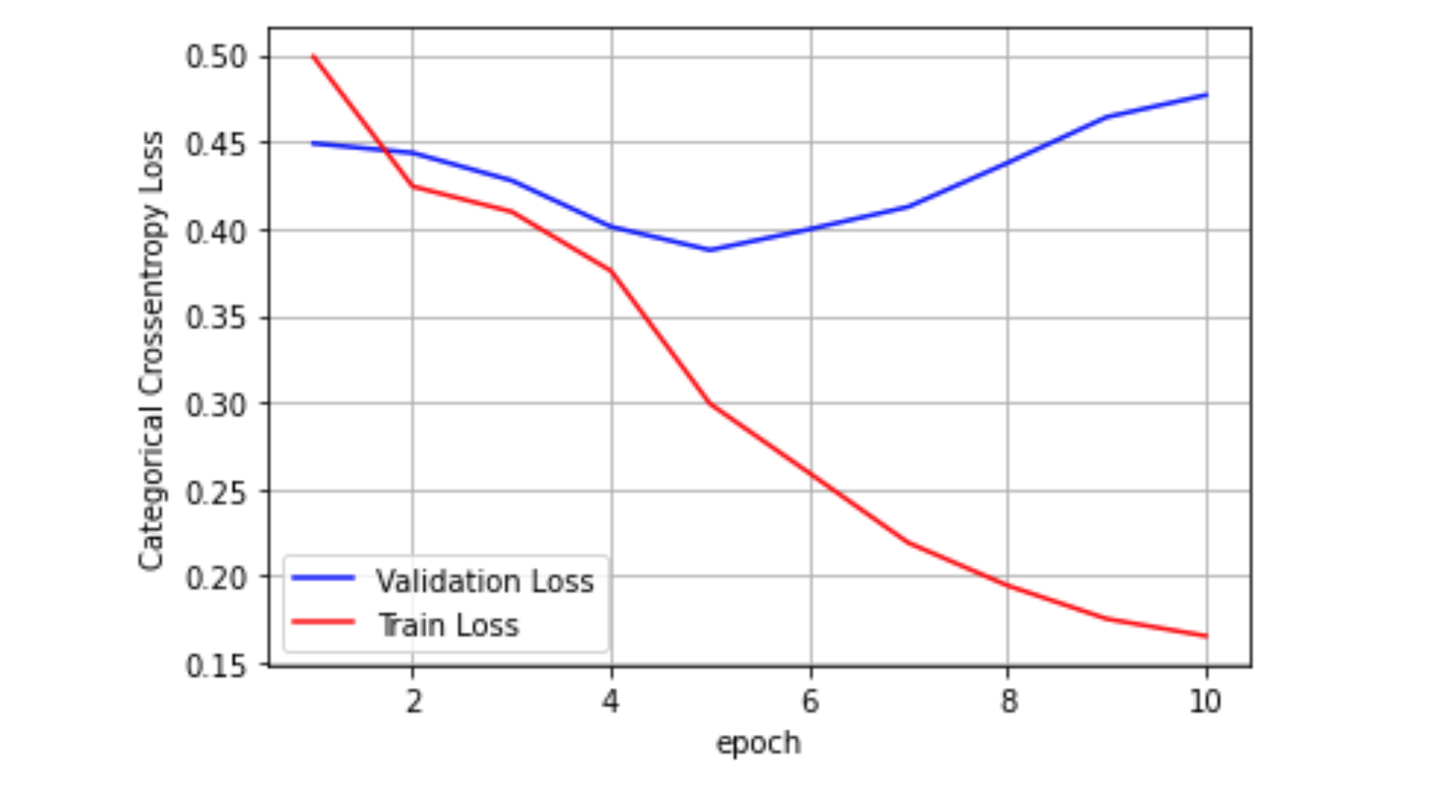
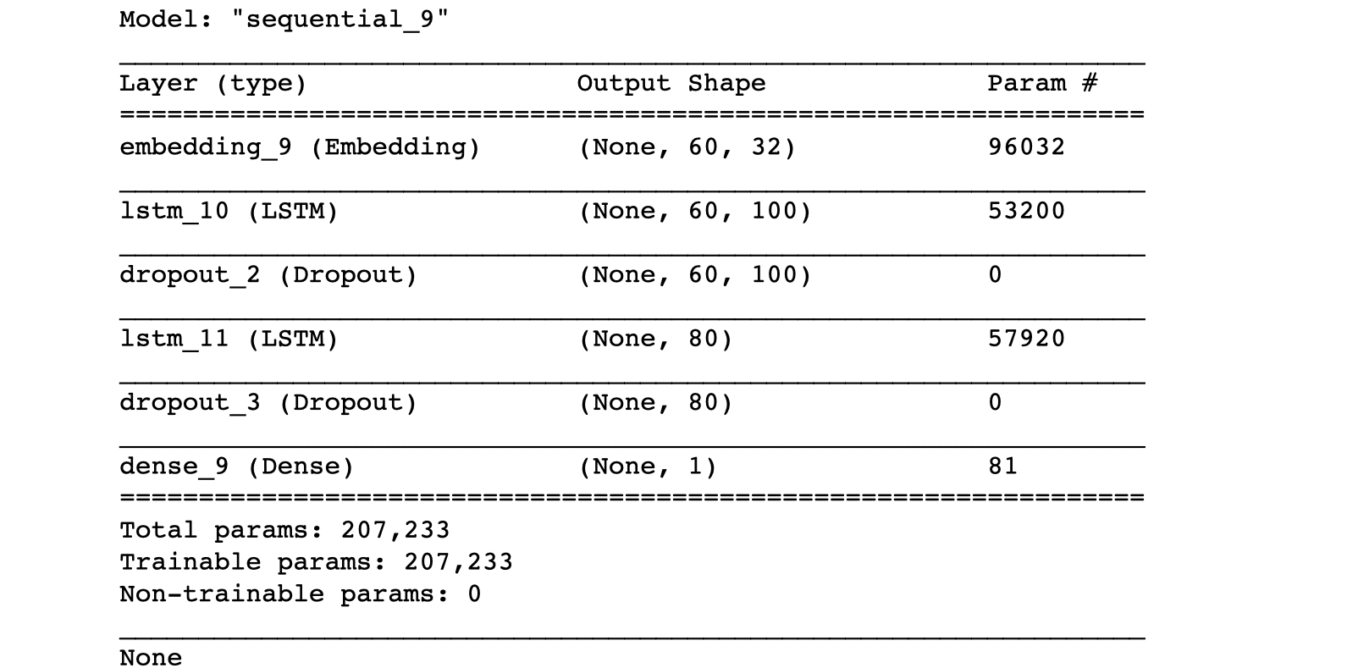
SENTIMENT ANALYSIS - AMAZON FINE FOOD REVIEWS
____________________________________________________________________________________________________________________
Model 3 : multiple LSTM layers along with dropout with ratio 0.25 and 0.5 respectively.
1. Performance Accuracy : 84.42%
2. Example :
Sentence : "Not as Advertised”
Output : Negative review with 55.76 % Accuracy
3. The model performed quite better than the previous with predicting actual sentiment although with quite less accuracy.

Slide 7
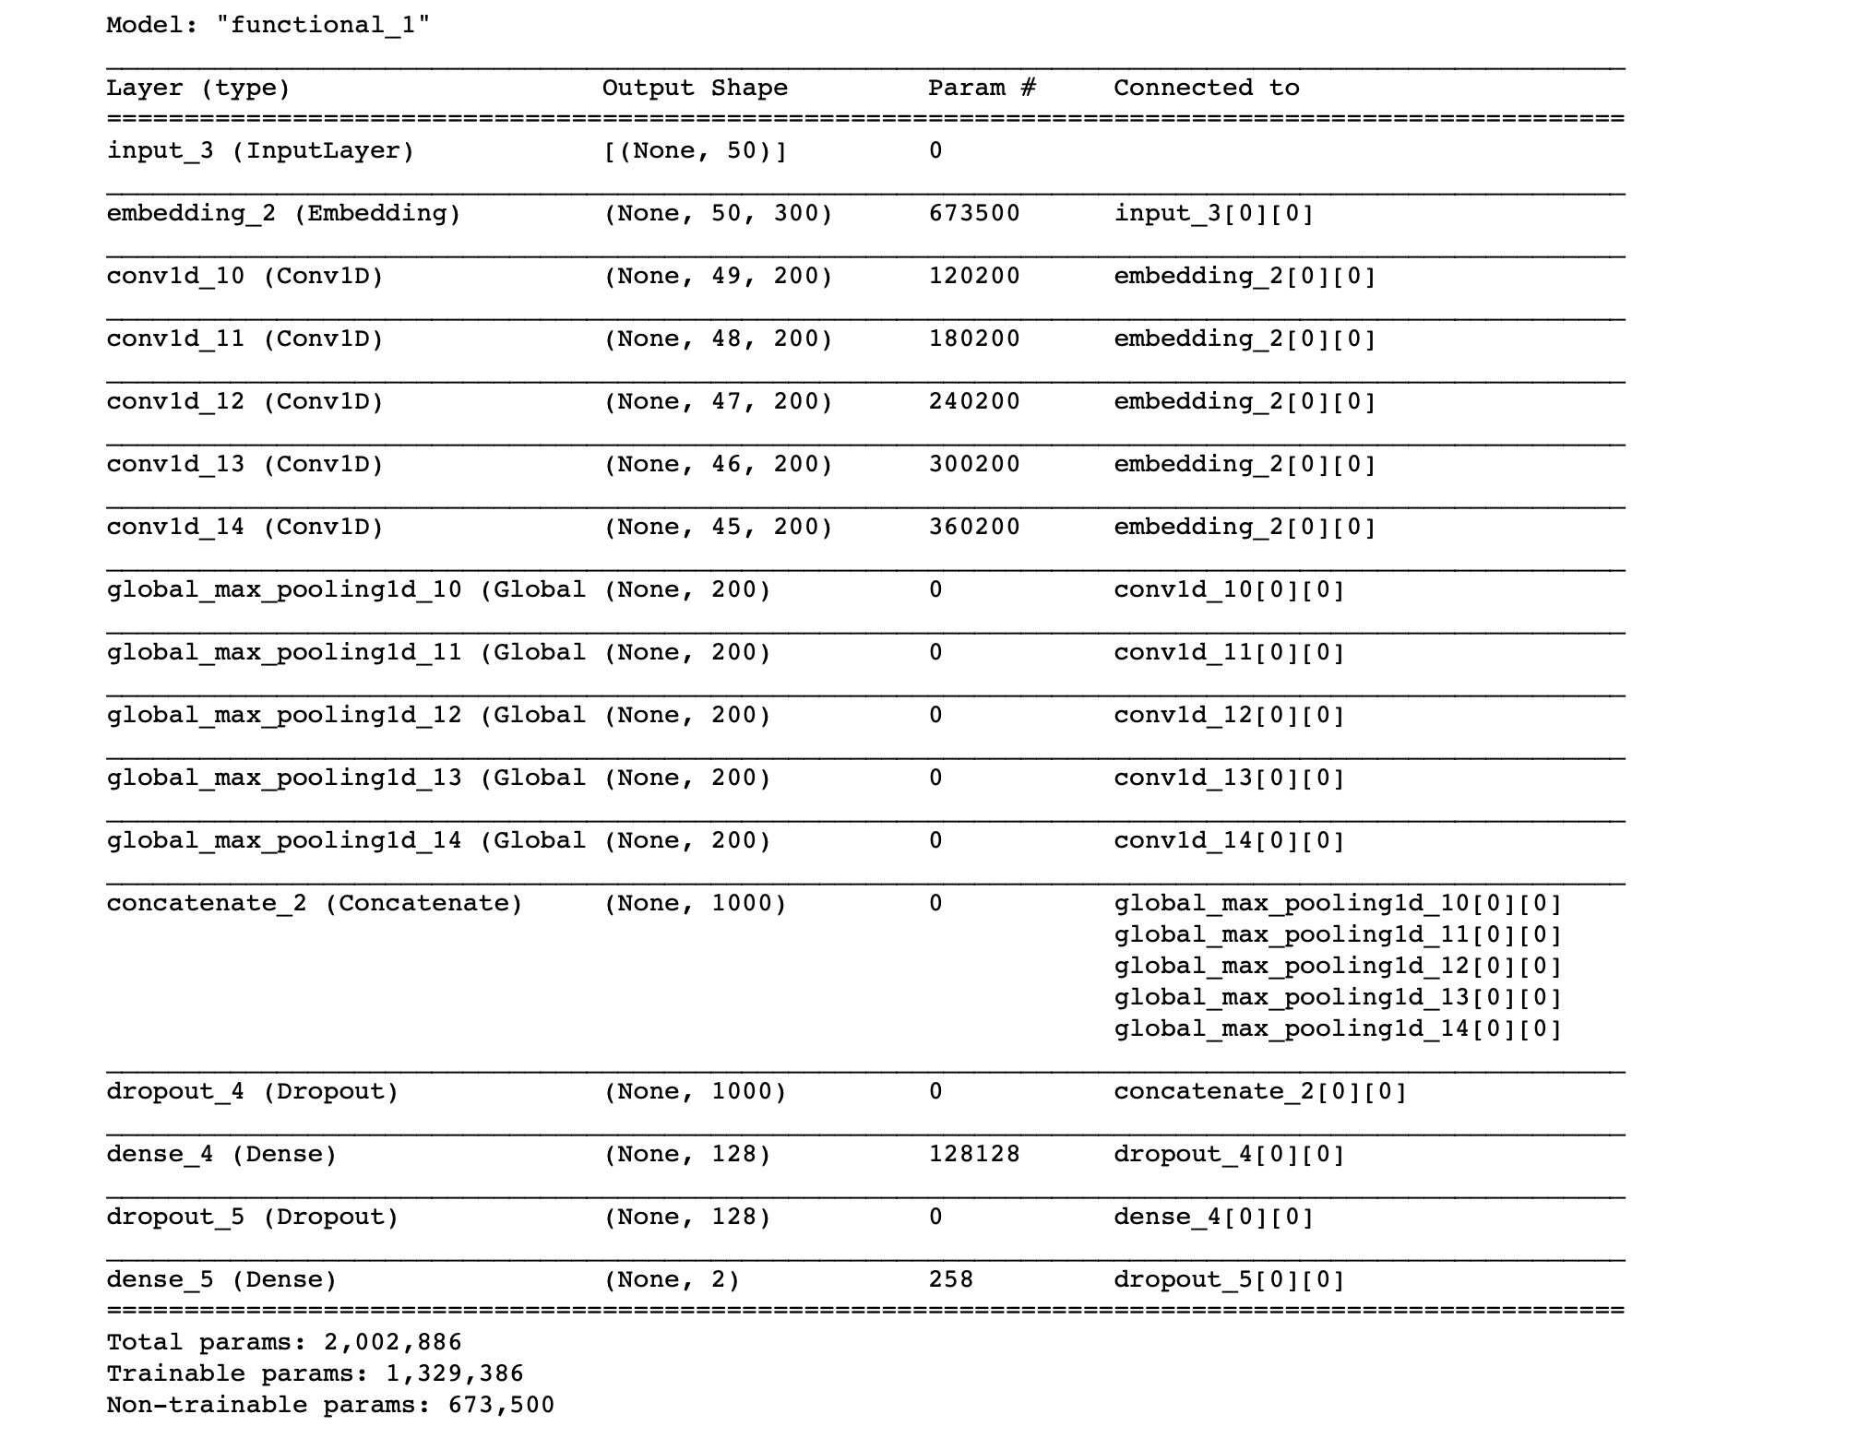
SENTIMENT ANALYSIS - IMDB MOVIE DATASET
____________________________________________________________________________________________________________________
Model 4 : Sentiment Analysis using Deep CNN
Performed Text Processing and Word Embeddings using the pre-trained Google news word2vec model
Applied five different sized filters in the CNN model.
Output : To predict score(positive(1) or negative(0) on the unseen data(Test data here).
Achieved an accuracy of 74.67% on the test dataset.

Slide 8
RESEARCH PAPER - NEURAL UNIFIED REVIEW RECOMMENDATION WITH CROSS ATTENTION
_____________________________________________________________________
Approaches about exploiting reviews information can be categorised in the following types:
Document-level methods : (document-encoder)
Review-level methods:(review_encoder and user/item encoder)
Apply cross-attention mechanism to the document/review encoder and user/item encoder to include important words and reviews respectively.
Goal : Predict the rating the user would score towards an unobserved item.

Slide 9
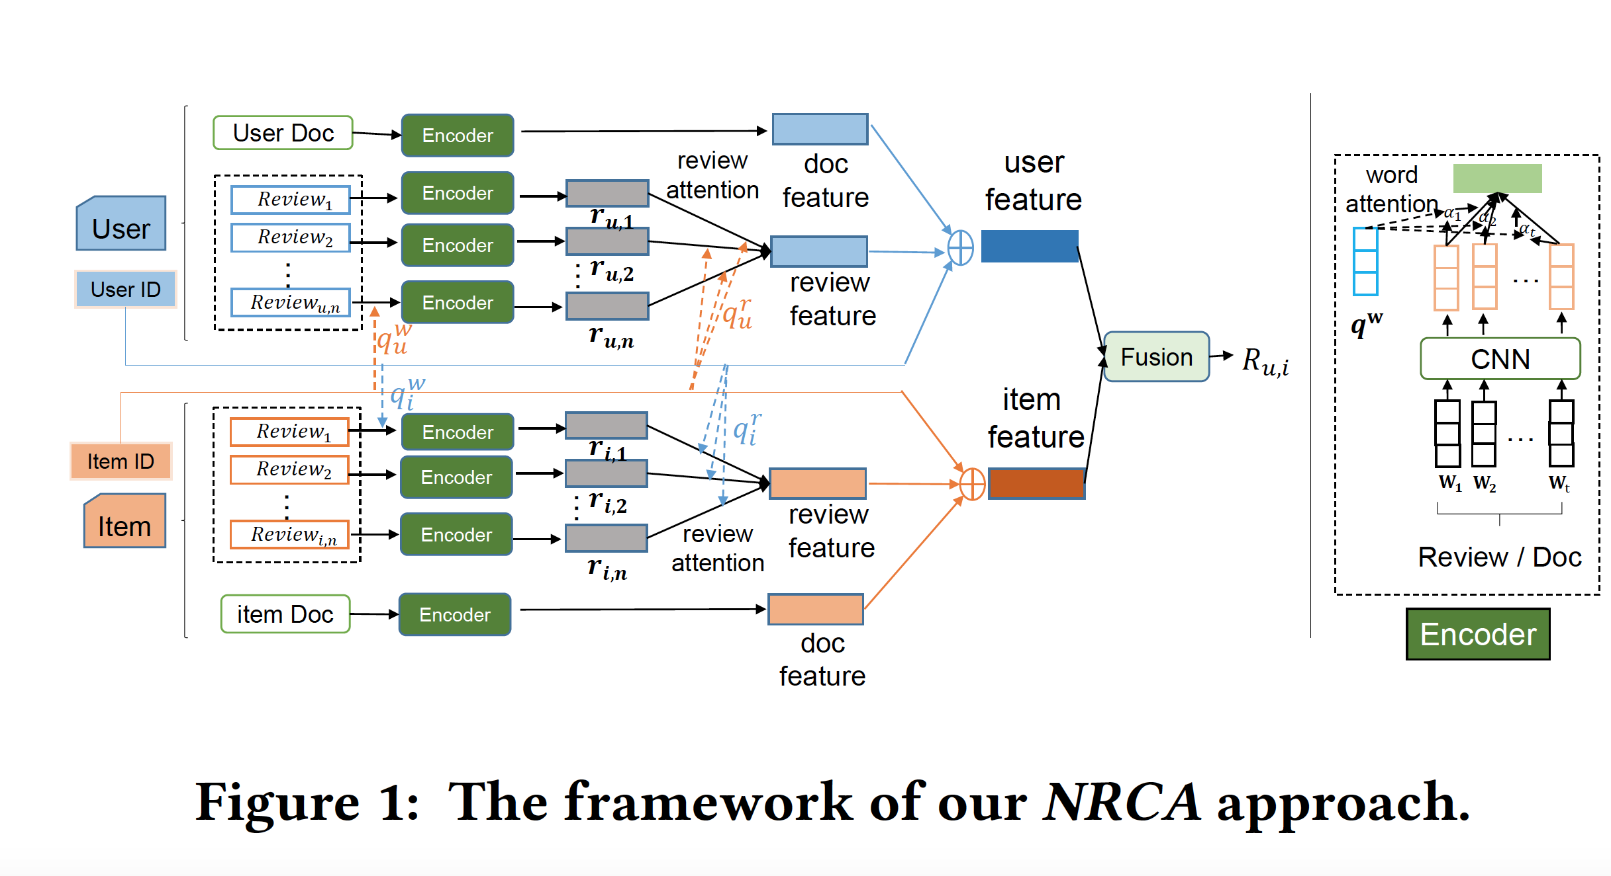
RESEARCH PAPER - CROSS ATTENTION MODULE
______________________________________________
Cross attention module to focus on important words and reviews.
Users and Items are represented into low-dimensional real-valued vectors as ID embeddings.
Based on user and item ID embedding, we utilise Multilayer Perceptron (MLP) to generate cross attention vectors for each user and item.

Slide 10
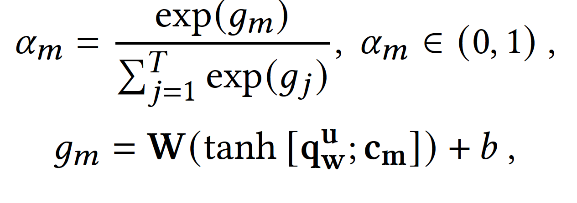

Research Paper - Review Level/Document Level Encoder
______________________________________________
Various word Embeddings model can be used (GLoVe model used here)
CNN to extract the semantic features
Cross Attention : From CNN we obtain the semantic feature vectors of all words. We introduce cross attention to highlight important words.
Then we obtain the representation vector of the 𝑖-th review of user 𝑢 based on the item 𝑖 via weighted summation of all words :

Slide 11
Research Paper - Review Level User/Item Encoder
____________________________________________
Since different reviews contribute differently we use review level cross attention mechanism.
We calculate weights of each review w.r.t a particular user and normalise the weights between 0 and 1.
Then we obtain review level feature for a user by aggregating all the reviews as per their weights.
Likewise we can obtain review level feature for a particular item.

Slide 12
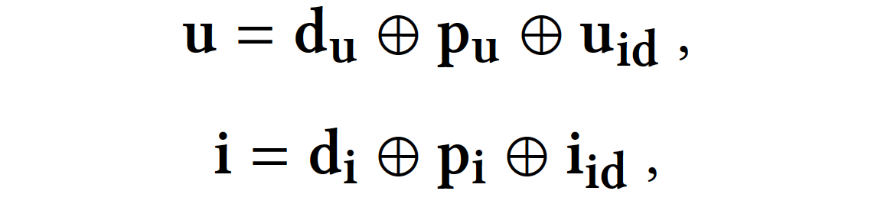
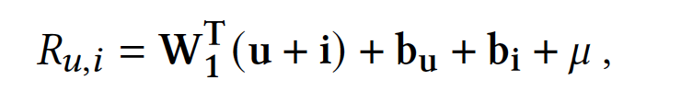
Fusion and rating Prediction
________________________________________________________________________________________________
The three features obtained from previous slides i.e. document encoder, review level encoder for user and item are fused together to represent user and item
After fusion we predict the rating for a user and item as follows:
where the bias terms are for user, item and global bias terms.

Slide 13
RESEARCH PAPER - EXPERIMENTS
Datasets : Digital Music, Grocery and Gourmet Food, Video Games, Office Products and Tools Improvement selected from Amazon review
Word embeddings : GloVe Model, dimension = 300
The dimension of user or item ID embedding = 32
Convolution : 100 convolution filters, window size = 3
Dropout ratio = 0.7 and learning rate = 0.003
Evaluation Metric : Mean Square Error(MSE)

Slide 14
Results :
Dataset Used : Amazon fine food Reviews
Ratings = 0 or 1(binary)
Text preprocessing and train_test split
Word Embeddings : Glove Model with output dimension=300
Model :
Convolution layer with five different filters
Dense hidden layer with 128 hidden unit
Regularisation Parameters : Dropout
Output:
Model outputs an accuracy of 78.67% on test dataset.
Example :
Sentence : “worst product ever”
Model Output : “Negative sentiment(Rating 0)with 52% accuracy
Conclusion : The model doesn’t perform well on unseen data and completely overfits due to less training data and imbalanced training dataset.

Slide 15
References
____________________________________________
Dataset :-
Amazon fine food reviews
IMBD movie review dataset
Research Paper : NEURAL UNIFIED REVIEW RECOMMENDATION WITH CROSS ATTENTION

Slide 16

THANK YOU
Abhik Naskar - 17CS30001

