Slide 1
Complementary Recommendation
Project Seminar-2020

Slide 2
Brief Introduction
Complementary recommendation
Two types of recommendations : Substitute and Complementary.
Complementary recommenders suggest items that are dissimilar to the source but are often sold as a companion item or service(mobile phone and power banks).
Substitute recommenders offer similar items to the source item.
In economics, a complement is defined as an item that is usually consumed with another.
Correspondingly the cross elasticity of demand is negative, which means that price drop for one item increases demand for its complements.
Within this context, data sources that potentially carry complementary items could be further classified by the cross-interaction between event time and object granularity as summarised below:
Simultaneously purchased item
Simultaneously purchased category
Consecutively purchased items
Consecutively purchased Categories

Slide 3

Market Basket AAnalysis
My WORK

Slide 4
Market Basket analysis
Complementary recommendation
Market basket analysis is a method or technique of data analysis for retail and marketing purpose.
Market basket analysis is done to understand the purchasing behaviour of customers.
Eg:if a customer is buying bread then he is likely to buy butter, jam or milk to compliment bread.
Applications of MBA:
Cross-selling is basically a sales technique in which seller suggests some related product to a customer after he buys a product.
Product Placement: It refers to placing the complimentary (pen and paper)and substitute goods (tea and coffee) together so that the customer addresses the goods and will buy both the goods together.
Fraud Detection: Market basket analysis is also applied to fraud detection. It may be possible to identify purchase behavior that can associate with fraud on the basis of market basket analysis data that contain credit card usage.

Slide 5
Association Rule
Complementary recommendation
Association Rules are widely used to analyse retail basket or transaction data, and are intended to identify strong rules discovered in transaction data using measures of interestingness, based on the concept of strong rules.
Let I={i1,i2,i3,…,in} be a set of n attributes called items and D={t1,t2,…,tn} be the set of transactions. It is called database. Every transaction, ti in D has a unique transaction ID, and it consists of a subset of item-sets in I.
Support: It gives an idea of how frequent an item-set is in all the transactions.To say in formal terms it's the fraction of total no. of transactions in which the item-set occurs.We refer to an item-set as a "frequent item-set" if you support is larger than a specified minimum-support threshold.
support(X->Y) = (𝑇𝑟𝑎𝑛𝑠𝑎𝑐𝑡𝑖𝑜𝑛𝑠𝑐𝑜𝑛𝑡𝑎𝑖𝑛𝑖𝑛𝑔𝑏𝑜𝑡ℎ𝑋𝑎𝑛𝑑𝑌)/(𝑇𝑜𝑡𝑎𝑙𝑁𝑜.𝑜𝑓𝑡𝑟𝑎𝑛𝑠𝑎𝑐𝑡𝑖𝑜𝑛𝑠)
It defines the likelihood of occurrence of consequent on the cart given that cart already has antecedent.It signifies the likelihood of item Y being purchased when item X is purchased.
confidence(X->Y) = support(X->Y)/support(X)
Lift : Lift gives the rise in the probability of having {Y} on the cart with the knowledge of {X} being present over the probability of having {Y} on the cart without knowledge about presence of {X}.
lift(X->Y) = confidence(X->Y)/support(Y)

Slide 6
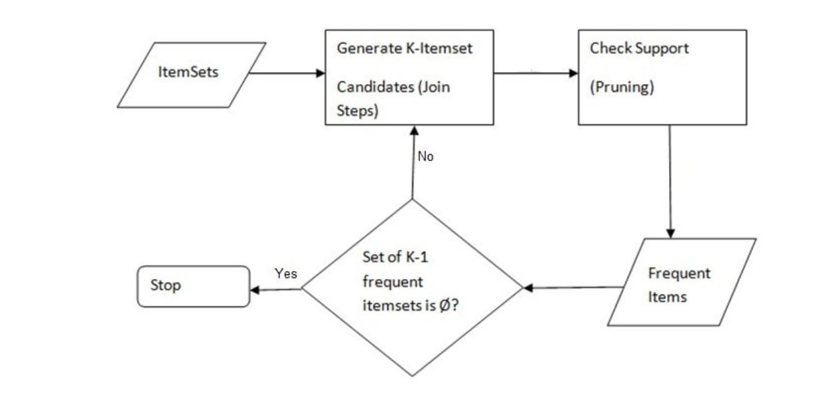
Apriori Algorithm
Complementary recommendation
Apriori algorithm is a classical algorithm in data mining. It is used for mining frequent item-sets and relevant association rules.
Rule - generation is a two step process. First is to generate frequent item set and second is to generate rules from the considered item-set.
Generating Frequent Item-set:
Generate all frequent item-sets each satisfying the minimum threshold and having only one item let it be L1. Next use self join and generate all possible combinations of L1 and now let the result be L2.
At each step as we keep on generating candidate item-sets, for each candidate we scan entire database so as to know its support and remove the candidates that do not satisfy minimum threshold.(Here To reduce the no of comparisons, store the generated candidate items in a Hash Tree,Instead of matching each of candidate item-sets against each transaction, match each transaction with the candidates in hash tree(there by we can enhance the speed of apriori using this method)
In similar way create Lk from Lk-1 until the point where we are unable to apply self join.
Generating frequent item-set.

Slide 7
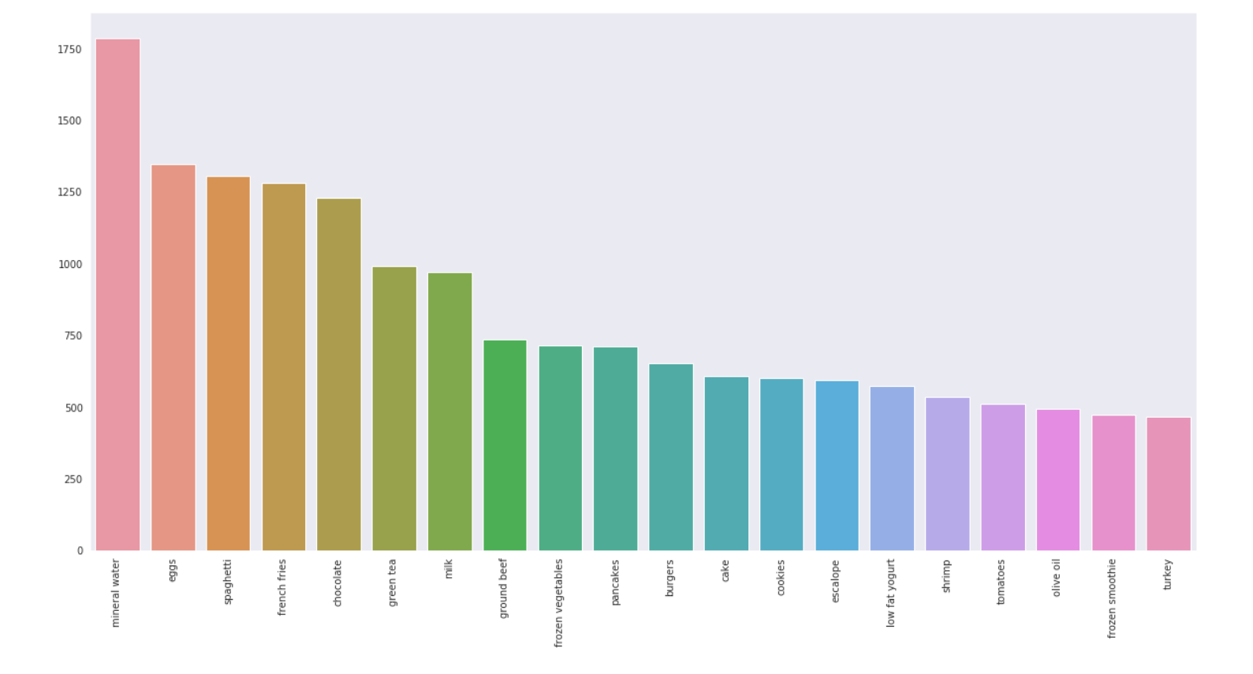
Data Analysis
Complementary recommendation
I have used the Market_Basket_Otimisation.csv to apply the Apriori Algorithm.
After data pre-processing, I analysed the top 20 frequently purchased item.
We can find that mineral water is the most purchased item from the store, we may advice that mineral water must be always in the stock not only that mostly we can see from the above graph what 20 items are being frequently purchased.
Tree Map Analysis also gives a detailed view of the most frequent 20 purchased items.

Slide 8
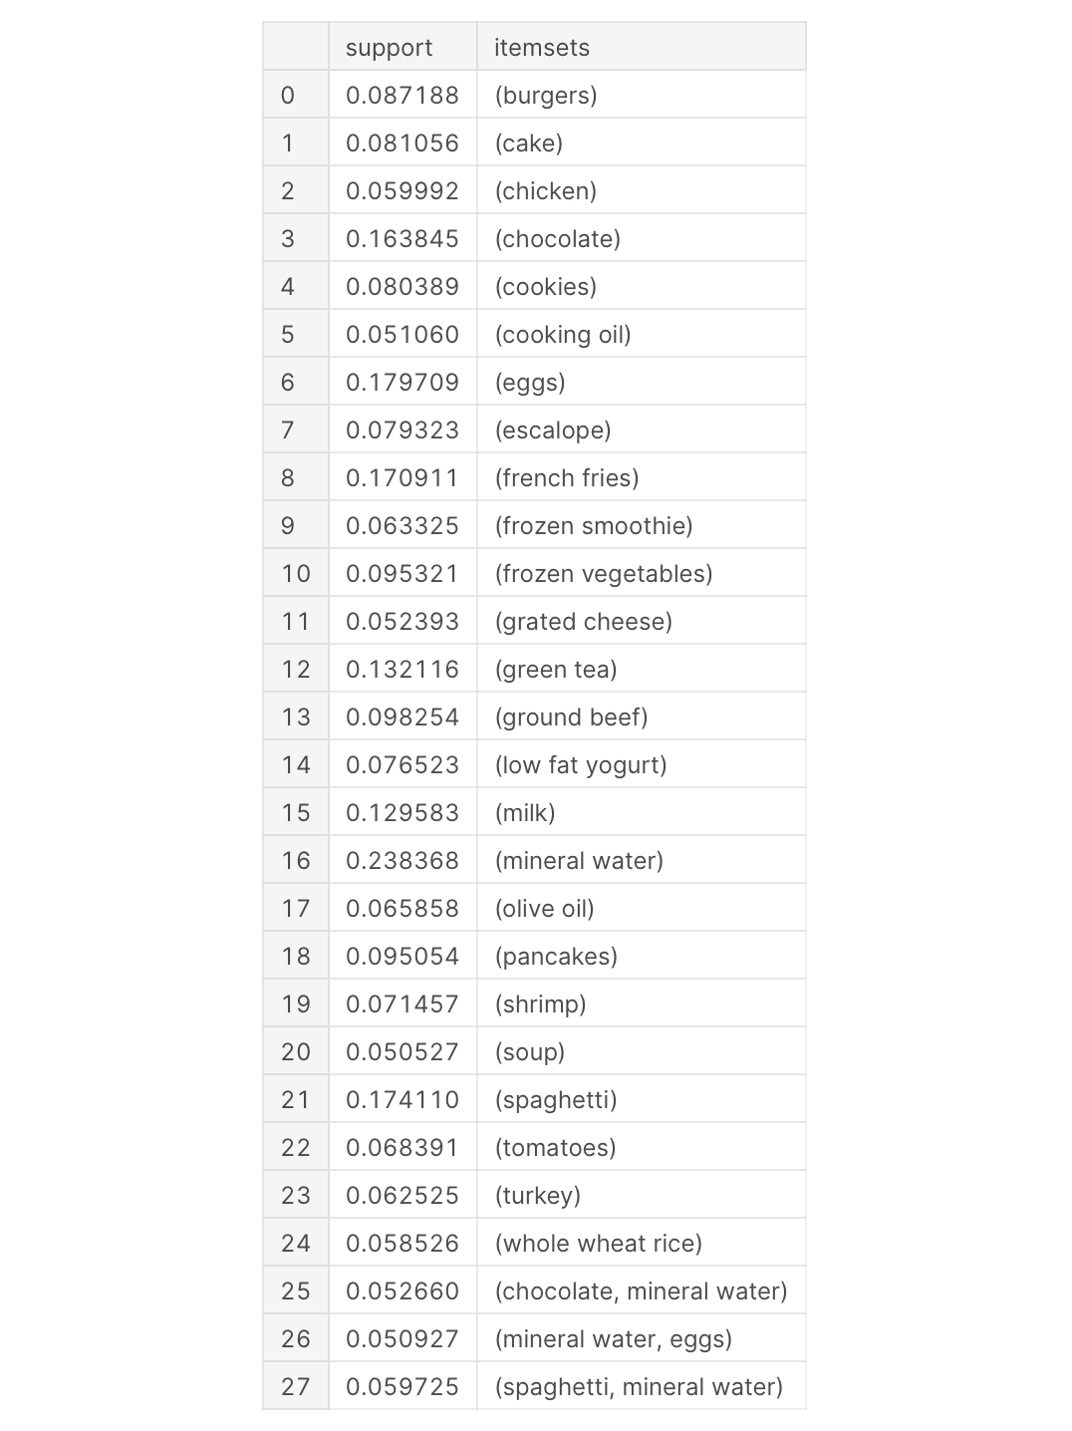
Algorithm ANALYSIS
Complementary recommendation
Now I applied the apriori algorithm on the pre-processed data with min_support = 0.05. The frequent items are listed below:
The details of the code with further analysis can be found here.

Slide 9
Shortcomings of Apriori Algorithm
Complementary recommendation
Using Apriori needs a generation of candidate item-sets. These item-sets may be large in number if the item-set in the database is huge.
Apriori needs multiple scans of the database to check the support of each item-set generated and this leads to high costs.
To overcome these redundant steps, a new association-rule mining algorithm was developed named Frequent Pattern Growth Algorithm.
It overcomes the disadvantages of the Apriori algorithm by storing all the transactions in a Trie Data Structure.

Slide 10
Frequent Pattern growth algorithm
Complementary recommendation
The first step is to scan the database to find the occurrences of the item-sets in the database. This step is the same as the first step of Apriori. The count of one-item-sets in the database is called support count or frequency of one-item-set.
The second step is to construct the FP tree. For this, create the root of the tree. The root is represented by null.
The next step is to scan the database again and examine the transactions. Examine the first transaction and find out the item-set in it. The item-set with the max count is taken at the top, the next item-set with lower count and so on. It means that the branch of the tree is constructed with transaction item-sets in descending order of count.
The next transaction in the database is examined. The item-sets are ordered in descending order of count. If any item-set of this transaction is already present in another branch (for example in the 1st transaction), then this transaction branch would share a common prefix to the root.
Also, the count of the item-set is incremented as it occurs in the transactions. Both the common node and new node count is increased by 1 as they are created and linked according to transactions.
The next step is to mine the created FP Tree. For this, the lowest node is examined first along with the links of the lowest nodes. The lowest node represents the frequency pattern length 1. From this, traverse the path in the FP Tree. This path or paths are called a conditional pattern base. Conditional pattern base is a sub-database consisting of prefix paths in the FP tree occurring with the lowest node (suffix).
Construct a Conditional FP Tree, which is formed by a count of item-sets in the path. The item-sets meeting the threshold support are considered in the Conditional FP Tree.
Frequent Patterns are generated from the Conditional FP Tree.

Slide 11
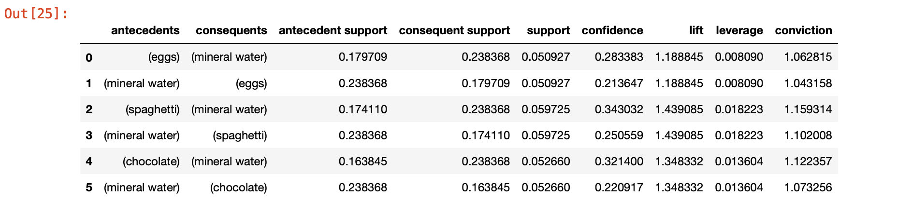
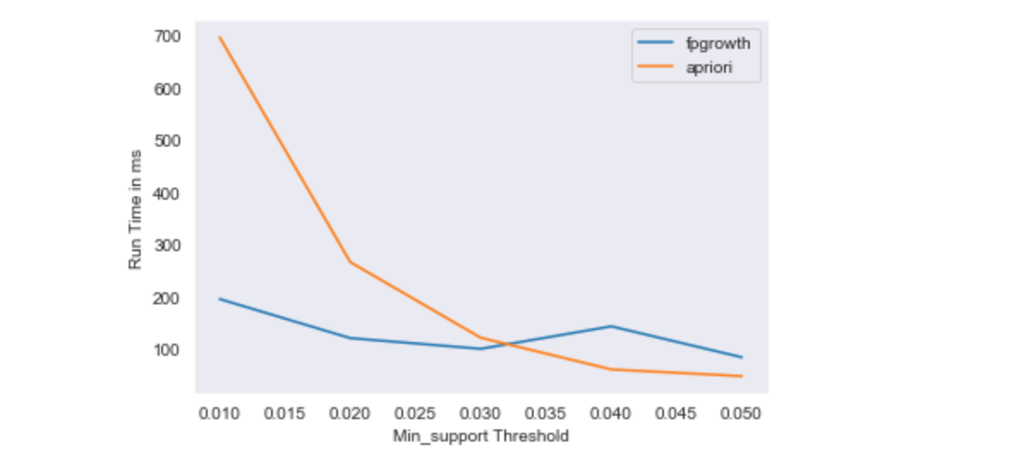
Analysis
Complementary recommendation
The algorithm is applied on the same dataset and association rule “lift” is used for analysis.
We could observe that {spaghetti}->{mineral water} is mostly like to occur as we can observe it from the lift.
Since FPGrowth is much faster than Apriori, a time variant analysis for both the algorithms shows:
The detailed analysis along with the codes can be found here.

