Slide 1

Data Analytics
Team “Data Nerds” Presents…

Slide 2
Data visualisation
Forest predictive analysis
At first we made detailed statistical analysis of the data table by splitting the training set into training and test set.
Cross validation was performed to make the accuracy of the model better.
These methods gave some interesting results which shall be discussed on later slides.

Slide 3
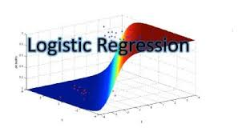
Algorithm used..
Forest predictive analysis
Since the data sheet was a binary classified model with only just 999 training examples and 12 features we decided to use binary classified Logistic Regression.

Slide 4
Data visualisation snippets
Forest predictive analysis
Firstly we split the data set into training set and test set in 0.75 ratio.
Then we applied the logistic regression on the training set using all the features. The outcome is shown below.
The logistic regression expression is as follows:
f(x) = 1 / (1 + exp-(b + b1x1 + b2x2 +…+bnxn)),
Where n is the number of features.

Slide 5
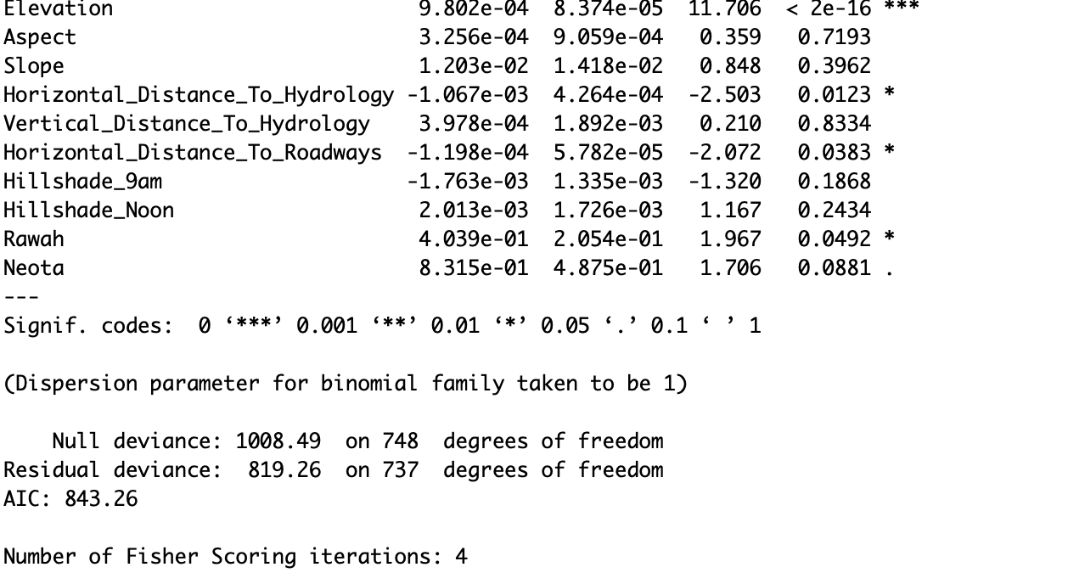
Here we see not all the features are relevant so we did further detailed analysis. Aic score should be minimum.
bbe be
Forest predictive analysis

Slide 6
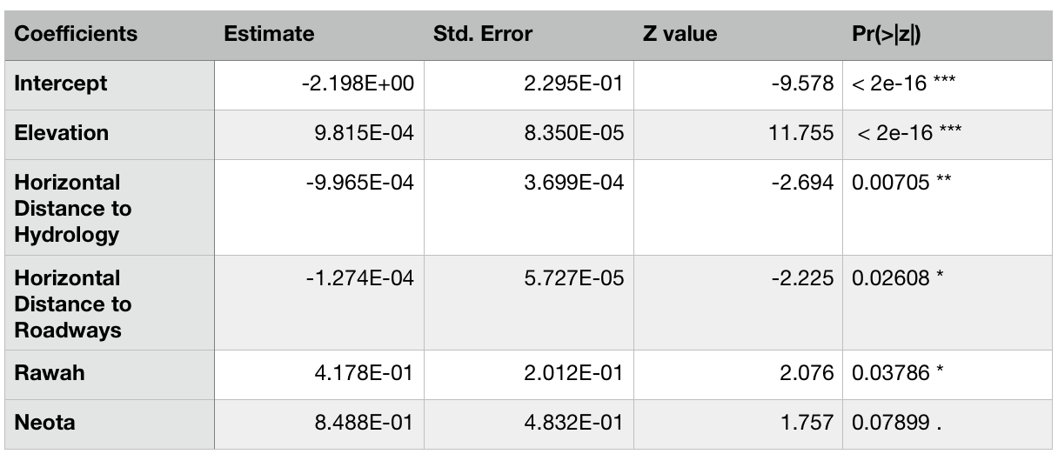
On detailed analysis we get the following table: AIC score was = 834.52
AAA
Forest predictive analysis
Table

Slide 7
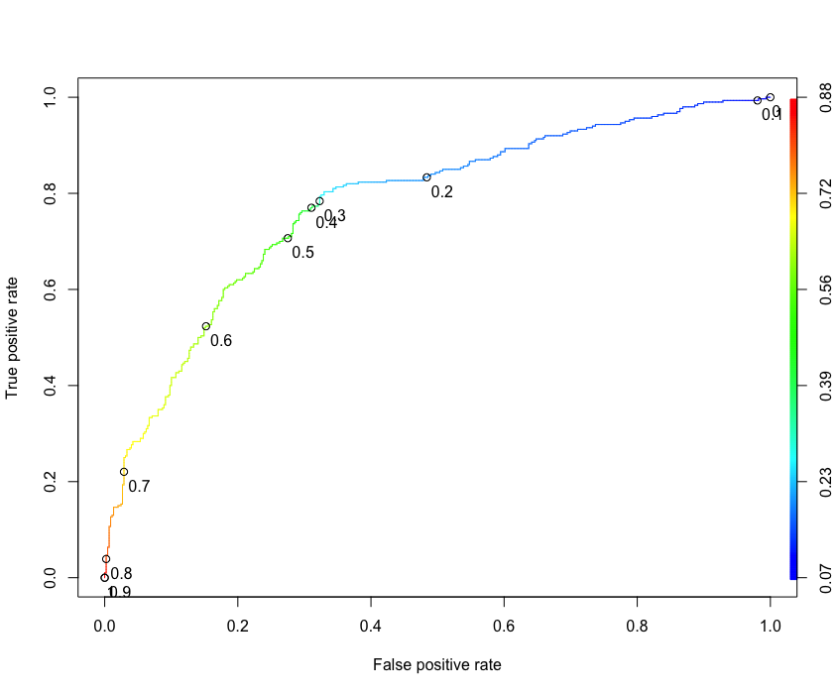
ROC Curve

Slide 8
Confusion matrix
Text
Thus after analysing the ROC(Receiver Operator Characteristic) curve we get the following confusion matrix.
 | Predicted = 0 | Predicted = 1
Actual = 0 | TN = 382 | FP = 67
Actual = 1 | FN = 140 | TP = 160

Slide 9
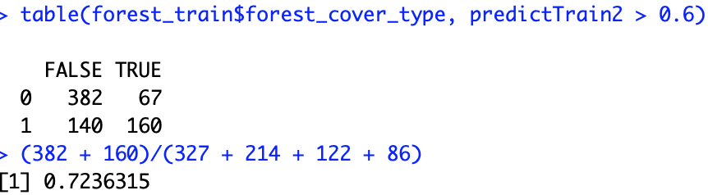
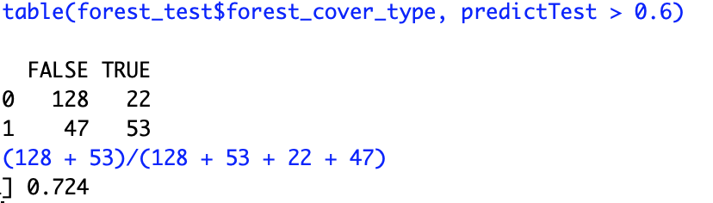
Accuracy
Forest predictive analysis
Overall Accuracy = (TP + TN) / N
Threshold value used = t = 0.6 as derived from ROC curve.
Test set accuracy is shown here.
AUC value = 0.7661333

Slide 10
Forest predictive analysis
After all this analysation we came to the conclusion that in logistic Regression we use the fact that C = 100(L2 regularisation parameter)
To curb the problem of overfitting we took the above necessary step.
Thus we analysed the data set and predicted the probabilities of forest type being 1 or 0.
The final accuracy of our test set was approx. 73%.

