Slide 1
Pucaro A tax payer’s voice
Group C4C [Code for Change]
Abhik Sarkar
Aditya Badola

Slide 2
Flow Chart of app
Tax Payer
I pay my income tax and GST
Where does this money get used?
Government Database
I had distributed your money for the development of these departments:
Dept 3 [Tourism], …
Departments
For a respective year and department, fetch correlated data of government expenditure to expected development in department
Dept 1 [Transport]
Dept 2 [Education]
Fully transparent user-government feedback

Slide 3
Tax Payer’s side
Income tax for different years:
1. 2015-16 10000 rupees
2. 2016-17 15000 rupees
3. 2017-18 20000 rupees
Government’s side
Money Utilization from tax payer for different departments [Tourism, Transport, Education]:
1. 2015-16 [5000, 2000, 3000]
2. 2016-17 [10000, 1000, 4000]
3. 2017-18 [200, 1800, 18000]

Slide 4
Tax Payer’s side
Income tax for different years:
1. 2015-16 10000 rupees
2. 2016-17 15000 rupees
3. 2017-18 20000 rupees
Transparent to taxpayer!
Government’s side
Money Utilization from tax payer for different departments [Tourism, Transport, Education]:
1. 2015-16 [5000, 2000, 3000]
2. 2016-17 [10000, 1000, 4000]
3. 2017-18 [200, 1800, 18000]

Slide 5
Why?
Positive feedback of helping someone by paying taxes
Exactment of knowledge [where, how own money is used]
Involvement with the governing system [for the people, by the people]

Slide 6
Just over 2 crore Indians, or
1.5 % of the total population
paid income tax in the assessment year (AY)
2016-17

Slide 7

Coefficient of Correlation
One dataset {x₁,...,x_{n}} containing n values
One dataset {y₁,...,y_{n}} containing n values then th formula for r is:
where:
is the sample size
are the single samples indexed with i
(the sample mean)
How much is government spending?
How much is the development?

Slide 8
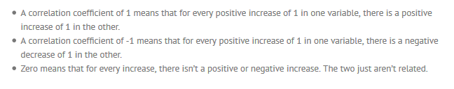
How does that help us?

Slide 9
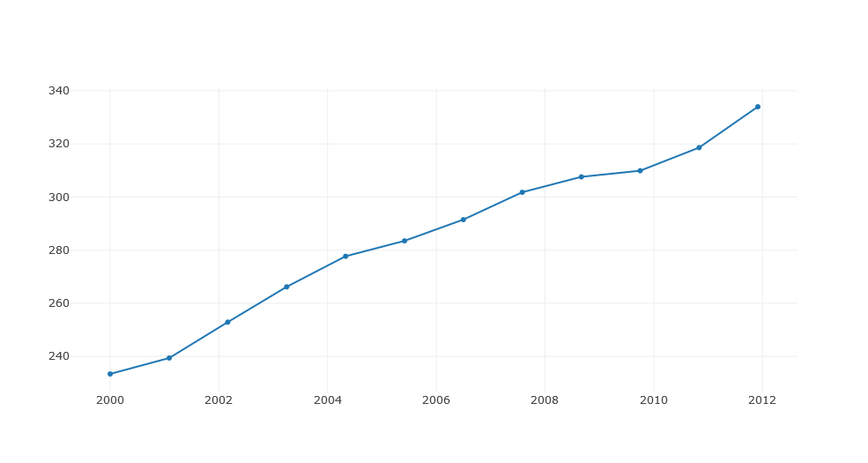
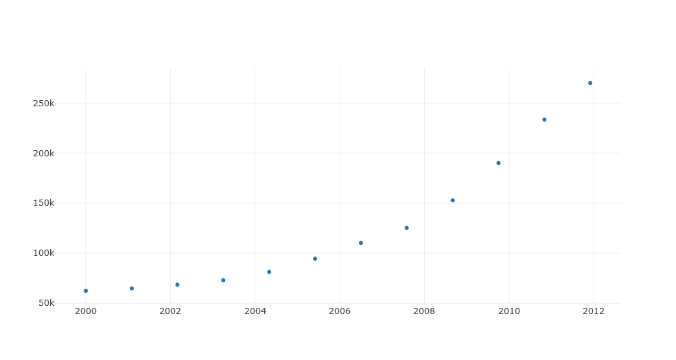

POSITIVE CORRELATION
Money (in lakhs) vs Year
Number of school registrations vs Year
Government Expenditure on Education
Number of School going children

Slide 10
You contributed to India’s development! (or did you?)
Possible conclusions:
Your money was well utilized in developing schools, staffing good teachers and spreading awareness about education (among many other things)
Your government ruling party is fulfilling its promises
Your voice is being heard among all your peers (as you may provide feedback/suggestions using Pucaro)
But…
Perhaps the data being used to correlate was linearly bound to increase in the first place regardless of the factor taken to account
[Biodiversity in a nation might be affected more by Global Warming than the tourism industry]

Slide 11
Selective Source-ability
After careful selection of certain data sets that are absolutely related to each other [like railway stations development and staffing in those stations/ Taxes spent in textile industry and Cotton sales], plots were created from reliable sources like:

Slide 12
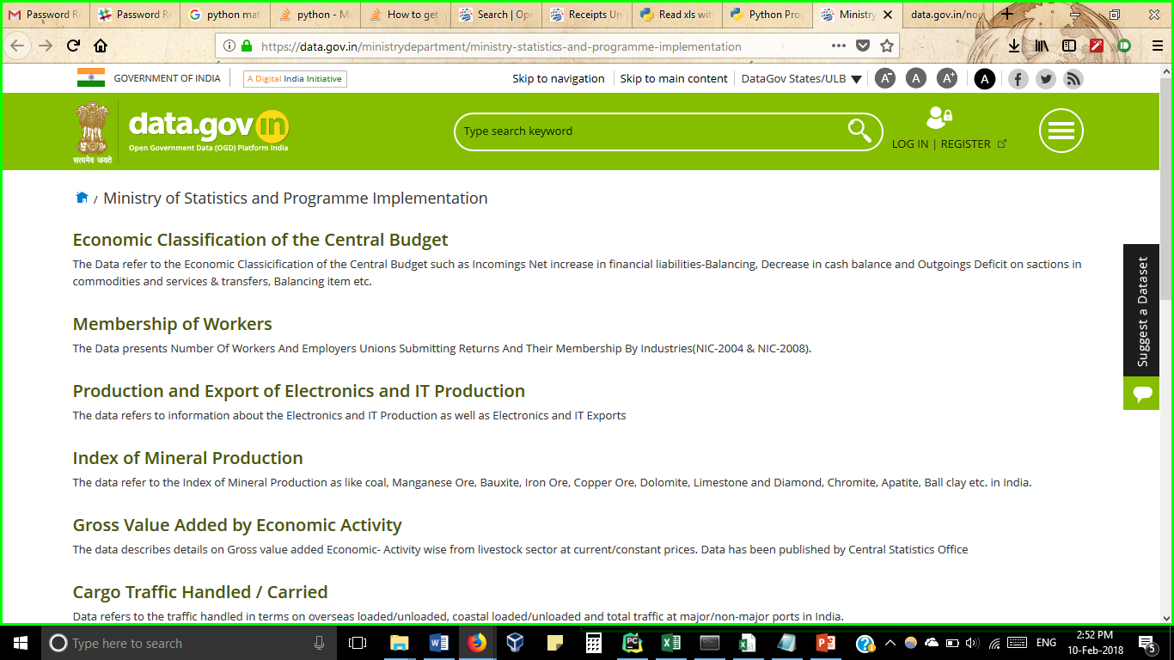
Data from data.gov.in (a digital India initiative)

Slide 13
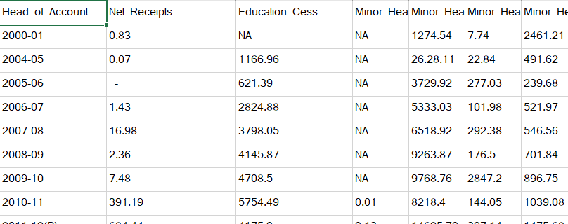
Publicly available government expenditures

Slide 14
Claims from reliable sources (a few instances)
Although tourism can be a mechanism to the maintenance of natural capital, many of the factors linked to biodiversity loss such as land clearance, pollution and climate change are also related to tourism development.
(Gössling & Hall, 2006 Gössling)
The government has provided the textile industry with more than Rs 10,000 crore for TUF (technology upgradation fund) interest subsidy so far, and is to provide an equivalent amount in future. It has also created 42 textile parks by spending Rs 1500 crore, though with questionable success in sales of cotton
(http://www.thehindubusinessline.com/opinion/Why-textiles-has-failed-to-perform/article20375913.ece )

Slide 15
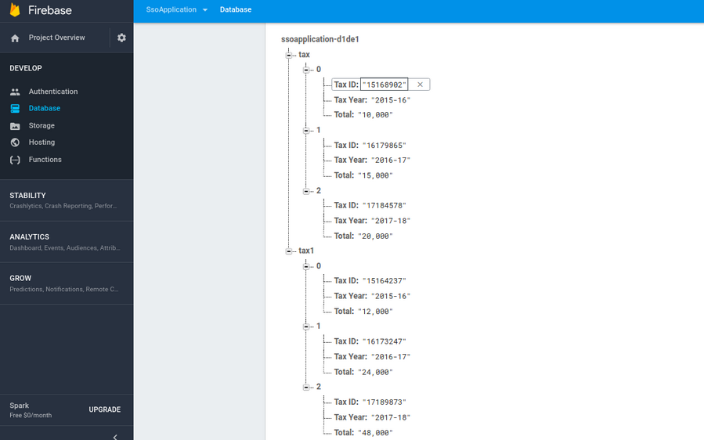
Prototypic data of tax utilization (for a taxpayer)
Note! This data does not represent actual tax money utilization and is meant just for representation purpose

Slide 16
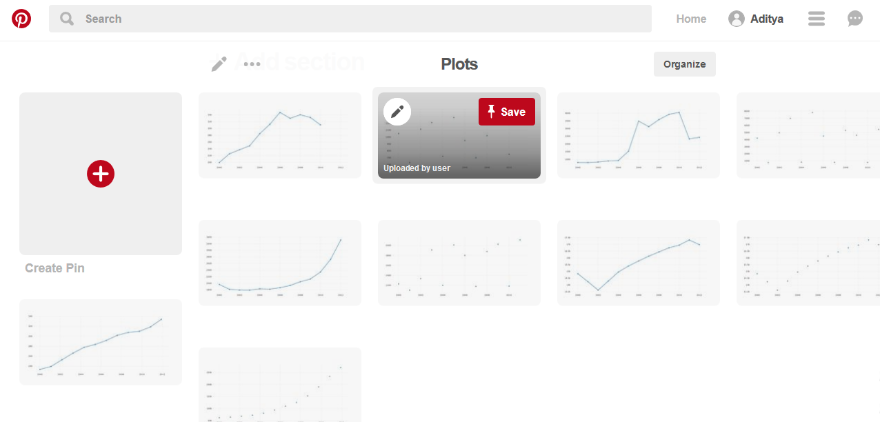
Pinterest Board containing all graphs (Government expenditure in various sectors vs Real value data of effect)
Link: https://in.pinterest.com/adityabadola97/plots/

Slide 17




Is the data correlated?
Sr. No. | Calculation | Coefficient of Correlation
 |  | 0.83 [POSITIVE CORRELATION] Education expenditure vs School going children
2. |  | 0.04 [LOW CORRELATION] Animal husbandry vs Livestock diseases
3. |  | 0.15 [LOW CORRELATION] Textile Expenditure vs Cotton Sales
4. |  | 0.103 [LOW CORRELATION] Tourism vs Expenditure on protecting biodiversity (No correlation)
5. |  | 0.535 [POSITIVE CORRELATION] Railways expenditure vs Staffing in railways

Slide 18

Soft-ware platforms/Languages used:
For data presentation and application usage:
Java & XML [Android Studios]
Firebase
For database manipulation:
Python 2.7 [iPython/Jupyter Notebook]
Visual Basic for Applications [Microsoft Excel]
JSON [Node JS, hosted on Hasura]

Slide 19
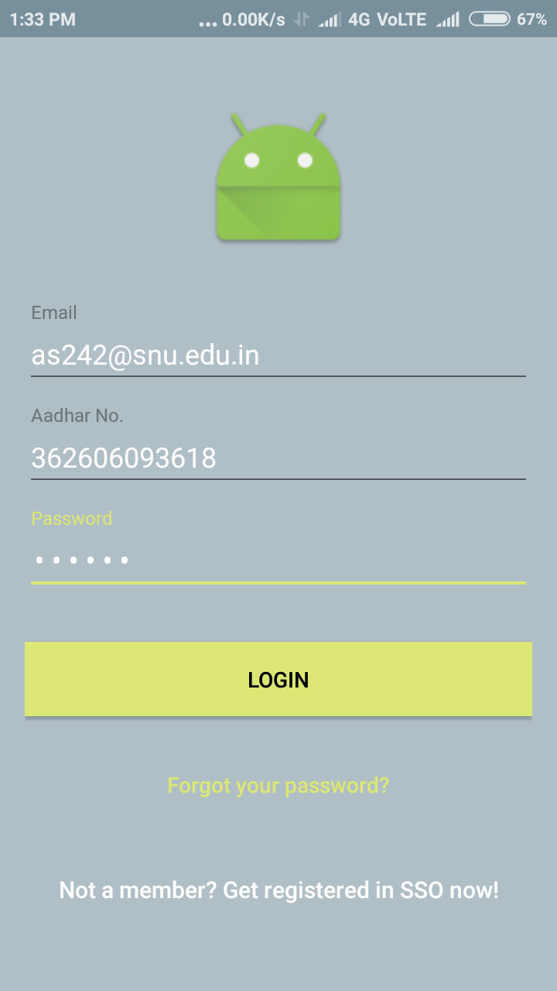
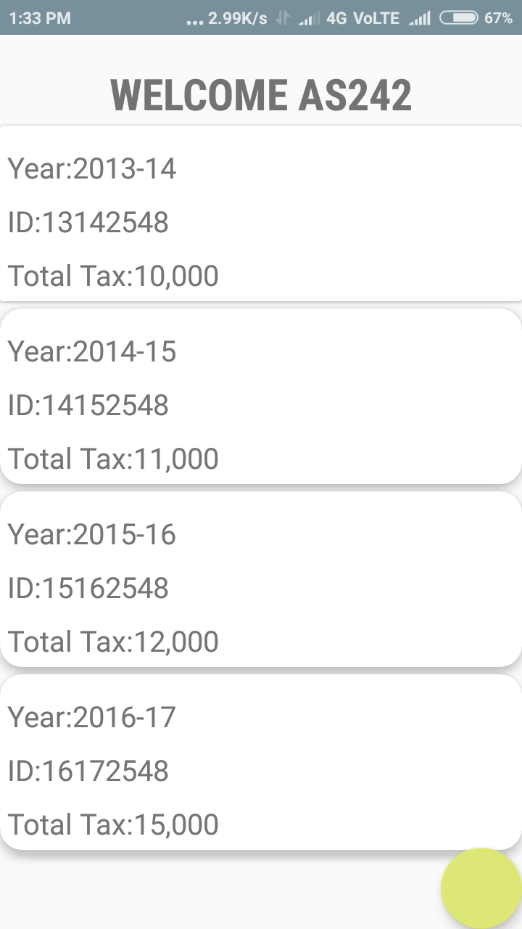
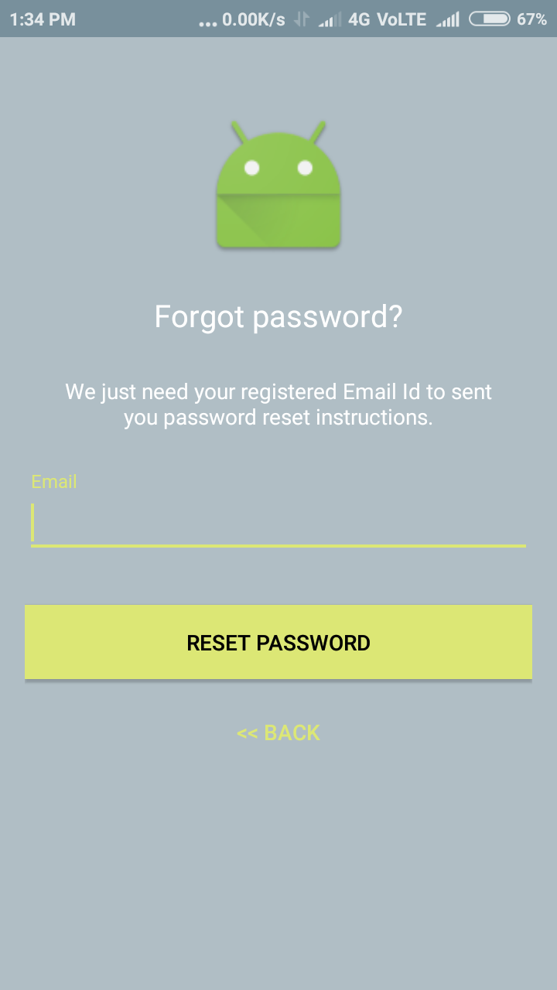
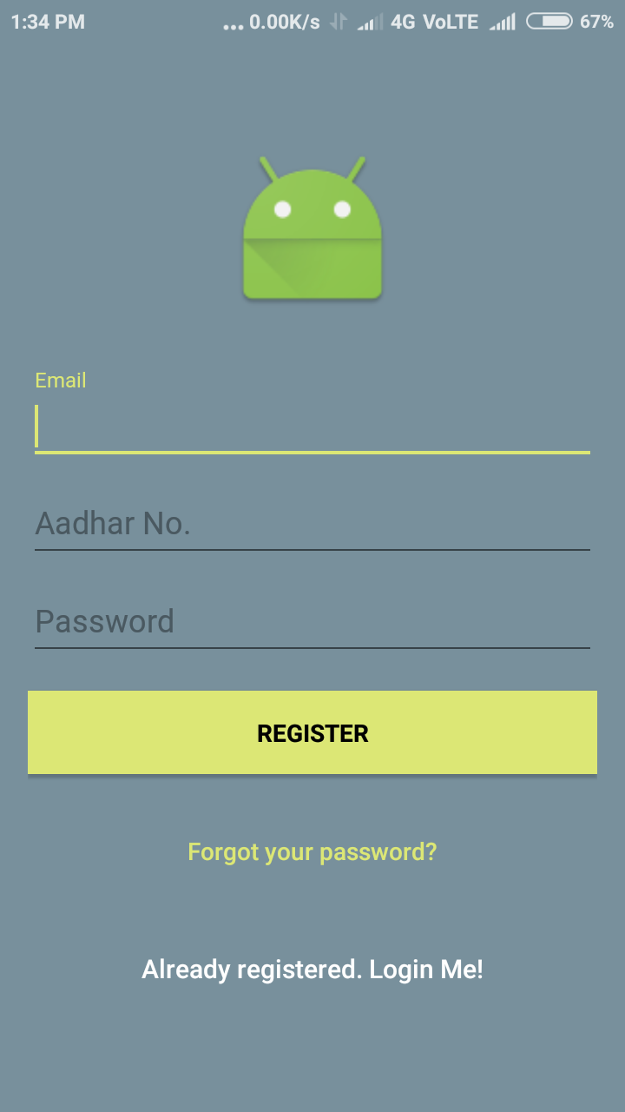
Screenshots
CORRECT LOGIN
INCORRECT LOGIN
Login
(Features Adhaar ID)
Your tax details of past few years
New login window
Forgot PW

Slide 20
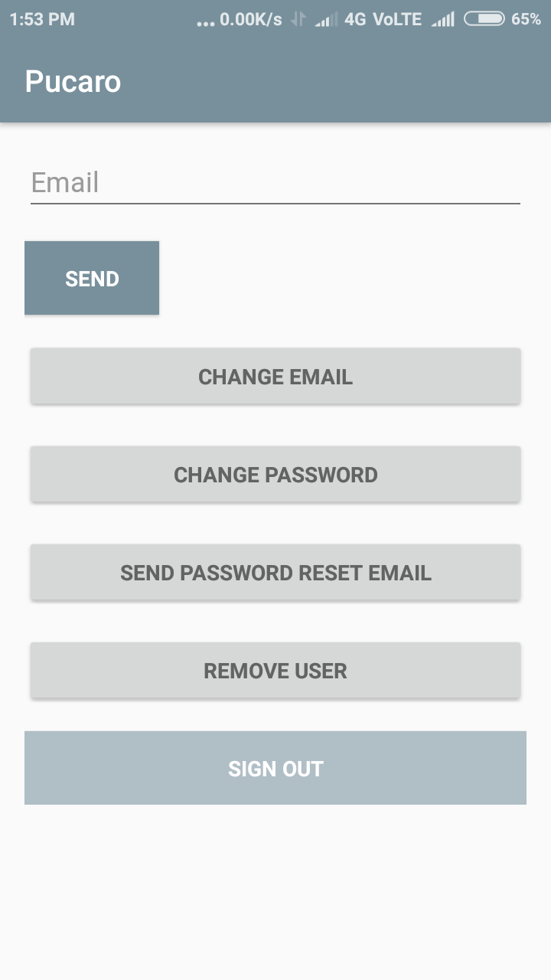
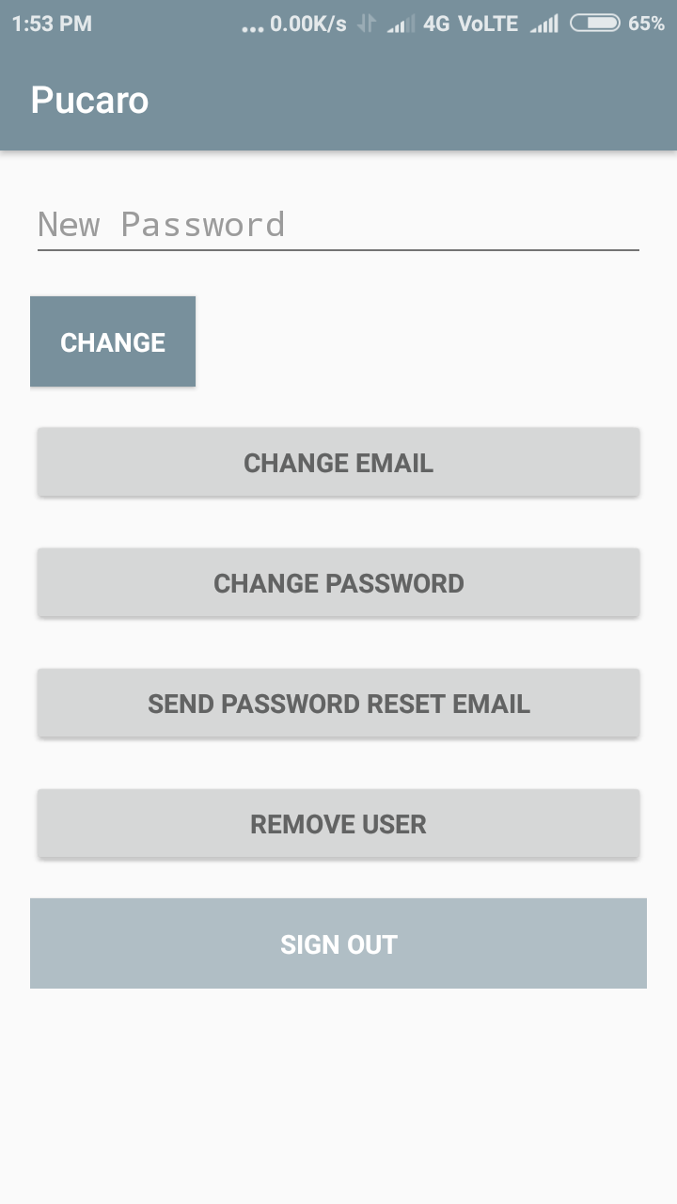
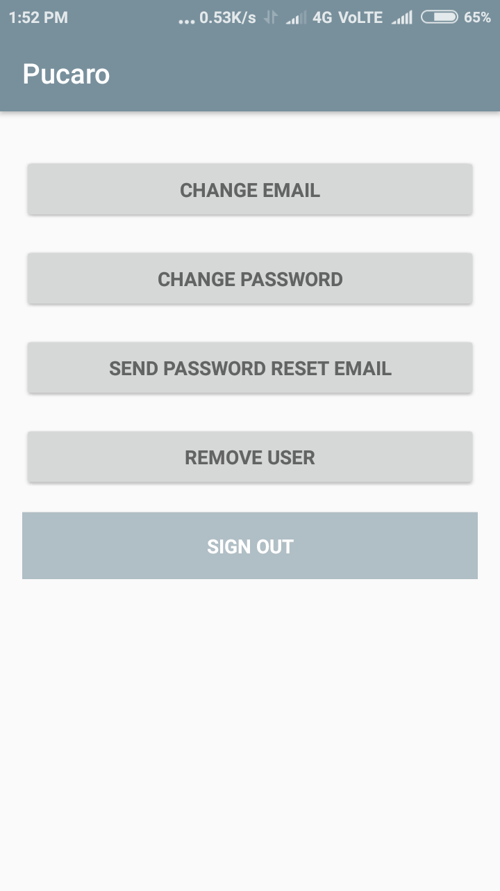
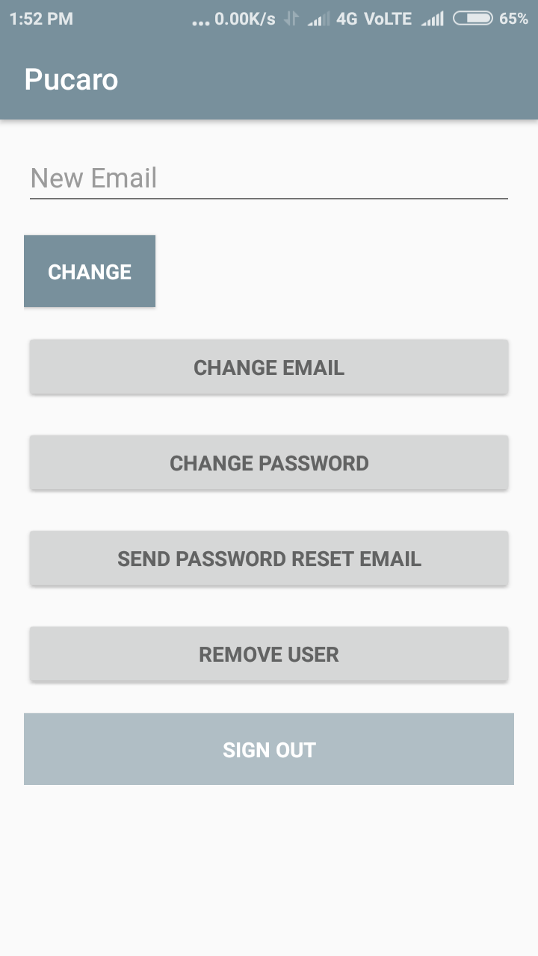
PUCARO CONSOLE
[CHANGE PASSWORD/EMAIL ID/REMOVE OR ADD ACCOUNT IN PUCARO]

Slide 21
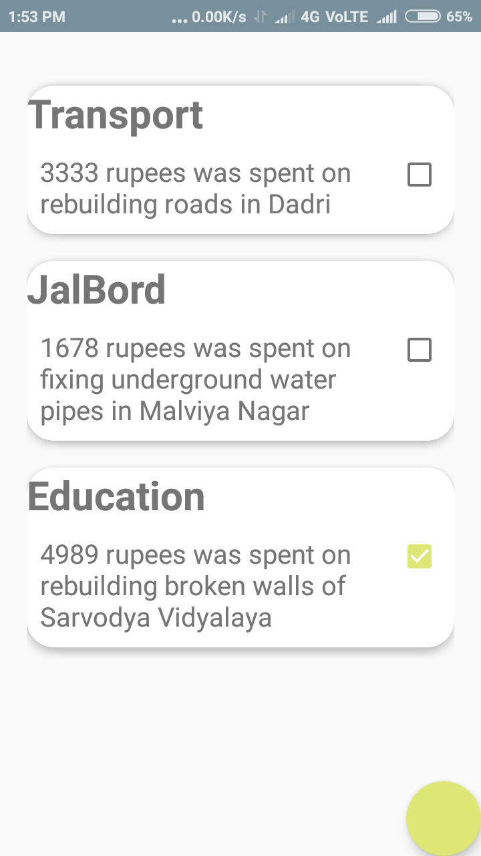
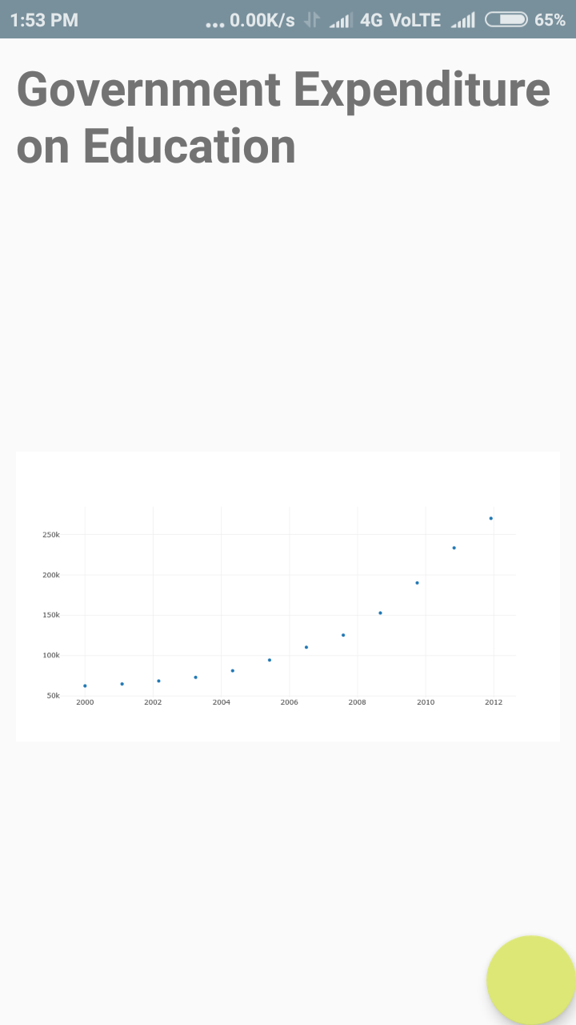
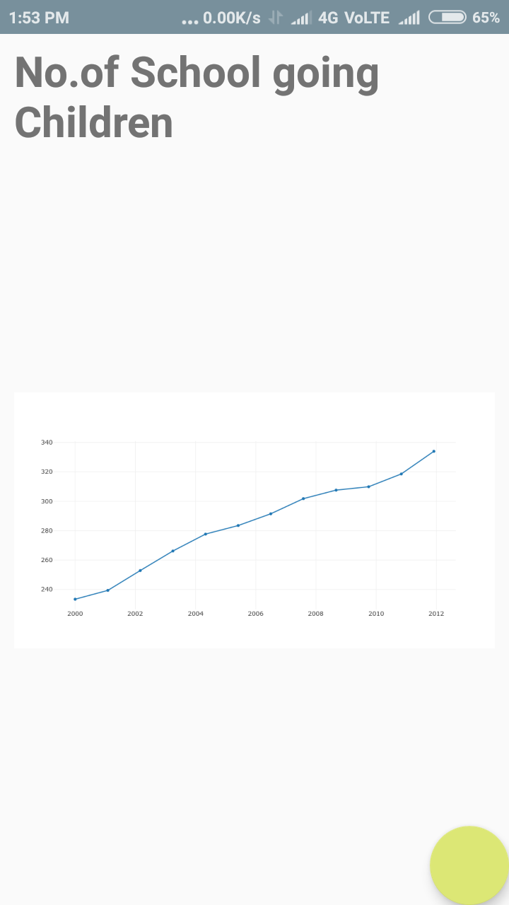
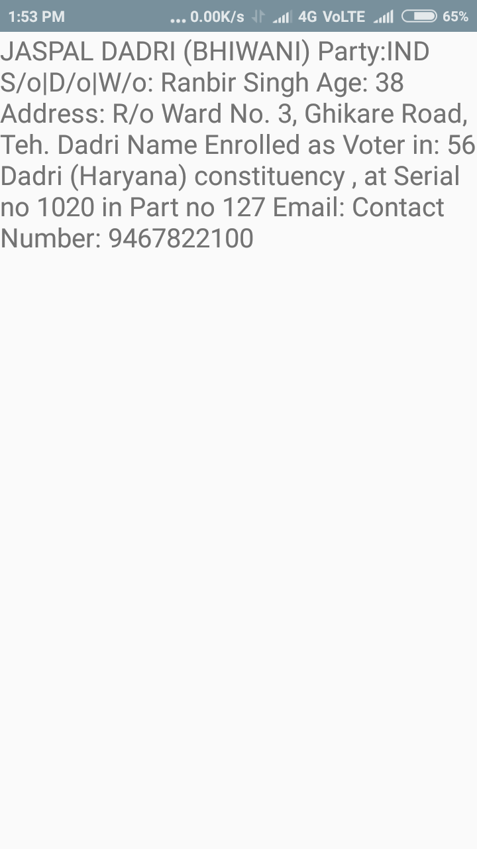
Comparison Plots showing Positive Correlation
(between govt expenditure on education vs school going children)
Tax Money spent on Education
Municipality Representative
(Neta)
Communication Details

Slide 22
Future Potential
As databases get increasingly intricate and well defined about where and how the tax payer’s money is being utilized, Pucaro will enable you to monitor well distribution of your money
[For example a week by week break down of tax payer money being utilized]
This app may allow us to make the government accountable for the usage of our tax money, hence there is a scope of adding features that enable the user to file complaints or lodge concerns asking for receipts.

Slide 23
Database References
http://mhrd.gov.in/sites/upload_files/mhrd/files/statistics/PubExpdt-2013.pdf //money spent by government in education department
https://www.educationcounts.govt.nz/statistics/schooling/teaching_staff //staffing in schools for the years [2004-17]
https://catalog.data.gov/dataset/brewery-count-by-state-1984-june-30-2017 //animal husbandry diseases
http://texmin.nic.in/sites/default/files/prod_variety_yarn.pdf //cotton sales
https://data.gov.uk/dataset/england_biodiversity_strategy_indicators //biodiversity
https://api.checkpoint61.hasura-app.io/hackdata //JSON of all graphs

Slide 24


P U C A R O C4C Code for Change

