Slide 1

Prescriptive modeling & optimization – Application Project
Team Members-
Abhiram Reddy Kanmatha Reddy
Praneel Naidu Lalam

Slide 2

Flight Assignment
Generally, Airlines want to reduce their labor costs, increase efficiency and improve customer satisfaction
We’ve optimized the flight assignment of a small airline company in order to minimize their costs
It is important to focus on the crew and maximize their hours in order to minimize costs

Slide 3
Understanding the problem and why it is important
Every airline struggles with balancing its labor costs. It might be optimizing crew, cabin staff, or on-ground staff.
Domestic airlines especially struggle to find an optimal solution and it results in employees going on strike or leaving the company
We focused only on the crew(Pilots and Co-Pilots) of a small airline company. We felt it is important to find an optimal solution that benefits both the company and its employees.

Slide 4
Understanding the data
The input data used to optimize is mix of real and dummy data. There are 3 data sources- Flights, Costs and Crew.
One type of input data is related to flights and the duration of the flights. Along with that, We have flights that have the same departure time. These are Incompatible flights as the pilot and copilot should be assigned to only one of the flights
Another type of input is the costs. Every pilot and copilot has a different cost for a specific flight route
Finally, We have the data of the crew. We have the names of all the pilots and co-pilots.

Slide 5
Defining the Decision variables(DVs), Objective and Constraints
Decision Variables(DVs)
There are 2 DVs of Binary domain type. One variable is for the Pilots and the other is for the Copilots.
Objective
Minimizing the total costs- (cost of pilot * DV of pilot + cost of copilot* DV of copilot)
Constraints
1. Each flight needs a pilot and copilot to depart.
2. Both Pilot and Copilot cannot exceed a weekly amount of flight hours.
3. Both should not be assigned to Incompatible flights(Flights having the same departure time)

Slide 6
Programming tools & Challenges
We used Python and Pyomo to build an optimization model. We leveraged python’s dictionaries and lists then used them to initialize the parameters and inputs needed for the model
Challenges- Struggled with how to transform the data into a model. We used several features of Pyomo i.e., Parameters, Sets, and rules to our advantage. It was the most impressive thing of the whole project.
We then solved the model using the GLPK solver.

Slide 7
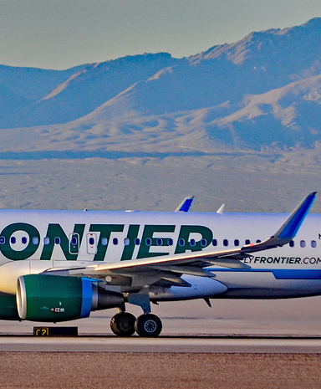
Hypothetical client
It will be very beneficial for domestic airlines such as Frontier Airlines, and Spirit airlines which operate with limited resources.
They focus heavily on optimization daily, and we think it is a necessity for the airlines.
This Photo by Unknown Author is licensed under CC BY-SA

Slide 8
Idea behind the project
Jeppesen – “Crew management tools improve operating efficiency”
Jeppesen is a Boeing subsidiary that helps several airlines including frontier in managing their operations
Frontier tied up with Boeing in 2020 to optimize their flights, crew, fuel and etc…
It drove our interest to work on a similar idea which we scaled down to optimizing pilots and copilots

Slide 9
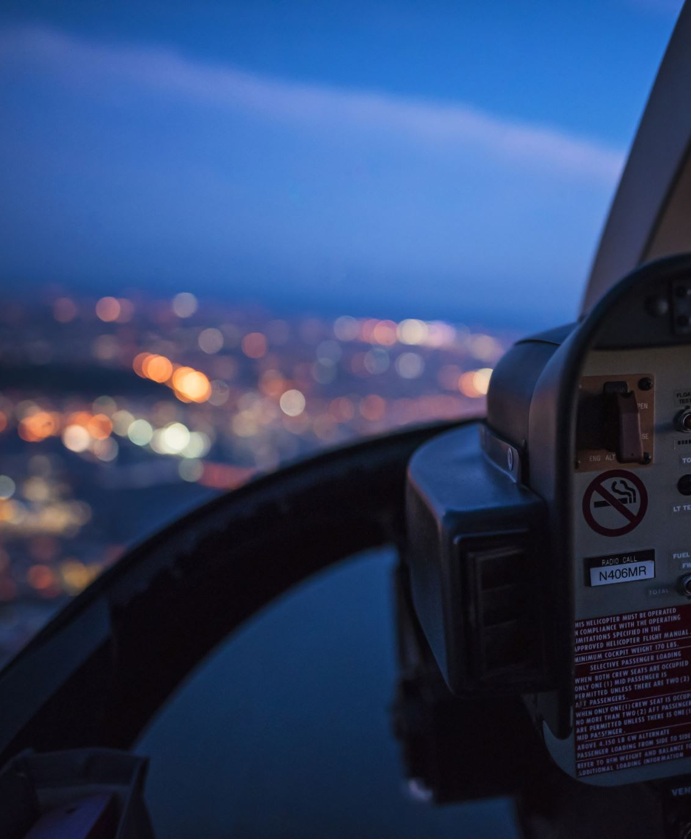
Limitations & scope of the project
We only focused on optimizing pilots and copilots whereas generally, airlines focus on crew including cabin staff.
We can add data related to the cabin staff and optimize the model which would be the next step of the project

Slide 10
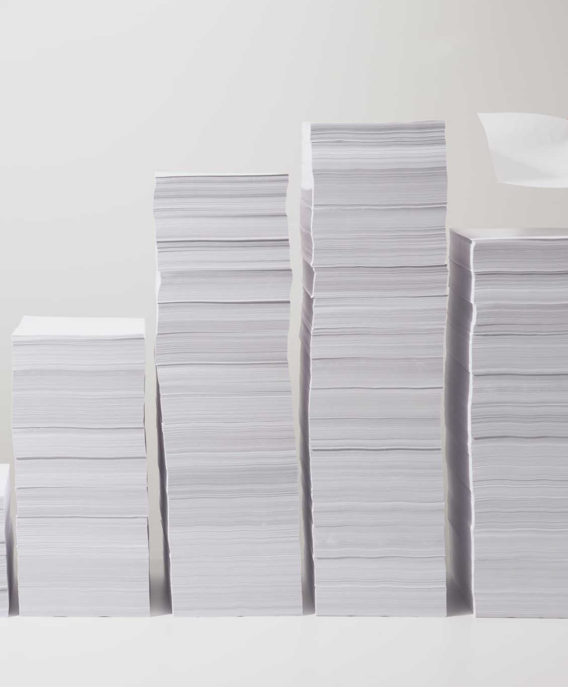
Outside resources for the project
Stack Overflow for general troubleshooting
Pyomo Documentation for defining Sets, Parameters, and Rules
Medium/Youtube for understanding the code workup

Slide 11

Supporting Files
Data Files
Flights.csv
Costs.csv
Crew.csv
Python File
Application_Project_Final.ipynb

Slide 12
Contributions
We both worked equally on the project
Abhiram Reddy- I worked extensively on the pyomo features. Looking at the real-world examples, There were certainly many tools to use, and I focused mainly on implementing them in the project.
Praneel Naidu- I worked on creating the data and building the DVs, Objectives and Constraints for the optimization model.

Slide 13
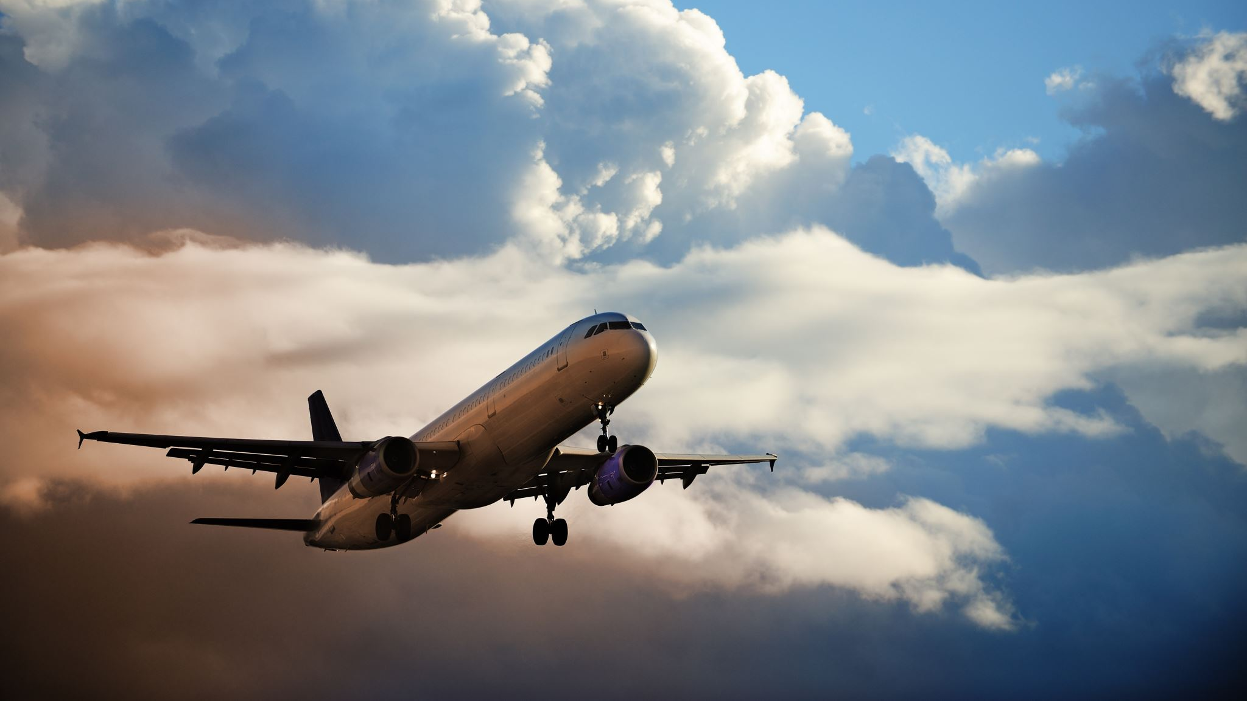
Ready for take-off Thank you & Happy Holidays

