Slide 1



Major Project - 1
Movie Meter : A Movie Recommendation System
Project NO. - 25
Team Members :-
Abhikant Kumar (211B408)
Saurabh Prakash (211B422)
Abhishek Bhardwaj (211B012)
This project explores a hybrid approach to building a movie recommendation system, combining traditional content-based filtering with collaborative filtering techniques. The goal is to create a system that delivers personalized and accurate recommendations for movies, enhancing user engagement and satisfaction.
Project Guide :-
Dr. Prateek Pandey

Slide 2


Objective
Enhance User Engagement
Improve Recommendation Accuracy
Maximize User Satisfaction
Deliver high-quality recommendations
that meet user expectations, minimizing
the need for manual searching and
increasing satisfaction with the system.
Provide personalized recommendations that resonate with individual preferences, fostering a more enjoyable and engaging viewing experience.
Leverage a hybrid approach to combine the strengths of content-based and collaborative filtering, resulting in more precise and relevant recommendations.

Slide 3

Tech Stack
Front-End
Back-End
React creates a user-friendly interface for browsing movies, accessing personalized recommendations, and providing feedback.
Node.js and Express provide a robust and scalable platform.
MongoDB efficiently stores and retrieves movie data and user preferences.
Machine Learning
Recommendation Algorithm
TensorFlow a for building and traning ML model.
Hybrid Model a combining popularity based, content
based and collaborative method (user based and item
based).
NumPy a for numerical computation.
Imdb API for fetching movie data.

Slide 4
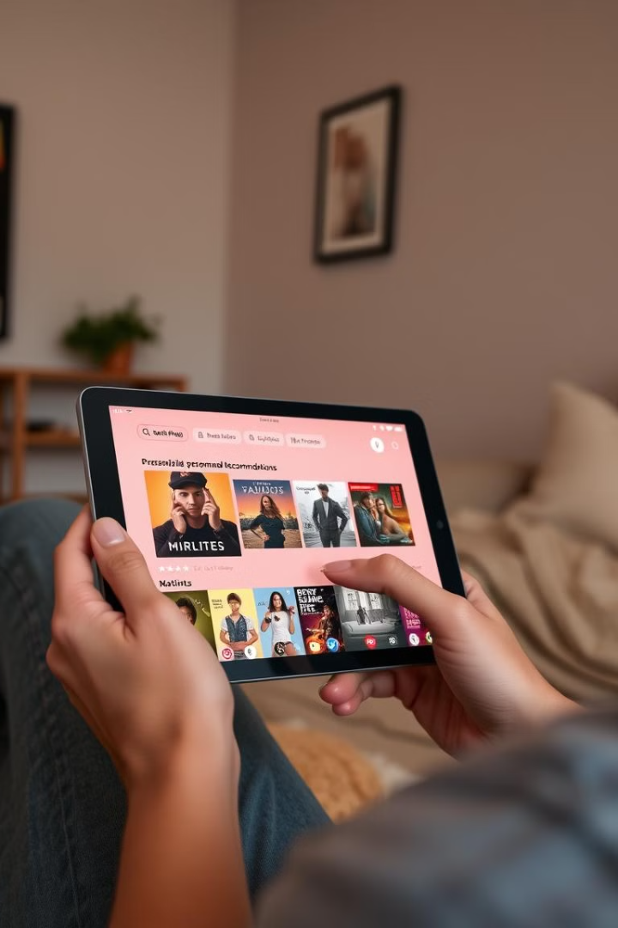

Features
Personalized Recommendations
Content-Based Filtering
Leverage user history and preferences to deliver tailored movie suggestions, enhancing user engagement and discovery.
Recommends movies based on similarities in genres, actors, directors, and plot summaries.
Collaborative Filtering
Hybrid Approach
Analyzes user ratings and preferences to suggest movies that similar users have enjoyed.
Combines content-based and collaborative filtering for a more comprehensive and accurate recommendation system.

Slide 5

Cosine Similarity and Matrix Factorization
Cosine Similarity
Matrix Factorization
This method measures how similar movies are based on their features, such as genre, actors, and release year. A score closer to 1 indicates a higher similarity.
This technique decomposes a user-item rating matrix into smaller matrices representing user and item features. Recommending movies is then done by predicting missing ratings based on these features.

Slide 6





Use Case Diagram
User
Interacts with the system, provides feedback, and receives personalized recommendations.
Movie Database
Stores information about movies, including genres, actors, directors, and
user ratings.
Recommendation Engine
Analyzes user preferences and movie data to generate personalized recommendations.

Slide 7


Action Plan
1
Data Acquisition
Gather and prepare movie data from various sources.
2
Feature Engineering
Extract relevant features from movie data for similarity analysis.
3
Model Training
Train content-based and collaborative filtering models.
4
System Integration
Integrate trained models into the recommendation system.
5
User Testing
Collect feedback from users to evaluate system performance.
6
Deployment and Monitoring
Deploy the system and monitor performance metrics.

Slide 8

Conclusion
Hybrid Approach
1
Combining content-based and collaborative filtering enhances recommendation accuracy and user satisfaction.
Personalized Experience
2
Tailored recommendations engage users and foster a more enjoyable viewing experience.
Future Development
3
Further exploration of advanced algorithms and user feedback will continue to improve the system.

