Slide 1
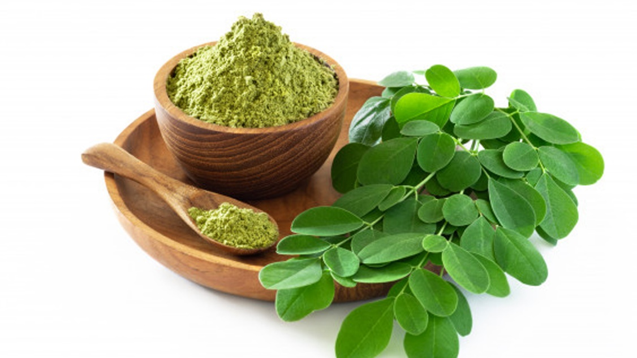
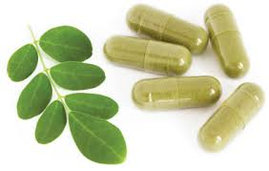

Drying Kinetics and Physico-chemical Analysis of Drumstick Leaves (Moringa oleifera)
Abhishek Kumar
Roll No.: 20AG63R22
Under the guidance of
Prof. P. Srinivasa Rao
DEPARTMENT OF AGRICULTURAL AND FOOD ENGINEERING
INDIAN INSTITUTE OF TECHNOLOGY KHARAGPUR, WEST BENGAL 721302

Slide 2

Table of contents
Introduction
Review of literature
Research gap
Objectives
Work plan
Results and discussion
Salient findings
References

Slide 3
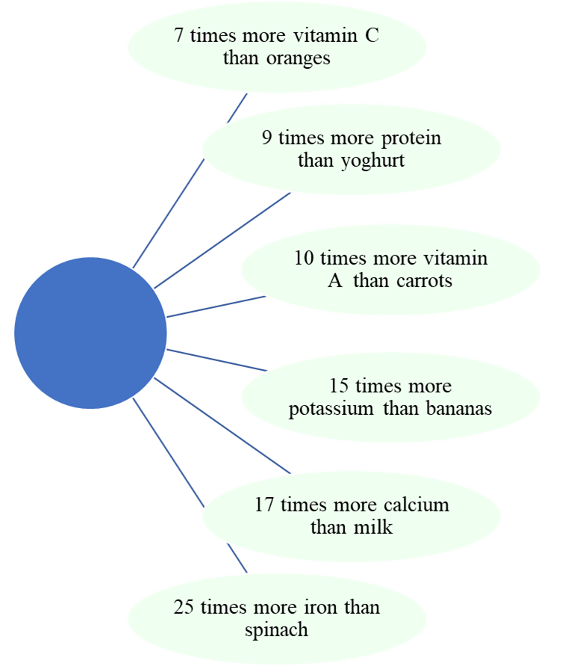
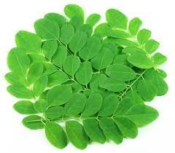
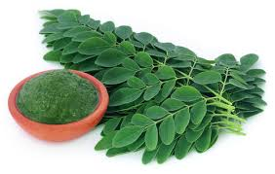
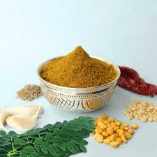
INTRODUCTION
Moringa oleifera commonly known as Drumstick or simply moringa
Native to the Sub-Himalayan tracts of India, Bangladesh, and Afghanistan
Incredible medicinal advantages
High in demand as a functional food supplement
Rich in protein, minerals, vitamins (A, K) and other essential phytochemicals
Extracts used to treat malnutrition
Potential antioxidant, anticancer, anti-inflammatory, antidiabetic and antimicrobial agent

Slide 4
LITERATURE REVIEW
Table 1 Review on moringa oleifera
Authors | Method | Inference
Premi et. al. (2010) | Hot air oven drying | Samples dried at 60 °C were found better as compared to the samples dried at 50, 70 and 80 °C
Dev et al. (2011) | Microwave assisted hot air drying | The rapid moisture migration occurring at 70 °C in MAHD resulted in a greater diffusion of volatile substances into the air, results in a very low concentration of the compound in the end product. Found better quality attributes in comparison to hot air drying, 80% reduction in drying time, optimum condition: T= 60 °C, power density = 1W/g
Tarafdar et. al. (2021) | Vacuum oven drying | Reported best results at 60 °C in terms of quality and time taken was 3.6 hours

Slide 5
LITERATURE REVIEW (Conti…)
Table 2 Drying effects on moisture diffusivity and quality attributes
Authors | Leaf | Method | Inference
Divya et al. (2012) | Coriander | Oven drying | Oven drying of coriander foliage at 45 °C resulted in loss of chlorophylls (65%) and carotenoids (35%)
Alibas (2014) | Celery | Microwave drying | Effective moisture diffusivities increased with increase in microwave output power density
Motevali et. al. (2016) | Chamomile | Microwave convective drying | Reported moisture diffusivity initially inc. and then dec. Also energy consumption inc. continuously with decreasing moisture content.
Amer et al. (2018) | Chamomile | Solar drying | Higher volatile oil contents were found in solar drying method than open sun drying method
Alibas et al. (2021) | Basil | Microwave drying | Dramatic losses in protein and nutrients can be attributed to the increase in the product’s oxidation due to the longer drying time

Slide 6
LITERATURE REVIEW (Conti…)
Table 3 Review on drying time
Authors | Leaf | Method | Inference
Shaw et al. (2007) | Coriander | Hot air drying and microwave drying | Reported that 300 minutes was required to dry to a final moisture content of 4.17% dry basis. Around 21 min required under MD to 12 % moisture content
Demirhan and Özbek (2011) | Celery leaves | Microwave drying | By increasing the microwave output power from 180 to 900W the drying time decreased from 34 to 8 min
Arslan and Özcan (2012) | Savory leaves | Microwave drying | Shortened the drying time over 99% compared to the sun drying
Ebadi et al. (2015) | Lemon Verbena | Vacuum oven drying | A two-fold reduction of drying time was observed in vacuum compared with hot air oven drying

Slide 7
RESEARCH GAP
Very less explored for its medicinal values
Limited research available on utilization of moringa oleifera in food fortification
Optimum drying condition required to make powder
Fewer studies available on storage stability of dried leaf powder of moringa oleifera

Slide 8
OBJECTIVES
To analyse the drying kinetics of Moringa Oliefera leaves under various drying methods
To evaluate the effect of drying on physico-chemical properties of Moringa Oliefera leaves dried using different drying methods
To study the storage stability of dried Moringa Oliefera leaves powder under different storage conditions
1
2
3

Slide 9
To analyse the drying kinetics of Moringa Oliefera leaves under various drying methods
Objective 1

Slide 10
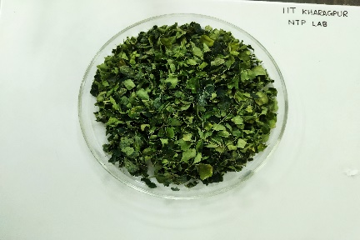
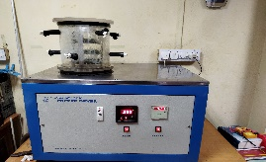
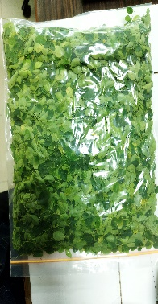
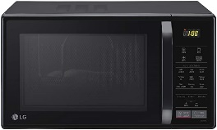
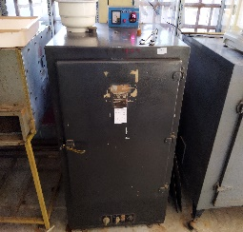
Objective 1
Work flow
Temp: - 44 °C
Vacuum: 0.024mbar
Freeze dryer
Drying time
% Moisture content
Drying rate curve
MC vs Time
MR vs Time
DR vs MC
ln(MR) vs Time
Effective moisture diffusivity
Power: 200, 400, 600 W
Time: 30 s
Microwave dryer
At temp: 55 °C, 65 °C, 75 °C
Preparation of sample (15 g)
Hot air oven dryer
Drying Kinetics

Slide 11
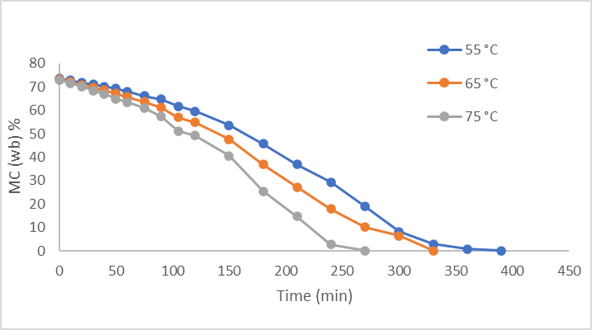
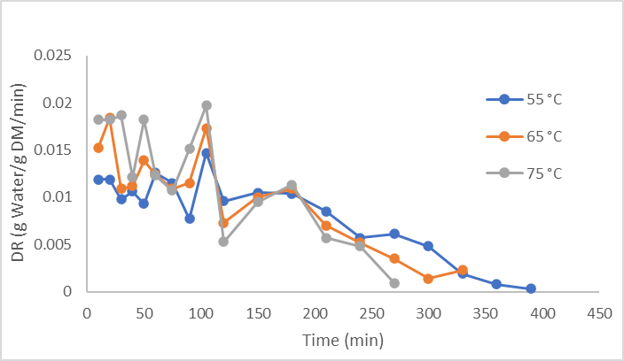
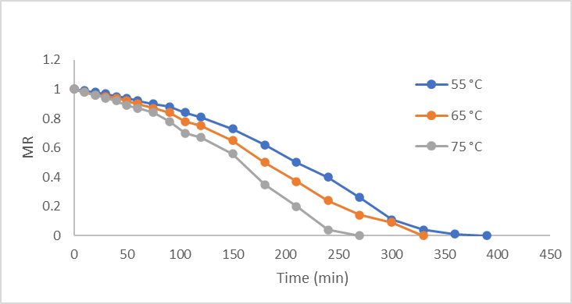
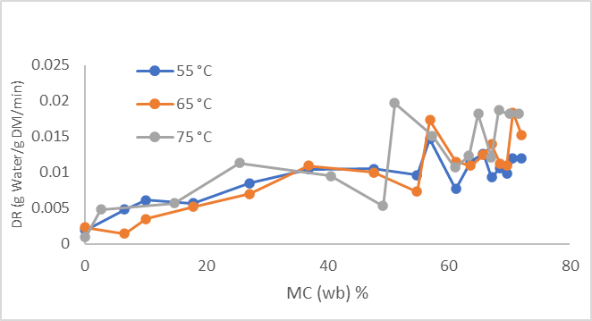
Drying kinetics under hot air oven drying
Results and discussion
(a)
(b)
(c)
(d)
Fig 1 (a) Moisture content vs Time (b) Drying rate vs Time (c) Moisture ratio vs Time (d) Drying rate vs Moisture content, under hot air oven drying

Slide 12
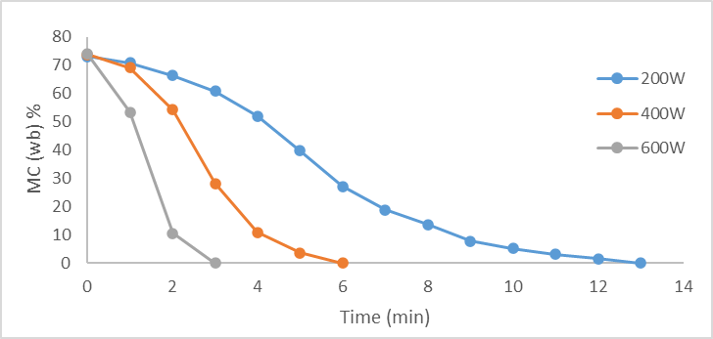
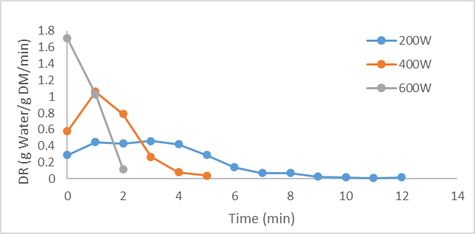
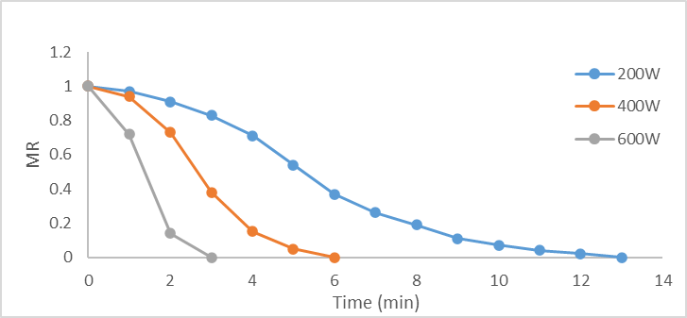
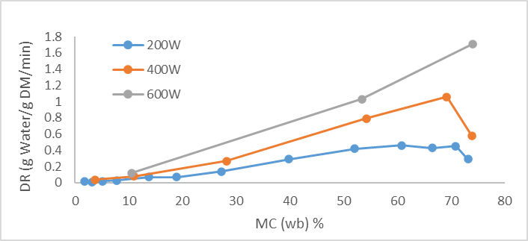
Drying kinetics under microwave drying
Results and discussion
(a)
(b)
(c)
(d)
Fig 2 (a) Moisture content vs Time (b) Drying rate vs Time (c) Moisture ratio vs Time (d) Drying rate vs Moisture content, under microwave drying

Slide 13
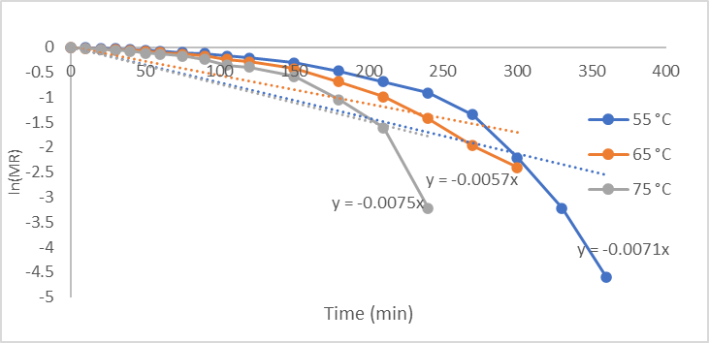
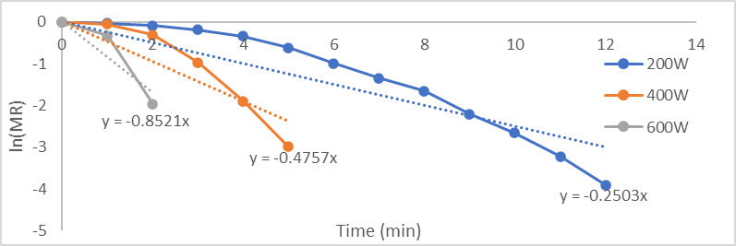
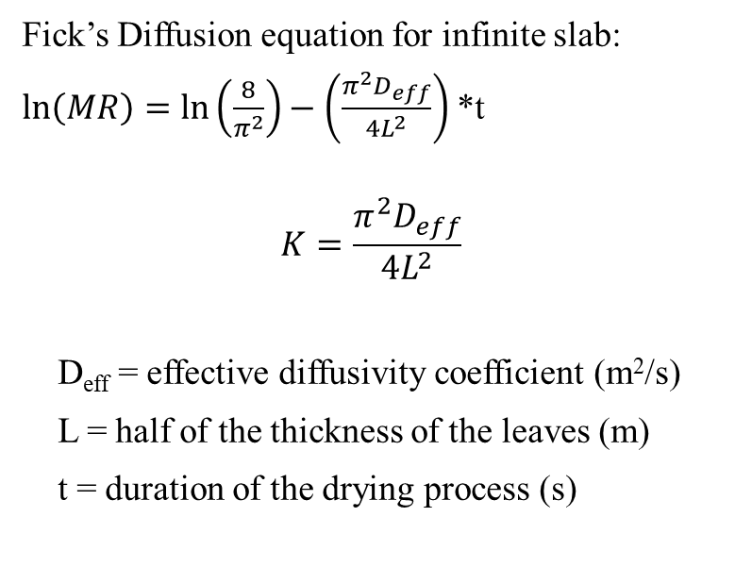
Calculation, effective moisture diffusivity
Results and discussion
Fick’s Diffusion equation for infinite slab:
$\ln\left(MR\right)=ln\left(\frac{8}{π^{2}}\right)−\left(\frac{π^{2}D_{eff}}{{4L}^{2}}\right)$ *t
$$K=\frac{π^{2}D_{eff}}{{4L}^{2}}$$
D_{eff} = effective diffusivity coefficient (m²/s)
L = half of the thickness of the leaves (m)
t = duration of the drying process (s)
(a)
(b)
Fig 3 (a) ln(MR) vs Time under hot air oven drying (b) ln(MR) vs Time under microwave drying

Slide 14
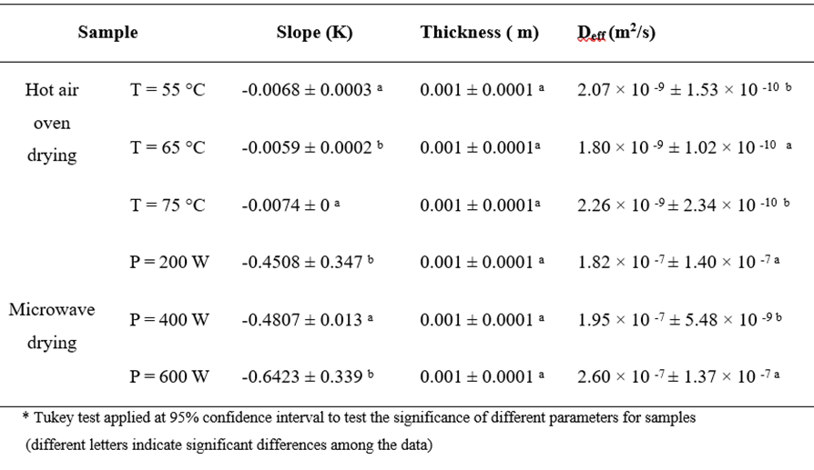
Results and discussion
Table 4 Effective moisture diffusivity values

Slide 15
To evaluate the drying effect on physico-chemical properties of Moringa Oleifera leaves dried using different drying methods
Objective 2

Slide 16
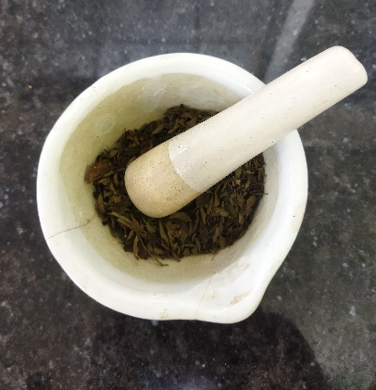
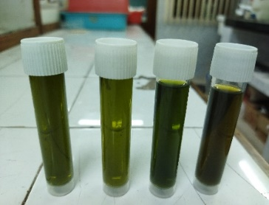
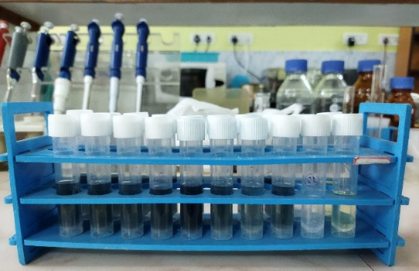
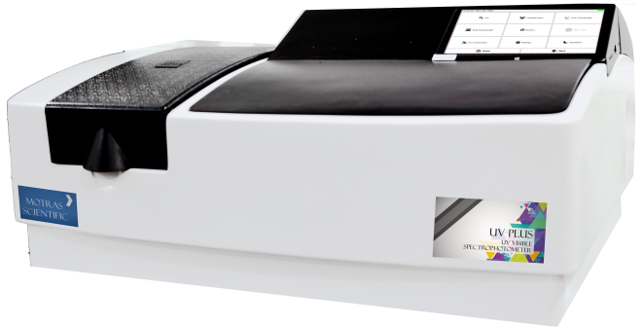
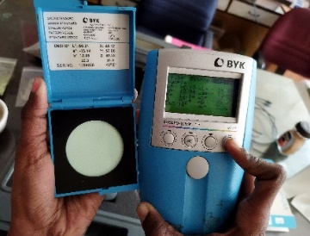
Objective 2
Work flow
Physio – chemical properties
Colour
TPC, 760 nm
TFC, 510 nm
AC, 517 nm
Extract preparation
Grinding of leaves
Sample preparation for spectrophotometer
Spectrophotometer
Colour measurement

Slide 17
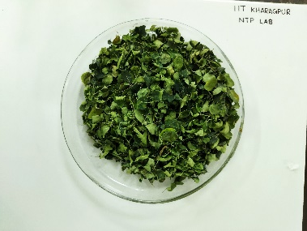
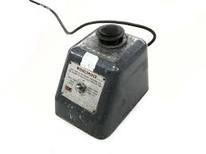
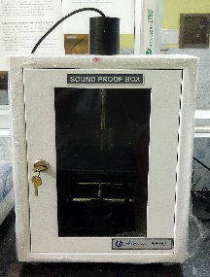
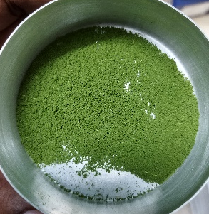
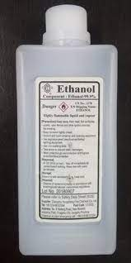
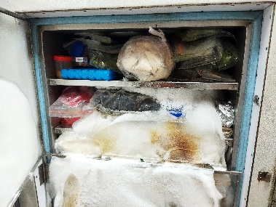
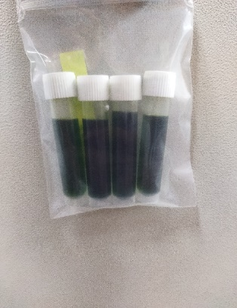
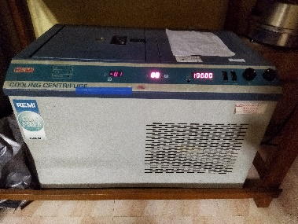
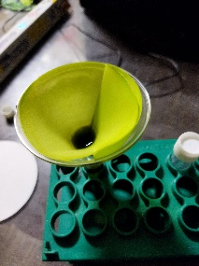

Extract Preparation
Objective 2
Dried Leaves
Leaf Powder
Ethanol
Vortexer
Sonicater
Deep Freezer
Leaf Extract
Filtration
Cooling Centrifuge

Slide 18
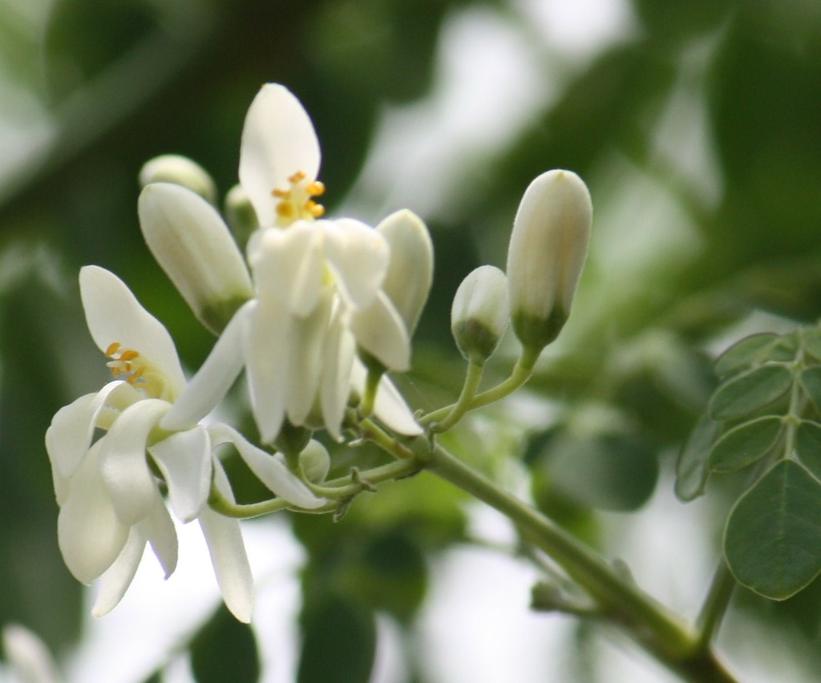
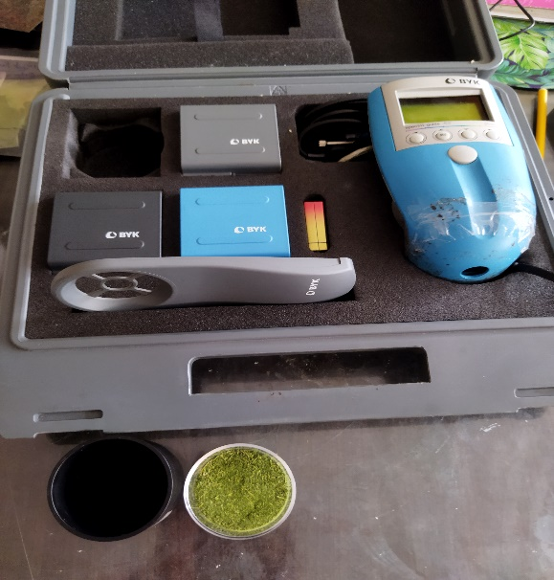
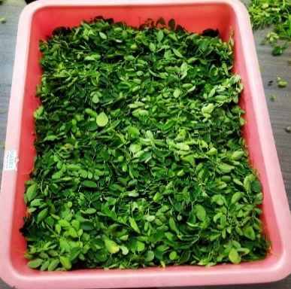
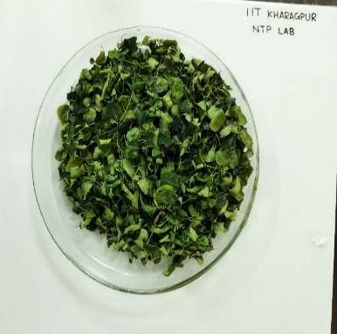
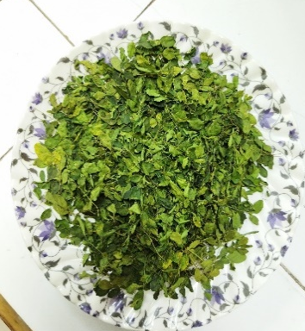
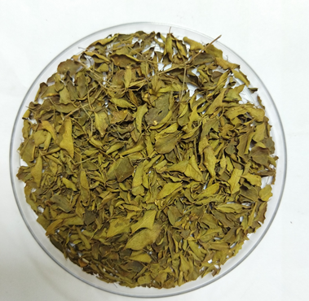
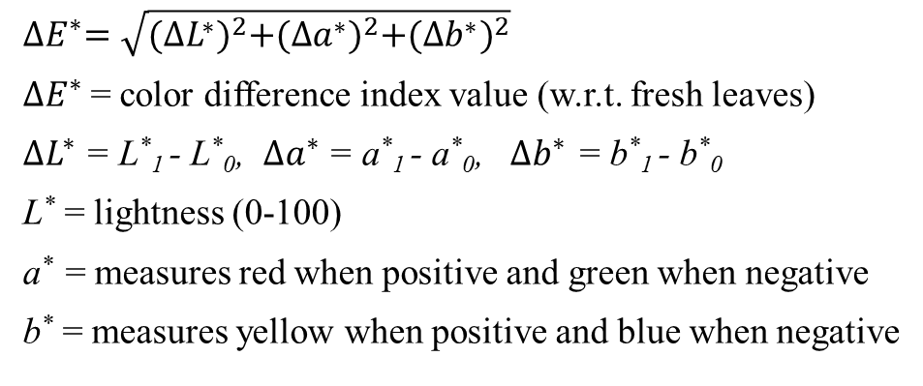
Colour Measurement
Results and discussion
$${∆E}^{∗}=\sqrt{{(∆L^{∗})}^{2}+{(∆a^{∗})}^{2}+{(∆b^{∗})}^{2}}$$
${∆E}^{∗}$= color difference index value (w.r.t. fresh leaves)
$∆L^{∗}$ = L*₁ - L*₀, $∆a^{∗}$ = a*₁ - a*₀, $∆b^{∗}$ = b*₁ - b*₀
L* = lightness (0-100)
a* = measures red when positive and green when negative
b* = measures yellow when positive and blue when negative
(a)
(b)
(c)
(d)
Fig 4 (a) Fresh leaves (b) Freeze dried (c) Microwave dried (d) Hot air oven dried, leaves

Slide 19
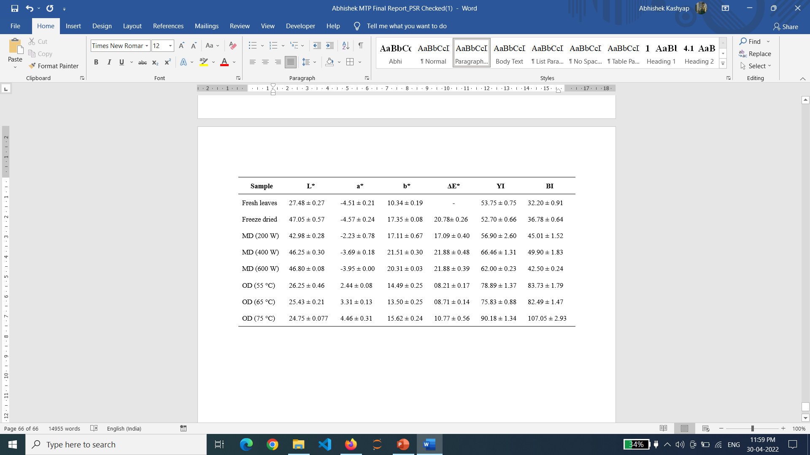
Results and discussion
Table 5 Colour parameter values
MD - Microwave drying, OD - Hot air oven Drying, ΔE* - Overall color change, YI – Yellowness Index, BI – Browning Index

Slide 20
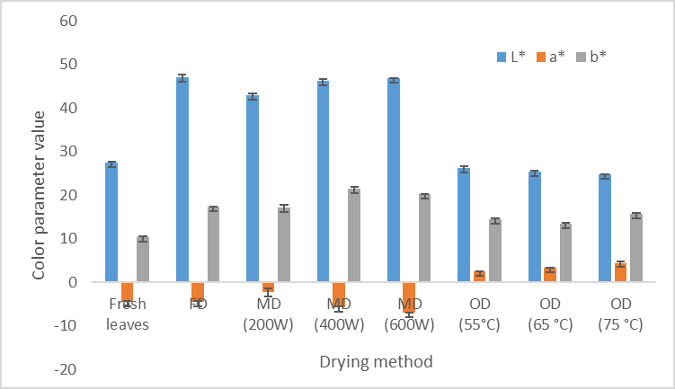
Colour parameters comparison between leaves dried under various drying methods
Results and discussion
FD – Freeze drying, MD - Microwave drying, OD - Hot air oven Drying
Fig 5 Colour parameter value of leaves dried in different drying methods

Slide 21
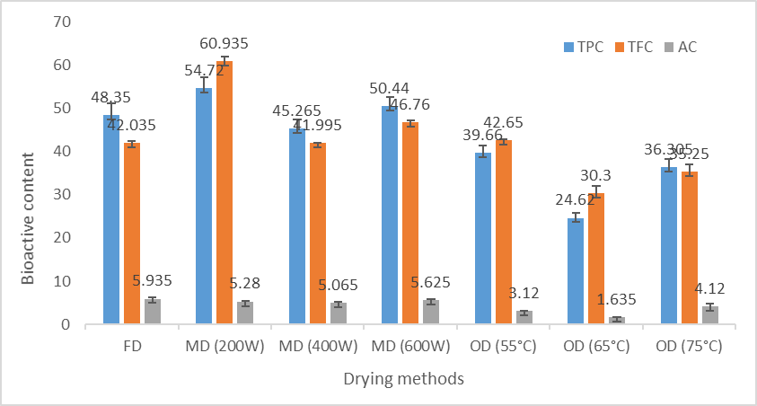
Bioactive compounds comparison between leaves dried under various drying methods
Results and discussion
FD – Freeze Drying, MD - Microwave drying, OD - Hot air oven Drying
Fig 6 Bioactive content of leaves dried under various drying methods

Slide 22
To study the storage stability of dried Moringa Oliefera leaves powder under different environment conditions
Objective 3

Slide 23
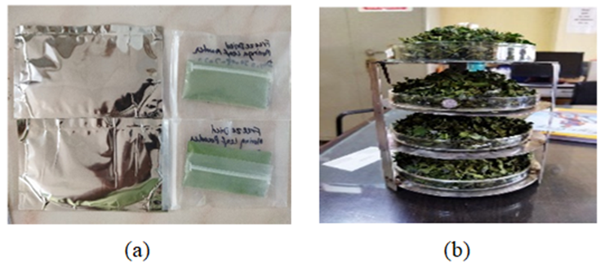
Objective 3
Work flow
Fig 7 (a) Samples prepared for storage study (b) Freeze dried leaves

Slide 24
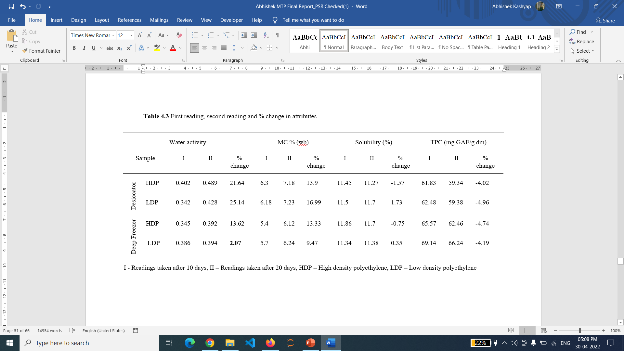
Results and discussion
Table 6 Change in quality attributes of moringa powder during storage

Slide 25
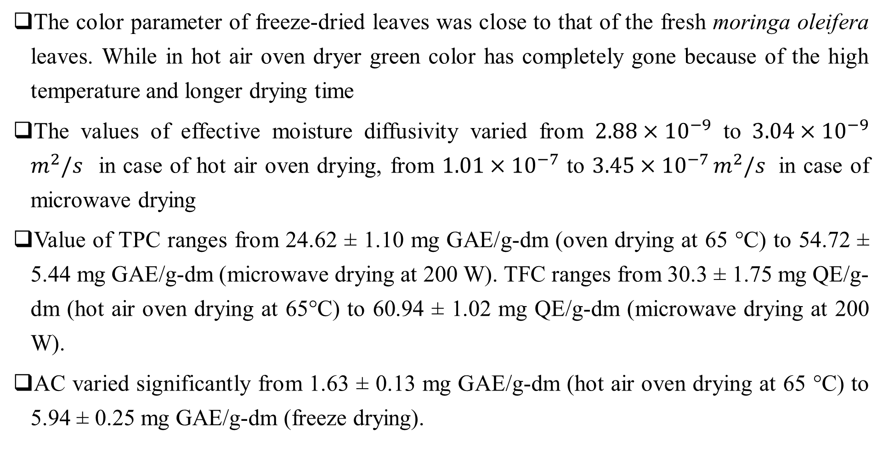
Salient Findings
The color parameter of freeze-dried leaves was close to that of the fresh moringa oleifera leaves. While in hot air oven dryer green color has completely gone because of the high temperature and longer drying time
The values of effective moisture diffusivity varied from $2.88×{10}^{−9}$ to $3.04×{10}^{−9}$ $m^{2}/s$ in case of hot air oven drying, from $1.01×{10}^{−7}$ to $3.45×{10}^{−7 }m^{2}/s$ in case of microwave drying
Value of TPC ranges from 24.62 ± 1.10 mg GAE/g-dm (oven drying at 65 °C) to 54.72 ± 5.44 mg GAE/g-dm (microwave drying at 200 W). TFC ranges from 30.3 ± 1.75 mg QE/g-dm (hot air oven drying at 65°C) to 60.94 ± 1.02 mg QE/g-dm (microwave drying at 200 W).
AC varied significantly from 1.63 ± 0.13 mg GAE/g-dm (hot air oven drying at 65 °C) to 5.94 ± 0.25 mg GAE/g-dm (freeze drying).

Slide 26
Conclusions
High drying temperature is the main cause of significant loss in bioactive compounds and other important nutritional content that found naturally in moringa oleifera leaves
Furthermore, antioxidant depletion may be due to grinding of dried leaves which could induce rapid oxidation reaction and also because of the heat generated due to the friction
Microwave drying (200 W) found to be best for drying of moringa oleifera leaves in terms of overall quality attributes
The water activity was found below 0.6 and other parameters were also in acceptable condition over the observation period (one month) in both packaging materials (LDP and HDP)

Slide 27
Future Scopes of research
HPLC analysis of moringa oleifera leaf extract can be carried for isolation of particular compound of interest.
Preparation of food products (like RTE snack food, RTC food like noodles, pasta, macaroni, baked products like cake, bread, cookies, etc.) incorporated with base material in a desired proportions and analyze their structural and physico-chemical properties.
In the present study, storage stability of dried leaves powder has not been observed over sufficient period. So, it can be studied further under accelerated storage using Arrhenius Equation.

Slide 28
REFERNCES
Alibas, I., 2014. Mathematical modelling of microwave dried celery leaves and determination of the effective moisture diffusivities and activation energy. Food Science Technology 34, 394–401.
Alibas, I., Yilmaz, A., Asik, B.B., Erdoğan, H., 2021. Influence of drying methods on the nutrients, protein content and vitamin profile of basil leaves. Journal of Food Composition and Analysis, 96.
Amer, B.M.A., Gottschalk, K., Hossain, M.A., 2018. Integrated hybrid solar drying system and its drying kinetics of chamomile. Renewable Energy 121, 539–547.
Arslan, D., Özcan, M.M., 2012. Evaluation of drying methods with respect to drying kinetics, mineral content, and colour characteristics of savoury leaves. Food Bioprocess Technology 5, 983–991.
Badi, M.T., Azizi, M., Sefidkon, F., Ahmadi, N., 2015. Influence of different drying methods on drying period, essential oil content and composition of Lippia citriodora Kunth. Journal of Applied Research on Medicinal and Aromatic Plants 2, 182–187.

Slide 29
REFERNCES
Demirhan, E., Özbek, B., 2011. Thin-layer drying characteristics and modeling of celery leaves undergoing microwave treatment. Chemical Engineering Communications 198, 957–975.
Dev, S. R. S., Geetha, P., Orsat, V., Gariépy, Y., & Raghavan, G. S. V., 2011. Effects of microwave-assisted hot air drying and conventional hot air drying on the drying kinetics, color, rehydration, and volatiles of Moringa oleifera. Drying Technology, 29(12), 1452–1458.
Divya, P., Puthusseri, B., Neelwarne, B., 2012. Carotenoid content, its stability during drying and the antioxidant activity of commercial coriander (Coriandrum sativum L.) varieties. Food Research International 45, 342–350.
Motevali, A., Minaei, S., Banakar, A., Ghobadian, B., Darvishi, H., 2016. Energy analyses and drying kinetics of chamomile leaves in microwave-convective dryer. Journal of the Saudi Society of Agricultural Sciences 15, 179–187.

Slide 30
REFERNCES
Premi, M., Sharma, H. K., Sarkar, B. C., & Singh, C., 2010. Kinetics of drumstick leaves (Moringa oleifera) during convective drying. African Journal of Plant Science, 4(10), 391–400.
Shaw, M., Meda, V., Tabil, L., Opoku, A., 2007. Drying and color characteristics of Coriander foliage using convective thin-layer and microwave drying. Journal of Microwave Power and Electromagnetic Energy 41, 59–68.
Tarafdar, A., Jothi, N., & Kaur, B. P., 2021. Mathematical and artificial neural network modeling for vacuum drying kinetics of Moringa oleifera leaves followed by determination of energy consumption and mass transfer parameters. Journal of Applied Research on Medicinal and Aromatic Plants 24, 100306.

Slide 31
Thank you

Slide 32

Antioxidant capacity
$\%Scavenging= \frac{\left(A_{s}−A_{b}\right)}{A_{c}}∗100$
A_{s} = absorbance of sample solution
A_{b}= absorbance of blank
A_{c} = absorbance of control

Slide 33

Total flavonoid content
$$TFC=\frac{CV}{m }$$
TFC = total flavonoid content mg QE/g dry extract
C = concentration of quercetin obtained from calibration curve in mg/mL
V = volume of extract in mL
m = mass of extract in gram

Slide 34

Total phenolic content
$T=\frac{CXV}{M}$ mg/g GAE
T = total phenolic content in mg/g of extracts as GAE
C = concentration of gallic acid established from calibration curve (mg/ml)
V = volume of extract solution in ml
M = wt of the extracts in g

Slide 35


Nutritional composition of Drumstick leaves
Nutrients values are taken per 100g of dried leaves powder
Nutrients | Fresh Leaves | Dry Leaves | Leaf Powder
Calories | 92 | 329 | 20.5
Protein(g) | 6.7 | 29.4 | 27.1
Fat (g) | 1.7 | 5.2 | 2.3
Carbohydrate (g) | 12.5 | 41.2 | 38.2
Fibre (g) | 0.9 | 12.5 | 19.2
Vitamin B1 (mg) | 0.06 | 2.02 | 2.64
Vitamin B2 (mg) | 0.05 | 21.3 | 20.5
Vitamin B3 (mg) | 0.8 | 7.6 | 8.2
Vitamin C (mg) | 220 | 15.8 | 17.3
Vitamin E (mg) | 448 | 10.8 | 113
Calcium (mg) | 440 | 2185 | 2003
Iron (mg) | 0.85 | 25.6 | 28.2
Source: (Gopalakrishnan et al., 2016)

Slide 36

Moisture Content Measurement
Oven drying of fresh leaves in an oven at 105°C for 24 hours
${\%MC}_{(wet)}=$ $\frac{\left(Initial wt−final wt\right)}{Initial wt}∗\left(100\right)$ => $\left(\frac{10.01−2.5}{10.01}\right)$*100 = 75.05%
${\%MC}_{(dry)}=$ $\frac{\left(Initial wt−final wt\right)}{final wt}∗\left(100\right)$=> $\left(\frac{10.01−2.5}{2.5}\right)$*100 = 300.4%

