Slide 1

Ansible Configuration Management Boot Camp
Ansible can radically simplify IT automation. This workshop will get you up and running with the most important Ansible skills and best practices.
Notes:
Thank you for participating in our Ansible workshop!
“Ansible Configuration Management Boot Camp” was designed as part of the Techtown Training technology innovation curriculum. Techtown Training is a division of ASPE Training, dedicated to modernizing enterprise application delivery, helping IT departments automate, and increasing the value stream and business outcomes of technology work.
“Ansible Configuration Management Boot Camp” is a lab-driven, expert-coached program. We ask you to actively participate in the workshop, ask questions, and discuss ideas and intentions about how to use Ansible in your own environment. Your subject-matter expert welcomes the opportunity to help solve your problems and answer your questions. If you stump your instructor with a question, we are always happy to investigate and get back to you.
“Ansible Configuration Management Boot Camp” was developed in a collaboration between Mitchell Smith, Charles Lane, Philip Roberts, and Chris Knotts for exclusive training delivery in ASPE and Techtown’s classrooms. Licensed for ASPE and Techtown classroom distribution only. All other rights reserved.

Slide 2
Welcome!
Logistics (Breaks, Facilities, Lunch, etc.)
Introductions – Who’s Who?
Rules of Engagement & Expectancies
What is your Name and Role/Job Function?
How are you currently using Ansible?
What are your short term and long term Ansible goals?
What’s on your Ansible “To-Do” list for this class?

Slide 3

Instructor Information
Who is your instructor?
A little about me…

Slide 4
Who’s Who?
What is your Name, Company, and Job Role?
How Are You Currently Using Ansible?
What Are Your Ansible Goals?
Short Term, & Long Term
What’s On Your Ansible “To-Do” List?

Slide 5
Who is this course for?
This workshop is well suited for:
IT Specialists who are moderately comfortable working in a Linux environment, and familiar with SSH use, commonly working as either:
Developers
Q/A or Testers
System Administrators/Engineers
DBAs
Or an IT in different job role who finds themselves in need of a simplified orchestration and configuration management program.

Slide 6
What to expect from this class
Hands-on experience from basic to real-world application.
Fully participatory and Ansible centered.
Conversations and coaching.
An effort to bring what we learn here from the “real-world”, to “your world”.

Slide 7
About the lab environment…
Due to the versatile nature and robust capabilities of Ansible, the lab environment used in this class can be built in a large number of configurations. Because of this, we have designed the labs and the necessary environments on which they will run, to have characteristics similar to what would be seen in the typical enterprise setting.
Additionally, some steps taken, configurations made, or modules used in the exercises will function as designed, you will likely recognize slight differences between this environment, and the environment you are used to. Regardless of this, the core principles used here remain the same, and the learning objectives will ultimately be achieved.

Slide 8
Exercise Resource Prerequisites:
For the purposes of this class, in order to successfully complete the lab exercises, the only software requirement is a SSH client such as PuTTY, OR a modern web browser capable of supporting HTML5 and JavaScript.
If you do not have one of these, let your instructor know at once so a solution may be found.

Slide 9
First Step: Getting To Know Ansible:
Section 1: Ansible Configuration Management Boot Camp
What we will cover in this section:
The Origin of Ansible
What is DevOps, and Why?
Continuous Integration/Continuous Delivery/Continuous Improvement
Ansible’s Place in the DevOps World
Simplified Automation With Ansible
Where is Ansible Used in the DevOps Team, and by Whom exactly?
How is Ansible Used by the typical DevOps Team?
Notes:
Section objectives continued on the next slide.

Slide 10
Section 1: Ansible Configuration Management Boot Camp
What we will cover in this section (Continued):
Why Configuration Management Anyway?
Comparison of Ansible and Other CM Tools
Strengths and weaknesses of Ansible
Understanding the Importance of Idempotence
Additional Resources and Reference Materials

Slide 11
The Origin of Ansible:
February, 2012
Michael DeHann’s “Ansible Project” started as he recognized a need to have a better way to approach automation and configuration management.
Ansible, Inc., formerly AnsibleWorks, Inc., acquired by RedHat in 2015.
Ansible grew into a solution which attempts to unify tools for configuration, provisioning, and deployment into a one-stop shop solution
Notes:
Ansible was created by Michael DeHaan initially as a project in early 2012 and was designed to meet the configuration management needs of enterprises around the world.
Since then, Ansible grown to become one of the most recognizable, feature rich, and easy to use DevOps tools available.
In true open-source form, Ansible has a thriving community available to provide a rich amount of resources, guides, use cases, and example code, all meant to help individuals and organizations get their instance of Ansible off the ground. Today, Ansible has contributions from over 2000 community contributors, and growing. All of whom share the common goal of continuously improving Ansible.
Ansible came about right in the era when the word DevOps was quickly becoming one of the hottest buzzwords used in business and IT.
Other interesting facts about Ansible:
The name "Ansible" was derived in reference to the interstellar instantaneous communication system used in the science fiction novel “Ender’s Game”, by Orson Scott Card.
Current releases are named after Led Zeppelin songs. Releases prior to 2.0 were named after Van Halen songs.
The devel branch corresponds to the release actively under development.

Slide 12
Level-set: DevOps – What is it, and Why?
The answer to these questions, are simultaneously very simple, and entirely more complicated.
Simple Answer: DevOps can be considered the accumulation of industry best practices, processes, procedures, methods, and frameworks, all implemented in such a way as to ensure continuous integration of the organization’s departments and teams, thereby empowering them to continuously deliver the organization’s product (code, service, etc.), while also continuously improving every facet of this methodology at every stage possible.
(Not so simple though, is it?)
Notes:
Level-set: “DevOps”
The complicated answer is that there is no single perfect definition of DevOps, rather many opinions about what it means to “be DevOps”, “do DevOps”, or adopt DevOps principles, practices, and methodologies.
Examples of these DevOps principles and practices include:
Automation (Deployment, Provisioning, Testing)
Configuration Management & Versioning
Collaboration
Change Control / Change Management
Incremental and Holistic Approaches
Iterative Processes
Continuous Integration, Continuous Delivery, Continuous Improvement
Culture Based Organizational Change

Slide 13
Ansible’s Place In The DevOps World
Simplified Automation (Deployment, Provisioning, Testing)
Provisioning of Systems, Platforms, and Infrastructure
Establishing Iterative Processes
Configuration Management
Managing Environments Consistently
All in the efforts to achieve: Continuous Integration
Continuous Delivery
Continuous Improvement
Notes:
While DevOps as a whole is the implementation of a wide array of practices and principles, Ansible was developed to meet, not just one of these needs, but multiple. Ansible is used to achieve the following:
Automation (Deployment, Provisioning, Testing), Configuration Management, Iterative Processes, thereby bringing the organization closer to achieving Continuous Integration and Continuous Delivery

Slide 14

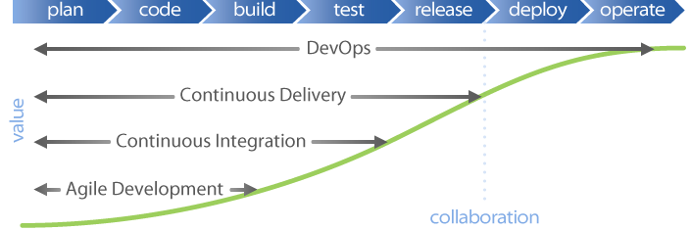
Continuous Integration Continuous Delivery Continuous Improvement
Notes:
Continuous Integration:
Continuous Integration is the practice of merging development work with a Master/Trunk/Mainline branch constantly so that you can test changes, and test that changes work with other changes. The idea here is to test your code as often as possible to catch issues early. Most of the work is done by automated tests, and this technique requires a unit test framework. Typically there is a build server performing these tests, so developers can continue working while tests are being performed.
Continuous Delivery is the continual delivery of code to an environment once the developer feels the code is ready to ship. This could be UAT or Staging or could be Production. But the idea is you are delivering code to a user base, whether it be QA or customers for continual review and inspection. This is similar to Continuous Integration, but it can feed business logic tests. The basis of Continuous Delivery is small batches of work continually fed to the next step will be consumed more easily and find more issues early on. This system is easier for the developer because issues are presented to the developer before the task has left their memory.
Continuous Improvement is exactly what it sounds like. Maintaining the mindset of continuously improving our processes, systems, and methods. Somewhat different from continuous delivery, Continuous Deployment, as an example, is the deployment or release of code to Production as soon as it is ready. There is no large batching in Staging nor long UAT process that is directly before Production. Any testing is done prior to merging to the Mainline branch and is performed on Production-like environments,

Slide 15











Ansible: Simplified Automation
Notes:
One of the best features of Ansible, is the level of integration and compatibility it has with the large number of tools in the DevOps world, and that this slide demonstrates Ansible’s ability to automate and orchestrate environments across a wide array of configurations and existing infrastructures.
For example, Ansible automates across:
DEVELOPMENT
Issue Tracking / Service Mgmt:
JIRA
ServiceNow
and more...
Devel Environment:
Vagrant
and more...
Source Control Mgmt:
GitHub
Atlassian Bitbucket Pipelines
Gitlabs
BZR
Mercurial
Subversion
and more...

Slide 16
Ansible: Simplified Automation
Notes:
TESTING / INTEGRATION
Test:
Selenium
Cucumber
and more...
Build and Artifact Mgmt:
Nexus
Maven
and more...
CI/CD:
Jenkins
Bamboo
Travis CI
Teamcity
and more...
DEPLOYMENT
Cloud Providers
Containers
Systems
Virtualization
and more...
MONITORING / ANALYTICS / CHATOPS
Monitor:
AppDynamics
Dynatrace
InfluxData
New Relic
Sensu
Nagios
BigPanda
DataDog
and more...
Analytics:
Splunk
and more...
Chat:
Slack
HipChat
IRC
Twilio
and more...

Slide 17
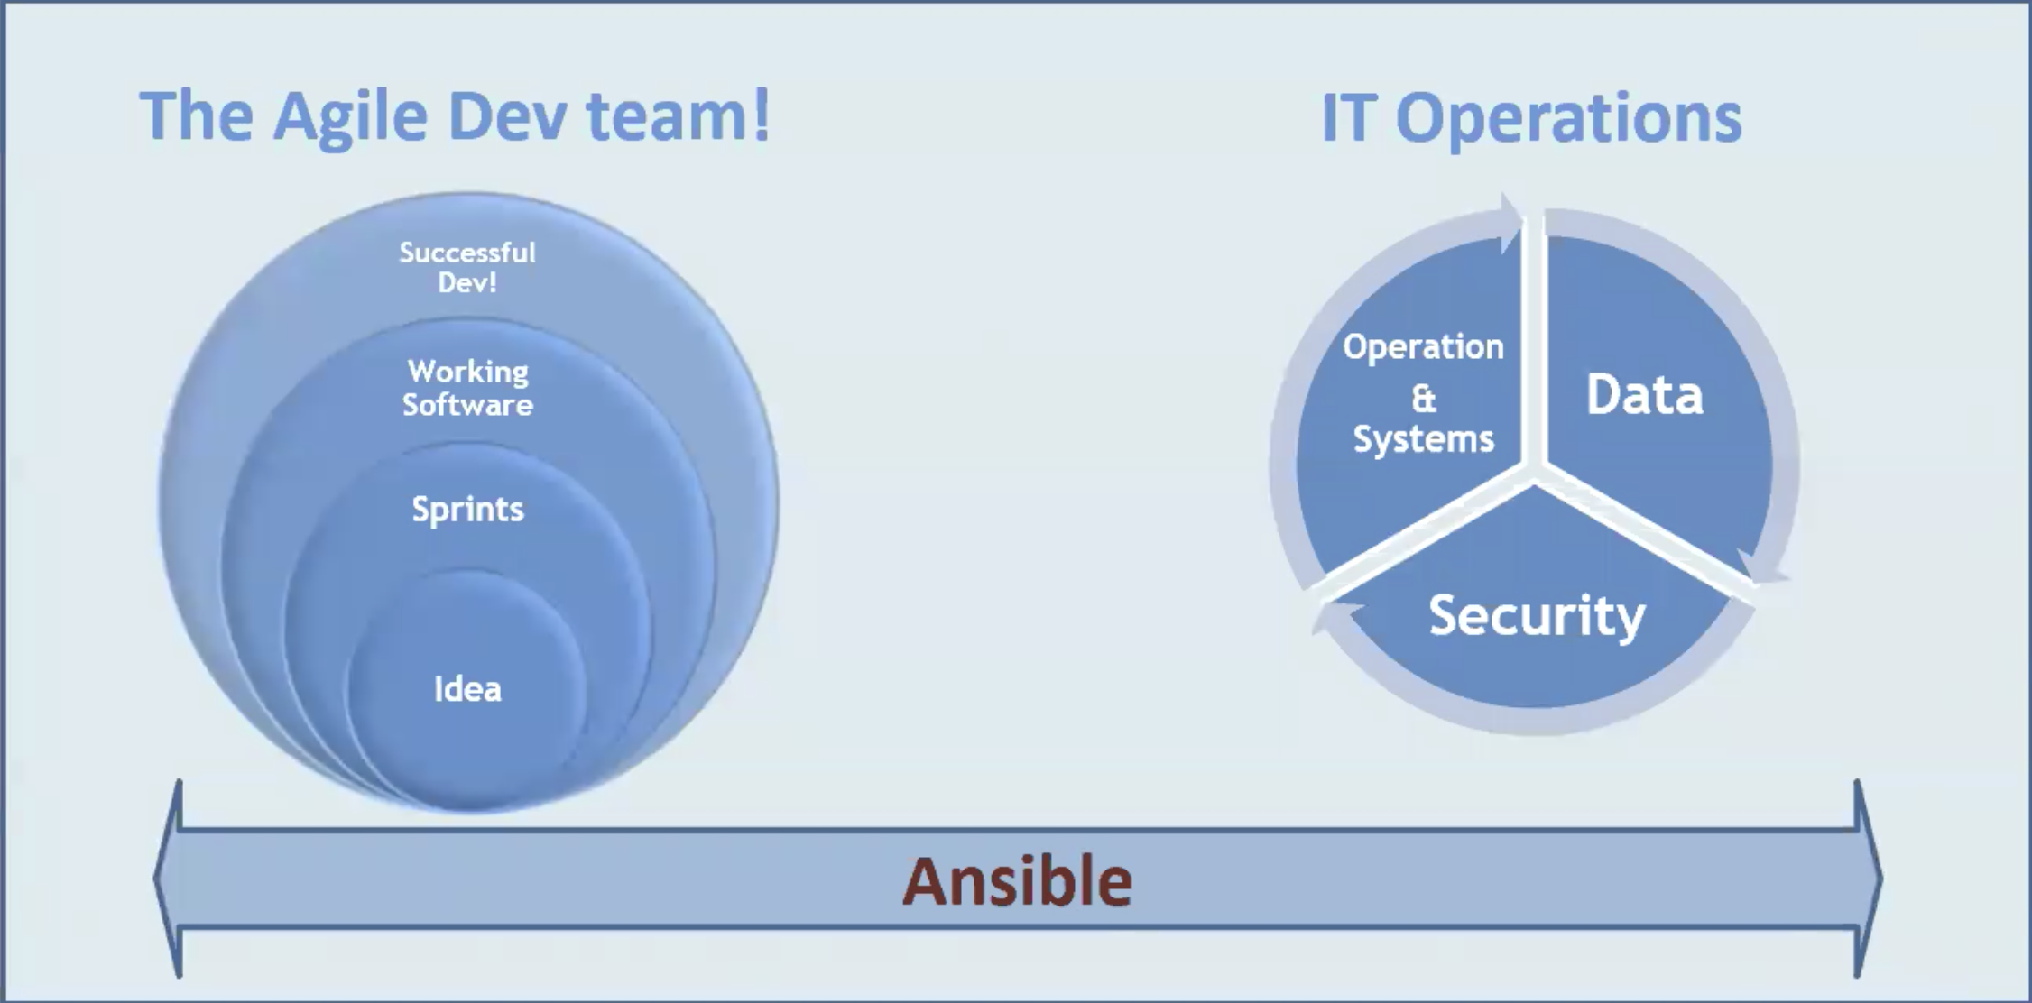
Ansible in The DevOps Team:
Notes:
infrastructure provisioned quickly, can be handed over a playbook for the purpose Data base management, security controls, and also operation on admin and user accounts

Slide 18
Key Term: Configuration Management
Ansible is often described as a configuration management tool, and is typically mentioned in the same breath as Chef, Puppet, and Salt.
Let’s clarify the definition of “configuration management.”
Notes:
Key Term: “Configuration Management”
Configuration management can seemingly mean different things to the various IT roles. For example, configuration management will likely mean something very different to a web application developer, than it would to a systems engineer, however ultimately, both of these individuals will generally have the same CM goals.
When talk about configuration management is brought up, there are a few common goals that are consistently set. When CM is discussed, primarily, we are talking about writing some kind of state definition for our environment or system, then using tools, processes, and policies to implement and establish this definition on the environment or system, verify their full and correct configurations, and ensure documentation is maintained. Secondly, CM hopes to simplify, and unify the configurations across environments (i.e. development, testing, production, etc…).
Managing environments consistently
With this increased complexity comes an increased need for testing. A typical environment might include development servers, testing servers, staging servers, production servers and disaster recovery servers. To ensure our projects run reliably across all these environments, and that what we are testing for in development applies to our production environment, we need to ensure our operating system, software packages, configuration files, and other components that make up our infrastructure are managed consistently across all environments.

Slide 19
Key Term: Configuration Management
Ansible is often described as a configuration management tool, and is typically mentioned in the same breath as Chef, Puppet, and Salt.
Let’s clarify the definition of “configuration management.”
Notes:
Here is an example of what a state definition might include:
User accounts have been created
Required packages are installed
Configuration files contain the expected values and have the expected permissions
The right services are running
Firewall rules have been applied
Note: We will be covering the “state definition”, and what it really means in greater detail a little further along in the courseware.

Slide 20

Why do we need configuration management?
Notes:
Level-set: “Configuration Management”
It is an interesting time to be working in the field of operations. The complexity of the infrastructure we manage has increased significantly over the last 2-3 decades. No longer are we deploying static web content to a single server; we now deploy software applications by stringing together services that run on a distributed set of computing resources and communicate over different networking protocols. A typical application can include web servers, application servers, memory-based caching systems, task queues, message queues, SQL databases, NoSQL datastores, and load balancers – not to mention the secondary services we also need to deploy and maintain, like logging, monitoring and analytics, as well as third-party services we need to interact with.

Slide 21

Question: How do you provision a new server?
Do you follow some documented instructions?
What is the current process you have in place?

Slide 22


Manual changes to servers, or any infrastructure, involves…
PEOPLE
Terrible at doing things repeatably...
Slow at doing things compared to machines...
Notes:
More than 80% of all mission-critical IT service outages are due to PEOPLE and process errors. Instead, good configuration management applies proven practices from software development:
Code and configuration is in version control system
Unit and integration tests
Safe acceptance testing in development/staging environments
Code review – manual and automated
Infrastructure should be treated like code.
Installation Packages
Server and application configuration (such as timezone settings and any other settings)
Relationships with other servers and services
System Documentation
We want:
Automated, repeatable operations
Predictable outcome
Remove manual, error prone steps
Manage change during server lifecycle
Ability to test outcomes
Store all artifacts, settings and documentation in source control

Slide 23
Ansible Vs. Other CM Tools: Strengths
Remarkably simple
Agentless
Secure ( SSH )
YAML (Playbooks)
Written in Python
Ansible Galaxy & Ansible Tower
Notes:
Ansible Vs. Other CM Tools:
While it is important to know what tools are available and major differences between them, our objective here is to simply understand what separates Ansible from the pack. Here is a condensed list of what makes Ansible a smart choice.
Ansible is arguably the easiest configuration management tool in the market to get up and running. The learning curve for this tool is significantly smaller than many others.
Ansible is agentless, meaning, that Ansible is in control of all communications between the controller and hosts, and accomplishes this through secure modules or SSH directly.
Speaking of SSH, this characteristic is not only a major plus for security, but also for usability as it is remarkably easy to configure.
Ansible playbooks, which we will cover in much greater detail further in the course, are written in YAML, which allows for easier readability, the use of reference anchors, and better comment support.
Ansible is written in Python making the administration and scripting tasks necessary, not only for initial setup, but also for easier, and more flexible scalability farther down the road.
Finally, Ansible Galaxy, which is the central collection of resources available for reusable content. We’ll talk a bit more about Ansible Galaxy, as well as Ansible Tower and the features offered here in just a little bit.

Slide 24
Ansible Vs. Other CM Tools: Weaknesses
No comprehensive GUI integrated by default. Alternative solutions are needed if a GUI is desired, such as Ansible Tower, Rundeck, or The Foreman.
Currently, only minimal support/compatibility for Windows, as the Ansible Controller, however this is one area where Ansible developers are focusing their efforts.
Documentation supporting Ansible still leaves something to be desired. Especially for more complex configurations beyond novice to intermediate levels.
Notes:
Just as importantly, we want to make sure we know the potential limitations, or possible deficiencies with our favorite CM tool.
The first thing that might be seen as a negative, is the lack of a comprehensive GUI in the standard version. While there is a pretty decent UI in Ansible Tower, however not every function can be accomplished through the UI and will need to be performed via the command line instead. Other alternatives include Rundeck, or The Foreman.
Another possible negative, which depending on one’s perspective, can also be looked at as a positive. Even though Ansible has support for Windows nodes, it does not however, have support for windows as the Ansible controller. Negatively, if a team is overly windows dependent, this can present an issue, and would still require a Linux machine to be the controller.
While the quality and quantity of well defined documentation continues to improve, having comprehensive, and granular documentation seems to be one area where Ansible can still greatly improve.

Slide 25
Key Term: Idempotence
When an action taken has the intended, and identical outcome, regardless of the number of times the action is taken, the result remains the same.
Idempotence = Consistency + Predictability + Reliability

Slide 26

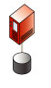
Managing environments consistently
Notes:
Managing environments consistently
With this increased complexity comes an increased need for testing. A typical environment might include development servers, testing servers, staging servers, production servers and disaster recovery servers. To ensure our projects run reliably across all these environments, and that what we are testing for in development applies to our production environment, we need to ensure our operating system, software packages, configuration files, and other components that make up our infrastructure are managed consistently across all environments.

Slide 27
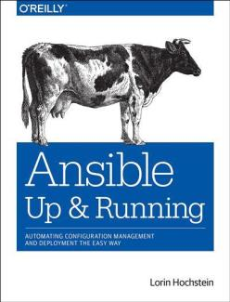
Additional Resources & Materials: Course Supplemental Text
The course includes the O’Reilly reference: “Ansible: Up and Running.”
While we do not rely heavily on this book during the class, the text will provide you with a reference you can use after class as you begin to apply the practices you learn here in greater detail.
As we progress through the courseware, we will occasionally reference topics in this text, and other resources for either further reading, or to give you a place to refresh your memory after the course.
Notes:
About Ansible: Up and Running
Publisher: O'Reilly Media; 1 edition (May 15, 2015)
Author: Lorin Hochstein
Language: English
ISBN-10: 1491915323
ISBN-13: 978-1491915325

Slide 28
Second Step: Getting Started with Ansible:
Section 2: Ansible Configuration Management Boot Camp
YAML Fundamentals
Basic YAML Syntax
YAML in Use
Authentication Basics
Authenticating with SSH Keys
Vagrant Basics
What we will cover in this section:
Ansible Basics
Terminology
Dependencies/Constraints
Components
The typical Ansible Environment
Best Practices

Slide 29
Ansible Basics: Common Ansible Terminology
Ansible Controller | The host/device we execute our Ansible code from
Inventory | A list of servers/devices in our environment Ansible will connect to
Playbook | The state definition we want Ansible to apply to our servers
Roles | A package of tasks, config files, templates and variables we can include from our playbooks
Notes:
Controller - can have multiple of those, but this is the host we use to execute our code from, we can divide our env into dev, staging and prod and have separate controllers for each but this is generally one.
Inventory: A file (by default, Ansible uses a simple INI format) that describes Hosts and Groups in Ansible. Inventory can also be provided via an Inventory Script (sometimes called an “External Inventory Script”)., also called hosts so not to be confused with /etc/hosts file. more things like setting variables, can set variables or force user accounts in inventory to take over
Playbooks: Playbooks are the language by which Ansible orchestrates, configures, administers, or deploys systems. They are called playbooks partially because it’s a sports analogy, and it’s supposed to be fun using them. They aren’t workbooks :) collection of plays (a singular task) which define a state of whatever is in our inventory files.
Plays: A playbook is a list of plays. A play is minimally a mapping between a set of hosts selected by a host specifier (usually chosen by groups but sometimes by hostname globs) and the tasks which run on those hosts to define the role that those systems will perform. There can be one or many plays in a playbook.
Roles: Roles are units of organization in Ansible. Assigning a role to a group of hosts (or a set of groups, or host patterns, etc.) implies that they should implement a specific behavior. A role may include applying certain variable values, certain tasks /plays , and certain handlers – or just one or more of these things. Because of the file structure associated with a role, roles become redistributable units that allow you to share behavior among playbooks – or even with other users. Can be treated as a package to do a specific config, like set up apache server which can be defined as a role. -- roles are a full on package to accomplish a specific task, can have playbooks, config files (like apache server config file),

Slide 30
Ansible Basics: Common Ansible Terminology
Ansible Controller | The host/device we execute our Ansible code from
Inventory | A list of servers/devices in our environment Ansible will connect to
Playbook | The state definition we want Ansible to apply to our servers
Roles | A package of tasks, config files, templates and variables we can include from our playbooks
Notes:
Other terms worth mentioning here:
Library: A collection of modules made available to /usr/bin/ansible or an Ansible playbook.
Modules: Modules are the units of work that Ansible ships out to remote machines. Modules are kicked off by either /usr/bin/ansible or /usr/bin/ansible-playbook (where multiple tasks use lots of different modules in conjunction). Modules can be implemented in any language, including Perl, Bash, or Ruby – but can leverage some useful communal library code if written in Python. Modules just have to return JSON. Once modules are executed on remote machines, they are removed, so no long running daemons are used. Ansible refers to the collection of available modules as a library. like shell module lets us allow to run shell commands, task is going to use a module to achieve a specified defined task.
Facts: Facts are simply things that are discovered about remote nodes. While they can be used in playbooks and templates just like variables, facts are things that are inferred, rather than set. Facts are automatically discovered by Ansible when running plays by executing the internal setup module on the remote nodes. You never have to call the setup module explicitly, it just runs, but it can be disabled to save time if it is not needed or you can tell Ansible to collect only a subset of the full facts via the gather_subset: option. For the convenience of users who are switching from other configuration management systems, the fact module will also pull in facts from the ohai and facter tools if they are installed. These are fact libraries from Chef and Puppet, respectively. (These may also be disabled via gather_subset:). playbook will fail and will stop running, so we can also skip that using some flags, can turn off the gathering flags to limit the amount of data flying around the network - ICMP packet , ping command. Ping command is not used using ICMP , python module is packaged and sent to the machine, and then put in the temp folder, and then run and deleted, and returned back to the host.
Source: Definitions pulled directly from the official Ansible glossary at: http://docs.ansible.com

Slide 31
Ansible Basics: Dependencies/Constraints
Jumping between modules, it is important to know which module should be used in each case. For example, the “command” and “shell” modules are commonly used in places where the other should have been.
Understanding the various input, output, configuration, and DSL formats seen and used in Ansible.
The modules used and commands input using Ansible depend on thorough understanding of the target host’s own dependencies.
For example, depending on your target node’s operating system, one module may need to be used over another.
Don’t forget about your network dependencies.
Notes:
Jumping between modules:
Command vs Shell modules:
Command: The command module takes the command name followed by a list of space-delimited arguments. The given command will be executed on all selected nodes. It will not be processed through the shell, so variables like $HOME and operations like "<", ">", "|", and "&" will not work (use the shell module if you need these features).
Shell: The shell module takes the command name followed by a list of space-delimited arguments. It is almost exactly like the command module but runs the command through a shell (/bin/sh) on the remote node.
Understanding the input, output, configuration, and DSL formats seen and used in Ansible:
Ansible and inventory configuration: INI format
Custom facts in facts.d: INI format
Variables: YAML format
Playbooks: YAML format, with key=value format inline
Booleans: Variable - yes/no format in some places and True/False format in other places
Output for introspection of facts: JSON format
Output for playbook runs: Ansible specific
Target dependencies example: Target OS differences: Linux distributions with different package managers will need different modules used, such as yum, rpm, pacman, etc…
Don’t forget about your network dependencies: Common problems arise out of misconfigured DNS, or communication related settings, especially with regards to host files.

Slide 32
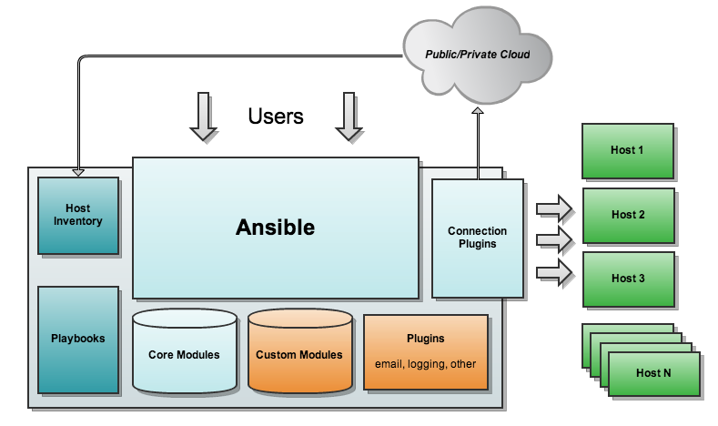
Ansible Basics: Components & Example of a Typical Ansible Environment
Notes:
-- ansible does nothing except a state management config tool, it asks the hosts “do u look like this “ if hosts says yes, nothing happens, if host says no, ansible says let me know when u r done, and it wont execute a task if its already done, like if the file is already copied it won’t do it again, it doesn’t check the content of the file.
-- core and custom modules - core modules which are already built with ansible (https://docs.ansible.com/ansible/devel/modules/list_of_all_modules.html ) , custom modules are anything that you write for a specific task. host can be a switch, router, firewall, vm anything that we are trying to configure.
-- connection module like using ssh, or using windows remote management, or windows powershell , mainly host dependent.

Slide 33
Ansible Basics: Best Practices
When getting started, here are some best practices to keep in mind to ensure we have a smooth overall experience with Ansible.
Don’t underestimate the importance of properly configuring SSH.
Assuming you are using Github, get Ansible to communicate with the Github server for you, and do so securely.
Keep your vars separate from your secret vars.
Separate your setup and deploy playbooks
Notes:
--- rather than hard coding the environment variables, or DNS names, better to save them as variables. some may need to be secret (firewall port), an admin password (shd be secret) shd use something like ansible vault, knowing how to write python and powershell need to be writing custom modules.
First Point:
Incorrectly configuring SSH can have dire consequences. For instance:
# For vagrant vms
Host 192.168.33.* *.testapp.dev
StrictHostKeyChecking no
UserKnownHostsFile=/dev/null
User root
LogLevel ERROR
This config is great for a NON PRODUCTION environment and simplifies things, however it should NOT be used in production environments as it opens up major security vulnerabilities.
use org level ssh set up and when using github or gitlab get ansible to communicate so it can use ssh to securely do so. setup and deploy playbooks are better if kept separate.

Slide 34
Ansible Basics: Best Practices
When getting started, here are some best practices to keep in mind to ensure we have a smooth overall experience with Ansible.
Don’t underestimate the importance of properly configuring SSH.
Assuming you are using Github, get Ansible to communicate with the Github server for you, and do so securely.
Keep your vars separate from your secret vars.
Separate your setup and deploy playbooks
Notes:
Second Point:
Repository proper use (Github):
Add Github to known_hosts the correct, and secure way:
To easily obtain the key from github:
ssh-keyscan -t rsa github.com
Then, create a task to securely lookup the key, and securely set it using the “lookup” feature:
- name: ensure github.com is a known host
lineinfile:
dest: /root/.ssh/known_hosts
create: yes
state: present
line: "{{ lookup('pipe', 'ssh-keyscan -t rsa github.com') }}"
regexp: "^github\\.com“
NOTE: If you have a lot of target servers, this could cause problems and accept_hostkeys=yes should be used in your git task instead.
Third Point:
Your group_vars/all can be a directory and all files in there can have variables for all hosts. Knowing that, you can have separate files for secure and non-secure configs. You can also use ansible-vault to encrypt your secret vars file, if desired.
Fourth Point:
To ensure consistency between your provisioned environments, organize your setup and deploy playbooks appropriately. For example, when using package modules, when setting the state=present, or state=latest, remember that by using latest, it will ensure the package gets updated, while the state=present will simply ensure the package is installed, whether or not it has been previously. This ensures you know precisely what the resulting configuration will be.

Slide 35
Authentication Basics: SSH Keys
Initiate SSH Connection
Send Random Challenge Message
Server
(Public Key)
Client
(Private Key
Encrypt Message With Private Key
Decrypt Message With Public Key
If Message Matches, Client Is Authenticated
Notes:
While SSH is not the only transport protocol that can be used with Ansible, it has the widest acceptance in the community. There are multiple Python API’s for disseminating connection types callbacks.
Authenticating with SSH Keys
SSH key pairs are two cryptographically secure keys that can be used to authenticate a client to an SSH server.
Each key pair consists of a public key and a private key.
The private key is retained by the client and should be kept absolutely secret.
Any compromise of the private key will allow the attacker to log into servers that are configured with the associated public key without additional authentication.
As an additional precaution, the key can be encrypted on disk with a passphrase.
The associated public key can be shared freely without any negative consequences.
The public key can be used to encrypt messages that only the private key can decrypt.
This property is employed as a way of authenticating using the key pair.
The public key is uploaded to a remote server that you want to be able to log into with SSH.
The key is added to a special file within the user account you will be logging into called ~/.ssh/authorized_keys.
When a client attempts to authenticate using SSH keys, the server can test the client on whether they are in possession of the private key.
If the client can prove that it owns the private key, a shell session is spawned or the requested command is executed.
Source: https://www.digitalocean.com/community/tutorials/how-to-configure-ssh-key-based-authentication-on-a-linux-server

Slide 36
Creating SSH Keys:
On your local computer, generate a SSH key pair by typing:
ssh-keygen
Which should result in the following output:
Generating public/private rsa key pair.
Enter file in which to save the key (/home/username/.ssh/id_rsa):
If you had previously generated an SSH key pair, you may see a prompt that looks like this:
/home/username/.ssh/id_rsa already exists.
Overwrite (y/n)?
Notes:
Creating SSH Keys
The utility will prompt you to select a location for the keys that will be generated. By default, the keys will be stored in the ~/.ssh directory within your user's home directory.
The private key will be called ”id_rsa” and the associated public key will be called ”id_rsa.pub”.
Usually, it is best to stick with the default location at this stage. Doing so will allow your SSH client to automatically find your SSH keys when attempting to authenticate.
If you would like to choose a non-standard path, type that in now, otherwise, press ENTER to accept the default.
If you had previously generated an SSH key pair, you may see a prompt that looks like this:
/home/username/.ssh/id_rsa already exists. Overwrite (y/n)?

Slide 37
Vagrant Basics
What is Vagrant?
A virtual machine environment managing and provisioning tool that can be used in conjunction with many other DevOps tools for creating, configuring, managing, and testing hosts, servers, and even entire infrastructures.
Vagrant Features & Capabilities:
Network interface management – Multi-machine management
Shared folder management: – Provisioning
Vagrant and Ansible:
Vagrant has easy integration with Ansible, and can work well together with Ansible as the provisioner. The processes to implement each work very similarly, and it is common to see them implemented together in a typical enterprise environment.
Notes:
With only a couple of dependencies, such as installing vagrant and VirtualBox, in just two commands, it is possible to get Vagrant up and running:
$ vagrant init hashicorp/precise64
$ vagrant up
Vagrant makes use of boxes, or base images able to be cloned quickly and easily without bogging down the system with full VMs which may be bulky and slow to provision. Once the box has been downloaded, it is globally stored for the current user.

Slide 38
Example of a Vagrantfile
1.# This is optimized for Vagrant 1.7 and above.
2.# Although versions 1.6.x should behave very similarly, it is recommended
3.# to upgrade instead of disabling the requirement below.
4.Vagrant.require_version ">= 1.7.0"
5.Vagrant.configure(2) do |config|
6. config.vm.box = "ubuntu/trusty64"
7.# Disable the new default behavior introduced in Vagrant 1.7, to
8.# ensure that all Vagrant machines will use the same SSH key pair.
config.ssh.insert_key = false
config.vm.provision "ansible" do |ansible|
11. ansible.verbose = "v“
12. ansible.playbook = "playbook.yml"
13. end
14.end
15.
Notes:
This is an example of a simple Vagrantfile. We can take a look and describe what is happening in this file. Simply enough, it is setting the Vagrant version, configuring a VM running Ubuntu, namely the trusty64 build, setting the SSH behavior of the VM while enabling verbose output, finally running the Ansible playbook named “playbook.yml”.

Slide 39
Getting to Know Our Lab Environment
Sub-section: Pre-exercise Level Set
What is Our Classroom Lab Setup Like?
Virtualization Crash Course
Overview of Jenkins
Brief Example of Ansible in a Jenkins Environment
Overview of LXC
Example of Ansible provisioned resources and LXC

Slide 40
What is Our Classroom Lab Setup Like?
Our lab environment is made up of a series of virtual machines which are unique to each student. Because of this, if something in your environment becomes corrupted or unusable, it won’t impact anyone else in the class.
When you first log to your student base machine using the credentials provided by your instructor, you are now in the Ansible Controller environment, this is where we will run most of our exercises from.
We have provided the code for most of the exercises in the ‘code’ directory under your particular student account name. To see this, enter this on your Ansible controller after logging in:
$ls ./code
Notes:
In addition to the base machine provided as your Ansible controller, there are a number of other virtual hosts your will have access to: installation.local helloworld.local docker.local gogs.local SSH keys have already been configured for your assigned student account on each of these hosts.
**We will also provide instructions on how you can build a lab environment after class that matches our class lab pretty closely.

Slide 41
Virtualization Crash Course: 30,000 ft. view
Virtualization leverages available software and hardware technologies to enable a single machine to operate as if it were multiple. How it does this can be very different depending on many factors including: The technologies or resources available, or even the overall goals to be met.
A system can be virtualized at various levels, serving different purposes. Here are some of these levels and a few of their defining characteristics:
Hardware-level – Low performance, low elasticity, minimal tenancy
Platform/Application Level – High abstraction, high tenancy, poor security/containment.
OS-level – High tenancy, high performance, relatively efficient resource use, better security, better compartmentalization, potentially slow provisioning speed
Containerization – Similar in resource sharing to traditional virtualization, just at a much smaller scale. Does not require the entire OS install to be provisioned.
Smaller. Faster. Better.
Notes:
-- hardware level is like ESX, hypervisor etc
-- platform or Appn level has some serious security flaws, has a high level of abstraction
-- OS level is like virtualbox, vmware uses hypervisor internally but slow provisioning speed
-- Containerization similar to OS level, but does not have a separate OS for every container thats running,

Slide 42
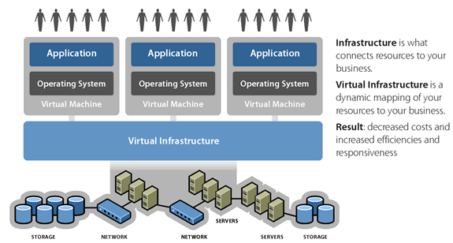
Infrastructure as a service
Notes:
Using Ansible to manage cloud infrastructure
Unless you have been living under a rock for the last ten years, you will likely have been inundated with one of the industry’s favorite buzz words: “cloud”.
“Cloud” has been so overused it’s original intention has almost been lost, but in this context what we are talking about is infrastructure as a service.
What this essentially means is rather than needing to purchase hardware, install it in a rack in some data center, patch it in to a network, install some virtualization hypervisor on it like VMware or OpenStack, you simply rent some computing resources from a third party vendor such as Amazon, Google, RackSpace, DigitalOcean or one of the many other providers out there who offer this service.
Often these resources are bundled where you rent an instance that comes with X number of CPU cores, X amount of RAM and X amount of storage for a period of time. Some cloud instances have a very short life span, created just long enough to build a project and execute a test suite and then destroyed again, and some run indefinitely.

Slide 43

Overview of Jenkins
Jenkins is a self-contained, Java-based Continuous Integration tool with an extensive library of plugins available in the Jenkins Update Center. This powerful open-source utility, when integrated with the right set of DevOps oriented tools, can be utilized to maximize the capabilities of nearly every aspect of your enterprise IT environment, both easily and efficiently.
Ansible has an excellent relationship with Jenkins, and the tools are commonly deployed together.
Combining Ansible with Jenkins, and containers, you can now provision from build to deploy, a fully functioning, testable, and repeatable Jenkins environment, all at the push of a button.
Well… perhaps just a few buttons need to be pushed.

Slide 44
Overview of LXC
LXC, or Linux Containers, offers a unique approach to virtualization, where the resources allocated to the container, or virtual machine without the overhead of a fully virtualized system, maintain the same level of access to the kernel, file systems, and other host resources through kernel namespaces over OS level virtualization.
Key features include:
Isolated CPU, RAM, I/O, and networking resources through cgroups
Controlled network connection to both the virtual and physical networks
Solid Linux support community
Relatively easy to moderate learning curve.
Notes:
Useful Basic LXC Commands:
List containers and summary information such as operational state and network configuration:
# lxc-ls --fancy
Show container details including operational state, resource utilization, and veth pairs:
# lxc-info --name container_name
Start a container:
# lxc-start --name container_name
Attach to a container:
# lxc-attach --name container_name
Stop a container:
# lxc-stop --name container_name

Slide 45

Exercise:
Installation and Lab Environment Walkthrough
Exercise Objective A: Accessing the Lab Environment (Prerequisite)
Exercise Objective C: Ansible Easy Install (Exercise 2)
Notes:
Accessing the Lab Environment
You can access the lab environment with SSH to studentX@techtownlab.com
You would replace X with your assigned student number. For example, if your student number is 10, then your username, and lab environment would be:
student10@techtownlab.com
The password is set to "techtownlab" by default.
If you don't have an SSH client available, let your instructor know at once so this can be resolved, otherwise, until then you can still perform the exercises by browsing to https://ssh.techtownlab.com/ and use the web SSH client.
Ansible Easy Install
We have already installed Ansible on the lab environment for you, but as a first exercise, we are going to show you how to install Ansible on a base installation of Centos
From your default lab environment, SSH to the installation.local host where we will perform the install by entering the following:
$ ssh installation.local
There are a number of ways we can install Ansible, by checking out the git repository and installing from source, by using the PIP Python package manager, or by using RPM packages available for Centos.
We are going to install from the RPM packages that are kept up-to-date with the current stable release.
The packages are part of EPEL, so the first thing we need to do is enable the EPEL package repository. To do this, enter:
$ sudo yum install epel-release
We can then go ahead and install Ansible by:
$ sudo yum install ansible
Finally, we can check that Ansible is installed and working by checking its version number by entering this:
$ ansible --version
We are now going to "exit" from our installation host and return to our Ansible controller host which we will use for future exercises.
To find out how to install Ansible on other distributions or from source, consult the online documentation at http://docs.ansible.com/ansible/intro_installation.html

Slide 46
Ansible Core Fundamentals:
Section 3: Ansible Configuration Management Boot Camp
What we will cover in this section:
Ansible Command Line
Basic Ansible Command Line Syntax
Installing Software/Packages
Managing Users, Permissions, and Services
Ansible GUI
A Glance at GUIs for Ansible

Slide 47
Ansible Core Fundamentals:
Section 3: Ansible Configuration Management Boot Camp
What we will cover in this section (Continued):
Inventory Breakdown
Ansible Hosts
Ansible Tasks
Ansible Plays
Ansible Roles
Ansible Modules
Ansible Playbooks
Ansible Management,
Provisioning With Ansible
Best Practices

Slide 48
Introduction to: The Ansible Command Line
Ansible comes with a number of command line tools which you will use to interact with the rest of your infrastructure. The most frequently used tools for most people are:
ansible - a low level tool useful for running ad-hoc commands.
ansible-playbook - the tool you use to kick off playbook runs across your environment.
ansible-galaxy - the tool you use to search, download and update community roles as well as create your own.
ansible-vault - used in the protection of sensitive information stored in your ansible repository.
Notes:
When using the “ansible” tool, low level commands can be used in an ad-hoc fashion. An ad-hoc command is something that you might type in to do something really quick, but don’t want to save for later. Think of these as the equivalent to running a command manually, as opposed to automatically like we see when we use playbooks.
The ansible-playbook tool is used to execute our playbooks on the designated hosts or environments.
The ansible-galaxy tool allows us to communicate with the ansible-galaxy website/web server, to access community resources, such as roles, or if so inclined, to submit your own role to the community.
Ansible-vault is a tool to integrate higher levels of security into our orchestration. Things that can be done with ansible-vault are: Encrypting, decrypting and managing encrypted files in Ansible, and even running encrypted playbooks with vault.

Slide 49
Modules Overview
Modules, which in many other settings may be more commonly referred to as library, or task plugins, are the core component on what is accomplishing the jobs we tell Ansible we want done.
Modules take a approach to arguments and are space delimited.
key=value
Notes:
ansible-doc –l - A list of all modules available
ansible-doc yum - Documentation on the selected item, namely here the yum package manager.
The overall objective for modules, both current and prospectively in the future, is to have.

Slide 50
Ansible Command Line: Installing Software/Packages
There are Ansible modules available to manage packages for many platforms. For instance, there are modules available for yum and apt.
Examples of these in use:
#Ensure a package is installed, but don’t update it:
$ ansible webservers -m yum -a "name=acme state=present"
#Ensure a package is installed to a specific version:
$ ansible webservers -m yum -a "name=acme-1.5 state=present"
#Ensure a package is at the latest version:
$ ansible webservers -m yum -a "name=acme state=latest"
#Ensure a package is not installed:
$ ansible webservers -m yum -a "name=acme state=absent"
Notes:
NOTE: These are simply examples, running these in your lab environment may not provide the intended result. There are modules available for yum and apt. Here are some examples with yum.
If you wanted to ensure a package is installed, but not updated you could use:
$ ansible webservers -m yum -a "name=acme state=present"
If you wanted to ensure a package is installed with a specific version:
$ ansible webservers -m yum -a "name=acme-1.5 state=present"
If you wanted to ensure a package is at the latest version:
$ ansible webservers -m yum -a "name=acme state=latest"
Alternatively, if you wanted to ensure a package is not installed:
$ ansible webservers -m yum -a "name=acme state=absent"
Ansible has modules for managing packages under many platforms. If there isn’t a module for your package manager, you can install packages using the command module or even contribute a module that you’ve created for your package manager. This practice is how Ansible continues to thrive in the open source community.

Slide 51
Ansible Command Line: Managing Users, Permissions, & Services
The ‘user’ module allows easy creation and manipulation of existing user accounts, as well as removal of user accounts that may exist:
For Example:
$ ansible all -m user -a "name=foo password=<encrypted password here>"
$ ansible all -m user -a "name=foo state=absent“
# Ensure a service is started on all webservers:
$ ansible webservers -m service -a "name=httpd state=started"
# Alternatively, restart a service on all webservers:
$ ansible webservers -m service -a "name=httpd state=restarted"
# Ensure a service is stopped:
$ ansible webservers -m service -a "name=httpd state=stopped"
Notes:
NOTE: Again, the examples here may not work if tried in your student environment, and are not intended to, necessarily. The tasks in your lab exercises match the lab configurations provided.
Example use of the user and the service modules:
$ ansible all -m user -a "name=foo password=<encrypted password here>"
$ ansible all -m user -a "name=foo state=absent“
# Ensure a service is started on all webservers:
$ ansible webservers -m service -a "name=httpd state=started"
# Alternatively, restart a service on all webservers:
$ ansible webservers -m service -a "name=httpd state=restarted"
# Ensure a service is stopped:
$ ansible webservers -m service -a "name=httpd state=stopped"

Slide 52
Inventory Breakdown
We have talked a lot about performing actions on a target machine, but so far we have only been dealing with a single target.
Ansible uses an “inventory” to define all the target machines in your environment, weather they are physical servers, virtual machines, or instances running on a third party cloud provider such as Amazon AWS or DigitalOcean.
An inventory in it’s most basic form can just be a text file containing a list of hostnames, but we can be a little more descriptive in our inventory and split our machines in to logical groups.
Notes:
Inventory:
A file (by default, Ansible uses a simple INI format) that describes Hosts and Groups in Ansible.
Inventory can also be provided via an Inventory Script (sometimes called an “External Inventory Script”).

Slide 53
Inventory – Groups: Example
When performing configuration tasks, we typically want to perform actions on groups of hosts, rather than on an individual host.
Consider our example inventory which defines two web nodes, and one database node:
[vagrant@ansible vagrant]$ cat hosts
node1 ansible_ssh_host=10.2.3.20
node2 ansible_ssh_host=10.2.3.30
node3 ansible_ssh_host=10.2.3.40
[web]
node1
node2
[database]
node3
Ansible automatically defines a group called all which includes all of the hosts in the inventory.
Notes:
Performing actions on host groups
When performing configuration tasks, we typically want to perform actions on groups of hosts, rather than on an individual host.
Consider our example inventory which defines two web nodes, and one database node:
[vagrant@ansible vagrant]$ cat hosts
node1 ansible_ssh_host=10.2.3.20
node2 ansible_ssh_host=10.2.3.30
node3 ansible_ssh_host=10.2.3.40
[web]
node1
node2
[database]
node3
Ansible automatically defines a group called all which includes all of the hosts in the inventory.

Slide 54
What if I want, or need a GUI?
For most operations, people working on the command line is part of the job. But if you have members of your organization that need the ability to execute tasks with Ansible, or you want to hide ansible behind a web interface, there are options to help with that.
Notes:
The first is a commercial tool from the company behind Ansible, Ansible Tower:
https://www.ansible.com/tower.
This is a pretty comprehensive tool that will help you manage Ansible job runs, implement access control, see a history of who ran what and when, and provide you with Ansible job scheduling.
Another in use by a lot of organizations who use Ansible is Rundeck: http://rundeck.org/ Like Ansible Tower, Rundeck allows you to preconfigure Ansible jobs that can be run with a click of a web interface. You can set up access control around who is allowed to run what, and you can see a history of what was run and what the output was. There are even roles on Ansible Galaxy that will help you install and configure Rundeck in your environment.
The last tool we will mention here is The Foreman
https://theforeman.org/
This is a provisioning and reporting tool for your infrastructure. It can manage physical servers, VMware and OpenStack virtualization and integrate with many third party cloud providers such as Amazon, Google, DigitalOcean and RackSpace. It was originally built as a tool for Puppet, but plugins have enabled it to work with all the config management packages including Chef, SaltStack and of course Ansible.

Slide 55
Exercise:
Command Line Basics
Exercise Objective A: Exercise 1 & 2
Exercise Objective B: Exercise 3
Exercise Objective C: Exercise 4
Notes:
Ansible comes with a number of command line tools which you will use to interact with the rest of your infrastructure. The most frequently used ansible tools for the majority of use cases are:
ansible -- a low level tool useful for running ad-hoc commands.
ansible-playbook -- the tool you use to kick off playbook runs across your environment.
ansible-galaxy -- the tool you use to search, download and update community roles as well as create your own.
ansible-vault -- used in the protection of sensitive information stored in your ansible repository.
To get started, let's change in to the hello-world directory of our code repository and have a look at some basic command line usage.
We will start by running some ad-hoc commands using the "ansible" tool.
An ad-hoc command is something that you might type in to do something really quick, but don’t want to repeat later.
We will start by running the ping module on our target host, this will tell us if Ansible can connect and login to our target host successfully. To do this, type the following and press enter:
$ ansible testbox -m ping
So long as your target host is reachable, you should receive a result like this:
testbox | SUCCESS => {
"changed": false,
"ping": "pong“
}
We only have one target machine in this environment but in a large environment you will probably want to execute several commands in parallel. By default, Ansible will fork 5 connections at a time, to increase this number you would supply the -f argument, along with the number of machines to run against. For example:
$ ansible all -f 10 -m command -a "uptime"
In this example, we forked 20 connections at once and used the command module to execute the uptime command on the target node(s), which in this case happens to be all nodes in the hosts file.
In the event you wanted to copy a file to all our servers, we could use the copy module, like we see in this example:
$ ansible all -m copy -a "src=/etc/motd dest=/etc/motd"
Facts represent discovered variables about a system. These can be used to implement conditional execution of tasks but also just to get ad-hoc information about your system. You can see all facts by entering the following:
$ ansible all -m setup

Slide 56
Recap From Yesterday:
What is Config Management?
What is Devops / CI - CD mean?
Ansible Basics (Inventory, Playbook, Roles)
Ansible Architecture
Basics of ssh, yaml files and vagrant fundamentals
Basics of Virtualization
Exercises on basics of Ansible modules, and setup
Notes:
Ansible comes with a number of command line tools which you will use to interact with the rest of your infrastructure. The most frequently used ansible tools for the majority of use cases are:
ansible -- a low level tool useful for running ad-hoc commands.
ansible-playbook -- the tool you use to kick off playbook runs across your environment.
ansible-galaxy -- the tool you use to search, download and update community roles as well as create your own.
ansible-vault -- used in the protection of sensitive information stored in your ansible repository.
To get started, let's change in to the hello-world directory of our code repository and have a look at some basic command line usage.
We will start by running some ad-hoc commands using the "ansible" tool.
An ad-hoc command is something that you might type in to do something really quick, but don’t want to repeat later.
We will start by running the ping module on our target host, this will tell us if Ansible can connect and login to our target host successfully. To do this, type the following and press enter:
$ ansible testbox -m ping
So long as your target host is reachable, you should receive a result like this:
testbox | SUCCESS => {
"changed": false,
"ping": "pong“
}
We only have one target machine in this environment but in a large environment you will probably want to execute several commands in parallel. By default, Ansible will fork 5 connections at a time, to increase this number you would supply the -f argument, along with the number of machines to run against. For example:
$ ansible all -f 10 -m command -a "uptime"
In this example, we forked 20 connections at once and used the command module to execute the uptime command on the target node(s), which in this case happens to be all nodes in the hosts file.
In the event you wanted to copy a file to all our servers, we could use the copy module, like we see in this example:
$ ansible all -m copy -a "src=/etc/motd dest=/etc/motd"
Facts represent discovered variables about a system. These can be used to implement conditional execution of tasks but also just to get ad-hoc information about your system. You can see all facts by entering the following:
$ ansible all -m setup

Slide 57
Hosts, Tasks, Roles, and Plays
Tasks – Playbooks exist to run tasks. Tasks combine an action (a module and its arguments) with a name and optionally some other keywords (like looping directives).
Plays – A play is minimally a mapping between a set of hosts selected by a host specifier (usually chosen by groups but sometimes by hostname globs) and the tasks which run on those hosts to define the role that those systems will perform.
Roles – Roles are units of organization in Ansible. Assigning a role to a group of hosts (or a set of groups, or host patterns, etc.) implies that they should implement a specific behavior.
Hosts– A host is simply a remote machine that Ansible manages.
Notes:
Tasks:
Playbooks exist to run tasks. Tasks combine an action (a module and its arguments) with a name and optionally some other keywords (likelooping directives). Handlers are also tasks, but they are a special kind of task that do not run unless they are notified by name when a task reports an underlying change on a remote system. like restarting a service after some changes, handlers can listen to the changes and then runs on remote systems as a result of the change.
Plays:
A playbook is a list of plays. A play is minimally a mapping between a set of hosts selected by a host specifier (usually chosen by groups but sometimes by hostname globs) and the tasks which run on those hosts to define the role that those systems will perform. There can be one or many plays in a playbook.
Roles:
Roles are units of organization in Ansible. Assigning a role to a group of hosts (or a set of groups, or host patterns, etc.) implies that they should implement a specific behavior. A role may include applying certain variable values, certain tasks, and certain handlers – or just one or more of these things. Because of the file structure associated with a role, roles become redistributable units that allow you to share behavior among playbooks – or even with other users.
Hosts:
A host is simply a remote machine that Ansible manages. They can have individual variables assigned to them, and can also be organized in groups. All hosts have a name they can be reached at (which is either an IP address or a domain name) and, optionally, a port number, if they are not to be accessed on the default SSH port.
Source: Definitions pulled directly from the official Ansible glossary at: docs.ansible.com.

Slide 58
YAML Fundamentals: Basic Syntax
Since we have already constructed a few example playbooks, you may have noticed files with the .yml extension.
Ansible uses YAML as the default language in which we write our Playbooks
“YAML is a human friendly data serialization standard for all programming languages.” (Source: www.yaml.org)
More simply put, and specifically for our use case here: YAML is a file format and is similar in intent to JSON, but generally easier for humans to read.
Notes:
Start of file and comments
Ansible uses YAML as the default language in which we write our Playbooks
“YAML is a human friendly data serialization standard for all programming languages.” (Source: www.yaml.org)
More simply put, and specifically for our use case here: YAML is a file format and is similar in intent to JSON, but generally easier for humans to read.
YAML is very white-space sensitive, so use your spaces and indentations carefully.

Slide 59
YAML Fundamentals: Basic Syntax
Start of file and comments
A YAML file generally starts with three “-“ characters on a line by itself
“#” character = Comment
Dictionaries and Lists
A dictionary is represented in a simple key: value form (the colon must be followed by a space):
Dictionaries and Lists can be in abbreviated form if desired, though usually done when more complex data structures are wanted.
List members, or items will always begin with a “– “
Strings
Strings in Quotes = Optional
Name: this is a string
Name: “Or you can put it in quotes”
Boolean
Ansible is fairly flexible on Boolean values or yes / no, true / false.
Values
Values can span multiple lines using a “ | “ or a “ > “
| includes new lines
> ignores new lines.
Dash
Space
Notes:
Start of file and comments
A YAML file generally starts with three “-“ characters on a line by itself, although if you forget to put this in, Ansible is pretty forgiving and will run without complaint.
Like many other languages, YAML uses the “#” character to indicate a comment, notes you can include in the file that won’t be executed.
Strings
In general you don’t need to quote string in YAML, even if it contains spaces, although if you put the quotes in YAML won’t complain.
Name: this is a string
Name: “Or you can put it in quotes”
Boolean
Ansible is fairly flexible on boolean values or yes / no, true / false.
You can use yes in place of true and no in place of false, but my preference is to stick to true and false for easier context switching with other languages.

Slide 60
YAML Fundamentals: YAML in Use
Lists (Delimited with hyphens):
---
# A List of “Family Guy” Characters
family_guy:
Peter Griffin
Lois Griffin
Meg Griffin
Chris Griffin
Stewie Griffin
Brian Griffin
Or inline:
family_guy: [Peter, Lois, Meg, Chris, Stewie, Brian]
Dictionaries:
---
# A Client Contact Record
analog:
company: Analog Coffee
address: 235 Summit Ave
city: Seattle
state: WA
website: http://analogcoffee.com/
Or Inline:
analog: {company: Analog Coffee, address: 235 Summit Ave, city: Seattle, state: WA, website: http://analogcoffee.com/}
Notes:
Lists
YAML lists are like arrays in JSON and Ruby or lists in Python. Technically, these are called sequences in the official YAML specification, but we will call them lists here to be consistent with the official Ansible documentation.
They are delimited with hyphens, like this:
- Peter Griffin
- Lois Griffin
- Meg Griffin
- Chris Griffin
- Stewie Griffin
- Brian Griffin
YAML also supports an inline format for lists, it looks like this:
[Peter, Lois, Meg, Chris, Stewie, Brian]
Note again how we didn’t have to quote the strings in YAML, even though they have spaces in them.

Slide 61
YAML Fundamentals: YAML in Use
Lists (Delimited with hyphens):
---
# A List of “Family Guy” Characters
family_guy:
Peter Griffin
Lois Griffin
Meg Griffin
Chris Griffin
Stewie Griffin
Brian Griffin
Or inline:
family_guy: [Peter, Lois, Meg, Chris, Stewie, Brian]
Dictionaries:
---
# A Client Contact Record
analog:
company: Analog Coffee
address: 235 Summit Ave
city: Seattle
state: WA
website: http://analogcoffee.com/
Or Inline:
analog: {company: Analog Coffee, address: 235 Summit Ave, city: Seattle, state: WA, website: http://analogcoffee.com/}
Notes:
Dictionaries
YAML dictionaries are like dictionaries in Python, or hashes in Ruby. Technically, these are called mappings in YAML, but we will call them dictionaries to be consistent with the official Ansible documentation.
They look like this:
analog:
company: Analog Coffee
address: 235 Summit Ave
city: Seattle
state: WA
website: http://analogcoffee.com/
YAML also supports an inline format for dictionaries, it looks like this:
analog: {company: Analog Coffee, address: 235 Summit Ave, city: Seattle, state: WA, website: http://analogcoffee.com/}

Slide 62
Introduction to Playbooks
Playbooks are expressed in YAML format
By composing a playbook of multiple ‘plays’, it is possible to orchestrate multi-machine deployments.
For each play in a playbook, you get to choose which machines in your infrastructure to target and what remote user to complete the steps (called tasks) as.
- hosts: Kubernetes_minon # Group name from inventory file
User: centos # Server authentication
Sudo: true # Server authentication
Roles:
- Java # Role installed on server
- Memcached # Role installed on server
Notes:
Playbooks are expressed in YAML format, and is exceptionally easy to read. This was the entire purpose initially. The use of Ansible, and its core functions, are meant for, not only developers, but other IT professionals who may not have a background, or familiarity for programming languages.

Slide 63
Breaking down a task:
Each task in our playbook starts with a name, and while the name value is optional, it helps others understand what your playbook is trying to do.
Also, as we saw when we executed our playbook, the name gets displayed when the task is run, so it helps us know what Ansible is doing.
These arguments tell the yum module that the "state" of the package named "epel-release" should be "present".
- name: Ensure the EPEL repository is present
yum: name=epel-release state=present
Notes:
Every task must contain a key with the name of a module, and a value with the arguments to that module. In the example below the module name is "yum" and the arguments are name=epel-release state=present.

Slide 64

Exercise:
Working with Playbooks
Exercise Objective A: Outlining and Creating A Simple Playbook (Exercise 5)
Notes:
Exercise Objective:
Create a simple playbook.
In this exercise we will create a simple playbook to install the NTP pacAkage on our helloworld host, so we can make sure its time is in sync.
Before we do anything, our playbook needs to define what hosts to be applied to, the package we want to install, and a service we want to make sure is running. To do this, we create a playbook ntp.yml. Let’s do this now.
Create the file ntp.yml as follows:
---
- hosts: all
become: yes
tasks:
- name: Install the NTP package
yum: "name=ntp state=present"
- name: Make sure ntpd is started
service: name=ntpd state=started enabled=yes
This is a pretty basic example, but it gives us a starting point we can expand upon later.
Let’s run the playbook against our helloworld host and make sure it works.
$ ansible-playbook ntp.yml
If it runs with 0 errors, you have just successfully created your first Ansible playbook.
This will be a simple walkthrough, or a demonstration of a complex playbook where the instructor will go step by step through a playbook, explaining what is occurring at each task, and how we know.

Slide 65
How a role works
All roles must have a tasks/main.yml file, this file gets executed first and describes how the rest of the role is defined.
The files folder contains files that get copied to a target node, while the templates folder contains templates that get turned in to files on the target node.
We will build our own role a bit later, but for now let’s see what happens when we execute our role.
Notes:
The structure of a role
You can see that, currently, our playbook is very short. All the work is done in the roles/rocketchat directory
$ ls -1 roles/rocketchat/
README.md
defaults
handlers
meta
tasks
templates
tests
vars
$ ls -1 roles/rocketchat/tasks/
main.yml
mongodb.yml
nginx.yml
repo_RedHat.yml
upgrade.yml
How a role works
All roles must have a tasks/main.yml file, this file gets executed first and describes how the rest of the role is defined. The files folder contains files that get copied to a target node, while the templates folder contains templates that get turned in to files on the target node.
We will build our own role a bit later, but for now let’s see what happens when we execute our rocket chat role.
What happened?
As we can see by executing the “ansible-playbook playbook.yml” command, a lot of tasks got executed on our target node.
- It detected our OS as RedHat (it’s CentOS so that’s close enough)
- It installed the EPEL repo
- It installed NodeJS
- It installed MongoDB
It set up users and groups
- It installed required software dependencies
- It installed RocketChat
- It installed Nginx to act as a front-end proxy
From your main desktop browse to http://localhost:3000 to make sure RocketChat is installed and functioning.
RocketChat is an open source package that aims to provide a service similar to Slack or Hipchat.

Slide 66
Proper Variable Use in Roles
Especially when security is a concern, ie. Ansible Vault is in play, we want to follow through with the official best practices from Ansible regarding Variables and Roles.
start with a group_vars/ subdirectory named after the group.
In this directory, create two files named vars and vault.
In vars, define all of the variables needed secure, or otherwise.
Then, copy all of the sensitive variables over to the vault file and prefix these variables with ”vault_”.
Finally, adjust the variables in the vars file to point to the matching vault_ variables and ensure that the vault file is vault encrypted.
This best practice has no limit on the amount of variable and vault files or their names.

Slide 67
Setting some default variables
ntp_driftfile: /var/lib/ntp/drift
ntp_server: [0.centos.pool.ntp.org, 1.centos.pool.ntp.org, 2.centos.pool.ntp.org, 3.centos.pool.ntp.org]
ntp_restrict:
- "restrict -4 default kod notrap nomodify nopeer noquery"
- "restrict -6 default kod notrap nomodify nopeer noquery"
- "restrict 127.0.0.1"
ntp_crypto: no
ntp_includefile: no
ntp_keys: no
ntp_trustedkey: no
ntp_requestkey: no
ntp_controlkey: no
ntp_statistics: no
ntp_broadcast: no
ntp_broadcastclient: no
ntp_multicastclient: no
Notes:
Setting some default variables (Example)
You can also specify some defaults for your role, these are variables that you can override later or someone else can substitute values to customize your role if you share it with the Ansible community. We might define these variables in roles/ntp/defaults/main.yml, as seen in the example below:
ntp_driftfile: /var/lib/ntp/drift
ntp_server: [0.centos.pool.ntp.org, 1.centos.pool.ntp.org, 2.centos.pool.ntp.org, 3.centos.pool.ntp.org]
ntp_restrict:
- "restrict -4 default kod notrap nomodify nopeer noquery"
- "restrict -6 default kod notrap nomodify nopeer noquery"
- "restrict 127.0.0.1"
ntp_crypto: no
ntp_includefile: no
ntp_keys: no
ntp_trustedkey: no
ntp_requestkey: no
ntp_controlkey: no
ntp_statistics: no
ntp_broadcast: no
ntp_broadcastclient: no
ntp_multicastclient: no

Slide 68
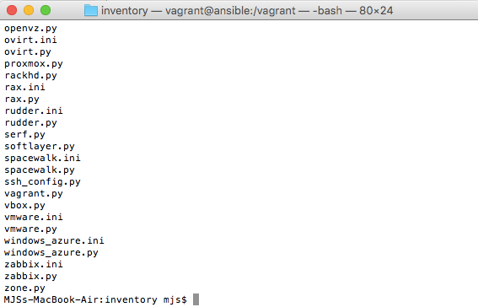
Dynamic inventory
Notes:
Dynamic inventory
Storing information about our inventory in text files is fine for small environments, but for large environments which change often we generally want to use dynamic inventory.
Dynamic inventory is a way of programmatically generating our inventory using a script, and returning a data structure that Ansible can use.
You can write your own dynamic inventory script, or use one of the many dynamic inventory scripts provided in the contrib/inventory directory of the ansible repository at https://github.com/ansible/ansible
Creating a dynamic inventory script
A dynamic inventory script can be written in any language, although most of the provided examples are in python. An inventory script needs to accept the —list argument which should return a JSON data structure containing a list of hosts, and the —host argument which should return information about an individual host.
If I exit from my ansible vagrant machine and run the “vagrant status” command I see information about the VMs currently running.
To get this information in a more computer friendly format that I can use in a script I add the —machine-readable argument.

Slide 69
Final notes on dynamic inventory
Dynamic inventory scripts can save you a lot of time populating your inventory manually.
It is also possible to mix static and dynamic inventory.
If you created a directory such as inventory/staging/ and put a static inventory file and a dynamic inventory script in that directory, when you give ansible the “-i inventory/staging” argument it will process both your static and dynamic inventory and combine the two together.

Slide 70
Ansible Documentation
The primary, and currently most detailed source of documentation on Ansible can be found in Ansible’s official documentation site: docs.ansible.com.
Examples of content available include:
Installation and how to get started with Ansible
Playbooks
Inventory
A Module Index including Network Modules
A link to community provided information and how to contribute
Information regarding Ansible-Container
And much more.
Notes:
An alternative location for much of the same information, however organized in a slightly different way, can be found at http://devdocs.io/ansible/, which you also may find helpful.

Slide 71
Taking a Look at the Ansible Galaxy
The website Ansible Galaxy, is a free site for finding, downloading, and sharing community developed Ansible roles. Downloading roles from Galaxy is a great way to jumpstart your automation projects.
Access the Galaxy web site using GitHub OAuth, and to install roles use the ‘ansible-galaxy’ command line tool included in Ansible 1.4.2 and later.
Installing Roles with Ansible Galaxy:
$ ansible-galaxy install username.rolename
Alternatively, specifying a specific directory where the downloaded role is placed:
$ ansible-galaxy install username.role -p ~/Code/ansible_roles/
Notes:
“Ansible Galaxy” can either refer to a website for sharing and downloading Ansible roles, or a command line tool for managing and creating roles.
The website Ansible Galaxy, is a free site for finding, downloading, and sharing community developed Ansible roles. Downloading roles from Galaxy is a great way to jumpstart your automation projects.
The ansible-galaxy command has many different sub-commands for managing roles both locally and at galaxy.ansible.com.

Slide 72
Best practices – directory layout
As we identified previously, it is best to split up our Ansible tasks in to reusable components or roles.
In order to keep our Ansible repository well organized, and so others we are collaborating with can find things easily, Ansible provides a suggested directory structure for your Ansible repository at:
http://docs.ansible.com/ansible/playbooks_best_practices.html
I have expanded a little on this directory layout based on using Ansible in real world environments and finding a structure that is comfortable for everyone to use.
Notes:
Best practice directory layout:
ansible.cfg - configuration defaults for ansible
requirements.yml - third party roles from ansible galaxy
inventory/ - directory containing your inventory files
+ development - inventory file for your development environment
+ staging - inventory file for your staging environment
+ production - inventory file for your production environment
group_vars/ - group variable definitions
+ all - apply to all hosts
+ webserver - apply to hosts in the webserver group
playbooks/ - playbooks directory
roles/ - directory containing your roles
+ internal/ - any internally developed roles
+ external/ - any external roles downloaded from ansible galaxy
scripts/ - any internal utility scripts like the example to update external roles
Note: you should add roles/external/* to your .gitignore file, external roles can be downloaded and updated with scripts/update_external_roles.sh

Slide 73
Exercise:
Advanced Inventory and Variables
Exercise Objective A: Advanced Inventory & Variables (Exercise 6)
Notes:
Examination of an Existing Environment
Still in our hello-world project, let's go over the playbook.yml
First we define the hosts to apply the playbook to, in this case we only have one in our environment and we say "all"
Next we store the path to the webapp folder in a variable which we can reference in tasks, templates, etc.
We have a pre task to install the EPEL repository, and as the name suggests, pre tasks run before any other tasks get executed
Using the yum module we next install the nodejs and npm packages
We use the file module to create the app directory and copy the files from our Ansible repository.
We then use npm to install some NodeJS modules, forever and any additional dependencies listed in /opt/webapp/package.json
Finally, we check the list of running processes, and start our app.
Let's run the playbook and verify it gets applied to our helloworld.local node, We do this by entering:
$ ansible-playbook playbook.yml
If all tasks run and we have no failures, we can query our app to see if it is running by entering the following:
$ curl http://helloworld.local:8080
Exercise: Thorough Examination of Ansible Components in an Existing Environment – Inventory, Hosts, Tasks, Roles, etc.)
Now that we are already in our helloworld project, we are going to walk through all of the components here, and discuss their importance, purpose, and how we are using it in our environment.

Slide 74
Playbook Templates
Template Options:
backup | serole
dest | setype
force | seuser
group | src
mode | unsafe_writes (added in 2.2)
owner | validate
selevel
Notes:
Templates are processed by the Jinja2 templating language (http://jinja.pocoo.org/docs/) - documentation on the template formatting can be found in the Template Designer Documentation (http://jinja.pocoo.org/docs/templates/).
Other variables which can be used in templates:
ansible_managed (configurable via the defaults section of ansible.cfg) contains a string which can be used to describe the template name, host, modification time of the template file and the owner uid,
template_host contains the node name of the template’s machine,
template_uid the owner,
template_path the absolute path of the template,
template_fullpath is the absolute path of the template, and
template_run_date is the date that the template was rendered.

Slide 75
Jinja2 Basics and Syntax
Ansible also uses Jinja2 to do variable substitution in playbooks. You will notice a similar {{ variable }} syntax while writing playbooks.
You can use all of the Jinja2 features in your templates, however that level of granularity on a tool which is non-specific to Ansible is outside of the depth of this course, and therefore will not be covered in great detail.
Check out the Jinja2 Template Designer Documentation at http://jinja.pocoo.org/docs/dev/templates/ for more details.
Notes:
Jinja2 is pretty flexible, for instance:
{% ... %} for Statements
{{ ... }} for Expressions to print to the template output
{# ... #} for Comments not included in the template output
# ... ## for Line Statements

Slide 76
Playbook Tags
To Tag, or Not To Tag?
There is a lot of healthy debate regarding the use of tags. Generally, though, industry best practices suggest to use them wisely, and not in excess.
Tags are good for troubleshooting/debugging as they allow you to run a portion of your playbook, without having to run it in its entirety.
Tags can be applied to playbooks, or roles.
Notes:
Lets examine a few proper ways to use tags, and a few improper ways to use tags.

Slide 77
Error and Exception Handling
In some cases, you might find it necessary to have Ansible continue executing steps in a playbook after a failure occurs.
To do this create a simple task like:
We also may need to ensure that our handlers will continue to leave our hosts in the state in which we expect them to be, even when a task fails after handlers were notified to take an action. This can be done with in the following three ways:
In a play:
Command-line option:
In ansible.cfg:
- name: do not see this as a failure
command: /bin/false
ignore_errors: yes
force_handlers: True
-- force-handlers
force_handlers = True
Notes:
Ansible will cease the execution of a playbook if a failure occurs, by default. However, especially when troubleshooting and debugging, you may find a need to have ansible continue to execute the playbook, even after a failure.
- name: do not see this as a failure
command: /bin/false
ignore_errors: yes
While this may help in relieving some types of errors that we may not want our users to see, this only quiets the notification of a returned ‘failed’ value. This will not prevent errors from displaying if they are network related, if there are undefined variables, are execution issues, or if anything else would prevent the task from running and returning a ‘failed’ value.
Additional Error handling should also include defining what exactly constitutes a failure. Namely, in the event that you want to simplify whether an error is defined by a string we specify and can easily identify, rather an error code, we could use this:
name: this command prints FAILED when it fails
command: /usr/bin/example-command -x -y -z
register: command_result
failed_when: "'FAILED' in command_result.stderr"
Simplifying the output to not display changed when the state changes as expected:
tasks:
- shell: /usr/bin/billybass --mode="take me to the river"
register: bass_result
changed_when: "bass_result.rc != 2"
# this will never report 'changed' status
- shell: wall 'beep'
changed_when: False
Or, to immediately abort the play in its entirety, instead of skipping the failed tasks:
hosts: somehosts
any_errors_fatal: true
roles: - myrole

Slide 78
Task Ordering: Pre and post tasks
A task is a single line item executed by the provisioning. If we look at our example below, we see a name:, and while the name is not required, it is highly recommended.
This is what will be displayed when the task is executed. And apt: is a built-in module in Ansible which relates to, and performs the tasks of the Debian-based distribution package manager: “apt”
- name: This is my task
apt: pkg=nano state=latest
Notes:
Task Ordering: Pre and Post Tasks
A task is a single line item executed by the provisioning. If we look at this example, we see a name:, and while the name is not required, it is highly recommended.
This is what will be displayed when the task is executed. And apt: is a built-in module in Ansible which relates to, and performs the tasks of the Debian-based distribution package manager: “apt”=
Pre and Post tasks
app_repository: https://github.com/mjsprojects/hello-world.git
app_version: "1.0.0"
app_directory: /opt/webapps/hello-world
You might want to execute a task on a server before or after a deployment runs, for example you might want to take a server out of a load balancer before the deployment, and then put it back in once the deployment has finished, we can use pre_tasks and post_tasks to achieve this.
See example in next slide
- name: This is my task
apt: pkg=nano state=latest

Slide 79
Pre and post tasks Example
---
- hosts: appservers
become: yes
serial: 1
pre_tasks:
- name: Disable the backend server in HAProxy.
haproxy:
state: disabled
host: '{{ inventory_hostname }}'
socket: /var/lib/haproxy/stats
backend: habackend
delegate_to: "{{ item }}"
with_items: groups.lb
tasks:
- debug: msg="Deployment would be done here."
post_tasks:
- name: Wait for backend to come back up.
wait_for:
host: '{{ inventory_hostname }}'
port: 8080
state: started
timeout: 60
- name: Enable the backend server in HAProxy.
haproxy:
state: enabled
host: '{{ inventory_hostname }}'
socket: /var/lib/haproxy/stats
backend: habackend
delegate_to: "{{ item }}"
with_items: groups.lb
Notes:
Task Ordering: Pre and Post Tasks
A task is a single line item executed by the provisioning. If we look at this example, we see a name:, and while the name is not required, it is highly recommended.
This is what will be displayed when the task is executed. And apt: is a built-in module in Ansible which relates to, and performs the tasks of the Debian-based distribution package manager: “apt”=
Pre and Post tasks
app_repository: https://github.com/mjsprojects/hello-world.git
app_version: "1.0.0"
app_directory: /opt/webapps/hello-world
You might want to execute a task on a server before or after a deployment runs, for example you might want to take a server out of a load balancer before the deployment, and then put it back in once the deployment has finished, we can use pre_tasks and post_tasks to achieve this.
---
- hosts: appservers
become: yes
serial: 1
pre_tasks:
- name: Disable the backend server in HAProxy.
haproxy:
state: disabled
host: '{{ inventory_hostname }}'
socket: /var/lib/haproxy/stats
backend: habackend
delegate_to: "{{ item }}"
with_items: groups.lb
tasks:
- debug: msg="Deployment would be done here."
post_tasks:
- name: Wait for backend to come back up.
wait_for:
host: '{{ inventory_hostname }}'
port: 8080
state: started
timeout: 60
- name: Enable the backend server in HAProxy.
haproxy:
state: enabled
host: '{{ inventory_hostname }}'
socket: /var/lib/haproxy/stats
backend: habackend
delegate_to: "{{ item }}"
with_items: groups.lb
- name: This is my task
apt: pkg=nano state=latest

Slide 80
Only run once
run_once and delegate_to are extremely helpful in scenarios like updating a database schema or clearing an application’s cache, where you need a particular task to only run one time, on a particular server.
For example:
- command: /opt/webapps/app/scripts/upgrade-database-schema
run_once: true
delegate_to: db1.techtown.com

Slide 81
Handlers
Handlers are one of the conditional forms that Ansible supports.
A handler is similar to a task, but it only runs if it has been notified by a task.
A task will fire the notification if Ansible recognizes that the task has changed the state of the target machine.
A task notifies a handler by passing the handler’s name as the argument.
Notes:
A quick example here of a Handler:
---
name: restart ntpd
service: name=ntpd state=restarted

Slide 82

Triggering our handler
We can change our roles/ntp/defaults/main.yml file to use a different set of NTP servers.
ntp_server: [0.ubuntu.pool.ntp.org, 1.ubuntu.pool.ntp.org, 2.ubuntu.pool.ntp.org, 3.ubuntu.pool.ntp.org, ntp.ubuntu.com]
Run the playbook again and see if the handler runs when the config file changes.
CLASSROOM WORK

Slide 83
Exercise:
Advanced PLaybooks
Exercise Objective A: Advanced Playbooks (Exercise 7)
Notes:
Exercise Objective:
In this exercise we will not only deploy a single application, but will also complete the task of deploying/implementing a full application stack.
Before We Begin:
Our example application is called Gogs, which is an in-house Git repository hosting service similar to GitLab or GitHub.
By implementing this full application stack we will explore using community provided roles from Ansible Galaxy, using variables to override default configurations, and how Ansible can simplify the delivery of a complete application stack.
Before we begin using Ansible to perform some magic on our behalf, we should start by defining what it is we need our Ansible project to do.
The first thing we need for this project if obviously Gogs, which is our application. For Gogs to work correctly, it needs a backend database. In this example, we will use MySQL. Additionally, we are going to add a simple firewall to secure our Gogs server. Finally, we are going to make sure it’s time is correct by installing NTP.
In our project we include the following roles:
geerlingguy.ntp
geerlingguy.firewall
geerlingguy.mysql
geerlingguy.git
geerlingguy.gogs
To find out what variables we can use to customize the behavior of each role we can look in the README file for each role, as well as the defaults/main.yml file.
Let’s change in to our gogs project directory for this exercise. Enter the following:
$ cd ~/code/gogs
While here, we could also take a look in roles we can see the community roles have already been added.
When working with community roles from Ansible Galaxy, you will likely notice the quality of roles varies greatly. After a little trial and error, you should start to identify things to look out for when deciding which community roles are well constructed, and those that need some polishing in order to be fully functional.
Characteristics of well written community roles include:
-They are easily customizable via variables
-They support multiple distributions
-They are well documented
-They are regularly updated and maintained
-They have been well tested.
Next let's customize the roles to match our requirements and environment.
We will store all our customizations under group_vars/all/ since there is currently only one target host in our environment.
$ ls group_vars/all/*
Finally, we create a playbook that includes all the roles in playbook.yml
Let's run the playbook and apply the roles to our gogs host. To do this, type the following and press enter:
$ ansible-playbook playbook.yml
As a result of our Ansible playbook configuration, this action will go out and install ntp, iptables, MySQL, Git, Gogs, as well as creating our database for us, and starting the appropriate services.
At the successful completion of the playbook you should be able to browse to:
http://gogs.techtownlab.com:port
where port is 8000 + your student number
For example: student13 would type: http://gogs.techtownlab.com:8013
Note the URL as we will need to use that again shortly.
After successfully navigating to URL, you will be taken to the Gogs installation page where you can fill out the database details and create your admin account.
The database password, as defined in group_vars/all/gogs is:
pa55w0rd
Additionally, we will change the Gogs URL from:
localhost:3000
to
http://gogs.techtownlab.com:port as noted above.

Slide 84
Creating Your Playbook
How are you currently planning your playbooks?
What do your current playbooks look like?
What problems do you currently have with your playbooks?
Notes:
-- errors on playbook, version control for your playbooks
--

Slide 85
Ansible and Git
If the opportunity to use Git is present, every single artifact should be located there in proper version control.
Regardless of how amazing Ansible is at configuration management, orchestration, and automation, everything falls by the way-side if we do not use version control appropriately.
Notes:
Use source and version. Ansible works excellently well with these tools.

Slide 86
A Brief Look at Ansible and AWS
Amazon provides three methods of accessing the AWS platform: web interface, command line interface and a REST API.
If you don't currently have an Amazon AWS account, you should create one at https://aws.amazon.com/free/
A large amount of support exists to aid you if you wish to learn more about how Ansible works with Amazon
Notes:
For more information about Ansible and AWS:
http://docs.ansible.com/ansible/guide_aws.html

Slide 87
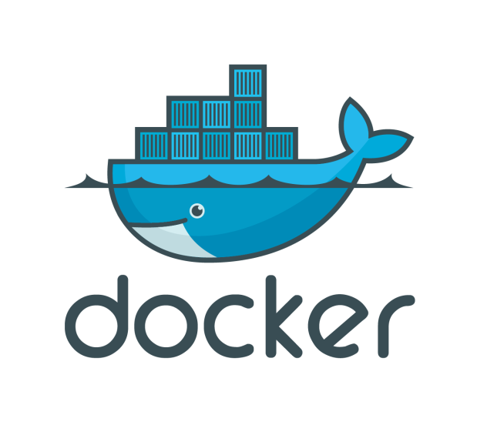
Docker
Notes:
Docker has literally taken the IT world by storm, since it’s introduction in March 2013 the Docker Github repo has seen 24,458 commits, 145 releases and 1,388 contributors.
That’s just the main Docker engine, we aren’t counting the endless list of open source projects, commercial services and other project integrations that have sprung up around Docker and aim to make the life of a Docker administrator a bit easier.

Slide 88
What is Docker exactly?
The philosophy behind Docker is to be able to build, ship, and run applications anywhere. What this translates to in real world terms is that Docker allows you to package an application with all of its dependencies into a standardized unit for distribution.
Docker containers wrap up a piece of software in a complete filesystem that contains everything it needs to run: code, runtime, system tools, system libraries – anything you can install on a server.
Notes:
Why is this useful?
How many times have you encountered a situation where an application works perfectly in development but runs in to unexpected problems in staging or production because it is missing a vital library, or the versions of packages are slightly different, or there is a required configuration change a developer forgot to tell you about.
By packaging up everything an application needs to run in a standard container we can be sure an application runs exactly the same, weather it is on a developers laptop, on a local server, or pushed up to the cloud to run on Amazon AWS or Google Compute Engine. This is the problem that Docker solves.

Slide 89

Docker Basics
Docker Image
The basis of a Docker container
Docker Container
The standard unit in which the application service resides
Docker Engine
Creates, ships and runs Docker containers deployable on physical or virtual host locally, in a datacenter or cloud service provider
Docker Registry
On-premises registry for image storing and collaboration
Notes:
A Docker image is a read-only template with instructions for creating a Docker container. For example, an image might contain an Ubuntu operating system with Apache web server and your web application installed. You can build or update images from scratch or download and use images created by others. An image may be based on, or may extend, one or more other images. A docker image is described in text file called a Dockerfile, which has a simple, well-defined syntax.
A Docker container is a runnable instance of a Docker image. You can run, start, stop, move, or delete a container using Docker API or CLI commands. When you run a container, you can provide configuration metadata such as networking information or environment variables. Each container is an isolated and secure application platform, but can be given access to resources running in a different host or container, as well as persistent storage or databases.

Slide 90
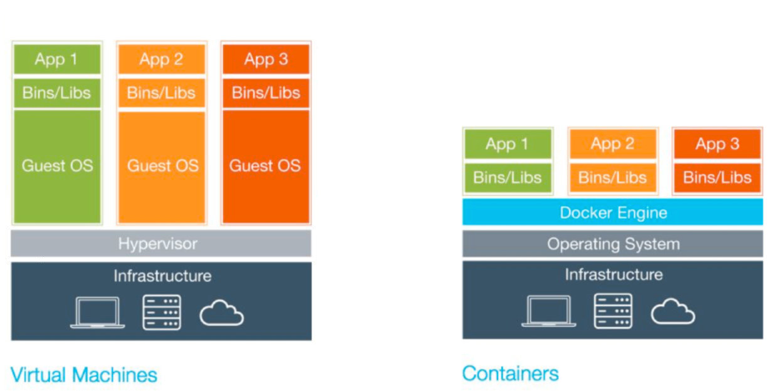
VMs vs. Containers

Slide 91
VMs vs. Containers
Virtual Machines (VMs) | Containers
Represents hardware-level virtualization | Represents operating system virtualization
Heavyweight | Lightweight
Slow provisioning | Real-time provisioning and scalability
Limited performance | Native performance
Fully isolated and therefore more secure (maybe) | Process-level isolation and therefore less secure (maybe)
Notes:
Size: VMs are very large which makes them impractical to store and transfer.
Performance: running VMs consumes significant CPU and memory, which makes them impractical in many scenarios, for example local development of multi-tier applications, and large-scale deployment of cpu and memory-intensive applications on large numbers of machines.
Portability: competing VM environments don't play well with each other. Although conversion tools do exist, they are limited and add even more overhead.
Hardware-centric: VMs were designed with machine operators in mind, not software developers. As a result, they offer very limited tooling for what developers need most: building, testing and running their software. For example, VMs offer no facilities for application versioning, monitoring, configuration, logging or service discovery.
Reference: https://github.com/docker/docker

Slide 92
Docker Application Life Cycle
Here’s what the typical lifecycle of a Docker-based application looks like:
Create Docker images on your local machine.
Push Docker images up from your local machine to the registry.
Pull Docker images down to your remote hosts from the registry.
Start up Docker containers on the remote hosts, passing in any configuration information to the containers on startup.
Notes:
Using Docker
You typically create your Docker image on your local machine, or on a continuous integration system that supports creating Docker images, like Jenkins. Once you’ve created your image, you need to store it somewhere where it can be downloaded onto your remote hosts.
Docker registries
Docker images typically reside in a repository called a registry. The Docker project runs a registry called “Docker Hub” which can host both public and private Docker images, and the Docker command-line tools have built-in support for pushing images up to a registry and for pulling images down from a registry.
You can also run your own in-house registry using the Docker registry container or a third party package like Portus (https://github.com/SUSE/Portus)

Slide 93
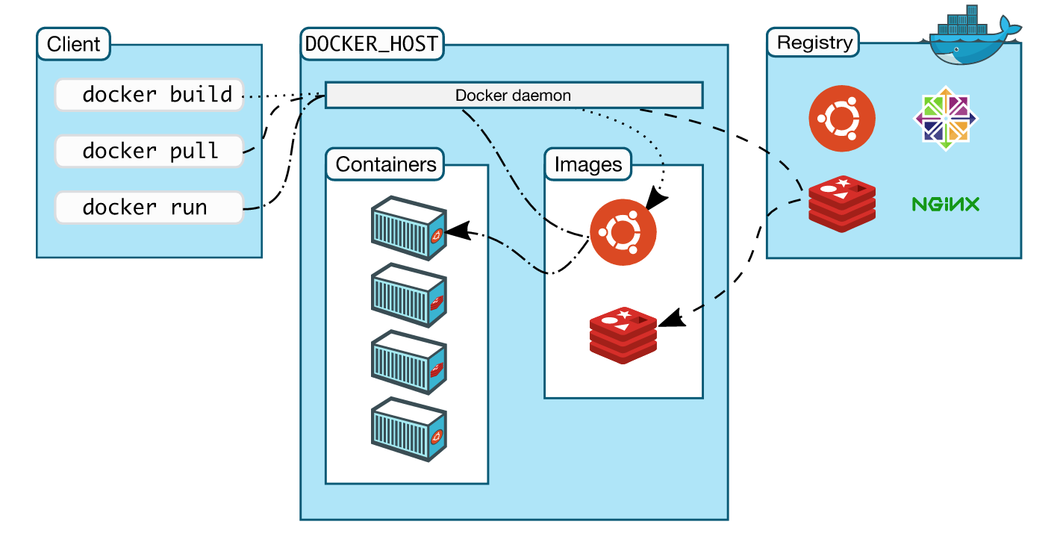
How is Docker Architected?
Notes:
Docker uses a client-server architecture. The Docker client talks to the Docker daemon, which does the heavy lifting of building, running, and distributing your Docker containers. The Docker client and daemon can run on the same system, or you can connect a Docker client to a remote Docker daemon. The Docker client and daemon communicate via sockets or through a REST API.
Note: The Docker daemon runs with root privileges which introduces an attack opportunity. More behind this: https://docs.docker.com/engine/security/security/

Slide 94
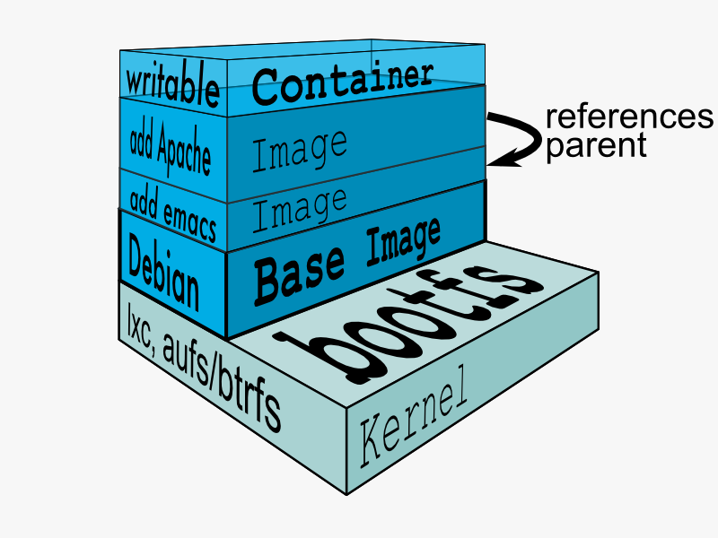
Docker Union File System
AuFS (AnotherUnionFS) is a multi-layered filesystem that implements union mount
allows several filesystems or directories to be simultaneously mounted and visible through a single mount point
appears to be one filesystem to the end user
Notes:
Union file systems, or UnionFS, are file systems that operate by creating layers, making them very lightweight and fast. Docker Engine uses UnionFS to provide the building blocks for containers. Docker Engine can use multiple UnionFS variants, including AUFS (the default for Ubuntu), btrfs, vfs, and DeviceMapper (the default for Red Hat and Centos.
How AuFS Works
1.Mount a base image as read-only
2.Add read-write file system over read-only file system
3.Change some files and directories to top as read- write file system
4.It is committed
5.Save incremental files and directories in new image
6.Mount the image as read-only and add read-write file system on top

Slide 95
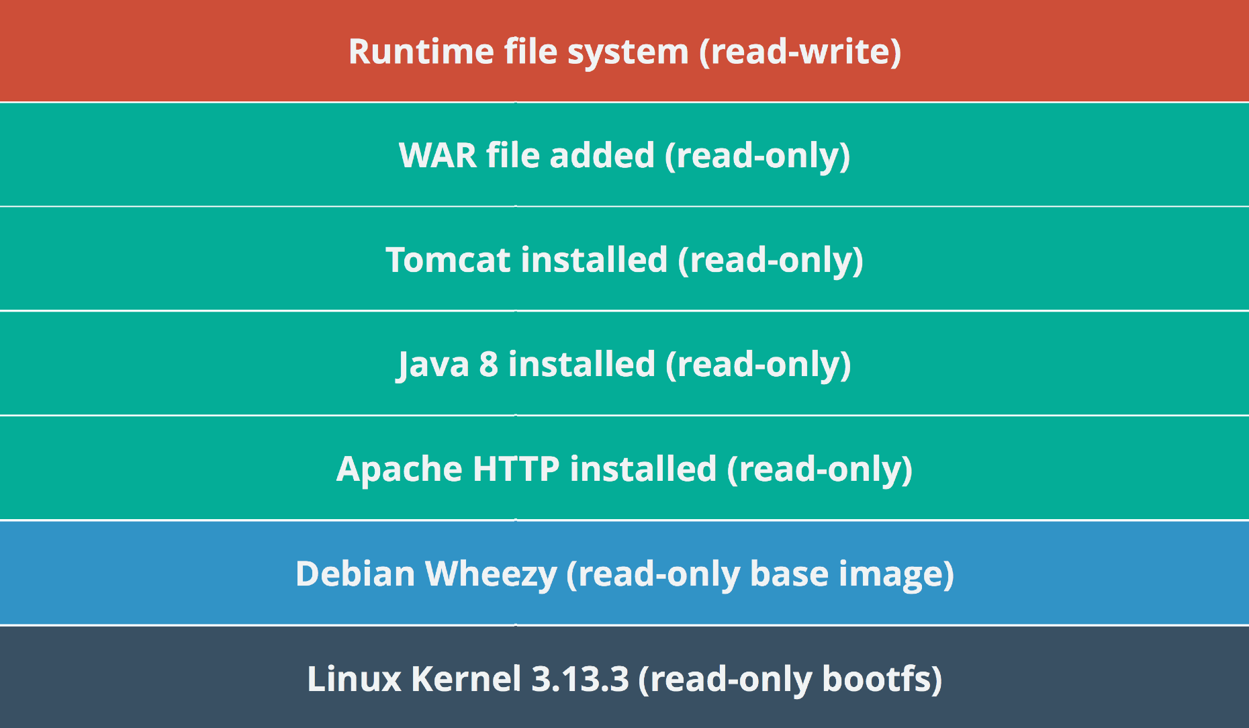
Example Docker Layers
Docker Layer – Each Docker image is composed of a series of layers. Docker uses Union File Systems to combine these into a single image. The combination of these layers gives the illusion of a traditional file system. Only the top layer is writeable.

Slide 96
Where Containers are used?
DevOps (Mostly in all types of Automation)
Automated testing (Unit, acceptance and stress testing)
CICD (if not tested on production-like environment, CICD will be risky)
Microservices
Less risky deployment architectures
Chef kitchen test
Not only used for testing but is used in production (along with container orchestration) in B2C and B2B organizations

Slide 97
Advantage of using Containers
Developers testing their code in Prod environments
Lesser hand-offs and drastically lesser waiting time (to get new environment setup)
Reduce technical debt
Overall system resilience - Service failure does not kill the application & may be invisible to users
Scalability
Seamless replication
High Availability
Less risky patterns for rolling updates available
Prevent server sprawl and Jenga infrastructure

Slide 98

A Brief Look at Ansible and Docker
Notes:
Docker (OLD LAB)
Docker is one of the fastest growing technologies in the DevOps space right now, and unsurprisingly Ansible has a module to help us in the building, provisioning and orchestration of Docker containers.
Change in to the docker directory in the course code and we'll explore what we can do with the Docker module. Enter:
$ cd ~/code/docker
The first thing we need to do is install Docker on our target host and start the service. The code to do this is very similar to code we have already seen so we won't go over it again, but you can explore the setup.yml playbook and docker role at a later time. Enter:
$ ansible-playbook setup.yml
Now that we have the Docker engine installed we are going to provision an applicaiton on it, the application we are going to use is called RocketChat, which is an open source chat platform similar to Slack. RocketChat requires a MongoDB database as a back end so the first thing we want to do is provision a MongoDB container. Once that is done we can start our RocketChat container and link it to the MongoDB container as db.
We also want to expose port 3000 on our RocketChat container to the outside world, so we can connect to it from a web browser, let's see what the code for doing all this would look like.
---
- hosts: all
become: yes
tasks:
- name: Run mongo container
docker:
name: db
image: mongo:3.2
state: started
- name: Run application container
docker:
name: rocketchat
image: rocket.chat
state: started
links: db
ports: "3000:3000"
env:
ROOT_URL: "http://rocketchat.techtownlab.com" It's pretty easy to follow what is going on here, we first provision our MongoDB container with the DockerHub image mongo:3.2, and then we start our RocketChat container with the DockerHub image rocket.chat, which automatically assumes the latest version
Let's run our rocketchat.yml playbook which will start our containers. Enter the following:
$ ansible-playbook rocketchat.yml
It doesn't look like much is going on here, but Ansible is instructing the Docker service to download the images for the containers we have requested, and then start them for us.
You can SSH to the docker environment and check to see that everything is running successfully. To do this, enter the following:
$ ssh docker.local
$ sudo docker ps
Return back to the Ansible control host with "exit"
You can try browsing to RockatChat with your desktop browser at http://rocketchat.techtownlab.com:port where "port" is 3000 + your student number, so for student5 you would browse to http://rocketchat.techtownlab.com:3005/
Further information on using Ansible to manage Docker can be found on the modules documentation page at
https://docs.ansible.com/ansible/docker_container_module.html

Slide 99

Deploying with Ansible
Notes:
Using Ansible for deployments
Deploying application code to servers is often one of the hardest tasks of any operations team. Most organizations using traditional deployment techniques (manual steps, shell scripts, and a lot of out-of-hours work) dread deployments, especially for complex, monolithic apps.
Deployments are less daunting when you adopt modern deployment processes and use the right amount of automation. In the best case, deployments become so boring and routine they barely register as a blip on your team’s radar.
Count the many ways - There are endless ways to try and solve the problem of deployment automation. However, we will leverage our now-familiar tool: Ansible.

Slide 100

Deploying from git
Notes:
Make good use of variables in your playbook and roles, it is much easier to make a quick change in group_vars or your inventory than finding hard coded values in your playbook and roles.
app_repository: https://github.com/mjsprojects/hello-world.git
app_version: "1.0.0"
app_directory: /opt/webapps/hello-world
We can quickly change the version number and redeploy, if that deployment has problems for whatever reason, we just change the version number back and rerun the deployment to revert the change.

Slide 101
Rolling updates
Ansible by default will fork five SSH connections at a time, which means it will execute the deploy tasks on five of your servers at the same time, for zero downtime deployments this might not be ideal. We can tell Ansible to execute the deployment one server at a time by putting this at the top of our deploy.yml playbook:
---
- hosts: appservers
gather_facts: no
become: yes
serial: 1

Slide 102
Deployment Strategies
Recreate
Ramped (Similar to Rolling Updates)
Blue - Green Deployment
Canary Deployment
A/B Testing
Shadow Deployments
Ref:- https://www.linkedin.com/learning/learning-kubernetes/next-steps
https://container-solutions.com/kubernetes-deployment-strategies/
https://github.com/ContainerSolutions/k8s-deployment-strategies
https://container-solutions.com/deployment-strategies/
Notes:
https://github.com/gravitational/workshop/blob/master/k8s101.md
Git clone https://github.com/gravitational/workshop.git
Sections:
Deployments and Replica Sets
Services
Back to Deployments
Configuration management basics

Slide 103
Notifications
Another important aspect of a successful deployment is communication, you can use one of the many built-in Ansible notification modules to share the deployment’s progress via chat or email.
Notes:
Notifications
Ansible includes easy-to-use notification modules for:
- Slack
- HipChat
- IRC
- Jabber
- Email
- Twilio
- Amazon SNS
- Campfire
- etc...
Many playbooks include notifications in both the pre_tasks and post_tasks sections, notifying the operations team in a chat channel when a deployment begins or ends.

Slide 104
Re-visiting our Directory layout
As we identified previously, it is best to split up our Ansible tasks in to reusable components or roles.
In order to keep our Ansible repository well organized, and so others we are collaborating with can find things easily, Ansible provides a suggested directory structure for your Ansible repository at:
http://docs.ansible.com/ansible/playbooks_best_practices.html
I have expanded a little on this directory layout based on using Ansible in real world environments and finding a structure that is comfortable for everyone to use.
Notes:
Best practice directory layout
ansible.cfg - configuration defaults for ansible
requirements.yml - third party roles from ansible galaxy
inventory/ - directory containing your inventory files
+ development - inventory file for your development environment
+ staging - inventory file for your staging environment
+ production - inventory file for your production environment
group_vars/ - group variable definitions
+ all - apply to all hosts
+ webserver - apply to hosts in the webserver group
playbooks/ - playbooks directory
roles/ - directory containing your roles
+ internal/ - any internally developed roles
+ external/ - any external roles downloaded from ansible galaxy
scripts/ - any internal utility scripts like the example to update external roles
Note: you should add roles/external/* to your .gitignore file, external roles can be downloaded and updated with scripts/update_external_roles.sh

Slide 105
Templating with Jinja2
Jinja2 is a python library which allows templates to be expanded in various ways, such as substituting a variable expression into parts of that template.
Key Features :
Sandboxed execution mode.
powerful automatic HTML escaping system for cross site scripting prevention.
Template inheritance makes it possible to use the same or a similar layout for all templates.
High performance with just in time compilation to Python bytecode.
Optional ahead-of-time compilation
Easy to debug
Configurable syntax.
Template designer helpers.
Notes:
Key Features of Jinja2:
Sandboxed execution mode. Every aspect of the template execution is monitored and explicitly whitelisted or blacklisted, whatever is preferred. This makes it possible to execute untrusted templates.
Powerful automatic HTML escaping system for cross site scripting prevention.
Template inheritance makes it possible to use the same or a similar layout for all templates.
High performance with just in time compilation to Python bytecode. Jinja2 will translate your template sources on first load into Python bytecode for best runtime performance.
Optional ahead-of-time compilation
Easy to debug with a debug system that integrates template compile and runtime errors into the standard Python traceback system.
Configurable syntax. For instance you can reconfigure Jinja2 to better fit output formats such as LaTeX or JavaScript.
Template designer helpers. Jinja2 ships with a wide range of useful little helpers that help solving common tasks in templates such as breaking up sequences of items into multiple columns and more.
Source: http://jinja.pocoo.org/

Slide 106
Tracking State
When you run ansible-playbook, Ansible outputs status information for each task it executes.
You will notice that the status for some of the tasks that run is changed, and the status for some others is ok.
Changed relates to whether the state that Ansible detected the target to be in, prior to executing the tasks, was modified to meet the parameters we set out in our task.
Ok status relates to the same verification which Ansible performs, however the initial state detected, met the desired state requirements.
Notes:
Tracking state
Any Ansible task that runs has the potential to change the state of the target machine in some way. Ansible modules will first check to see if the state of the target machine needs to be changed before taking any action. If the state of the host matches the arguments of the module, then Ansible takes no action on the host and responds with a status of ok.
However if there is a difference between the state of the target machine and the arguments to the module, then Ansible will action the change and return a status of changed.

Slide 107
Testing, CI/CD/CI, and Final Steps
SECTION 5: Keeping IT going
We will cover:
Testing, Validating, & Debugging
Continuous Integration, Continuous Delivery & Continuous Improvement
Ansible in “The Wild”
Final Step: Revisiting Your Ansible Needs

Slide 108
Testing, Validating, & Debugging
Common Issues and Finding the Root Cause
Basic unit, integration, and functional testing with Ansible
Is My Sin-Tax Correct?
Test “All The Things”
Debugging & Best Practices
Introduction to ServerSpec and RoleSpec for testing

Slide 109
Common Issues & Finding the Root Cause
The most common problems seen with Ansible usually surround:
SSH and Authentication
“Your key is not known”
Your key is missing from authorized_keys
SSH agent not running
known_hosts conflicts
Sshdconfig
Sudo Failures
While the above are quite common, the most common issue brought up usually isn’t a result of a problem with Ansible, rather a problem of other tools not playing nicely that we have Ansible rely upon.

Slide 110
Test All The Things: Basic Testing with Ansible
Unit Testing
Integration Testing
Functional Testing
Other Useful Modules for Testing:
Check Mode ( - check ) – Example: Drift Testing
- wait_for: host={{ inventory_hostname }} port=22 - Example: Port status check.
delegate_to: localhost
- script - Just like scripting in any language.
https://blog.theodo.fr/2015/10/best-practices-to-build-great-ansible-playbooks/
tasks:
- service: name=foo state=started enabled=yes
Notes:
Because Ansible is meant to be a fail fast system, meaning that if a task in a playbook fails, the default behavior in Ansible is to immediately see it fail and tell you about it (and in most cases, it will definitely tell you about it, boldly). This allows for a quicker dissection of the problem at hand, reducing time spent in backing out, rolling back, or undoing changes.
Ansible is designed to set a desired state. Inherently, this allows for exceptionally quick layers of tests that are able to be performed simply due to the check-sum style nature of this tool. Tie that in with roles telling Ansible to check more granular, and well defined configurations, it can be applied to nearly every level of testing desired, in one way or another.
Testing lifecycle

Slide 111

Production considerations - Is My Sin-Tax Correct?
Notes:
Production considerations
This is a pretty efficient system for testing most config management tools, not just Ansible. If you plan on implementing this in production though I would highly recommend looking at using LVM backed storage for your LXC containers or BTRS snapshots, it is faster than cloning a directory of files which means the pinup and teardown time for your tests will be a bit more efficient.
Beyond a basic playbook run
There is a lot more we can do to exercise our Ansible code than a basic playbook run to test it’s reliability..We can do a syntax check on our code, we can use ansible-lint to check for best practices, we can test the environment after a playbook run with tools like ServerSpec (http://serverspec.org/) or Bats (https://github.com/sstephenson/bats) and don’t underestimate the value of doing code review across your team.

Slide 112
ServerSpec
ServerSpec is a testing tool written in Ruby, it is very popular with teams that use Chef and Puppet, but it works equally as well with Ansible.
Notes:
Using ServerSpec with Ansible
ServerSpec
ServerSpec is a very popular testing tool which we can use after an Ansible run to make sure Ansible has done its job correctly. ServerSpec is written in Ruby, but it has a pretty basic syntax which is easy to pick up. Change in to the serverspec directory in the course code where we will have a look at some tests we can run against the Gogs environment we built earlier.
$ cd ~/code/serverspec
We have created a few test cases in the spec/gogs.local directory to test that ntp is installed and running, that MySQL is installed and running, and that Gogs has been downloaded and started.
$ cat spec/gogs.local/ntp_spec.rb
$ cat spec/gogs.local/mysql_spec.rb
$ cat spec/gogs.local/gogs_spec.rb
As you can see from these examples, we are checking to make sure packages have been installed, users and directories have been created, that services are running, and that the appropriate TCP ports for MySQL and Gogs are listening.
We just use the rake command to run all our tests by entering:
$ rake
It should come back with the number of tests run and the number of failures, if any.We can integrate a testing suite like this with any CI tool such as Jenkins, Bamboo or Travis CI to automatically execute our Ansible code and then test our environment to make sure everything is set up correctly. More information about ServerSpec and the resource types you can test for can be found on the ServerSpec homepage http://serverspec.org/

Slide 113
RoleSpec
Before we wrap up with testing, another testing framework worth bringing to your attention is called RoleSpec.
It is relatively new but was built specifically for Ansible.
Notes:
Final notes on RoleSpec
It is designed to run on TravisCI out of the box, but is trivial to get working on other CI environments.
It might not be as fully featured as ServerSpec, but you can achieve quite a lot with the current feature set.
Visit the authors GitHub page for further details https://github.com/nickjj/rolespec

Slide 114
Continuous Integration Continuous Delivery Continuous Improvement
Continuous Integration & Ansible:
Continuous Delivery & Ansible:
Continuous Improvement & Ansible:
Notes:
Lets revisit the concepts of Continuous Integration, Continuous Delivery, and Continuous Improvement:
Continuous Integration: is the practice of merging development work with a Master/Trunk/Mainline branch constantly so that you can test changes, and test that changes work with other changes. The idea here is to test your code as often as possible to catch issues early. Most of the work is done by automated tests, and this technique requires a unit test framework. Typically there is a build server performing these tests, so developers can continue working while tests are being performed.
Continuous Delivery is the continual delivery of code to an environment once the developer feels the code is ready to ship. This could be UAT or Staging or could be Production. But the idea is you are delivering code to a user base, whether it be QA or customers for continual review and inspection. This is similar to Continuous Integration, but it can feed business logic tests. The basis of Continuous Delivery is small batches of work continually fed to the next step will be consumed more easily and find more issues early on. This system is easier for the developer because issues are presented to the developer before the task has left their memory.
Continuous Improvement is exactly what it sounds like. Maintaining the mindset of continuously improving our processes, systems, and methods.
Somewhat different from continuous delivery, Continuous Deployment, as an example, is the deployment or release of code to Production as soon as it is ready. There is no large batching in Staging nor long UAT process that is directly before Production. Any testing is done prior to merging to the Mainline branch and is performed on Production-like environments,
Now that we have a better picture of what Ansible can do, and how it does it, how do you plan to use Ansible to achieve each of these three goals?

Slide 115
Orchestrating with Ansible
Ultimately, we want to take our workflows from where they are right now, to hopefully something like this (if not already):
Then eventually, to a workflow that gets us to a level of Continuous Deployment, which might look like this:
- Use the same playbook all the time with embedded tests in development
- Use the playbook to deploy to a staging environment (with the same playbooks) that simulates production
- Run an integration test battery written by your QA team against staging
- Deploy to production, with the same integrated tests.
- Write and use automation to deploy local development VMs
- Have a CI system like Jenkins deploy to a staging environment on every code change
- The deploy job calls testing scripts to pass/fail a build on every deploy
- If the deploy job succeeds, it runs the same deploy playbook against production inventory

Slide 116
Automate All the Things
What can be automated with Ansible?
System & Network Configuration Management
Testing/Auditing
Integration
Monitoring
Deployments small and/or large scale
Provisioning
Maintenance/Patching
Itself… yes, Ansible can automate Ansible!
Notes:
Essentially… Ansible, with the right kinds of creative minds, can automate an incredible amount of things.

Slide 117
Obtaining Zero Downtime
The more we achieve automation nirvana, the closer we can get to reaching zero downtime.
Until 2016, 80% of all mission-critical IT service outages were due to PEOPLE and process errors, with more than 50% of those outages caused by change/ configuration/release integration and handoff issues.
– source: Gartner RAS Core research, 2010

Slide 118
Ansible in The Wild
Let’s discuss how Ansible is being used in the real world:
Ansible at Cogapp
Ansible at HootSuite
Ansible at NASA
Additional Ansible References & Resources

Slide 119
Ansible in The Wild: Cogapp
Cogapp – An Ansible Case Study:
Provisioning and Content Development:
https://www.ansible.com/hubfs/Whitepapers__Case_Studies/Cogapp_Case_Study.pdf?t=1472592588864

Slide 120
Ansible in The Wild: HootSuite
HootSuite – An Ansible Case Study:
Orchestration in a SaaS infrastructure:
https://cdn2.hubspot.net/hub/330046/file-480366621-pdf/pdf_content/Hoot_Suite_Case_Study.pdf?t=1472592588864

Slide 121
Ansible in The Wild: NASA
NASA – An Ansible Case Study:
https://www.ansible.com/hs-fs/hub/330046/file-1649288715-pdf/Whitepapers__Case_Studies/nasa_ansible_case_study.pdf?t=1472592588864

Slide 122
Additional Info: Capistrano-style deployments
The role can be found at https://galaxy.ansible.com/f500/project_deploy/
There is a very comprehensive presentation explaining its use at http://www.slideshare.net/ramondelafuente/ansible-projectdeploy
Notes:
Using an Ansible role for Capistrano-style deployments
Most people who have worked with Rails application have come across the Capistrano deployment gem. The way Capistrano works is it deploys your application in to a directory on your server that is named with the date and time, and then it sam links the “current” directory to point to that location, so “current” always points at the latest version of the code. If you need to role back a release you just change the sam link to point to the previous location. Although, Capistrano can do quite a bit more than that, many people wish to replicate this element of workflow using Ansible. Fortunately there is a role that can help you do this called project_deploy.
The role can be found at:
https://galaxy.ansible.com/f500/project_deploy/
With explanatory presentation at:
http://www.slideshare.net/ramondelafuente/ansible-projectdeploy

Slide 123
Additional Info: Blue-Green deployments
Ansible has a great blog post that goes into further details about this type of deployment:
https://www.ansible.com/blog/immutable-systems
Notes:
Blue-Green deployments with Ansible
Many organizations have started adopting the practice of Blue-Green deployments. The basic concept behind this approach is you spin up a second production environment, deploy your latest release to that, and then cut over from the blue environment to the green environment.
With containerization and being able to quickly spin up and tear down compute instances programmatically on a provider such as Amazon AWS, this is reasonably easy to achieve with Ansible.

Slide 124
Preparing for Ansible back at work
If time permits, let’s revisit some questions we posed at the beginning of this workshop:
How are you using Ansible?
What are your Ansible Goals?
Short Term?
Long Term?
What is on your “To Do” list, now that we have seen what Ansible can do?
Notes:
Time for us to put some focused thought on what are next steps are going to be by identifying what is now on our Ansible ‘To-Do” list.

Slide 125
Course Evaluation
Please take a moment to complete your course evaluation
Go to http://www.metricsthatmatter.com/ASPE
Choose the class name listed with the date of the class and your instructor’s name
Fill out and submit the form
It is available for 10 calendar days
Thank You!
Notes:
Thank you, and don’t forget to complete your course evaluation!

