Slide 1

BJIT ACADEMY
Design DIAGRAM
CHORKI.com
KHALID MAHMUD
ID: 11280
Khalid.mahmud@bjitgroup.com
Image Placeholder

Slide 2
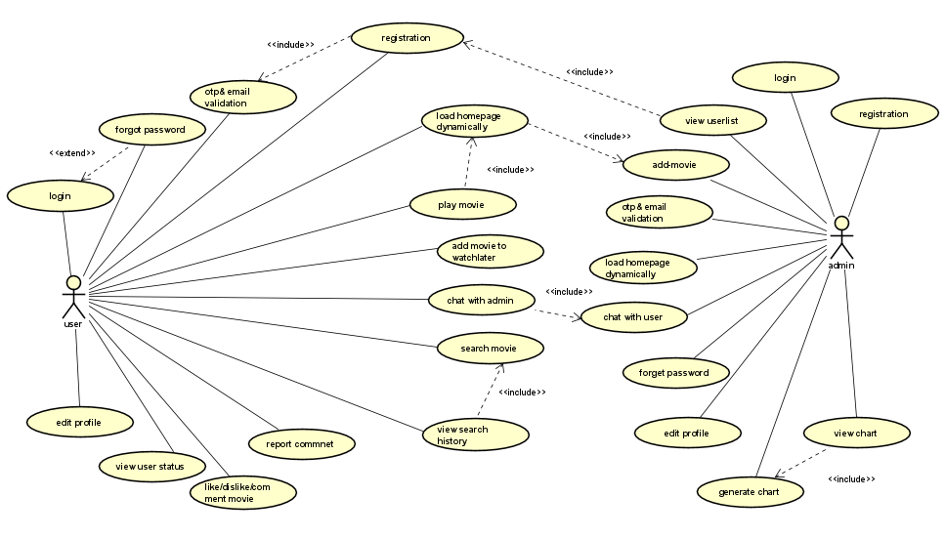
USECASE DIAGRAM

Slide 3
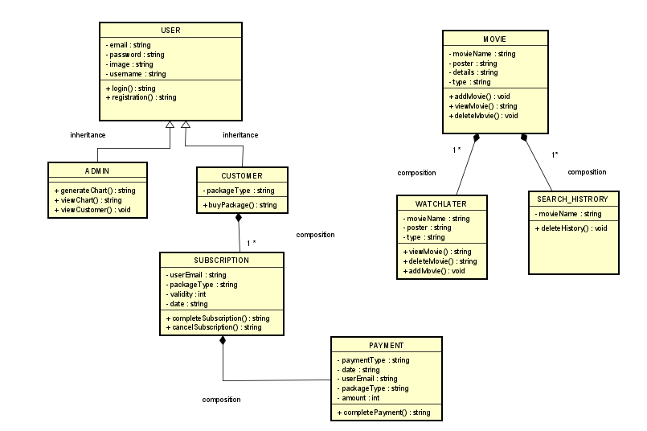
CLASS DIAGRAM

Slide 4
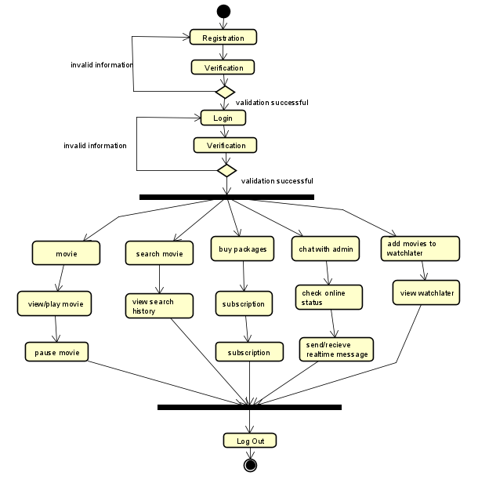
ACTIVITY DIAGRAM

Slide 5
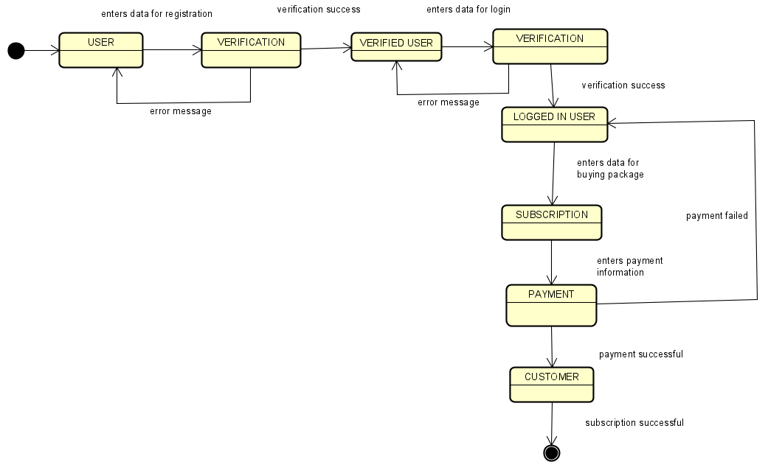
STATE CHART DIAGRAM

Slide 6
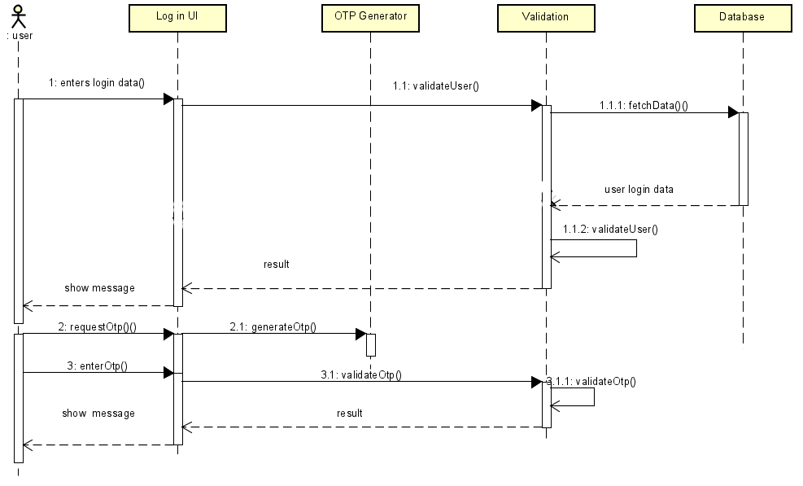
SEQUENCE DIAGRAM

Slide 7
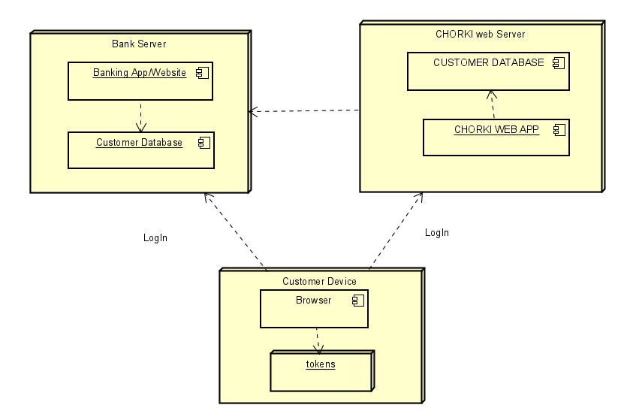
DEPLOYMENT DIAGRAM

Slide 8
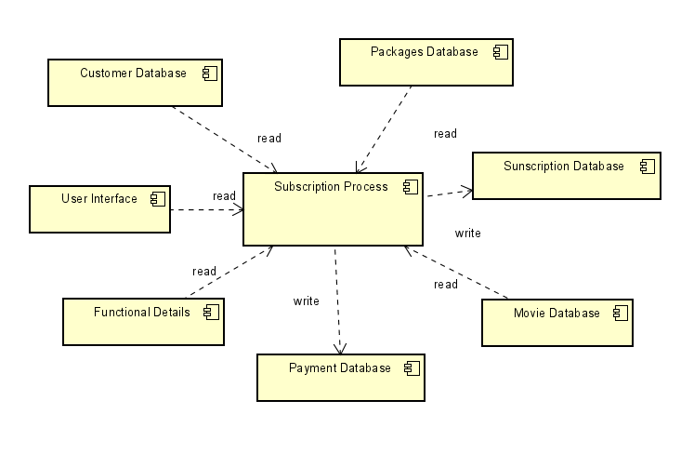
COMPONENT DIAGRAM

Slide 9
Thank you

