Slide 1



Team Details
  Team name: OpEx
  Team leader name: Srihitha Pulapa
  Problem Statement: Manufacturing: Intelligent Operations & Industrial Efficiency
Operations copilot for CNC and auto-component plants.
Finds the fault early, prices the fix in rupees, and an engineer decides.
Built from scratch in the Cup's build window, 7 Sept to 18 Oct 2026.
Notes:
Team OpEx, Manufacturing track. Working prototype: github.com/srihitha2005/Opex.

Slide 2
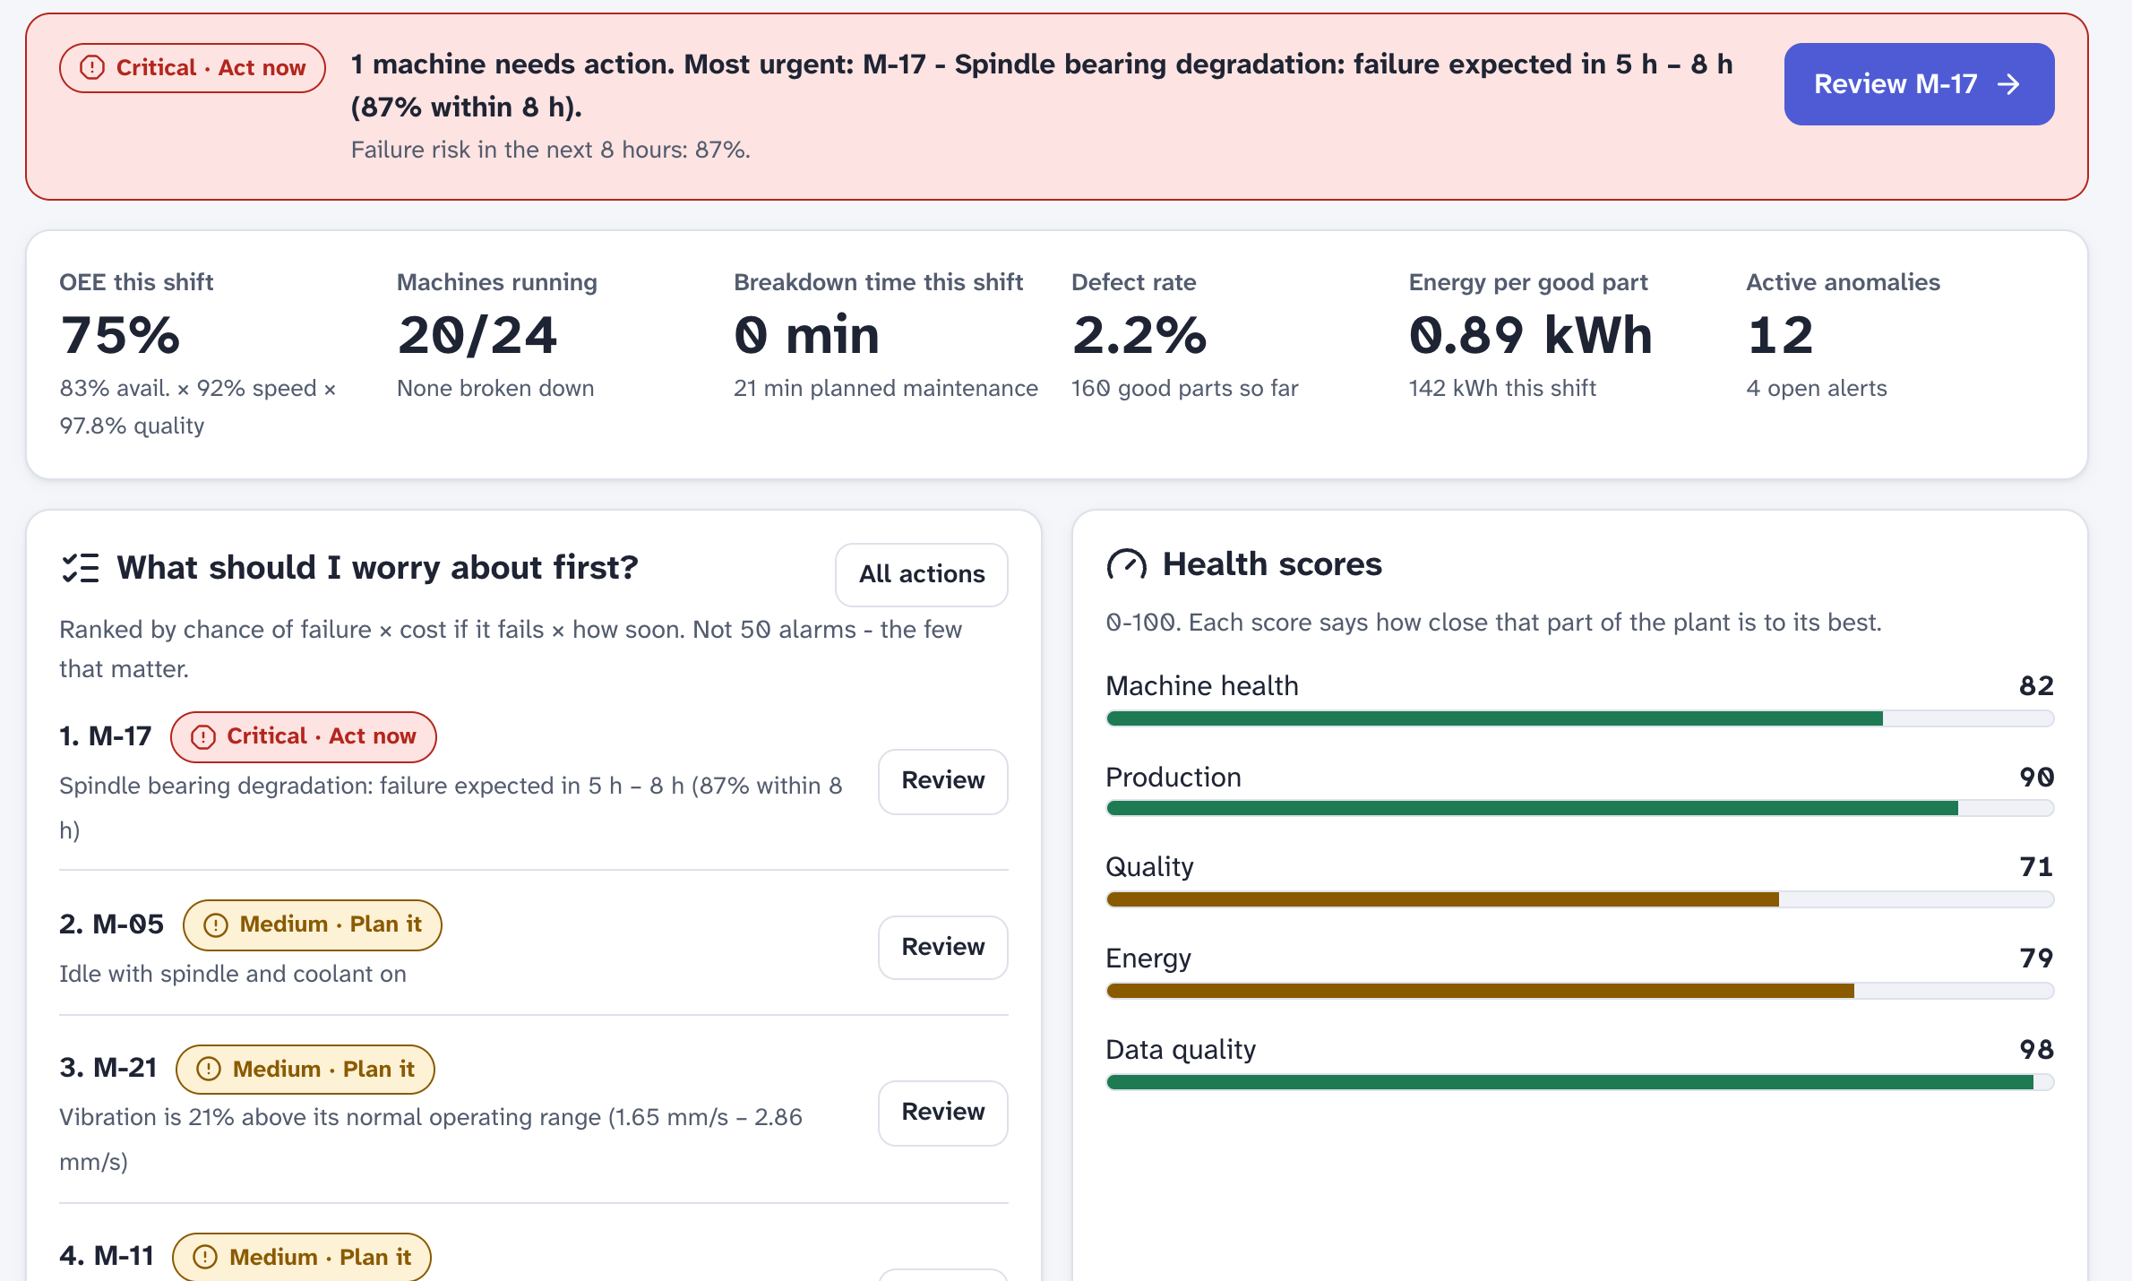
Brief about the idea
A plant usually finds out about a failing spindle bearing when the machine stops. OpEx finds out hours to days earlier, prices every option in rupees, and an engineer makes the call.
Who it is for. Tier-2 and Tier-3 auto-component plants with 10 to 50 CNC machines. ACMA has 1,100+ member companies of this kind; the industry turned over ₹7.59 lakh crore in FY26 and employs 1.5 million people directly.¹
The problem. 88% of Indian industrial businesses have an unplanned outage at least once a month and 19% still run machines until they fail.² Alarm screens list fifty thresholds, not one cause, and nobody knows what a fix costs until the invoice arrives. In our plant model a machine-hour is worth ₹4,200 to 6,500 of lost contribution, so one bearing failure with secondary damage costs ₹6 to 9 lakh.
What OpEx does. It reads every machine each plant minute, turns abnormal signals into one plain-language cause with a failure window, prices seven ways of dealing with it, has three Gemini agents review the case, and records whether the chosen action worked. Operators can ask it anything, by voice, in English or five Indian languages.
Simulated, 24 machines, 5 years: 74% fewer breakdowns, ₹7.11 Cr net after paying for OpEx, 12.1× the cost. Arithmetic and sensitivity on the slide 'How we calculated the 5-year numbers'.
The overview as the engineer sees it: M-17 first, failure expected in 5 to 8 h, then three 'plan it' items. Ranked by chance of failure × cost × urgency.
¹ ACMA, Industry Performance Review FY2025-26. ² ABB, Value of Reliability survey, Sapio Research, July 2023, n = 3,215, India cut. Plant economics are our model's assumptions, editable in the app; every number is listed on the Sources slide.
Notes:
Open with the M-17 story on the right; the rest of the deck shows how that one line becomes a priced, approved decision.

Slide 3
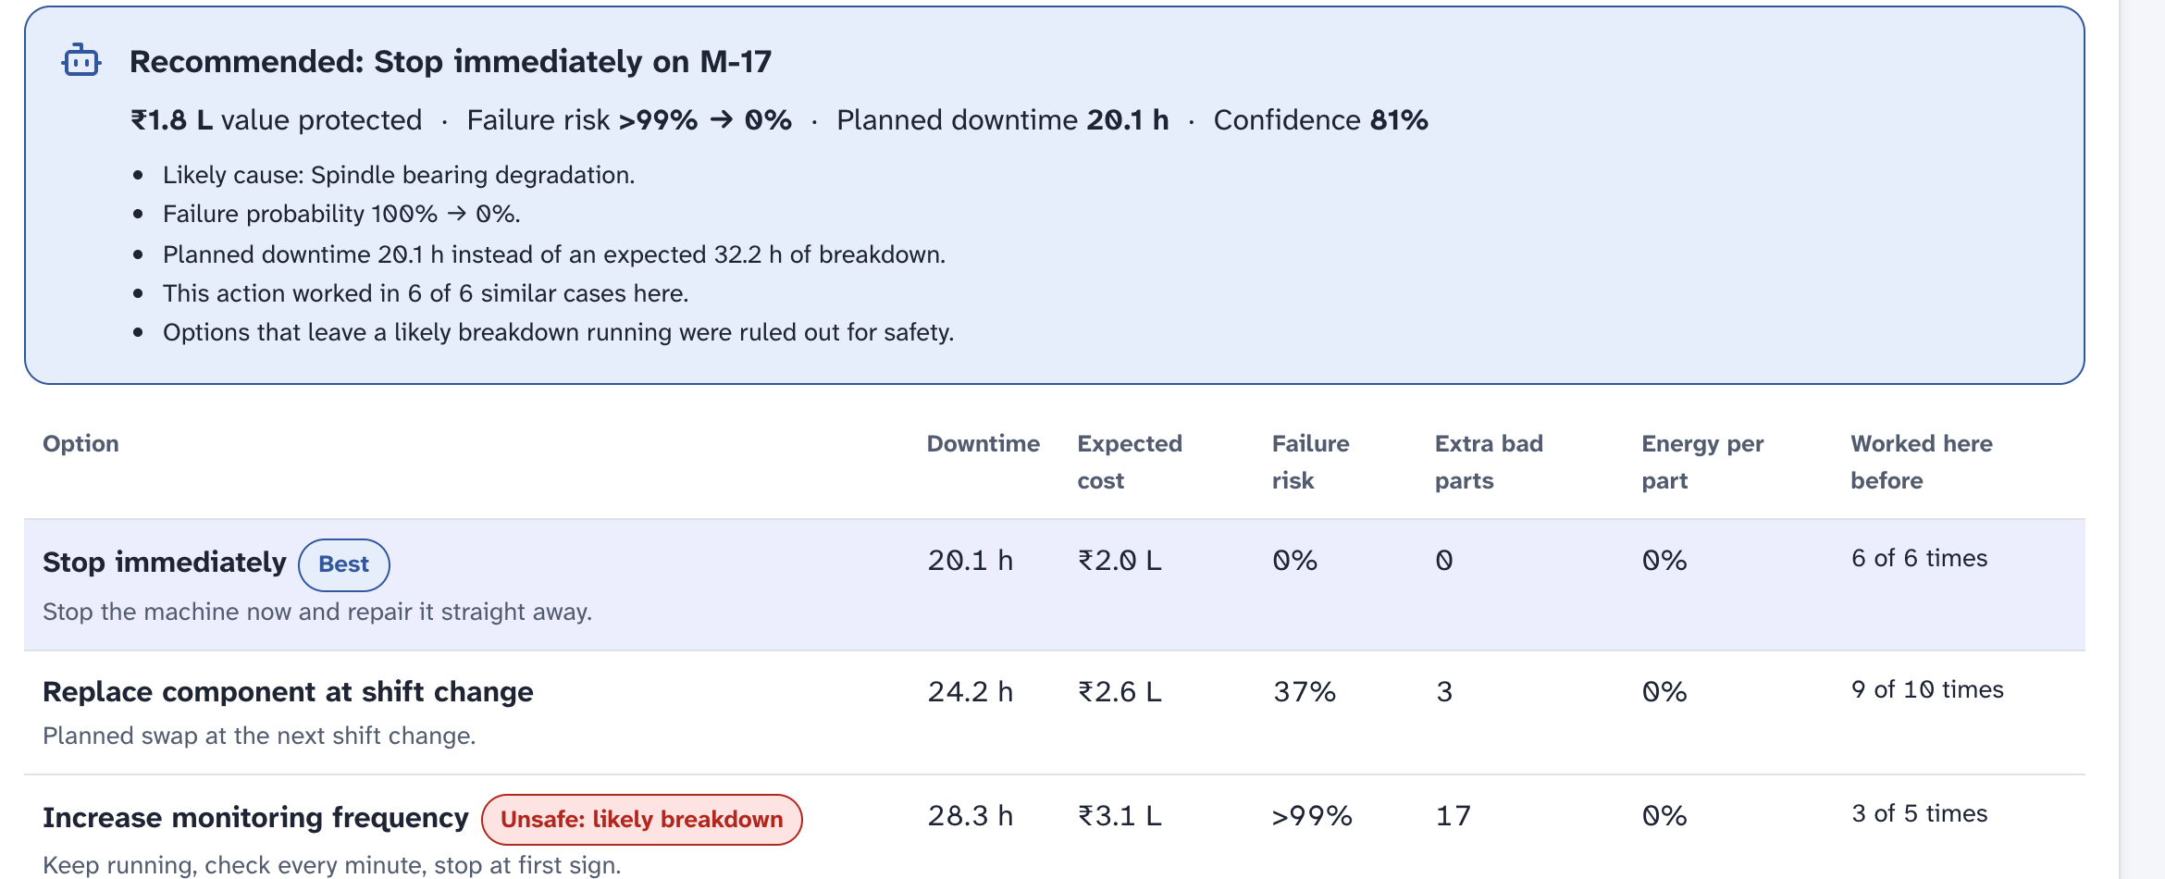
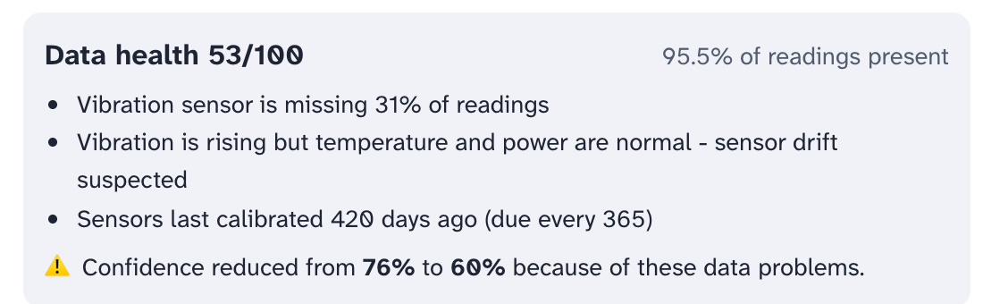
Opportunities
How different is it from any of the other existing ideas?
Most predictive-maintenance tools stop at 'risk: high' and a work order. OpEx carries on to the decision: one root cause across machine, quality and energy signals; every option priced in ₹ with its chance of still breaking down; and a record of how often each action has worked in this plant, which re-ranks the options next time. When sensor data is bad it says so and lowers the stated confidence, and a drifting sensor is diagnosed as a sensor fault.
How will it be able to solve the problem?
Warnings arrive about a day ahead on average (median lead 24 to 32 h on held-out Azure PdM data; the M-17 example is a fast failure caught 5 to 8 h out), so the part is on the shelf and the swap lands in the Sunday window instead of at 2 a.m. The engineer sees downtime, cost, failure risk and extra scrap side by side and approves in one screen. The plant head gets a five-year with-versus-without case before buying a single sensor.
Options for M-17: downtime, ₹ expected cost, failure risk, extra bad parts, energy, 'worked here before'. Unsafe options stay visible but are never recommended.
USP of the proposed solution
A Gemini incident room in which a Diagnostician, a Planner and a Safety officer argue the case from measured facts, technicians' past notes and the plant's own SOPs, in the user's language. 'Rewind the factory', which replays one of the plant's own breakdowns with OpEx watching. And a simulator that charges itself for missed detections, false alarms and ignored advice, then shows how the answer moves when those assumptions get worse.
M-21: vibration rising but temperature and power normal, 31% of readings missing, so the diagnosis is sensor drift and the confidence drops from 76% to 60%.
Notes:
Answer the three template questions in order; point at the 'Worked here before' column and the 'Unsafe' tags on the right.

Slide 4
List of features offered by the solution
Feature | What you see in the app | Who
Ranked factory health | OEE 75% = 83% availability × 92% speed × 97.8% quality. 'What should I worry about first?' orders problems by chance of failure × cost if it fails × how soon, so one machine is at the top, not fifty alarms | Everyone
Diagnosis in plain words | 'Vibration is 160% above its normal range (1.20 to 2.08 mm/s) and has been outside it for 180 minutes.' One root cause with a chain of impact and 'similar to 7 past incidents, 7 confirmed' from 194 incidents and 793 jobs | Engineer
Honest about data | Missing readings, drift, calibration age and a physics check (power vs V × I) lower the stated confidence: 'reduced from 76% to 60% because of these data problems'. A drifting sensor is called a sensor fault | Engineer
Seven priced options | Stop, slow 10%, continue, shift load, partial fix, replace, watch. Each shows downtime, ₹ expected cost, failure risk, extra bad parts, energy and 'worked 6 of 6 times'. Unsafe options are flagged and never recommended | Engineer
Gemini incident room | Diagnostician, Planner and Safety officer review the case from measured facts, past technician notes and the plant's SOPs (lockout-tagout steps included). Their reasoning is saved with the decision | Engineer
Ask OpEx | Gemini with six function tools, so every number comes from plant data. Voice in, read-aloud, English plus five Indian languages, photo check of a finished part, a shift-handover note written from live data | Operator
Approval and learning | Approve, reject or pick another option; roles enforced on the server; outcome re-checked 2 plant hours later and fed back into the ranking. A 5-year with-vs-without simulation and 'Rewind the factory' for the plant head | All roles
Three different numbers appear next to a machine: chance of failure (the prediction model), pattern match (how closely the signals resemble a known fault) and confidence (lowered by data problems). The incident history is seeded from Azure PdM maintenance records re-dated onto this plant; a real plant starts from its own CMMS export. Screens in this deck were captured on different days of the live twin, so M-17's numbers vary.
Notes:
Every row is working in the prototype; the quoted sentences are copied from the screens.

Slide 5
Process flow diagram or Use-case diagram
The top row runs on its own every plant minute. The bottom row always includes a person, and what the person decides changes the ranking next time.
Automatic
1 Readings
vibration, temperature, rpm,
torque, current, coolant pressure
2 Data health
missing, drift, physics check
→ confidence multiplier
3 Detect
how far outside normal,
for how long
4 Diagnose
one cause, chain of impact,
'seen this before?'
5 Predict
failure window, remaining
life, quality, energy
With a person in the loop (read right to left)
10 Learn
success counts per
problem × action
9 Act, then check
outcome measured 2 plant
hours later
8 Human decides
approve / reject / modify,
by role, with a note
7 Gemini incident room
Diagnostician · Planner ·
Safety officer
6 Price 7 options
₹ cost, failure risk, scrap,
energy, 'worked before'
What worked in this plant feeds step 6 the next time the same problem appears
Operator. acknowledges alerts, approves tool changes, standby and recalibration, asks by voice
Maintenance engineer. approves stops, speed cuts and part swaps; writes investigations; adds SOPs
Plant manager. sets priorities and ₹ assumptions, reads the learning log, runs the 5-year case
Warnings are held for 45 plant minutes so they do not flicker (ISA-18.2). Screens stay grey when normal; colour appears with an icon and a word only when something is wrong (ISA-101).
Notes:
Steps 1 to 5 are automatic; 6 to 10 include a human decision; the green line is the learning loop.

Slide 6
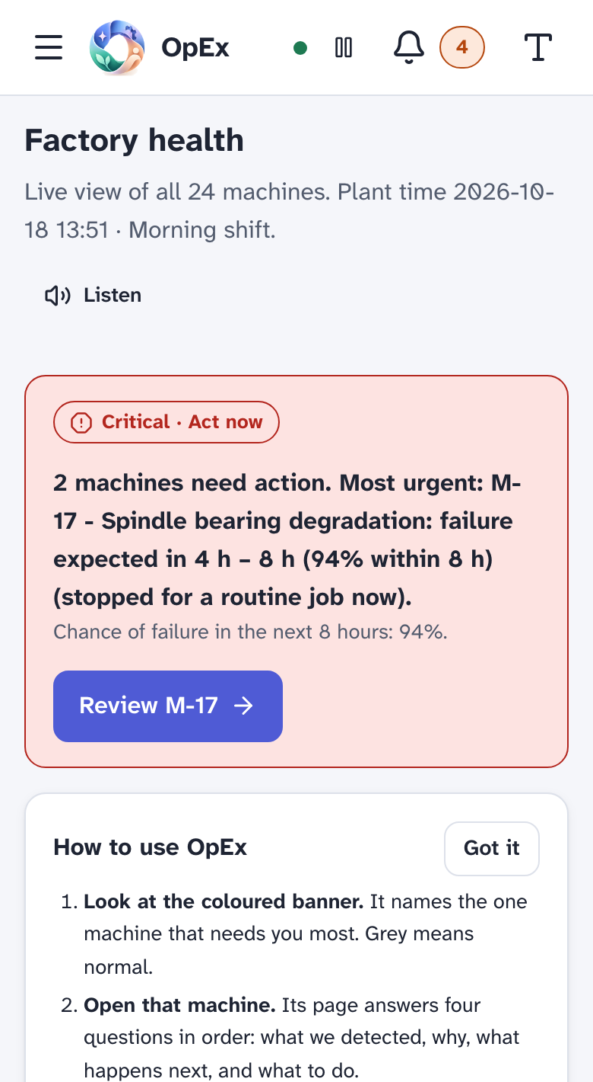
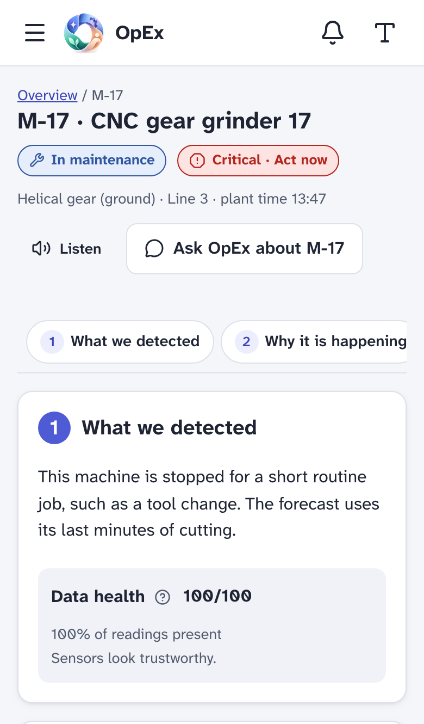
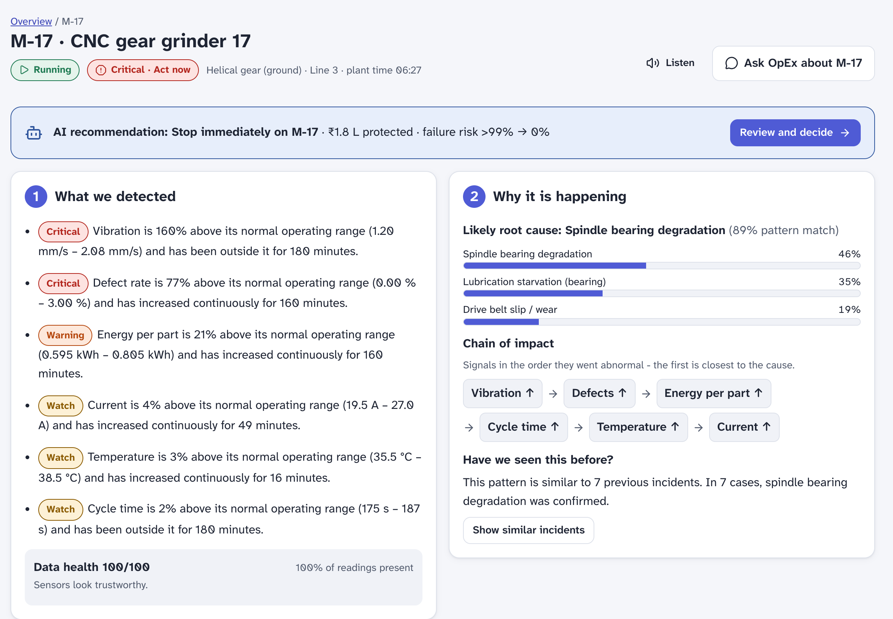
Wireframes/Mock diagrams of the proposed solution (optional)
The same four questions on a phone at the machine and on a desktop in the maintenance office
Every machine page answers, in order: 1 What we detected, 2 Why it is happening, 3 What happens next, 4 What should we do. Jargon has a '?' with a plain explanation, long lists show the top three first, and nothing times out.
Phone: the overview and M-17 during the same critical episode.
Notes:
Screenshots at phone and desktop widths. Status is always icon plus word plus colour, never colour alone.

Slide 7
Architecture diagram of the proposed solution
One Cloud Run container with Gemini beside it and Postgres underneath
Cloud Run, one container, asia-south1 · one URL for every device
Gemini
3.5-flash-lite default · 3.8-flash · embedding-001
Vertex AI in production, AI Studio key for the demo
Shop floor
CNC controllers and sensors
via OPC UA / MTConnect
gateway or direct push
React 19 web app
accessible UI, voice,
6 languages
FastAPI
Google sign-in, roles,
API, ingest endpoint
Live plant twin
1-min readings, analytics
cached per plant minute
Postgres: Supabase (Mumbai) today
users, roles, decisions, incidents, runs, audit log · RLS on
Cloud SQL for PostgreSQL is a connection-string change
Pub/Sub
readings in,
critical alerts out
BigQuery sandbox
daily simulation results, decision snapshot
for Looker Studio
Decision engine
7 priced options, ranking,
learning loop
5-year simulator
2.1 M machine-hours
in about 4.5 s
Gemini agents + copilot
function calling,
hybrid search over SOPs
Cloud Storage
sensor CSV uploads, part photos
Scale path. The demo keeps one plant twin in memory on a single instance. With real readings, state lives in Postgres and Pub/Sub, so Cloud Run can run as many instances as a plant group needs; the pipeline that trains the three models and calibrates the simulator runs in 30 s and needs no extra service at this scale.
If Gemini is unreachable the incident room, copilot, shift briefing, photo check and investigation writer fall back to rule-based text and are labelled as such on screen. Detection, prediction and pricing are deterministic and unaffected.
Notes:
Single deployable unit. The right column is what Google Cloud and Supabase provide. The scale path answers 'max 1 instance'.

Slide 8
Technologies to be used in the solution
Gemini does the reasoning and the language. Deterministic code does the arithmetic, so every number can be audited.
Technology | What it does in OpEx | Why this choice
Gemini via google-genai: gemini-3.5-flash-lite default, gemini-3.8-flash optional. Vertex AI for production (one flag); AI Studio key for the free demo | Three incident-room agents (structured JSON); copilot with 6 function tools; investigation writer; shift briefing; part-photo check; 6 languages | Agents receive facts the engine already computed, so a light model is enough; its free tier covers a demo day
gemini-embedding-001 + TF-IDF | Hybrid search over factory memory: SOPs, manuals, 194 past incidents with technician notes | About 250 chunks today; numpy in milliseconds, pgvector when it passes ~100k
Cloud Run (asia-south1) | One container: web app, API, live twin, analytics, simulator, agents | One URL to judge, scales to zero, one gcloud command to deploy
Supabase Postgres with Row Level Security | Users, roles, decisions, outcomes, incidents, runs, audit log | Managed Postgres in Mumbai; SQLite fallback for an offline laptop
Google sign-in | OAuth ID token verified on the server, httpOnly session cookie, roles checked on every request | People use the account they have; no passwords stored for real users
BigQuery sandbox · Pub/Sub · Cloud Storage | Simulation and decision tables for Looker Studio; sensor push in and alerts out; uploads and photos | Each has a concrete job and sits inside its free tier at demo scale
Python 3.12, FastAPI, scikit-learn, numpy | Three trained models, analytics, 5-year simulator with shared random draws | 11,400 lines of code; 38 automated tests pass
React 19, TypeScript, Recharts, Atkinson Hyperlegible | WCAG 2.2 AA interface, voice in and out, phone to desktop | Shop floors have gloves, glare and older eyes
Not used at this scale: Dataflow and Vertex AI training (the models train in 30 s inside the container). The next slide lists what we would add with a budget and what each costs today.
Notes:
Every service maps to a module in backend/app/integrations or backend/app/ai.

Slide 9
Technologies to be used in the solution (2 of 2): held back for cost
The prototype runs entirely on free tiers so any plant can try it before paying. These are the paid services we would add, what each improves, and its list price today.
Service | What it would add to OpEx | Why it beats what runs today | List price (USD) | When
Vertex AI for Gemini (already wired, off for the demo) | Data residency in asia-south1, IAM, higher quotas, prompts never used for training | The demo runs on a free AI Studio key; a plant's sensor data needs the enterprise terms | Same per-token price as the API ($0.30 in / $2.50 out per 1M for 3.5 Flash-Lite); no free tier | First paying plant
gemini-3.8-flash as default | Sharper multi-step reasoning in the incident room and investigations | Flash-Lite was chosen for its free daily quota, not its depth | $0.75 in / $3.75 out per 1M tokens, about 2.5× Flash-Lite | About ₹8k a month
Gemini Live API (3.8-live) | Real two-way voice at the machine, interruptions, six languages | Voice today uses the browser's speech engine, which varies by phone | Audio $3.00 in / $12.00 out per 1M tokens (about $0.005 / $0.018 a minute) | Operator pilot
Speech-to-Text (Chirp 3) | Server-side transcripts of operator notes in Indian languages | Same quality on every device; transcript stored with the decision | $0.016 a minute after 60 free minutes a month | Operator pilot
Vertex AI Agent Engine + ADK | Hosted, traced, versioned agents with sessions and memory | The three agents run in-process; tracing and evaluation are hand-rolled | $0.0864 per vCPU-hour, $0.009 per GiB-hour after 50 free vCPU-hours | Second plant
Vertex AI Vector Search | Factory memory beyond about 100k chunks | In-memory search is enough for 250 chunks; pgvector is the step between | About $0.75 per node-hour reported (about $550 a month minimum) | Multi-plant memory
Dataflow (streaming) | Pub/Sub → BigQuery at more than 10k readings a second | Readings go straight into the twin; BigQuery gets daily summaries | About $0.069 per vCPU-hour plus $0.0036 per GiB-hour | Past ~200 machines
Visual Inspection AI | Line-camera defect detection instead of a manual photo check | Today an operator photographs a part and Gemini judges it | $100 per camera stream per solution a month (restricted GA) | Quality pilot
Manufacturing Data Engine + Connect | Native connectors for FANUC, Siemens and Mitsubishi controllers | The prototype ingests through an API key; real plants need controller drivers | Enterprise pricing via sales; a Kepware FANUC driver suite is about $995 | First real plant
Public list prices read 17-18 Oct 2026 (ai.google.dev pricing, cloud.google.com pricing pages, Google Cloud release notes), ₹95 per USD; numbered on the Sources slide. Each row replaces a module that already has an interface in the code.
Notes:
The honest answer to 'why not Vertex, why not Dataflow': money and scale. Each row names the trigger that would make us switch it on.

Slide 10
Estimated implementation cost (optional)
₹16.8 lakh to start and ₹8.4 lakh a year for 24 machines. Costs are quotes and list prices; the benefit side is simulated.
Item | How the number is built | Amount
Sensor retrofit | ₹45,000 per machine × 24: wireless vibration + temperature sensor, current clamp, gateway share. Indian list prices: ₹15,000 to 50,000 per wireless vibration sensor; a Banner QM30VT2 lands at ₹55,009 with duties | ₹10.8 L
Setup and training | Gateway and driver licence ≈ ₹1.5 L (Kepware FANUC suite $995 plus hardware); 25 engineer-days of integration at ₹12,000 a day = ₹3 L; four training days and travel ≈ ₹1.5 L | ₹6.0 L
Cloud, per year | Budgeted at ₹2.4 L; the estimate on the right is about ₹1.5 L, the rest is headroom | ₹2.4 L
Support, per year | A ₹50,000 monthly retainer: about four engineer-days a month for model re-fits, help desk and updates | ₹6.0 L
Five-year total | ₹16.8 L once + ₹8.4 L × 5 | ₹58.8 L
Cloud cost a month, estimated
Gemini 3.5 Flash-Lite: about 300 agent and copilot calls a day × 6k tokens ≈ 54 M tokens a month. 40 M in × $0.30 + 14 M out × $2.50 ≈ $47 ≈ ₹4.5k
Cloud Run, 1 vCPU and 2 GiB kept warm around the clock so the plant twin never sleeps: 2.63 M s × ($0.000018 + 2 × $0.000002) ≈ $58 ≈ ₹5.5k
Supabase Pro $25 ≈ ₹2.4k. BigQuery sandbox, Cloud Storage and Pub/Sub stay inside their free tiers
About $130 ≈ ₹12.3k a month, ₹1.5 L a year
Against ₹58.8 L of cost the default simulation returns ₹7.69 Cr of benefit, ₹7.11 Cr net, over five years. Return = net ÷ cost = 12.1×, payback in month 3. The pessimistic run (60% adherence, 70% coverage) nets ₹3.2 Cr, 5.5×.
Gemini API pricing page (Sept 2026 update); Cloud Run instance-based pricing; Supabase Pro plan; sensor prices from Zbotic (2026), tanotis.com (Banner QM30VT2) and IndiaMART listings; day rates are our assumptions. ₹95 per USD. Factory economics are editable under Settings → Factory economics.
Notes:
Support at ₹6 L a year is a full service retainer, deliberately generous. Even so the simulated payback is month 3.

Slide 11
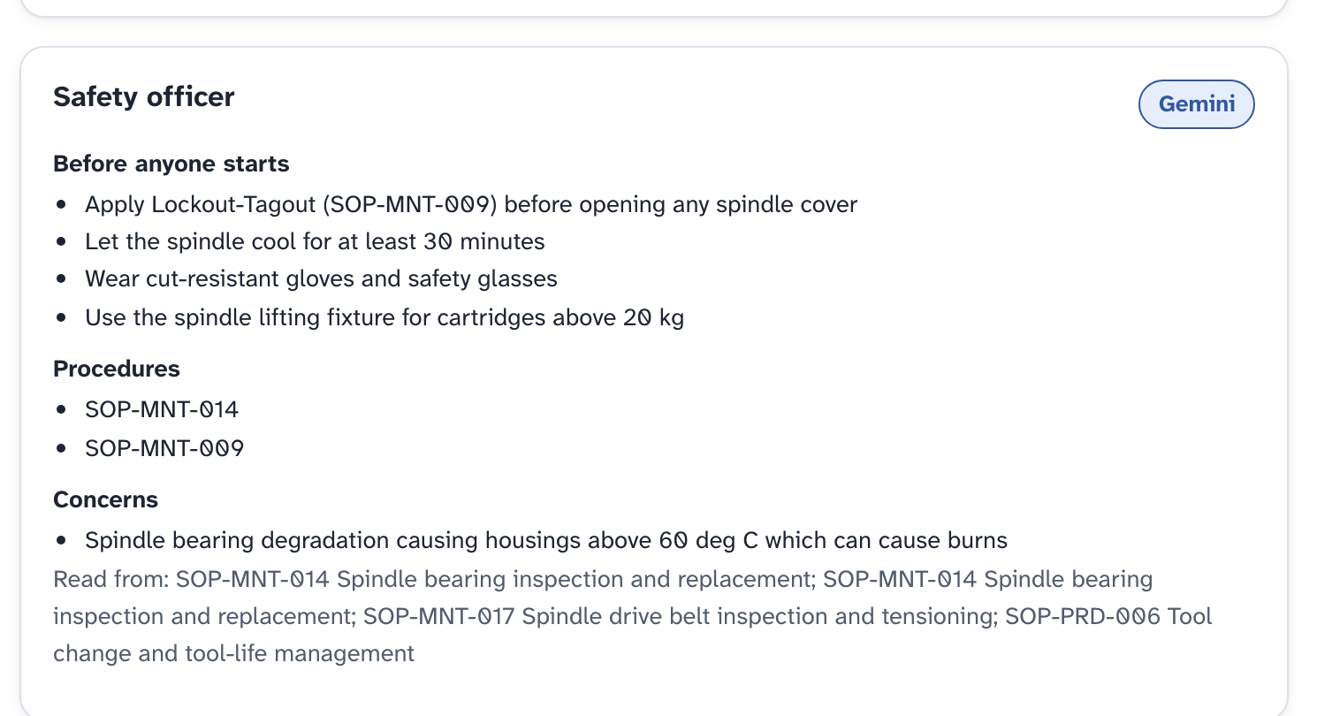
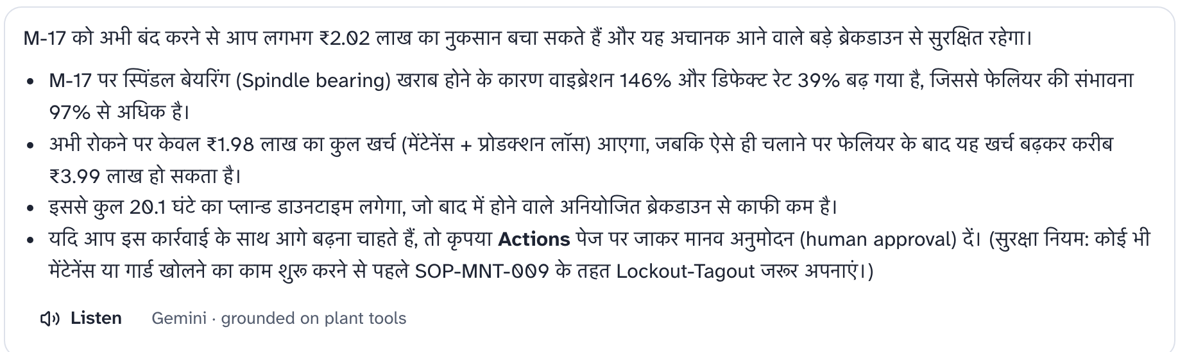
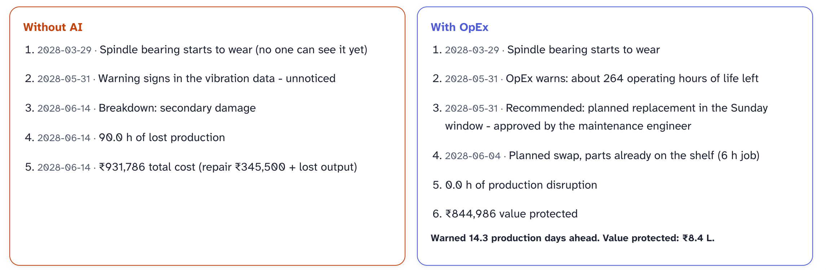
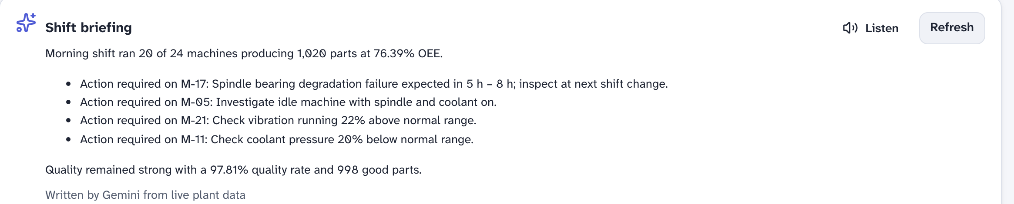
Snapshots of the prototype
Gemini at work in the prototype. It adds the procedure, the language and the judgement; the engine supplies the numbers, and every answer carries a Gemini or rule-based label.
Ask OpEx, in Hindi, 'what happens if I shut M-17 down now?': Gemini calls the pricing tool, quotes ₹1.98 L against ₹3.99 L, and cites the lockout-tagout SOP.
Incident room, third agent: the Safety officer adds what the engine cannot, lockout-tagout, a 30-minute cool-down and a burn hazard, and names the SOPs it read.
Shift briefing written by Gemini from the live overview, read aloud on request.
Rewind the factory: one of the plant's own breakdowns replayed with OpEx watching, same bearing, same luck, ₹8.4 L protected.
Notes:
Gemini screens captured 18 Oct 2026 with an AI Studio key, plus the Rewind page. Also in the app: investigation reports and the part-photo check.

Slide 12
Prototype Performance report/Benchmarking
Model scores on held-out data, and a simulated plant result that stays inside published ranges even when we make our own assumptions worse
Model (held-out test) | Data | Result
Component precursor model, 48 h horizon | Azure PdM telemetry (synthetic sample), trained Jan-Aug 2015, tested Sep-Dec | Caught 94 to 100% of component failures 24 to 32 h ahead; 11.9 false alarms per machine-year (1.2 to 5.8 per component), all charged in the simulator
Remaining-life model + 10/90% quantiles | NASA C-MAPSS FD001, NASA's 100 test engines | RMSE 13.0 cycles (published FD001 results sit around 11 to 16); 10-90% band covers 82%; every engine warned ≥ 10 cycles ahead
Failure-mode classifier | AI4I 2020 (synthetic, known to be easy), 2,000 test rows | ROC AUC 0.996, precision 94%, recall 89%; tool-wear failures are near-random in this set (11% caught)
App | 24 machines, 1-minute data | Overview 0.18 s warm; 5-year simulation (2.1 M machine-hours) about 4.5 s; 38 automated tests pass
Simulated improvement vs published ranges (a check, not a result)
Validation status. Not yet run on a real plant. The live plant is a calibrated twin and the breakdown reduction follows from our own prevention assumption (recall × 90% coverage × 85% adherence), so the chart checks that assumption against published ranges; it does not validate it. The next slide shows the result at 70%, 60% and 50% adherence.
Downtime fell 63% against the DOE's 35-45% because ours counts equipment stops only; material and set-up stops (17.5% of planned time, from a real line) are identical in both worlds, which is also why OEE moves just +1.0 point.
Ranges: US DOE/FEMP O&M Best Practices Guide R3.0 §5.4 ('independent surveys'); Deloitte Analytics Institute position paper. Scores: models/*.json.
Notes:
Lead with Azure PdM and C-MAPSS; AI4I is the weak dataset and we say so. The chart is a calibration check, not a result.

Slide 13
How we calculated the 5-year numbers
Same plant, same luck, two policies. Every random draw is shared, so the ₹7.11 Cr comes only from the decisions.
Benefit line | Formula and inputs | 5 years
Production protected | 140,944 extra good parts × contribution ₹175 to 760 per part | ₹4.45 Cr
Maintenance saved | parts + technician hours at ₹300/h (× 1.5 after a breakdown) + secondary damage (40% chance of a ₹2.2 L spindle job) + inspections | ₹2.22 Cr
Scrap avoided | 8,643 fewer bad parts × ₹380 to 1,450 scrap cost | ₹55.2 L
Energy saved | 507 MWh × ₹9.25/kWh (MSEDCL HT-I(A), MERC order 25 Mar 2026); 342 t CO₂ at 0.675 t/MWh | ₹46.9 L
Total benefit | sum of the four lines | ₹7.69 Cr
Net and return | ₹7.69 Cr − ₹58.8 L cost = ₹7.11 Cr; ÷ cost = 12.1×; payback in month 3 | 12.1×
Where the inputs come from
Failures per machine-year: bearing 1.79, drive 2.59, electrical 1.92, coolant 1.31 (Azure PdM, 761 failures)
Life spread Weibull k = 4.41; wear curve damage(u) = (e^3.75u − 1)/(e^3.75 − 1) (NASA C-MAPSS)
Prevented = model recall × sensor coverage 0.90 × adherence 0.85 ≈ 72 to 76%; warning error N(0.04, 0.20)
Minor stops 8.9%, set-ups 8.6%, repair-time σ 0.82, performance 92.9%, quality 98.3% (Zenodo 17855209, a real line at 59% OEE)
6,750 planned hours a year (3 shifts × 7.5 h × 300 days)
If people trust it less and sensors see less
Adherence | Coverage | Net 5 yr | Return | Payback
85% | 90% | ₹7.1 Cr | 12.1× | month 3
70% | 80% | ₹4.8 Cr | 8.2× | month 3
60% | 70% | ₹3.2 Cr | 5.5× | month 4
50% | 60% | ₹2.2 Cr | 3.7× | month 5
Breakdowns a year, without and with OpEx
Same seed and plant; only the two assumptions change. The baseline of 7.6 failures per machine-year is Azure PdM's; calmer fleets sit lower in this table.
Notes:
Walk the table, then the sensitivity block: the case does not depend on everyone trusting the AI.

Slide 14
Additional Details/Future Development (if any)
What comes next, why it can grow, and who gains besides the plant's accountant
Next steps
Why it can grow
Who else gains
Pilot. Six machines in one plant with an OPC UA / MTConnect gateway; health estimators re-fitted per machine during commissioning. No plant has signed yet; the ask of the finale is introductions to two ACMA members.
6 to 12 months. Multi-plant view and benchmarking; Dataflow into BigQuery; per-machine fine-tuning on Vertex AI once six months of real data exist; Live API voice for operators.
Later. Line-camera inspection with Visual Inspection AI; spare-parts auto-ordering; tariff-aware scheduling.
The 1,100+ ACMA members alone, at ₹8.4 lakh a year each, are about ₹92 crore a year of recurring revenue, before counting non-member job shops. India bought about USD 3.7 billion of machine tools in FY25, roughly half for automotive (IMTMA).
The models see health-index features rather than raw machine-specific sensors, so they transfer to any machine that can produce a health index. One container per plant today; the same image serves a plant group once readings are real, with Postgres holding the state.
Cloud costs about ₹1.5 lakh a year per plant at full use, and nothing until a plant decides to pay.
Workers. 1.5 million people work directly in Indian auto components (ACMA). Fewer 2 a.m. emergency repairs; lockout-tagout steps are part of every stop recommendation.
Language and access. Hindi, Telugu, Tamil, Kannada, Marathi; read-aloud and voice for low-literacy and low-vision staff; WCAG 2.2 AA.
Energy. 507 MWh and 342 t CO₂ avoided per 24-machine plant over five years in the simulation, mostly from idle spindles and coolant pumps put on standby.
IMTMA figure as reported at the AMT/IMTMA briefing, 2025; ACMA FY26 review. Revenue figure is members × our list price, not a forecast.
Notes:
Be plain about the pilot status. The bottom-up revenue number is more credible to a judge than an analyst market size.

Slide 15
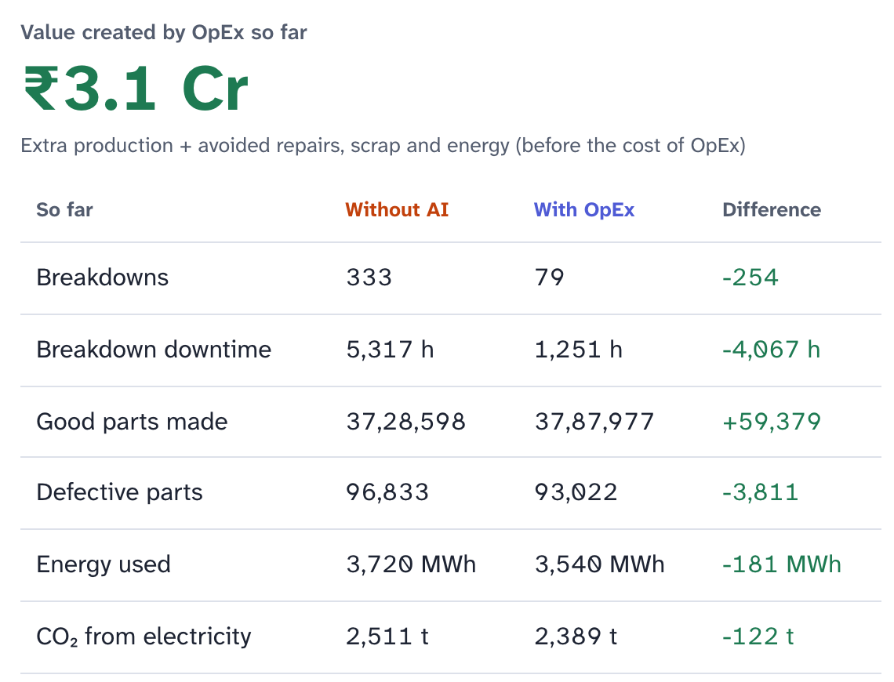
Provide links to your:
GitHub Public Repository: github.com/srihitha2005/Opex
Demo Video Link (3 Minutes): [add before submitting]
Final Product Link: [add before submitting]
Try it in 60 seconds
1. Click 'Explore as a guest' on the sign-in page (demo accounts are listed in the README).
2. Open M-17. Read steps 1 to 4, open the AI incident room, compare the priced options, approve one.
3. Open 5-year simulation, choose a 20-second replay, Simulate, Skip to results, then Rewind the factory.
4. Ask OpEx: 'What happens if I shut down Machine 17?' by voice, in Hindi if you like.
5. Settings → Display: high contrast, extra-large text, Lexend, simple words.
AUDIT.md explains every key in plain language; HOW_TO_RUN.md has the 3-minute tour.
5-year simulation at day 665: value created so far and the running with-vs-without table.
Notes:
Replace the two bracketed items with the real links before exporting.

Slide 16
Sources: every external number on these slides, and where it comes from
1 ACMA, Industry Performance Review FY2025-26 and acma.in/about-us: turnover ₹7.59 lakh crore (USD 85.9 bn), 1,100+ members, 1.5 million direct jobs, 2.3% of GDP.
2 ABB, 'Value of Reliability' survey (Sapio Research, July 2023, n = 3,215, India cut): 88% see unplanned outages at least monthly; 19% run to fail; about ₹7 million lost per hour. new.abb.com/news/detail/108271
3 US DOE / FEMP, O&M Best Practices Guide Release 3.0 (PNNL-19634, 2010), §5.4: predictive maintenance 'industrial average savings' of breakdowns −70-75%, maintenance cost −25-30%, downtime −35-45%, ROI 10×. The guide attributes these to independent surveys; we use them only as a sanity range.
4 Deloitte Analytics Institute, Predictive Maintenance position paper: breakdowns −70%, maintenance costs −25%, productivity +25%, uptime +10-20%.
5 Datasets. AI4I 2020 (UCI 601, CC BY 4.0; synthetic); NASA C-MAPSS FD001; Microsoft Azure Predictive Maintenance sample (synthetic); Zenodo record 17855209 (real serial line, 62 shifts, 635 stops, OEE 59.1% before improvement, CC BY 4.0); NIST Nestor vocabulary.
6 Electricity. MERC order of 25 March 2026 (Case 75 of 2025) on MSEDCL tariffs; HT-I(A) energy plus wheeling entered as ₹9.25/kWh in backend/app/plant/factory.py and editable in Settings.
7 Grid emissions. CEA CO₂ Baseline Database v22 (Aug 2026) weighted average 0.675 t/MWh as entered in the app; the v21 guide published 0.710 for FY2024-25 and v20 0.727 for FY2023-24. cea.nic.in
8 Wages and repairs. In-house technician about ₹19k a month (Indeed India, Oct 2026) blended with OEM visits to ₹300/h; engineer day rate ₹12,000 is our assumption; BHEL spindle-bearing repair tender (2020) ₹2.88 L sets the scale of secondary damage.
9 Plant economics. Contribution ₹175 to 760 per part (₹4,200 to 6,500 per machine-hour), scrap ₹380 to 1,450, repair hours and stock-out odds are the demo plant's assumptions in factory.py, all editable under Settings → Factory economics.
10 Model literature. C-MAPSS FD001 RMSE of 11 to 16 cycles is the range of commonly cited CNN, LSTM and transformer results; our 13.0 is in that range, not above it.
11 Standards. ISA-101 HMI design, ISA-18.2 alarm management, ISO 10816-3 vibration zones (heuristic for spindles), WCAG 2.2 AA.
12 Gemini API pricing, ai.google.dev/gemini-api/docs/pricing (updated Sept 2026): gemini-3.5-flash-lite $0.30 in / $2.50 out per 1M tokens; gemini-3.8-flash $0.75 / $3.75 (to 31 Dec 2026); gemini-3.8-live audio $3.00 / $12.00. The embedding model we call, gemini-embedding-001, is listed as superseded by gemini-embedding-2 at $0.20 per 1M; switching is a one-line model-name change. Free tier available for the Flash models; daily limits are per project and shown in AI Studio.
13 Cloud Run pricing, cloud.google.com/run/pricing: instance-based $0.000018 per vCPU-second and $0.000002 per GiB-second; free tier 180,000 vCPU-seconds, 360,000 GiB-seconds and 2 million requests a month.
14 Other Google Cloud prices. Vertex AI Agent Engine runtime $0.0864 per vCPU-hour, $0.009 per GiB-hour (2026); Visual Inspection AI $100 per camera stream per solution per month (cloud.google.com/vision-ai/pricing); Speech-to-Text v2 $0.016 per minute; Dataflow streaming about $0.069 per vCPU-hour, $0.003557 per GiB-hour (cloud.google.com/dataflow/pricing); Vector Search about $0.75 per node-hour for e2-standard-16 (Google developer forum estimate); Looker Studio Pro $9 per user per project per month.
15 Supabase, Pro plan $25 a month; free projects pause after 7 days without use. supabase.com/pricing
16 Sensor and gateway prices. Zbotic (2026 guide): commercial wireless vibration sensors ₹15,000 to 50,000; Banner QM30VT2 ₹55,009 incl. duties (tanotis.com); IndiaMART single-axis wireless vibration sensor ₹12,500; Kepware FANUC FOCAS driver suite about $995 (industrialmonitordirect.com).
17 Market. IMTMA: Indian machine-tool consumption about USD 3.7 bn in FY2024-25, about half from automotive (AMT/IMTMA briefing, 2025). The ₹92 crore figure is 1,100 members × ₹8.4 lakh a year.
18 Exchange rate. ₹95 per USD, interbank close of 17 Oct 2026 (reported between 94.71 and 94.96).
19 Simulation. Default run of the app's 5-year simulation, seed 2026 (pitch/numbers.json); sensitivity runs in pitch/sensitivity.json; model scores in models/*.json; every simulator input with its source and method in data/processed/calibration.json.
Notes:
Everything with a number has a line here. Where a figure could not be checked against a primary document, the line says so.

Slide 17

Notes:
Thank you. Team OpEx.

