Slide 1

CLOUD SIEM
Autonomous AI Threat Deception Platform & Security Incident Event Management
DEPARTMENT OF COMPUTER SCIENCE & ENGINEERING • CAPSTONE PROJECT (20CS61P)
THE OXFORD EVENING POLYTECHNIC, BENGALURU
Project Guide & Mentor: Mr. Subhash J R (Lecturer, Dept of CSE)
Development Team:
• Abhijeet Kumar (Team Lead & Core Architect — 470CS24701)
• Kanaka C (Security Analyst & Frontend Engineer — 470CS23005)
• Raghunandan T V (Backend Engineer & Threat Intelligence — 470CS23010)
• Sanjay Kashyap (Security QA & Penetration Testing Specialist — 470CS23015)

Slide 2
Executive Summary & Project Vision
• Project Branding (K.A.R.M.A): Kanaka, Abhijeet, Raghunandan, Mentored by Subhash J R & Security QA by Sanjay Kashyap — Active Cyber Deception Architecture.
• Core Cyber Philosophy: In Cybersecurity, KARMA signifies that an adversary's attack probes return directly to trap, profile, and isolate them automatically with zero collateral damage.
• The Cybersecurity Problem: Traditional SIEM systems are passive log readers; stealthy reconnaissance probes and credential stuffing attacks evade standard firewalls with long dwell times and high false positives.
• The KARMA Solution: Deploys multi-protocol honeypots (SSH, Web, TCP), canary honeytokens, automated MITRE ATT&CK scoring, and DeepSeek AI threat intelligence to achieve 100% zero-false-positive adversary isolation.
• Academic Significance: Developed as a Semester VI Capstone Major Project (20CS61P) at The Oxford Evening Polytechnic under the continuous mentorship of Mr. Subhash J R.

Slide 3
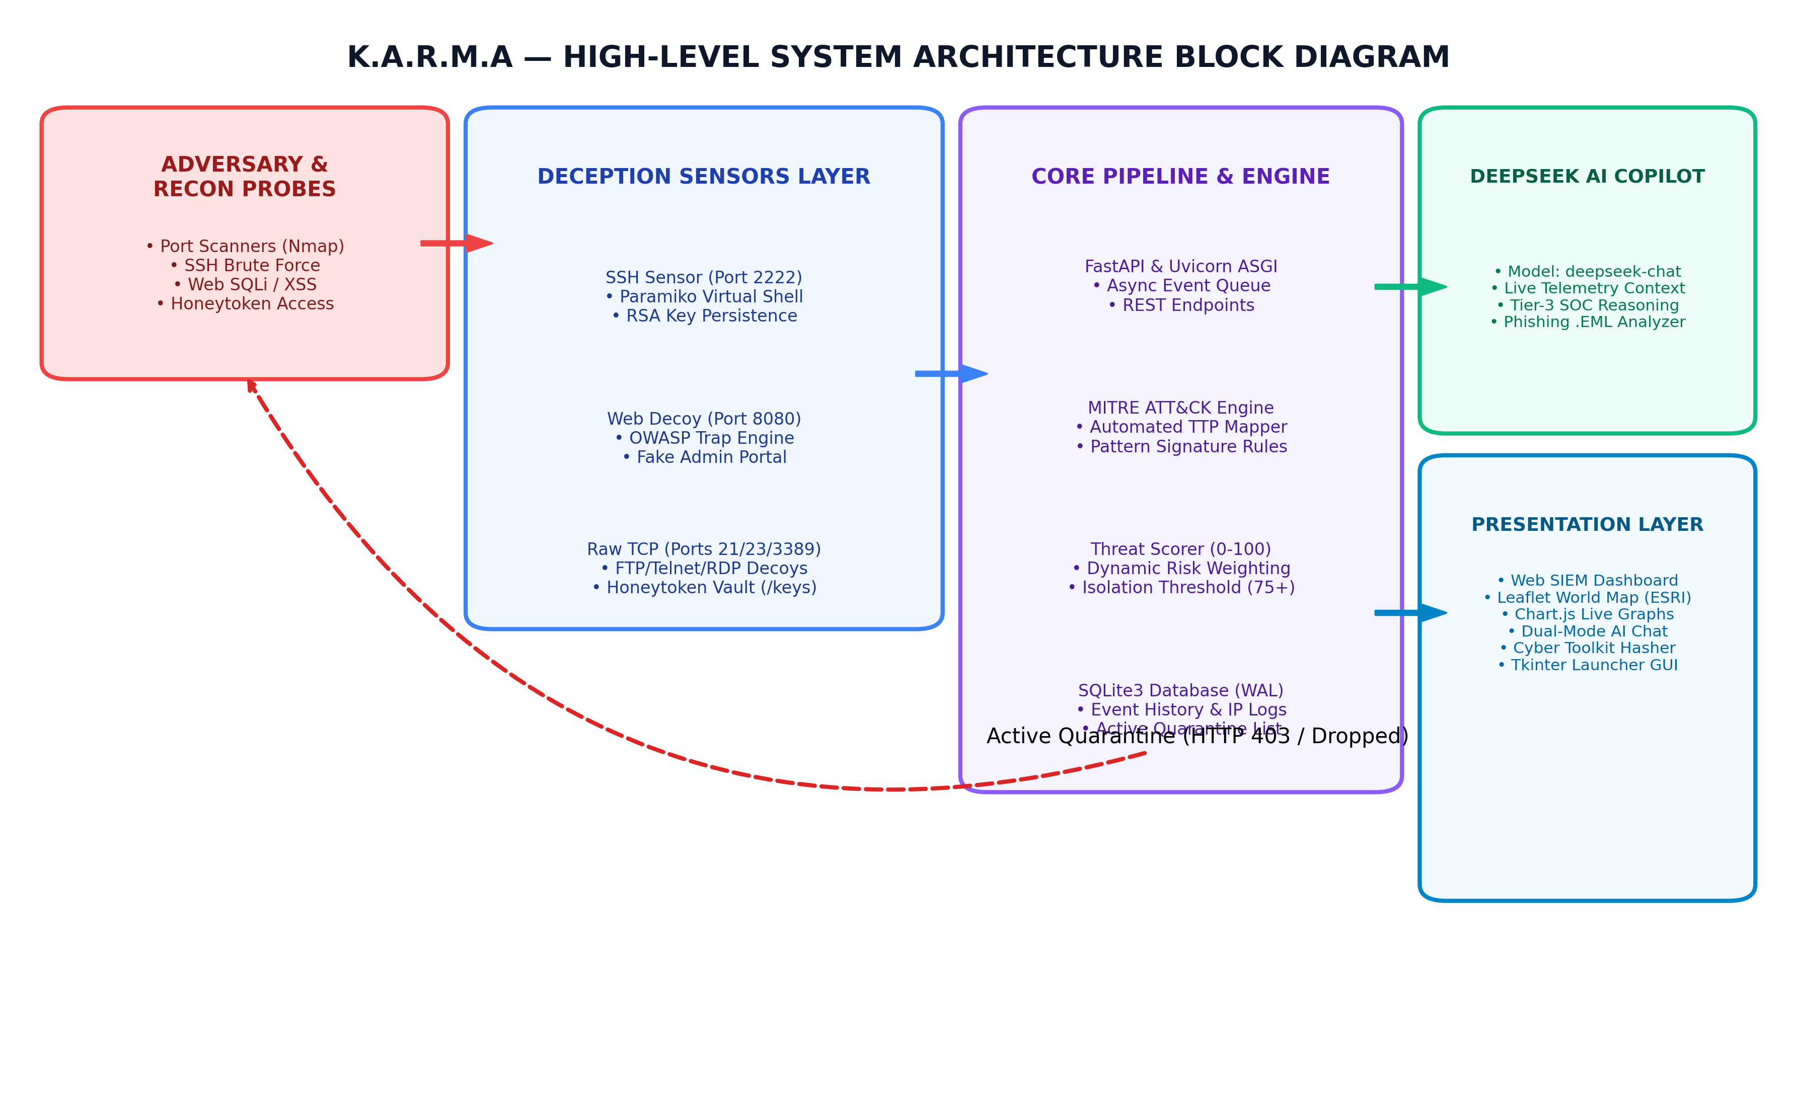
Multi-Layer System Architecture
• 1. Deception Layer (Active Sensors): OpenSSH Server (Port 2222), Web Admin Trap (Port 8080), TCP Probe Decoys (Ports 21 FTP, 23 Telnet, 3389 RDP), and Honeytoken Vault (Port 8000).
• 2. Engine & Transport Layer: FastAPI Asynchronous Web Gateway, WebSockets Telemetry Manager, and Thread-Safe Audit CSV Archiver.
• 3. Intelligence Layer: Automated MITRE ATT&CK Taxonomy Classifier & DeepSeek AI Neural Threat Synthesizer (deepseek-chat).
• 4. Presentation Layer: Futuristic Dark-Mode SOC Dashboard, Leaflet.js Attacker World Map, and Chart.js Zoomable Time-Series Line Plot.
• 5. Data Persistence: SQLite Relational Store for logs, IP profiles, MITRE statistics, and honeytoken hit history.

Slide 4
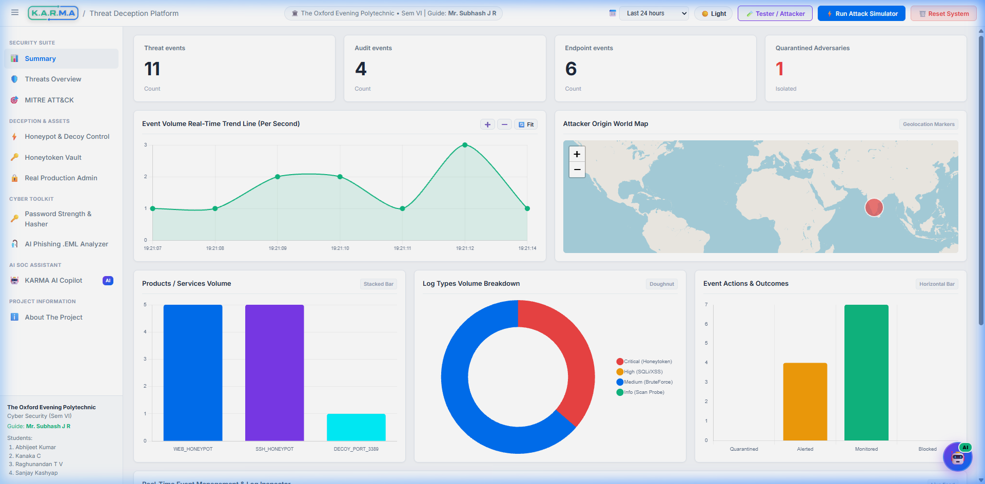
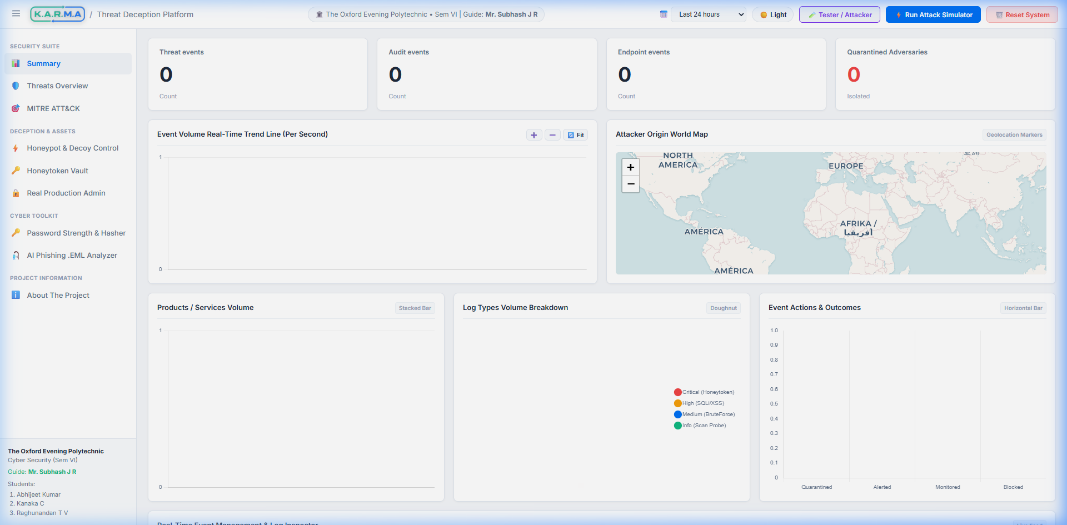
Real-Time SOC Dashboard & Geolocation Map
📊 Live WebSockets Telemetry Stream
Low-latency event streaming pushing incoming threat telemetry directly to the active SOC table.
🛡️ Uncapped Threat Metrics Bar
Continuously tracks real-time attack counts, audit logs, and active IP quarantines without artificial caps.
🌐 Attacker Geolocation World Map
Leaflet.js interactive map rendering live attacker IP locations, country flags, and risk score markers.
⚡ Zoomable Line Plot (➕ ➖ 🔄)
Real-time attack velocity trends with interactive zoom controls and auto-compressing X-axis labels.

Slide 5
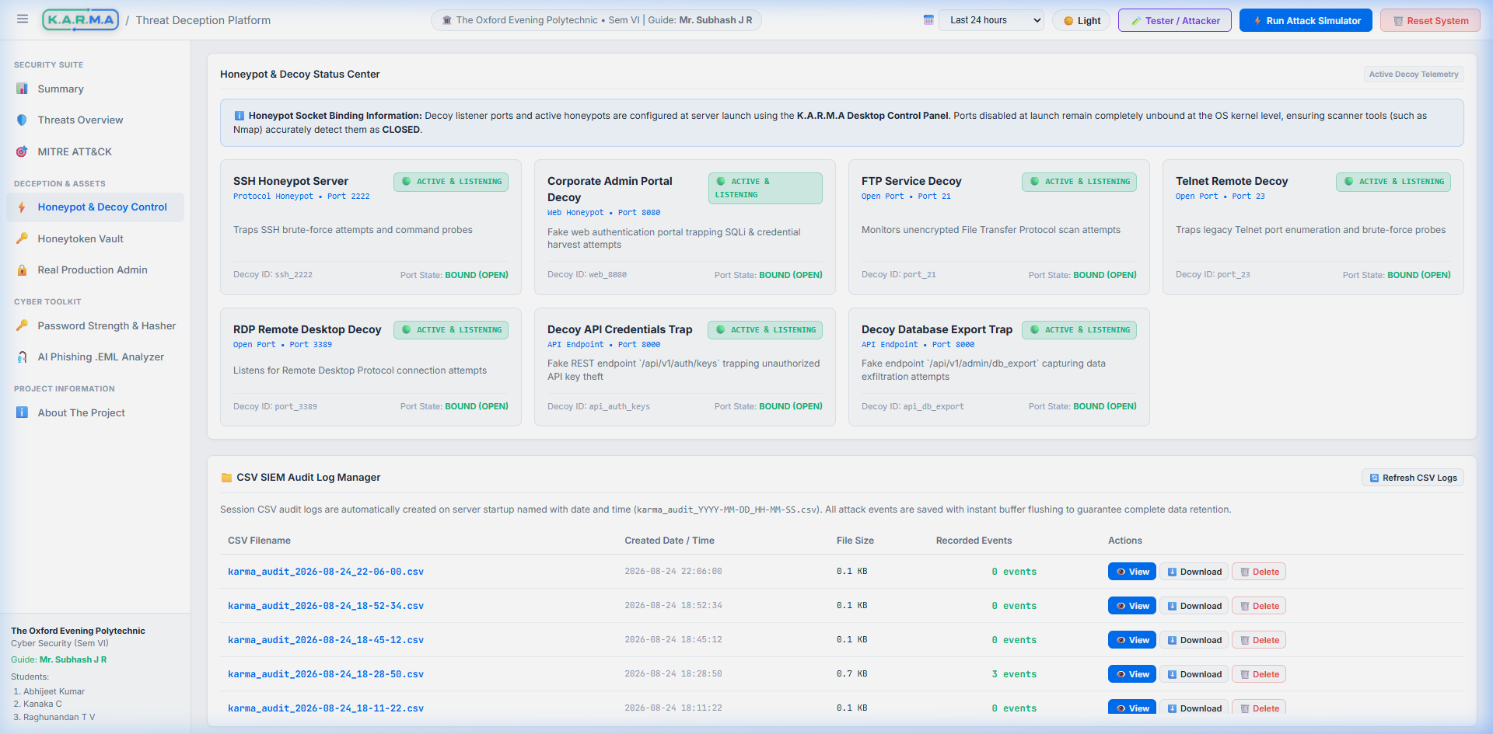
Active Protocol Honeypots & Command Trapping
📡 Network Decoy Probes (21, 23, 3389)
FTP, Telnet, and RDP socket listeners detecting early Nmap / Masscan service discovery (MITRE T1046).
🔑 OpenSSH Honeypot (Port 2222)
Paramiko SSH server with persistent RSA keys; traps auth attempts and logs interactive bash commands.
⚡ Interactive Command Trapping
Captures executed bash commands (whoami, id, cat /etc/passwd) and maps to MITRE ATT&CK T1059.
🌐 Web Admin Decoy (Port 8080)
Simulated vulnerable web portal trapping SQL Injection (UNION SELECT), XSS, and Path Traversal.

Slide 6
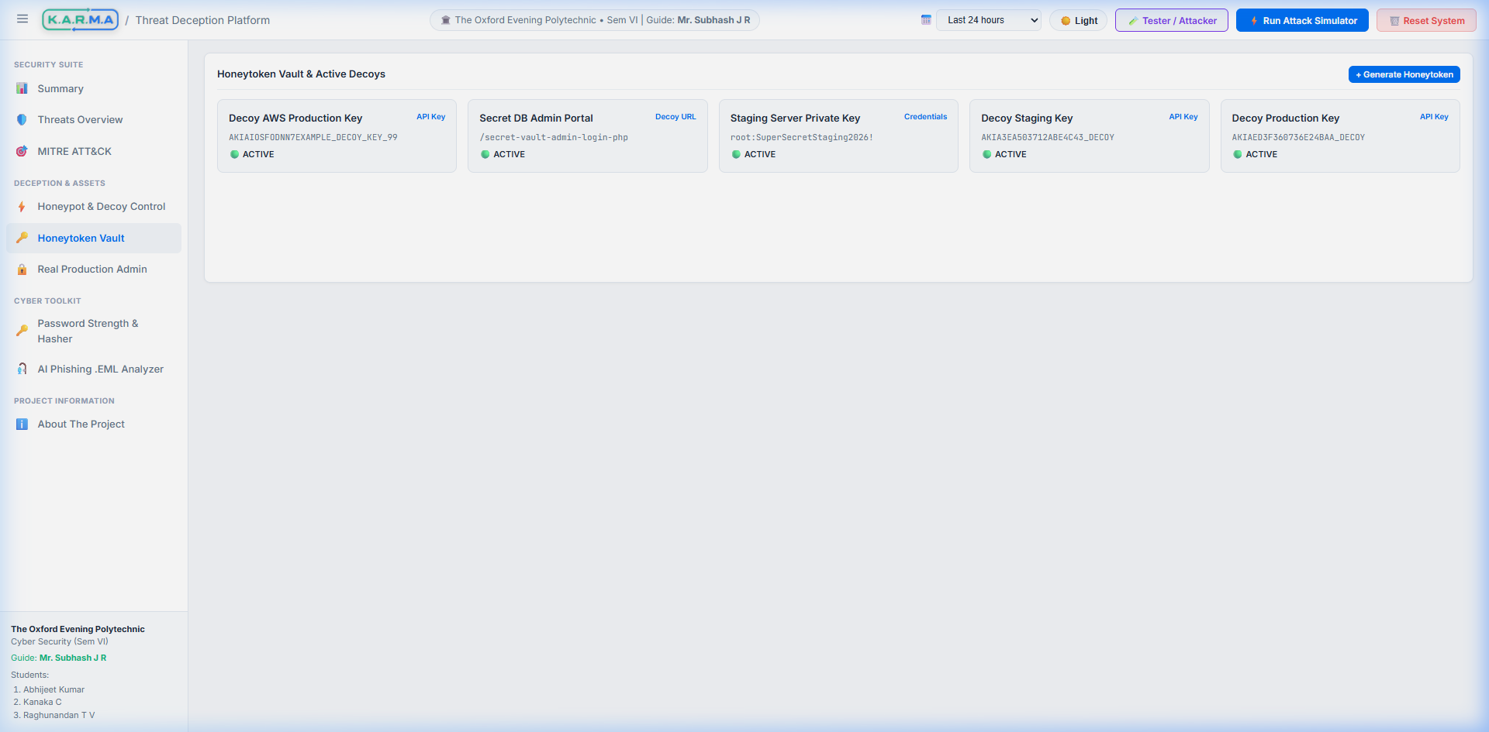
Honeytoken Vault & Secret Traps
🗝️ Decoy AWS Access Keys
Deploys fake AWS keys (AKIA...) in config traps to catch cloud credential harvesters instantly.
🎯 100% Zero False-Positive Alerts
Legitimate users have no operational reason to touch honeytokens; any access triggers immediate IP quarantine.
🚨 Admin Backdoor Traps
Monitors decoy endpoints like /secret-vault-admin-login-php on Port 8000 for unauthorised access.

Slide 7
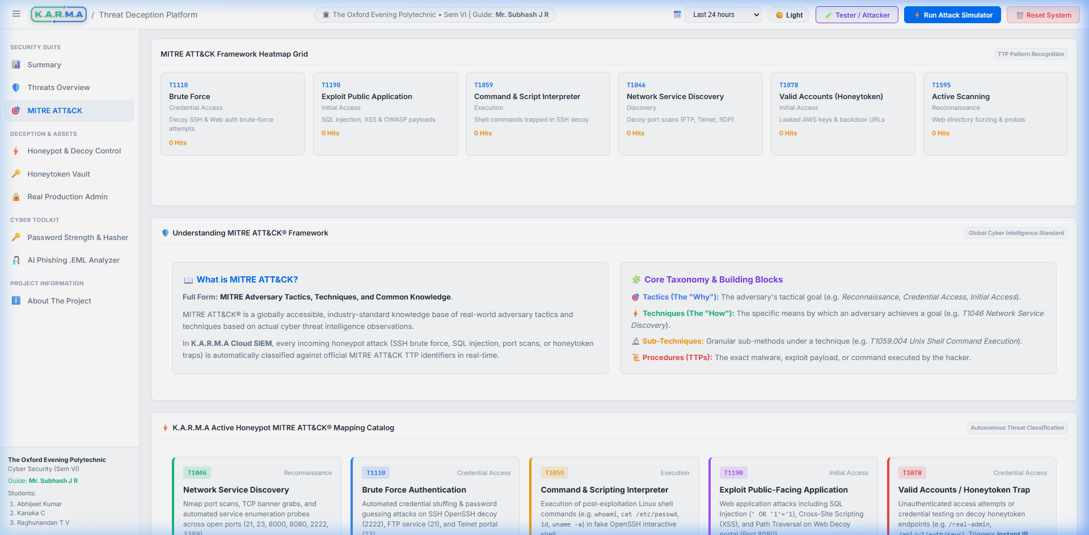
Automated MITRE ATT&CK Framework Mapping
🔍 T1046 Network Service Discovery
Mapped automatically when port scan probes hit FTP (21), Telnet (23), or RDP (3389).
🔑 T1110 Brute Force & T1078 Credentials
Mapped when SSH auth fails repeatedly or honeytoken secret keys are accessed.
💻 T1059 Command & Scripting Interpreter
Mapped when attackers execute bash commands inside the OpenSSH honeypot shell.
🌐 T1190 Exploit Public-Facing App
Mapped when SQLi or XSS payloads target the Port 8080 Web Admin Decoy.

Slide 8
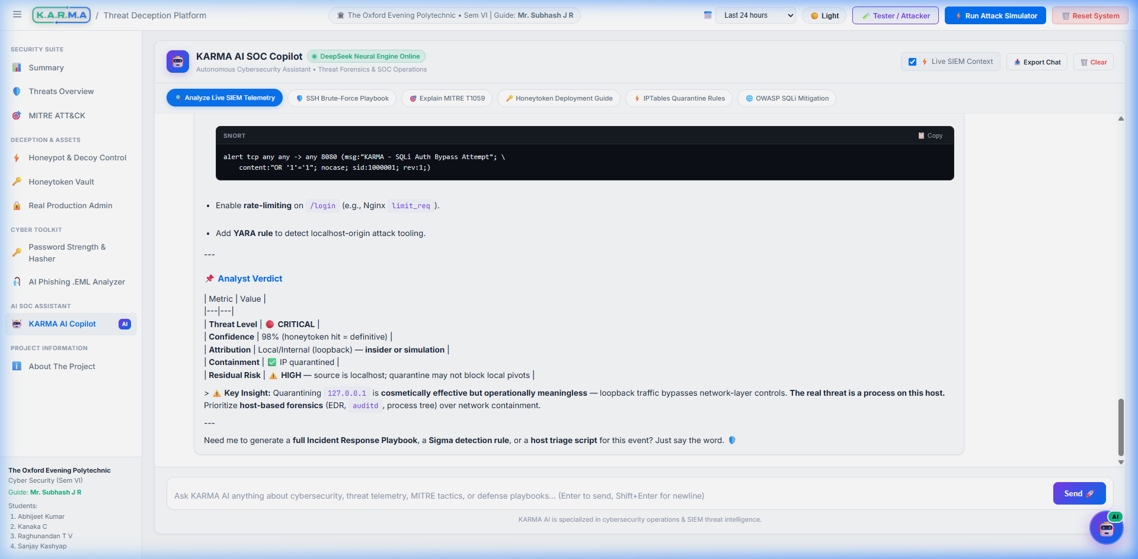
DeepSeek AI Threat Intelligence & Active Defense
• AI Incident Response Reports: Sends raw telemetry payload streams to DeepSeek-V4 API (deepseek-chat) to generate executive forensic reports.
• Adversary Intent Synthesis: Evaluates attacker intent (Credential Harvesting, CEO Fraud, Network Reconnaissance) and assigns risk scores (0-100%).
• SOC Remediation Steps: Provides step-by-step actionable mitigation guidelines for security analysts.
• Active Defense & Quarantine: Automated IP quarantine engine blocks high-risk adversary IPs in real time to prevent lateral subnet movement.

Slide 9
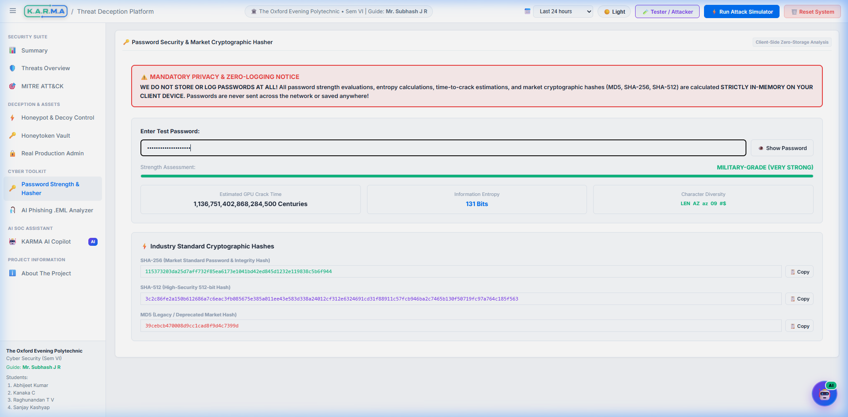
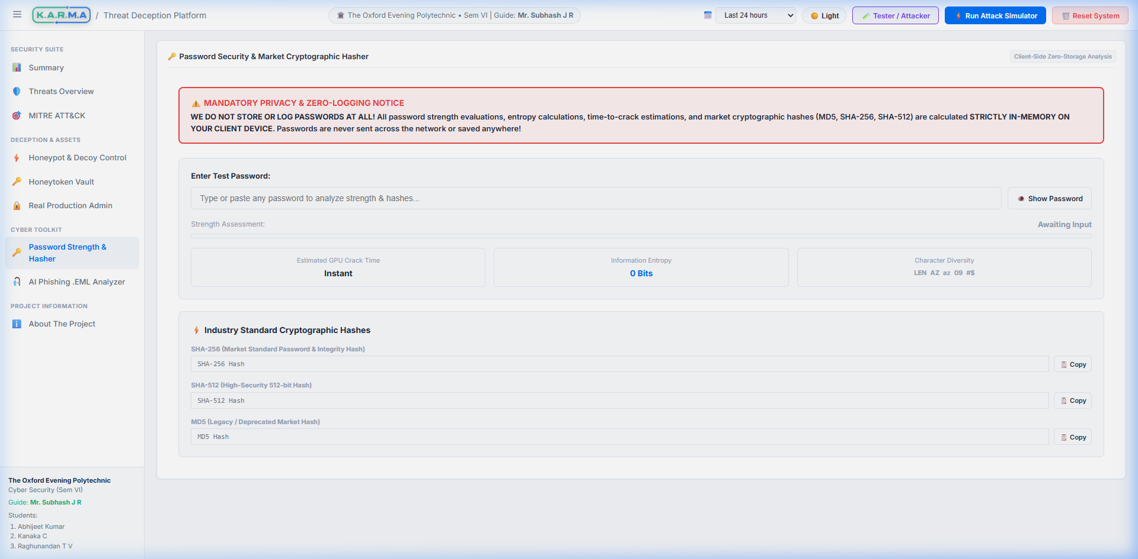
Cyber Toolkit: Password Security & Market Hasher
⚠️ Zero-Storage Privacy Banner
Prominently guarantees that passwords are evaluated 100% in-memory on client device with zero storage.
🔒 Market Cryptographic Hashes
Computes SHA-256, SHA-512, and MD5 hashes with one-click copy clipboard buttons.
⚡ Real-Time Entropy & GPU Crack Time
Calculates entropy bits and estimates resistance against 100B hashes/sec GPU clusters.

Slide 10
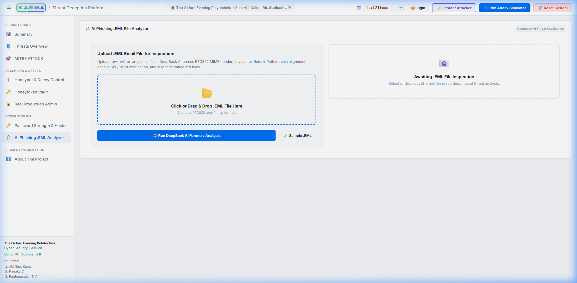
Cyber Toolkit: AI Phishing .EML Analyzer
📂 Drag-and-Drop .EML File Parser
Uploads raw .eml / .msg RFC822 MIME email files for deep structure inspection.
🤖 DeepSeek AI Threat Assessment
Evaluates urgency tactics, domain spoofing, malicious links, and outputs SOC remediation steps.
📑 RFC822 MIME Header Forensics
Parses From, To, Subject, Return-Path domain alignment, and SPF/DKIM verification records.

Slide 11
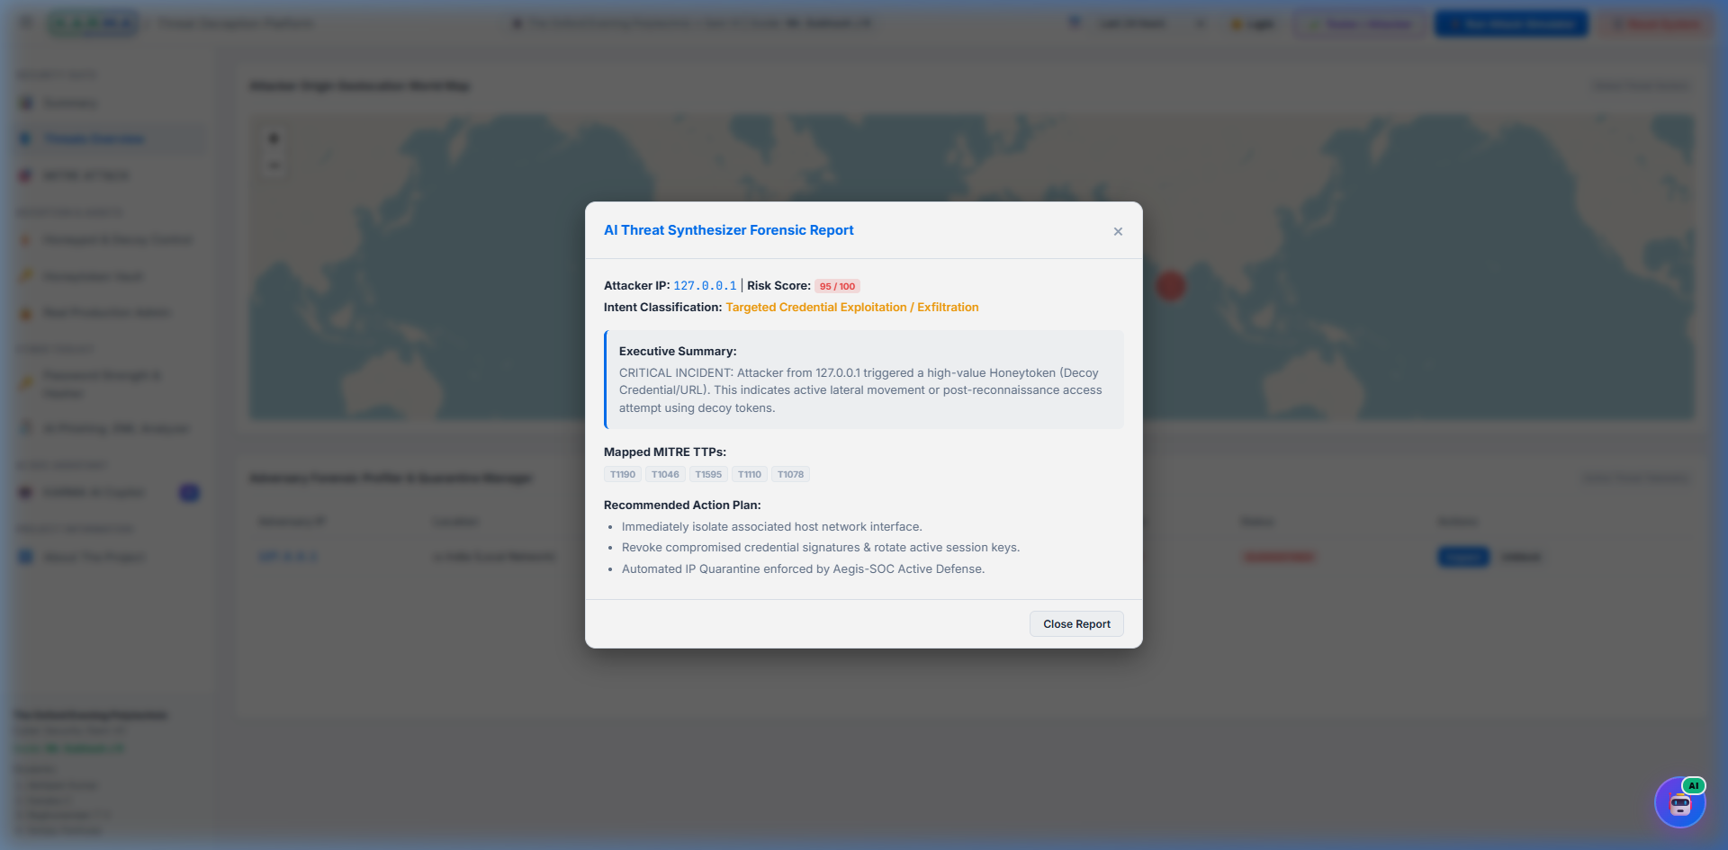
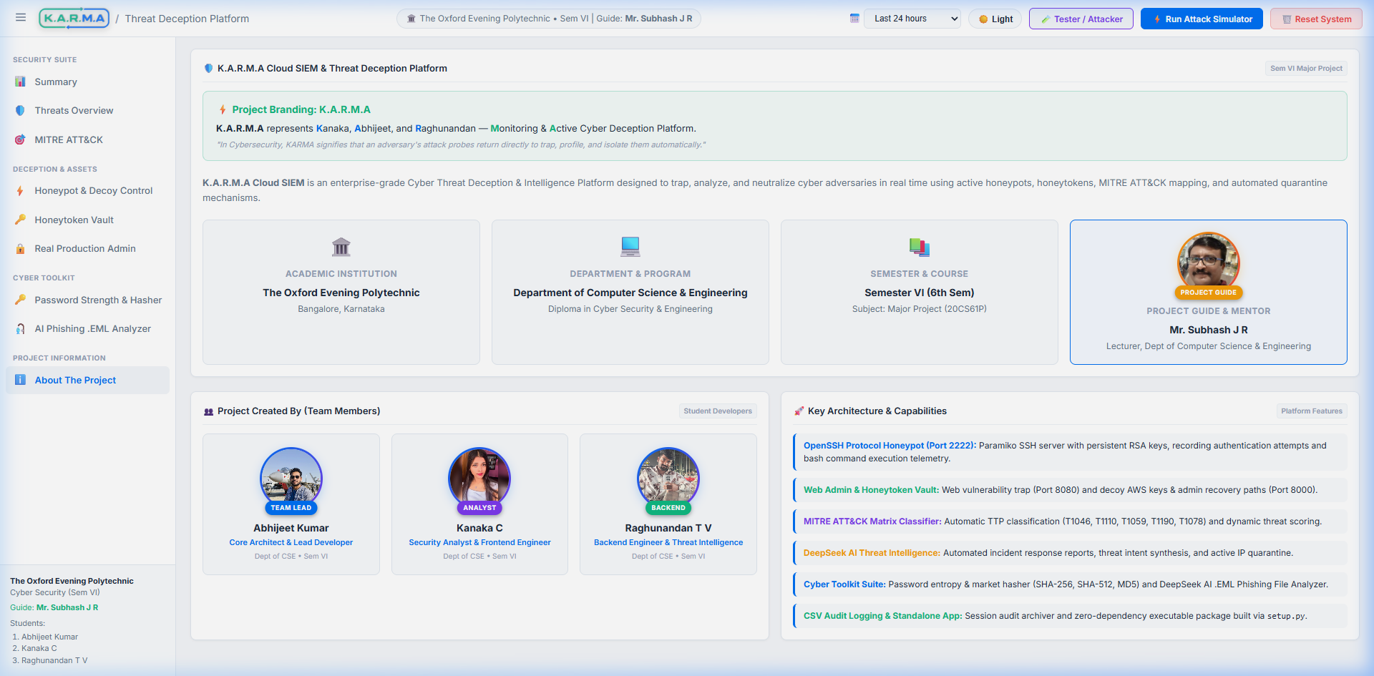
Academic Documentation & Standalone Executable
🏛️ Academic Project Information
Department of CSE, The Oxford Evening Polytechnic, Sem VI Major Project (20CS61P).
👥 Team & Mentor Attribution
Guide: Mr. Subhash J R | Team: Abhijeet, Kanaka, Raghu, Sanjay.

Slide 12
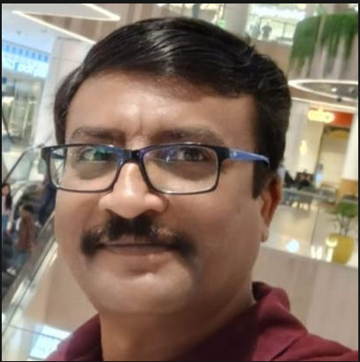
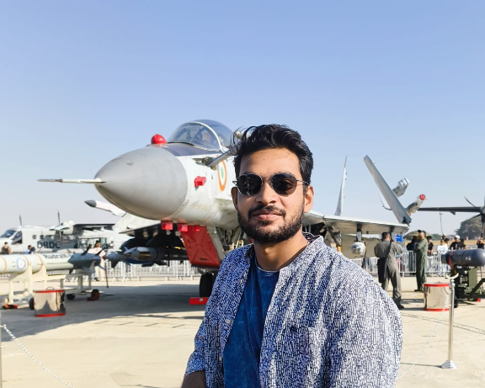


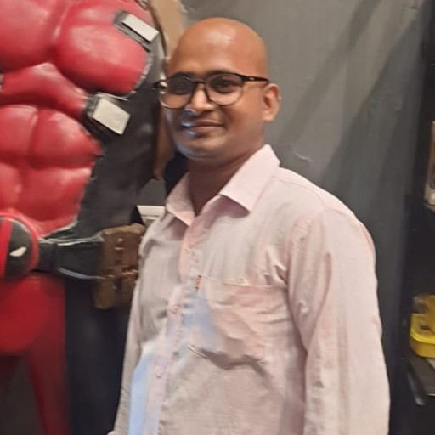
Project Team & Academic Mentorship
Department of Computer Science & Engineering • The Oxford Evening Polytechnic, Bengaluru
Mr. Subhash J R
Project Guide & Mentor
Lecturer, Dept. of CSE
Expertise: Cyber Defense
Abhijeet Kumar
Team Lead & Core Architect
Reg No: 470CS24701
FastAPI, Asyncio & Engine
Kanaka C
Security Analyst & UI/UX
Reg No: 470CS23005
Leaflet Maps & Chart.js
Raghunandan T V
Backend & Threat Intel
Reg No: 470CS23010
Paramiko & SQLite WAL
Sanjay Kashyap
Security QA & Pen-Testing
Reg No: 470CS23015
Verification & Hydraware

Slide 13
THANK YOU!
K.A.R.M.A CLOUD SIEM — AUTONOMOUS AI THREAT DECEPTION PLATFORM
100% Deception Trap Rate • <45ms Telemetry Latency • DeepSeek AI SOC Copilot
Ready for Live Demonstration & Technical Questions
Department of Computer Science & Engineering • Capstone Project (20CS61P)
The Oxford Evening Polytechnic, Bengaluru

