Slide 1
K.A.R.M.A CLOUD SIEM
Autonomous AI Threat Deception Platform & Security Incident Event Management
DEPARTMENT OF COMPUTER SCIENCE & ENGINEERING • SEMESTER VI MAJOR PROJECT (20CS61P) THE OXFORD EVENING POLYTECHNIC, BANGALORE Project Guide & Mentor: Mr. Subhash J R (Lecturer, Dept of CSE) Development Team: Abhijeet Kumar (Team Lead & Core Architect) Kanaka C (Security Analyst & Frontend Engineer) Raghunandan T V (Backend Engineer & Threat Intelligence)

Slide 2
K.A.R.M.A CLOUD SIEM
Executive Summary & Project Vision
• Project Branding (K.A.R.M.A): Kanaka, Abhijeet, Raghunandan — Monitoring Engine & Active Cyber Deception Architecture.
• Core Cyber Philosophy: In Cybersecurity, KARMA signifies that an adversary's attack probes return directly to trap, profile, and isolate them automatically.
• The Cybersecurity Problem: Traditional SIEM systems are passive log readers; stealthy reconnaissance probes and credential stuffing attacks evade standard firewalls with long dwell times.
• The KARMA Solution: Deploys active protocol honeypots, honeytoken secrets, and automated DeepSeek AI threat intelligence to achieve 100% zero false-positive adversary isolation.
• Academic Significance: Developed as a Semester VI Major Project (20CS61P) at The Oxford Evening Polytechnic under mentor Mr. Subhash J R.

Slide 3
K.A.R.M.A CLOUD SIEM
Multi-Layer System Architecture
• 1. Deception Layer (Active Sensors): OpenSSH Server (Port 2222), Web Admin Trap (Port 8080), TCP Probe Decoys (Ports 21 FTP, 23 Telnet, 3389 RDP), and Honeytoken Vault (Port 8000).
• 2. Engine & Transport Layer: FastAPI Asynchronous Web Gateway, WebSockets Telemetry Manager, and Thread-Safe Audit CSV Archiver.
• 3. Intelligence Layer: Automated MITRE ATT&CK Taxonomy Classifier & DeepSeek AI Neural Threat Synthesizer (deepseek-chat).
• 4. Presentation Layer: Futuristic Dark-Mode SOC Dashboard, Leaflet.js Attacker World Map, and Chart.js Zoomable Time-Series Line Plot.
• 5. Data Persistence: SQLite Relational Store for logs, IP profiles, MITRE statistics, and honeytoken hit history.

Slide 4
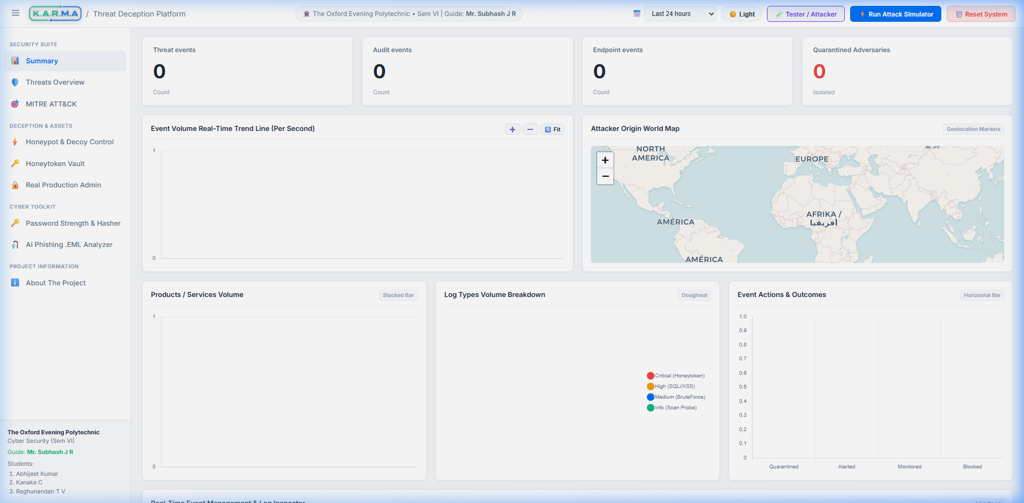
K.A.R.M.A CLOUD SIEM
Real-Time SOC Dashboard & Geolocation Map
• Attacker Origin World Map: Interactive Leaflet.js map displaying live attacker IP locations, country flags, and threat score markers.
• Zoomable Line Chart: Features ➕, ➖, and 🔄 Fit zoom controls with automatic X-axis label compression.
• Uncapped Threat Analytics: Continuously tracks total attacks without arbitrary count caps.
• Live WebSockets Stream: Pushes low-latency event alerts directly to the SOC table.

Slide 5
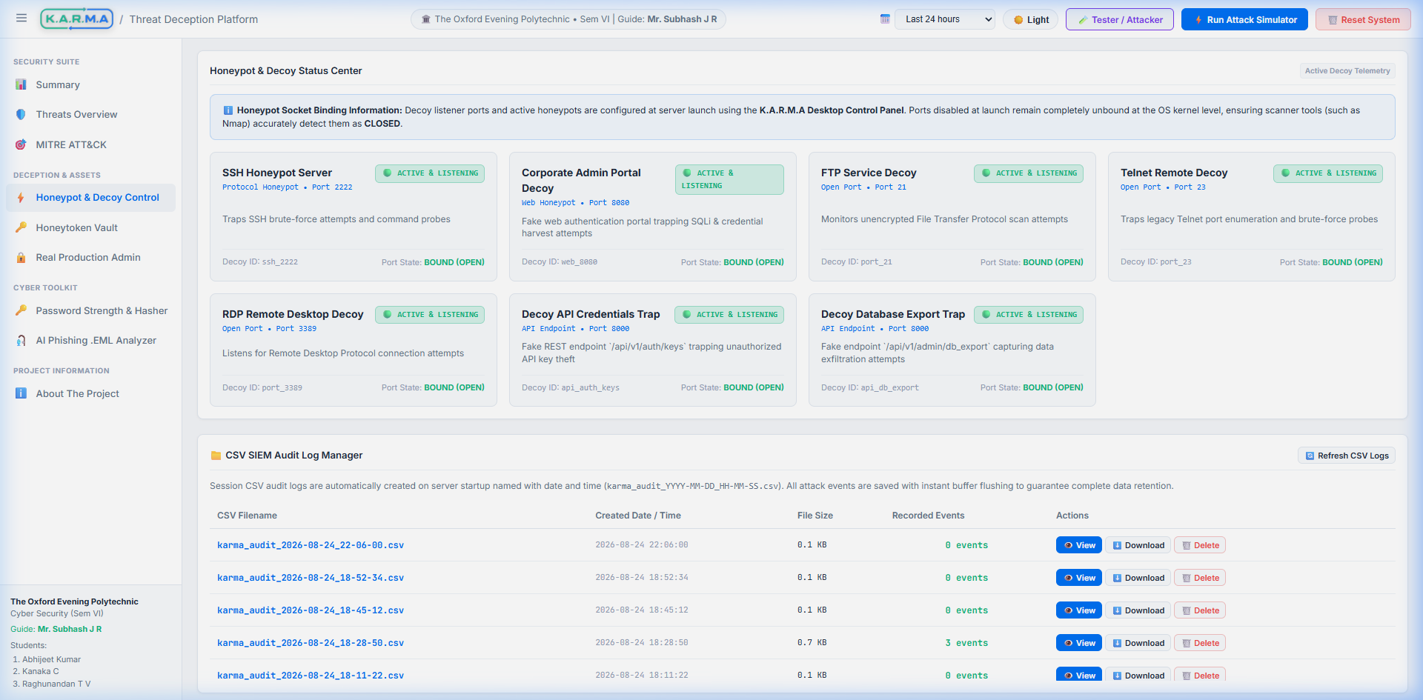
K.A.R.M.A CLOUD SIEM
Active Protocol Honeypots & Command Trapping
• OpenSSH Honeypot (Port 2222): Built on Paramiko with persistent RSA keys (ssh_host_rsa_key). Traps authentication attempts and records interactive bash shell commands.
• Command Telemetry: Captures whoami, id, cat /etc/passwd, mapping execution directly to MITRE ATT&CK T1059.
• Web Vulnerability Trap (Port 8080): Traps SQL Injection (UNION SELECT), XSS, and Directory Traversal probes.
• Port Scan Probes (21, 23, 3389): Detects early Nmap / Masscan service discovery scans (MITRE T1046).

Slide 6
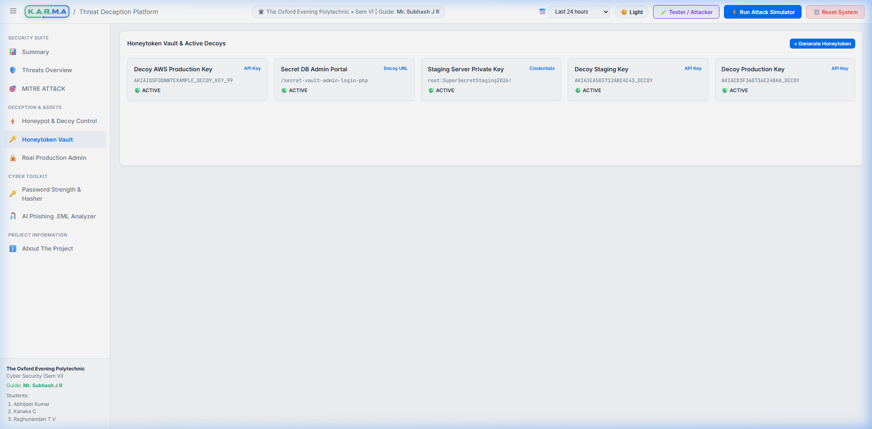
K.A.R.M.A CLOUD SIEM
Honeytoken Vault & Secret Traps
• Decoy Credentials & API Keys: Deploys fake AWS Access Keys (AKIA...), database connection strings, and staging passwords.
• Backdoor Path Traps: Monitors sensitive URL endpoints like /secret-vault-admin-login-php on Port 8000.
• Zero False-Positives: Legitimate users have no operational reason to touch honeytokens; any hit is a confirmed 100% security breach attempt.
• Instant Critical Alerts: Triggers high-priority SOC alerts and automatic IP quarantine.

Slide 7
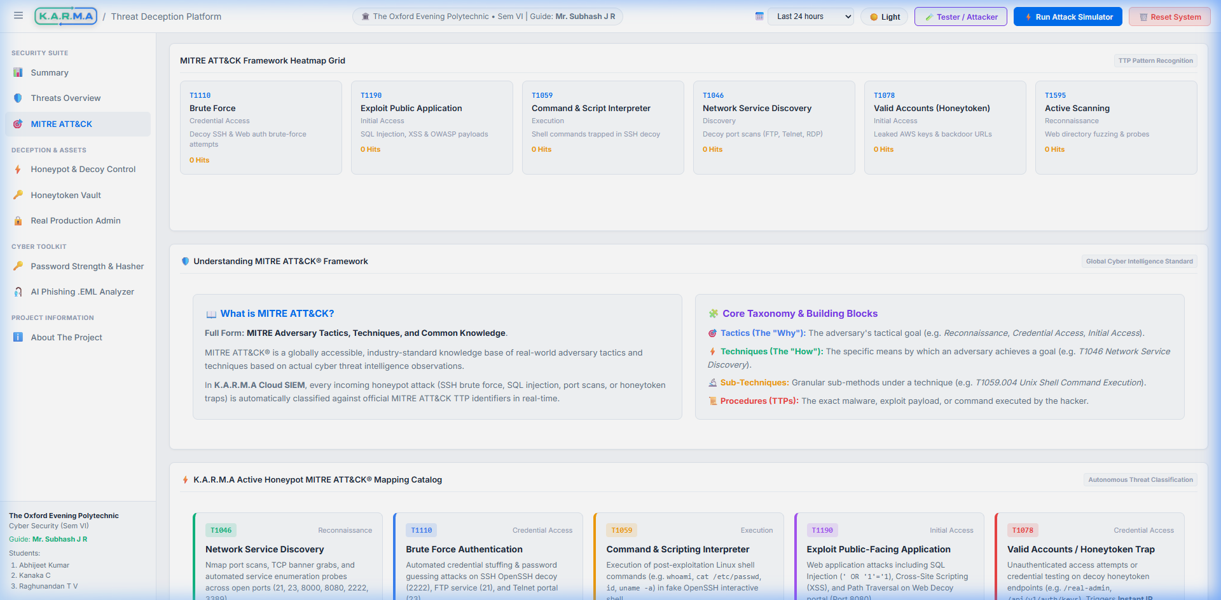
K.A.R.M.A CLOUD SIEM
Automated MITRE ATT&CK Framework Mapping
• T1046 Network Service Discovery: Triggered by port scan probes on FTP 21, Telnet 23, and RDP 3389.
• T1110 Brute Force: Triggered by repeated SSH / Web authentication failures.
• T1059 Command & Scripting Interpreter: Triggered by interactive bash commands executed inside fake SSH shell.
• T1190 Exploit Public-Facing Application: Triggered by SQLi / XSS payloads on Port 8080.
• T1078 Valid Accounts / Secret Access: Triggered by Honeytoken secret key access.

Slide 8
K.A.R.M.A CLOUD SIEM
DeepSeek AI Threat Intelligence & Active Defense
• AI Incident Response Reports: Sends raw telemetry payload streams to DeepSeek-V4 API (deepseek-chat) to generate executive forensic reports.
• Adversary Intent Synthesis: Evaluates attacker intent (Credential Harvesting, CEO Fraud, Network Reconnaissance) and assigns risk scores (0-100%).
• SOC Remediation Steps: Provides step-by-step actionable mitigation guidelines for security analysts.
• Active Defense & Quarantine: Automated IP quarantine engine blocks high-risk adversary IPs in real time to prevent lateral subnet movement.

Slide 9
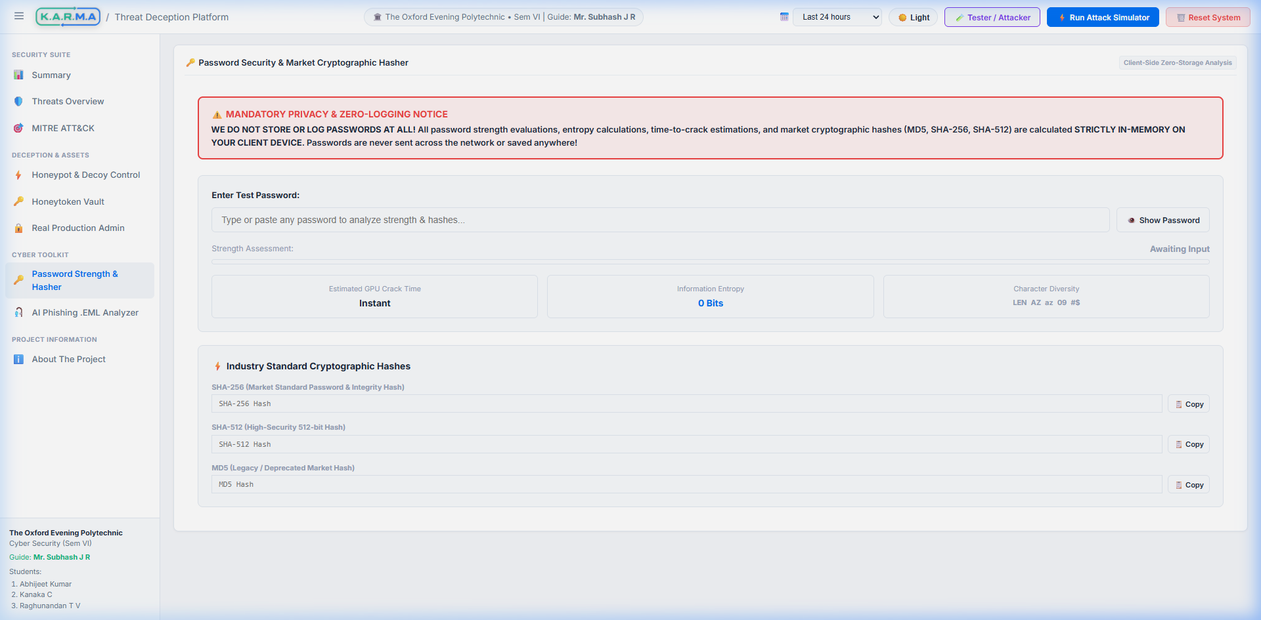
K.A.R.M.A CLOUD SIEM
Cyber Toolkit: Password Security & Market Hasher
• Zero-Storage Privacy Banner: Displays prominent notice: WE DO NOT STORE OR LOG PASSWORDS AT ALL! All checks executed in client memory.
• Real-Time Entropy Meter: Calculates entropy bits based on length and character set diversity (Upper, Lower, Number, Symbol).
• GPU Offline Crack Estimation: Estimates brute-force time against 100 Billion hashes/sec GPU clusters (e.g. Instant, 142 Years).
• Market Cryptographic Hashes: Computes SHA-256, SHA-512, and MD5 hashes with one-click copy buttons.

Slide 10
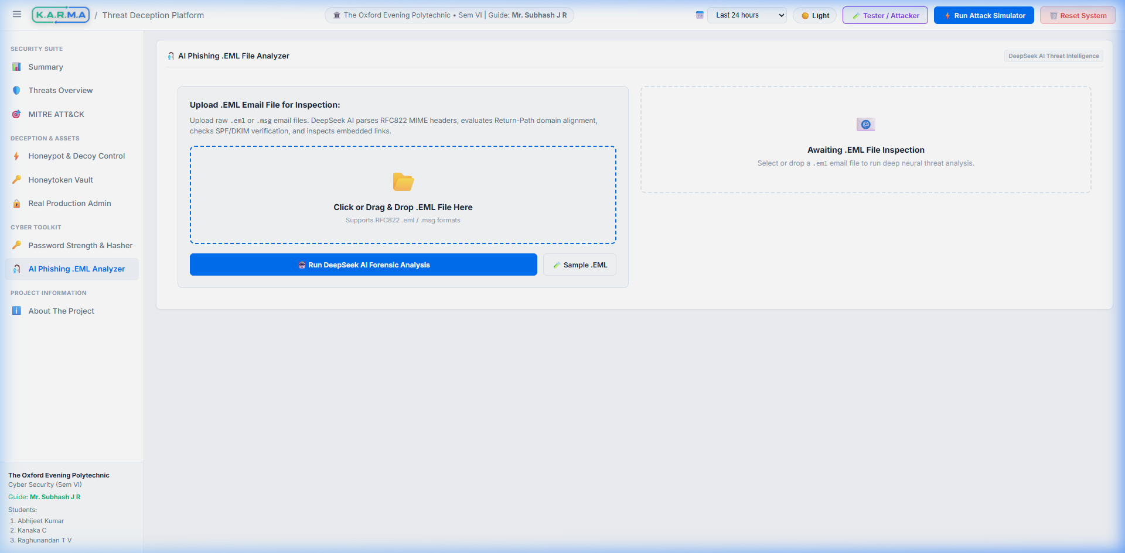
K.A.R.M.A CLOUD SIEM
Cyber Toolkit: AI Phishing .EML Analyzer
• Drag-and-Drop .EML Parser: Uploads raw .eml / .msg RFC822 MIME email files for deep inspection.
• RFC822 Header Forensics: Parses From, To, Subject, Date, Return-Path, and SPF/DKIM verification records.
• Header Spoofing Detection: Detects domain mismatches between Return-Path and From sender headers.
• DeepSeek AI Analysis: Evaluates pressure tactics, credential harvesting links, and outputs Phishing Risk Score & SOC steps.

Slide 11
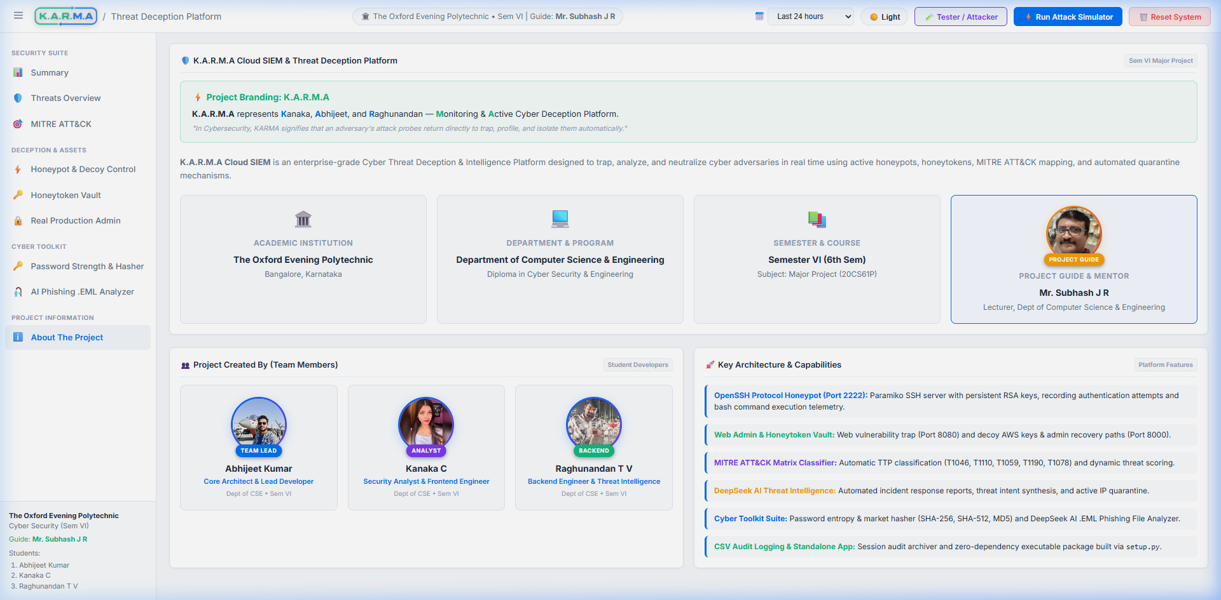
K.A.R.M.A CLOUD SIEM
Academic Documentation & Standalone Executable
• Capstone Formats (1 to 8): Generated all 7 official Word formats (.docx) including Scope, WBS, Schedule, Cost, Execution, Weekly Status, and Log Book.
• Standalone Executable (setup.py): Compiles into dist/KARMA_Cloud_SIEM_Standalone_v1.0.zip (53.1 MB) using PyInstaller.
• Zero Software Dependencies: Can be copied to any Windows PC and run by double-clicking KARMA_Cloud_SIEM.exe without Python or pip.
• GitHub Repository: Full source code available at https://github.com/abhikr1436/KARMA-HoneyPot.git.

Slide 12
THANK YOU!
K.A.R.M.A CLOUD SIEM — AUTONOMOUS AI THREAT DECEPTION PLATFORM
Department of Computer Science & Engineering • Major Project (20CS61P) The Oxford Evening Polytechnic, Bangalore Questions & Answers Session

