Slide 1
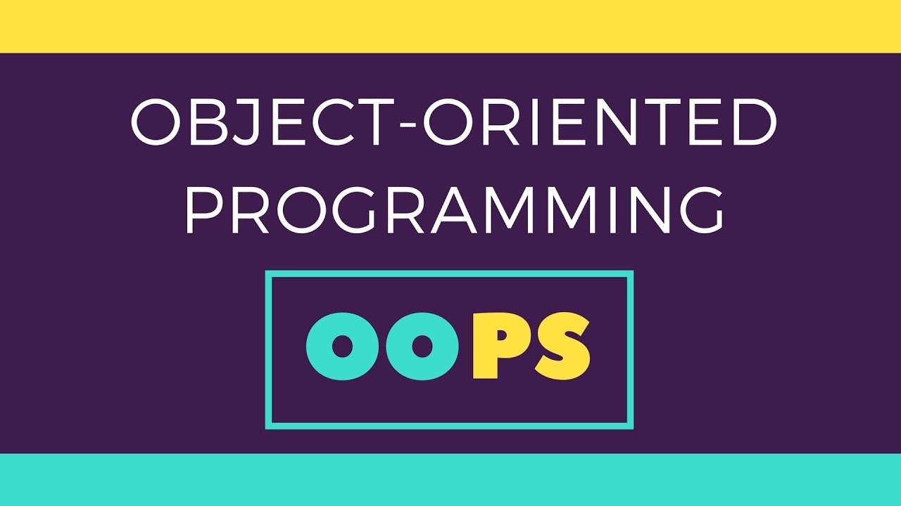
Double Tap to Add Subtitle
Abhishek Kumar Chaudhary

Slide 2


Object Oriented Programming
1. It uses objects in programming
2. Mapping real world entity to an object .
3.The main aim of OOP is to bind together the data and the functions that operates on them so that no other part of code can access this data except that function
Suppose we need to store the model, price and colour of these cars. So you can think creating variables for each car but this isn’t good approach. So we can think of creating array for each thing like model, price and colour. But dealing with this approach isn’t easy. So a better approach can be making a box of Car which contain three partition and store all those value. So for defining this car box you need to define a blueprint of this car box i.e. object. So defining this blueprint is called class.
This Photo by Unknown Author is licensed under CC BY-SA

Slide 3
Classes and Objects
#include<bits/stdc++.h>
using namespace std;
//Defining a class
class Car{
public:
int price; //4 bytes
int model; //4 butes
string color; //8 bytes
};
int main(){
int x;
//Creating object
Car C;
cout<<sizeof(C); //C is an object
}
Class is a blueprint of data and functions or methods. Class does not take any space. A class definition starts with the keyword class followed by the class name; and the class body, enclosed by a pair of curly braces. A class definition must be followed either by a semicolon or a list of declarations.
Objects are instances of a class these are defined as user defined data types. Object take up space in memory and have an associated address. We declare objects of a class with exactly the same sort of declaration that we declare variables of basic types.

Slide 4
Data Member and Function
#include<bits/stdc++.h>
using namespace std;
//Defining a class
class Car{
public:
int price; //4 bytes
int model; //4 butes
string color; //8 bytes
void start(){
cout<<"Grrr"<<endl;
}
};
int main()
{ Car c; //Initialisation
c.price=500;
c.model=121;
c.color="blue";
c.start();
}
We can access the data member and function of the class by using dot operator.
c.price = 500;
c.model =121;
c.color = “blue”;
c.start();

Slide 5
Access Modifiers
Public
All the class members declared under public will be available to everyone. The data members and member functions declared public can be accessed by other classes too. The public members of a class can be accessed from anywhere in the program using the direct member access operator (.) with the object of that class.
used to implement important feature of Object Oriented Programming known as Data Hiding.
What is Data Hiding Consider a real life example: What happens when a driver applies brakes? The car stops. The driver only knows that to stop the car, he needs to apply the brakes. He is unaware of how actually the car stops. That is how the engine stops working or the internal implementation on the engine side. This is what data hiding is.
Access modifiers or Access Specifiers in a class are used to set the accessibility of the class members. That is, it sets some restrictions on the class members not to get directly accessed by the outside functions.
Private
The class members declared as private can be accessed only by the functions inside the class. They are not allowed to be accessed directly by any object or function outside the class. Only the member functions or the friend functions are allowed to access the private data members of a class.
Protected
Protected access modifier is similar to that of private access modifiers, the difference is that the class member declared as Protected are inaccessible outside the class but they can be accessed by any subclass(derived class) of that class.

Slide 6
Getters and Setters
#include <iostream>
using namespace std;
class Car{
private:
int price;
public:
int model_no;
char name[20];
void start(){
cout<<"Grrrr...starting the car “<<name<<endl ; }
void setPrice(int p){
price=p;}
int getPrice(){
return price; }
};
int main(){
Car C;
C.price =500;
C.model_no = 1001;
C.name[0] = 'B’;C.name[1] = 'M'; C.name[2] = 'W'; C.name[3] = '\0’;
C.start();
C.setPrice(1200);
cout<<C.getPrice();
}
Getters and Setters allow you to effectively protect your data. This is a technique used greatly when creating classes. For each variable, a get() method will return its value and a set() method will set the value. If you decide that some action should be taken every time you change the value of a particular variable, you only need to edit the set() method instead of looking for every place you change the variable.

Slide 7
4-Default Method of Classes
Default method is a function which is present in every class.
Constructor
Copy Constructor
Shallow Copy and Deep Copy
Destructor

Slide 8
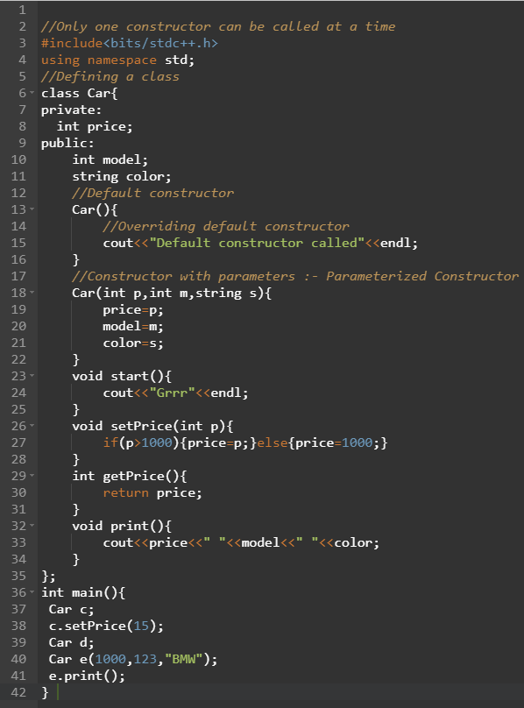
Constructor
Constructor
Constructor name is same as class name. It gets called automatically whenever you create a object of class. It does all the allocation work.
Default constructor is the constructor which doesn’t take any argument. It has no parameters. Note Even if we do not define any constructor explicitly, the compiler will automatically provide a default constructor implicitly. The default value of variables is 0 in case of automatic initialization.
Parameterized constructor, simply add parameters to it the way you would to any other function. When you define the constructor’s body, use the parameters to initialize the object

Slide 9
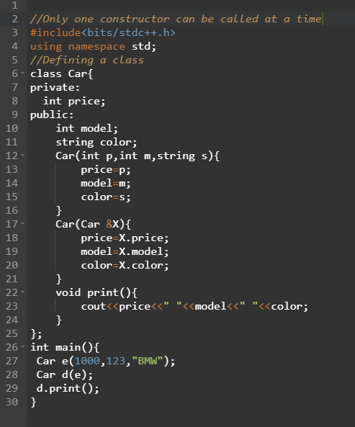
Copy Constructor
The goal of the copy constructor is to create a copy of given object of same type.
We don’t need to create copy constructor .It exist by default .
Car F(E);
Car F = E;
So if we do any update on F it will have no effect on E.

Slide 10
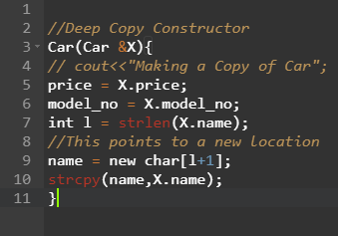
Shallow Copy and Deep Copy
A shallow copy of an object copies all of the member field values. This works well if the fields are values, but may not be what you want for fields that point to dynamically allocated memory. The pointer will be copied. but the memory it points to will not be copied – the field in both the original object and the copy will then point to the same dynamically allocated memory, which is not usually what you want. The default copy constructor and assignment operator make shallow copies.
Suppose you have two car and so you can have a copy and update the name for second car. So if you update the name in second car the name of first car also get update and this creates a problem.
A deep copy copies all fields, and makes copies of dynamically allocated memory pointed to by the fields. To make a deep copy, you must write a copy constructor and overload the assignment operator, otherwise the copy will point to the original, with disasterous consequences

Slide 11
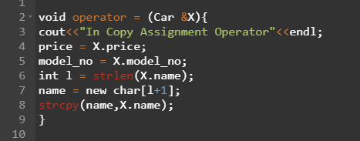
Copy Assignment Operator
Suppose you have two car object name A and B. If you do
B = A. Then all the properties of B are replaced by A. This
‘=‘ is called copy assignment operator.
This also makes shallow copy. So we have to write our own
Copy assignment operator. So we need to make deep copy in order to prevent this hazard :p.
Copy constructor is called only once but assignment operator are called numerous time.

Slide 12
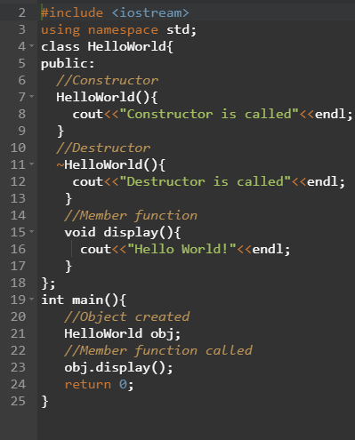
Destructor
The idea of the destructor is to destroy memory which is created by object.
If we do not write our own destructor in class, compiler creates a default destructor for us. The default destructor works fine unless we have dynamically allocated memory or pointer in class. When a class contains a pointer to memory allocated in class, we should write a destructor to release memory before the class instance is destroyed. This must be done to avoid memory leak.

Slide 13
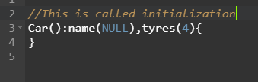
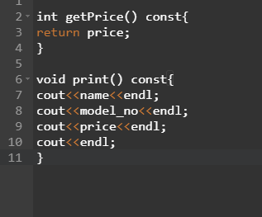
Constant Data Member
There are particular member which are constant that cant be changed. We can initialize any value and make it constant so that we don’t change it late.
To make a variable constant initialize it with const.
When we enter the body of the constructor if we do any change in value then it is assignment but before it if something is done then it is called initialization. And in case of const we need to do initialization.
Constant Function
A function becomes const when const keyword is used in function’s declaration. The idea of const functions is not allow them to modify the object on which they are called. We make those function const which don’t update the data member so that it makes our debugging easier.

Slide 14
Function Overloading
Multiple constructor having same name but differ in no of parameter . Function aren’t stored anywhere . Their local variables are created in stack . After execution they are removed from stack. If object are created using new then they are allocated memory in heap.
Operator Overloading
Suppose we have two complex number and we need to add ,subtract and perform different operation on them.

Slide 15
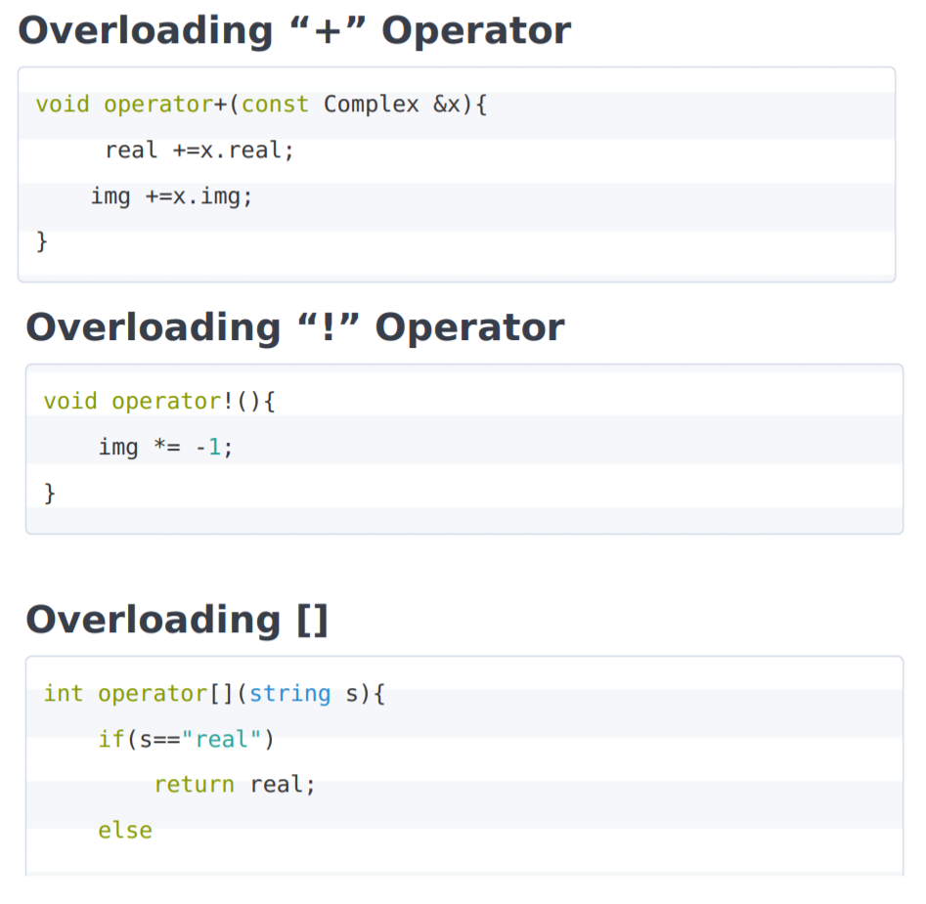
Some examples of Operator Overloading

Slide 16
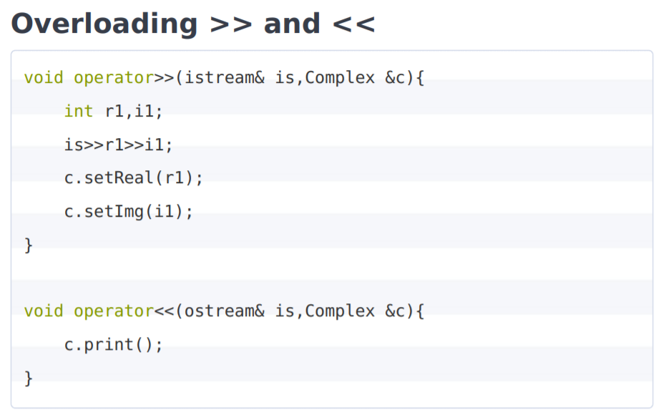

Slide 17
First Lesson Summary
You have learnt the basic concept of OOPS. To learn about Hashmap , Pattern Matching,Trie , Graph.
Visit This
Conclusion
First Skill
Second Skill
Third Skill

