Slide 1
Nano Machine Learning
Associated mentor : Purushottam Kar

Slide 2
Problem Statement
We are in the age of Internet Of Things (IoT) devices
Smartphones, smartwatches, smartmirrors, ...
Need to implement ML algorithms on these devices
Challenge is to perform well under scarcity of resources
Few KBs of RAM and few MHz processor available

Slide 3
Existing Work
ProtoNN: Compressed and Accurate k-NN for Resource-scarce Devices, Chirag Gupta Et al. , ICML 2017
Resource-efficient Machine Learning in 2 KB RAM for the Internet of Things, Ashish Kumar Et al. , ICML 2017
Two-Bit Networks for Deep Learning on Resource-Constrained Embedded Devices, Wenjia Meng Et al., CoRR 2017

Slide 4
Problem With current Approach
Proto-NN sends all the data to server, trains on server
Lot of energy wastage in transmission
Security issues- data may be intercepted
Once the model goes to micro controller it can't be updated again

Slide 5

Our Approach
What if we don't send any data to server Online Proto-NN
Pros
- Will Solve the problem of security
- Can train at micro-controller itself
- Can keep learning as and when required
- Zero Transmission Costs
Cons
- Lot of computation done on microcontroller
- Will need good processor
Details will be covered shortly

Slide 6
Our Approach
If we have to send data, can we do it smartly? Ballogorithm
Pros
- Will reduce transmission cost by order of 10
- Approximately same accuracy obtained
Obtained by vanilla Proto-NN
- Novel extensions possible in future
Cons
- Training on Server
Details will be covered shortly

Slide 7

Online Proto-NN …... Inspired from NN based methods
Instead of storing points, store prototypes and their score vector (B, Z)
Will have a dimensionality reducing matrix (W)
Learn these three with alternating optimization
Predict using following formula :

Slide 8
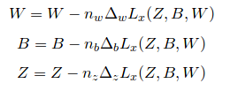
Online Proto-NN …... Inspired from NN based methods
Algorithm
Initialize W, B, Z
Take input a point x
Predict label using formula in previous slide
For j = 1,2,...e
Instead of sending the data, train on each point at microcontroller itself
Exact Calculations in Project Report

Slide 9

Amount of Computation
More details to come in report

Slide 10
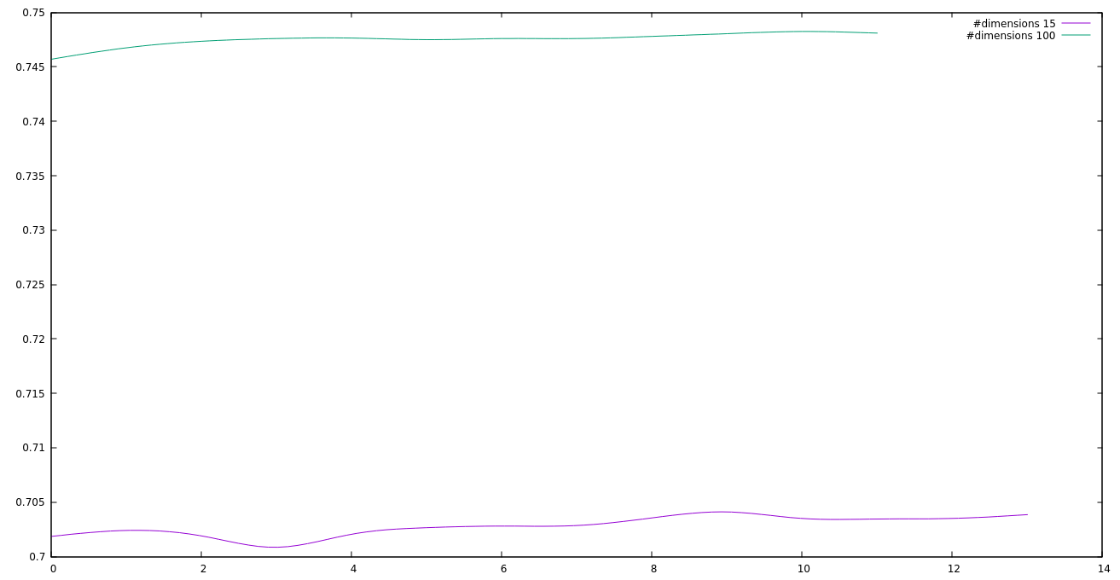
Online Proto-NN Results
It is not surprising that increasing dimensions increases accuracy. Similar behaviour is observed for number of prototypes
However, this leads to lot of calculation.
Should be chosen according to budget
Interval of 2 in x coordinate means : 5k points

Slide 11
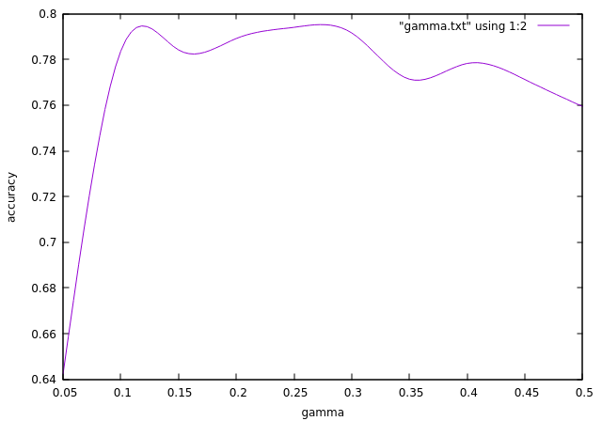
Online Proto-NN Results

Slide 12
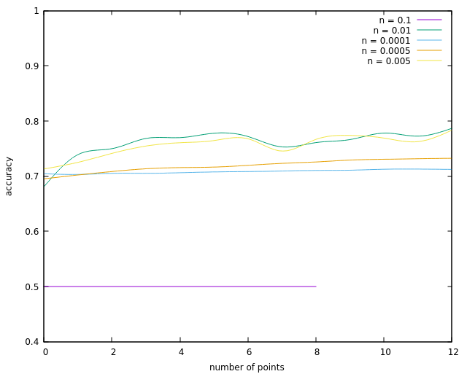
Online Proto-NN Results
Simple strategy for step length to avoid large computations
Interval of 2 in x coordinate means : 5k points

Slide 13
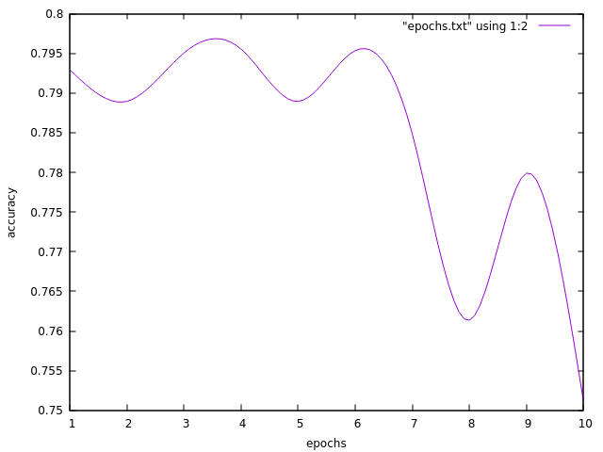
Online Proto-NN Results

Slide 14
Upshots
Our Algorithm
Vanilla ProtoNN
We are able to achieve 80% accuracy on MNIST dataset
However we use much simplified model with less number of prototypes, very small value of epochs
ProtoNN achieves 87%
To get 87% you will have to use a large number of prototypes, very high value of epochs, preprocessing on data, humongous computations
Such preprocessing is infeasible in online settings

Slide 15

Ballogorithm....If we have to send points, why not send it smartly?
Points which are close to each other must get similar labels
Closeness may be defined with euclidean norm, kernel values etc.
Instead of sending points what if we send their representatives and apply Proto-NN
Let's say we have some ball centers present in space
Each ball has some radius(r) and some initial capacity(c)
Both these are hyperparameters and determine how many points will be sent
When a new point comes, we check whether it is close to some ball center

Slide 16
Ballogorithm....If we have to send points, why not send it smartly?
If yes then we discard this point and decrease the capacity of the
Corresponding ball
If no we'll define a new ball centered at this point with radius(r) capacity (c)
After every 1k points or so, send the ball centers
Or if some ball's capacity goes to zero, send the ball centers
Capacity constraint is needed so that not many points are mapped to same ball
Experiment shows that if a lot of points are mapped to same ball, then model learnt is weak

Slide 17
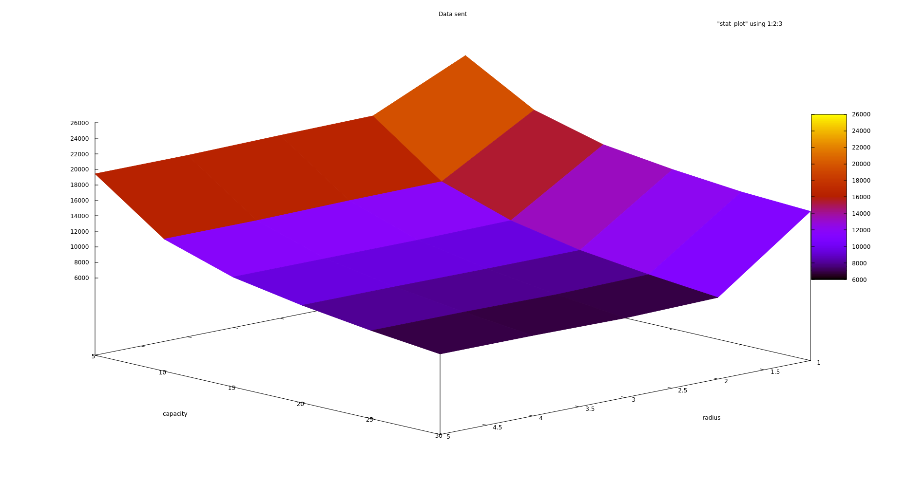
Results Ballogorithm

Slide 18
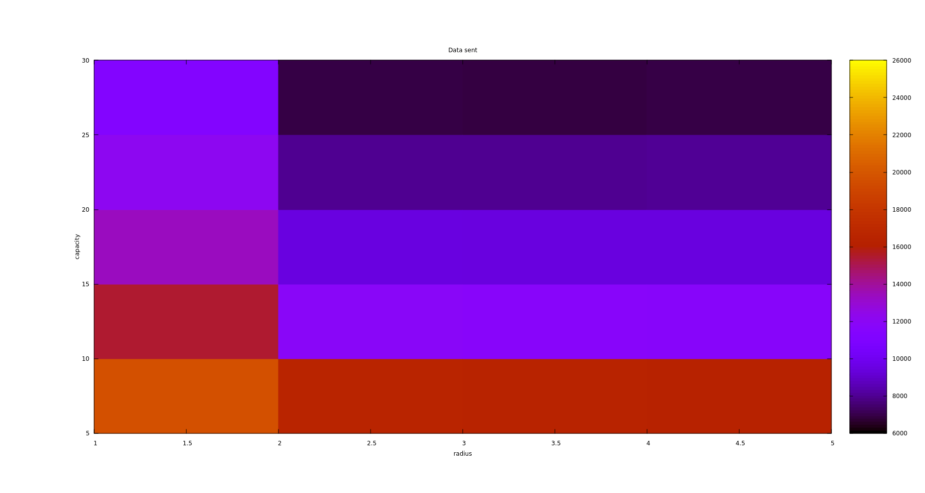
Results Ballogorithm

Slide 19
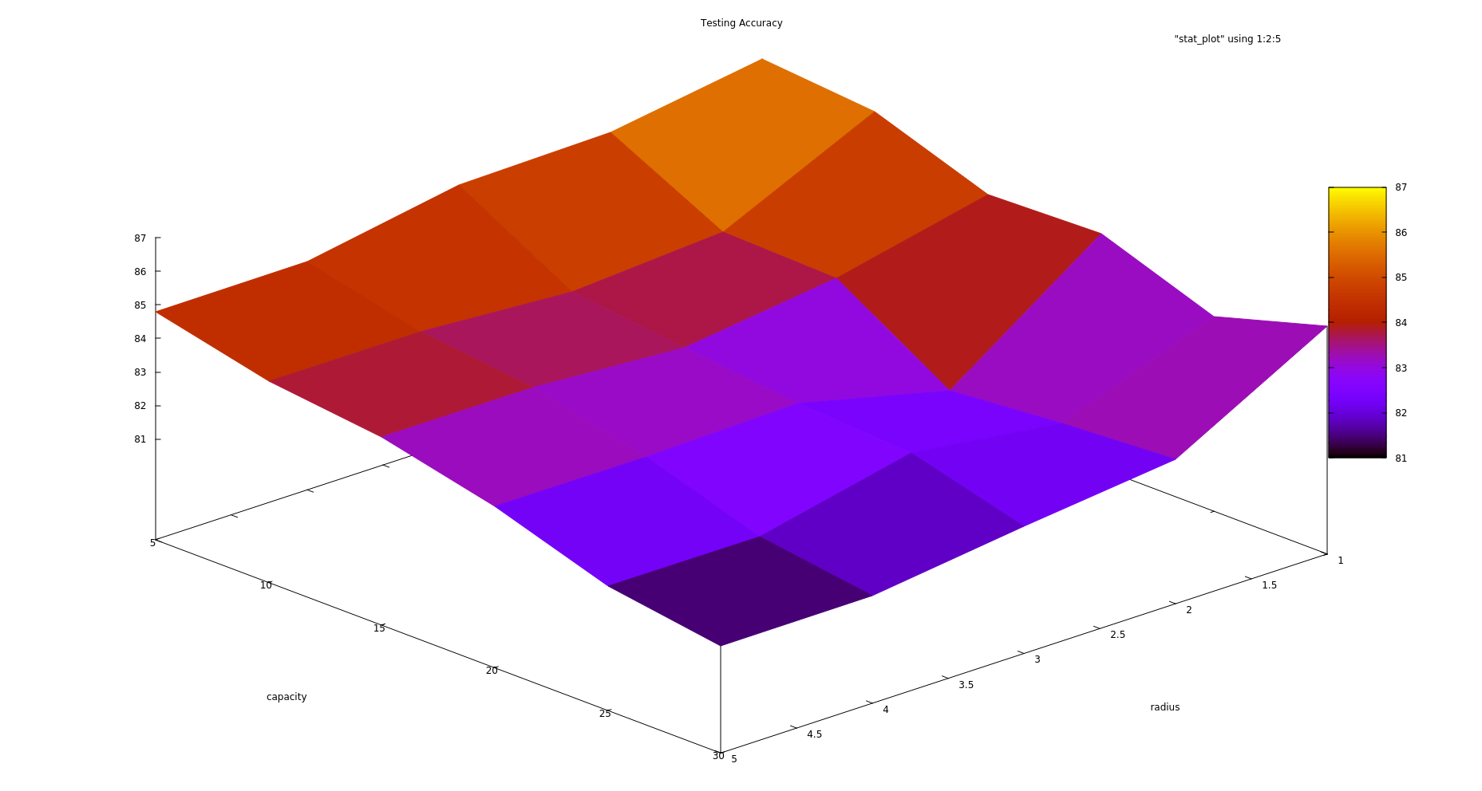
Results Ballogorithm

Slide 20
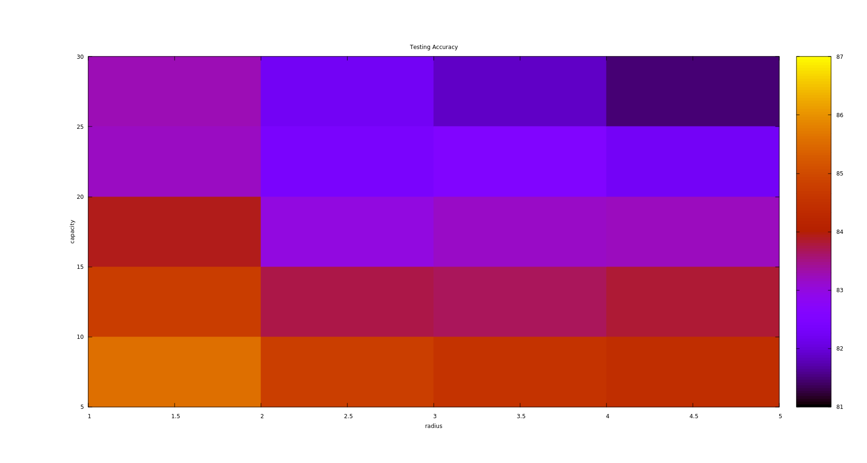
Results Ballogorithm

Slide 21
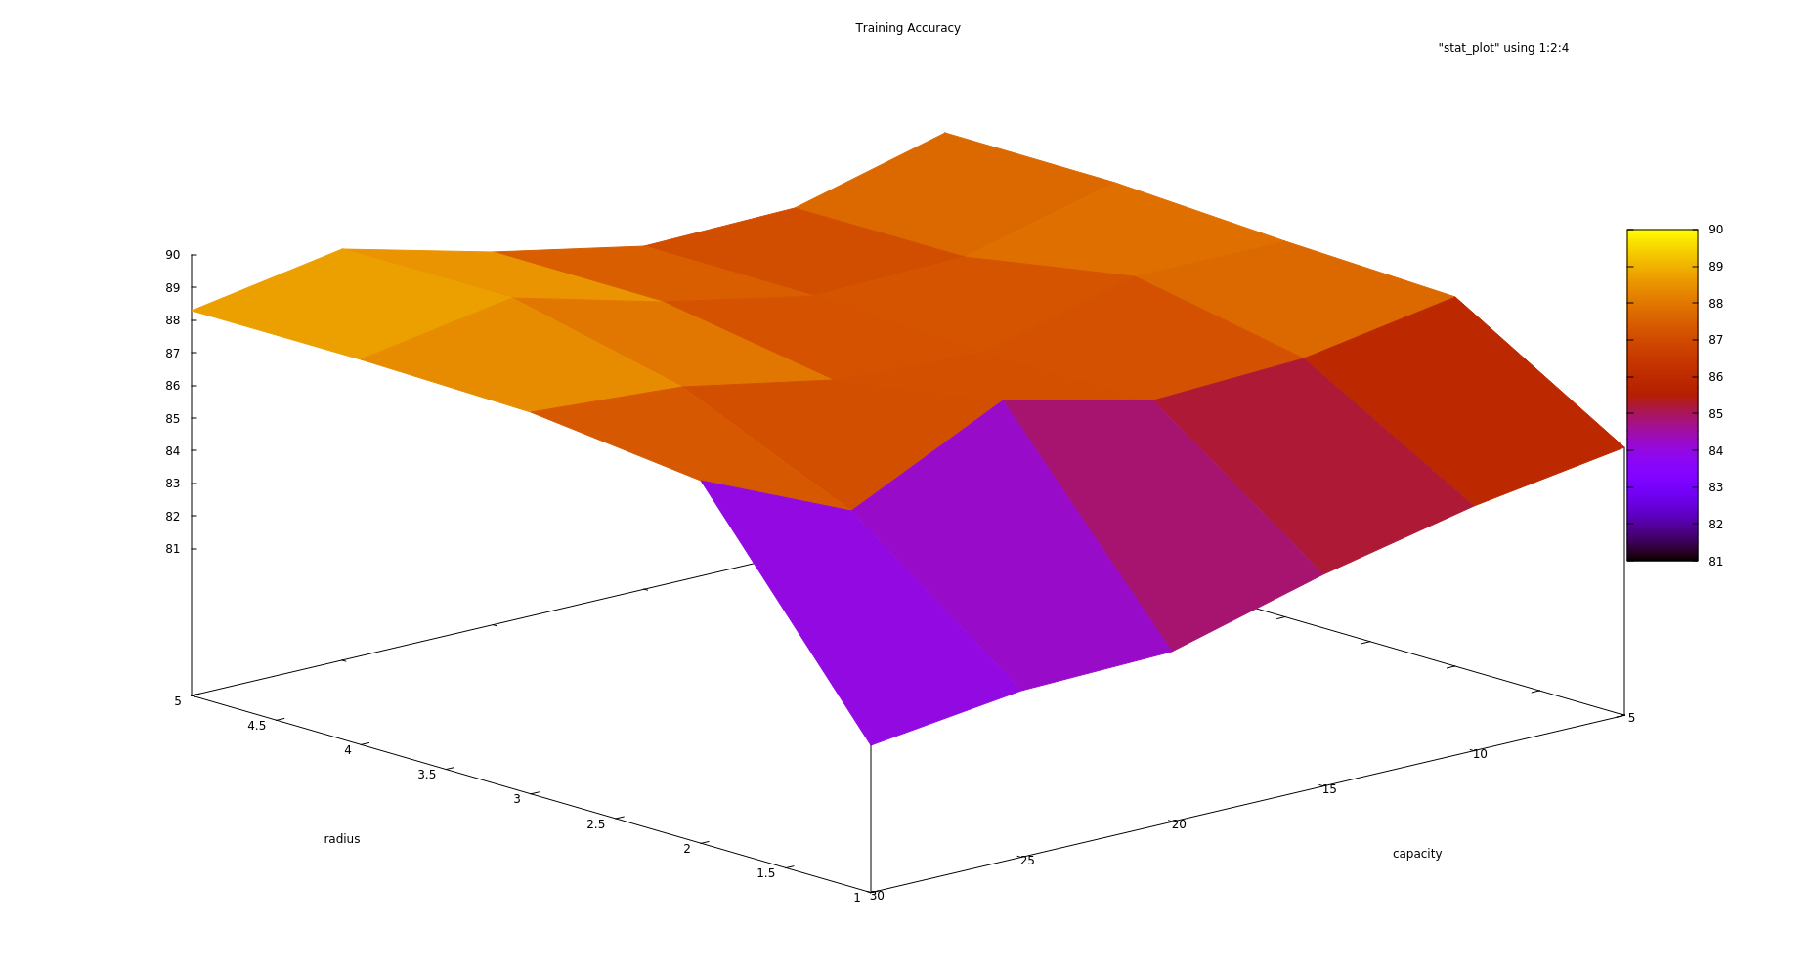
Results Ballogorithm

Slide 22
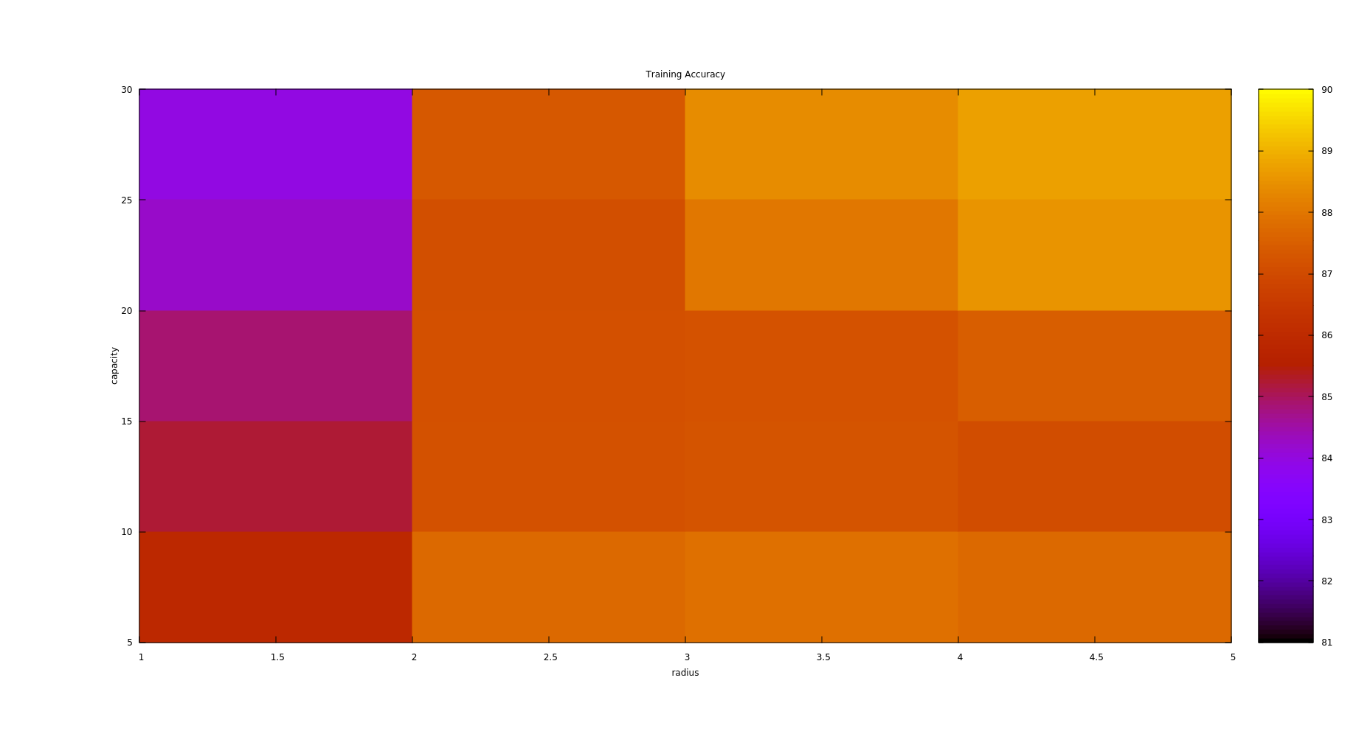
Results Ballogorithm

Slide 23
Upshots
We are able to achieve accuracy as high as 87% with only 200 prototypes
Points sent is less than 50% of what Proto-NN sends in above case
Can reduce #points sent by order of tens and sacrificing 2% accuracy
Proto-NN also achieves 87% on same dataset with 200 prototypes

Slide 24

Other Approaches that failed
Percepto-NN We obtained an initial model by sending first few points and then sent only the points that were misclassified. Updated model when accuracy fell below a certain level.
- This approach gave jumpy accuracy
- This will fail on any dataset that is not entirely separable because
- We were trying to adjust to outliers and were not rewarding our model for correct classification

Slide 25
Other Approaches that failed
Second Approach We obtained an initial model by sending first few points and then sent only the points by reducing the dimension. Ran Proto-NN on the decreased dimensions.
- Prototypes were considered as representatives for correctly classified points
- Achieved this by assigning weights
- We realized that we were sacrificing far too much information
- Gave poor accuracy

Slide 26
Further Progress
We can reduce the calculations at microcontroller by approximating the gradient
We can choose to not entertain some points based on some calculations
Instead of directly assigning to balls, we can come up with "soft" version of the Ballogorithm

Slide 27
Thank you
-by MLG_16

