Slide 1

Rapid Analysis of Milk Using MIR Spectra and Multivariate Analysis
Abhishek Kumar
20200544

Slide 2
Introduction
Cow’s milk is an Important component of human’s diet.
From an economic point of view 17,500 daily farms are involved in milk production in Ireland, and directly employs 60, 000 people.
Analysis of milk data can be useful.
Composition of milk provides info about:
  Nutritional value
  Health of the cow
Animal health monitoring helps in:
  Livestock management in dairy industry
  Optimized milk production and reduces workload
Infrared spectroscopy can be used at a low cost:
  Detect milk adulteration
  Determine milk content

Slide 3
Individual Milk Protein and Technological traits
Milk proteins are categorized into 2 types:
  Casein : Constitutes 80% of milk protein and is necessary for cheese making.
  Whey : Essential constituent in protein drinks.
Technical traits like heat stability, pH, milk coagulation time etc. provides the idea about outcomes of heat treatment measures applied, spoilage, and curd firmness time of a milk sample.
Results obtained for these features from analysis are provided in next slide.

Slide 4
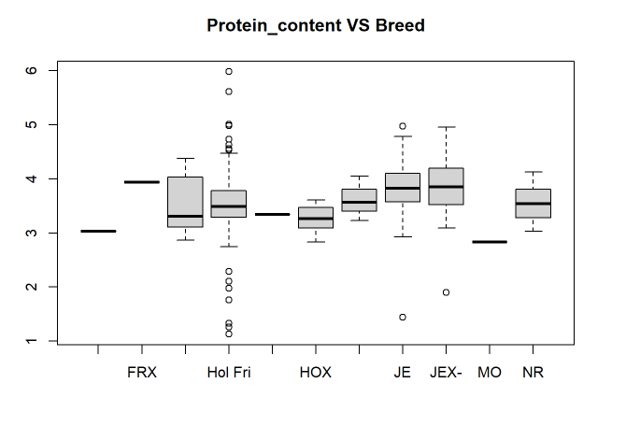
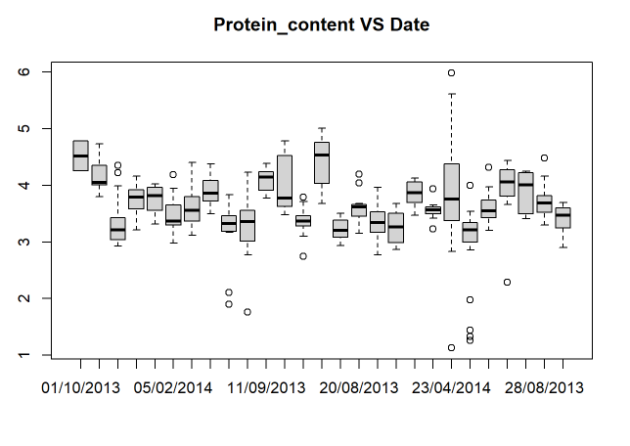
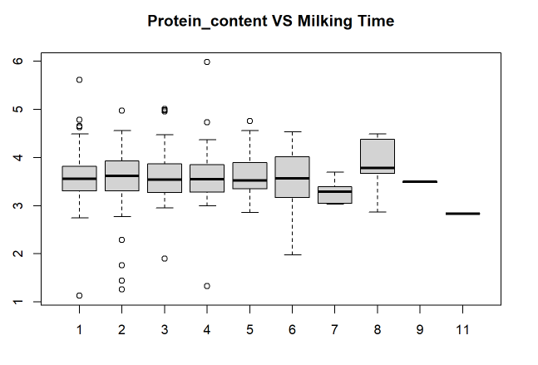
Casein, Whey and technological traits
Average values of different types of casein found in a milk samples:
Average values of different types of Whey found in a milk samples:
Average values of across these features was found to be around:
αs1 casein | αs2 casein | β casein | k casein
13.82 | 3.45 | 12.61 | 5.73
Alpha Lactalbumin | Beta Lactoglobulin A | Beta Lactoglobulin B
1.20 | 2.48 | 2.45
Log(Heat Stability) | pH | RCT | k20 | A30 | A60 | Log(CMS)
1.9773 | 6.702 | 21.23 | 6.65 | 22.29 | 28.26 | 5.19

Slide 5
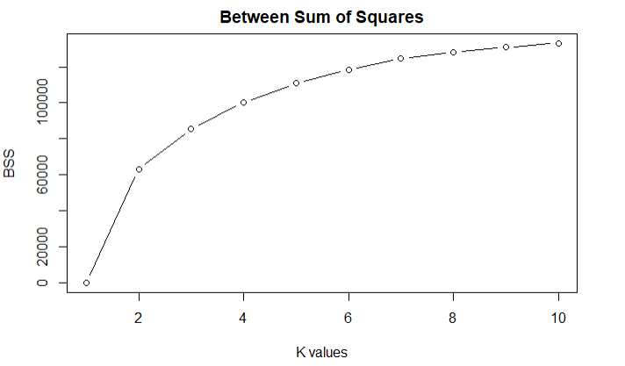
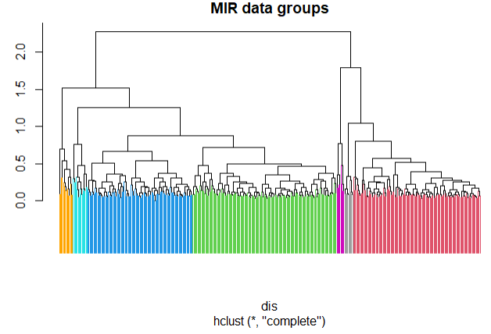
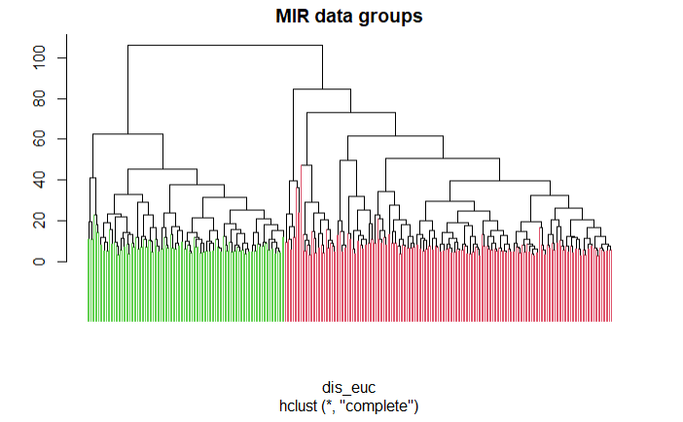
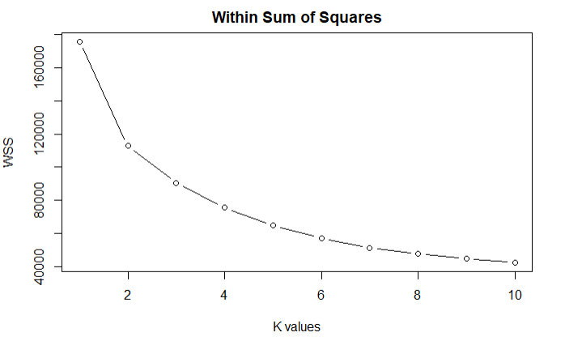
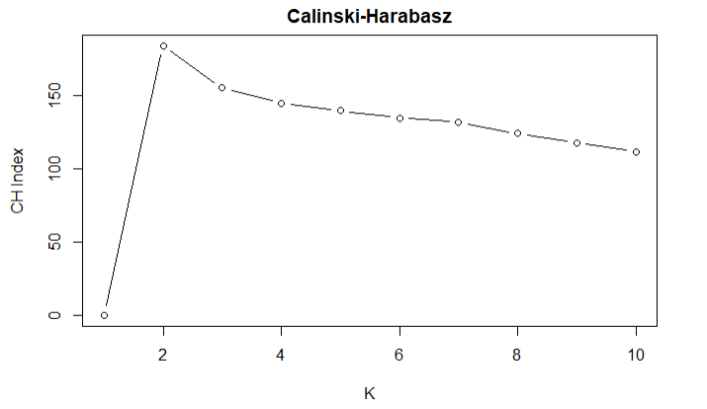
Clustering (Groups in MIR spectral data)
Clustering techniques on MIR spectrum for different milk samples was applied to find groups within it like hierarchical and k-means clustering.
Two major groups within samples was discovered.
  Presence of subgroups within these major groups can also be seen (2 and 5 in each groups ).
  These groups relate with the milking time of the milk samples.
  Subgroups possibly relates to the breeds of cows.
  Clustering model results were cross referenced with the actual observed data in sample.
  Good level of agreement between the reference clusters and model was obtained.
  This indicates correct number of clusters were identified among the data.

Slide 6
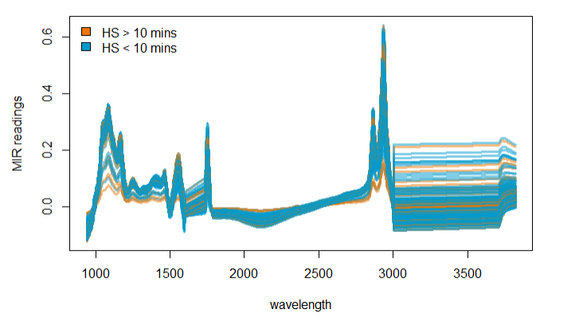

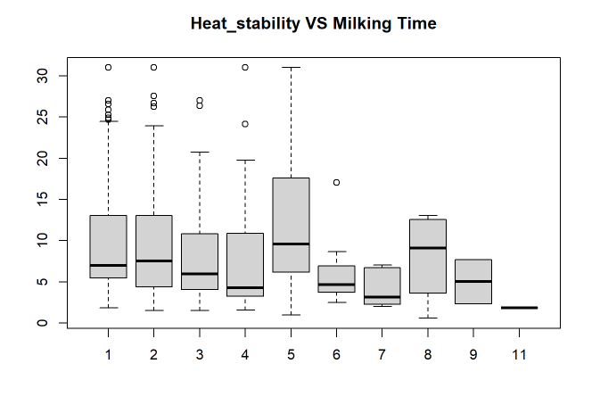
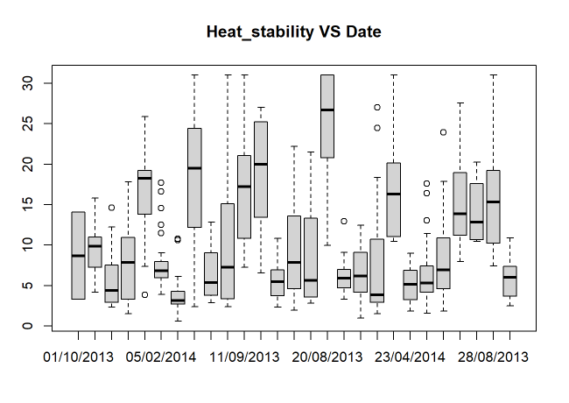
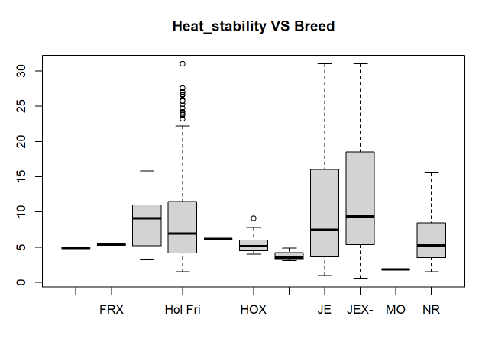
Classification of Milk samples-based on heat stability time
MIR spectra of milk samples
Spikes suggesting HS < 10 mins
Classification techniques were used to build a model which can classify a new milk sample into categories having either heat stability time of less than or greater than 10 minutes.
A set of MIR readings recorded for milk sample was used to learn the task of classifying milk samples.
Then, new milk samples which were unused for learning this process were used to predict the categories they belong to based on previous experience.
Overall accuracy achieved in classification of new milk sample was approximately around 75%.
MIR spectra of milk sample can be used to identify the heating stability time.
A spike in MIR reading in general is suggesting the heat stability time of less than 10 mins
Misclassification rates with different models

Slide 7
Conclusion
Features of milk varies with breed of cow, period of year during which milking was done and on milking time as well.
Casein is dominant form of protein found in cow milk and constitutes around 80% of total protein content.
Two major groups (Milking Time) and subgroups(Breeds) within data can be observed by analysis on MIR spectra on milk samples.
I was able to classify accurately new milk samples having heat stability time (greater or smaller than 10 mins) based on the MIR readings of the sample.
Attached is the documented report with detailed explanation and code.

