Slide 1
CS 2104 Prog. Lang. Concepts
Dr. Abhik Roychoudhury
School of Computing
Introduction

Slide 2
Learning Objectives
Familiarity with the key concepts underlying modern programming languages.
Highlight the similarities and differences between various programming paradigms.
Ability to choose a programming paradigm or
program construct given a problem scenario.

Slide 3
Course Focus
More on the concepts of programming.
Less on individual prog. Languages.
More on clean programming styles.
Less on specific programming tricks.

Slide 4
Topics
Basics of program syntax and semantics.
Elementary and structured types
Subprograms
Abstract Data types, Inheritence, OO
Functional and Logic Programming
Type Checking/Polymorphism

Slide 5
Assessment
10 Homeworks : 20%
Midterm : 25%
Tutorial participation : 5%
Final examination : 50%

Slide 6
Textbook
Programming Languages
  Allen Tucker and Robert Noonan
  McGraw Hill Publishers
  Available in Bookstore
Textbook changed from last year.

Slide 7
Course Workload
Weekly homeworks : 2-3 hrs.
Weekly reading : 4-5 hrs.
Lecture : 2 hrs.
Tutorial : 1 hr.
TOTAL : 10 hrs. (approx)
Workload reduced from last year

Slide 8
The people
You
TA : Soo Yuen Jien
Instructor :
  Dr. Abhik Roychoudhury
Look up the course web-page http://www.comp.nus.edu.sg/~cs2104/

Slide 9
Keeping in touch
Post a message to the IVLE discussion forum
  Course code CS2104
Send e-mail to cs2104@comp.nus.edu.sg
Meet lecturer/TA during consultation hours.
Announcements posted in the course web-page: http://www.comp.nus.edu.sg/~cs2104/
Coming to class….. Might want to consider it ☺

Slide 10
CS 2104 Prog. Lang. Concepts
Reading: Textbook chapter 2.1 - 2.3
Dr. Abhik Roychoudhury
School of Computing
Language Syntax

Slide 11
Program structure
Syntax
What a program looks like
BNF (context free grammars) - a useful notation for describing syntax.
Semantics : Meaning of a program
Static semantics - Semantics determined at compile time:
  var A: integer; Type and storage for A
Dynamic semantics - Semantics determined during execution:
  X = ``ABC'' X a string; value of X

Slide 12
Formal study of syntax
Programming languages typically have common building blocks:
  Identifiers
  Expressions
  Statements
  Subprograms
Need to formally specify how a “syntactically correct” program is constructed out of these building blocks.
This need is satisfied by BNF grammars. It is simply a notation which allows us to write how “synt. Correct” programs are constructed.

Slide 13
An Example
A grammar for arithmetic expressions (common in programming languages)
<E> ::= <E> + <E>
<E> ::= <E> *<E>
<E> ::= ( <E> )
<E> ::= <Id>
Assuming a,b,c are identifiers
  (a + b) is an expression
  (a + b) * c is an expression
All arith. Expressions with addition and multiplication can be generated using the above rules.

Slide 14
Study of Grammars
Grammars simply give us rules to generate the syntactic building blocks of a program e.g. expressions, statements.
We saw an example of a grammar for expressions.
The rules in the grammar can be applied repeatedly to generate all possible expressions. These expressions are called the language of the grammar.
Furthermore, given an expression, the grammar could be used to check whether it can be generated using its rules. This is called parsing.
Let us now study BNF grammars more carefully.

Slide 15
BNF grammars
Nonterminal: A finite set of symbols: <sentence> <subject> <predicate> <verb> <article> <noun>
Terminal: A finite set of symbols: the, boy, girl, ran, ate, cake
Start symbol: One of the nonterminals: <sentence>

Slide 16
BNF grammars
Rules (productions): A finite set of replacement rules:
<sentence> ::= <subject> <predicate>
<subject> ::= <article> <noun>
<predicate>::= <verb> <article> <noun>
<verb> ::= ran | ate
<article> ::= the
<noun> ::= boy | girl | cake
Replacement Operator: Replace any nonterminal by a right hand side value using any rule (written ⇒)

Slide 17
Empty strings
How to characterize strings of length 0? –
In BNF, ε-productions: S → SS | (S) | () | ε
Can always delete them in grammar. For example:
X → abYc
Y → ε
Delete ε-production and add production without ε:
X → abYc
X → abc

Slide 18
Example BNF sentences
<sentence> ⇒ <subject> <predicate> First rule
⇒ <article> <noun> <predicate> Second rule
⇒ the <noun> <predicate> Fifth rule
... ⇒ the boy ate the cake
Also from <sentence> you can derive
⇒ the cake ate the boy
Syntax does not imply correct semantics
Note: Rule <A> ::= <B><C>
This BNF rule also written with equivalent syntax:
A → BC

Slide 19
Language of a Grammar
Any string derived from the start symbol is a sentential form.
Sentence: String of terminals derived from start symbol by repeated application of replacement operator
A language generated by grammar G (written L(G)) is the set of all strings over the terminal alphabet (i.e., sentences) derived from start symbol.
That is, a language is the set of sentential forms containing only terminal symbols.

Slide 20
Derivations
A derivation is a sequence of sentential forms starting from start symbol.
Grammar: B → 0B | 1B | 0 | 1
Derivation: B ⇒ 0B ⇒ 01B ⇒ 010
Each step in the derivation is the application of a production rule.

Slide 21

Parse tree
A parse tree is a hierarchical synt. structure
Internal node denote non-terminals
Leaf nodes denote terminals.
Grammar: B → 0B | 1B | 0 | 1
Derivation: B ⇒ 0B ⇒ 01B ⇒ 010
From derivation get parse tree
as shown in the right.

Slide 22
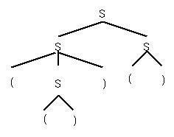
Derivations
Derivations may not be unique
S → SS | (S) | ()
S ⇒ SS ⇒(S)S ⇒(())S ⇒(())()
S ⇒ SS ⇒ S() ⇒(S)() ⇒(())()
Different derivations but get the same parse tree

Slide 23
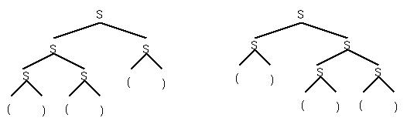
Ambiguity
Each corresponds to a unique derivation:
S ⇒ SS ⇒ SSS ⇒()SS ⇒()()S ⇒()()()
But from some grammars you can get 2 different parse trees for the same string: ()()()
A grammar is ambiguous if some sentence has 2 distinct parse trees.

Slide 24
Why Ambiguity is a problem
BNF grammar is used to represent language constructs.
If the grammar of a language is non-ambiguous, then we can assign a unique meaning to every program written in that language.
If the grammar is ambiguous, then a program can have two or more different interpretations.
The two different interpretations of a given program will be shown by the two different parse trees constructed from the grammar.

Slide 25
Exercise 1
Is the grammar of arithmetic expressions shown earlier an
ambiguous grammar ? Try to construct a derivation with two different parse trees.
<E> ::= <E> + <E>
<E> ::= <E> *<E>
<E> ::= ( <E> )
<E> ::= <Id>

Slide 26
Exercise 1 - Answer
<E> ::= <E> + <E>
<E> ::= <E> *<E> 2 + 3 * 4
<E> ::= ( <E> )
<E> ::= <Id>
E
E
E
E
+
+
E
E
*
Id
Id
Id
Id
Id
Id
*
+
2
2
3
4
3
4

Slide 27
Extended BNF
This is a shorthand notation for BNF rules. It adds no power to the syntax,only a shorthand way to write productions:
[ ] – Grouping from which one must be chosen
  Binary_E -> T [+|-] T
{}* - Repetition - 0 or more
  E -> T {[+|-] T}*

Slide 28
Extended BNF
{}⁺ - Repetition - 1 or more
  Usage similar to {}*
{}_{opt} - Optional
  I -> if E then S | if E then S else S
  Can be written in EBNF as
  I -> if E then S { else S}_{opt}

Slide 29
Extended BNF
Example: Identifier - a letter followed by 0 or more letters or digits:
Extended BNF Regular BNF
I → L { L | D }* I → L | L M
L → a | b |... M → CM | C
D → 0 | 1 |... C → L | D
L → a | b |...
D → 0 | 1 |...

Slide 30
Exercise 2:
BNF and EBNF are convenient notations for writing syntax of programs.
Try to write both the BNF and the EBNF descriptions for the switch statement in Java.
Remember that your description must generate
  All syntactically correct switch statements
  No other statements.

Slide 31
Parsing
BNF and extended BNF are notations for formally describing program syntax.
Given the BNF grammar for the syntax of a programming language (say Java), how do we determine that a given Java program obeys all the grammar rules.
This is achieved by parsing.
We now discuss a very simple parsing algorithm to give an idea about the process.

Slide 32
Recursive descent parsing overview
A simple parsing algorithm
Shows the relationship between the formal description of a programming language and the ability to generate executable code for programs in the language.
Use extended BNF for a grammar, e.g., expressions:
<arithmetic expression>::=<term>{[+|-]<term>}*

Slide 33
Recursive descent parsing
<arithmetic expression>::=<term>{[+|-]<term>}*
( Each non-terminal of grammar becomes a procedure )
procedure Expression;
begin
Term; /* Call Term to find first term */
while ((nextchar=`+') or (nextchar=`-')) do
begin
nextchar:=getchar; /* Skip operator */
Term
end
end

Slide 34
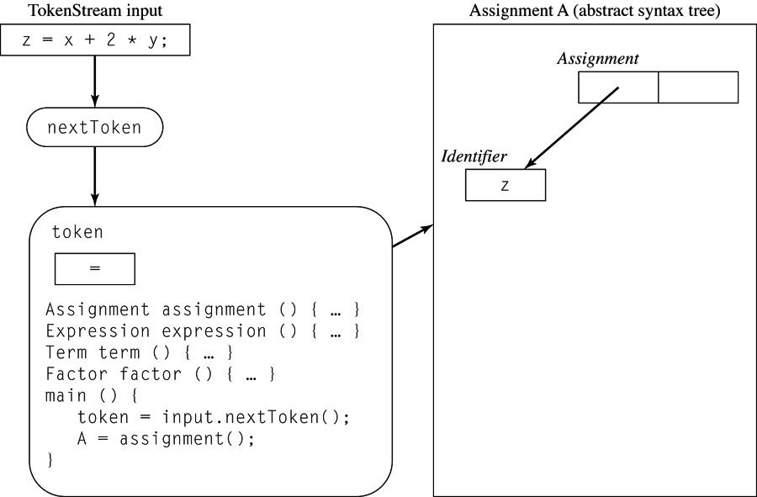
Partially Completed Recursive
Descent Parse for Assignments

Slide 35
Summary
We need a “description language” for describing the set of all allowed programs in a Prog. Lang.
BNF and EBNF grammars are such descriptions.
Given a program P in a programming language L and the BNF grammar for L, we can find out whether P is a syntactically correct program in language L.
This activity is called parsing.
The Recursive Descent Parsing technique is one such parsing technique.

